Slide 1
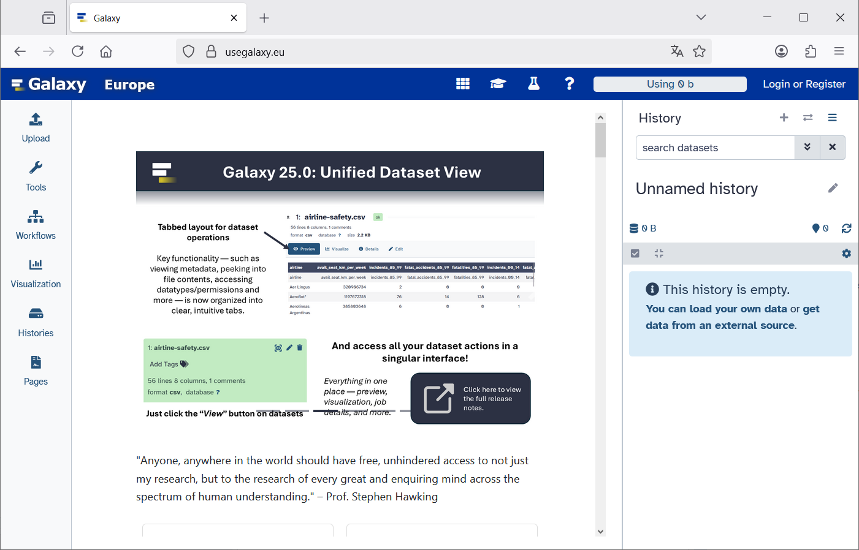
https://usegalaxy.eu
Login or register

Slide 2
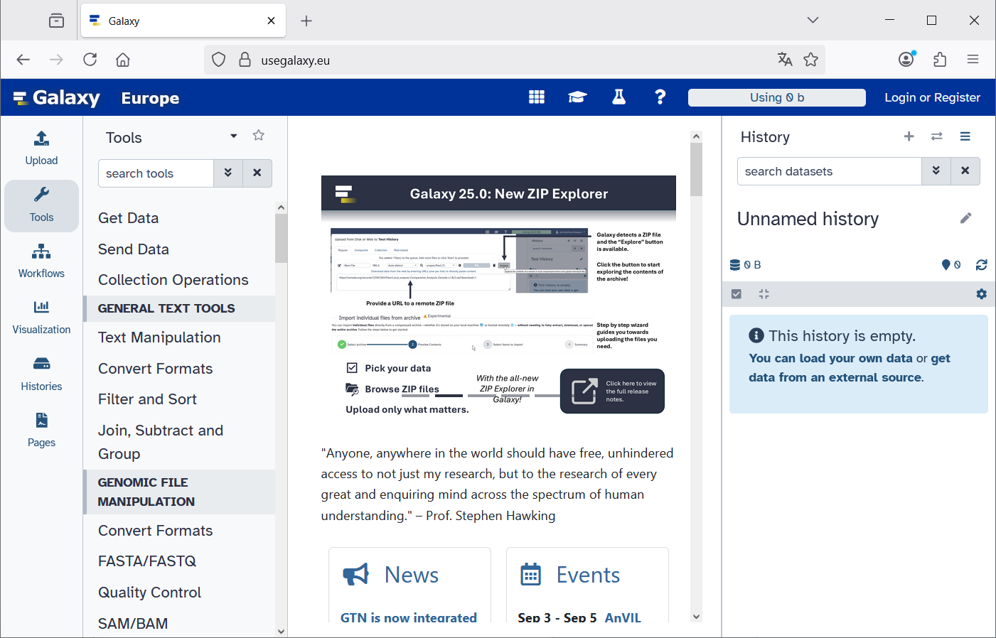
History
Center Panel
Tools
Activity Bar

Slide 3
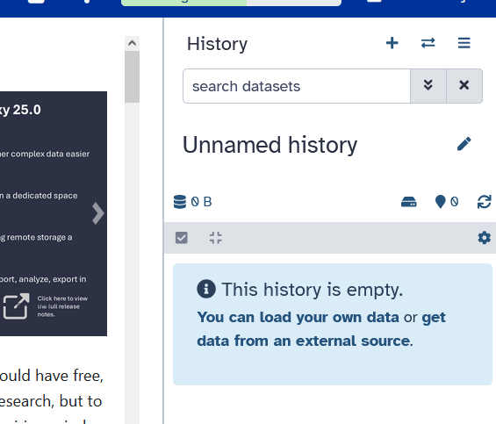
Click on „+“ to create
a new history

Slide 4
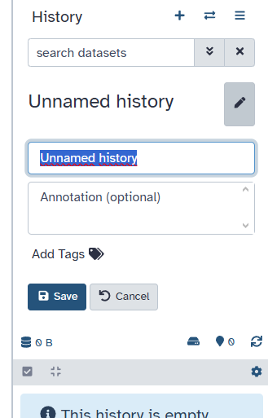
1. Click on Pen to edit the name of the new history
2. Type new name:
Data NCBI
3. Save

Slide 5
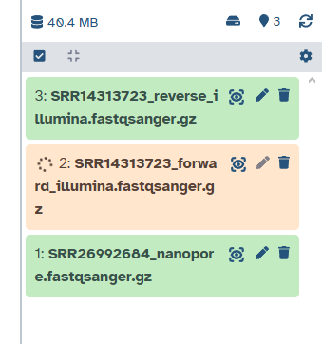
Green: File is ready
Orange: File is being processed

Slide 6
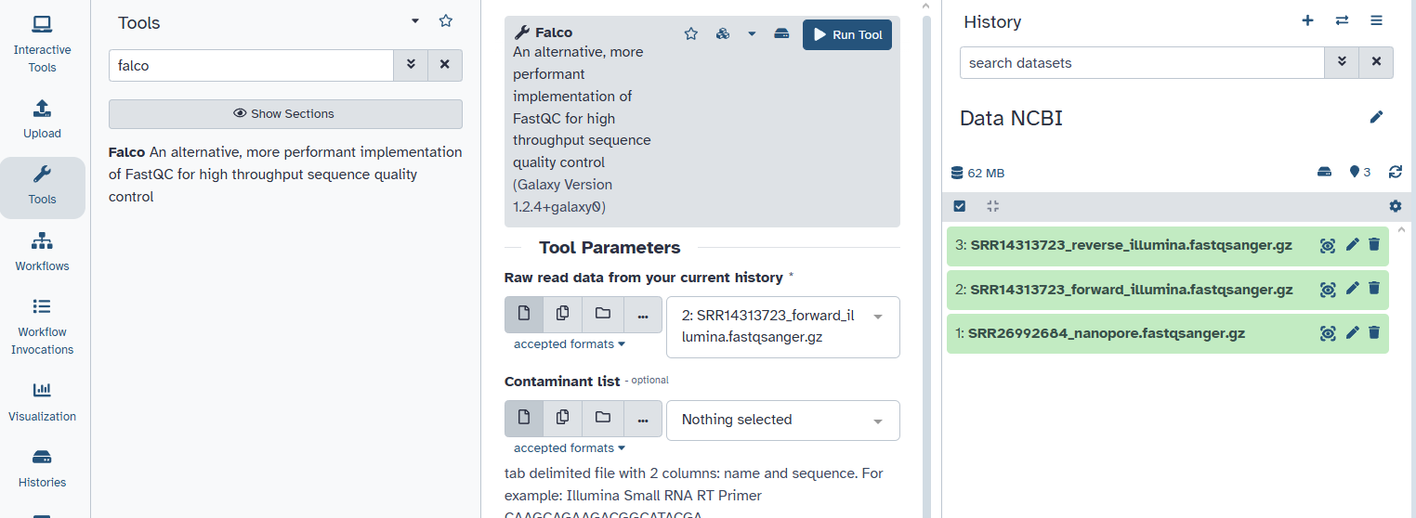
5. Click on „Run Tool“
2. Type „falco“
1. Click on Tools
3. Click on the tool
4. Chose only the Illumina forward file.

Slide 7
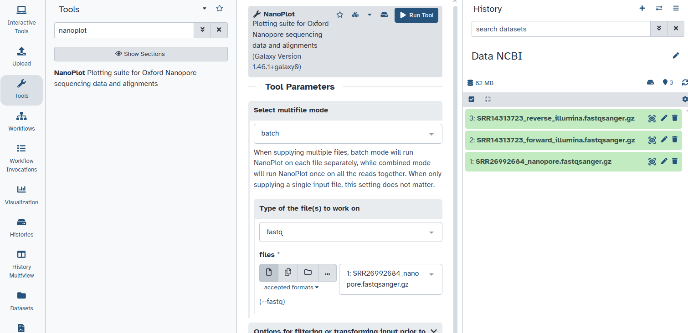
5. Click on „Run Tool“
2. Type „nanoplot“
3. Click on the tool
1. Click on Tools
4. Chose only the Nanopore file.

