Slide 1
Chapter 11:
Limitations of Algorithmic Power
The Design and Analysis of Algorithms
P, NP and harder problems

Slide 2
Limitations of Algorithmic Power
Introduction
Lower Bounds
P, NP, NP-complete and NP-hard Problems

Slide 3
Introduction
Algorithm efficiency:
Logarithmic
Linear
Polynomial with a lower bound
Exponential
Some problems cannot be solved by any algorithm
Question: how to compare algorithms and their efficiency

Slide 4
Lower Bounds
Lower bound: an estimate on a minimum amount of work needed to solve a given problem
Lower bound can be
an exact count
an efficiency class (Ω)
Tight lower bound: there exists an algorithm with the same efficiency as the lower bound

Slide 5
Example
Problem Lower bound Tightness
sorting Ω(nlog n) yes
searching in a sorted array Ω(log n) yes
element uniqueness Ω(nlog n) yes
n-digit integer multiplication Ω(n) unknown
multiplication of n-by-n matrices Ω(n²) unknown

Slide 6
Methods for Establishing Lower Bounds
trivial lower bounds
information-theoretic arguments (decision trees)
adversary arguments
problem reduction

Slide 7
Trivial Lower Bounds
Based on counting the number of items that must be processed in input and generated as output
Examples
  finding max element
  sorting
  element uniqueness
Not always useful

Slide 8
Decision Trees
A convenient model of algorithms involving comparisons in which:
internal nodes represent comparisons
leaves represent outcomes

Slide 9
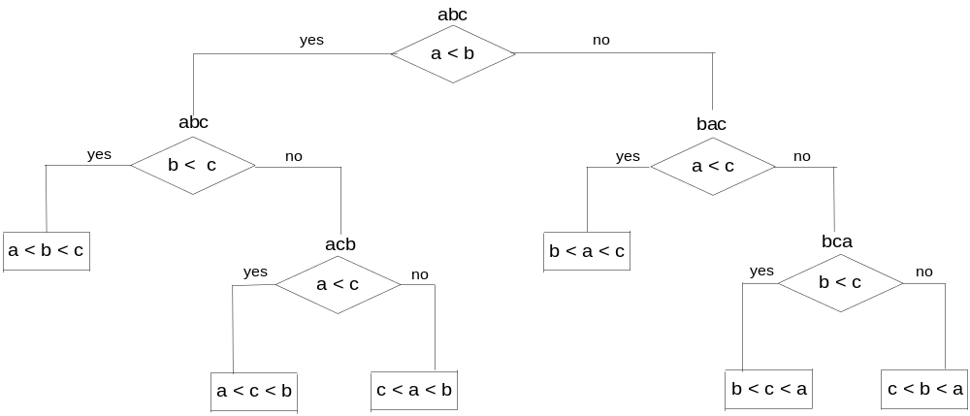
Decision tree for 3-element insertion sort

Slide 10
Decision Trees and Sorting Algorithms
Any comparison-based sorting algorithm can be represented by a decision tree
Number of leaves (outcomes) ≥ n!
Height of binary tree with n! leaves ≥ ⎡log₂n!⎤
Minimum number of comparisons in the worst case ≥ ⎡log₂n!⎤ for any comparison-based sorting algorithm
⎡log₂n!⎤ ≈ n log₂n
This lower bound is tight (mergesort)

Slide 11
Adversary Arguments
Adversary argument: a method of proving a lower bound by playing role of adversary that makes algorithm work the hardest by adjusting input
Example: “Guessing” a number between 1 and n with yes/no questions
Adversary: Puts the number in a larger of the two subsets generated by last question

Slide 12
Lower Bounds by Problem Reduction
Idea: If problem P is at least as hard as problem Q, then a lower bound for Q is also a lower bound for P.
Hence, find problem Q with a known lower bound that can be reduced to problem P in question. Then any algorithm that solves P will also solve Q.

Slide 13
Example of Reduction
Problem Q: Given a sequence of boolean values, does at least one of them have the value “true”?
Problem P: Given a sequence of integers, is the maximum of integers positive?
f(x₁, x₂, … x_{n}) = y₁, y₂, … y_{n}
where y_{i} = 0 if x_{i} = false, y_{i} = 1 if x_{i} = true

Slide 14
P, NP, NP-complete, and NP-hard Problems
Decision and Optimization problems
Decidable, semi-decidable and undecidable problems
Class P, NP, NP-complete and NP-hard problems

Slide 15
Decision and Optimization Problems
Optimization problem: find a solution that maximizes or minimizes some objective function
Decision problem: a question that has two possible answers yes or no. The question is about some input.

Slide 16
Decision Problems: Examples
Given a graph G and a set of vertices K, is K a clique?
Given a graph G and a set of edges M, is M a spanning tree?
Given a set of axioms (boolean expressions) and an expression, is the expression provable under the axioms?

Slide 17
Decidability of Decision Problems
A problem is decidable if there is an algorithm that says yes if the answer is yes, and no otherwise
A problem is semi-decidable if there is an algorithm that says yes if the answer is yes, however it may loop infinitely if the answer is no.
A problem is undecidable if we can prove that there is no algorithm that will deliver an answer.

Slide 18
Example of semi-decidable problem
Given a set of axioms, prove that an expression is true.
Problem 1: Let the axioms be:
A v B
A v C
~B
Prove A.
To prove A we add ~A to the axioms.
If A is true then ~A will be false and this will cause a contradiction - the conjunction of all axioms plus ~A will result in False
(A v B) Λ ~A = B
B Λ (A v C) = (B Λ A) v (B Λ C)
B Λ ~ B = False

Slide 19
Example of semi-decidable problem
Problem 2: Let the axioms be:
A v B
A v C
~B
Prove ~A.
We add A and obtain:
(A v C) Λ A = A
(A v B) Λ A = A
A Λ ~B = A Λ ~B
(A Λ ~B) Λ (A v B) = A Λ ~ B
…..
This process will never stop, because the expressions we obtain will always be different from False

Slide 20
Example of undecidable problem
The halting problem
Let LOOP be a program that checks other programs for infinite loops:
LOOP(P) stops and prints "yes" if P loops infinitely
LOOP(P) enters an infinite loop if P stops
What about LOOP(LOOP)?
http://www.cgl.uwaterloo.ca/~csk/washington/halt.html

Slide 21
Decision and Optimization Problems
The classes P, and NP are defined for decidable decision problems
Definition of Algorithm : a formal abstract device (Turing machine) that given an input (an instance of a problem) will process it in a finite number of steps

Slide 22
Turing Machines
Turing machines are defined formally as a language recognition devices
A string in a language may cause one of three things to happen –
  the machine may stop in a halting state 'yes',
  the machine may stop in a halting state 'no',
  the machine may loop infinitely.
  a) and b) - the language is decidable - i.e. the machine accepts a string if it is in the language (halts at 'yes') or rejects it if it is not in the language (halts at 'no').

Slide 23
Decidable and semi-decidable languages
Decidable language: the machine accepts a string if it is in the language (halts at 'yes') or rejects it if it is not in the language (halts at 'no').
Semi-decidable language: the machine accepts a string if it is in the language (halts at 'yes') or may loop infinitely if it is not in the language

Slide 24
Problem Instances and Languages
Problem instances can be treated as strings in some language.
Example: the set of problem instances of all graphs that have a clique of size K.
We can build a machine that will stop at 'yes' for each element in the set. The machine will stop at 'no' for any instance of a graph that does not have a clique of size K.
The number of the steps determines the
complexity class (P or NP) of the problem.

Slide 25
Decision Versions of Optimization Problems
Optimization problems are not stated as "yes/no' questions.
An optimization problem can be transformed to a decision problem using a bound on the solution
Example:
  TSP Optimization: Find the shortest path that visits all cities
  TSP Decision: Is there a path of length smaller than B?

Slide 26
Class P
P: the class of decision problems that are solvable in O(p(n)) time, where p(n) is a polynomial of problem’s input size n. Problems in this class are called tractable
Examples:
  searching
  graph connectivity

Slide 27
Class NP
NP (nondeterministic polynomial): class of decision problems whose proposed solutions can be verified in polynomial time = solvable by a nondeterministic polynomial algorithm.
Problems in this class are called intractable

Slide 28
Nondeterministic Polynomial Algorithms
An abstract two-stage procedure that:
  generates a random string purported to solve the problem
  checks whether this solution is correct in polynomial time
By definition, it solves the problem if it is capable of generating and verifying a solution on one of its tries

Slide 29
Example: CNF Satisfiability I
Problem: Is a boolean expression in its conjunctive normal form (CNF) satisfiable, i.e., are there values of its variables that makes it true?
This problem is in NP. Nondeterministic algorithm:
  Guess truth assignment
  Substitute the values into the CNF formula to see if it evaluates to true

Slide 30
Example: CNF Satisfiability II
(A | ¬B | ¬C) & (A | B) & (¬B | ¬D | E) & (¬D | ¬E)
Truth assignments:
A B C D E
0 0 0 0 0
. . .
1 1 1 1 1
Checking phase: O(n)

Slide 31
Problems in NP
Hamiltonian circuit existence
Partition problem: Is it possible to partition a set of n integers into two disjoint subsets with the same sum?
Decision versions of TSP, knapsack problem, graph coloring, and many other combinatorial optimization problems. (Few exceptions include: MST, shortest paths)

Slide 32
P and NP
All the problems in P can also be solved in this manner (but no guessing is necessary), so we have:
P ⊆ NP
Big question: P = NP ?

Slide 33
NP-Complete Problems I
Definition:
Problem A reduces to problem B, A ≤ p B
if there is a function f that can be computed by an algorithm in polynomial time such that for all instances x,
x ∈A ⇔ f(x) ∈B
If we have a solution for B,
then we have a solution for A.
B is at least as hard as A.

Slide 34
NP-Complete Problems II
Definition:
A decision problem D is NP-complete if it’s as hard as any problem in NP, i.e.
  D is in NP
  every problem in NP is polynomial-time reducible to D

Slide 35
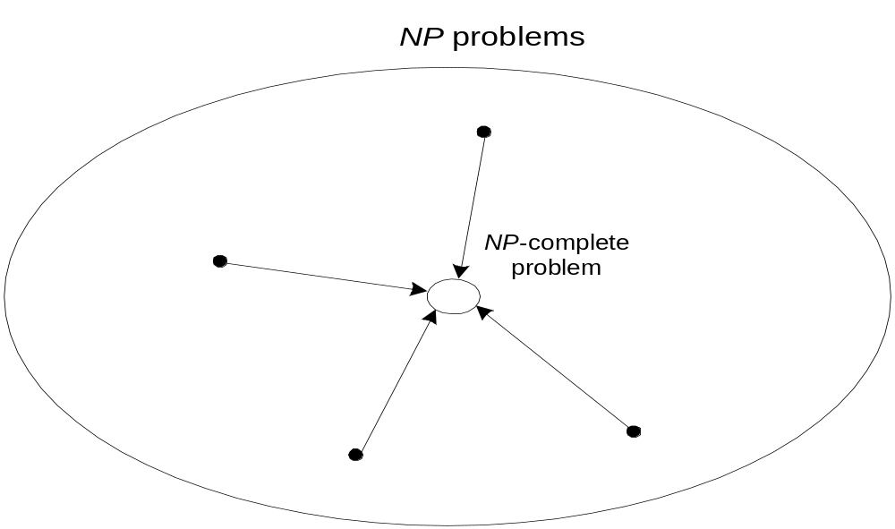
NP-Complete Problems III

Slide 36
Cook’s Theorem (1971)
CNF-sat is NP-complete
http://www.cs.toronto.edu/DCS/People/Faculty/sacook.html
Other NP-complete problems can be obtained through polynomial-time reductions from a known NP-complete problem
Examples: TSP, knapsack, partition, graph-coloring and hundreds of other problems of combinatorial nature

Slide 37
P = NP ?
P = NP would imply that every problem in NP, including all NP-complete problems, could be solved in polynomial time
If a polynomial-time algorithm for just one NP-complete problem is discovered, then every problem in NP can be solved in polynomial time, i.e., P = NP
Most but not all researchers believe that P ≠ NP , i.e. P is a proper subset of NP

Slide 38
NP-Hard Problems
NP-hard problems are NP-complete but not necessarily in NP.
Examples – the optimization versions of the NP problems

