Slide 1
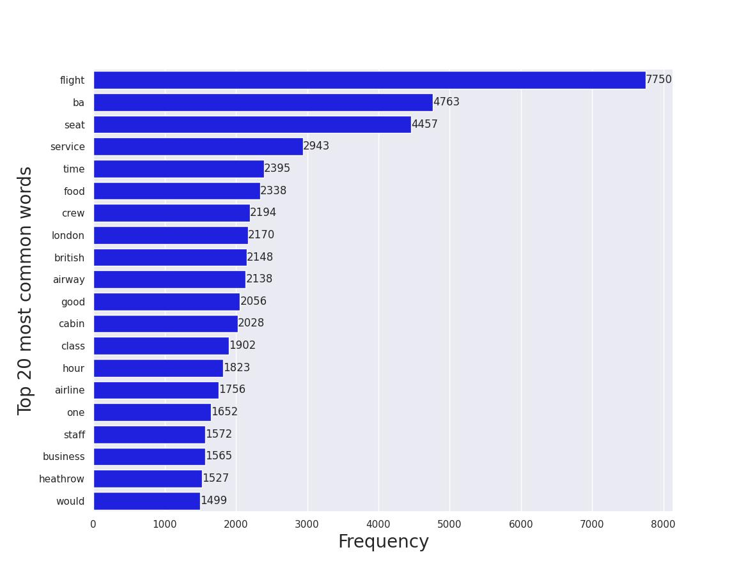
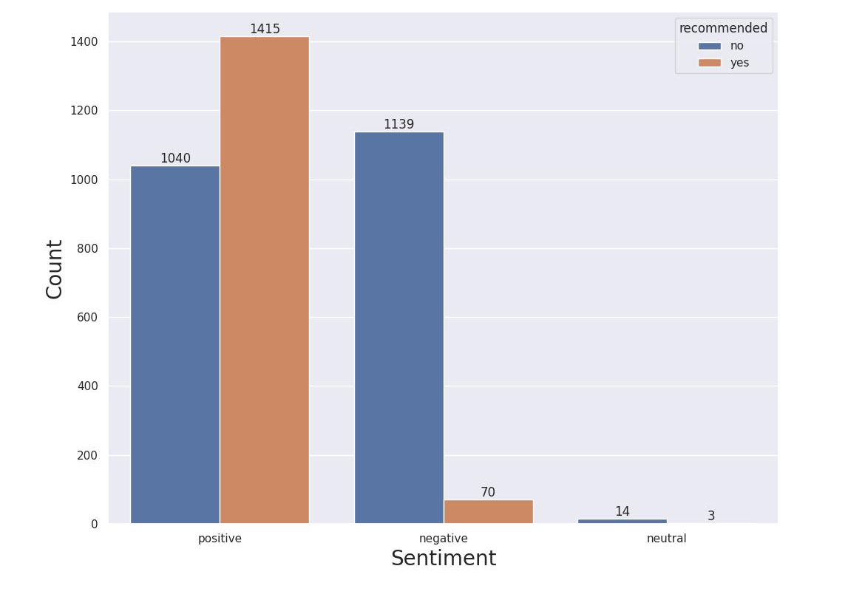
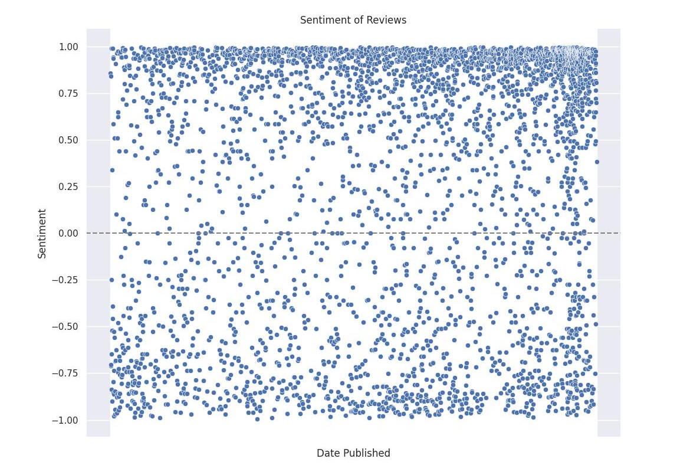
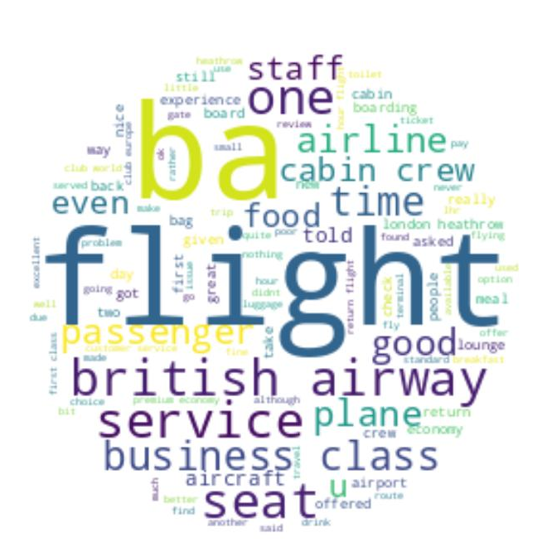
Most common words
Sentiment Analysis
The sentiment of the reviews was analysed using Python’s Natural Language Toolkit and compared to the recommendation given by the reviewer, giving us the top graph. Although the overall sentiment of the reviews is positive, there is a larger number of revierwers who would not recommend the airline to others. The bottom graph shows the change in sentiment over time.
The data was cleaned to remove stopwords and any information irrelevant to the review. The reviews were also lemmatized to group together similar terms to avoid duplicates.

