Slide 1
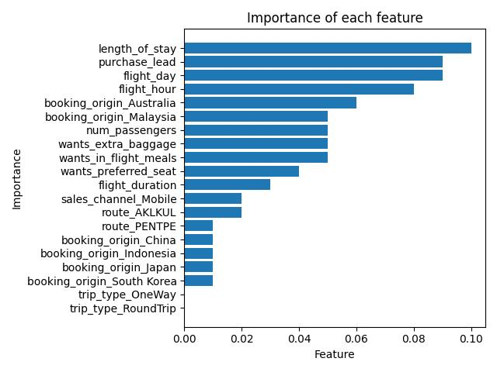
The most important variable in deciding whether a passenger will book or not is the ‘length of stay’, that is, how many days they stay at the destination. The ‘purchase lead’, or number of days between travel date and booking date is also important. Interestingly, the booking origin is also important.

