Slide 1


Model Validation in Extraction of the Inclusive Muon Neutrino Charged Current Cross Section at MicroBooNE
Xiangpan Ji and Wenqiang Gu (BNL)
On behalf of the MicroBooNE collaboration
APS April Meeting 2021

Slide 2
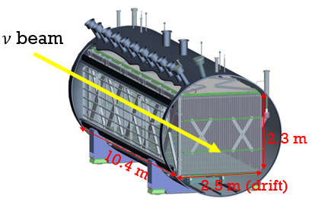
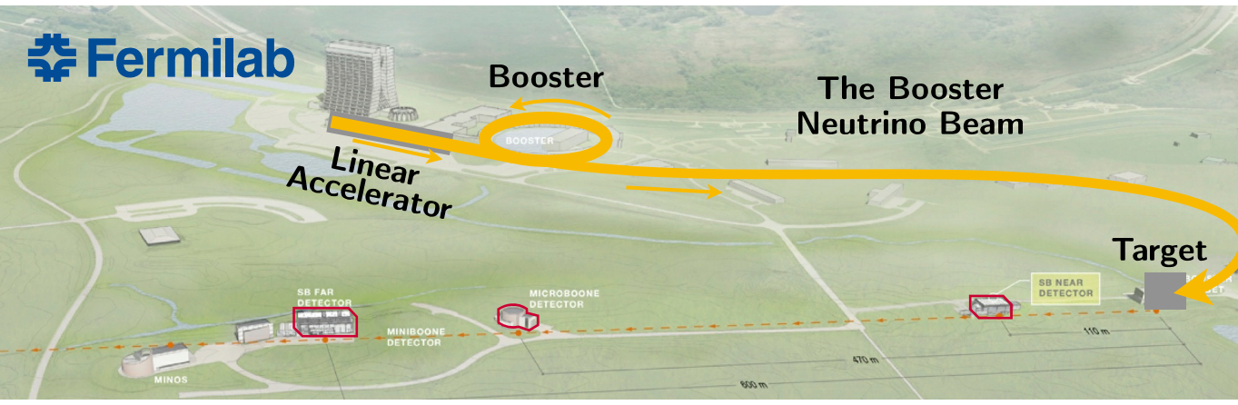
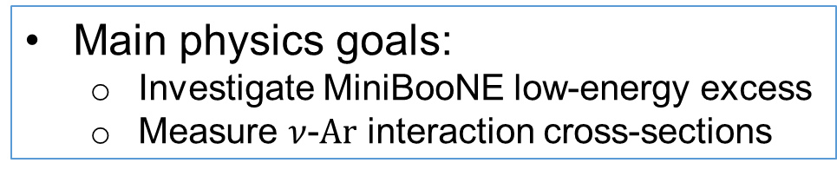
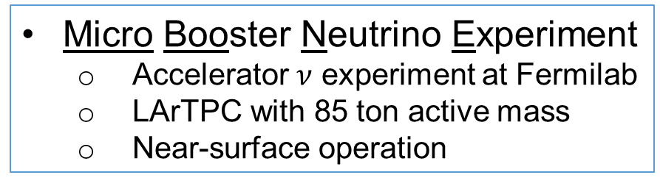
MicroBooNE Overview
Micro Booster Neutrino Experiment
Accelerator $ν$ experiment at Fermilab
LArTPC with 85 ton active mass
Near-surface operation
Main physics goals:
Investigate MiniBooNE low-energy excess
Measure $ν$-$Ar$ interaction cross-sections
MicroBooNE
MicroBooNE detector
There are 16 presentations given by MicroBooNE at this meeting!

Slide 3
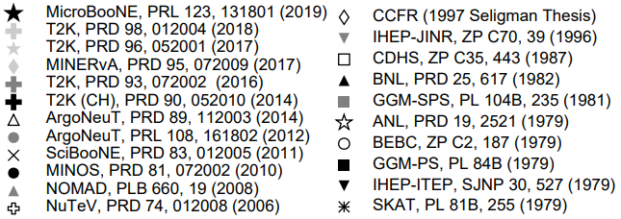
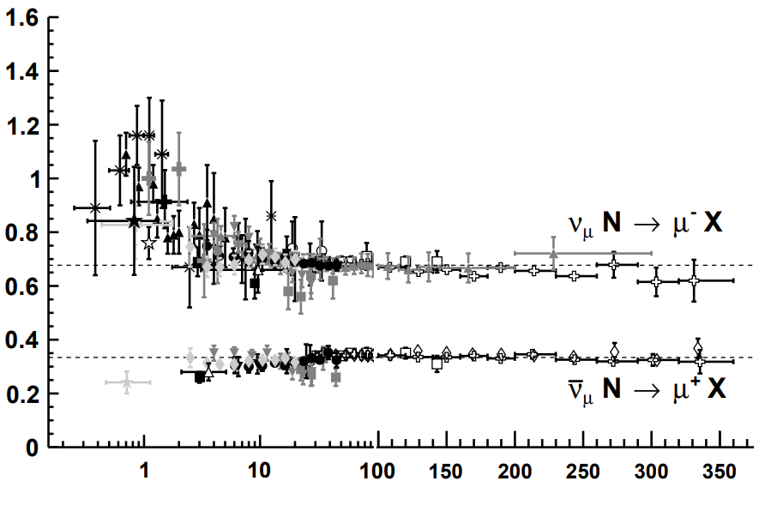


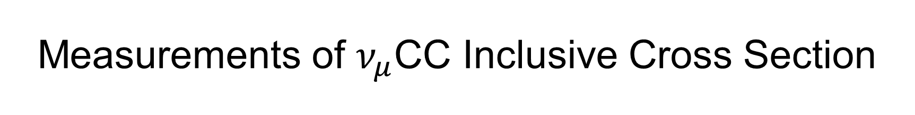
Measurements of $ν_{μ}$CC Inclusive Cross Section
Review of Particle Physics
PDG, PTEP 2020 (2020) 8, 083C01
Few measurements at low neutrino energy, especially in Argon target

Slide 4

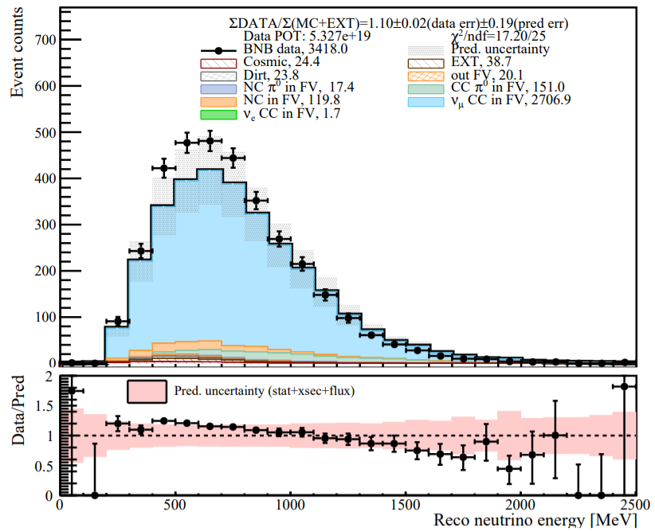
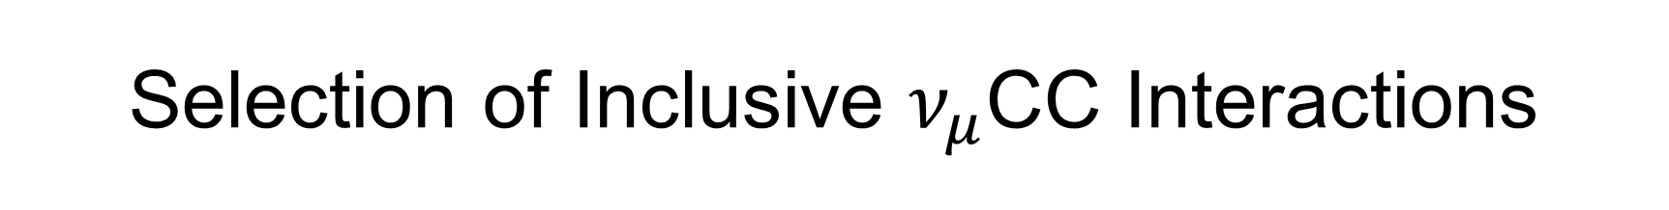
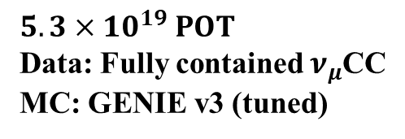
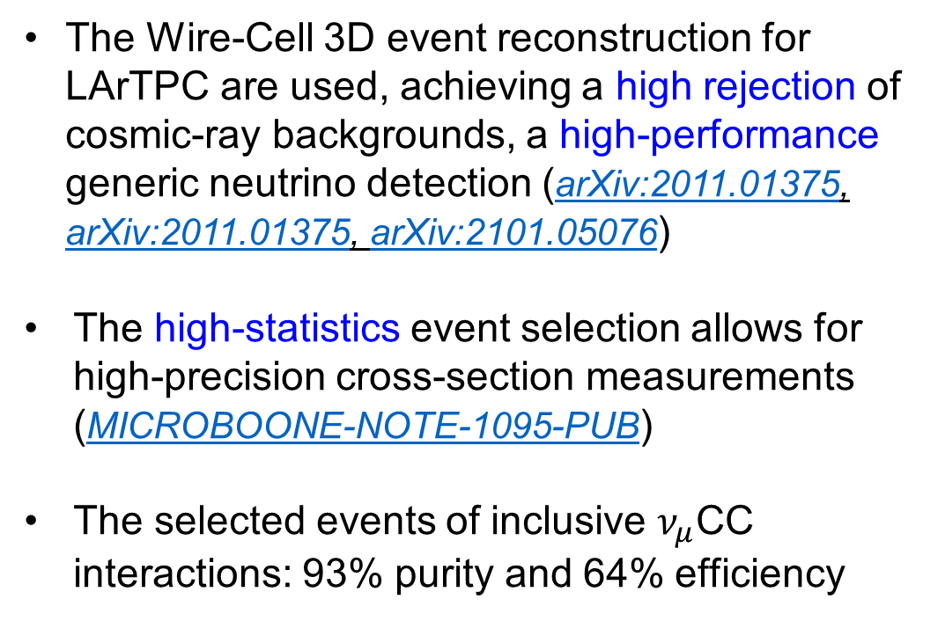
Selection of Inclusive $ν_{μ}$CC Interactions
MicroBooNE Preliminary
The Wire-Cell 3D event reconstruction for LArTPC are used, achieving a high rejection of cosmic-ray backgrounds, a high-performance generic neutrino detection (arXiv:2011.01375, arXiv:2011.01375, arXiv:2101.05076)
The high-statistics event selection allows for high-precision cross-section measurements (MICROBOONE-NOTE-1095-PUB)
The selected events of inclusive $ν_{μ}$CC interactions: 93% purity and 64% efficiency
$$5.3×{10}^{19} POT$$
Data: Fully contained $ν_{μ}$CC
MC: GENIE v3 (tuned)

Slide 5

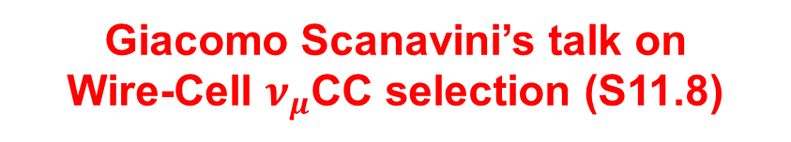
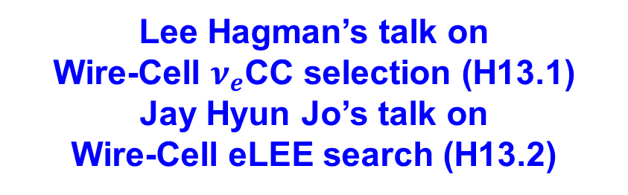
Selection of Inclusive $ν_{μ}$CC Interactions
London Cooper-Troendle’s talk on Wire-Cell generic neutrino detection (E18.2)
MicroBooNE Preliminary
The Wire-Cell 3D event reconstruction for LArTPC are used, achieving a high rejection of cosmic-ray backgrounds, a high-performance generic neutrino detection
The high-statistics event selection allows for high-precision cross-section measurements (MICROBOONE-NOTE-1095-PUB)
The selected events of inclusive $ν_{μ}$CC interactions: 93% purity and 64% efficiency
Hai Wang Yu’s talk on
Wire-Cell pattern recognition (Z19.1)
$$5.3×{10}^{19} POT$$
Data: Fully contained $ν_{μ}$CC
MC: GENIE v3 (tuned)
Lee Hagman’s talk on
Wire-Cell $ν_{e}$CC selection (H13.1)
Jay Hyun Jo’s talk on
Wire-Cell eLEE search (H13.2)
Giacomo Scanavini’s talk on
Wire-Cell $ν_{μ}$CC selection (S11.8)

Slide 6
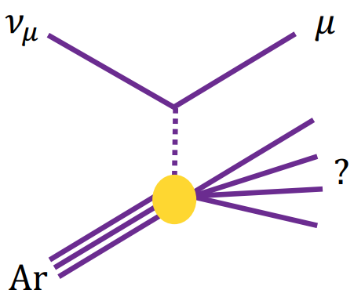


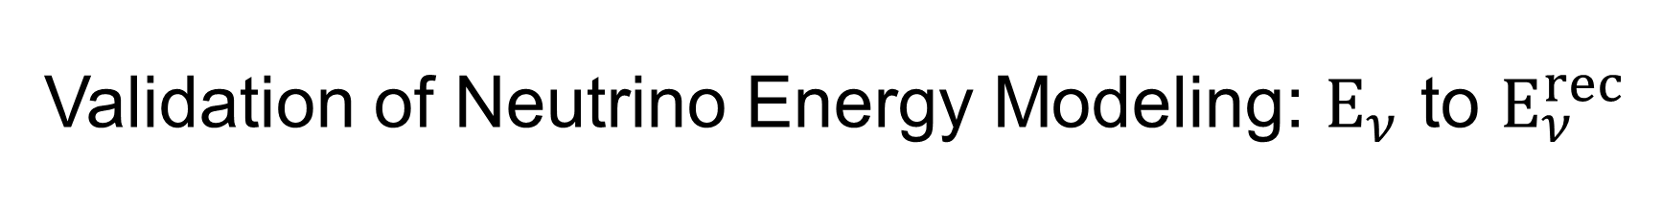

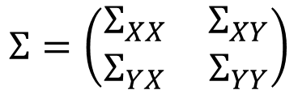


Validation of Neutrino Energy Modeling: $E_{ν}$ to $E_{ν}^{rec}$
Neutrino energy modeling is crucial to neutrino oscillation measurement
Key challenge: understanding $ν$-Ar cross section as a function of energy
A method: validate $E_{had}^{rec}$ after applying the constraint of muon kinematics distribution
Common systematics are suppressed, providing a more stringent validation
$$E_{ν}^{rec}=E_{μ}^{rec}+E_{had}^{rec}$$
Method Description*
Given the vector of variable X, Y with their mean and covariance matrix
muon kinematics $⇒X$
$$μ_{X,Y}=\left(\begin{matrix}μ_{X} \\ μ_{Y}\end{matrix}\right)$$
$$Σ=\left(\begin{matrix}Σ_{XX} & Σ_{XY} \\ Σ_{YX} & Σ_{YY}\end{matrix}\right)$$
We can calculate the conditional mean and conditional variance
total reco energy of hadrons $E_{had}^{rec}⇒Y$
$$μ_{Y|X}^{constrained}=μ_{Y}+Σ_{YX}Σ_{XX}^{−1}\left(m_{X}−μ_{X}\right)$$
Expectations on Y
$$Σ_{Y|X}^{constrained}=Σ_{YY}−Σ_{YX}Σ_{XX}^{−1}Σ_{YX}$$
Uncertainties on Y
*E. L. Morris “Multivariate Statistics: a Vector Space Approach” 1983

Slide 7
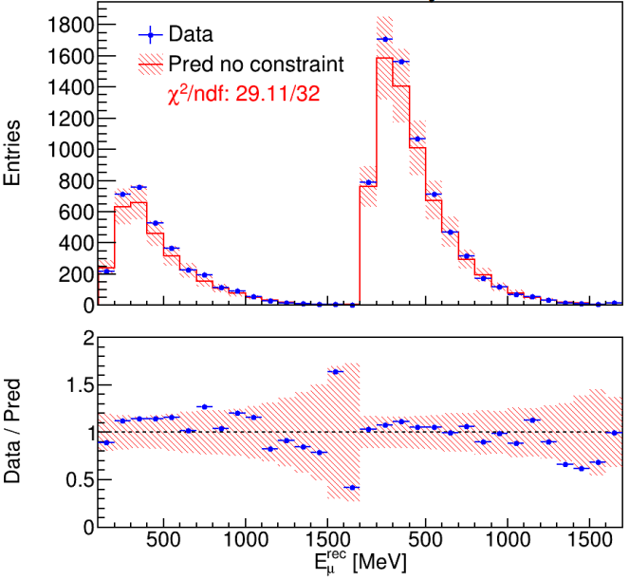
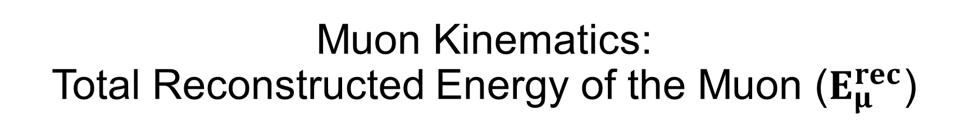

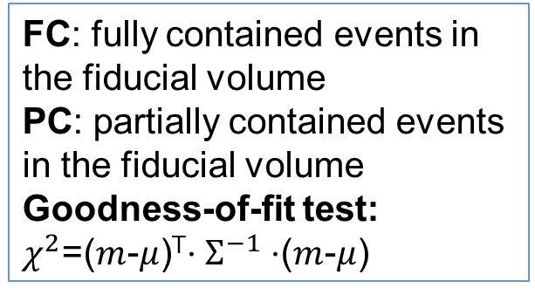
Muon Kinematics: Total Reconstructed Energy of the Muon ($E_{μ}^{rec}$)
MicroBooNE Preliminary
FC: fully contained events in the fiducial volume
PC: partially contained events in the fiducial volume
Goodness-of-fit test:
$χ^{2}$=($m$-$μ$)^{T}$⋅Σ^{−1}⋅$($m$-$μ$)
$χ^{2}$/ndf=29.1/32
FC
PC
Error band for statistic, flux and cross section systematic uncertainties
The reasonable value of goodness-of-fit test show good agreement between data and model prediction

Slide 8
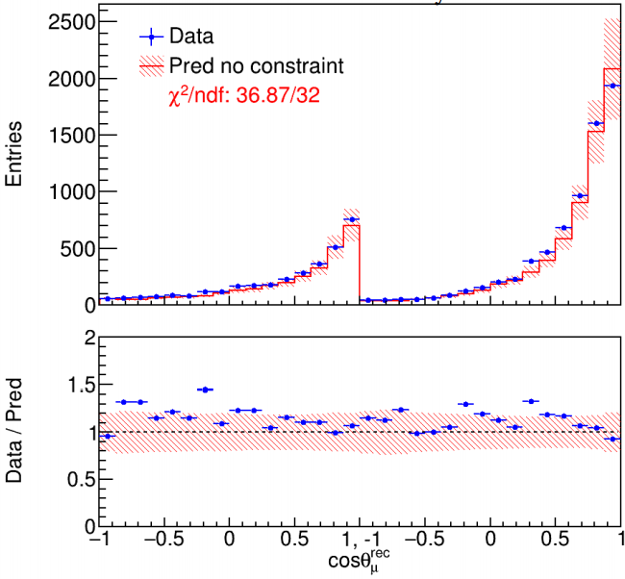
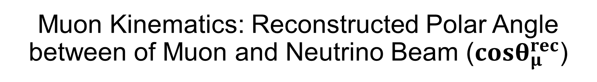


Muon Kinematics: Reconstructed Polar Angle between of Muon and Neutrino Beam ($cosθ_{μ}^{rec}$)
MicroBooNE Preliminary
FC: fully contained events in the fiducial volume
PC: partially contained events in the fiducial volume
Goodness-of-fit test:
$χ^{2}$=($m$-$μ$)^{T}$⋅Σ^{−1}⋅$($m$-$μ$)
$χ^{2}$/ndf=36.9/32
$χ^{2}$/ndf=29.1/32
FC
PC
FC
PC
Error band for statistic, flux and cross section systematic uncertainties
The reasonable value of goodness-of-fit test show good agreement between data and model prediction

Slide 9
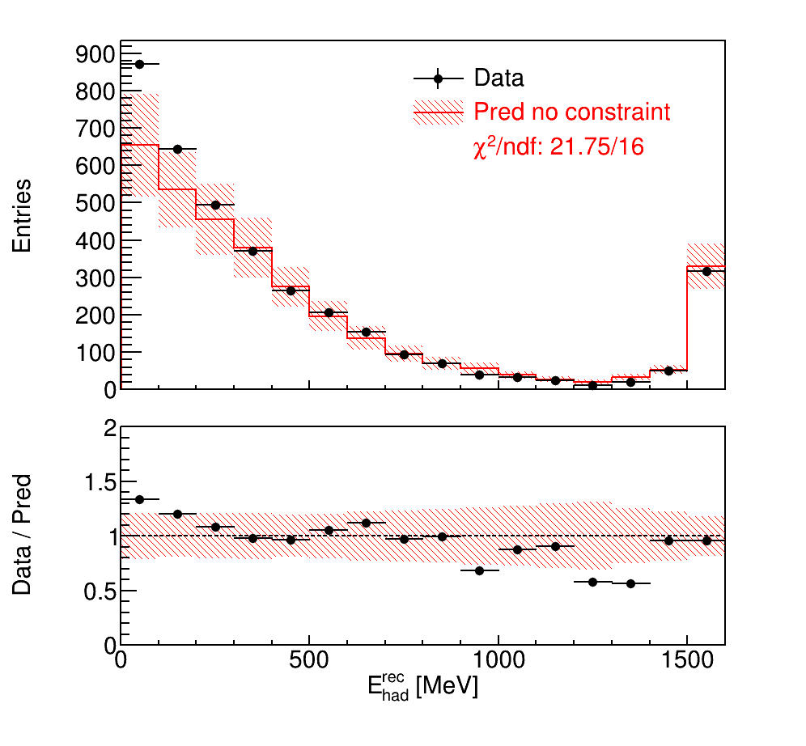

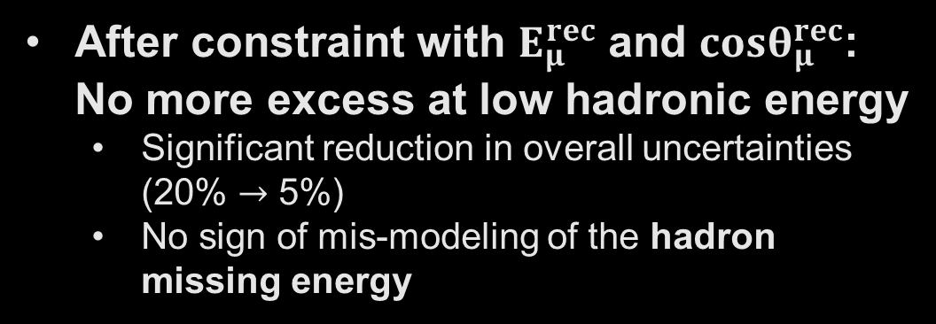
Validation of Hadronic Energy Reconstruction
MicroBooNE Preliminary
Before constraint: Excess observed at low hadronic energy
Mis-modeling of missing energy in the hadron final states?
$χ^{2}$/ndf=21.8/16
Before constraint
FC events
After constraint with $E_{μ}^{rec}$ and $cosθ_{μ}^{rec}$: No more excess at low hadronic energy
Significant reduction in overall uncertainties (20% $→$ 5%)
No sign of mis-modeling of the hadron missing energy
overflow bin
* Similar result of PC events

Slide 10
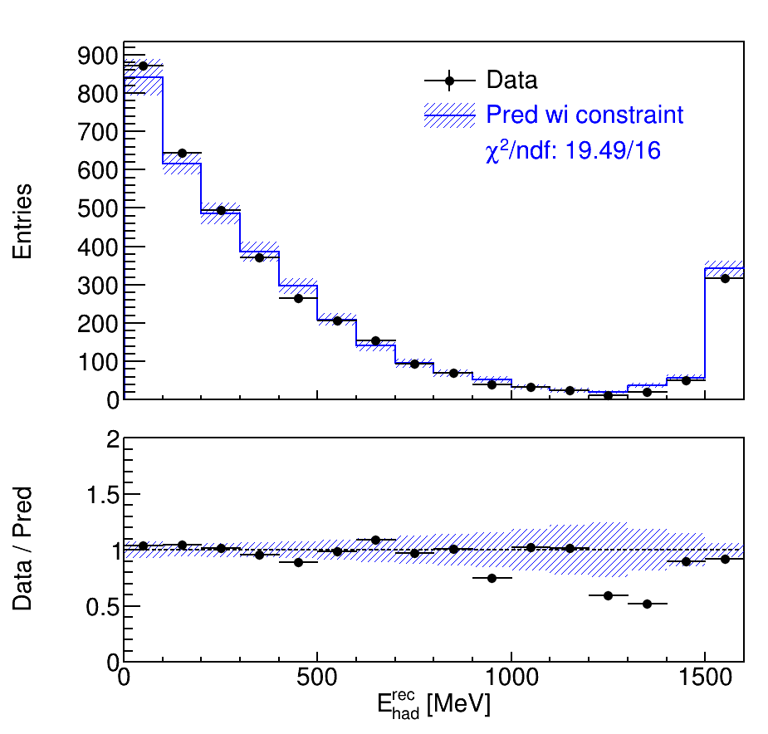
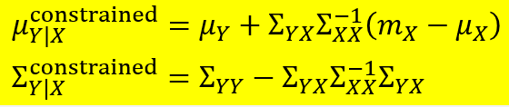



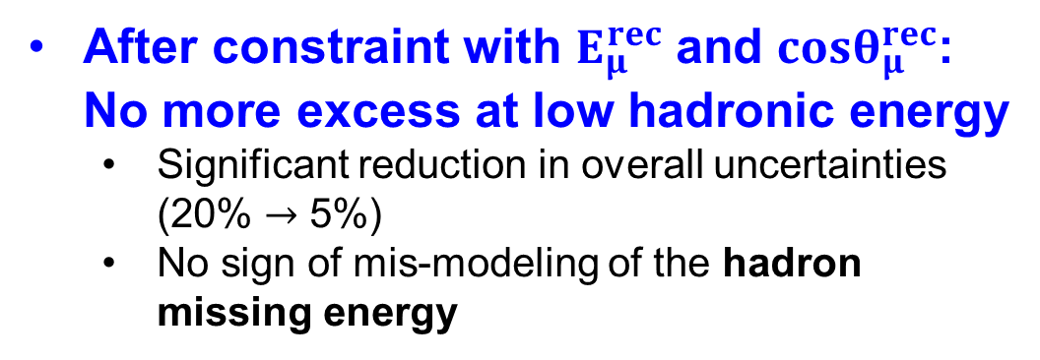
Validation of Hadronic Energy Reconstruction
MicroBooNE Preliminary
Before constraint: Excess observed at low hadronic energy
Mis-modeling of missing energy in the hadron final states?
$χ^{2}$/ndf=19.5/16
After constraint
FC events
After constraint with $E_{μ}^{rec}$ and $cosθ_{μ}^{rec}$: No more excess at low hadronic energy
Significant reduction in overall uncertainties (20% $→$ 5%)
No sign of mis-modeling of the hadron missing energy
overflow bin
$$Y:E_{had}^{rec}$$
X$:E_{μ}^{rec} \text{and} cosθ_{μ}^{rec}$
* Similar result of PC events

Slide 11
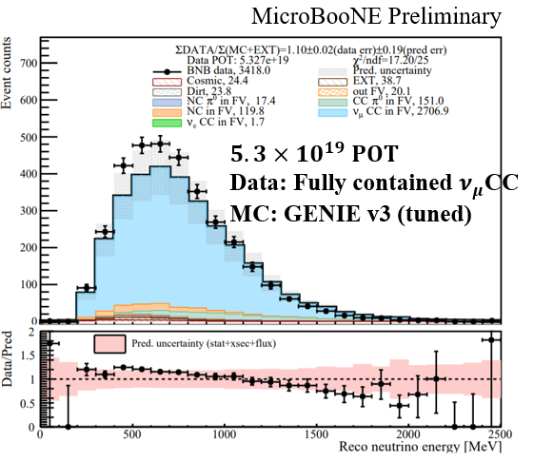
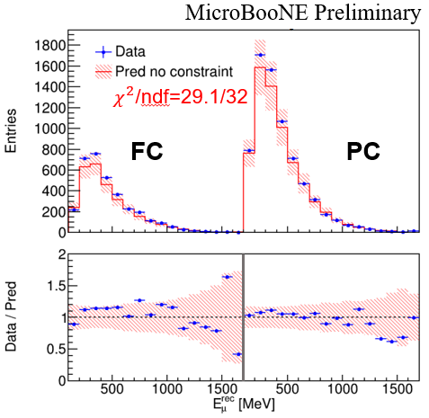
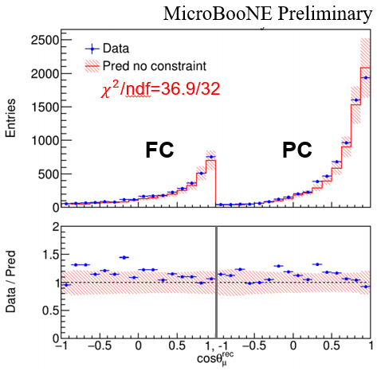
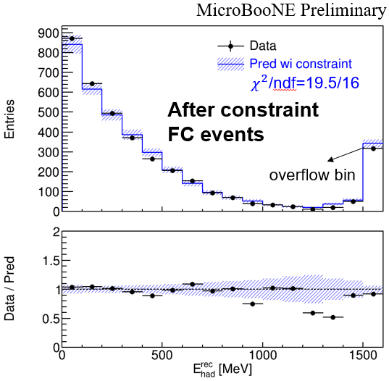
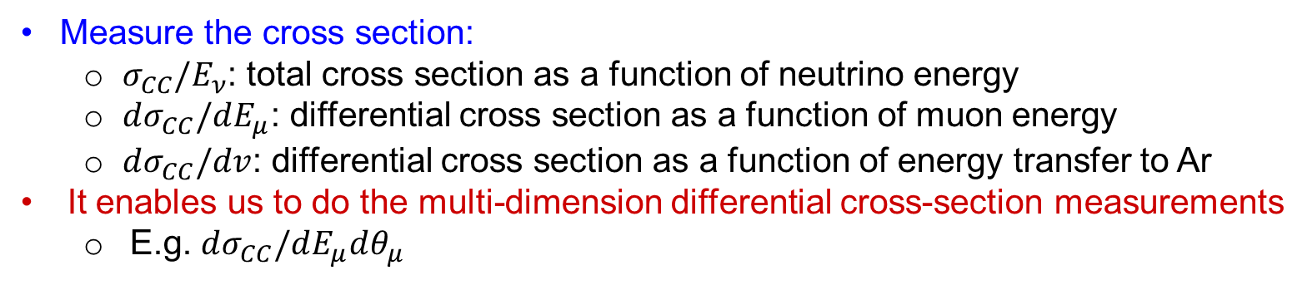
To measure the cross section
Reco neutrino energy
Reco muon energy
Reco polar angle
Reco hadrons energy
Measure the cross section:
$σ_{CC}/E_{ν}$: total cross section as a function of neutrino energy
$dσ_{CC}/dE_{μ}$: differential cross section as a function of muon energy
$dσ_{CC}/dv$: differential cross section as a function of energy transfer to Ar
It enables us to do the multi-dimension differential cross-section measurements
E.g. $dσ_{CC}/dE_{μ}dθ_{μ}$

Slide 12
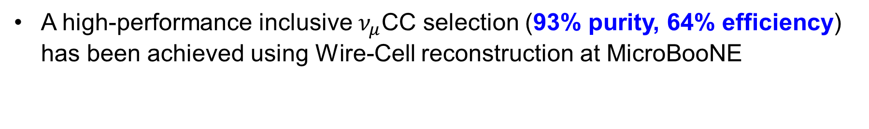
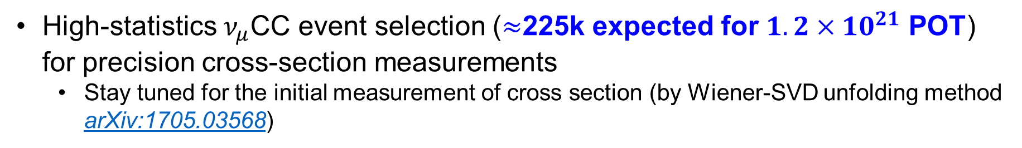
Summary
A high-performance inclusive $ν_{μ}$CC selection (93% purity, 64% efficiency) has been achieved using Wire-Cell reconstruction at MicroBooNE
New technique with conditional constraint allows for more stringent validations of the cross-section modeling and neutrino energy reconstruction for oscillation and cross section measurements
Examination of hadronic energy distribution after constraint by muon kinematics explains the observed low-hadronic-energy excess
High-statistics $ν_{μ}$CC event selection ($≈$225k expected for $1.2×10^{21}$ POT) for precision cross-section measurements
Stay tuned for the initial measurement of cross section (by Wiener-SVD unfolding method arXiv:1705.03568)

Slide 13
Thank you!

