Slide 1

Measurements and Model Validations of Inclusive $ν_{μ}$CC Events with the Wire-Cell Reconstruction at MicroBooNE
Wenqiang Gu
BNL
on behalf of the MicroBooNE

Slide 2
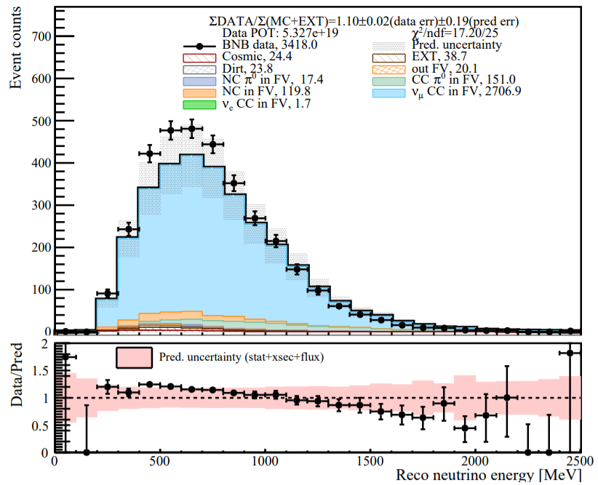

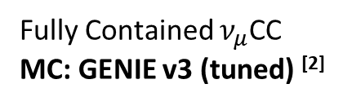

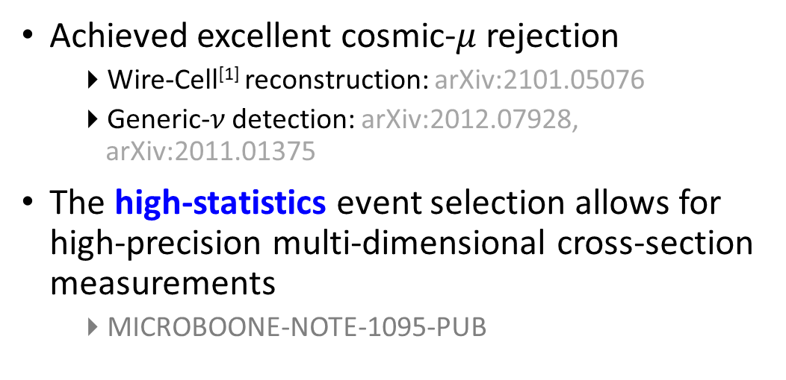
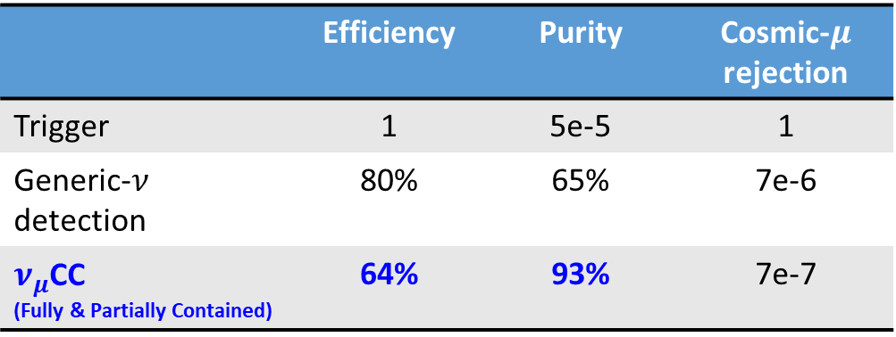
Event Selection of Inclusive Charged-Current $ν_{μ}$ Interactions
MicroBooNE Preliminary
 | Efficiency | Purity | Cosmic-$μ$ rejection
Trigger | 1 | 5e-5 | 1
Generic-$ν$ detection | 80% | 65% | 7e-6
$ν_{μ}$CC (Fully & Partially Contained) | 64% | 93% | 7e-7
Fully Contained $ν_{μ}$CC
MC: GENIE v3 (tuned) ^{[2]}
Achieved excellent cosmic-$μ$ rejection
Wire-Cell^{[1]} reconstruction: arXiv:2101.05076
Generic-$ν$ detection: arXiv:2012.07928, arXiv:2011.01375
The high-statistics event selection allows for high-precision multi-dimensional cross-section measurements
MICROBOONE-NOTE-1095-PUB
Calorimetric energy:
$$E_{ν}^{rec}=E_{μ}^{rec}+E_{had}^{rec}$$
Notes:
Elena: try more concise bullets
Kirsty: try different color for sub-bullets and highlight the main text
Difference is covered by the uncertainty, no impact on LEE analysis
Genie version 3 + uB tune (fit world data, T2K QE similar energy, no miniboone, no microboone)
Cite GENIE (see technote)
LArTPC is a “slow” detector: time -> position. On the surface, cosmic background

Slide 3
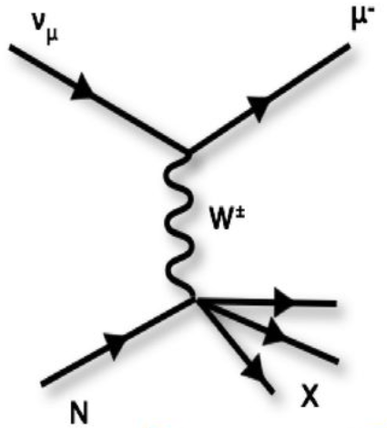
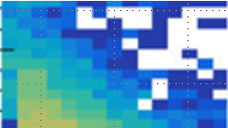
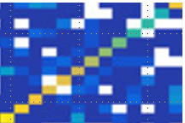
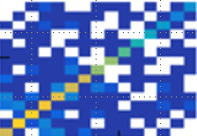
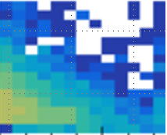

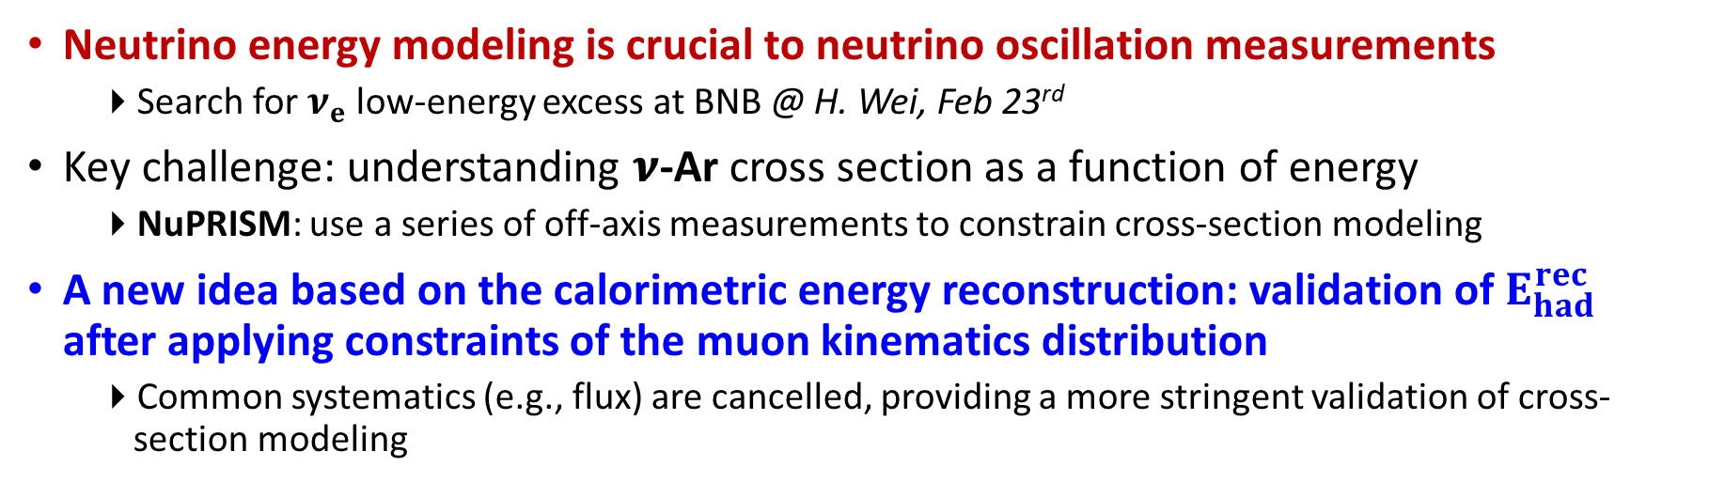

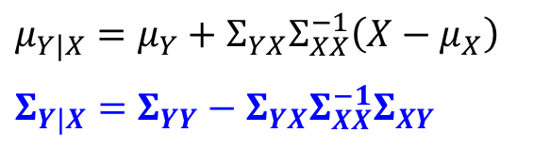

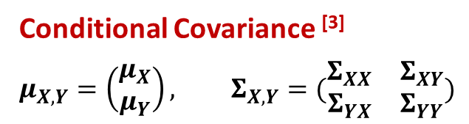

Validation of Neutrino Energy Modeling: $E_{ν}$ to $E_{ν}^{rec}$
Neutrino energy modeling is crucial to neutrino oscillation measurements
Search for $ν_{e}$ low-energy excess at BNB @ H. Wei, Feb 23rd
Key challenge: understanding 𝝂-Ar cross section as a function of energy
NuPRISM: use a series of off-axis measurements to constrain cross-section modeling
A new idea based on the calorimetric energy reconstruction: validation of $E_{had}^{rec}$ after applying constraints of the muon kinematics distribution
Common systematics (e.g., flux) are cancelled, providing a more stringent validation of cross-section modeling
$E_{μ}^{rec}⇒X$
Conditional Covariance ^{[3]}
$$μ_{X,Y}=\left(\begin{matrix}μ_{X} \\ μ_{Y}\end{matrix}\right), Σ_{X,Y}=(\begin{matrix}Σ_{XX} & Σ_{XY} \\ Σ_{YX} & Σ_{YY}\end{matrix})$$
Correlated statistical uncertainty with bootstrapping method
$$E_{μ}^{rec}$$
$$μ_{Y|X}=μ_{Y}+Σ_{YX}Σ_{XX}^{−1}\left(X−μ_{X}\right)$$
$$Σ_{Y|X}=Σ_{YY}−Σ_{YX}Σ_{XX}^{−1}Σ_{XY}$$
$$E_{had}^{rec}⇒Y$$
(reduce uncer.)
$$E_{had}^{rec}$$
Notes:
Much well-known Muon energy
Numu -> nue constrain flux
Muon energy reconstruction calibrated with dedicated sample

Slide 4
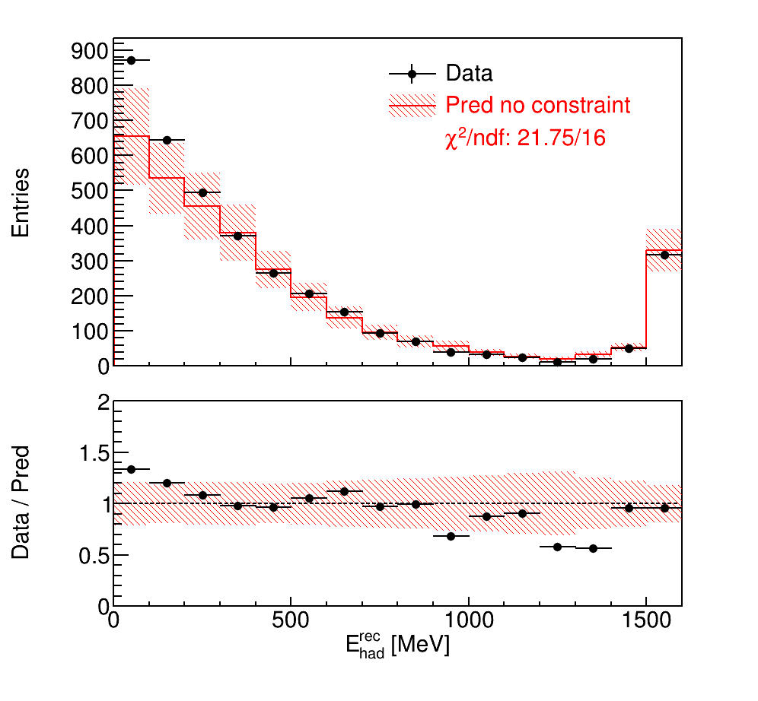
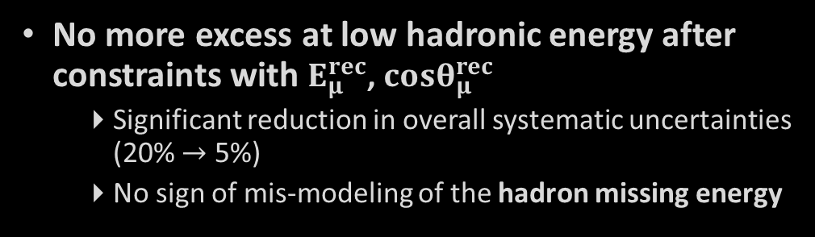

Model Constraint with Conditional Covariance
MicroBooNE Preliminary (5.327E19 POT)
Excess observed at low hadronic energy
Mis-modeling of missing energy in the hadron final states?
(FC $ν_{μ}$CC)
Before Constraints
Overflow bin
No more excess at low hadronic energy after constraints with $E_{μ}^{rec}$, $cosθ_{μ}^{rec}$
Significant reduction in overall systematic uncertainties (20% $→$ 5%)
No sign of mis-modeling of the hadron missing energy
Notes:
Matt: “underprediction from model” sounds a softer tune

Slide 5
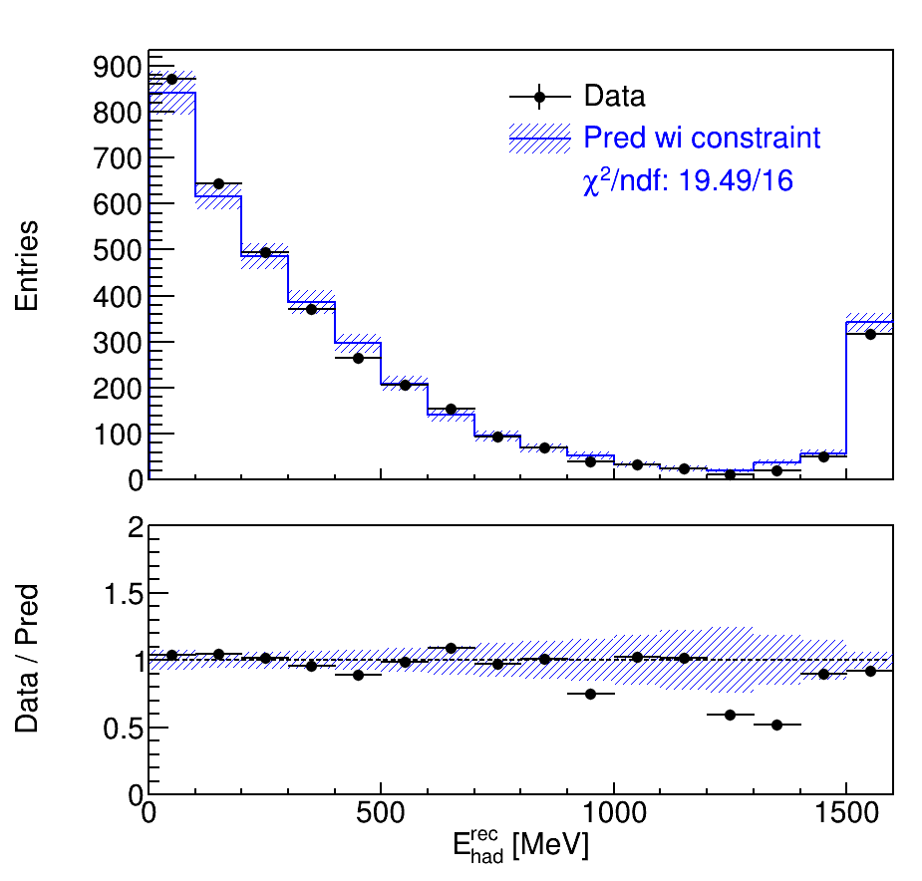
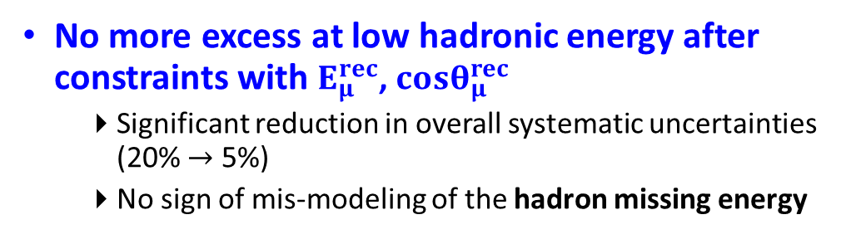
Model Constraint with Conditional Covariance
MicroBooNE Preliminary (5.327E19 POT)
Excess observed at low hadronic energy
Mis-modeling of missing energy in the hadron final states?
(FC $ν_{μ}$CC)
After Constraints
Overflow bin
No more excess at low hadronic energy after constraints with $E_{μ}^{rec}$, $cosθ_{μ}^{rec}$
Significant reduction in overall systematic uncertainties (20% $→$ 5%)
No sign of mis-modeling of the hadron missing energy
Notes:
Matt: “underprediction from model” sounds a softer tune

Slide 6
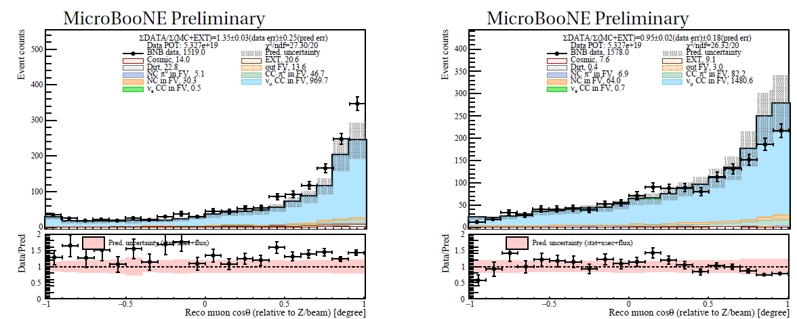
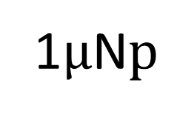
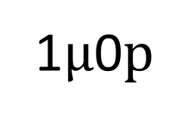
Model Comparison in High Dimension
1$μ$0$p$
1$μ$N$p$
Overall excess
Deficit at muon forward angle
High-statistics $ν_{μ}$CC allows for multi-dimensional cross-section measurements
Notes:
Costh is muon kinematics, it is not proton

Slide 7
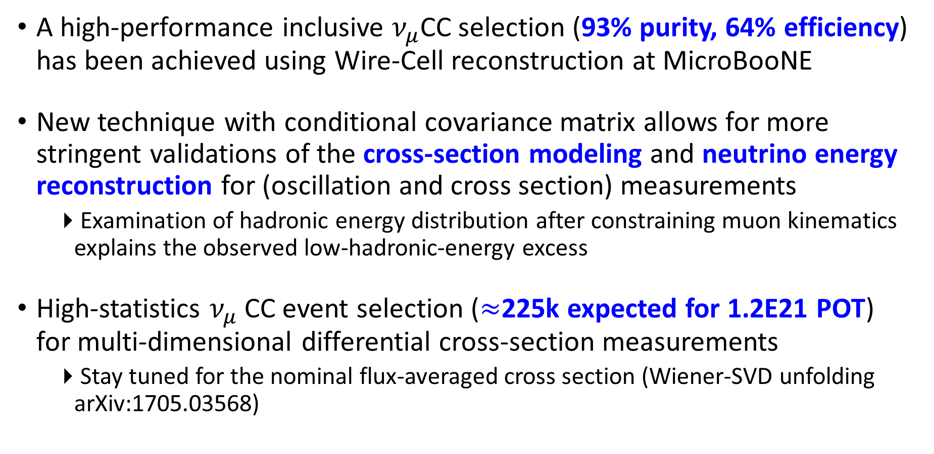
Summary
A high-performance inclusive $ν_{μ}$CC selection (93% purity, 64% efficiency) has been achieved using Wire-Cell reconstruction at MicroBooNE
New technique with conditional covariance matrix allows for more stringent validations of the cross-section modeling and neutrino energy reconstruction for (oscillation and cross section) measurements
Examination of hadronic energy distribution after constraining muon kinematics explains the observed low-hadronic-energy excess
High-statistics $ν_{μ}$CC event selection ($≈$225k expected for 1.2E21 POT) for multi-dimensional differential cross-section measurements
Stay tuned for the nominal flux-averaged cross section (Wiener-SVD unfolding arXiv:1705.03568)
Notes:
Prepared questions:
When is Xs result coming out?
Is there any comparison with other generators for 1u0P 1uNP? We haven’t compared, but we compared with GENIE v2. 1uNp channel

Slide 8
References
[1]: Wire-Cell Software Package for LArTPC: https://lar.bnl.gov/wire-cell/
[2]: Neutrino Interaction Model and Uncertainties for MicroBooNE Analyses. MICROBOONE-NOTE-1074-PUB
[3]: Eaton, Morris L. (1983). Multivariate Statistics: a Vector Space Approach. John Wiley and Sons. pp. 116–117. ISBN 0-471-02776-6

Slide 9

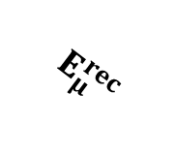
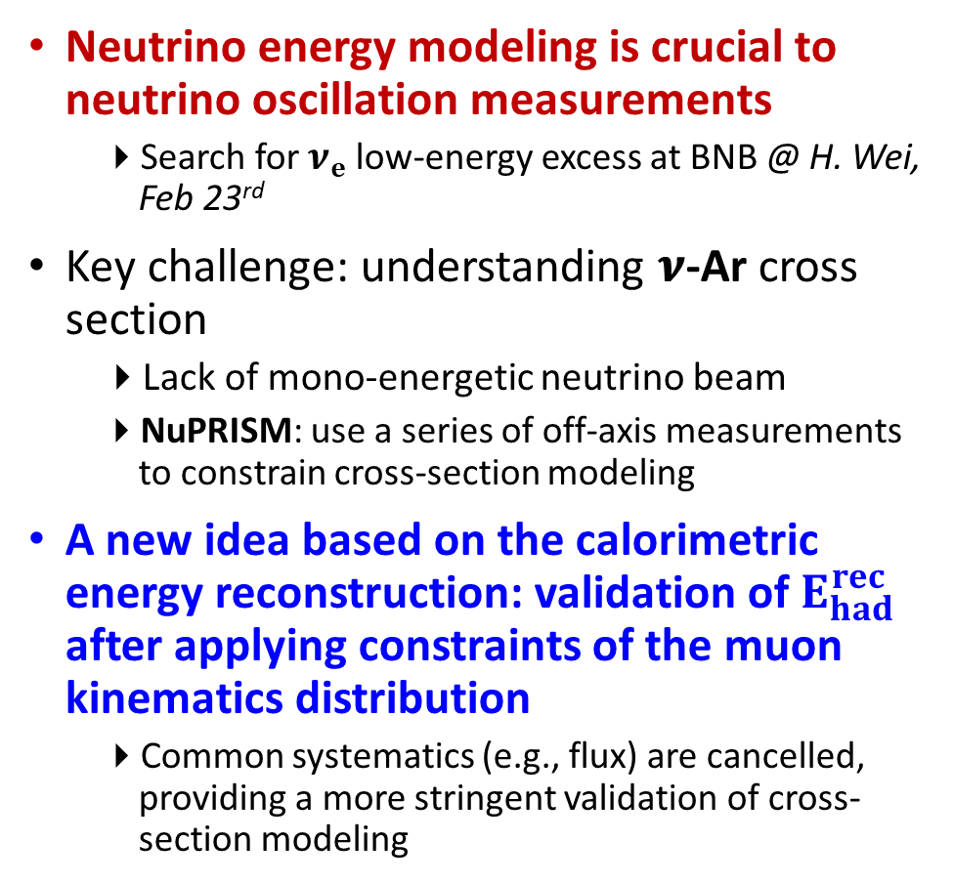
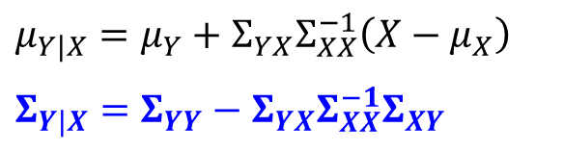
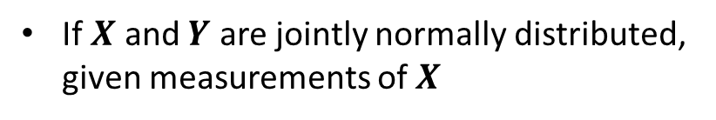
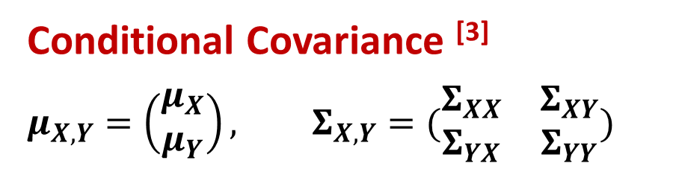
Validation of Neutrino Energy Modeling: $E_{ν}$ to $E_{ν}^{rec}$
Neutrino energy modeling is crucial to neutrino oscillation measurements
Search for $ν_{e}$ low-energy excess at BNB @ H. Wei, Feb 23rd
Key challenge: understanding 𝝂-Ar cross section
Lack of mono-energetic neutrino beam
NuPRISM: use a series of off-axis measurements to constrain cross-section modeling
A new idea based on the calorimetric energy reconstruction: validation of $E_{had}^{rec}$ after applying constraints of the muon kinematics distribution
Common systematics (e.g., flux) are cancelled, providing a more stringent validation of cross-section modeling
Conditional Covariance ^{[3]}
$$μ_{X,Y}=\left(\begin{matrix}μ_{X} \\ μ_{Y}\end{matrix}\right), Σ_{X,Y}=(\begin{matrix}Σ_{XX} & Σ_{XY} \\ Σ_{YX} & Σ_{YY}\end{matrix})$$
If $X$ and $Y$ are jointly normally distributed, given measurements of $X$
$$μ_{Y|X}=μ_{Y}+Σ_{YX}Σ_{XX}^{−1}\left(X−μ_{X}\right)$$
$$Σ_{Y|X}=Σ_{YY}−Σ_{YX}Σ_{XX}^{−1}Σ_{XY}$$
(reduce uncer.)
Correlated statistical uncertainty with bootstrapping method
$$E_{μ}^{rec}$$
$$E_{had}^{rec}$$
Notes:
Much well-known Muon energy
Numu -> nue constrain flux
Muon energy reconstruction calibrated with dedicated sample

Slide 10
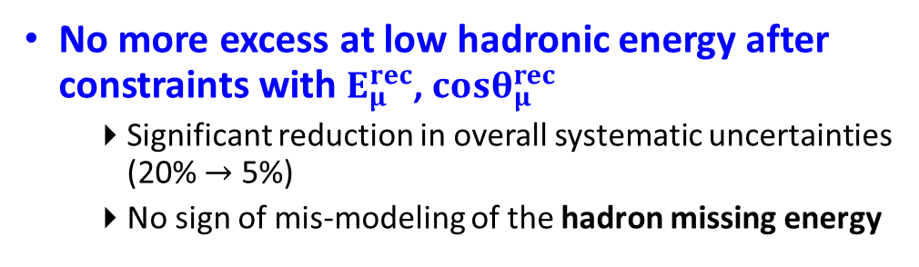
Model Constraint with Conditional Covariance
(5.327E19 POT)
MicroBooNE Preliminary
MicroBooNE Preliminary
(FC $ν_{μ}$CC)
Before Constraints
After Constraints
Overflow bin
Excess observed at low hadronic energy
Mis-modeling of missing energy in the hadron final states?
No more excess at low hadronic energy after constraints with $E_{μ}^{rec}$, $cosθ_{μ}^{rec}$
Significant reduction in overall systematic uncertainties (20% $→$ 5%)
No sign of mis-modeling of the hadron missing energy
Notes:
Matt: “underprediction from model” sounds a softer tune

