Slide 1

大亚湾中微子实验绝对效率研究 Absolute ${\overline{ν}}_{e}$Detection Efficiency at Daya Bay
顾文强 上海交通大学
Wenqiang Gu(SJTU)
on behalf of the Daya Bay Collaboration

Slide 2
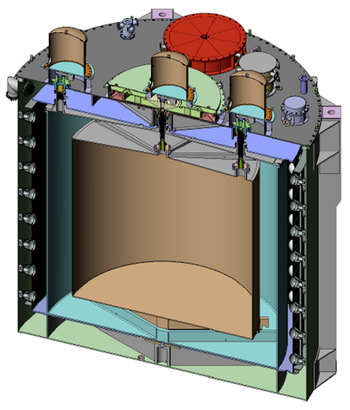
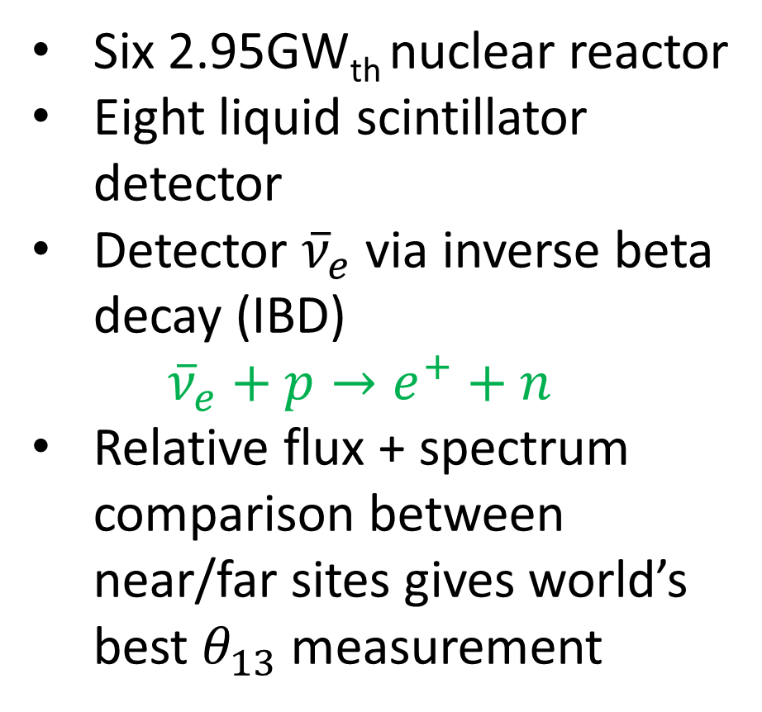
The Daya Bay Experiment
Six 2.95GW_{th} nuclear reactor
Eight liquid scintillator detector
Detector ${\overline{ν}}_{e}$ via inverse beta decay (IBD)
${\overline{ν}}_{e}+p→e^{+}+n$
Relative flux + spectrum comparison between near/far sites gives world’s best $θ_{13}$ measurement
Gd-LS
target volume

Slide 3
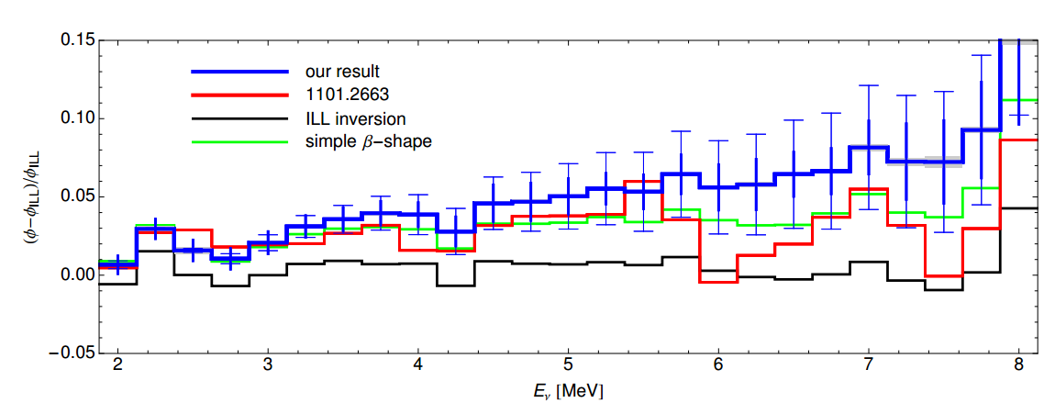
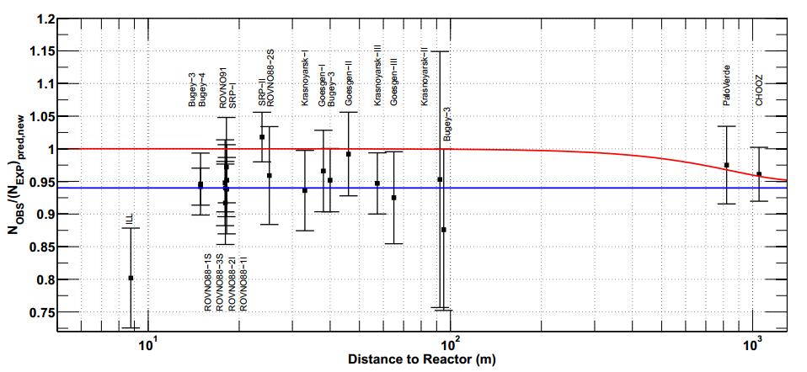
Measuring Absolute Reactor Flux
How many neutrinos are coming out of nuclear reactor per fission?
Current models are based on measurement of fission isotope beta spectra
Direct measurement of flux at Daya Bay can serve as further validation of existing models, and as a benchmark for use by future reactor experiments
P. Huber, PRC 84 (2011)
PRD83, 073006 (2011)

Slide 4
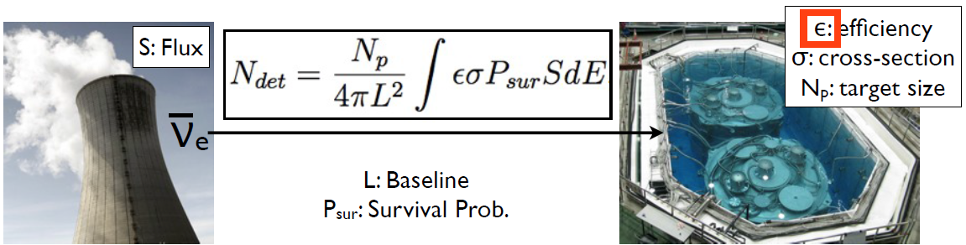
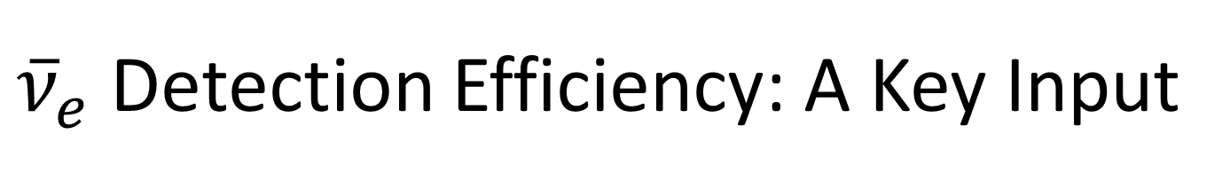
${\overline{ν}}_{e}$ Detection Efficiency: A Key Input
Daya Bay has already detected well over 300,000 inverse beta decays
Dominant error on flux measurement comes from efficiency uncertainty

Slide 5
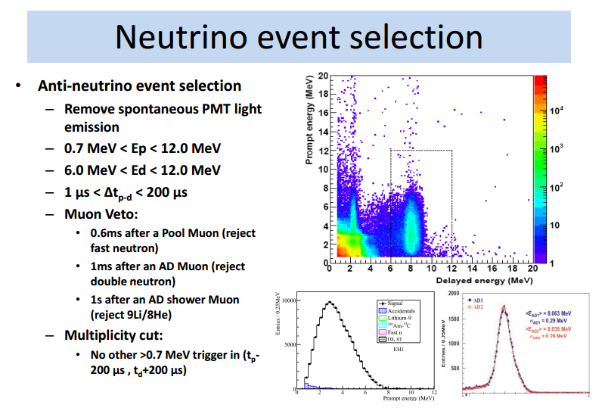
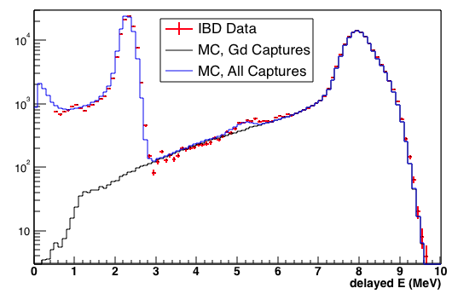
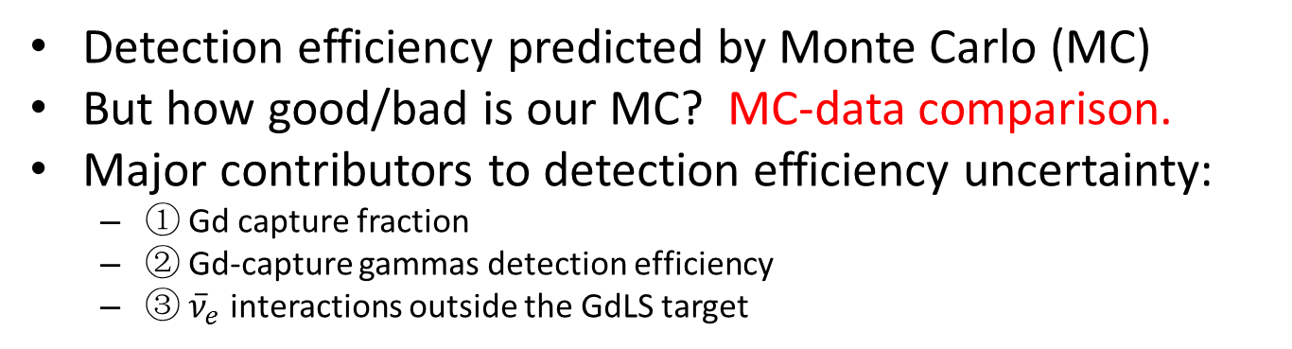
Main idea
Detection efficiency predicted by Monte Carlo (MC)
But how good/bad is our MC? MC-data comparison.
Major contributors to detection efficiency uncertainty:
① Gd capture fraction
② Gd-capture gammas detection efficiency
③ ${\overline{ν}}_{e}$ interactions outside the GdLS target
By 王志明
①: H-capture
Gd
C
②: gamma leakage
Delayed energy spectra

Slide 6
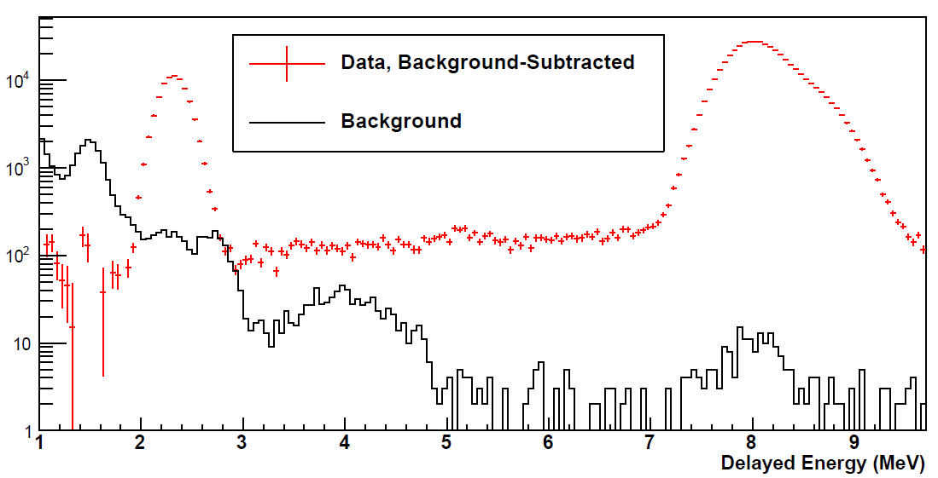
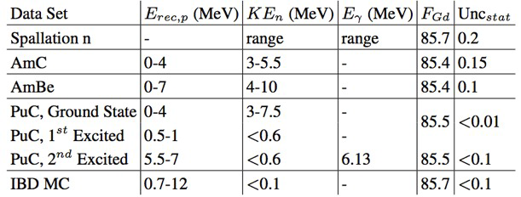
(I) Target Gd Capture Fraction
6 MeV delayed energy signal selection cut removes all non-Gd capture (nH & nC)
Monte Carlo (MC) predicts Gd capture fraction, need constraint from calibration.
Detector-center Gd fraction measured in many datasets, compared to MC
F_{Gd} = N_{nGd} / (N_{nGd} + N_{nH})
AD-center F_{Gd} using spallation neutrons
AD-center F_{Gd} for various datasets

Slide 7
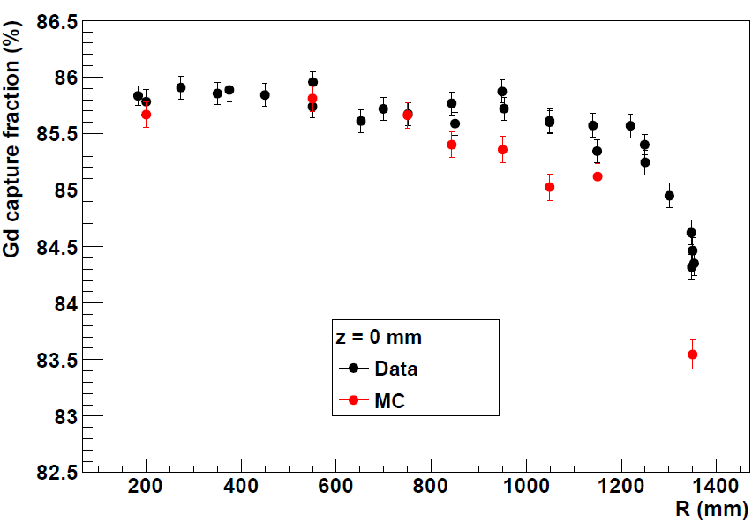
Target Gd Capture Fraction (cont’)
Full-volume fraction determined by Gd concentration, leakage of neutrons out of GdLS
Full-volume Gd fraction measured with PuC neutron source deployed via articulating arm, compared to MC
Total uncertainty (δε/ε) of 0.95%
F_{Gd} versus R position of PuC neutron source, detector Z-center

Slide 8
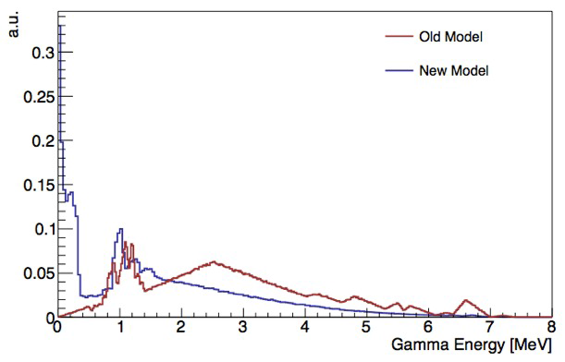
(II) Gd Capture Detection Efficiency
Gamma spectrum for nGd capture is complicated(~ 8MeV)
GEANT4 provides good fit to data > 3MeV
Treat region below 3 MeV (0.9% of MC nGd) with 100% uncertainty, since nH peak obscures nGd tail in data
HPGe measurement of nGd ɣs: a input from MC cross-check
Total uncertainty (δε/ε) of 0.97%
Signal events:
delayed n capture
energy > 6 MeV
92.7% efficiency
nGd gamma spectra in MC
Measured versus MC IBD delayed energy spectra

Slide 9
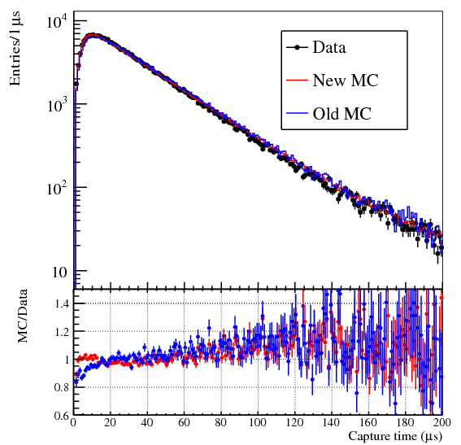
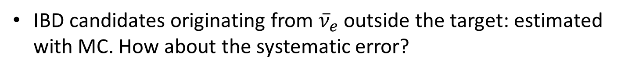
(III) Spill-In Contributions
IBD candidates originating from ${\overline{ν}}_{e}$ outside the target: estimated with MC. How about the systematic error?
MC calibrated with high-energy AmC n source in LS: MC, data agree to 1%
Tuning of neutron thermal scattering model (<4eV) impacts on both spill-in & neutron’s capture time. So constrain spill-in with IBD neutron’s capture time via data-MC comparison.
These constraints give conservative uncertainty (δε/ε) of 1.5%
IBD neutron’s capture time: Measured vs MC

Slide 10
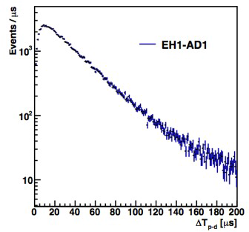
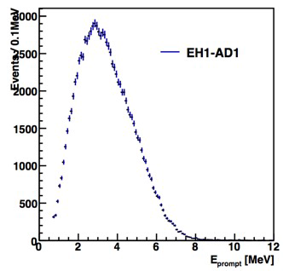
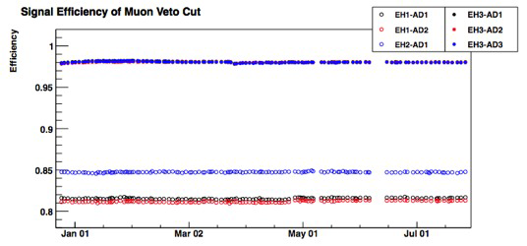
Other Contributions
High-efficiency cuts common between detectors: Ep, timing, and flasher cuts
Muon-veto, multiplicity cut efficiencies vary with site; small uncertainty
Target protons uncertainty from target mass, proton density measurements
Coincidence Time
Prompt Energy

Slide 11
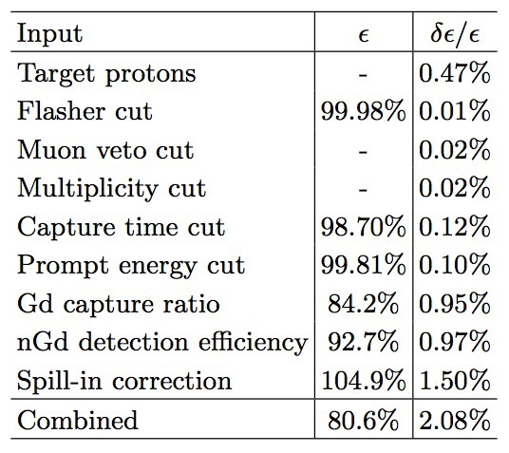
Results and Future Improvements
Total absolute detection efficiency common between all detectors of 80.6%
Total efficiency is a major input in measuring abs. reactor flux at Daya Bay
Looking to improve uncertainties through further analysis, collection of additional GdLS full-volume calibration data
Alternate event selection may minimize major uncertainty contributions
Preliminary

Slide 12
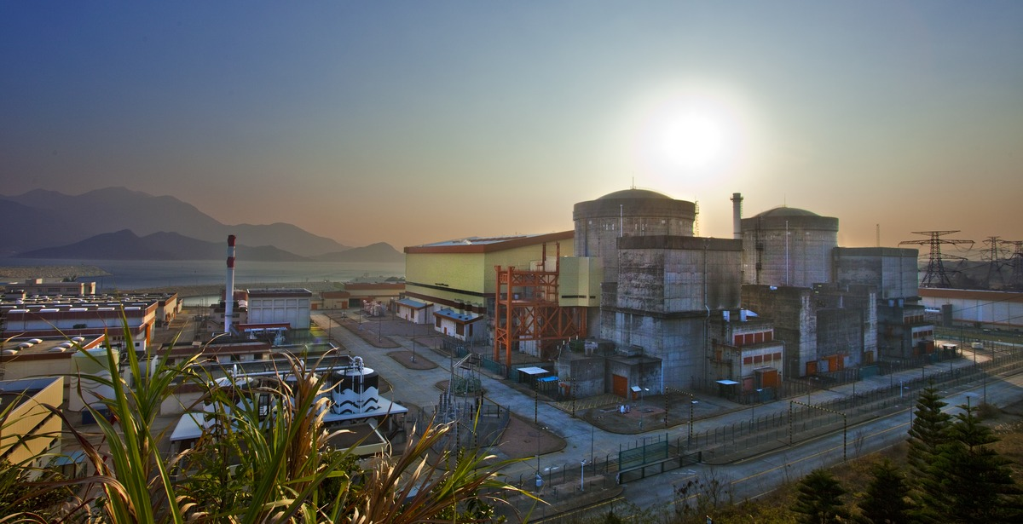
Thank you! 谢谢!

