Slide 1
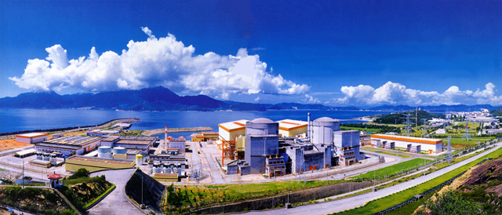
Towards a Precise Determination of the Reactor Antineutrino Flux at Daya Bay
Wenqiang Gu
Shanghai Jiao Tong University
on behalf of Daya Bay Collaboration

Slide 2
Outline
Detection of Reactor Antineutrinos
“Reactor Antineutrino Anomaly” (RAA)
Reactor Antineutrino Flux Measurement at Daya Bay
New Neutron Calibration Campaign in 2016
Summary

Slide 3
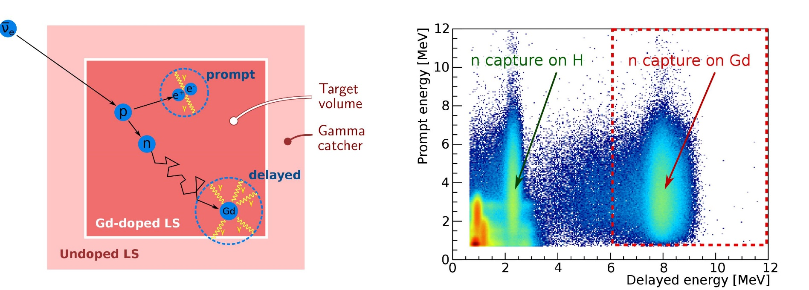
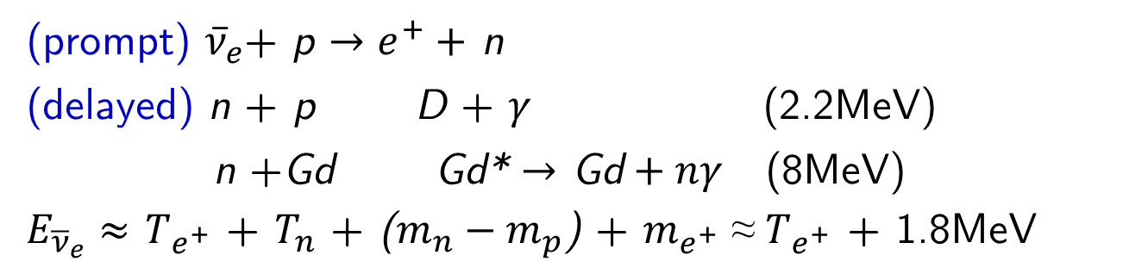

Detection of Antineutrinos via Inverse Beta Decay (IBD)
Coincidence in time, space and energy
(prompt) ${\overline{ν}}_{e}$+ p $→e^{+}+$ n
(delayed) n + p D + $γ$ (2.2MeV)
n +Gd Gd* $→$ Gd$+ nγ$ (8MeV)
$E_{{\overline{ν}}_{e}}≈$ $T_{e^{+}}$ + $T_{n}$ + ($m_{n}−m_{p}$) + $m_{e^{+}}$ ≈ $T_{e^{+}}$ + 1.8MeV
$$τ≈30μs$$

Slide 4
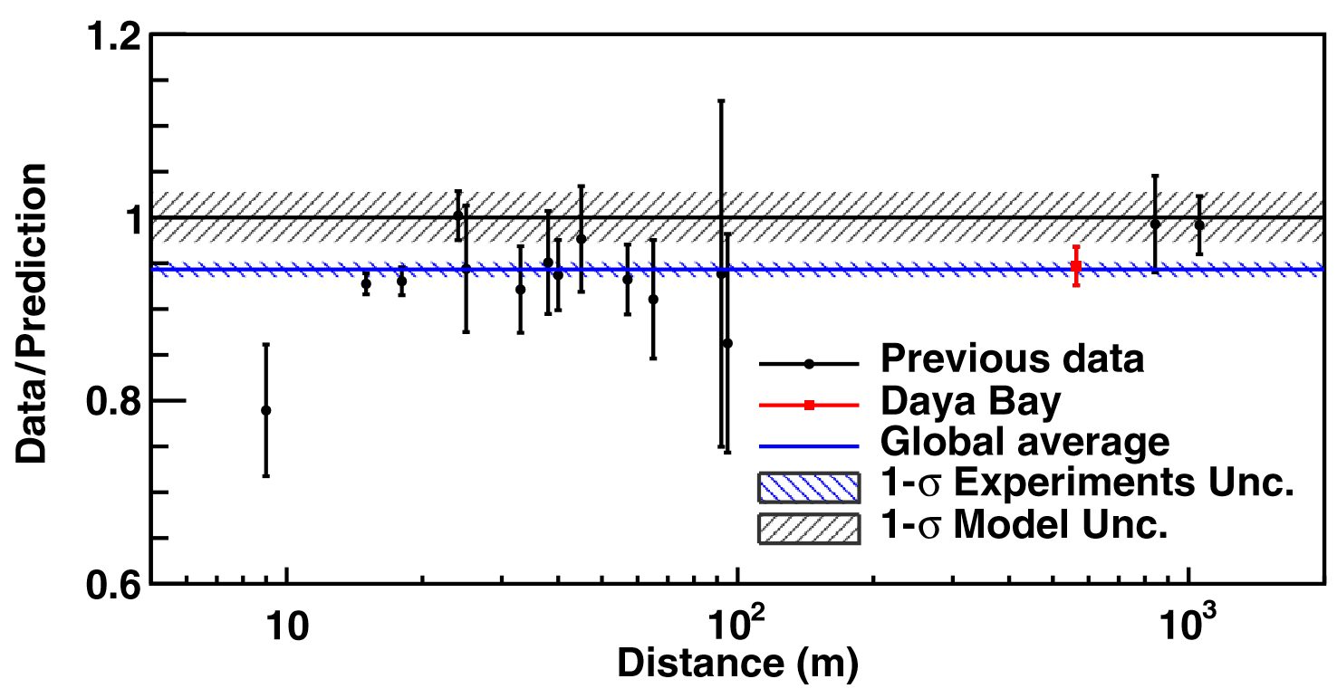
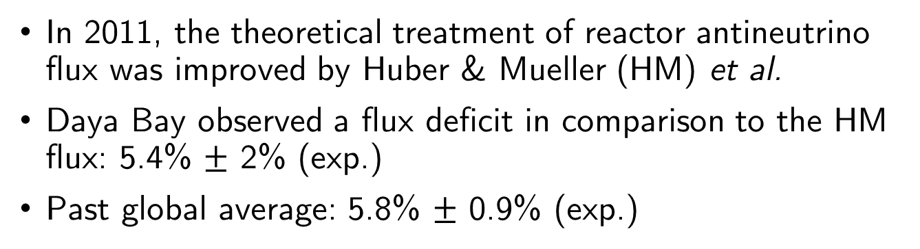
“Reactor Antineutrino Anomaly” (RAA)
In 2011, the theoretical treatment of reactor antineutrino flux was improved by Huber & Mueller (HM) et al.
Daya Bay observed a flux deficit in comparison to the HM flux: 5.4% $±$ 2% (exp.)
Past global average: 5.8% $±$ 0.9% (exp.)
Daya Bay, Chin. Phys. C 41(1) (2017)

Slide 5
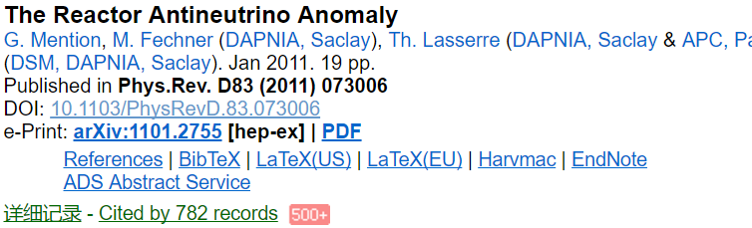
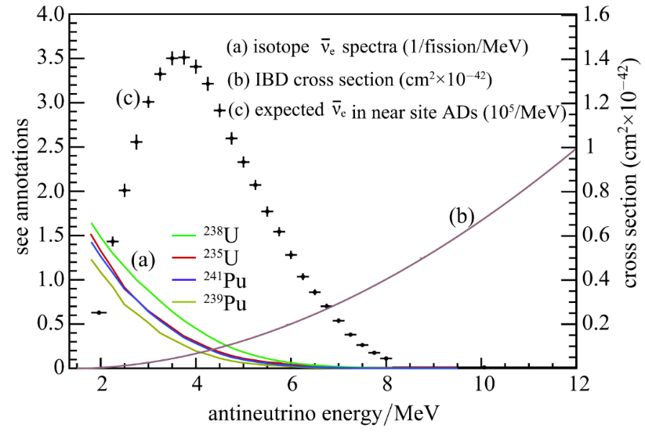
Possible Explanation
The existence of eV scale sterile neutrinos!
Systematic uncertainties in reactor flux calculations (²³⁵U, ²³⁹Pu, ²³⁸U, ²⁴¹Pu)
Daya Bay can probe this!

Slide 6
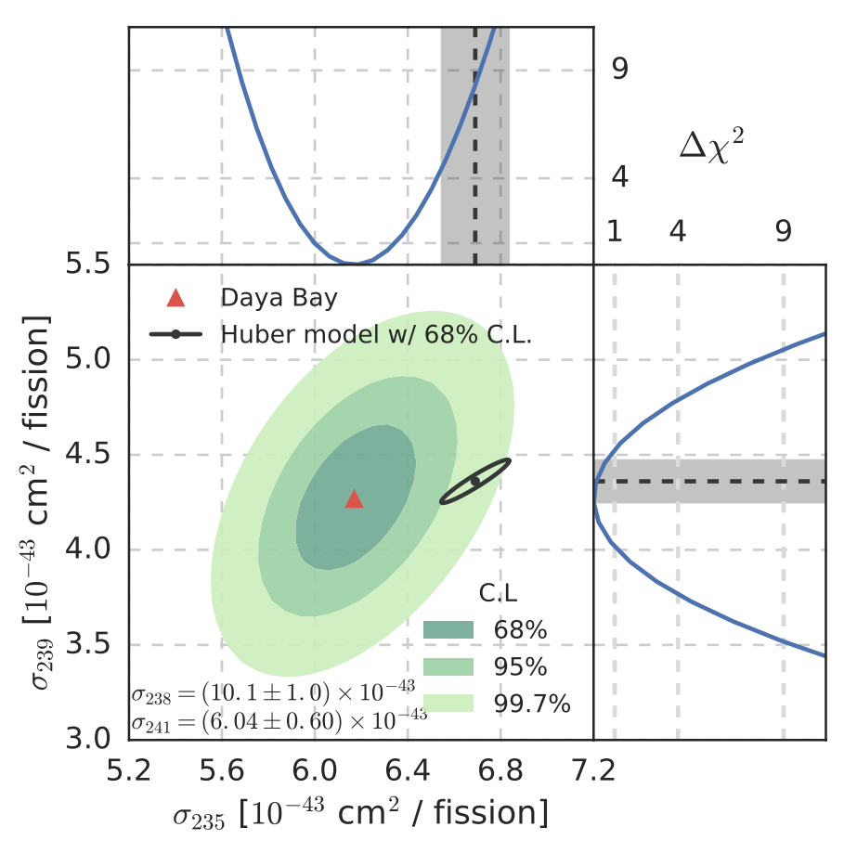
Reactor Antineutrino Flux from Individual Isotopes at Daya Bay
Phys. Rev. Lett. 118, 251801
Daya Bay data implies that HM flux overestimates the antineutrino flux from ²³⁵U
7.8%

Slide 7
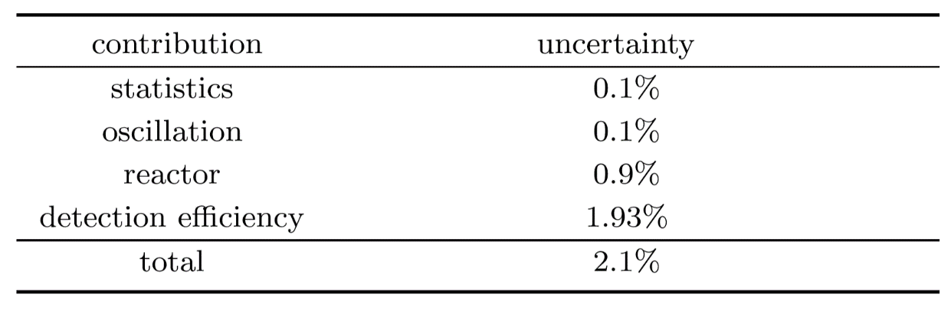
Can We Improve Further?
Uncertainty budget in the Daya Bay flux measurement
Daya Bay, Chin. Phys. C 41(1) (2017)
dominant!

Slide 8
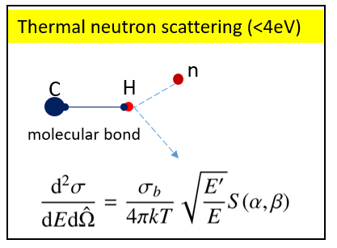
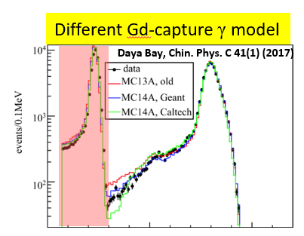
Systematics/Difficulties for Detection Efficiency
Ab initio scattering model not available for thermal neutron in the scintillator
n-Gd capture γ model lacks constraints under n-H peak
⇒ ”full volume” neutron calibration will help

Slide 9
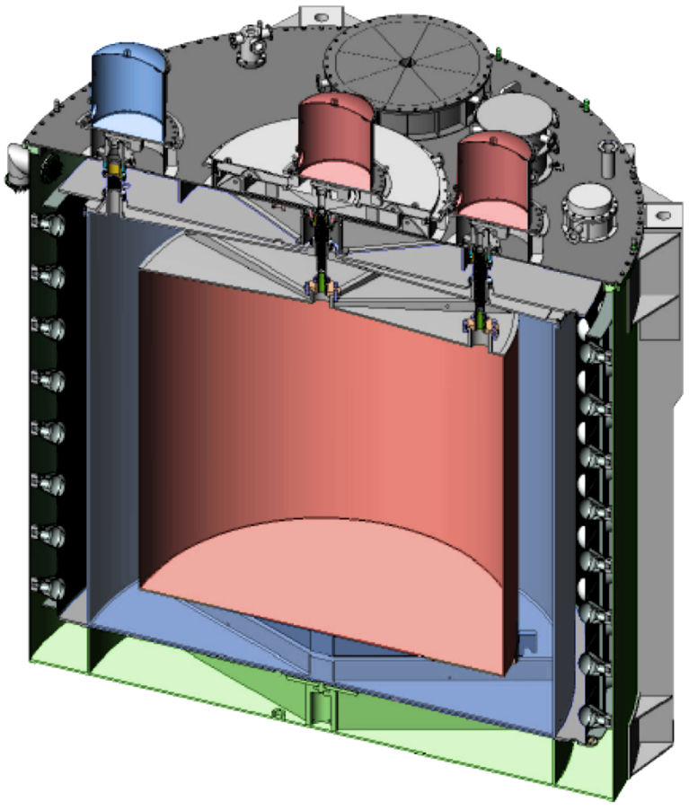
Neutron Calibration Campaign
Extensive neutron calibration campaign at the end of 2016 at Daya Bay
AmC and AmBe (few MeV) sources along three z-axes of the automated calibration units (ACU)
Target: improve the IBD detection efficiency (x2) ⇒ more precise reactor flux measurement
r =1.775m
r =0m
r =1.35m

Slide 10
Neutron calibration (AmC, AmBe)
AmC
AmBe
AmC
AmBe
ACU-A | ACU-B | ACU-C
1.5 (m) | 1.5 | 1.6
- | 1.35 | 1.35
0.75 | 0.75 | 0.75
0 | 0 | 0
-0.75 | -0.75 | -0.75
- | -1.35 | -1.35
-1.45 | -1.45 | -1.6
AmBe ~ 3.5 hours (per location) | AmC ~ 5 hours AmBe ~ 2.5 hours | AmC ~ 5 hours AmBe ~ 1.5 hours
AmBe
Total down time for neutrino data: 25 days (including system upgrade and data collection)

Slide 11
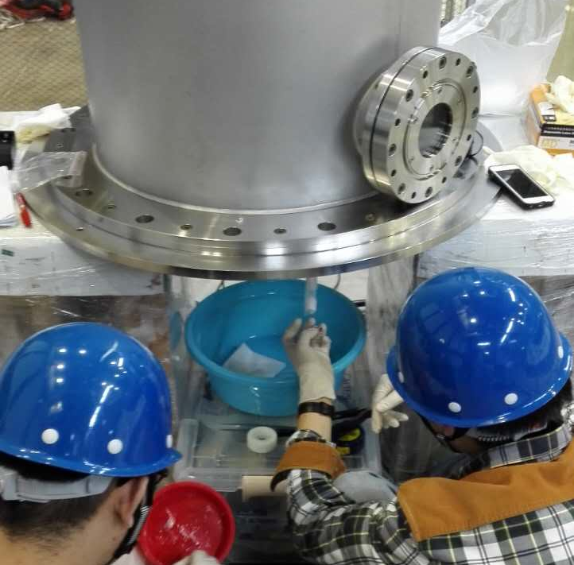
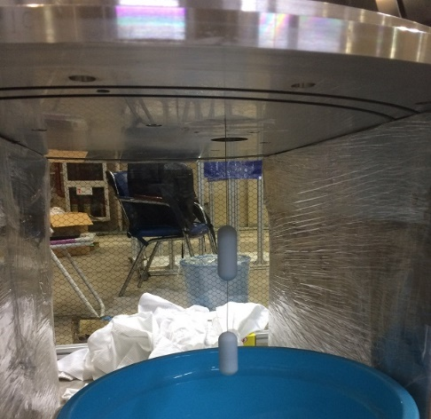
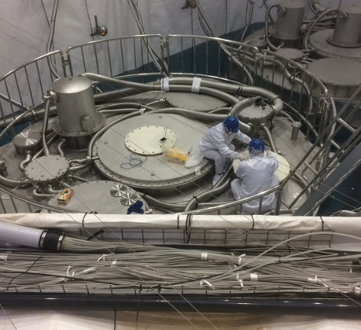
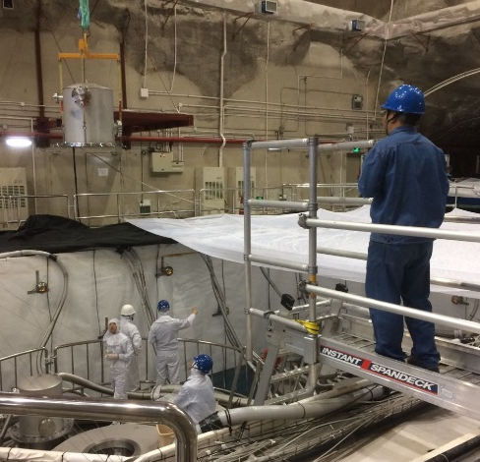
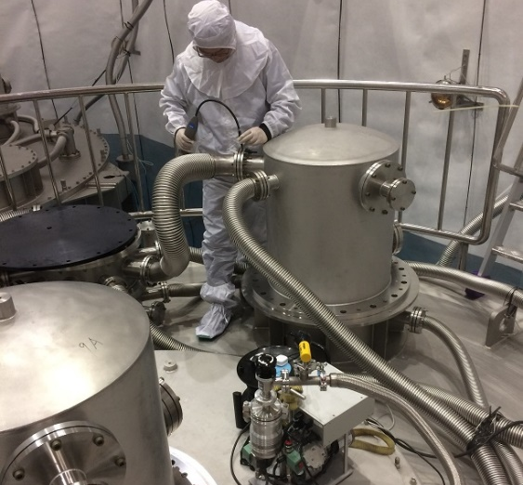
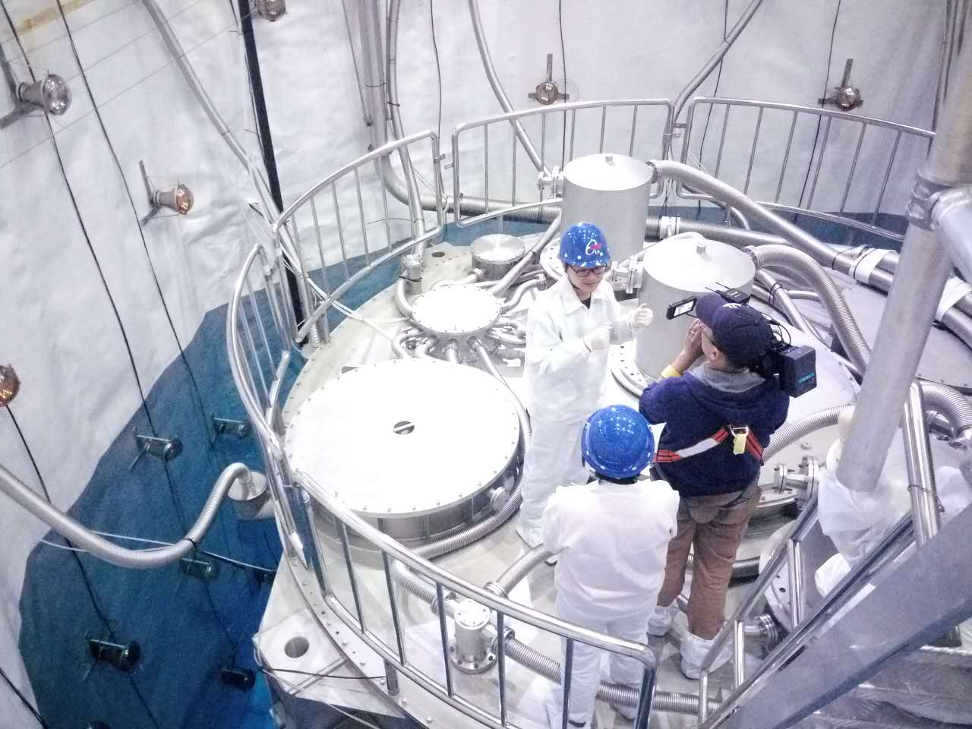
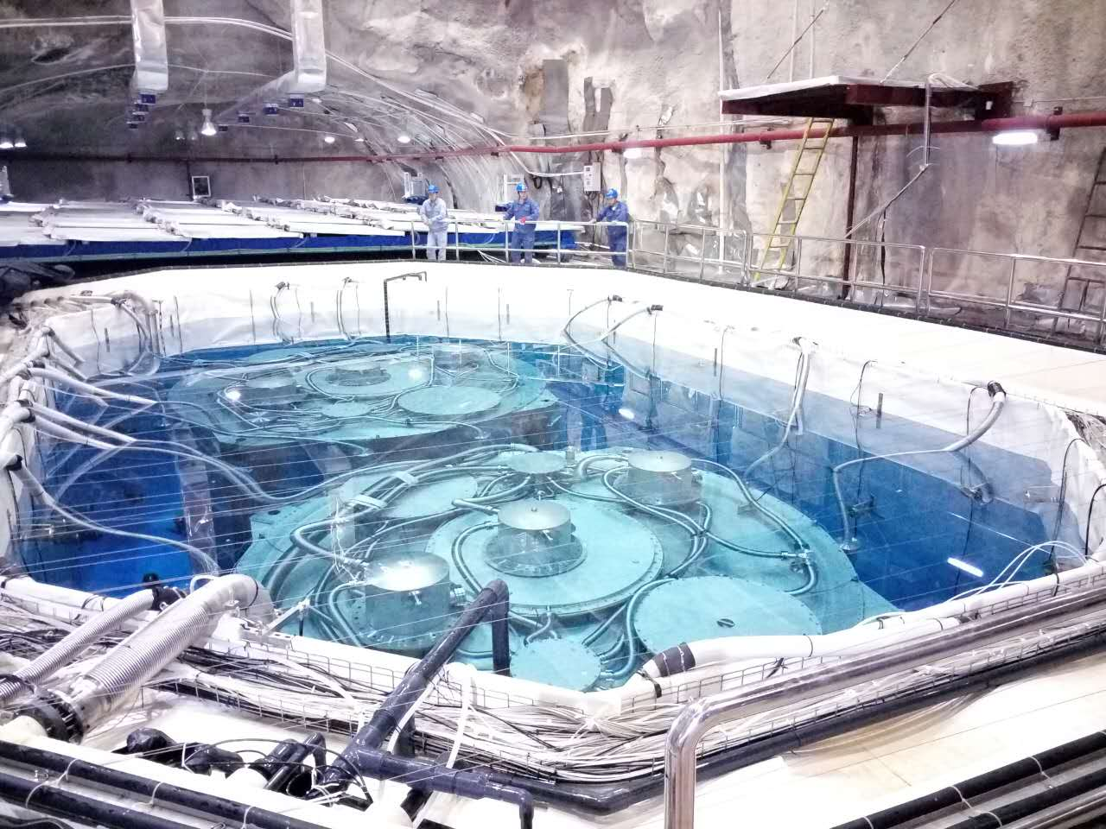
Happy Time
source
That’s me!

Slide 12
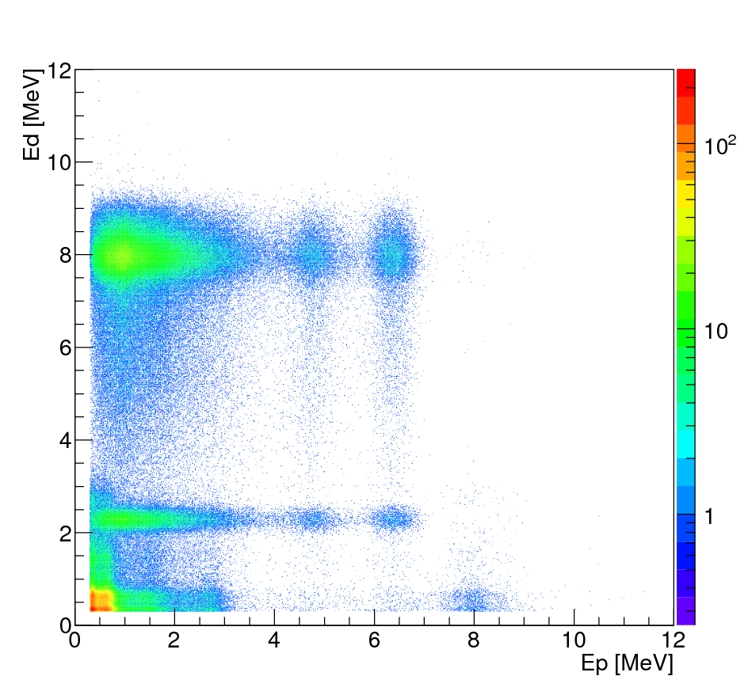
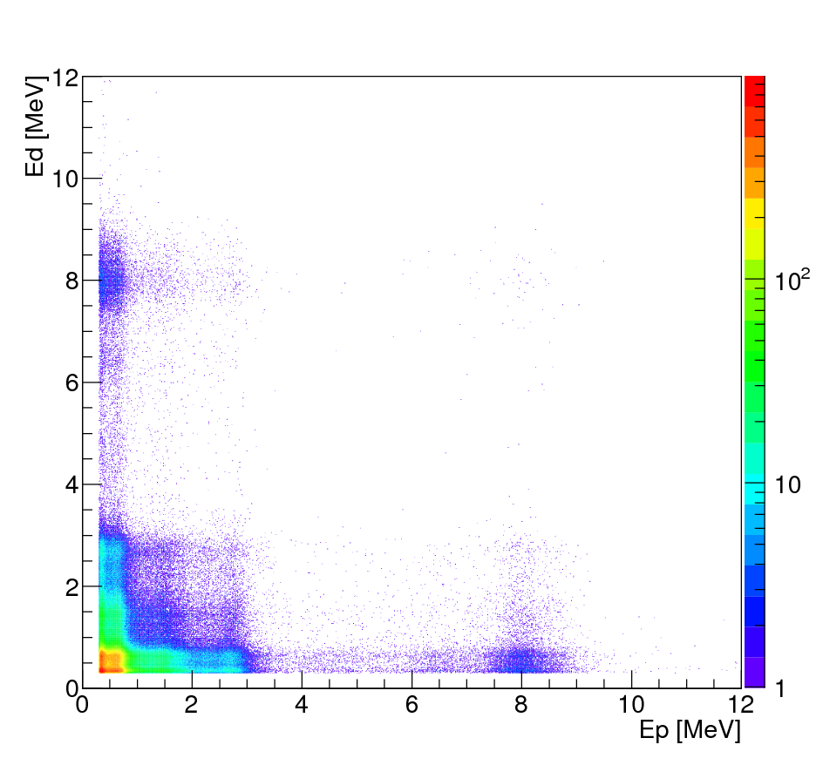
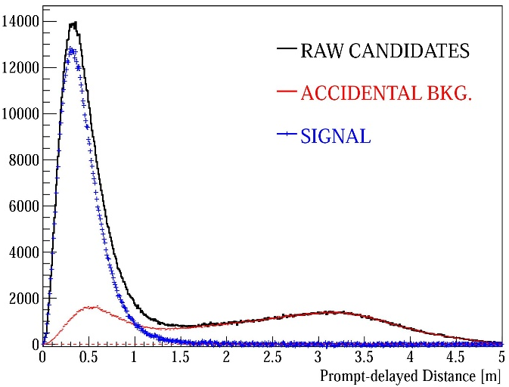
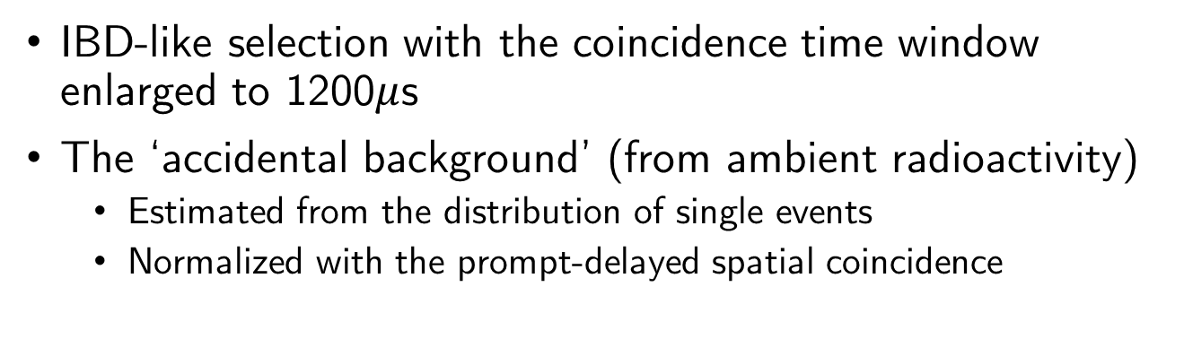
Data Selection
IBD-like selection with the coincidence time window enlarged to 1200$μ$s
The ‘accidental background’ (from ambient radioactivity)
Estimated from the distribution of single events
Normalized with the prompt-delayed spatial coincidence
raw candidates
accidental bkg.
(single events)
delayed energy [MeV]
delayed energy [MeV]
prompt energy [MeV]
prompt energy [MeV]

Slide 13
Monte Carlo (MC) Simulation
Geant4-based MC simulation
Scattering: ‘water’ model from nuclear database (ENDF)
Approximation for thermal neutron scattering in the scintillator
Alternative: ’polyethylene’ model
Capture gammas: Four different Gd γ models inherited from previous analysis

Slide 14
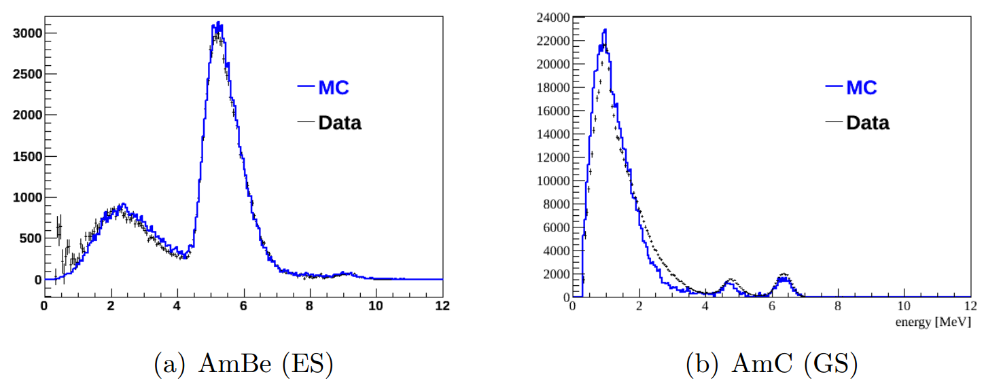
Data v.s. Nominal MC: Prompt Energy
ES
GS
GS
nC*
ES
AmBe at ACU-A z=0m
AmC at ACU-B z=0m
A reasonable agreement between data and MC for
Ground state (GS): proton recoil
Excited state (ES): proton recoil + γ

Slide 15
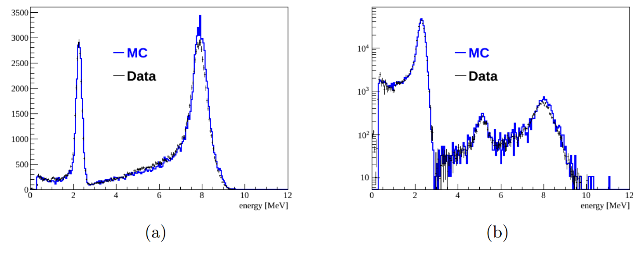
Data v.s. Nominal MC: Delayed Energy
Efficiency:
F = N([6,12]MeV) / N([1.5,12]MeV)
AmBe (ES) at ACU-A z=-1.45m
(bottom of the target volume)
AmC (GS) at ACU-C z=0m
(boundary of the target volume)
A reasonable agreement between data and MC

Slide 16
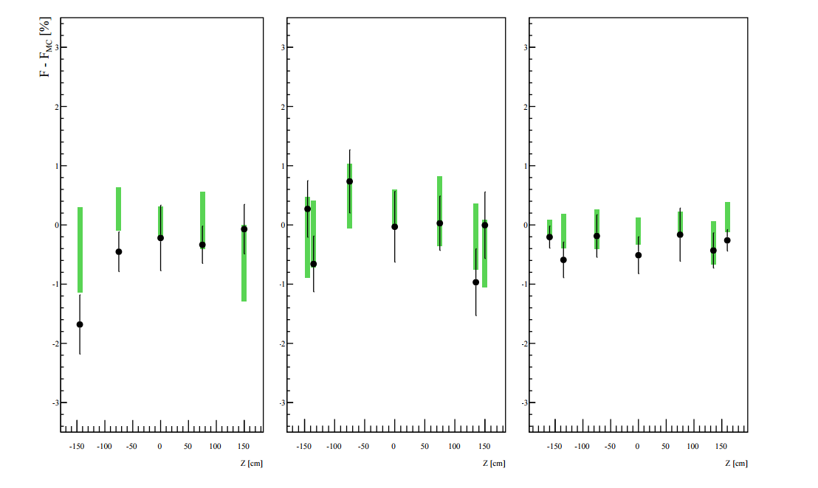
Efficiency: (Data – MC) for AmBe (GS)
ACU-A
ACU-B
ACU-C
Green bar: systematic uncertainty from model variation in MC
Data in reasonable agreement with MC (within model uncertainty)

Slide 17
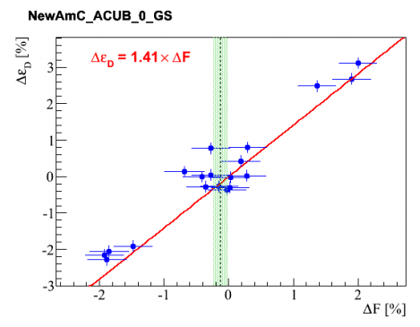
Efficiency Correction for IBD
IBD and neutron source efficiency correlated for given model
IBD
calibration
Using measured neutron source efficiency ⇒ correction to IBD efficiency
Different subsets of calibration data ⇒ different correction ⇒ systematic uncertainty
This analysis is VERY near completion!

Slide 18
Summary
The RAA is being probed experimentally at Daya Bay
Bias in theoretical prediction for ²³⁵U may be responsible for RAA
An elaborated neutron calibration campaign was performed at Daya Bay in 2016, aiming to further improve the IBD detection efficiency
Stay tuned!

