Slide 1


Background Estimation in the Daya Bay Reactor Antineutrino Experiment
顾文强
上海交通大学
on behave of the Daya Bay collaboration
April 21st, 2012, 昆明

Slide 2
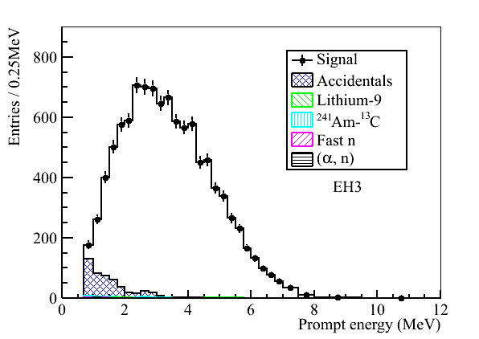
Background Sources
Accidental background
Two unrelated signals mimic an IBD
Correlated background
Muon spallation products
⁹Li/⁸He
Fast neutron
(α,n)
²⁴¹Am¹³C
EH3

Slide 3
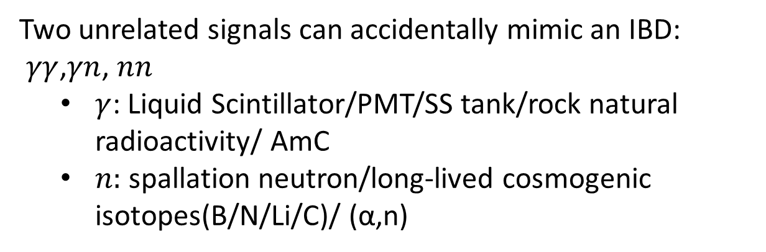
Formation of Accidental Background
Two unrelated signals can accidentally mimic an IBD:
$γγ$,$γn$, $nn$
$γ$: Liquid Scintillator/PMT/SS tank/rock natural radioactivity/ AmC
$n:$spallation neutron/long-lived cosmogenic isotopes(B/N/Li/C)/ (α,n)
Main source of n-like singles* | Rate of singles(/day/AD) | Fraction(%)
AmC sources | ~250 | ~18.2
¹²B/¹²N | ~648 | ~47.3
⁸Li/⁸B | ~270 | ~19.7
⁹C | ~50 | ~3.6
*$n−like single: uncorrelated signal in neutron energy region$

Slide 4
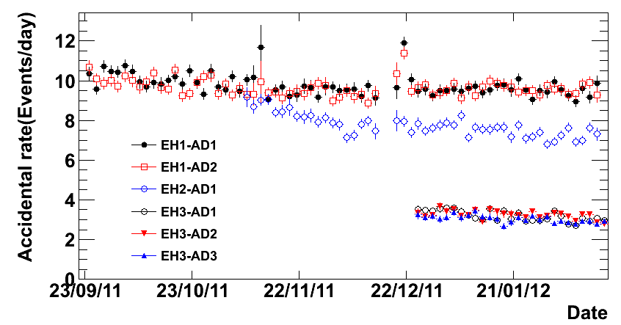
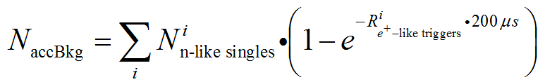
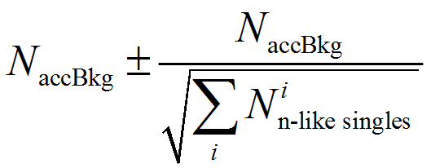
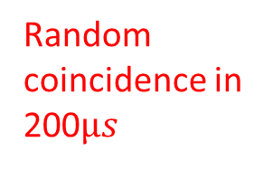
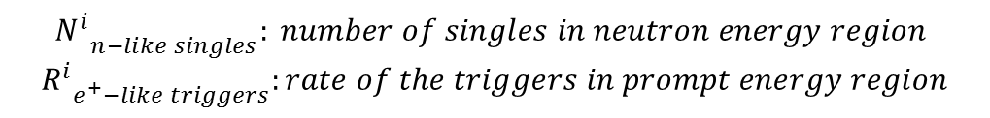
Accidental Backgrounds Evaluation
Oscillation analysis
$${N_{}^{i}}_{n−like singles}: number of singles in neutron energy region$$
$${R_{}^{i}}_{e^{+}−like triggers}:rate of the triggers in prompt energy region$$
Random coincidence in 200$µs$

Slide 5
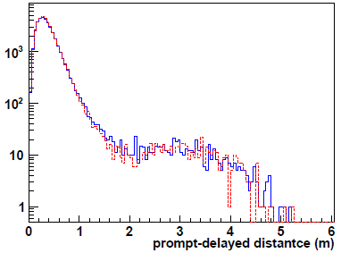
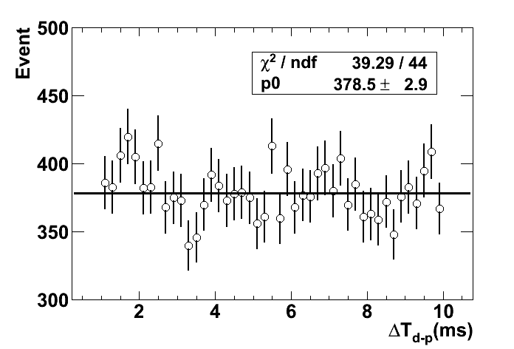
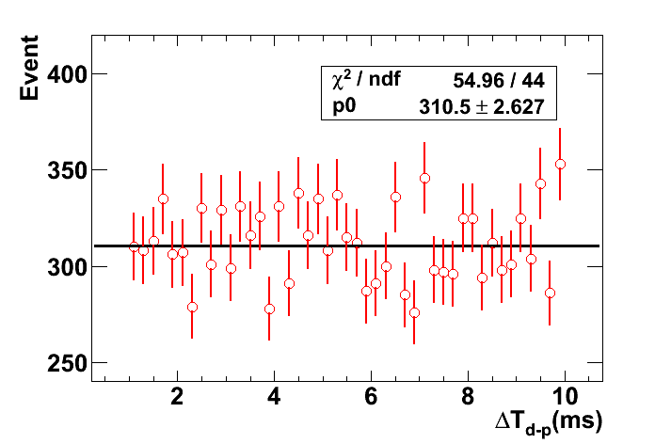
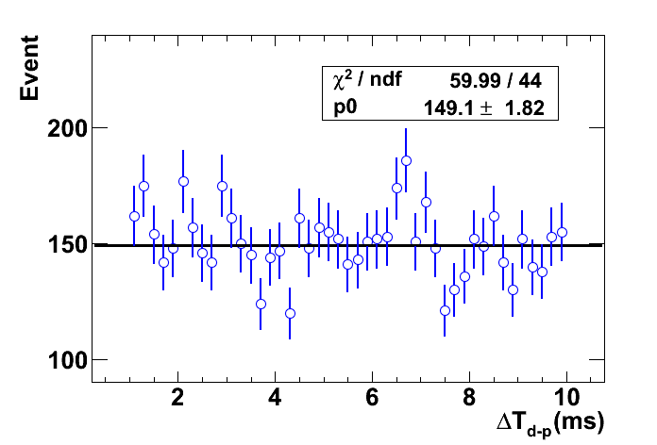
Accidental Backgrounds: Cross Checks
Prompt-delayed distance distribution. Check the fraction of prompt-delayed pair with distance>2m
Off-window coincidence → ‘measure’ the accidental background
Results in agreement within 1%.
Accidental bkg.
EH1-AD1
EH2-AD1
EH3-AD1

Slide 6
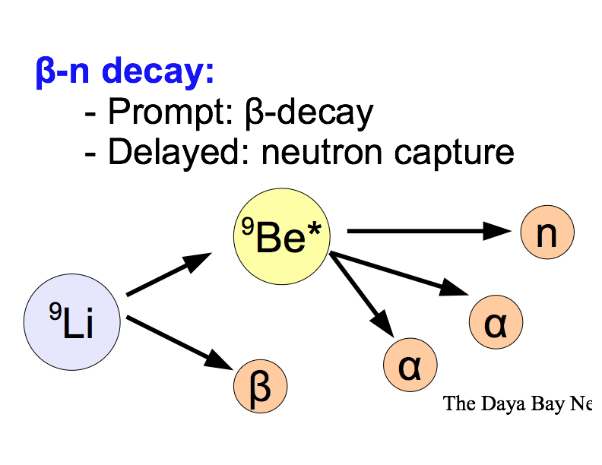
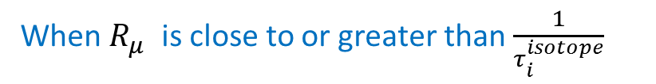


⁹Li/⁸He: $β$-$n$ decay
Muon interactions in LS produce radioactive isotopes.
⁹Li and ⁸He are long-lived β,n emitters that can fake the IBD signature
Time since last muon fit
NIM A 564 (2006) 471-474
$R_{μ}:muon rate$
$$λ_{i}= R_{μ}+ \frac{1}{τ_{i}^{isotope}}$$
$$N_{i}:counts of the specific kind of isotopes$$
$$τ_{i}^{isotope}:life time of the specific kind of isotopes$$
⁹Li: τ_{½} = 178 ms, Q = 13. 6 MeV
⁸He: τ_{½} = 119 ms, Q = 10.6 MeV
When $R_{μ}$ is close to or greater than $\frac{1}{τ_{i}^{isotope}}$

Slide 7
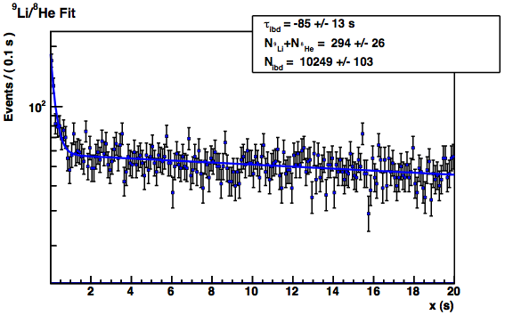
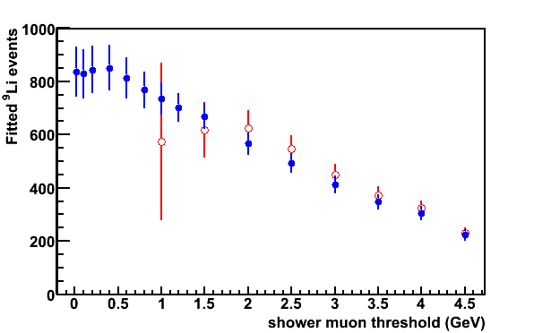

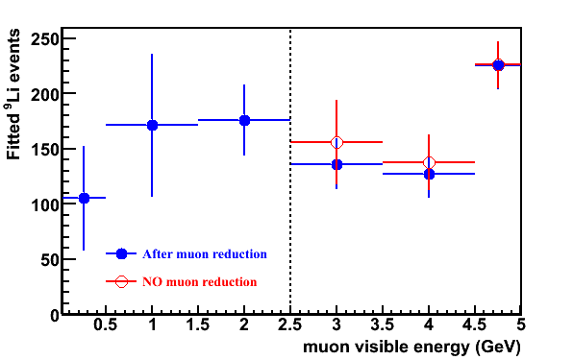
9Li
Fitted ⁹Li above threshold
Random IBD,muon coincidences
Eμ>4 GeV
Time since muon (s)
The precision of the fitted ⁹Li rate is given by
Measure 9Li with two selection methods based on the energy deposited in the AD and the detected co-production of neutrons.
The neutron co- production requirement reduces the muon rate and allows a measurement of the ⁹Li rate.
Comparison of rates allows uncertainty estimate.
Fitted ⁹Li in energy bins
Require neutron reduction
All muons

Slide 8
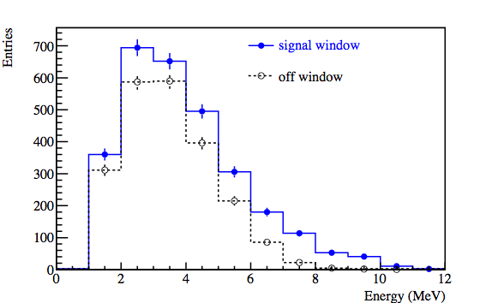
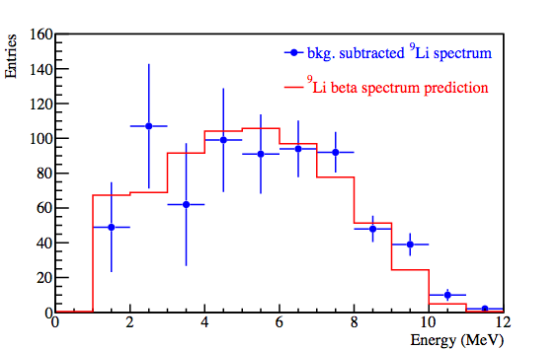
Compare measured and expected ⁹Li spectra
Data from all ADs with >2.5 GeV muon energy cut
Signal window: (1ms, 1s)
Off window: (1s, 2s)
Require distance between prompt and delayed <1m

Slide 9
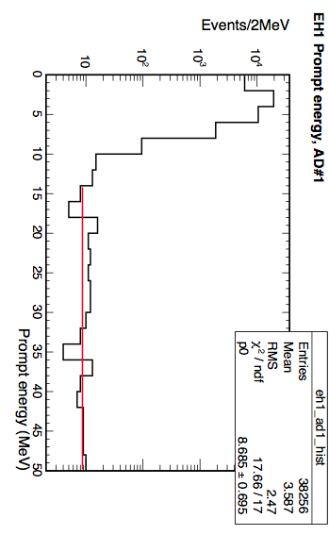
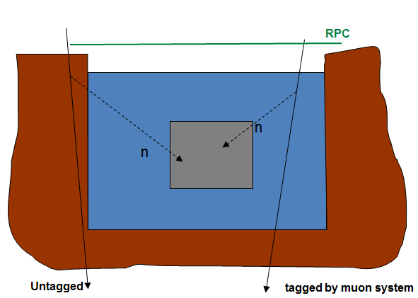
Fast neutron
“Fast” neutrons produced by cosmic muons external to the AD can enter the AD, slow and be captured.
It can fake IBD events via:
Prompt: proton recoil in antineutrino detector
Delayed: neutron captured on Gd
Constrain fast neutron by extrapolating from prompt energy distribution (15-50) MeV.

Slide 10
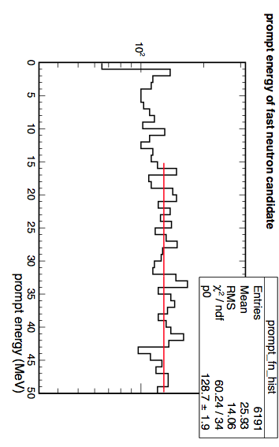
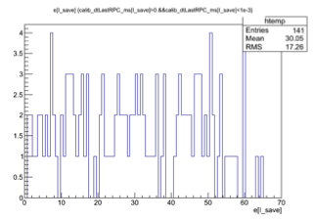
Validate extrapolation method
Check validity of extrapolation by tagging fast neutrons using the water pool and RPCs.
Fast neutrons tagged
by water pool
Both spectra are flat
Fast neutrons tagged
by RPC only
Approximately 30% of fast neutrons untaggable by the water pool can be tagged by the RPCs based on MC and data.

Slide 11
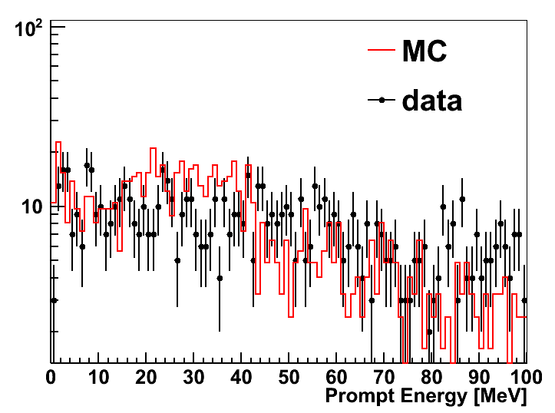
Cross Checks
Fast neutrons from water pools
Obtain the rate and energy spectrum of fast neutrons by tagged muons in water pool. Consistent with MC simulation.
Estimate the untagged fast neutron by using water pool inefficiency
Fast neutrons from nearby rock
Estimated based on MC simulation
 | Fast neutron (event/day) | Cross checks(event/day)
AD1 | 0.84±0.28 | 0.6±0.4
AD2 | 0.84±0.28 | 0.6±0.4
AD3 | 0.74±0.44 | 0.6±0.4
AD4 | 0.04±0.04 | 0.04±0.04
AD5 | 0.04±0.04 | 0.04±0.04
AD6 | 0.04±0.04 | 0.04±0.04
Results are consistent

Slide 12
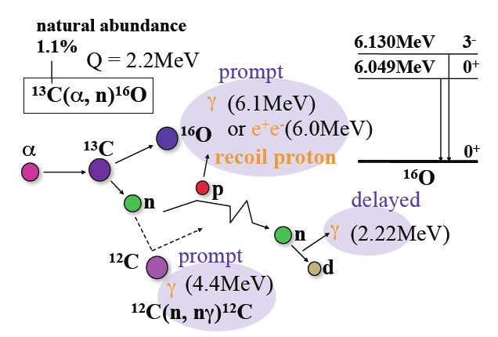
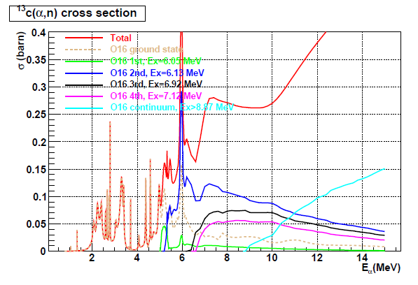
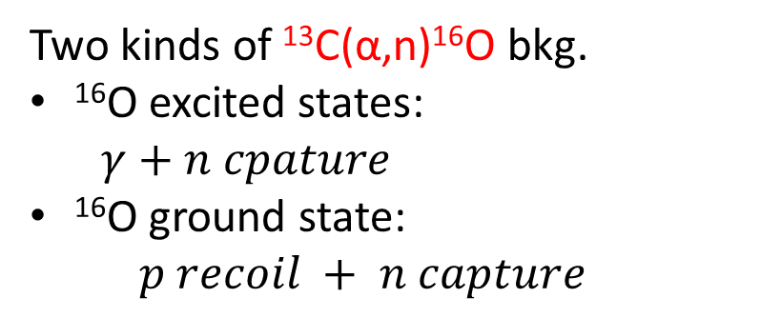
Background ¹³C(α,n)¹⁶O
8
Two kinds of ¹³C(α,n)¹⁶O bkg.
¹⁶O excited states:
$γ$ $+ n cpature$
¹⁶O ground state:
$$p recoil + n capture$$
Neutron yield calculated from α rate and (α,n) cross section analytically

Slide 13
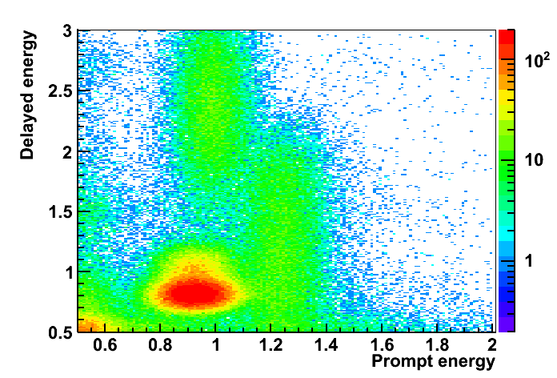
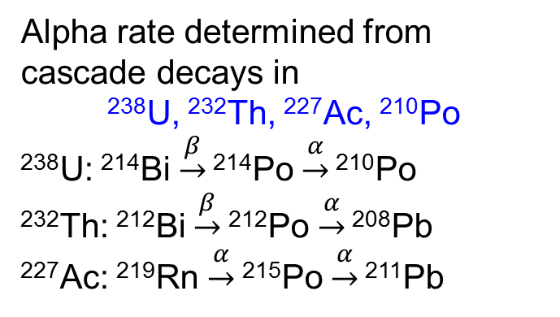
Alpha rate determination
Alpha rate determined from cascade decays in
²³⁸U, ²³²Th, ²²⁷Ac, ²¹⁰Po
²³⁸U: ²¹⁴Bi $\underset{→}{β}$ ²¹⁴Po $\underset{→}{α}$ ²¹⁰Po
²³²Th: ²¹²Bi $\underset{→}{β}$²¹²Po $\underset{→}{α}$ ²⁰⁸Pb
²²⁷Ac: ²¹⁹Rn $\underset{→}{α}$²¹⁵Po $\underset{→}{α}$ ²¹¹Pb
D
F
G
B
E
A
C
Uncertainty: 50%
 | Components | Total α rate | BG rate
Region A | Acc. Coincidence of ²¹⁰Po&²¹⁰Po | ²¹⁰Po: 10Hz at DYB 8Hz at LA 6Hz at Far | 0.02/day at DYB 0.015/day at LA 0.01/day at Far
Region B | Acc. Coincidence of ²¹⁰Po&⁴⁰K
Region C | Acc. Coincidence of ⁴⁰K&²¹⁰Po
Region D | Acc. Coincidence of ²⁰⁸Tl&²¹⁰Po
Region E | Cascade decay in ²²⁷Ac chain | 1.4 Bq | 0.01/day
Region F | Cascade decay in ²³⁸U chain | 0.07Bq | 0.001/day
Region G | Cascade decay in ²³²Th chain | 1.2Bq | 0.01/day

Slide 14
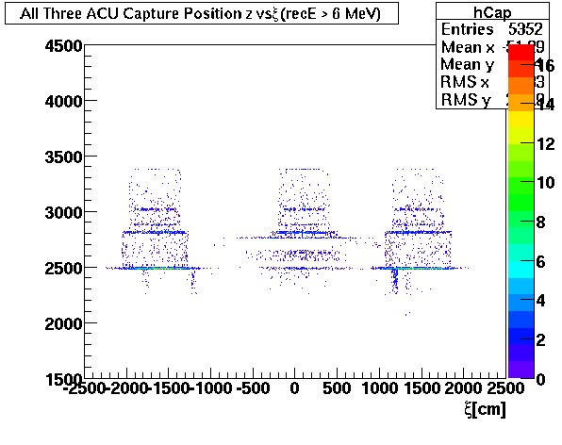
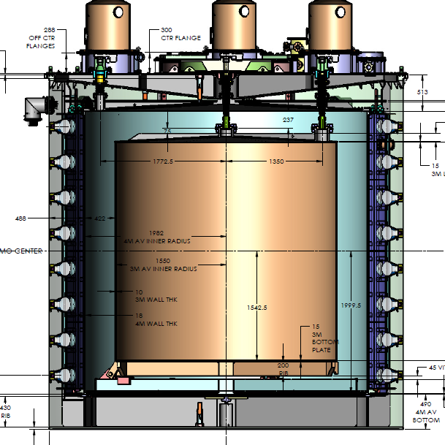
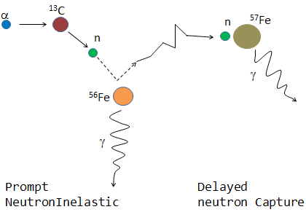
²⁴¹Am-¹³C background
Position of neutron capture
from simulation
~ 0.5 Hz ²⁴¹Am¹³C source
During physics data-taking, nearly no AmC neutron leak into AD, but gamma from neutron will.
n capture:
contribute to accidental bkg.
n inelastic scattering + n capture:
contribute to correlated bkg.

Slide 15
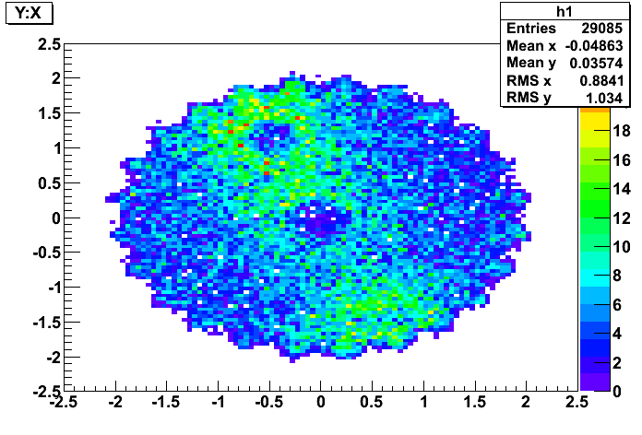
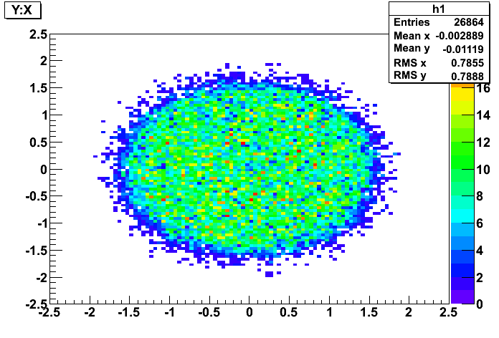
Far site ADs Y vs X for delayed candidates
Singles
IBDs
Singles with Ed>6 MeV
in top half of AD
IBD candidates
(prompt, delayed pairs)
ACUs
3

Slide 16
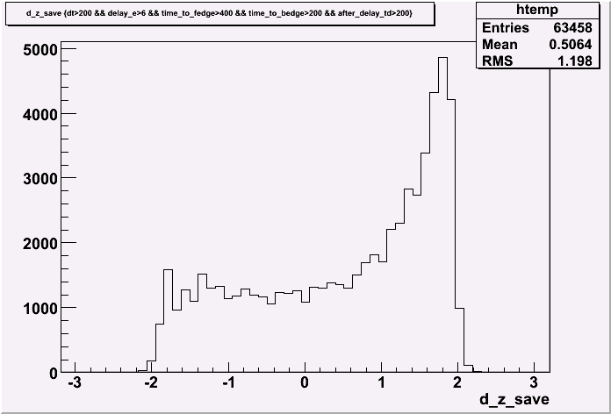
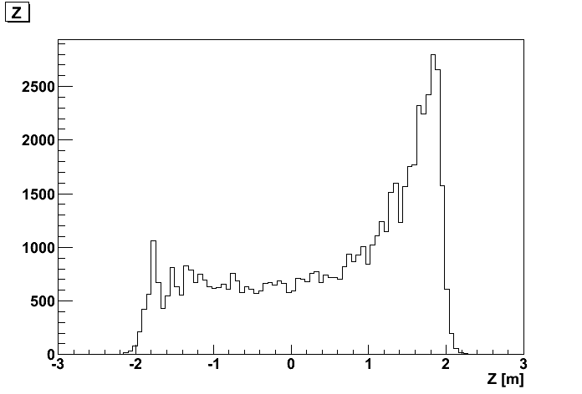
Am-C background rate
Measured single neutron background due to AmC ~ 230±40 /day/module
Agrees well with Monte Carlo prediction 285 /day/module
Single neutrons
Z [m]
Estimate ratio of correlated/uncorrelated rate using Monte Carlo, which predicts a 0.2/day/module correlated background from AmC source (we take it with 100% uncertainty)

Slide 17
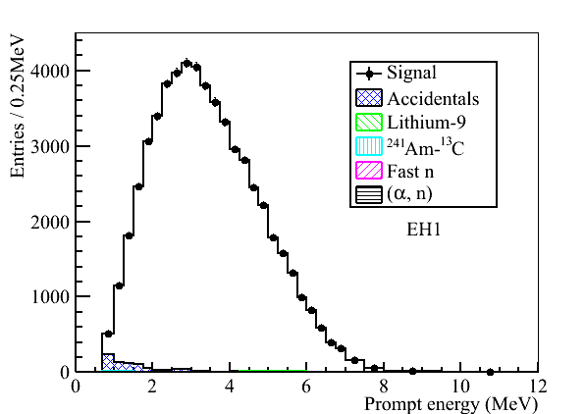
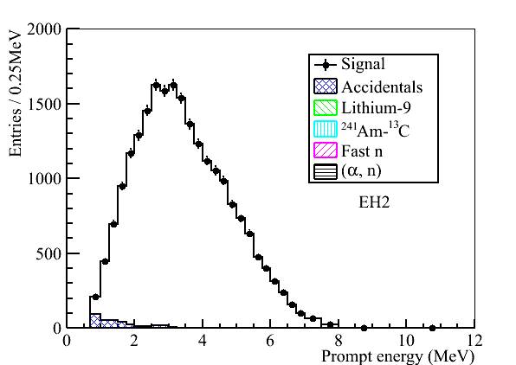
Summary of Backgrounds
Background | Near | Far | Fractional Accuracy (%)
Accidental | ~1.4 % | ~4.5 % | <1%
Fast Neutrons | ~0.1% | ~0.06% | <100%
⁸He/⁹Li | ~0.4% | ~0.2% | <70%
Am-C | ~0.03% | ~0.3% | 100%
(α-n ) | ~0.01% | ~0.04% | <70%
EH1
EH2
EH3

Slide 18
谢谢！

