Slide 1
Measurement of Energy-dependent Inclusive Muon Neutrino Charged-Current Cross Section at MicroBooNE
Wenqiang Gu (BNL)
On behalf of the MicroBooNE collaboration
APS DPF21

Slide 2
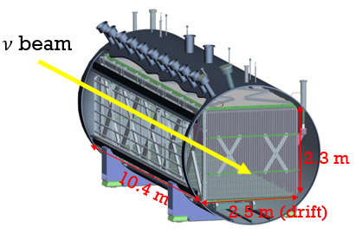
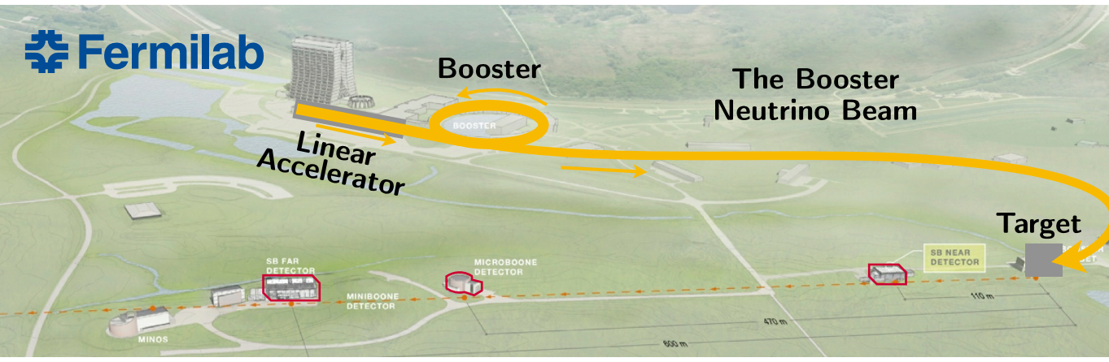
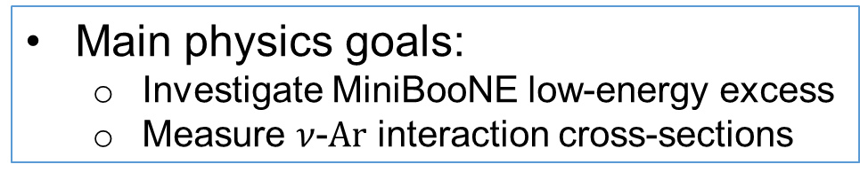
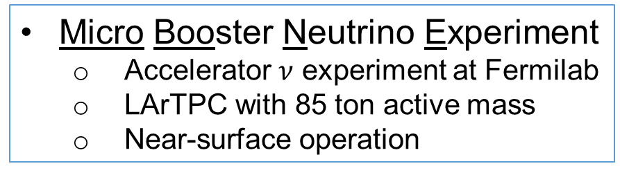
MicroBooNE Overview
Micro Booster Neutrino Experiment
Accelerator $ν$ experiment at Fermilab
LArTPC with 85 ton active mass
Near-surface operation
Main physics goals:
Investigate MiniBooNE low-energy excess
Measure $ν$-$Ar$ interaction cross-sections
MicroBooNE
MicroBooNE detector

Slide 3
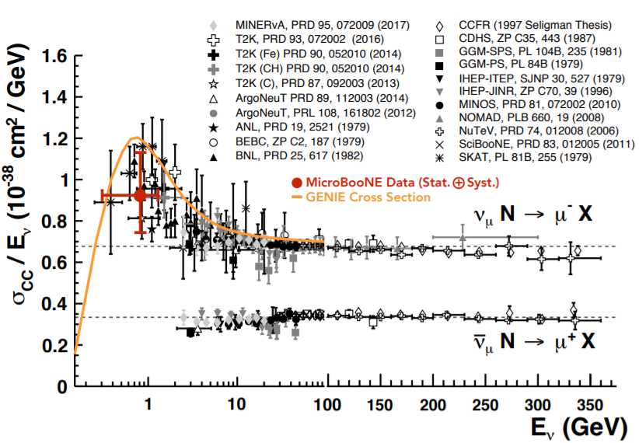
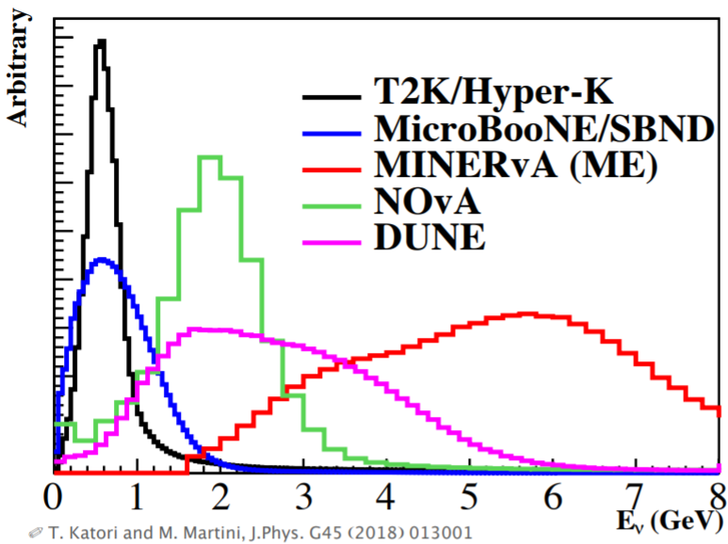
Measurements of Inclusive $ν_{μ}$CC Cross Section
(v2 based)
Review of Particle Physics
PDG, PTEP 2020 (2020) 8, 083C01
Inclusive cross section is a good test of overall modeling of all the interaction processes
Notes:
The CC inclusive cross section is important to measure
There are not so many measurements at our energy
...and very few on argon
And that's potentially a problem for MicroBooNE, SBN, and DUNE measurements

Slide 4

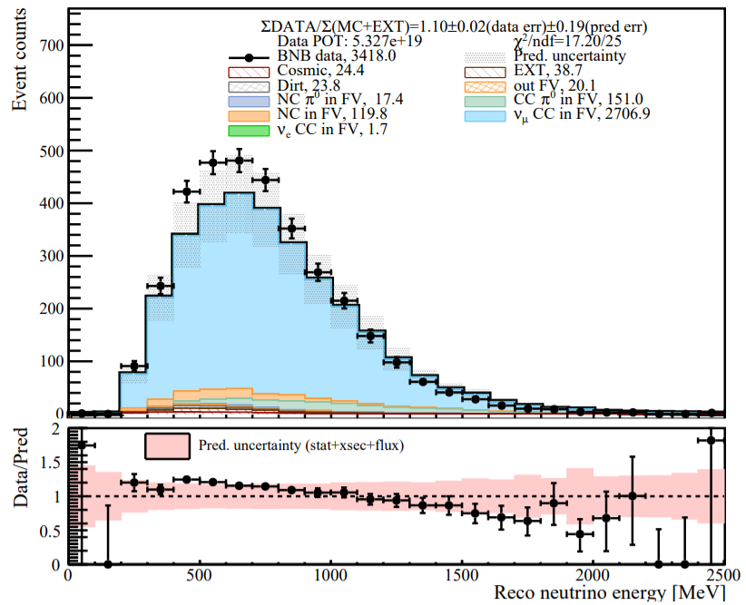

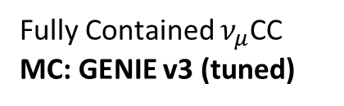

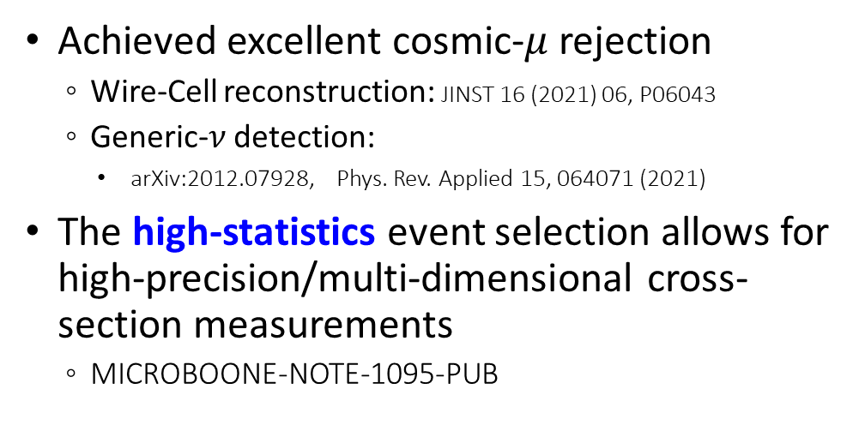
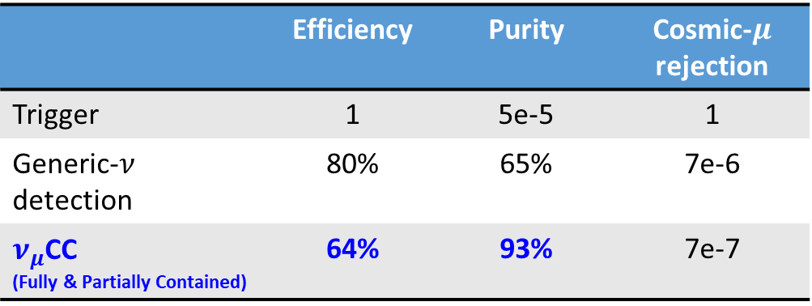
Selection of Inclusive Charged-Current $ν_{μ}$ Interactions
MicroBooNE Preliminary
 | Efficiency | Purity | Cosmic-$μ$ rejection
Trigger | 1 | 5e-5 | 1
Generic-$ν$ detection | 80% | 65% | 7e-6
$ν_{μ}$CC (Fully & Partially Contained) | 64% | 93% | 7e-7
Fully Contained $ν_{μ}$CC
MC: GENIE v3 (tuned)
Achieved excellent cosmic-$μ$ rejection
Wire-Cell reconstruction: JINST 16 (2021) 06, P06043
Generic-$ν$ detection:
arXiv:2012.07928, Phys. Rev. Applied 15, 064071 (2021)
The high-statistics event selection allows for high-precision/multi-dimensional cross-section measurements
MICROBOONE-NOTE-1095-PUB
Calorimetric energy:
$$E_{ν}^{rec}=E_{μ}^{rec}+E_{had}^{rec}$$
Notes:
Elena: try more concise bullets
Kirsty: try different color for sub-bullets and highlight the main text
Difference is covered by the uncertainty, no impact on LEE analysis
Genie version 3 + uB tune (fit world data, T2K QE similar energy, no miniboone, no microboone)
Cite GENIE (see technote)
LArTPC is a “slow” detector: time -> position. On the surface, cosmic background

Slide 5
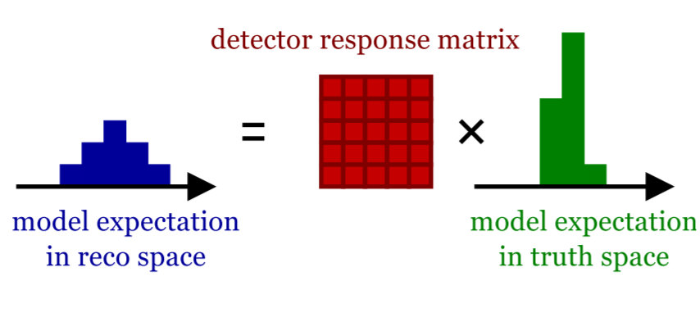
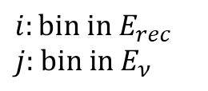



Towards $σ(E)$ with Unfolding
Understanding the cross section as a function of energy, $σ\left(E\right)$, is crucial for oscillation measurements
We plan to measure $σ(E)$ using Wiener-SVD unfolding
Measurements
ν_{μ}CC cross section
Detector response matrix
Selection efficiency
ν_{μ} Neutrino Flux
Background
$$M\left(E_{rec}\right)=POT⋅T⋅\int{F\left(E_{ν}\right)⋅σ\left(E_{ν}\right)}⋅D\left(E_{ν},E_{rec}\right)⋅ε\left(E_{ν},E_{rec}\right)⋅dE_{ν}+B\left(E_{rec}\right)$$
$$M_{i}=\sum_{j}{R_{ij}⋅S_{j}}+B_{i}$$
$$i:\text{bin} \text{in} E_{rec}$$
$$j\text{: }\text{bin} \text{in} E_{ν}$$
Notes:
Unfolding: The process of extracting information about the truth content given the observed measurements

Slide 6
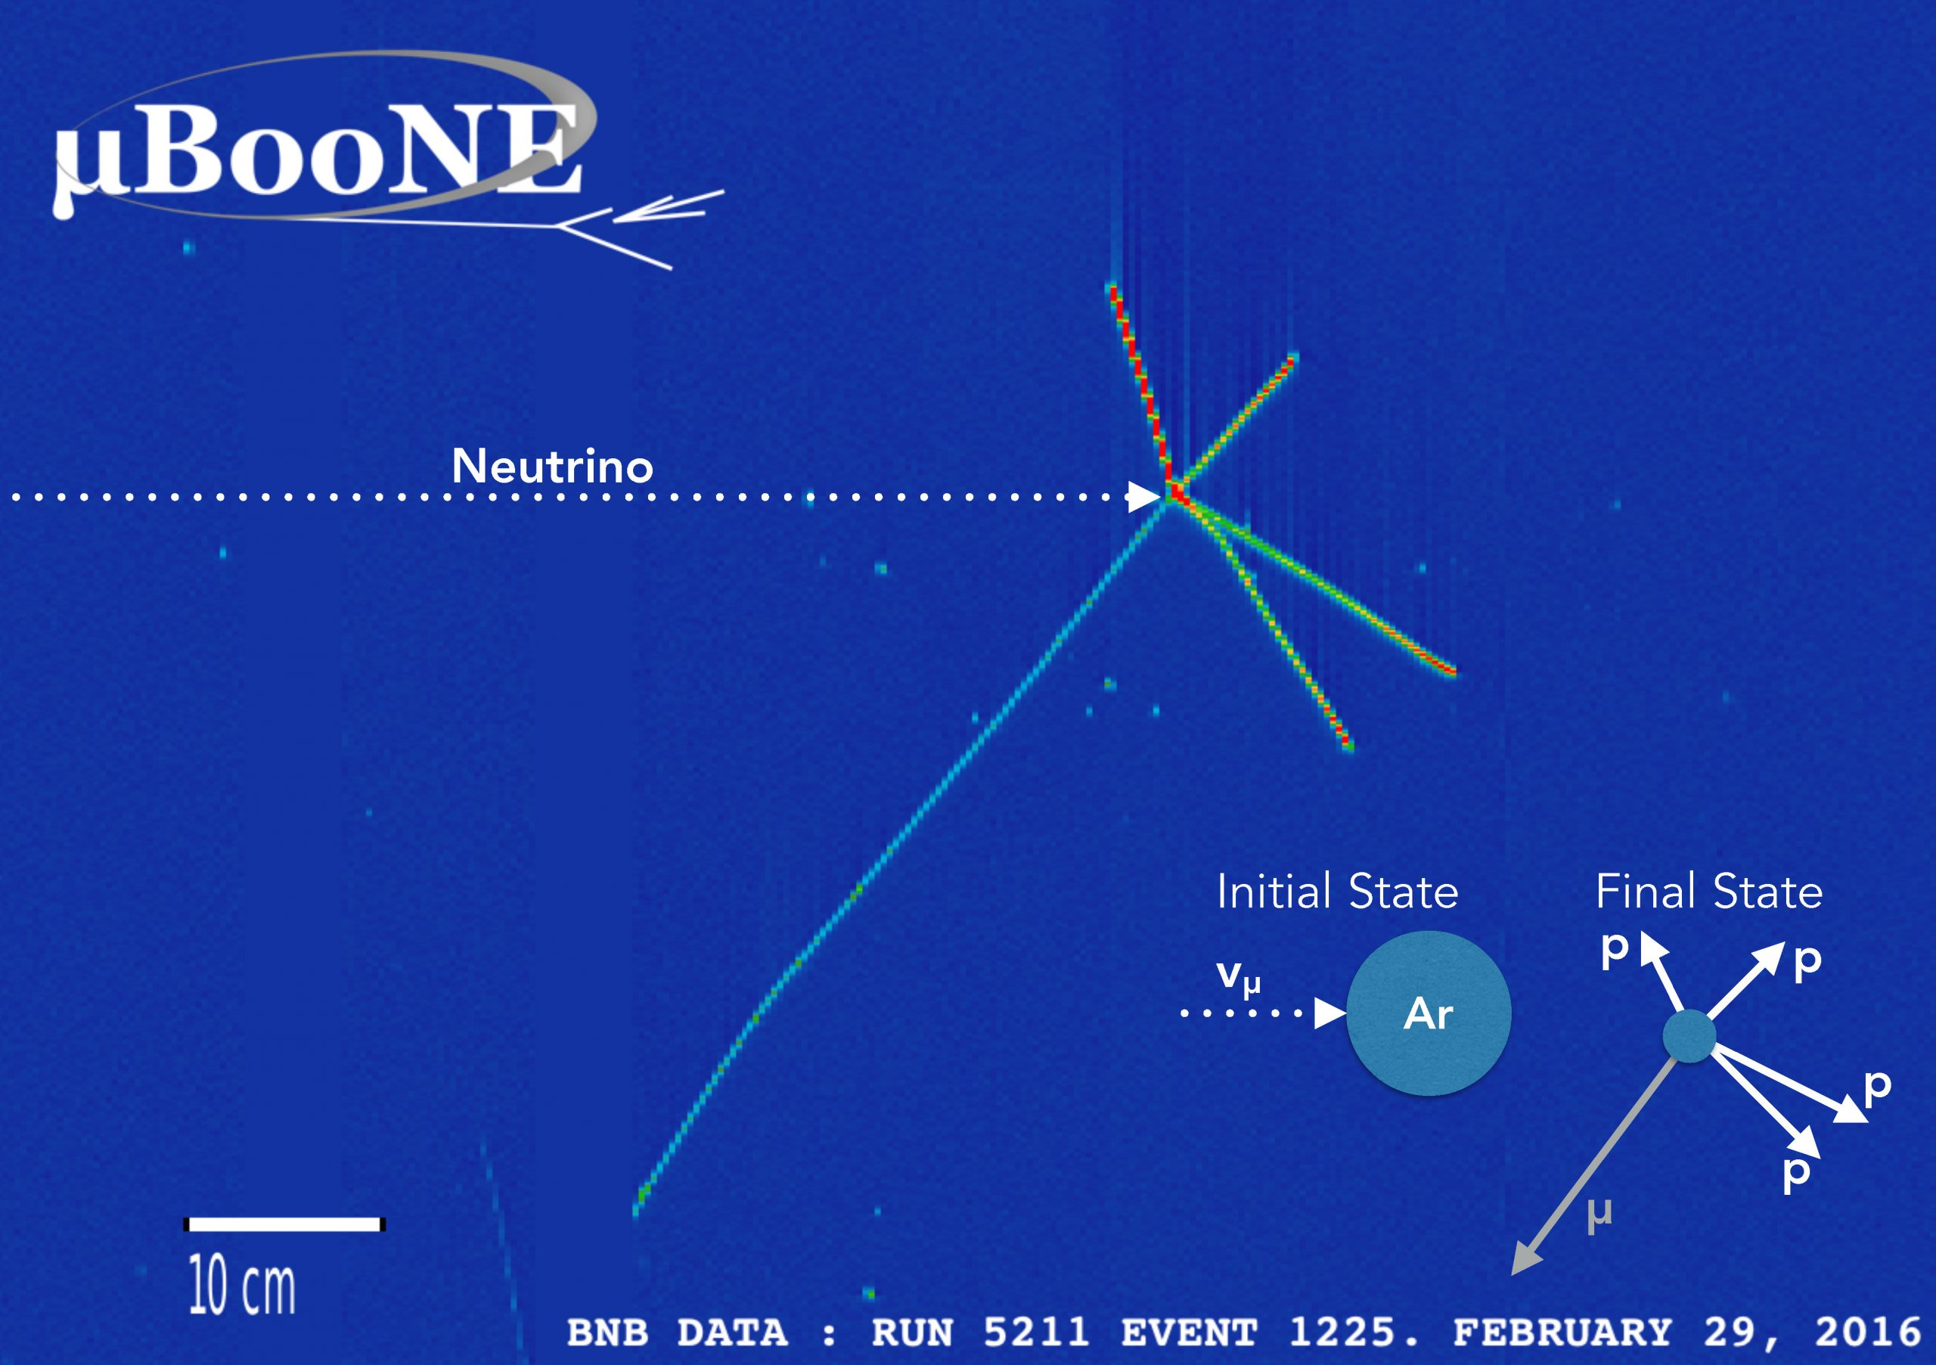



Energy Model Validation: $E_{ν}^{true}$ to $E_{ν}^{rec}$
Neutrino energy modeling is crucial to neutrino oscillation measurements
Key challenge: understanding 𝝂-Ar cross section as a function of energy
$$E_{ν}={E_{lepton}+E}_{had,visible}+E_{had,missing}$$
$$E_{had,visible}$$
$$E_{lepton}$$
Fermilab News
@ Anne Schukraft, Marco Del Tutto
Notes:
LArTPC can separate lepton and hadronic energy from charged-current interactions
Key challenge: understanding 𝝂-Ar cross section as a function of energy

Slide 7
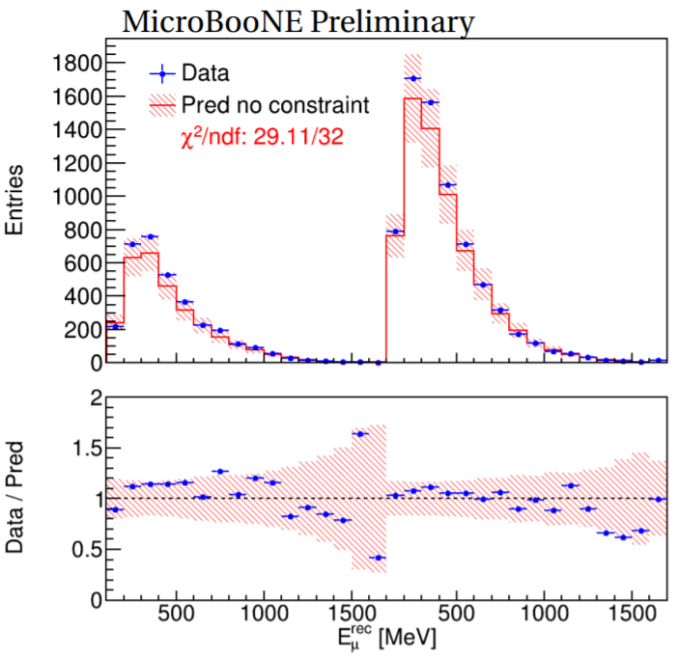
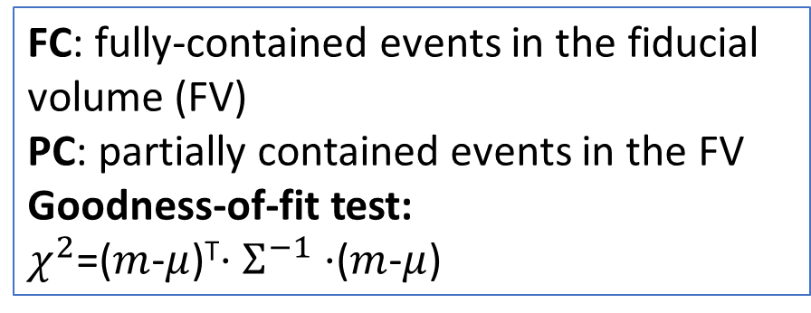
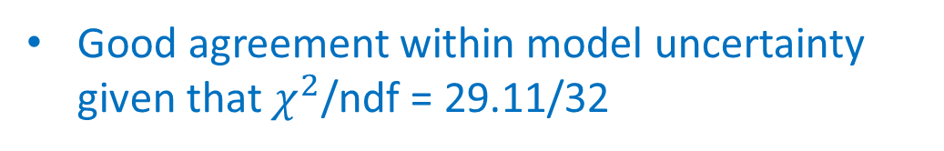
Energy Model Validation: $E_{ν}^{true}$ to $E_{ν}^{rec}$
LArTPC can separate lepton and hadronic energy from charged-current interactions
$$E_{ν}={E_{lepton}+E}_{had,visible}+E_{had,missing}$$
FC: fully-contained events in the fiducial volume (FV)
PC: partially contained events in the FV
Goodness-of-fit test:
$χ^{2}$=($m$-$μ$)^{T}$⋅Σ^{−1}⋅$($m$-$μ$)
FC
PC
Good agreement within model uncertainty given that $χ^{2}$/ndf = 29.11/32
Notes:
LArTPC can separate lepton and hadronic energy from charged-current interactions
Key challenge: understanding 𝝂-Ar cross section as a function of energy

Slide 8
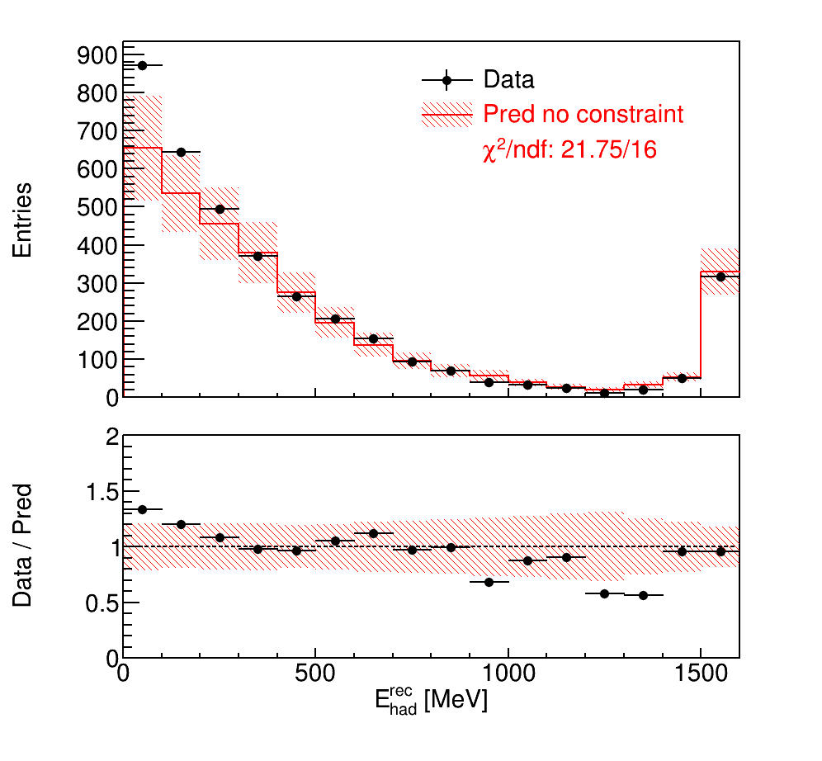
Energy Model Validation: $E_{ν}^{true}$ to $E_{ν}^{rec}$
LArTPC can separate lepton and hadronic energy from charged-current interactions
$$E_{ν}={E_{lepton}+E}_{had,visible}+E_{had,missing}$$
Reasonable GoF value
Lepton kinematics share systematic uncertainties with hadron side, leading to a model constraint
Before Constraint
Overflow
Although excess at low hadronic energy, uncertainty can cover it
However, more biases hidden by large uncertainty?
Indicates mis-modeling of missing energy?
FC

Slide 9
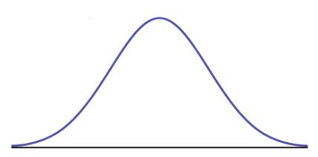
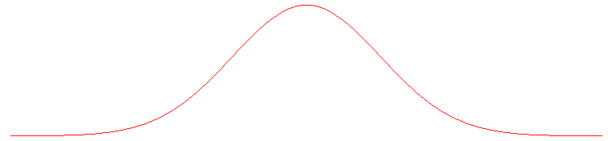
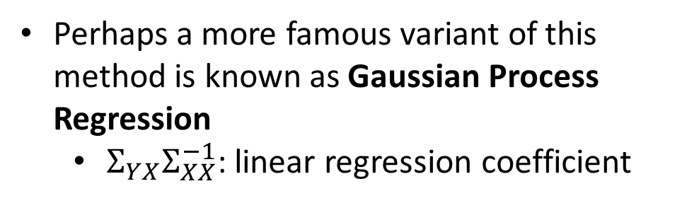
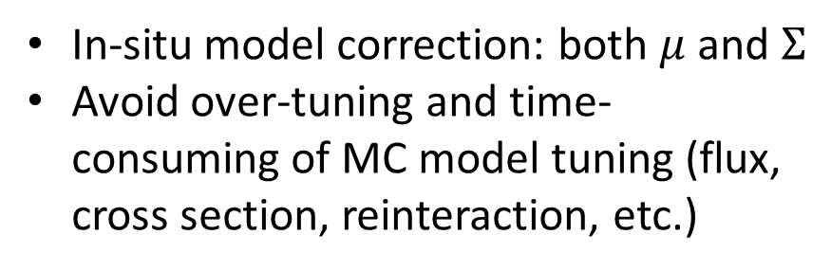
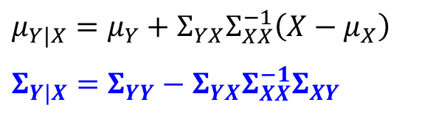
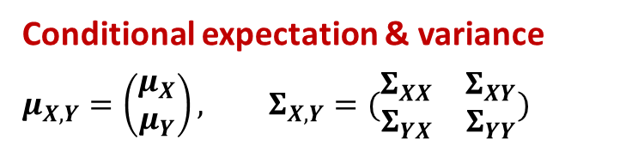

Conditional expectation & variance
Conditional expectation & variance
$$μ_{X,Y}=\left(\begin{matrix}μ_{X} \\ μ_{Y}\end{matrix}\right), Σ_{X,Y}=(\begin{matrix}Σ_{XX} & Σ_{XY} \\ Σ_{YX} & Σ_{YY}\end{matrix})$$
Perhaps a more famous variant of this method is known as Gaussian Process Regression
$Σ_{YX}Σ_{XX}^{−1}$: linear regression coefficient
$$μ_{Y|X}=μ_{Y}+Σ_{YX}Σ_{XX}^{−1}\left(X−μ_{X}\right)$$
$$Σ_{Y|X}=Σ_{YY}−Σ_{YX}Σ_{XX}^{−1}Σ_{XY}$$
In-situ model correction: both $μ$ and $Σ$
Avoid over-tuning and time-consuming of MC model tuning (flux, cross section, reinteraction, etc.)
$$(μ_{X},μ_{Y})$$
After Constraint
Before Constraint
X

Slide 10
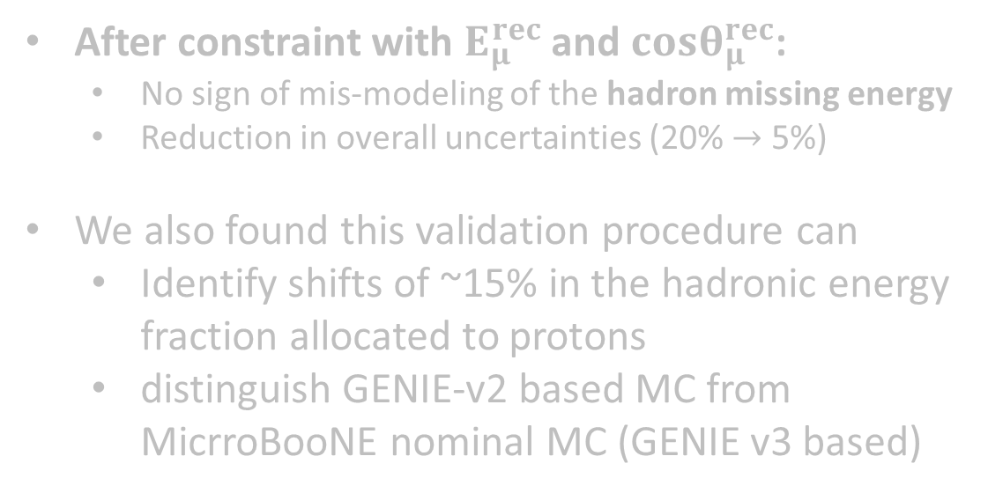

Validation of Hadronic Energy Reconstruction
MicroBooNE Preliminary
Before constraint: Excess observed at low hadronic energy
Mis-modeling of missing energy in the hadron final states?
$χ^{2}$/ndf=21.8/16
Before constraint
FC events
After constraint with $E_{μ}^{rec}$ and $cosθ_{μ}^{rec}$:
No sign of mis-modeling of the hadron missing energy
Reduction in overall uncertainties (20% $→$ 5%)
We also found this validation procedure can
Identify shifts of ~15% in the hadronic energy fraction allocated to protons
distinguish GENIE-v2 based MC from MicrroBooNE nominal MC (GENIE v3 based)
overflow bin
* Similar result of PC events

Slide 11
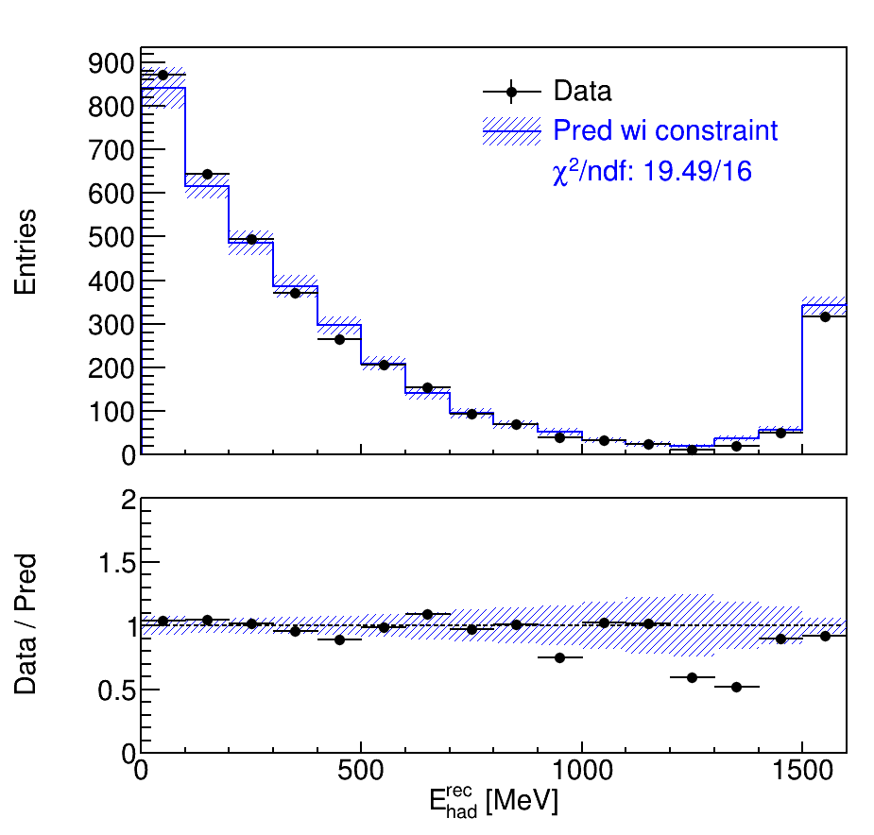


Validation of Hadronic Energy Reconstruction
MicroBooNE Preliminary
Before constraint: Excess observed at low hadronic energy
Mis-modeling of missing energy in the hadron final states?
$χ^{2}$/ndf=19.5/16
After constraint
FC events
After constraint with $E_{μ}^{rec}$ and $cosθ_{μ}^{rec}$:
No sign of mis-modeling of the hadron missing energy
Reduction in overall uncertainties (20% $→$ 5%)
We also found this validation procedure can
Identify shifts of ~15% in the hadronic energy fraction allocated to protons
distinguish GENIE-v2 based MC from MicrroBooNE nominal MC (GENIE v3 based)
overflow bin
* Similar result of PC events

Slide 12
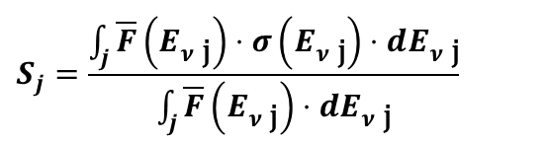
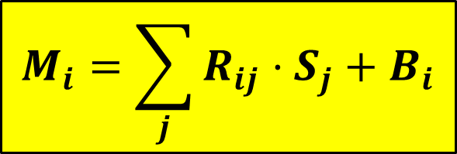


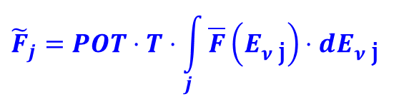
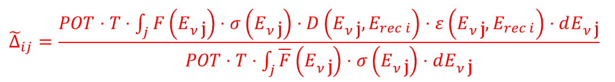
Cross Section Extraction
Measurements
ν_{μ}CC cross section
Detector response matrix
Selection efficiency
ν_{μ} Neutrino Flux
Background
$$M\left(E_{rec}\right)=POT⋅T⋅\int{F\left(E_{ν}\right)⋅σ\left(E_{ν}\right)}⋅D\left(E_{ν},E_{rec}\right)⋅ε\left(E_{ν},E_{rec}\right)⋅dE_{ν}+B\left(E_{rec}\right)$$
$$M_{i}=\sum_{j}{R_{ij}⋅S_{j}}+B_{i}$$
$${\tilde{F}}_{j}=POT⋅T⋅\int_{j}{\overline{F}\left(E_{ν \text{j}}\right)⋅dE_{ν \text{j}}}$$
$$R_{ij }={\tilde{Δ}}_{ij} {\tilde{F}}_{j}$$
$${\tilde{Δ}}_{ij}=\frac{POT⋅T⋅\int_{j}{F\left(E_{ν \text{j}}\right)⋅σ\left(E_{ν \text{j}}\right)⋅D\left(E_{ν \text{j}},E_{rec i}\right)}⋅ε\left(E_{ν \text{j}},E_{rec i}\right)⋅dE_{ν \text{j}}}{POT⋅T⋅\int_{j}{\overline{F}\left(E_{ν \text{j}}\right)⋅σ\left(E_{ν \text{j}}\right)⋅dE_{ν \text{j}}}}$$
$$S_{j}=\frac{\int_{j}{\overline{F}\left(E_{ν \text{j}}\right)⋅σ\left(E_{ν \text{j}}\right)⋅dE_{ν \text{j}}}}{\int_{j}{\overline{F}\left(E_{ν \text{j}}\right)⋅dE_{ν \text{j}}}}$$
$$i:\text{bin} \text{in} E_{rec} j\text{: }\text{bin} \text{in} E_{ν}$$
Nominal-flux weighted cross section
MicroBooNE’s nominal MC (GENIE v3 based) is used to determine $R_{ij}$
Notes:
Extraction of total ν_{μ}CC cross section as neutrino energy

Slide 13
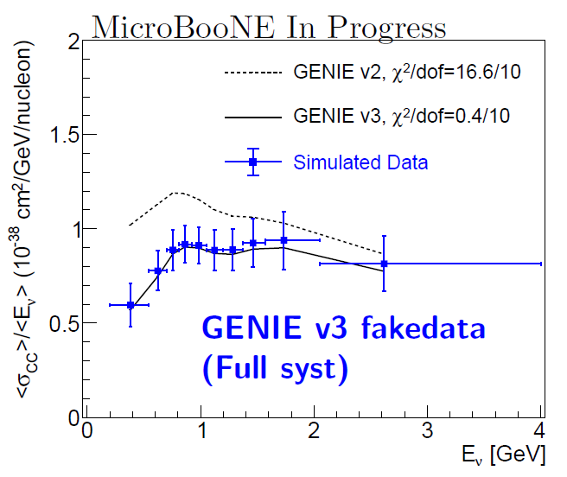
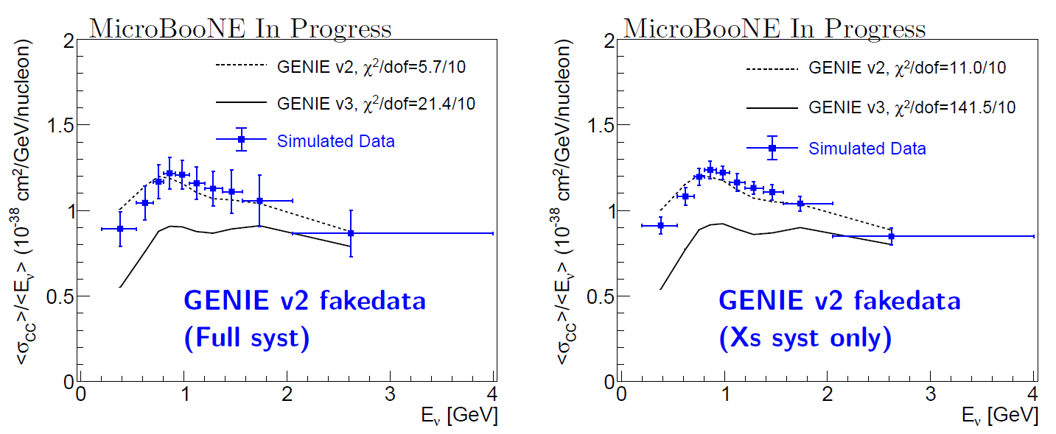
Procedure Validation with Simulated Data
True Model
True Model
MicroBooNE’s nominal MC is used to extract the cross section from the “fake dataset” – same treatment as data
Analyses of cross-section extraction from two simulated data sets justify the unfolding procedure

Slide 14
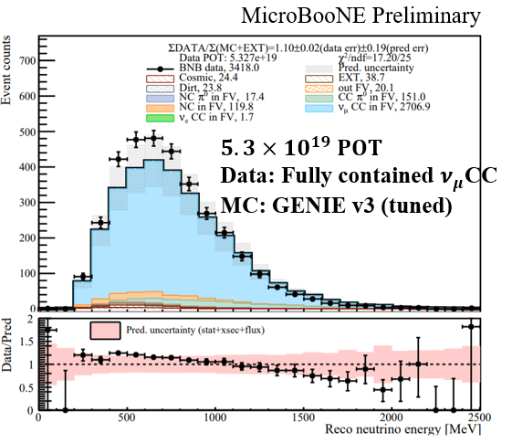
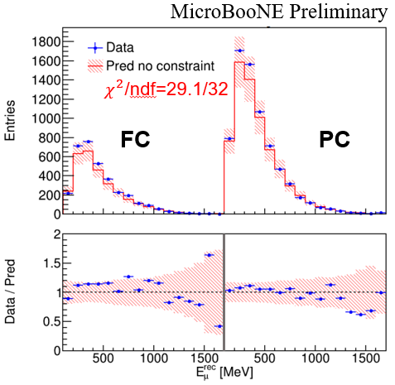
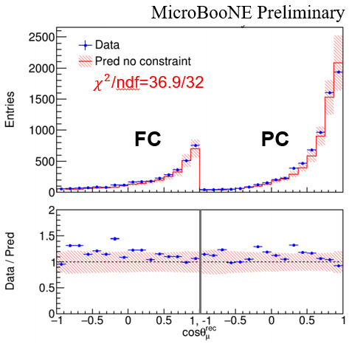
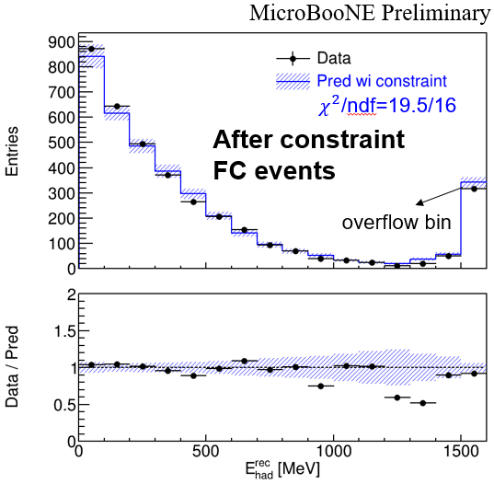
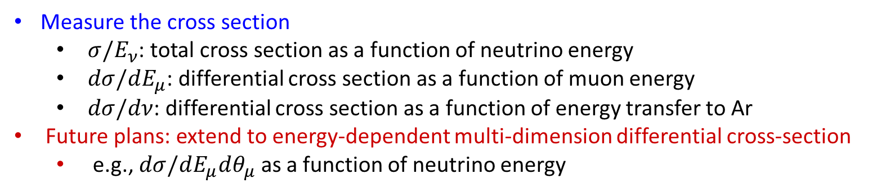
To measure the cross section
Reco neutrino energy
Reco muon energy
Reco polar angle
Reco hadronic energy
Measure the cross section
$σ/E_{ν}$: total cross section as a function of neutrino energy
$dσ/dE_{μ}$: differential cross section as a function of muon energy
$dσ/dν$: differential cross section as a function of energy transfer to Ar
Future plans: extend to energy-dependent multi-dimension differential cross-section
e.g., $dσ/dE_{μ}dθ_{μ}$ as a function of neutrino energy

Slide 15
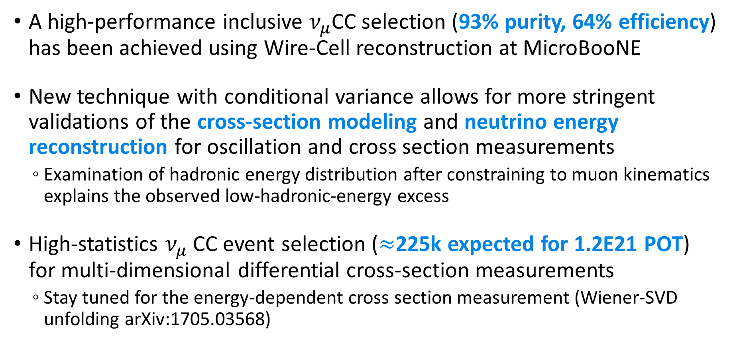
Summary
A high-performance inclusive $ν_{μ}$CC selection (93% purity, 64% efficiency) has been achieved using Wire-Cell reconstruction at MicroBooNE
New technique with conditional variance allows for more stringent validations of the cross-section modeling and neutrino energy reconstruction for oscillation and cross section measurements
Examination of hadronic energy distribution after constraining to muon kinematics explains the observed low-hadronic-energy excess
High-statistics $ν_{μ}$CC event selection ($≈$225k expected for 1.2E21 POT) for multi-dimensional differential cross-section measurements
Stay tuned for the energy-dependent cross section measurement (Wiener-SVD unfolding arXiv:1705.03568)
Notes:
Prepared questions:
When is Xs result coming out?
Is there any comparison with other generators for 1u0P 1uNP? We haven’t compared, but we compared with GENIE v2. 1uNp channel

Slide 16
Backup Slides

Slide 17
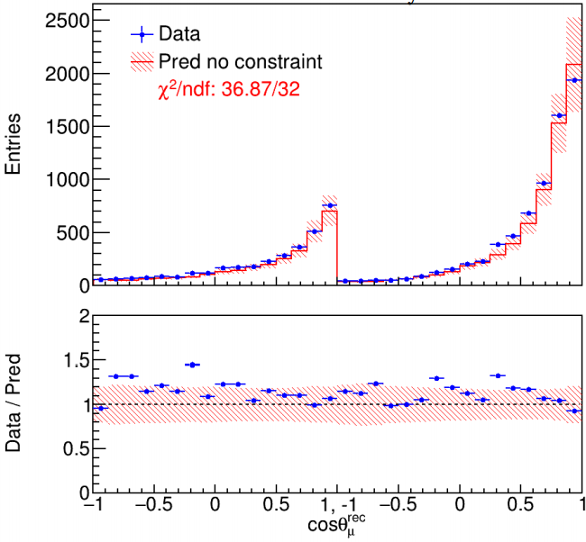



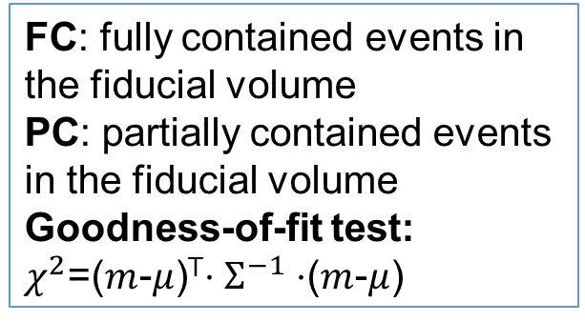
Muon Kinematics: Reconstructed Polar Angle between of Muon and Neutrino Beam ($cosθ_{μ}^{rec}$)
MicroBooNE Preliminary
FC: fully contained events in the fiducial volume
PC: partially contained events in the fiducial volume
Goodness-of-fit test:
$χ^{2}$=($m$-$μ$)^{T}$⋅Σ^{−1}⋅$($m$-$μ$)
$χ^{2}$/ndf=36.9/32
$χ^{2}$/ndf=29.1/32
FC
PC
FC
PC
Error band for statistic, flux and cross section systematic uncertainties
The reasonable value of goodness-of-fit test show good agreement between data and model prediction

Slide 18
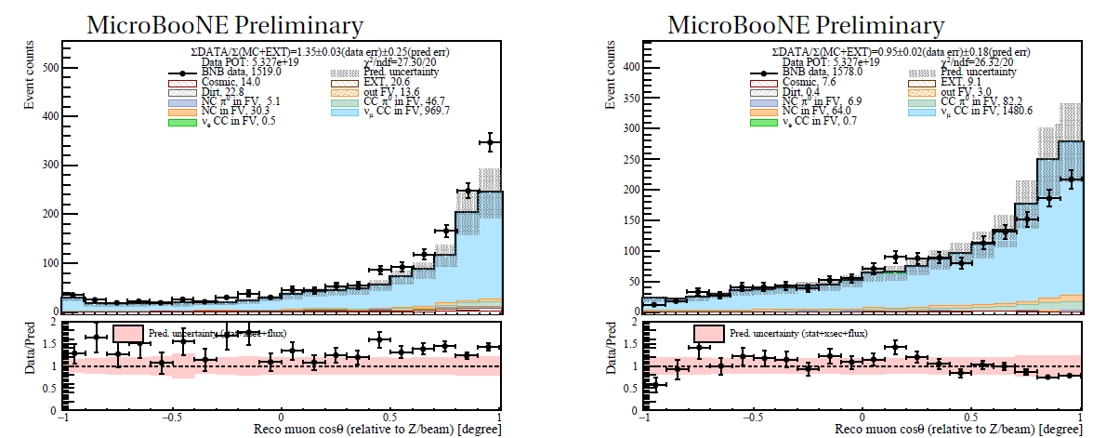
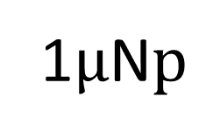
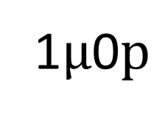
Model Comparison in High Dimension
1$μ$0$p$
1$μ$N$p$
Overall excess
Deficit at muon forward angle
High-statistics $ν_{μ}$CC allows for multi-dimensional cross-section measurements
Notes:
Costh is muon kinematics, it is not proton

Slide 19
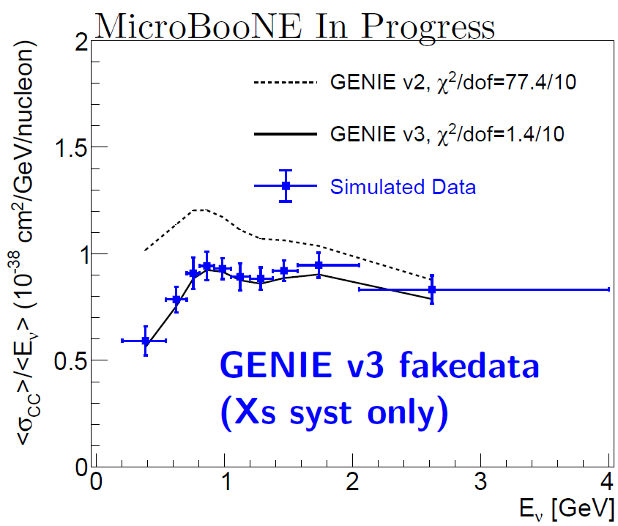
Validation with Simulated Data

