Slide 1


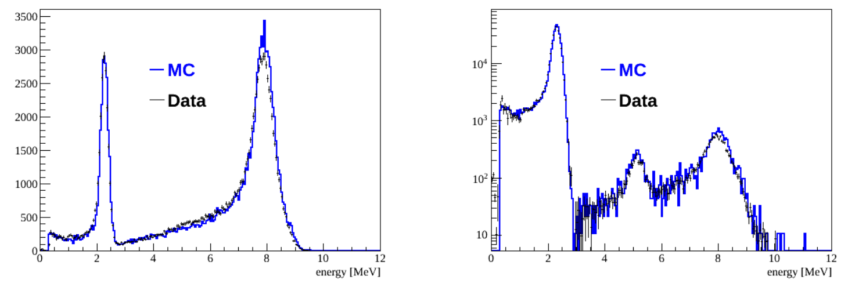
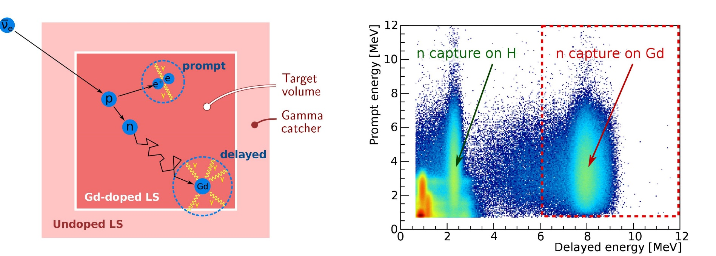
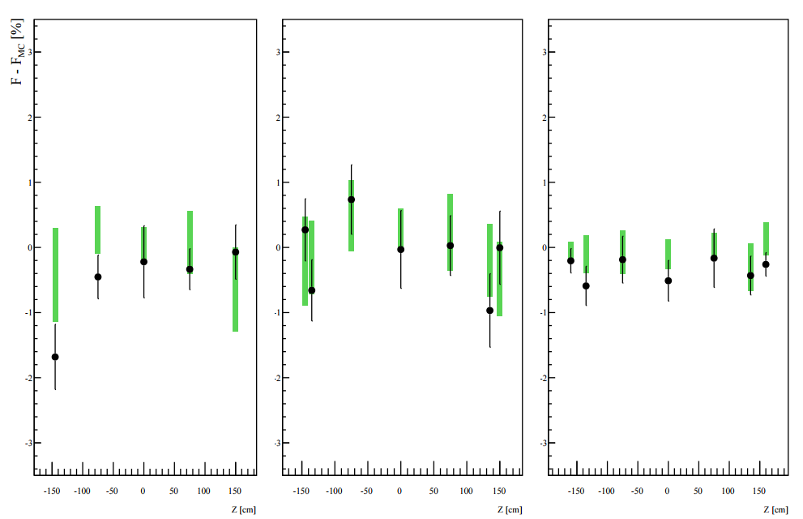
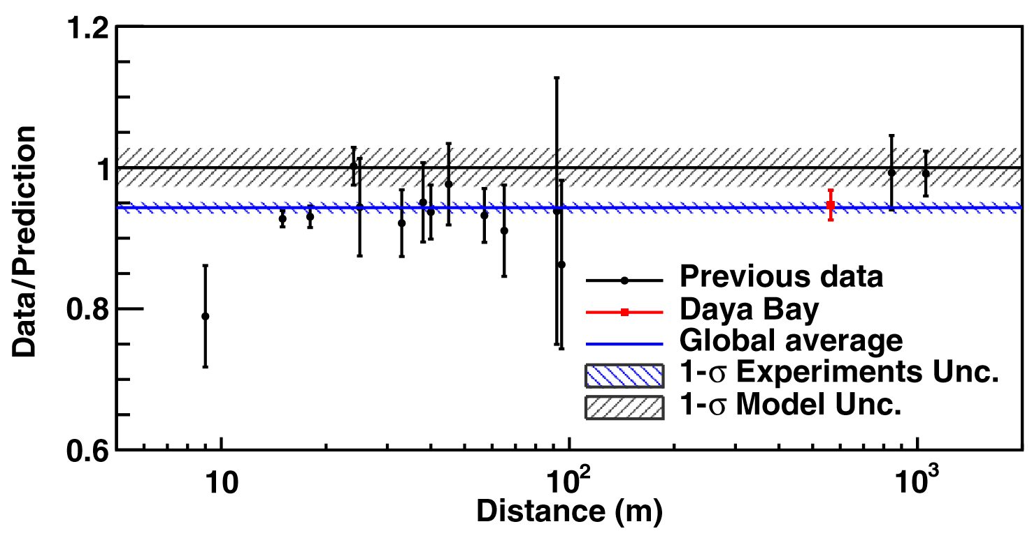
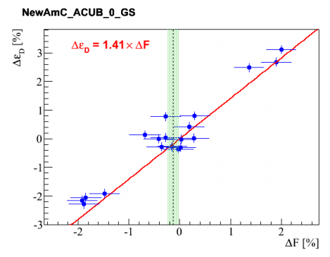
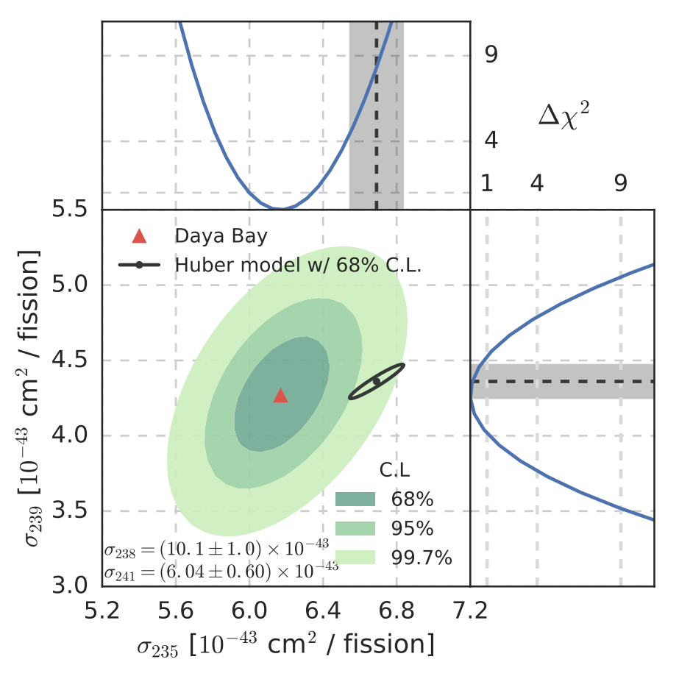
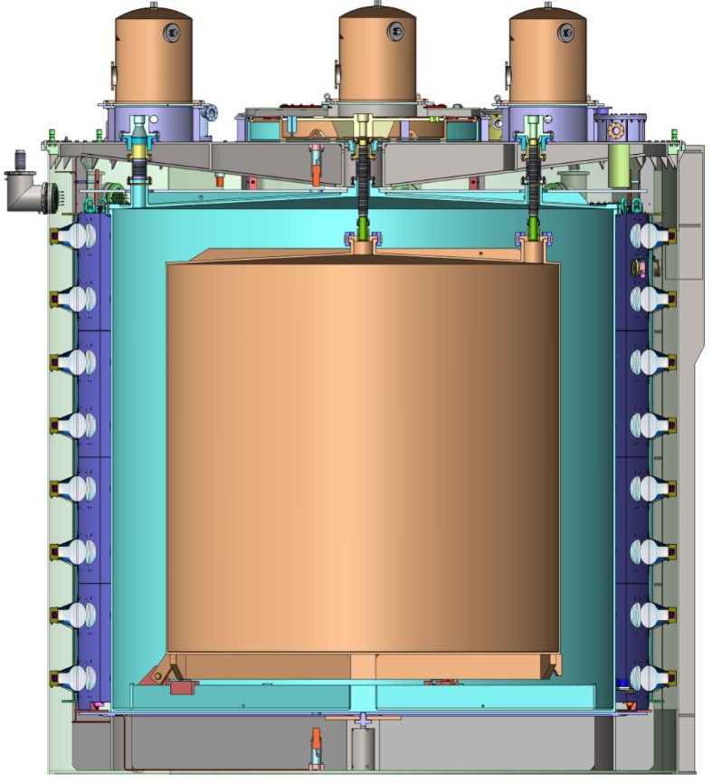
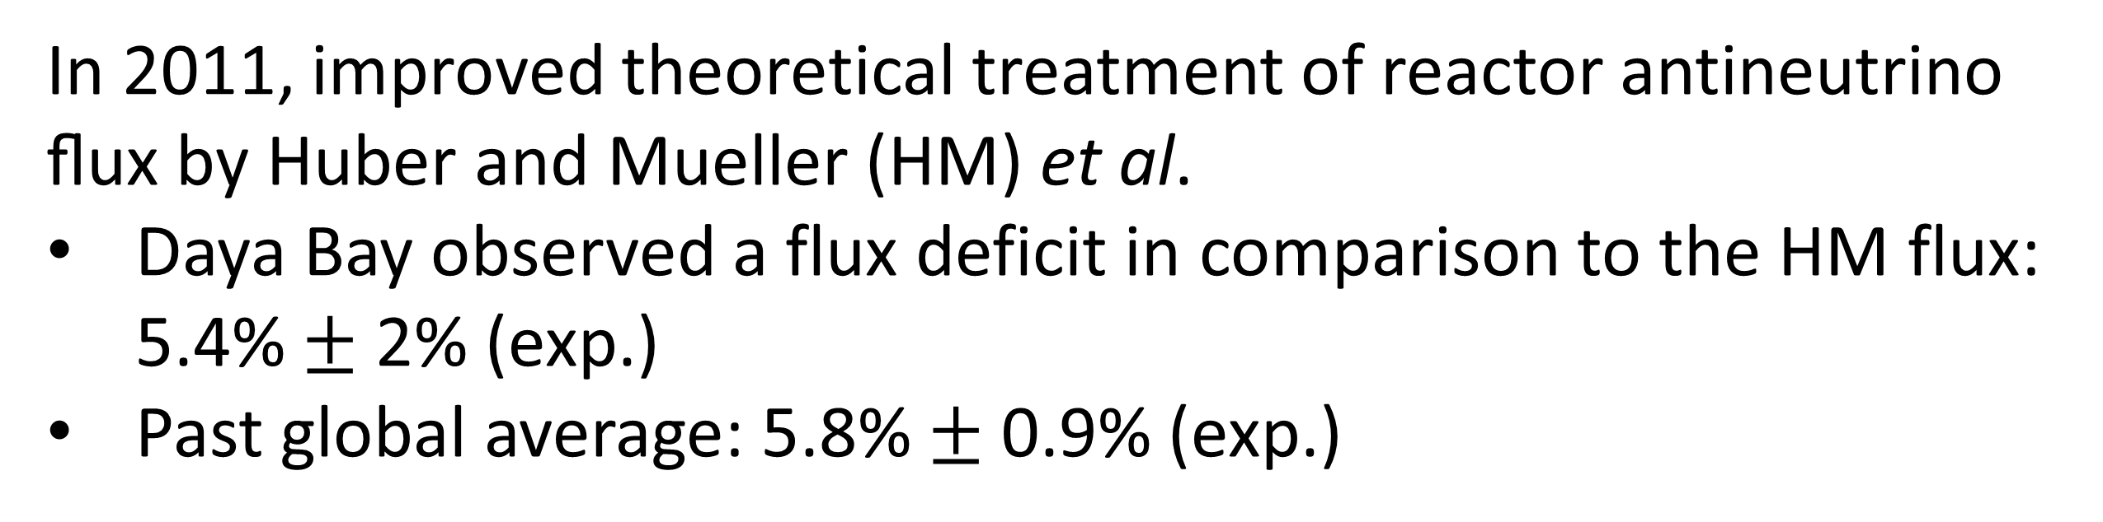

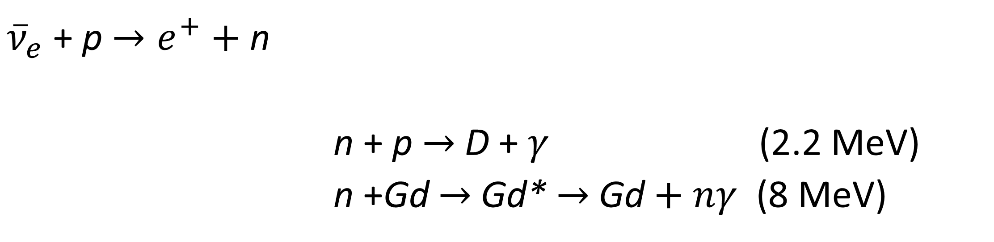
Towards a Precise Determination of the Reactor Antineutrino Flux at Daya Bay
Wenqiang Gu (Shanghai Jiao Tong University)
on behalf of the Daya Bay Collaboration
Detection of Antineutrinos
Data and MC Comparison
Antineutrinos are detected via Inverse Beta Decay (IBD)
Prompt-delayed coincidence between positron and neutron
Delayed energy spectra at two edgy locations
${\overline{ν}}_{e}$ + p $→e^{+}+$ n
n + p $→$ D + $γ$ (2.2 MeV)
n +Gd $→$ Gd* $→$ Gd$+ nγ$ (8 MeV)
AmBe at ACU-A z=-1.45m
AmC at ACU-C z= 0m
$$τ≈30μs$$
Efficiency
F = N([6,12]MeV) / N([1.5,12]MeV)
Efficiency difference between data and MC along three z-axes. Reasonable agreement with MC
“Reactor Antineutrino Anomaly” (RAA)
ACU-A
ACU-B
ACU-C
In 2011, improved theoretical treatment of reactor antineutrino ﬂux by Huber and Mueller (HM) et al.
Daya Bay observed a flux deficit in comparison to the HM flux: 5.4% $±$ 2% (exp.)
Past global average: 5.8% $±$ 0.9% (exp.)
Green bar: systematic uncertainty from model variation in MC
Daya Bay, Chin. Phys. C 41(1) (2017)
Efficiency Correction for IBD
The physics models were varied in the simulation
- neutron transportation
- n-Gd capture γ spectrum
common systematics for IBD and neutron sources!
Possible explanation
The existence of eV scale sterile neutrinos!
Systematic uncertainties in reactor flux calculations
Daya Bay data implies that HM flux overestimates the antineutrino flux from ²³⁵U (Phys. Rev. Lett. 118, 251801)
IBD and neutron source efficiency correlated for given model in the MC
7.8%
Systematic uncertainties
detection efficiency (dominant!)
reactor related
statistics
Measured neutron source efficiency ⇒ correction to IBD
Different subsets of calibration data
different correction
⇒ systematic uncertainty
Summary
Neutron Calibration Campaign
The RAA is being probed experimentally at Daya Bay
The incorrect theoretical prediction for ²³⁵U may be responsible for RAA
An elaborate neutron calibration campaign was performed at Daya Bay in 2016, aiming to further improve the IBD detection efficiency
At the end of 2016
AmC and AmBe source
Along three z-axes of the automated calibration units (ACUs)
Target: improve the IBD detection efficiency (x2)
⇒ more precise reactor flux measurement
Gordan Research Conference, Particle Physics (2017)
wenqiang.gu@sjtu.edu.cn

