Slide 1


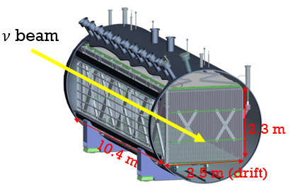
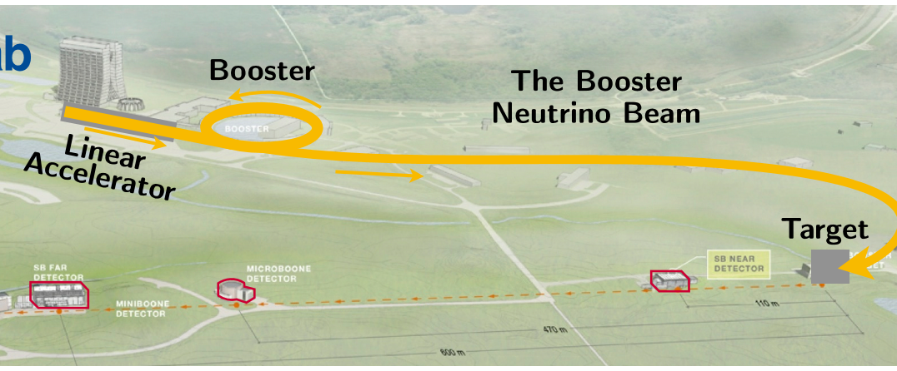
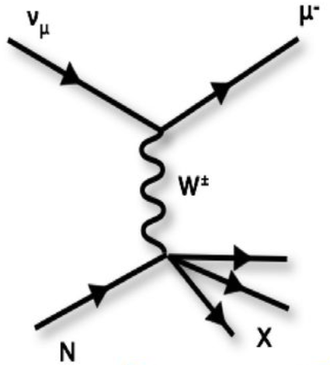
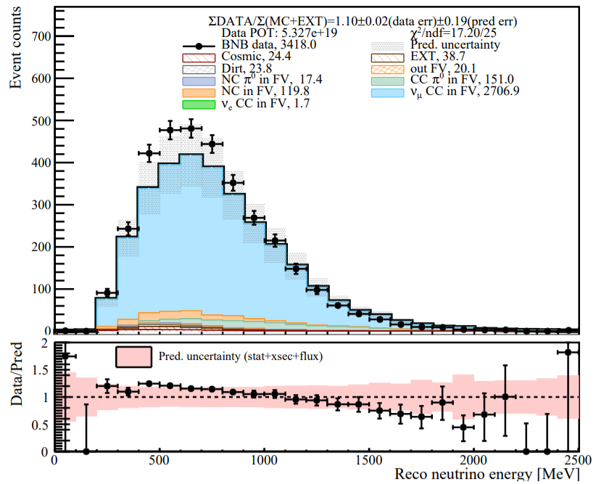
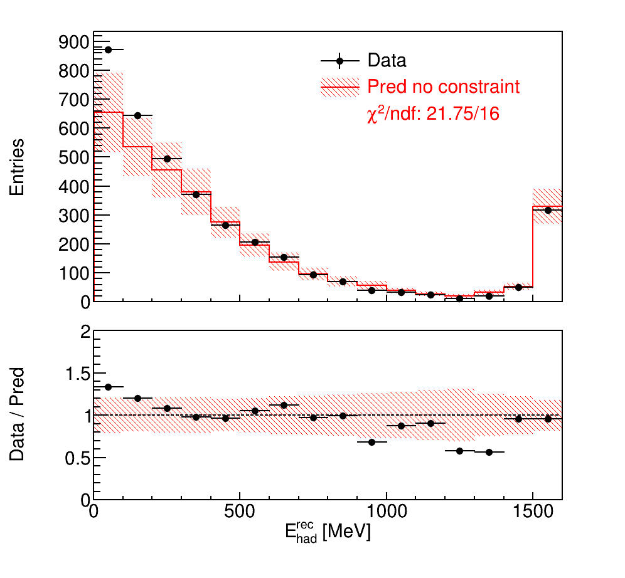
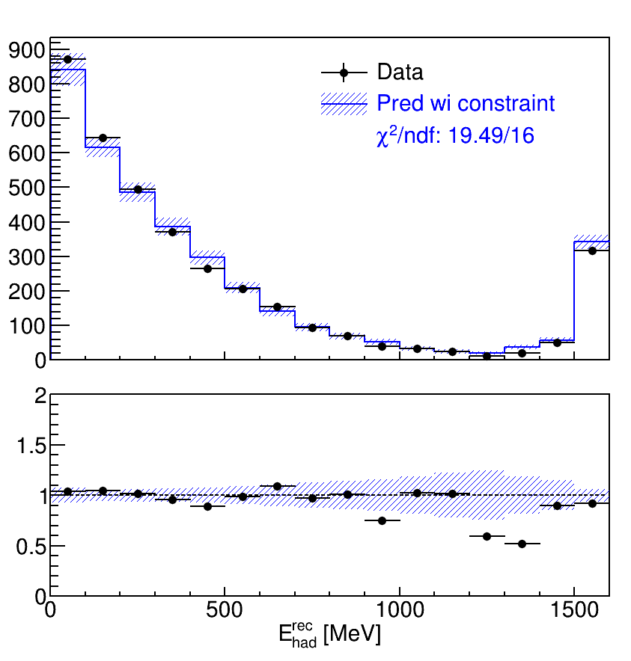

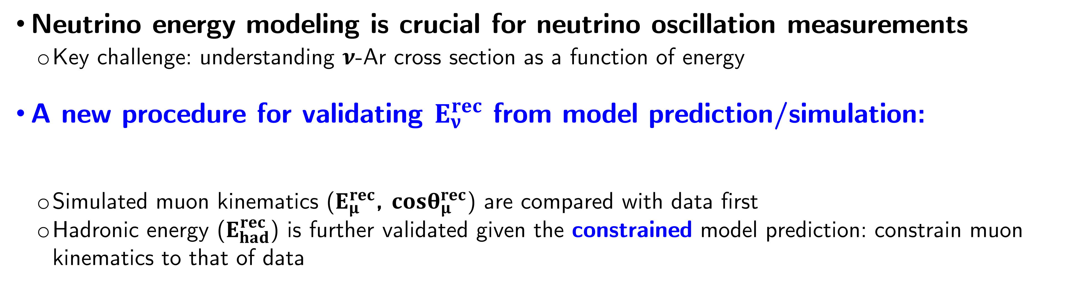
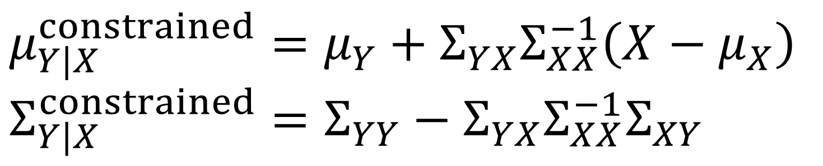
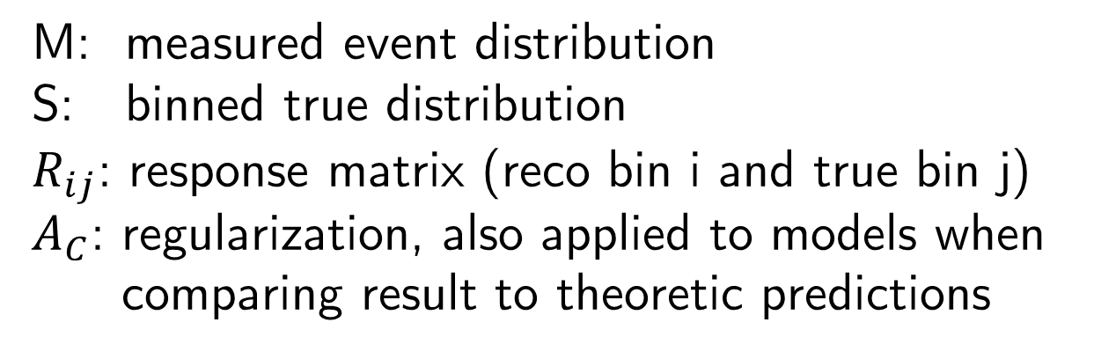


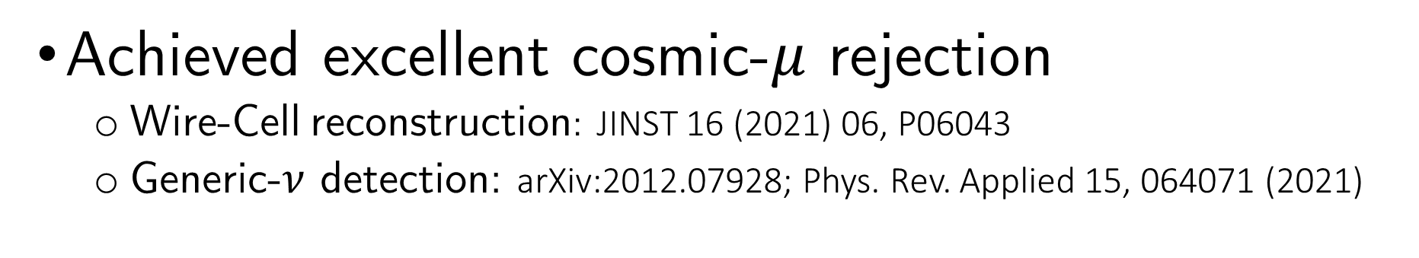
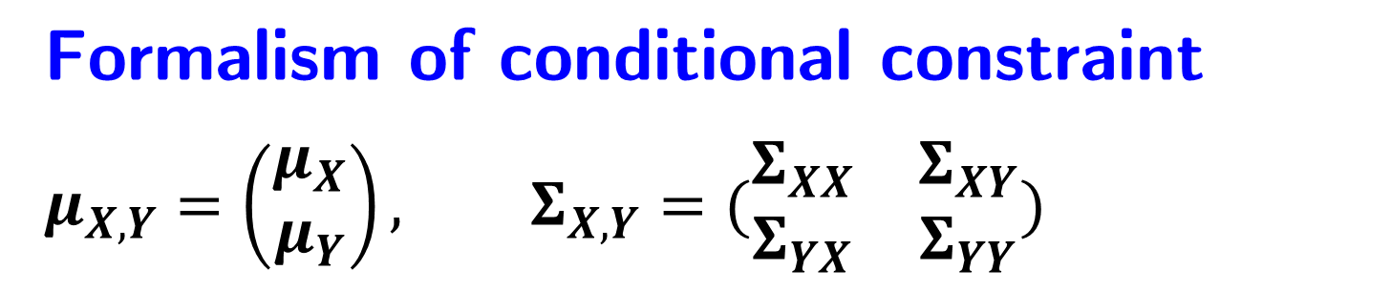
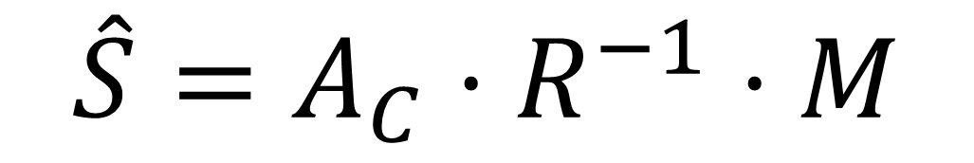
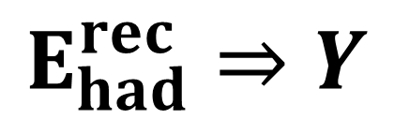

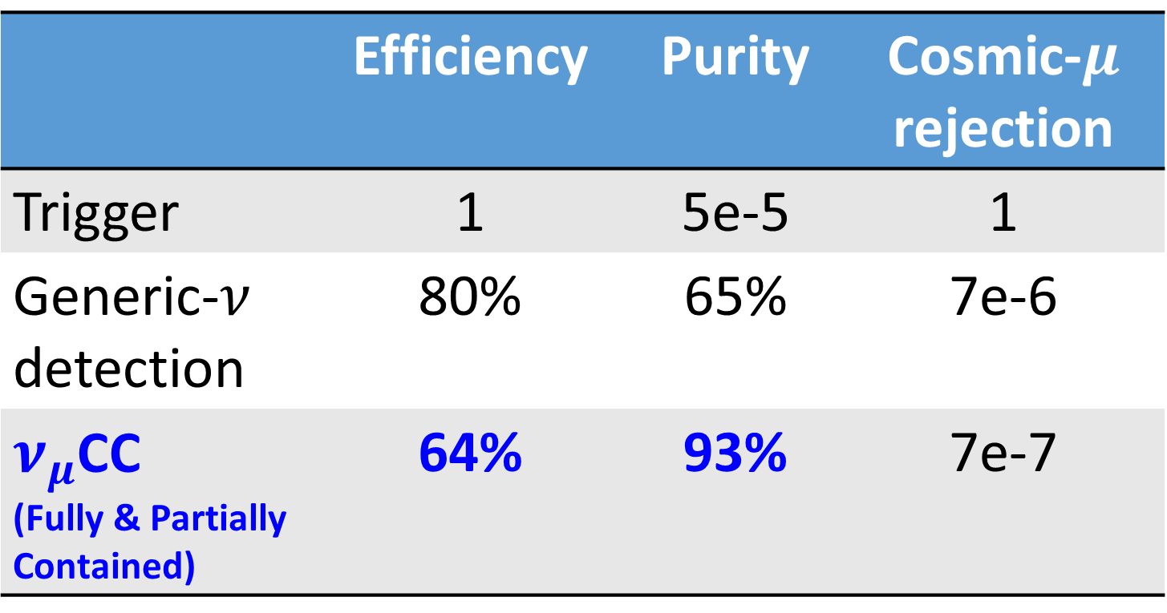
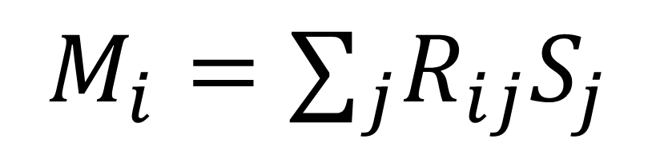

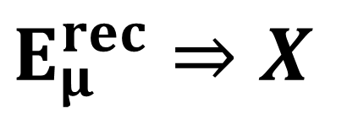
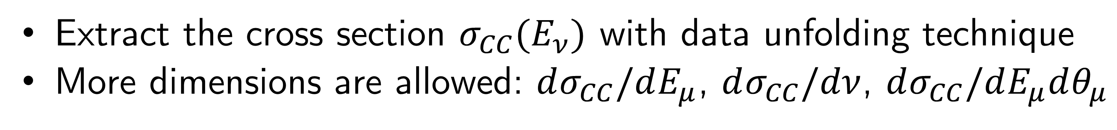

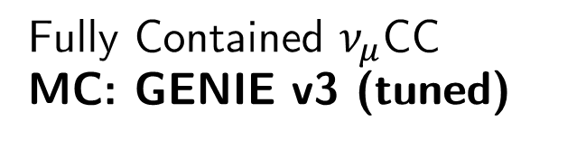


Extraction of the Inclusive $ν_{μ}$CC Cross-Section
Wenqiang Gu Brookhaven National Laboratory | wgu@bnl.gov
1. MicroBooNE
3. Model validation: $E_{ν}$ to $E_{ν}^{rec}$
Accelerator $ν$ experiment at Fermilab
LArTPC with 85-ton active mass
Near-surface operation
Main physics goals
Investigate MiniBooNE low-energy excess
Measure $ν$-Ar interaction cross sections
Neutrino energy modeling is crucial for neutrino oscillation measurements
Key challenge: understanding 𝝂-Ar cross section as a function of energy
A new procedure for validating $E_{ν}^{rec}$ from model prediction/simulation:
Simulated muon kinematics ($E_{μ}^{rec}$, $cosθ_{μ}^{rec}$) are compared with data first
Hadronic energy ($E_{had}^{rec}$) is further validated given the constrained model prediction: constrain muon kinematics to that of data
$E_{ν}^{rec}=E_{μ}^{rec}+E_{had}^{rec}$
MicroBooNE
A data-driven correction for the model prediction of Y given a measurement of X
Common systematic uncertainties (e.g., flux) are reduced
$⇒$ more stringent model validation
$ν$ beam
$E_{μ}^{rec}⇒X$
Formalism of conditional constraint
$$μ_{X,Y}=\left(\begin{matrix}μ_{X} \\ μ_{Y}\end{matrix}\right), Σ_{X,Y}=(\begin{matrix}Σ_{XX} & Σ_{XY} \\ Σ_{YX} & Σ_{YY}\end{matrix})$$
2. $ν_{μ}$ CC inclusive selection
Joint mean
Joint covariance
 | Efficiency | Purity | Cosmic-$μ$ rejection
Trigger | 1 | 5e-5 | 1
Generic-$ν$ detection | 80% | 65% | 7e-6
$ν_{μ}$CC (Fully & Partially Contained) | 64% | 93% | 7e-7
MicroBooNE Preliminary
$$E_{had}^{rec}⇒Y$$
$$μ_{Y|X}^{constrained}=μ_{Y}+Σ_{YX}Σ_{XX}^{−1}\left(X−μ_{X}\right)$$
$$Σ_{Y|X}^{constrained}=Σ_{YY}−Σ_{YX}Σ_{XX}^{−1}Σ_{XY}$$
Fully Contained $ν_{μ}$CC
MC: GENIE v3 (tuned)
4. Validation of hadron energy reconstruction
MicroBooNE Preliminary (5.327E19 POT)
MicroBooNE Preliminary (5.327E19 POT)
Achieved excellent cosmic-$μ$ rejection
Wire-Cell reconstruction: JINST 16 (2021) 06, P06043
Generic-$ν$ detection: arXiv:2012.07928; Phys. Rev. Applied 15, 064071 (2021)
After constraint with $E_{μ}^{rec}$ and $cosθ_{μ}^{rec}$: no more excess at low hadronic energy
Significant reduction in overall uncertainties (20% $→$ 5%)
No sign of mis-modeling of the hadron missing energy
Calorimetric energy:
Before Constraint
After Constraint
High-statistics event selection allows for high-precision cross-section measurements
MICROBOONE-NOTE-1095-PUB
$$E_{ν}^{rec}=E_{μ}^{rec}+E_{had}^{rec}$$
Overflow bin
Reco lepton (muon) energy
Reco hadron energy
5. Towards a cross-section extraction
Measured # of events
Target nucleons
Cross section
Selection efficiency
Background
Proton-on-target
Neutrino flux
Detector response
MC folding vs. data unfolding
(a re-smearing process to extract truth model)
M: measured event distribution
S: binned true distribution
$R_{ij}$: response matrix (reco bin i and true bin j)
$A_{C}$: regularization, also applied to models when comparing result to theoretic predictions
Extract the cross section $σ_{CC}(E_{ν})$ with data unfolding technique
More dimensions are allowed: $dσ_{CC}/dE_{μ}$, $dσ_{CC}/dν$, $dσ_{CC}/dE_{μ}dθ_{μ}$
$$M_{i}=∑_{j}R_{ij}S_{j}$$
$$\hat{S}=A_{C}⋅R^{−1}⋅M$$

