Slide 1
Cell Building
Next UI Design System
How to make design in run time
by lijianbo

Slide 2
Strcuture of Launcher
Slide workspace
cell layout1
Cell layout2
Cell layout3
Cell
Cell
Cell
Cell
Cell
Cell
Cell
Cell
Cell
Cell
Cell
Cell
Cell
Cell
Cell

Slide 3


Cell Layout
Square Grid Matrix
3×2
Division of the screen
Locate cell
4×2

Slide 4
Cell Layout dimension
M*N Grid matrix
specific square grid dimension like 30dp*20dp
Vertical or horizontal Space between each cell grid

Slide 5
What is Cell?
A layout building block
Is a content block
Basic UI Element
The elements of a rapid display content
Content can be text, image ,audio, video

Slide 6
Basic Cell Infomation Structure
Cell Type
Title
Image(bmp resource url )
Intent
Original dimension , ex 100pix*100pix
Requested grid size , ex 20pix*20pix
Unique id
Container
Screen
Cell X
Cell Y
spanX
spanY

Slide 7

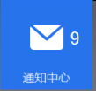






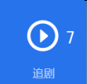

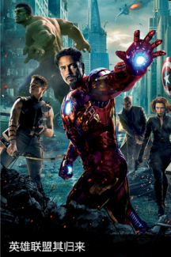


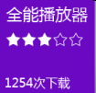
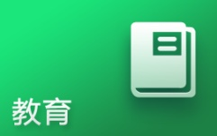


Cell bank

Slide 8
Cell category
Poster cell(local data, UI)
App cell(local data, UI)
Widget cell(remote provider, push message)

Slide 9
Publish cell description
Poster cell
url image
Resource id
28276
server
Json
Client app tool
Cell description
db
Cell Type:”poster”
Intent[action:detailactivity]
url image
Json
Client app tool
Resource id
28279
Cell Type:”poster”
Intent[action:detailactivity]

Slide 10
Publish App cell description
App cell
Install apps
Client app tool
Subsititute icon
Cell description
db
Resolve
App info
App title
Intent[app class name]

Slide 11



Cell Building
Cell bank UI
Cell building Workspace
Cell bank Filter
Cell description
db
Favorite Cell
db

Slide 12

Cell Building

Slide 13
Regroup Cell

Slide 14























Cell Layout Thumbnail

Slide 15
Restore From Cell Layout Thumbnail

Slide 16
Cell Layout Effect

Slide 17
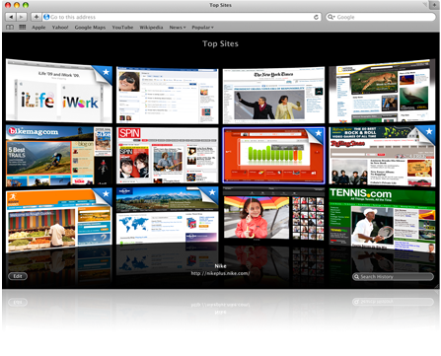
Cell Layout Special Effect

Slide 18

Cell Style

Slide 19



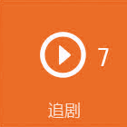
Cell system Theme

Slide 20
reconstitution cell

Slide 21
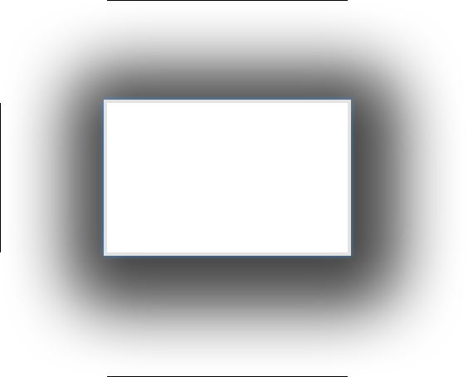
cell factory

