Slide 1

Coffee Review Analysis & Rating Prediction
Wenshan, Liu

Slide 2
Project Objectives
Problem Statement
Data Wrangling & EDA
Data Wrangling
Exploratory Data Analysis (EDA)
Machine Learning Methodology
Baseline Models
Advanced Models
Model Evaluation
Data Visualization
Data Inferential Statistic
Hyperparameter Tuning
Model Evaluation
Feature Importance
Preprocessing
Feature Scaling
Split dataset

Slide 3
Problem Statement
Challenges in Coffee Quality Assessment
Coffee quality evaluation is highly subjective, often based on expert cupping scores.
Key attributes include: aroma, acidity, aftertaste, body, balance, and flavor.
These evaluations are complex and can lead to inconsistencies.
It's often difficult for producers, roasters, and distributors to pinpoint what exactly drives high scores.
The scoring system may vary due to human bias or inconsistent grading standards across different experts.

Slide 4
Data Sources
Scape coffee review data from Coffee Review website
Weather data of coffee region from Open Weather API
Geography data from Python package

Slide 5

Data Wrangling Basic Data Cleaning
Handling Missing Values
Missing values were removed if necessary
Encoding Categorical Variables
Convert Categorical
Encoded region data by using one-hot encoding
Deal with the coffee price in the same unit
Convert various currency and weight units to USD per pound.

Slide 6
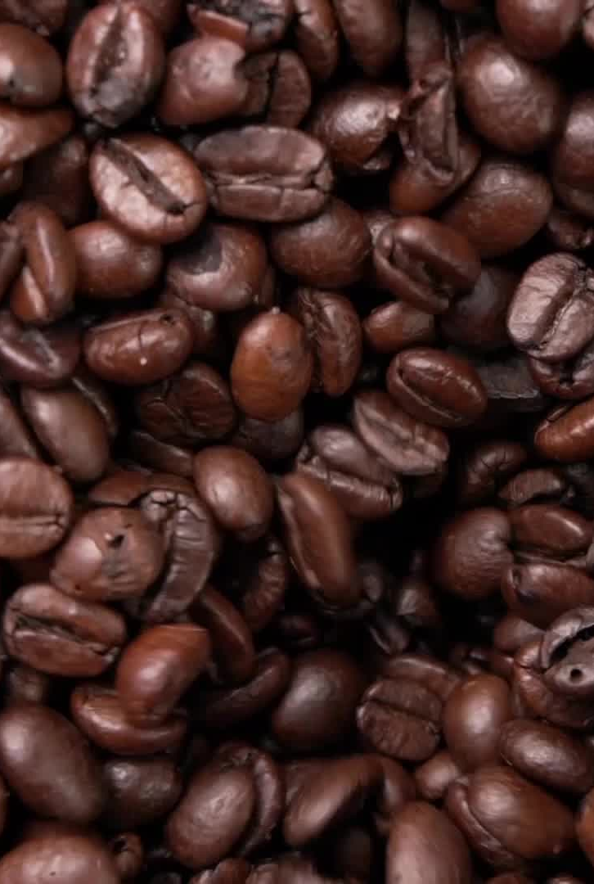
Exploratory Data Analysis (EDA)
Data Visualization
Sensory features such as Aroma, Acidity had a strong positive correlation with overall coffee ratings.
Coffee beans from Hawaii tended to receive higher median ratings compared to other regions.
Data Inferential Statistic
Medium roast coffees demonstrated the highest average scores and dark roast coffees showed significantly lower scores compared to medium roasts
blending coffee beans is significantly affects quality ratings

Slide 7
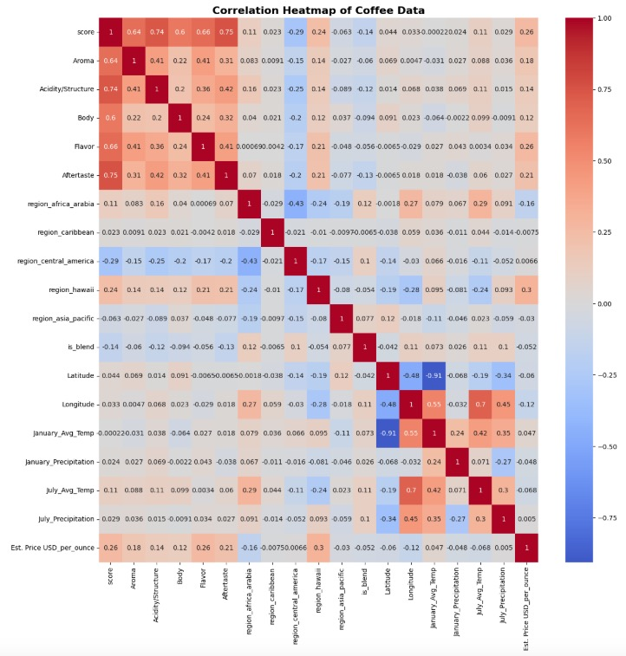
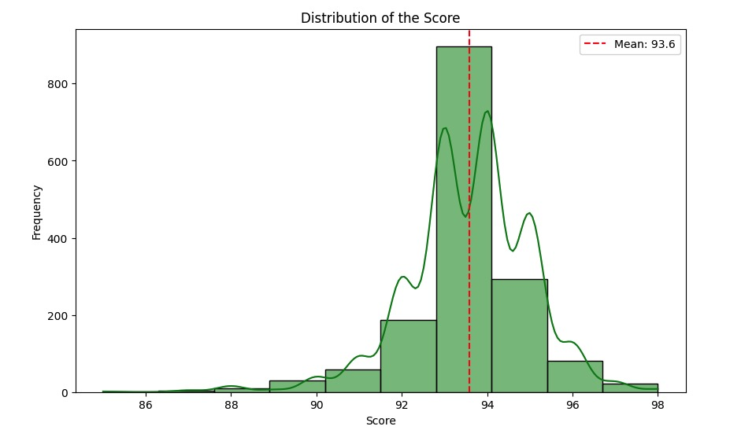
Data Visualization

Slide 8
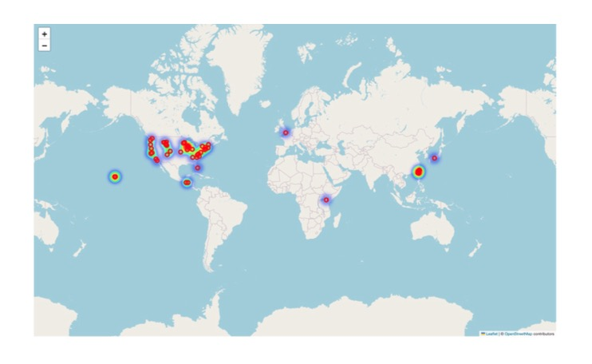
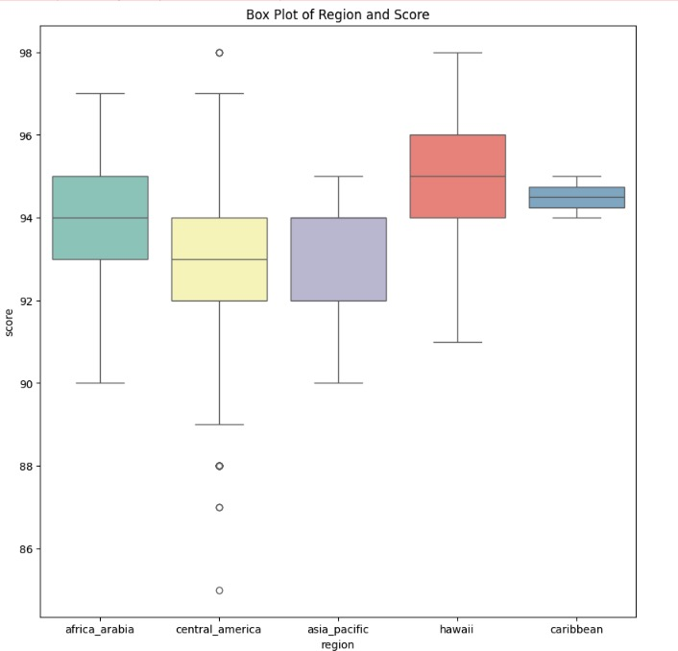
Data Visualization

Slide 9
Data Inferential Statistic
Statistic test | Examination | Result
ANOVA | coffee origin and the score | p-value < 0.05, indicating that the region of coffee beans significantly affects the score.
t-test | coffee blended (Y/N) and the score (continuous numeric) | p-value < 0.05, meaning the analysis showed significant differences in coffee scores depending on whether the coffee is blended or not. This indicates that blending coffee beans significantly affects the scores.
ANOVA | Roasters and prices | p-value <0.05, which means the analysis showed significant differences in coffee price across different roasters.
ANOVA | Roast levels and scores | p-value<0.05, which is significant different . In addition, after post hoc test (tukey HSD), it shows that : - Medium roast coffees demonstrated the highest average scores. - Dark roast coffees showed significantly lower scores compared to medium roasts

Slide 10
Pre-processing
Outlier Detection
Define the price over 1.5* IQR as outliers
Deal with outliers
Feature Scaling
Normalization the features as Standard Scales
Splitting dataset
Splitting dataset for training / testing dataset(80/20)

Slide 11
Machine Learning Methodology
Modeling:
Baseline Models: Ridge Regression(L2 regression), Decision Tree
Advanced Models: XGBoost, Multi-Layer Perceptron (MLP)
Tuning:
GridSearchCV and optimizing key parameters such as:
Number of trees in Decision Forest and XGBoost
Maximum depth of trees
Learning rate for XGboost and MLP model

Slide 12
Model Evaluation
Algorithm | Model accuracy score(R2) | Mean Squared Error(MSE)
Ridge linear Regression | 0.994493 | 0.012673
Decision Tree Regressor | 0.983122 | 0.038837
XGBoost | 0.986694 | 0.030617
MLP | 0.563319 | 1.004845

Slide 13
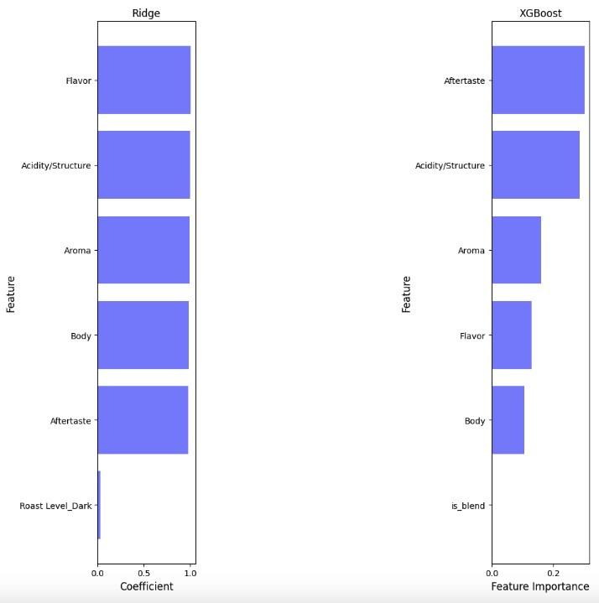
Feature Important
Compare with Ridge regression and the XGBoost model and see their feature importance. The top 5 features importance in both models are the same, though they are in a different order.

Slide 14
Future Work
Sentiment Analysis: Using Natural Language Processing (NLP) to analyze customer reviews as well as numerical scores.
Deep Learning Models: Exploring Convolutional Neural Networks (CNNs) to analyze coffee bean images for quality assessment.

Slide 15
Reference
[1] Rodgers, E. (2025, February 25). Coffee Statistics: Consumption, Preferences, & Spending.
Drive Research. https://www.driveresearch.com/market-research-company-blog/coffee-survey/
[2] Coffee Review - the world’s leading coffee guide. (2025, February 13). Coffee Review. https://www.coffeereview.com/
[3] geopy. (2023, November 23). PyPI. https://pypi.org/project/geopy/
[4] OpenWeatherMap.org. (n.d.). Weather API - OpenWeatherMap. https://openweathermap.org/api

