Slide 1


An Online Mechanism for Ridesharing in Autonomous Mobility-on-Demand Systems
Wen Shen¹, Cristina V. Lopes¹ and Jacob W. Crandall²
¹UC Irvine & ²Masdar Institute

Slide 2
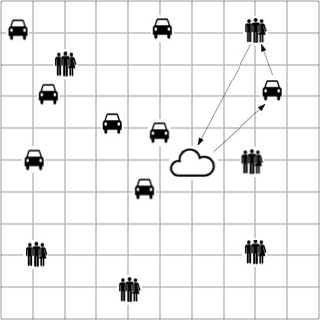
AMoD Systems
Components:
A fleet of electric, driverless cars
Information Center (Dispatch center)
Passengers (Demand)
Environment (Infrastructure)
Objective:
To satisfy passengers’ mobility demand with limited resources

Slide 3
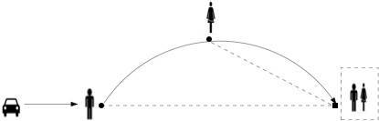
Ridesharing in AMoD Systems
Characteristics:
No drivers
Challenges:
Truthful demand information needed
Passengers may not cooperate

Slide 4
Limits of Existing work
Key Limits:
require passengers to directly reveal their valuation
need additional constraints to satisfy desirable properties
do not work in online settings
(For a complete list, see the introduction in Shen et. al., 2016)

Slide 5
Integrated Online Ridesharing (IORS) Mechanism
An Overview :
Fare Estimation
Pickup Assignment
Payment Calculation

Slide 6







Fare Estimation
?
Providing an upper bound of the cost

Slide 7

Pickup Assignment
Computing the optimal pickup assignment

Slide 8

Payment Calculation
Calculating the final payment upon arrival

Slide 9
IORS is Desirable
Properties:
Ex-post Incentive compatibility
Individual rationality
Budget balance

Slide 10
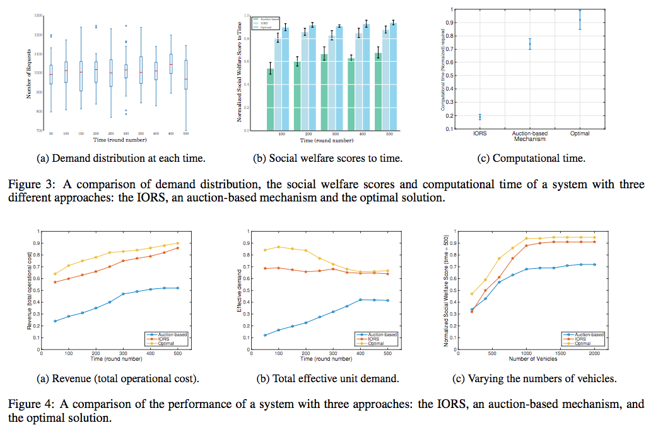

IORS is Competitive

Slide 11
Conclusion
Contribution:
Introduce a posted-price, online mechanism (IORS)
IORS is ex-post incentive compatible
IORS is competitive
Future work:
Distributed mechanisms
Simulation platform

Slide 12
Thanks!
Mondego Group@UCI: mondego.ics.uci.edu

