Slide 1


UK Retail Customer Churn Prediction & Segmentation
A Data-Driven Approach to Retain Valuable Customers
UFCFMM Data Mining Project Group
Notes:
Good morning/afternoon. We are the UFCFMM Data Mining Project Group, and today we are pleased to present our findings on 'UK Retail Customer Churn Prediction & Segmentation'. This project leverages data mining techniques to address critical business pain points, such as high customer churn rates and rising acquisition costs. Let's dive into our presentation.

Slide 2






CONTENTS
01. Project Background & Objectives
04. Customer Segmentation with RFM
02. Data Understanding & Preprocessing
05. Churn Prediction Model
03. Exploratory Data Analysis (EDA)
06. Strategic Recommendations
07. Conclusion & Acknowledgements
Notes:
This presentation is structured into seven key sections. We will start with the project background and objectives, then move through data understanding, preprocessing, exploratory analysis, customer segmentation using the RFM model, building a churn prediction model, and finally, providing strategic recommendations based on our findings, before concluding with a summary and acknowledgements.

Slide 3






PART 1: Project Background & Data Preparation
Industry Challenges
Core Objectives
High churn rate (30-40%)
Unsustainable customer turnover plaguing retailers.
Build an Early Warning System
Identify high-risk churn customers proactively.
Soaring acquisition costs
5-25x more expensive than retaining existing users.
RFM Customer Segmentation
Enable precise targeting for personalized marketing.
Significant annual losses (£4B+)
Direct financial impact on e-commerce revenue streams.
Boost CLV & Reduce Churn
Deliver actionable strategies for sustainable growth.
Bridging the gap between critical business challenges and data-driven solutions for the UK e-commerce sector.
Notes:
The UK e-commerce market is highly competitive, plagued by a high churn rate of 30-40%. Acquiring new customers is far more expensive than retaining existing ones, costing 5 to 25 times more. This leads to substantial annual losses for retailers, exceeding £4 billion. To address these challenges, we set three core objectives: first, to identify customers at high risk of churning and build an early warning system; second, to segment customers using the RFM model for targeted marketing; and third, to provide actionable strategies to reduce churn and ultimately increase customer lifetime value.

Slide 4






UCI Online Retail II Dataset
Data Source
Timeframe
Volume Scale
UCI Machine Learning Repository, a trusted source for ML datasets.
Spanning two years: December 2009 to December 2011.
1,067,371 transactions from 4,372 unique customers.
Key Features
Geographic Focus
InvoiceNo, StockCode, Quantity, UnitPrice, CustomerID, Country.
Over 90% UK transactions, fully GDPR compliant for privacy.
A comprehensive e-commerce dataset ideal for customer behavior analysis and market trend prediction.
Notes:
Our analysis is based on the UCI Online Retail II dataset, which spans from December 2009 to December 2011. It contains over a million transactions from more than 4,000 unique customers. The dataset includes key features like invoice numbers, product codes, quantities, prices, and customer IDs. Importantly, over 90% of the transactions are from the UK, making it a perfect fit for our study of the UK retail market, and it is fully GDPR compliant.

Slide 5





Data Preprocessing Steps
Remove Missing
Filter Anomalies
Feature Eng.
Outlier Removal
Final Dataset
Excluded 135,080 records with missing CustomerID to ensure validity.
Removed return orders, negative quantities, and zero unit prices.
Calculated TotalAmount and converted date formats for time-series analysis.
Filtered extreme values to maintain data quality and model robustness.
Contains 824,364 valid records and 4,372 unique customers for analysis.
Data preprocessing is critical for ensuring the accuracy and reliability of subsequent business intelligence models.
Notes:
To ensure the accuracy of our analysis, we performed a rigorous data preprocessing phase. First, we removed records with missing customer IDs, which accounted for about 13% of the data. Next, we filtered out anomalies like return orders and invalid quantities or prices. We then engineered new features, such as total amount spent per transaction, and converted date formats. Finally, we removed outliers to ensure data quality. This process resulted in a clean dataset with over 800,000 valid records for our subsequent analysis.

Slide 6
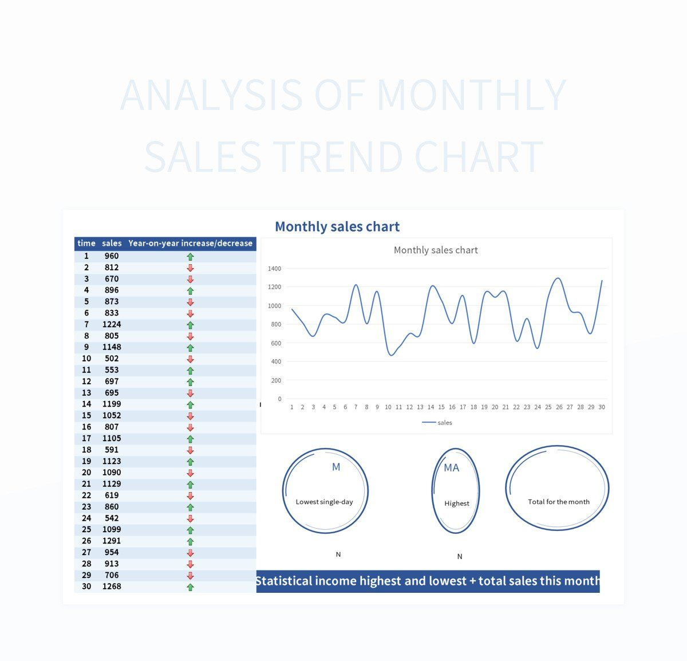
Exploratory Data Analysis (EDA): Sales Trend
Key Finding: Seasonality
Visualization: 2010-2011 Trend
A strong seasonal pattern is evident in the sales data. Analysis reveals a significant sales peak occurring consistently during theNovember-December Christmas season.
This insight highlights the critical importance of developing targeted holiday marketing strategies to maximize revenue during this high-demand period.
Monthly sales volume clearly showing Q4 spike
Data Source: Retail Transaction Records (2010-2011) | Analysis: EDA Team
Notes:
Our exploratory data analysis revealed several key insights. First, looking at sales trends, we observed a strong seasonality, with a pronounced peak in sales during the Christmas season, specifically November and December.
This line chart clearly illustrates this pattern, underscoring the critical role of holiday sales for the retailer and the need for targeted marketing campaigns during this period.

Slide 7

PART 2: Customer Segmentation Analysis
Key Finding
Over 90% of all transactions originate from the UK, indicating a highly concentrated domestic market. This allows the retailer to focus its marketing efforts primarily on the UK audience for maximum efficiency.
"The data strongly suggests a domestic-focused strategy will yield the highest ROI."
Notes:
Second, analyzing the geographic distribution of customers, we found that over 90% of transactions are from the UK. This pie chart visualizes this concentration, confirming that the retailer's market is predominantly domestic. This insight allows for highly focused and efficient marketing strategies tailored to the UK audience.

Slide 8

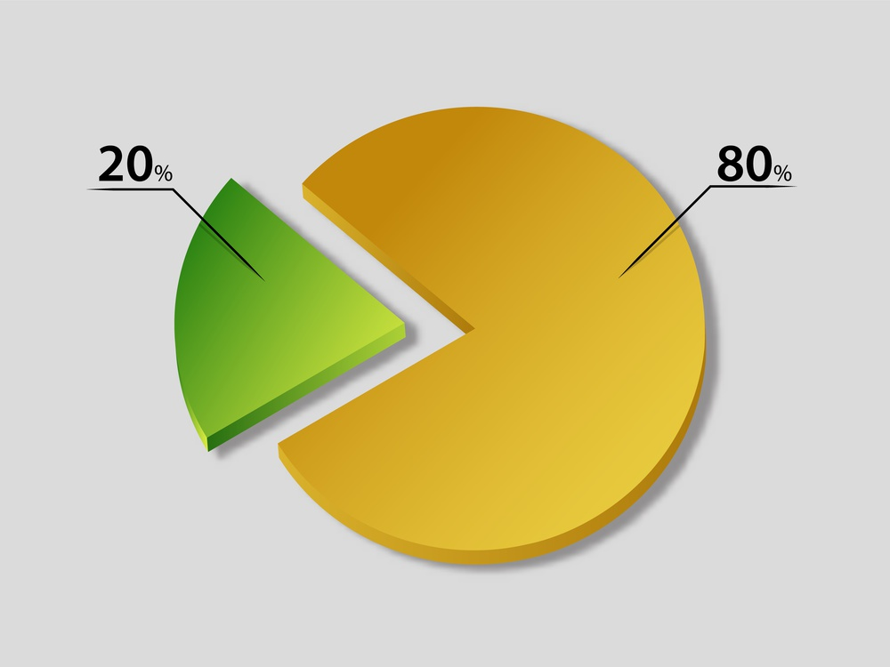
EDA: Customer Value Distribution (Pareto Principle)
Key Finding: The 80/20 Rule
The Pareto Principle holds true for our dataset: thetop 20% of high-value customerscontribute approximately80% of the total revenue.
This highlights the critical importance of prioritizing retention strategies for this small, impactful segment.
Visualization: Revenue Contribution Distribution
Notes:
Our third key finding from EDA relates to customer value distribution. The classic Pareto Principle, or 80/20 rule, is clearly evident here: the top 20% of customers generate around 80% of the total revenue. This bar chart illustrates this phenomenon, emphasizing that focusing retention efforts on this small segment of high-value customers can yield disproportionate rewards for the business.

Slide 9



Customer Segmentation: RFM Model
Recency (R)
Frequency (F)
Monetary (M)
Measures the number of days since a customer's last purchase. A lower value indicates a more recent purchase and potentially higher engagement.
Represents the total number of purchases a customer has made. Higher frequency indicates greater loyalty and regular interaction with the brand.
Calculates the total amount of money a customer has spent. Higher monetary value indicates a higher-value customer contributing more to revenue.
These three metrics provide a comprehensive view of customer behavior, enabling precise segmentation.
Notes:
To move beyond broad observations, we employed the RFM model for customer segmentation. RFM stands for Recency, Frequency, and Monetary value. Recency measures how recently a customer purchased, Frequency counts how often they purchase, and Monetary value sums up their total spending. These three metrics together provide a comprehensive view of customer behavior and value, allowing us to group customers into distinct segments.

Slide 10

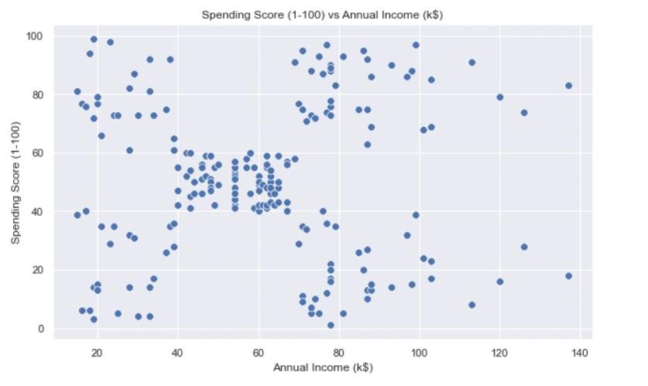

K-Means Clustering: Optimal K=4
Methodology
Applied the K-Means algorithm to segment customers using their RFM (Recency, Frequency, Monetary) scores as key features.
Optimal Cluster Number
Elbow method determined K=4 as optimal. Silhouette score of 0.55 confirms well-defined separation between clusters.
Segment Visualization
Scatter plot (Frequency vs. Monetary) clearly shows four distinct customer segments with varying spending behaviors.
Figure: Customer Segmentation Scatter Plot (Frequency vs. Monetary)
Notes:
Using the RFM metrics, we applied the K-Means clustering algorithm to group customers. The elbow method helped us determine that the optimal number of clusters is four, as indicated by the point where the within-cluster sum of squares begins to decrease at a much slower rate. The resulting silhouette score of 0.55 confirms that the clusters are well-defined. This scatter plot, plotting Frequency against Monetary value, visually represents the four distinct customer segments we identified.

Slide 11



Customer Segment 1: High-Value Loyal Customers (27.5%)
Characteristics
Contribution
Strategy
Low recency (recently purchased), high frequency (buy often), and high monetary value (spend a lot). They represent our most loyal user base.
Despite being only27.5%of the total customer base, this segment drives a staggering58.2%of the company's total revenue.
Prioritize retention and nurturing. Implement exclusive rewards programs, dedicated VIP support, and offer early access to new products/promotions.
"This segment is the cornerstone of our revenue; protecting their loyalty is business-critical."
Notes:
Our first segment consists of High-Value Loyal Customers, making up 27.5% of the customer base. These customers buy frequently, spend heavily, and have made recent purchases. Critically, they contribute over 58% of the total revenue. The strategy for this group is clear: retain and nurture them. Offering exclusive rewards, VIP services, and personalized experiences are key to keeping these valuable customers engaged and loyal.

Slide 12


Customer Segment 2: Mid-Value Active Customers (18.1%)
Characteristics
Strategy
These customers exhibit stable purchasing behavior with moderate frequency and monetary value. They are active but not in the top tier.
This segment presents excellent opportunities for cross-selling and upselling. By analyzing their purchase history, we can recommend complementary products or premium alternatives to increase their average order value and move them into the high-value segment.
Notes:
The second segment is Mid-Value Active Customers, representing 18.1% of customers. They are consistent buyers with moderate spending. This group is prime for growth. The strategy here is to implement cross-selling and upselling techniques. By understanding their preferences, we can recommend related products or upgrades, effectively increasing their spending and potentially elevating them to the high-value segment.

Slide 13


Customer Segment 3: Low-Value Inactive Customers (42.1%)
Key Characteristics
Engagement Strategy
This is the largest segment (42.1%), consisting of customers who spend little, purchase infrequently, and have not bought anything recently (high recency). They are essentially inactive.
Re-engaging this large group requires low-cost, high-volume campaigns. Targeted discount offers, personalized re-engagement emails, or limited-time promotions can be effective in reactivating some of these customers without incurring high costs.
Focus on cost efficiency and high volume to reactivate the largest segment.
Notes:
Our third segment is the largest, comprising 42.1% of customers: Low-Value Inactive Customers. These customers have low spending, low frequency, and haven't purchased in a long time. Re-engaging them is challenging but potentially rewarding due to their sheer numbers. The strategy is to use low-cost campaigns, such as targeted discounts or re-engagement emails, to win back a portion of this segment without significant investment.

Slide 14



Customer Segment 4: High-Risk Churn Customers (12.3%)
Characteristics
Retention Strategy
These customers show signs of disengagement:
Haven't purchased recently (high recency)
Declining spending or purchase frequency
At a critical stage with high churn risk
Immediate and proactive efforts are crucial to prevent churn:
Deploy personalized outreach campaigns
Offer targeted retention incentives/offers
Conduct feedback surveys to address pain points
Key Insight:Intervention at this stage is cost-effective compared to acquiring new customers. Focus on resolving their issues to win them back.
Notes:
The fourth and final segment is High-Risk Churn Customers, making up 12.3% of the base. These customers have stopped purchasing recently, and their spending patterns are declining. They are on the verge of leaving. The strategy here is proactive retention: reaching out to them personally with special offers or feedback requests can help identify and resolve issues, potentially saving these customers before they churn.

Slide 15



PART 3: Churn Prediction & Strategic Recommendations
Model Selection
Feature Selection
Train-Test Split
We chose the Random Forest classifier for its robustness, ability to handle non-linear relationships, and resistance to overfitting.
Key features included RFM metrics (Recency, Frequency, Monetary) and derived features such as average order value and purchase interval.
The dataset was strategically split into 80% for training the model and 20% for testing its performance and generalization ability.
Data-Driven Decision Making for Customer Retention
Notes:
Beyond segmentation, we aimed to predict which customers are likely to churn. We built a predictive model using the Random Forest algorithm, chosen for its robustness and effectiveness with complex data. We used RFM metrics and other derived features to train the model, splitting our data into training and testing sets to ensure reliable results.

Slide 16



Model Evaluation & Results
Performance Metrics
Confusion Matrix Analysis
The model achieved a high accuracy of85%. It also demonstrated strong precision, recall, and F1-score, validating its robustness in predicting customer churn.
True Positive (TP)
Correctly Predicted Churn
False Positive (FP)
Incorrectly Predicted Churn
False Negative (FN)
Missed Churn Signals
True Negative (TN)
Correctly Predicted Non-Churn
Key Business Insight
The model successfully identifies a significant portion of at-risk customers. This enables the business to deployproactive retention strategiesbefore churn occurs.
The matrix reveals the distribution of correct and incorrect predictions, highlighting the model's ability to minimize costly false negatives.
Outcome:The Random Forest model is production-ready and will be integrated into the CRM system for real-time risk scoring.
Notes:
Our Random Forest model performed well, achieving an accuracy of approximately 85%. This confusion matrix breaks down the model's predictions, showing how many customers were correctly identified as churners or non-churners. The high precision and recall confirm that the model is reliable and can effectively flag customers at risk, allowing the business to take timely action.

Slide 17

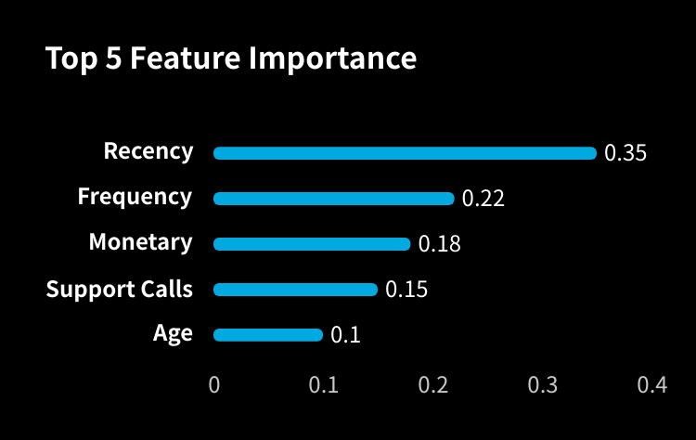
Feature Importance Analysis
Visualization
A bar chart ranking the top features by their importance in predicting churn. Recency (how long since the last purchase) is typically the most critical factor.
Insight
Understanding factors like long periods of inactivity provides actionable insights for developing targeted retention strategies and prioritizing interventions.
Data Source: Random Forest Model Output | Focus: Customer Churn Prediction
Notes:
To understand why customers churn, we analyzed the feature importance from our Random Forest model. This bar chart shows that Recency, or the time since the last purchase, is the most important predictor of churn. Other factors like purchase frequency and monetary value also play significant roles. This insight is invaluable, as it tells us exactly where to focus our retention efforts—on reactivating customers who haven't purchased in a while.

Slide 18


Strategic Recommendations & Action Plan
For Loyal Customers
For Active Customers
Implement a loyalty program with tiered rewards, offer exclusive previews of new products, and provide dedicated VIP customer service.
Use personalized product recommendations for cross-selling, and create limited-time offers to encourage upselling and increase AOV.
For Inactive Customers
For High-Risk Customers
Launch win-back email campaigns with targeted discounts, and re-engage with personalized content based on past purchases.
Conduct proactive outreach with special retention offers, initiate feedback surveys to identify pain points, and resolve issues promptly.
Notes:
Based on our segmentation and prediction model, we can now outline a comprehensive action plan. For loyal customers, focus on retention with exclusive rewards. For active customers, drive growth through cross-selling and upselling. For inactive customers, use low-cost campaigns to win them back. And for high-risk customers, implement proactive retention measures with personalized outreach and offers. These targeted strategies are designed to address the specific needs of each segment and maximize overall customer retention and revenue.

Slide 19


Conclusion
Achievements
Business Value
Future Work
Successfully segmented customers into four distinct groups using the RFM model and built an accurate Random Forest model to predict customer churn.
Enables data-driven decision-making for targeted marketing and retention, significantly reducing churn rates and increasing revenue.
Explore advanced models like XGBoost or neural networks, and incorporate external data (social media, demographics) for deeper insights.
Notes:
In conclusion, our project has successfully demonstrated how data mining can be applied to solve real-world business problems. We segmented customers effectively and built a robust churn prediction model. The insights and strategies derived from this analysis provide significant business value by enabling targeted retention efforts, ultimately aiming to reduce churn and boost revenue. For future work, we plan to explore more advanced models and integrate additional data sources to further enhance our understanding of customer behavior.

Slide 20


Thank You
Q&A
Notes:
Thank you for your attention. We would now be happy to take any questions you may have.

