Slide 1
Inspecting COVID-19 Using SAIRS Model with Immunization
Wensi Ai, Zhengtong Liu, Yutong Yi, Guofeng Zhang, Yulun Wu, Yijiao Guo

Slide 2
Background & Goals
Different mathematical modeling papers in fighting and controlling COVID-19
SAIR Model [5]
To build the SAIRS model with the immunization factor
To find out the equilibrium point, study what conditions could make desired equilibrium points stable, and explore real life implications
To find which parameter have the most impact on the outcome by tuning each of them

Slide 3
Model Explanation: Definitions
Population definitions Parameters definitions
S | Susceptible
A | Asymptomatic
I | Identified Infected
R | Recovered and vaccinated
𝜷_{A} | Contact rate between S and A
𝜷_{I} | Contact rate between S and I
𝜸_{A} | Recover rate of A
𝜸_{I} | Recover rate of I
𝜹 | Identification rate
𝝎 | Vaccination rate
𝜃 | Re-susceptible rate

Slide 4
Model Explanation: Key Assumptions
Total population is fixed with no vital dynamics => S + A + I + R = 1
Any person who is infected must first become asymptomatic before becoming infected (showing symptoms)
Some constant proportion of R will become susceptible again (going back to S) within unit of time.
The immunization rate, ω, is a constant per unit of time.
Only people in S will get vaccinated.

Slide 5
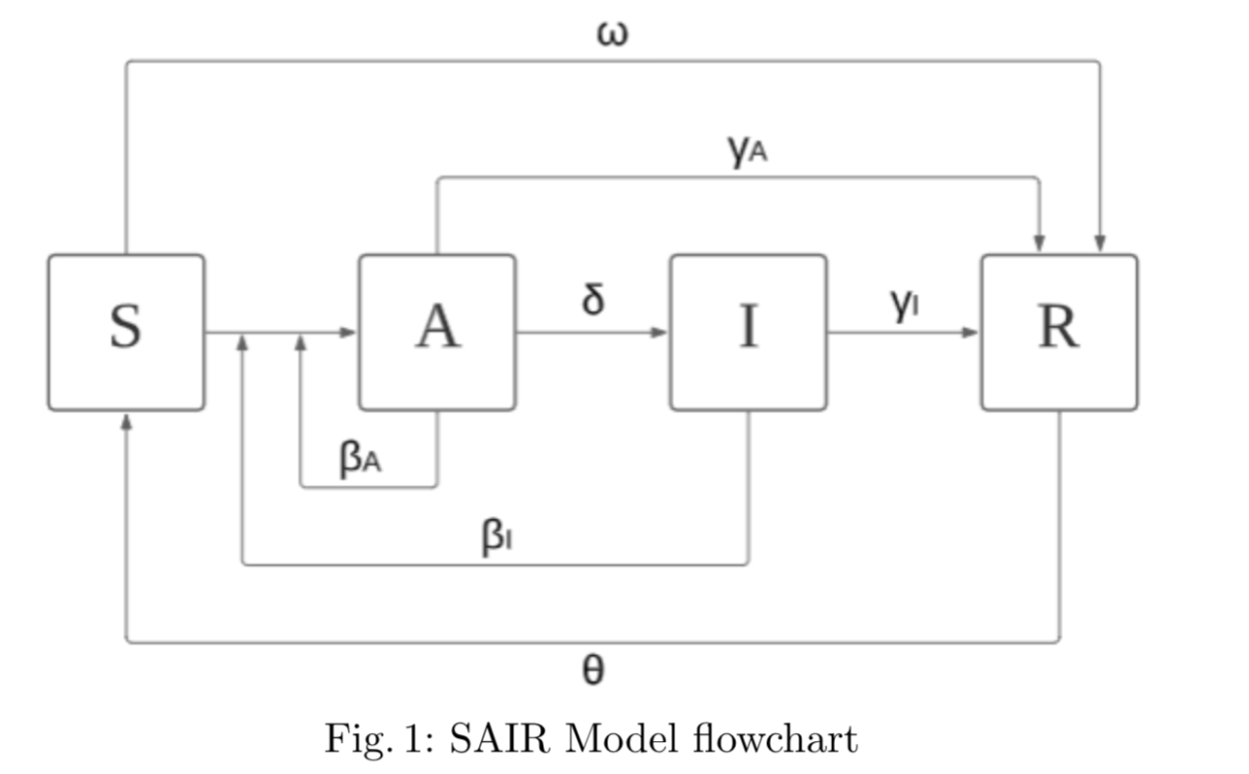
Model Explanation: SAIRS Model
𝜷_{A} | Contact rate between S and A
𝜷_{I} | Contact rate between S and I
𝜸_{A} | Recover rate of A
𝜸_{I} | Recover rate of I
𝜹 | Identification rate
𝝎 | Vaccination rate
𝜃 | Re-susceptible rate

Slide 6
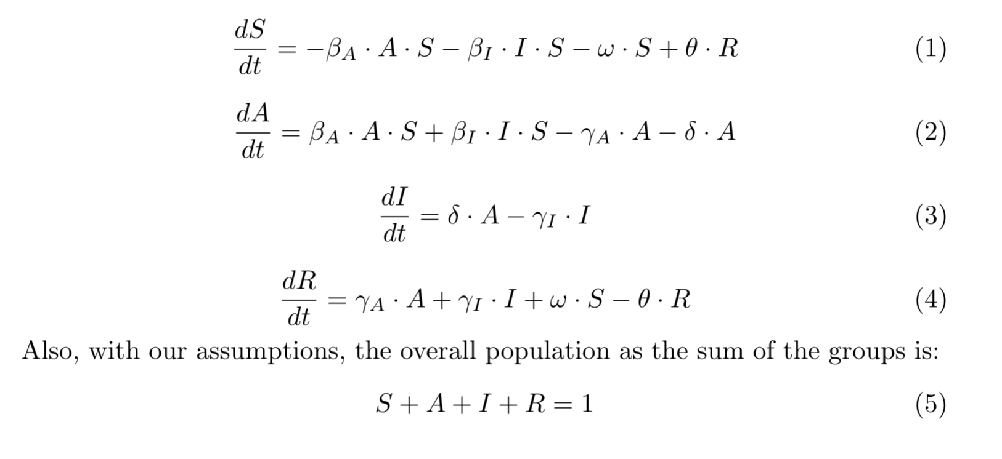
Model Explanation: SAIRS Model

Slide 7
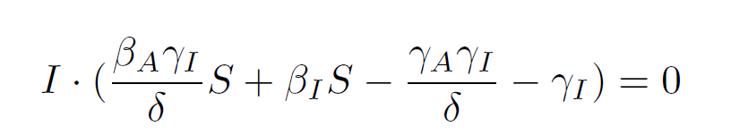
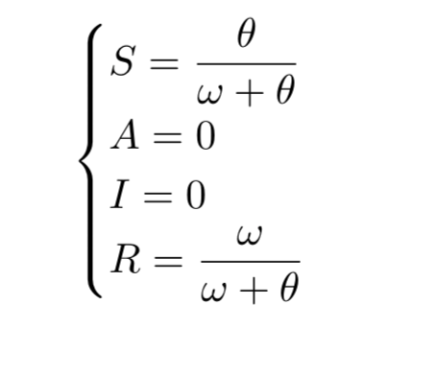
Theoretical Investigation: Equilibrium Point 1
End of the pandemic!

Slide 8
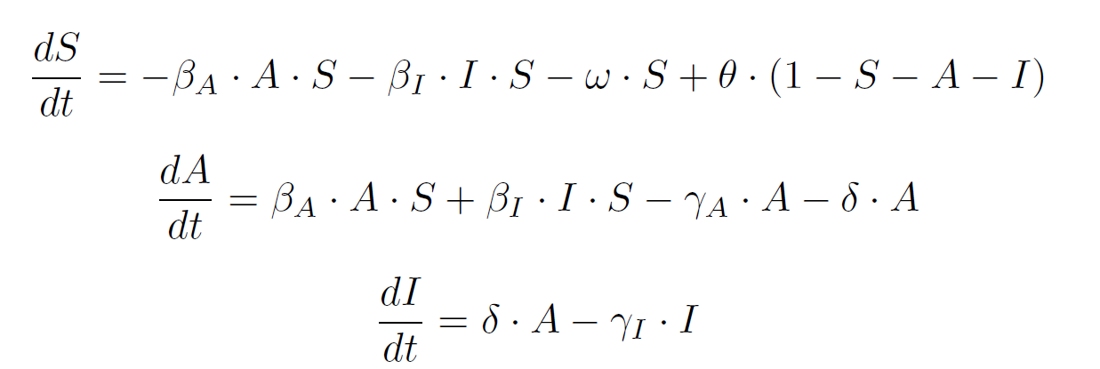
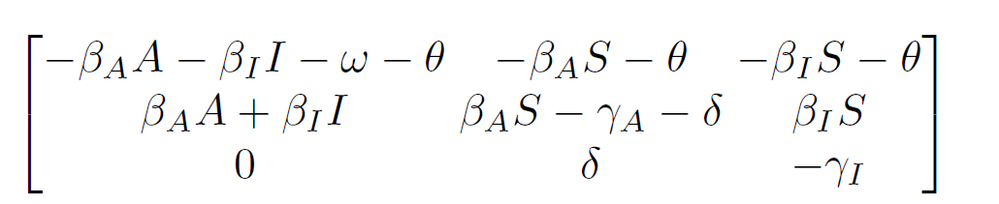
Reduced System and Linear Approximation Matrix

Slide 9
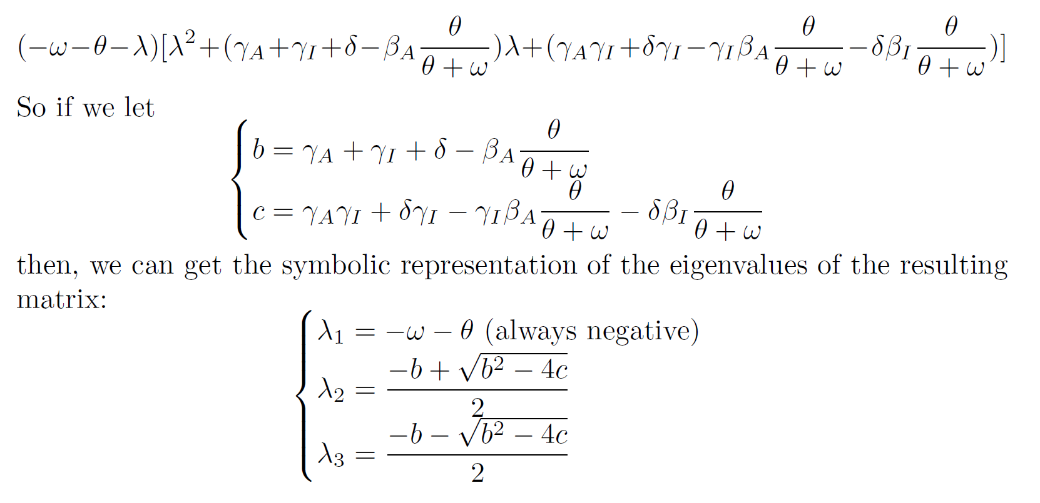
Stability Analysis - Analytic Solution
Characteristic Polynomial:

Slide 10
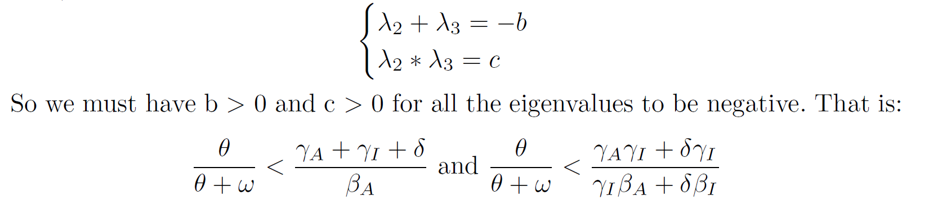
Stable Condition
The other two eigenvalues follows:

Slide 11
Stable Condition
From the inequalities, the equilibrium point in general tends to be stable as:
𝜸↑: Improving medical level or inventing specialized medicine
𝜷↓: Promoting protective measures such as wearing a mask and social distancing
𝝎↑: Promoting vaccination
𝜃↓: Encouraging people who are recovered or vaccinated to keep their
awareness of continuous protection
𝜹↑: Conducting COVID-19 tests more frequently

Slide 12
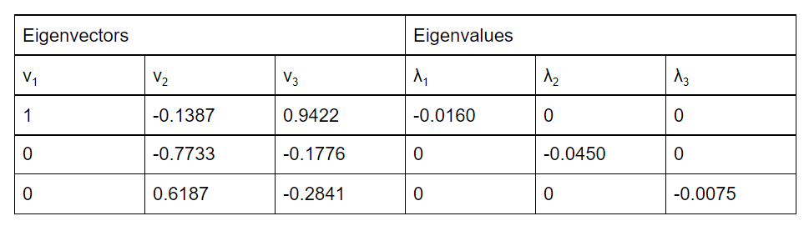
Stability Analysis: Numeric Solution
Empirical parameters from the referenced paper [2]
𝜷_{A} = 0.28, 𝜷_{I} = 0.25, 𝜸_{A} = 0.03, 𝜸_{I} = 0.02 and 𝜹 = 0.02
Our new parameters:
𝜃 = 0.001, 𝝎 = 0.015

Slide 13
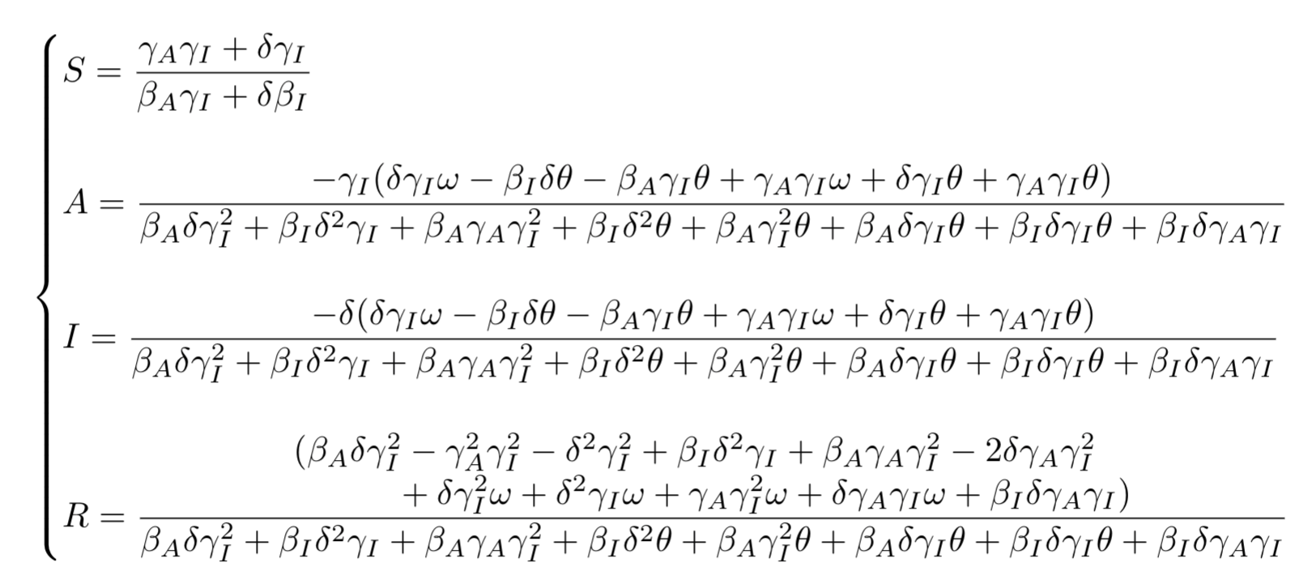
Theoretical Investigation: Equilibrium Point 2
Recall that:

Slide 14
Theoretical Investigation: Stability 2
The symbols are overly complicated!
Use the same set of realistic parameters to calculate eigenvalues/eigenvectors instead
𝜷_{A} = 0.28, 𝜷_{I} = 0.25, 𝜸_{A} = 0.03, 𝜸_{I} = 0.02, 𝜹 = 0.02
𝞱 = 0.001 and 𝝎 = 0.015

Slide 15
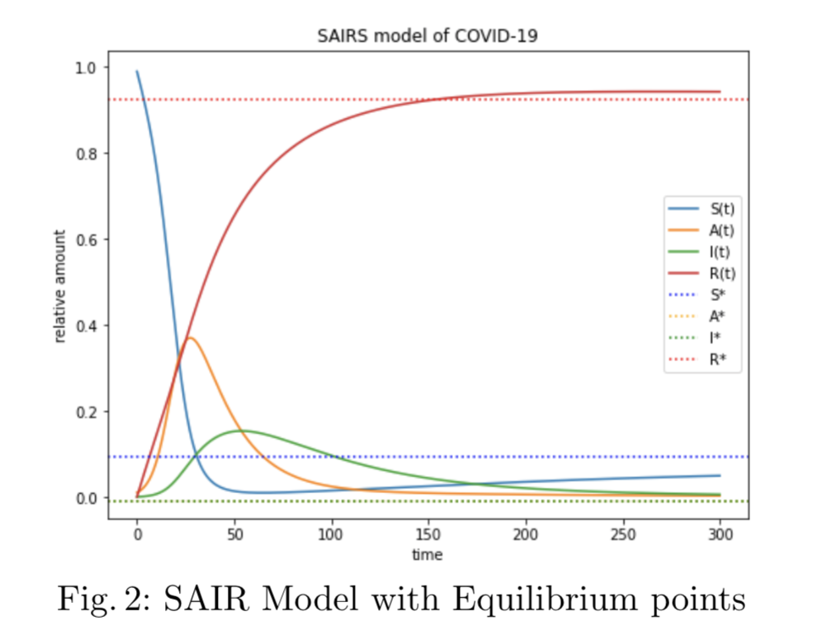
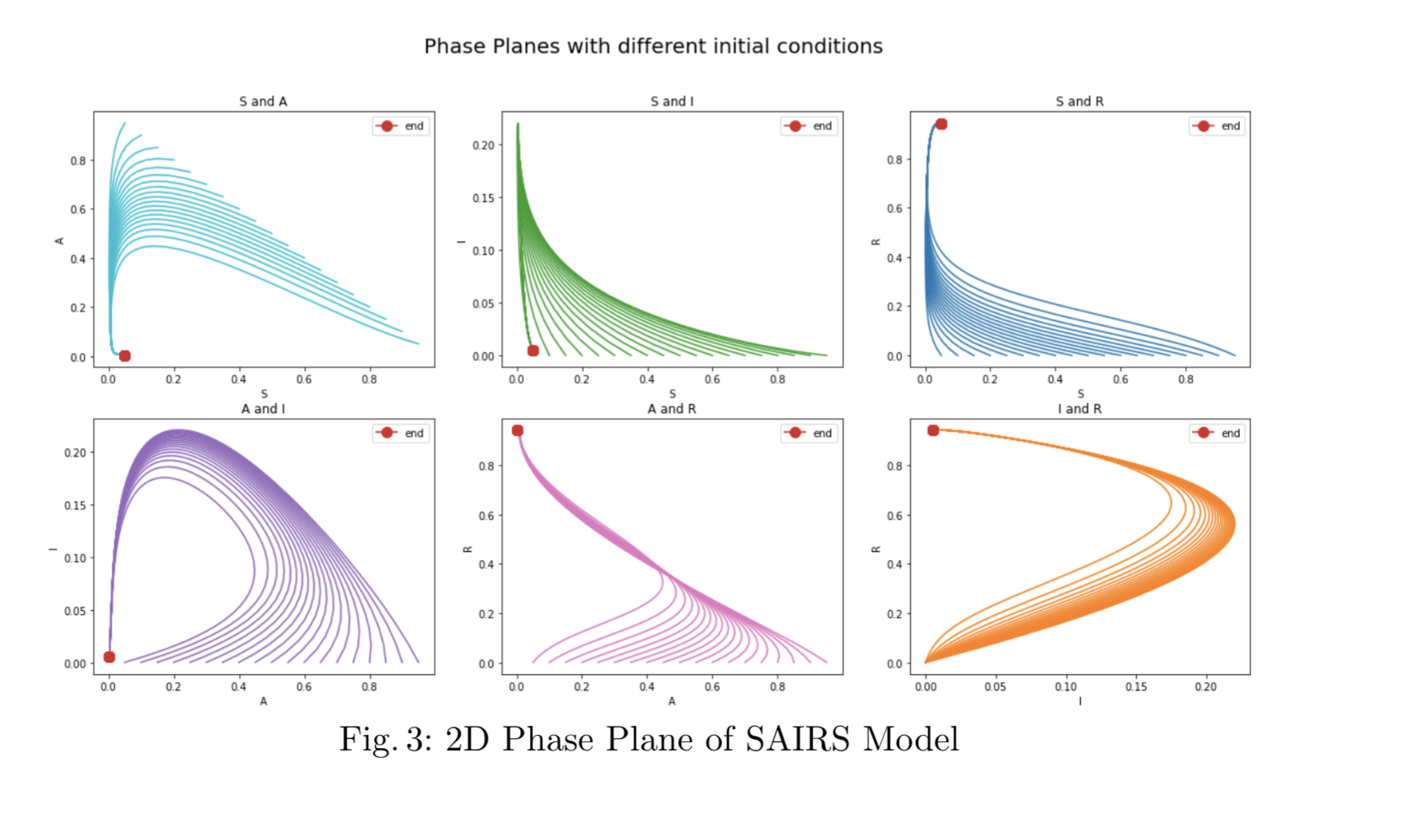
Simulations: Equilibrium Points

Slide 16
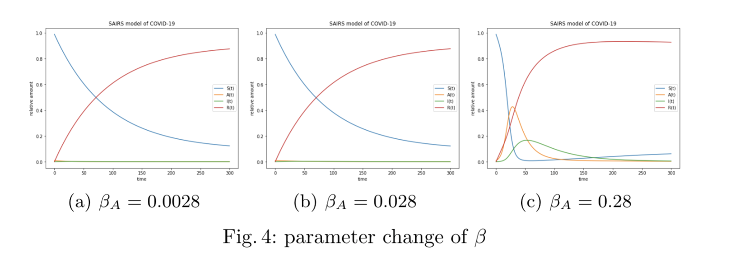
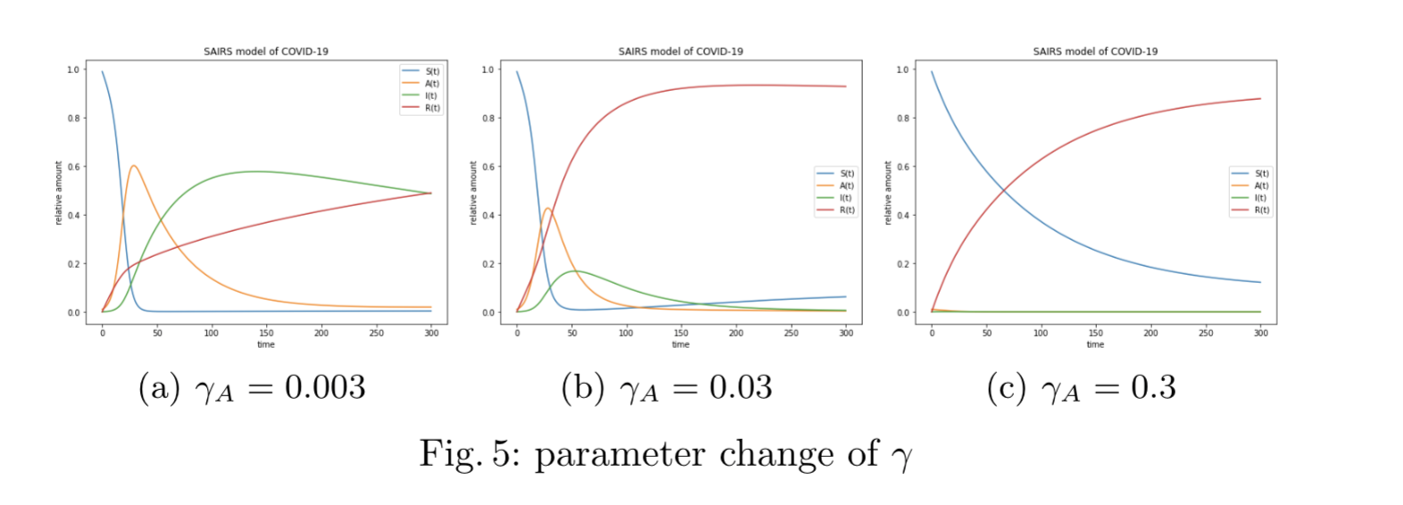
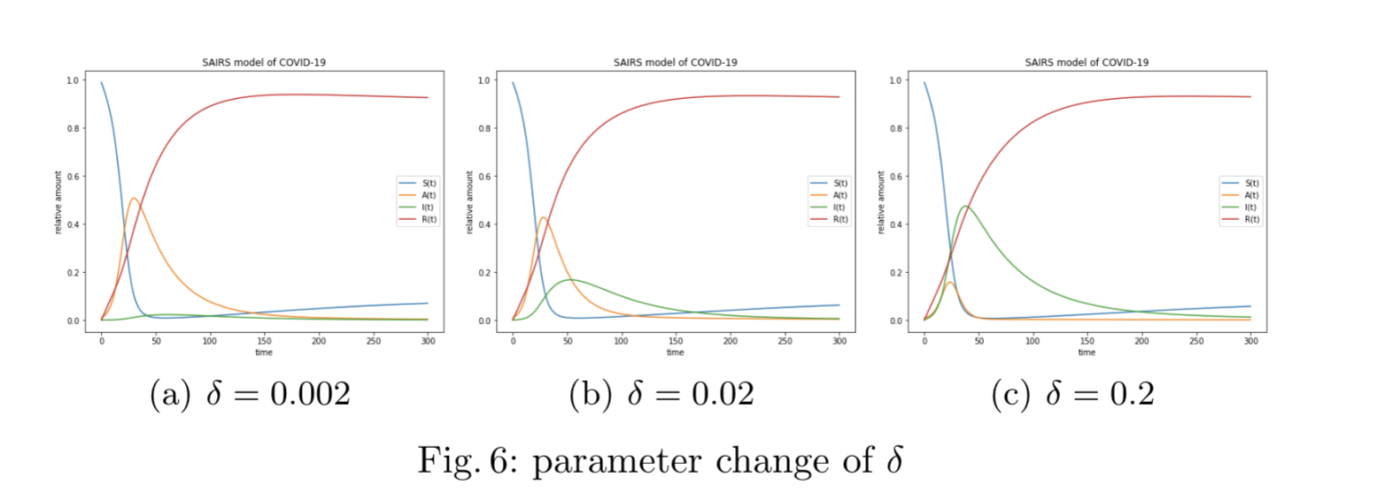
Simulations: Parameters Tuning

Slide 17
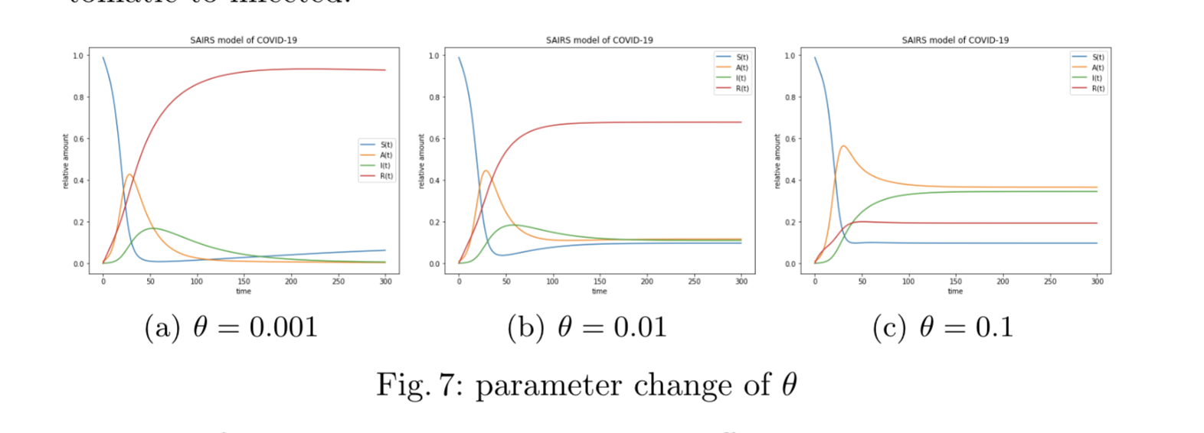
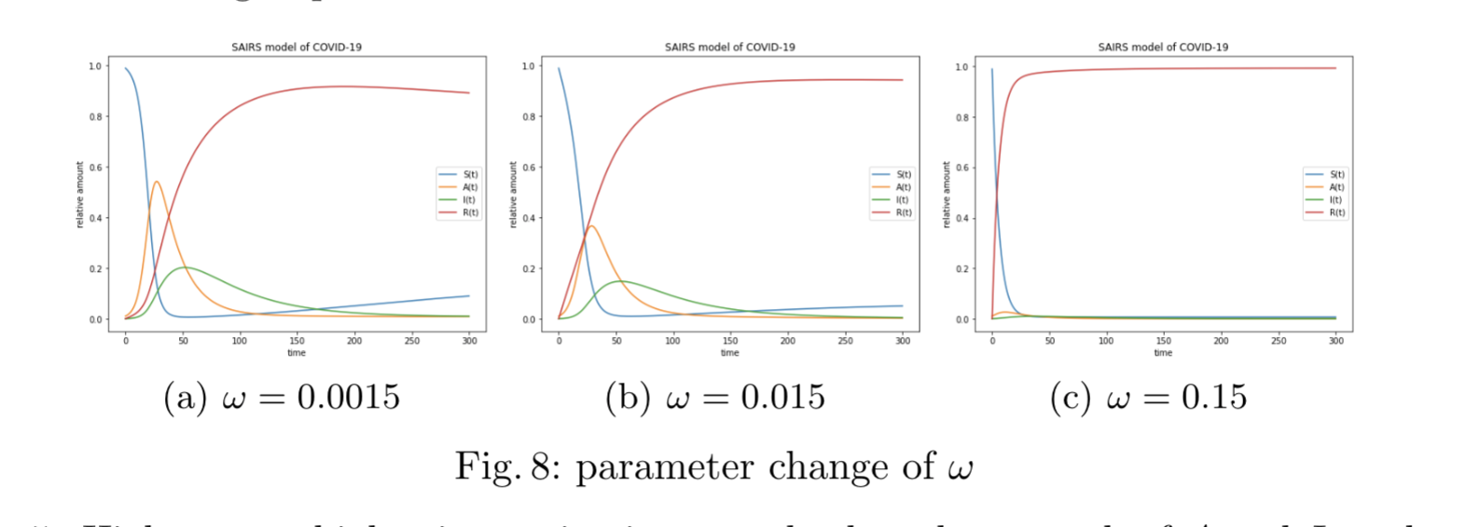
Simulations: Parameters Tuning

Slide 18
Summary: Conclusion
SAIRS Model with Immunization Rate
Theoretical Investigation
Two discovered equilibrium points
Under the empirical parameters, one is stable and explainable; the other is unstable and unrealistic
Simulations
Validate and visualize the model
𝜃 and ⍵ are crucial to our model

Slide 19
Summary: Future Studies
Vaccinated people as a separate group
Vital Dynamics
Nonlinear relationship between the susceptible and infected group [5]

Slide 20
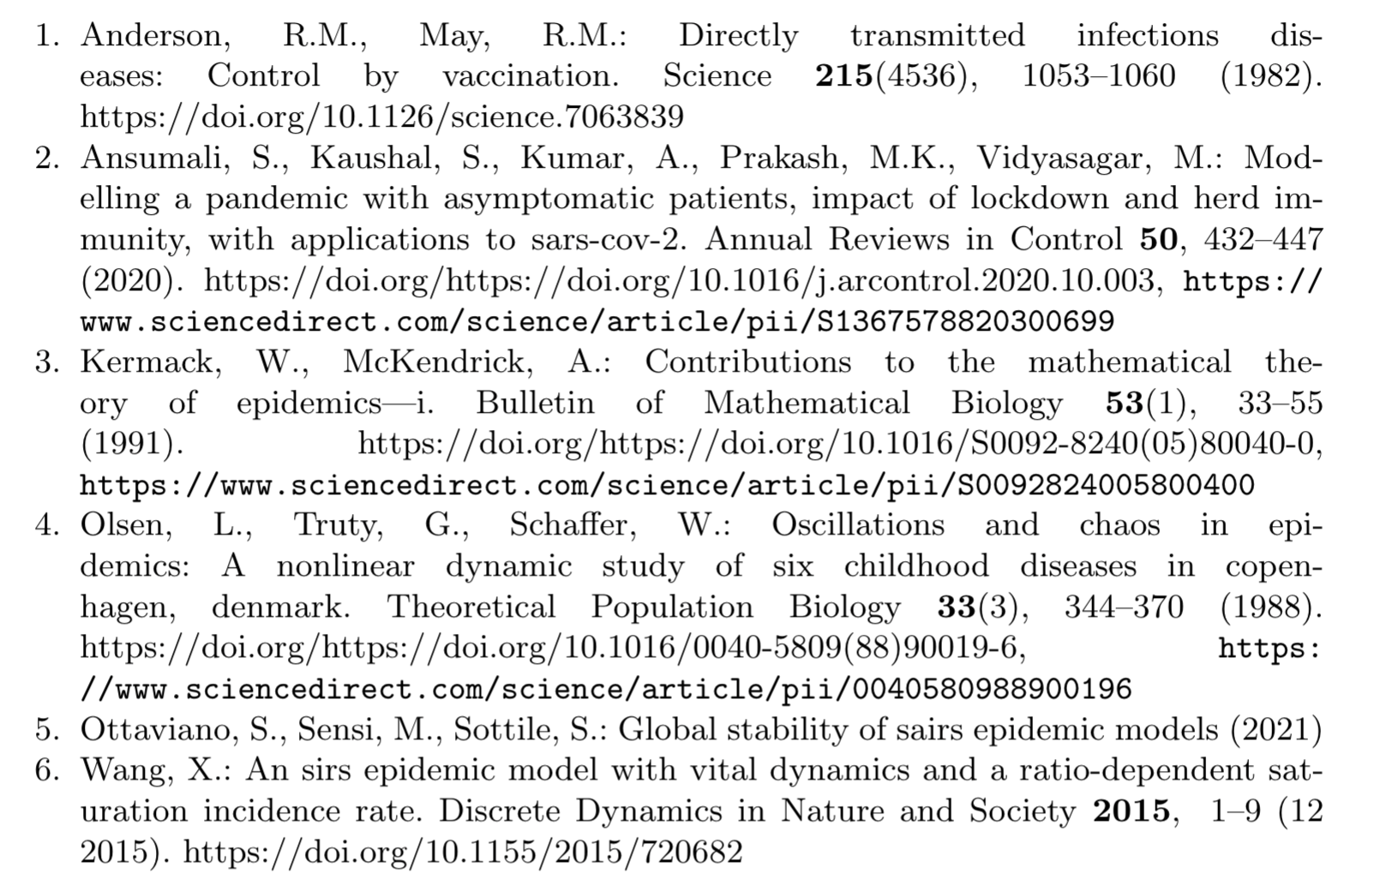
Reference

