Slide 1
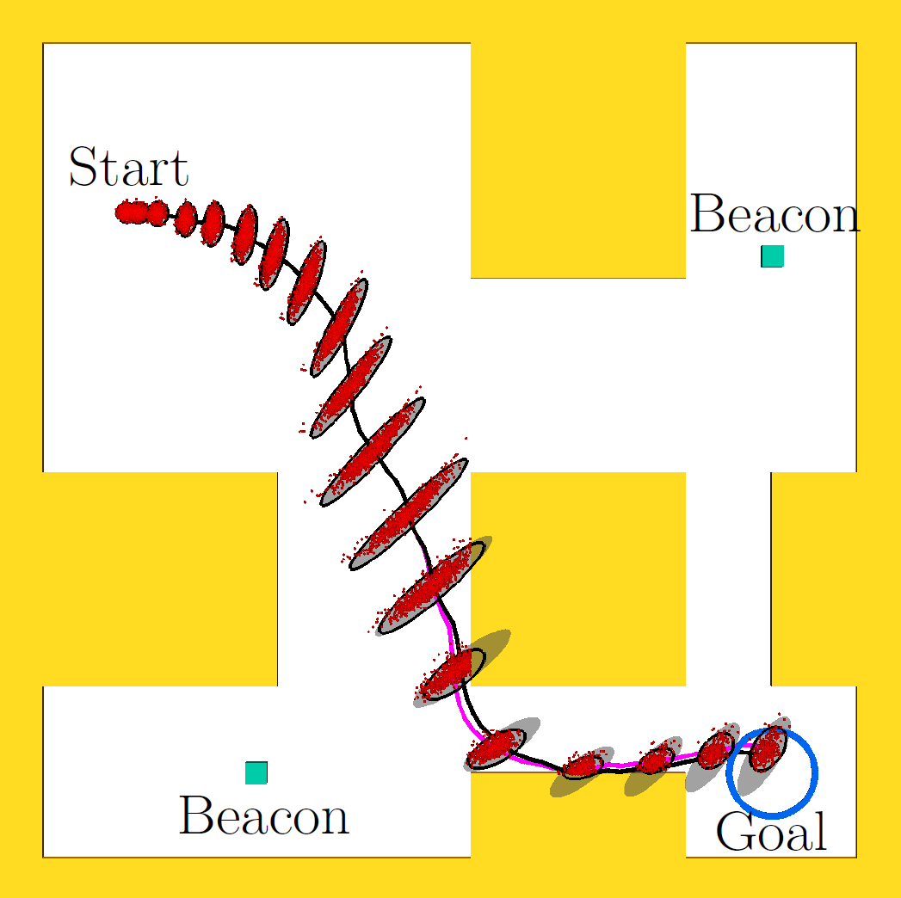
Estimating Probability of Collision for Safe Motion Planning under Gaussian Motion and Sensing Uncertainty
Sachin Patil and Ron Alterovitz
Department of Computer Science, UNC Chapel Hill, USA
Jur van den Berg
School of Computing, University of Utah, USA
Estimating probability of collision is crucial for characterizing safety of motion plans under uncertainty
New fast, analytical method to estimate collision probability for a plan
Accurate estimation based on a priori state distributions along plan
Orders of magnitude speed-up over naïve Monte Carlo simulations
Directly applicable to variety of existing motion planners to improve performance and plan quality
Estimating collision probability for car-like robot with stochastic dynamics and noisy, partial sensing

