Slide 1
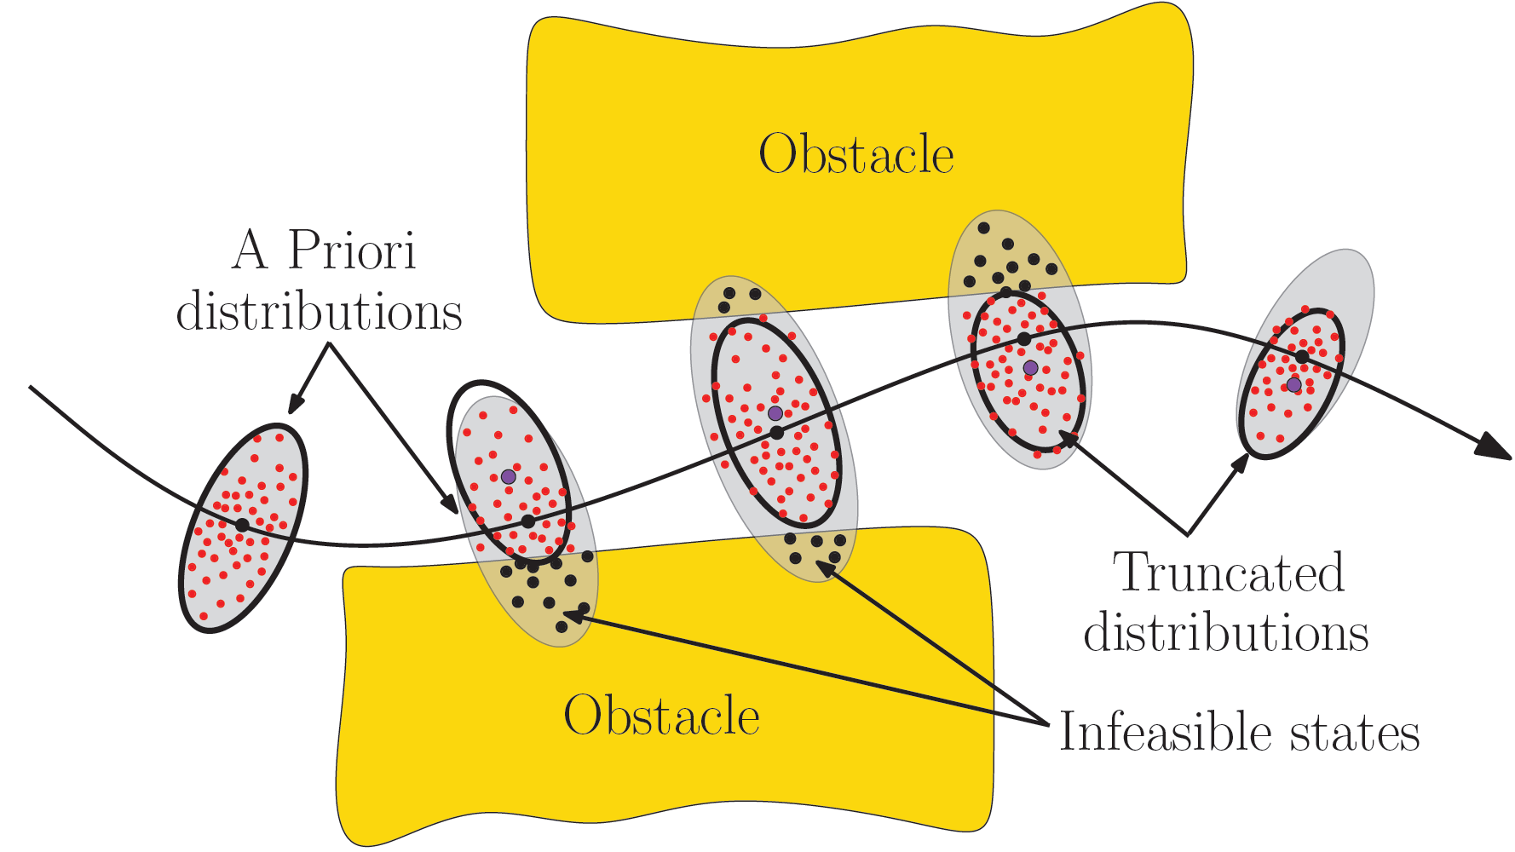
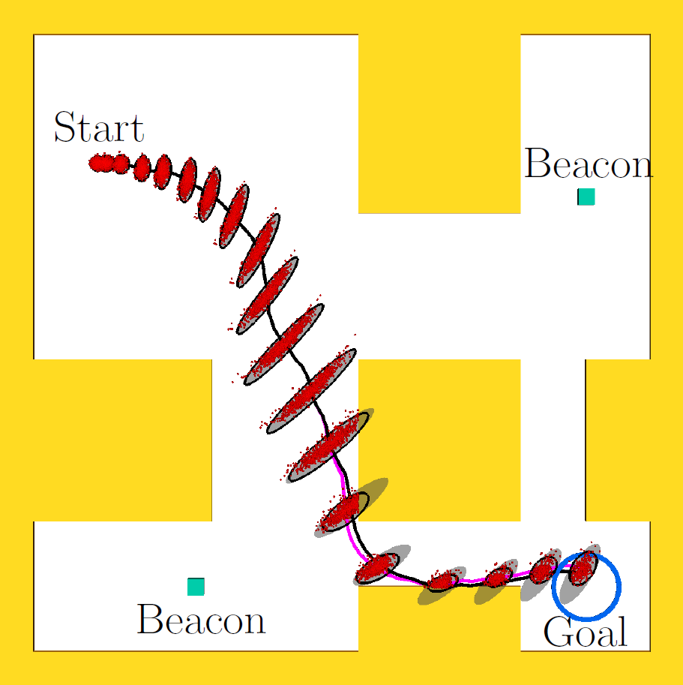
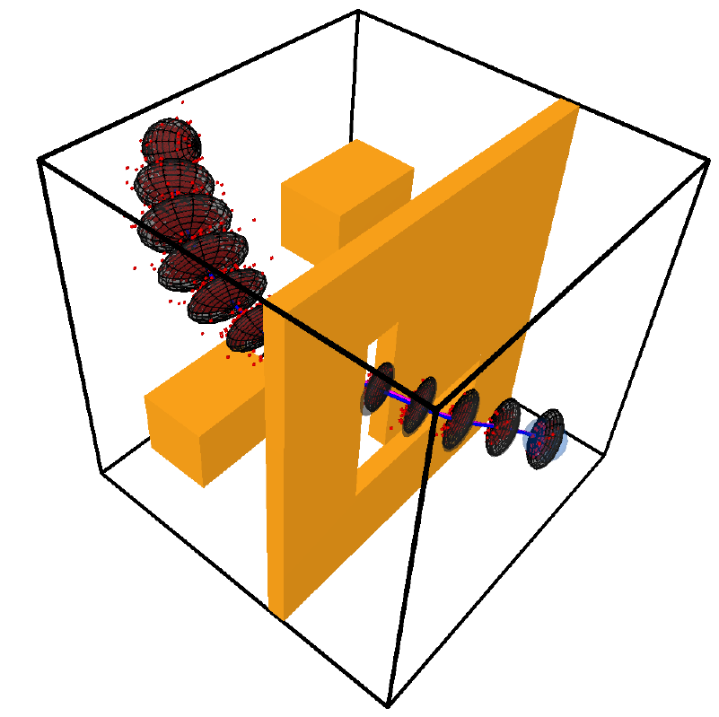
Estimating Probability of Collision for Safe Motion Planning under Gaussian Motion and Sensing Uncertainty
Sachin Patil¹, Jur van den Berg², Ron Alterovitz¹
¹Dept. of Computer Science, UNC Chapel Hill
²School of Computing, University of Utah

Slide 2
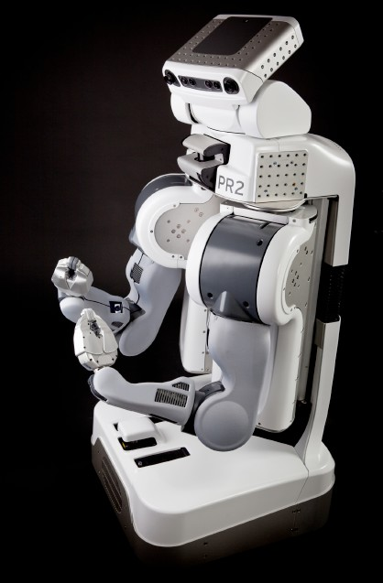
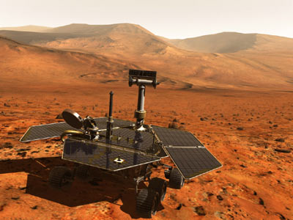
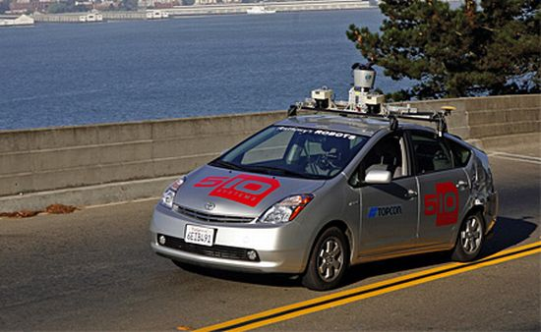
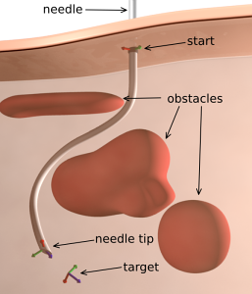
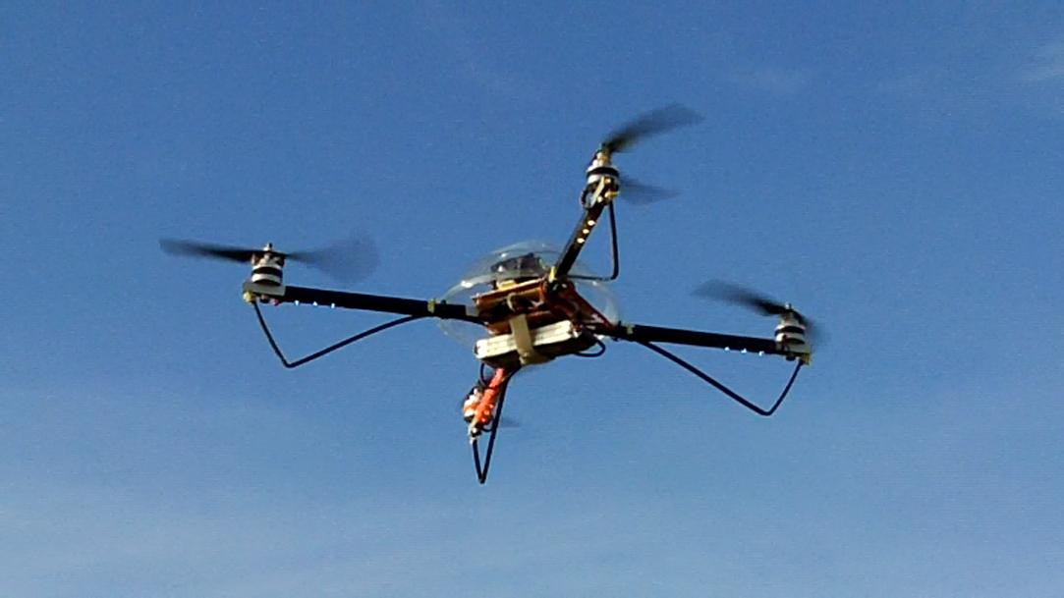
Motion Planning in the Real World

Slide 3

Safe Motion Planning
Obstacle
Uncertainty!
Obstacle

Slide 4
Motion Planning under Uncertainty
How do we know that a plan is safe a priori to execution?
Estimate the probability of collision; lower the better.

Slide 5
Problem Definition
Inputs:
Dynamics model:
Motion noise (Gaussian):
Observation model:
Sensing noise (Gaussian):
Plan:
State
Control input

Slide 6
Problem Definition
Inputs:
State estimation (Kalman filter)
Feedback control (Linear controller)
: (Estimate of )
:

Slide 7
Objective
Estimate a priori probability of collision
Subroutine for many methods for motion planning under uncertainty

Slide 8
Approach 1: Monte Carlo Estimation
Handle arbitrary noise models
How many samples?
Slow if performed repeatedly

Slide 9
Approach 2: A Priori State Distributions
Compute a priori state distributions along plan
Berg et al. [RSS 10], Bry and Roy [ICRA 11], Vitus and Tomlin [ICRA 11]
For:

Slide 10
Approach 2: A Priori State Distributions
X
X
Distributions are propagated regardless of obstacles

Slide 11
Approach 2: A Priori State Distributions
Overly conservative probability estimate!
Should be:

Slide 12
Our Approach
where:
X
X
Propagation:
Key insight: Approximate collision-free states with truncated Gaussians
and propagate

Slide 13
Truncating Conditional Distributions

Slide 14
Non-Convex Regions

Slide 15
Truncating Gaussians: Multiple Constraints
Previously used for Kalman filtering with state constraints
D. Simon [2006], Tully et al. [IROS 11]
Novelty: Truncation independent of order in which constraints are processed

Slide 16
Estimating Collision Probability
Boole’s inequality
where:

Slide 17
Car-like Robot
Dynamics model:
Observation model:

Slide 18
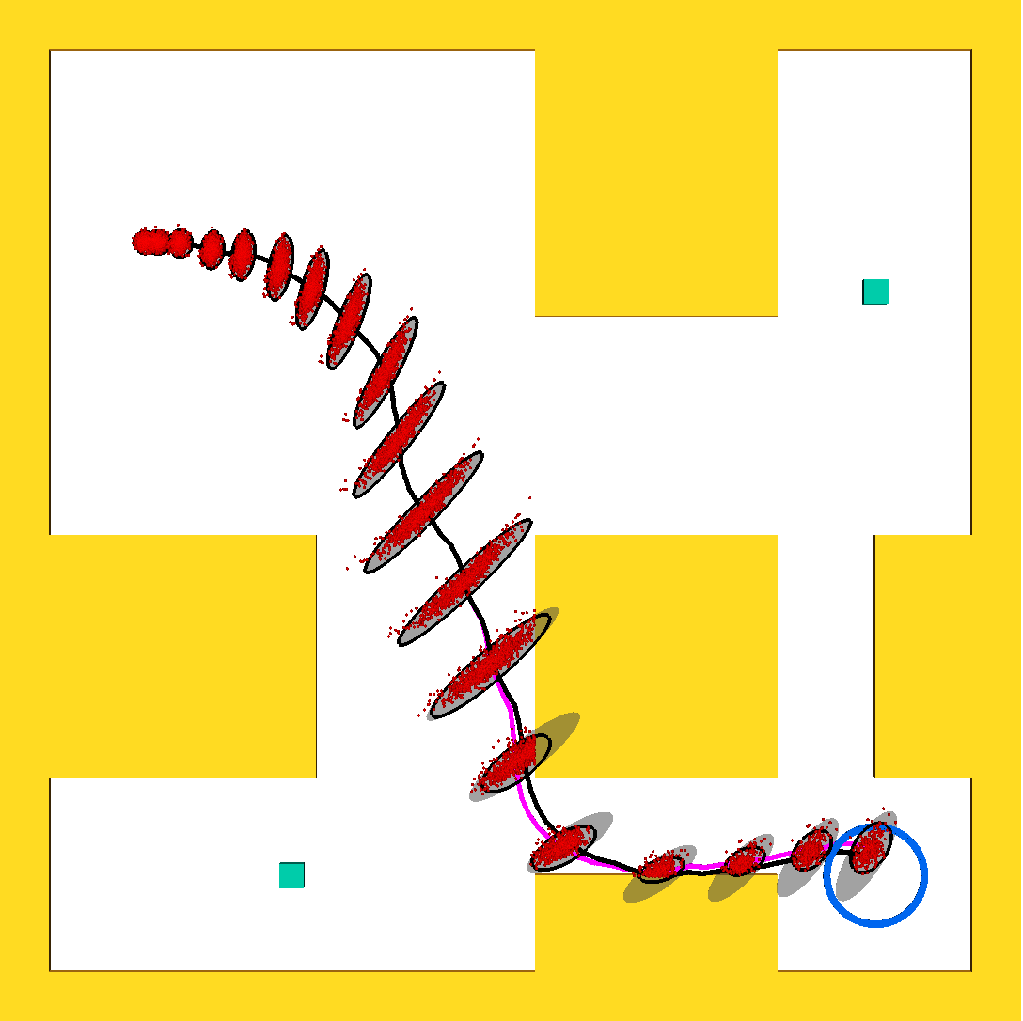
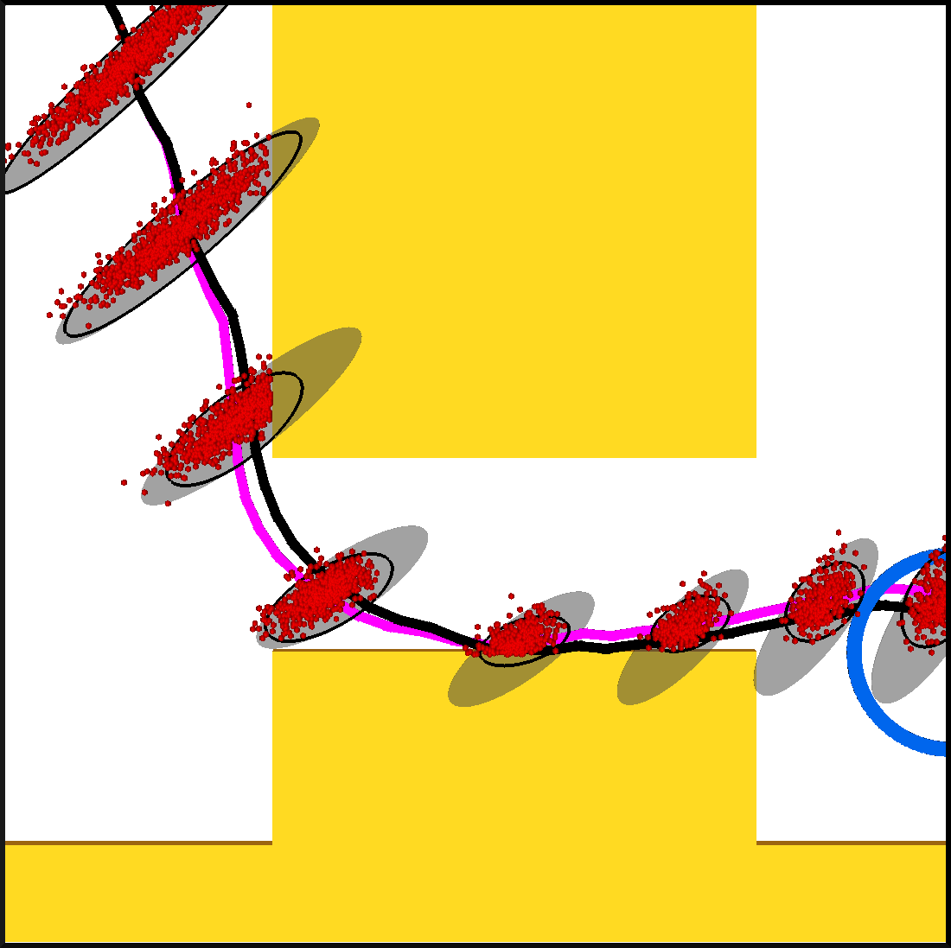
Car-like Robot
Probability collision: Our method – 68.9%
Monte-Carlo – 67.3%

Slide 19
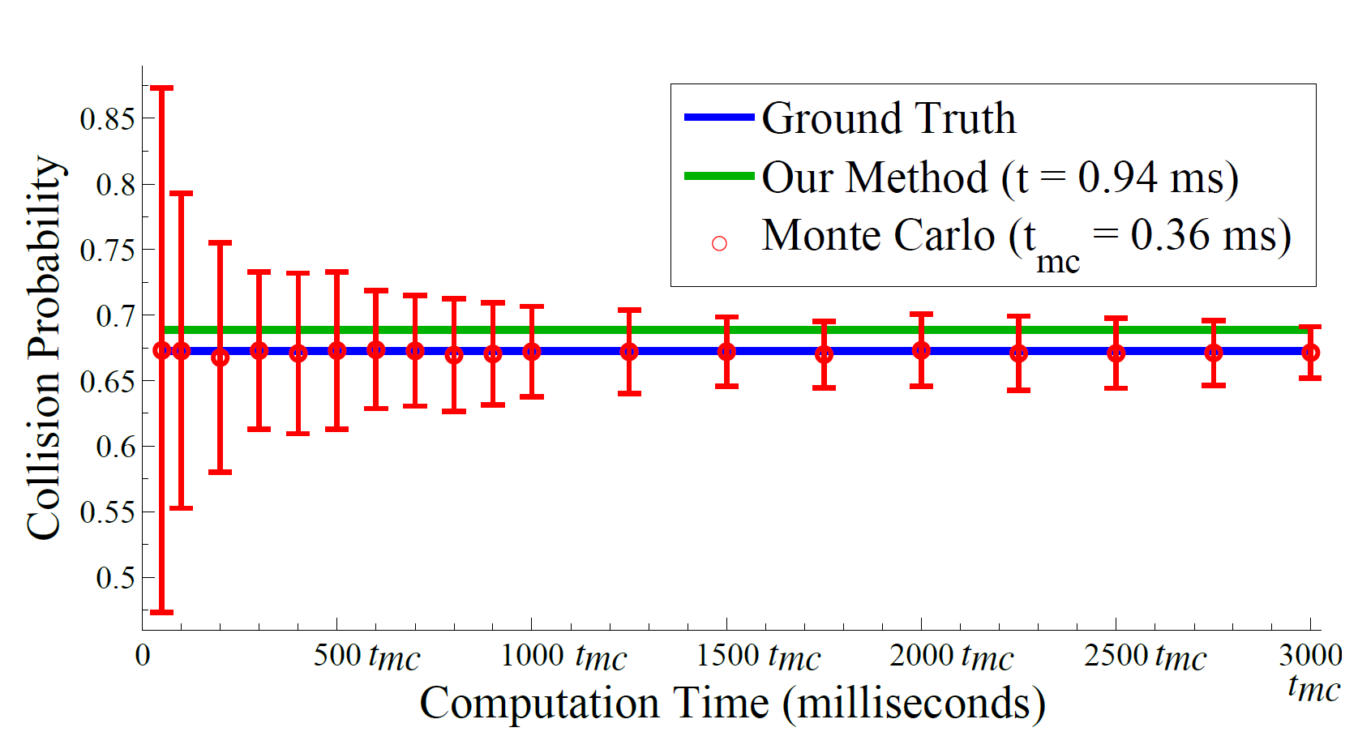
Comparison with Prior Methods
vs. Monte Carlo
Our method |  | Unconditional |  | LQG-MP
MAE (%) | Avg. time | MAE (%) | Avg. time | MAE (%) | Avg. time
3 (± 2) | 9 ms | 28 (± 15) | 6 ms | 52 (± 15) | 4 ms
Computed over 100 plans

Slide 20
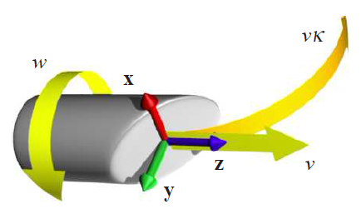
Nonholonomic Flexible Needle
Dynamics model:
Observation model:

Slide 21
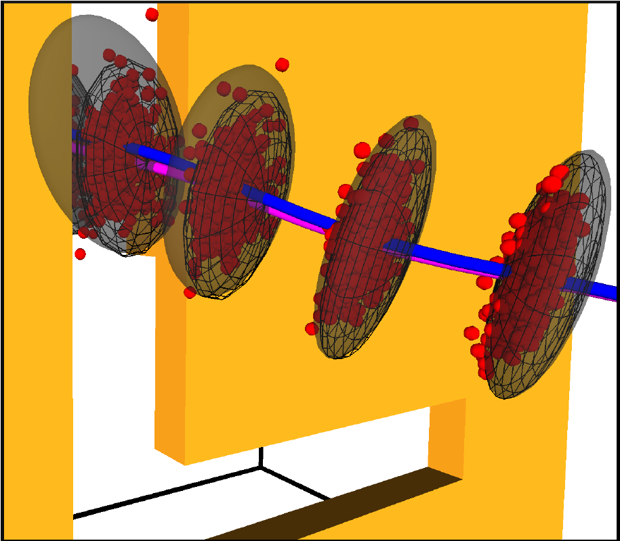
Nonholonomic Flexible Needle
Probability collision: Our method – 54.5%
Monte-Carlo – 52.4%

Slide 22
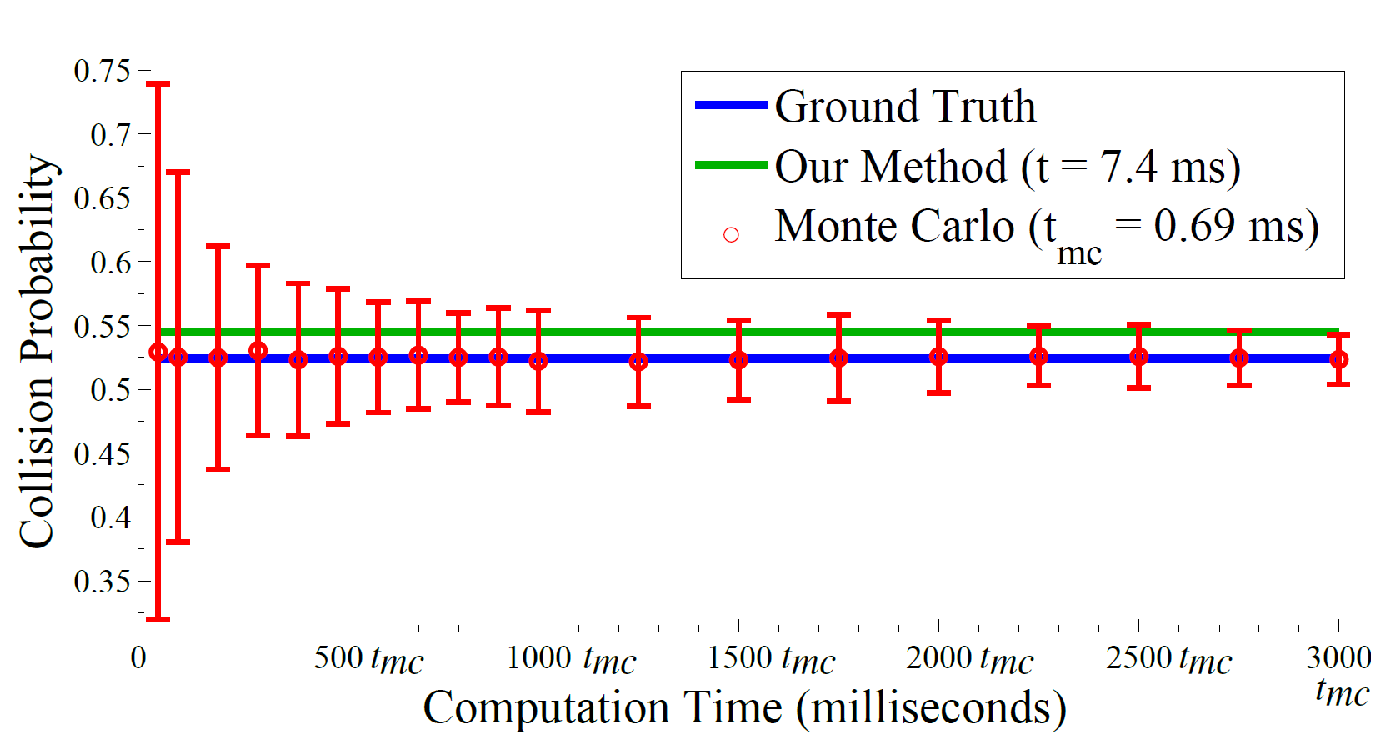
Comparison with Prior Methods
vs. Monte Carlo
Our method |  | Unconditional |  | LQG-MP
MAE (%) | Avg. time | MAE (%) | Avg. time | MAE (%) | Avg. time
5 (± 3) | 14 ms | 21 (± 7) | 12 ms | 62 (± 12) | 10 ms
Computed over 100 plans

Slide 23
Conclusion
Estimating collision probability crucial for characterizing plan safety
Fast, analytical method to estimate collision probability
Accurate estimation based on a priori state distributions along plan
Directly applicable to variety of planners to improve plan quality and performance

Slide 24
Future Work
Principled extension to handle n0n-point robots
Uncertain geometry

Slide 25


Thank You!
Contact:
Sachin Patil: sachin@cs.unc.edu
Jur van den Berg: berg@cs.utah.edu
Ron Alterovitz: ron@cs.unc.edu
Acknowledgements:

Slide 26
ABC
XYZ
PQR

