Slide 1
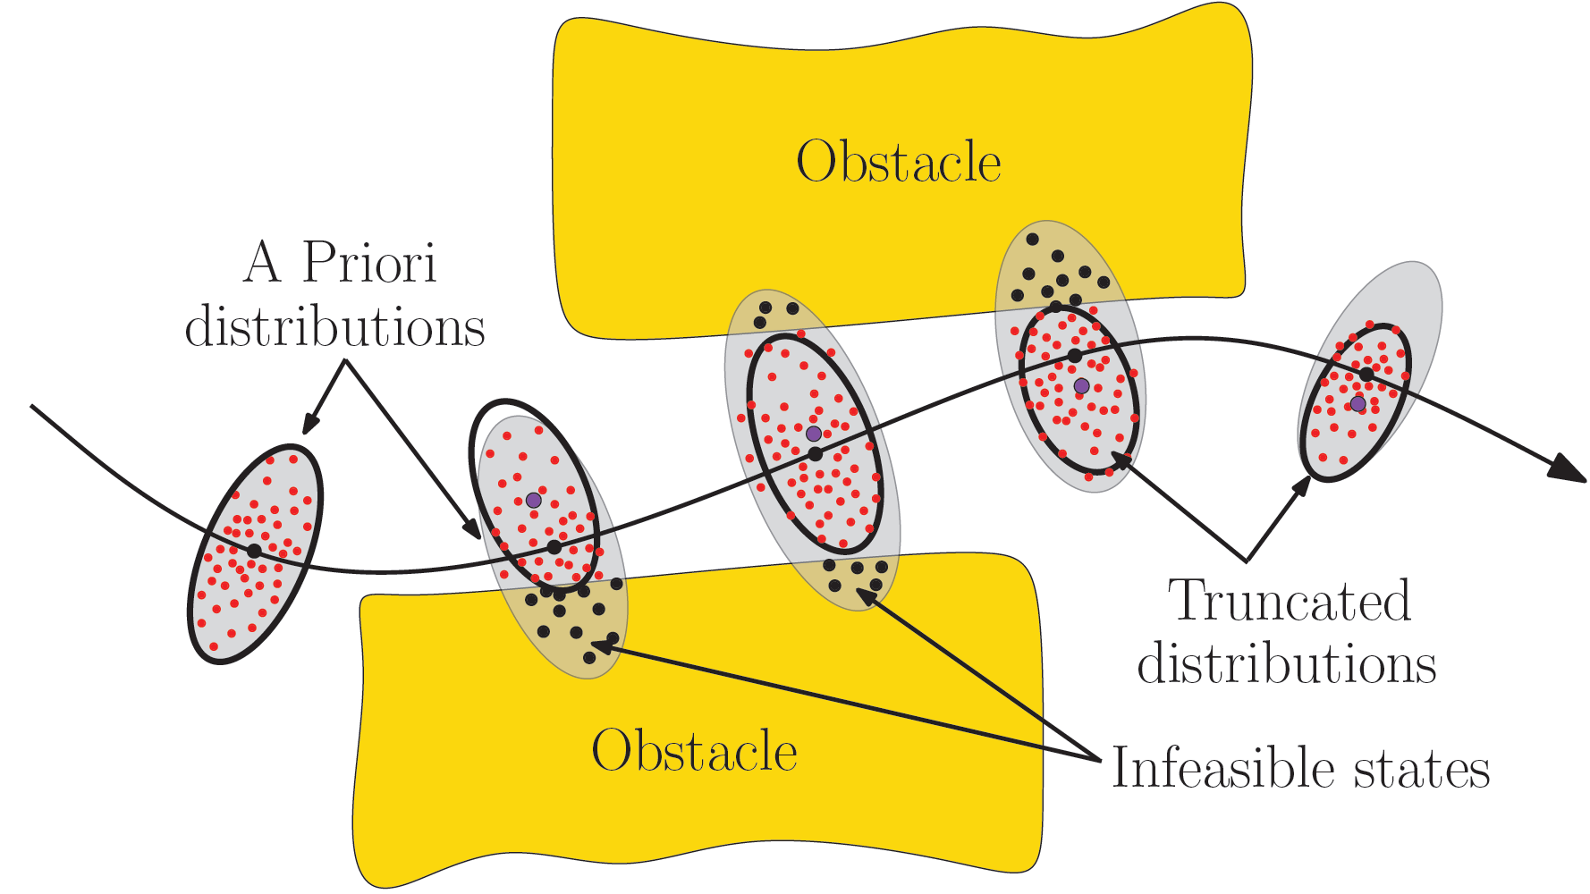
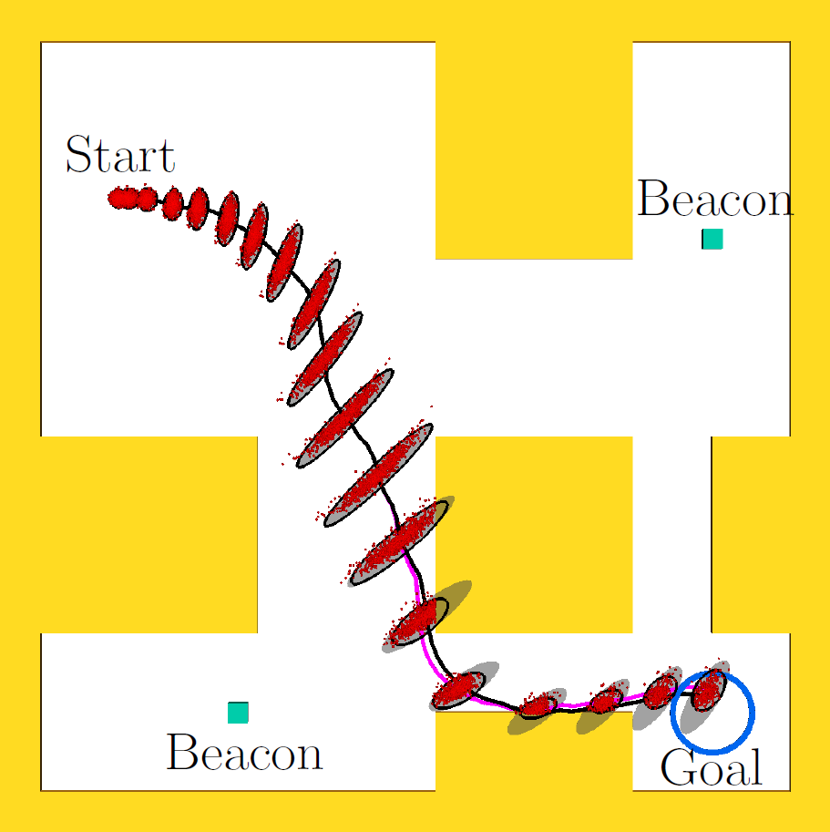
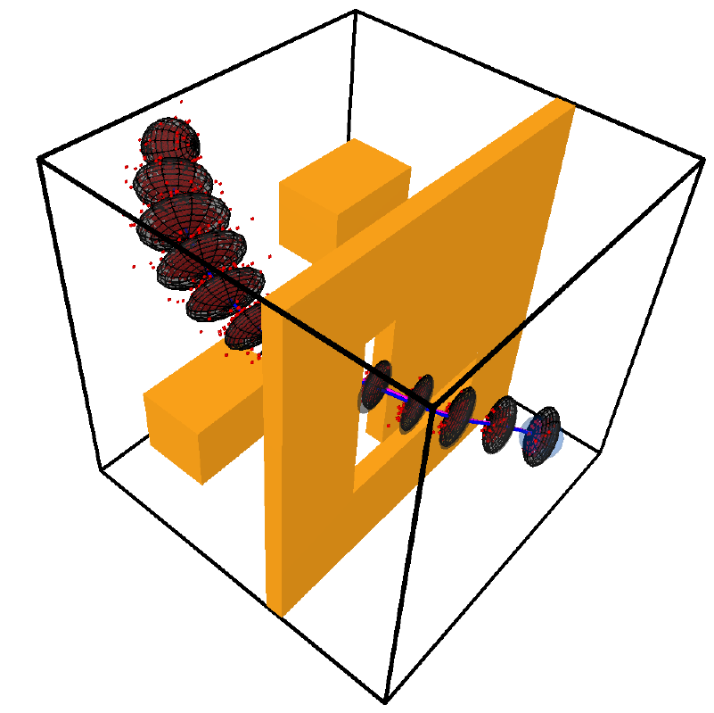
Estimating Probability of Collision for Safe Motion Planning under Gaussian Motion and Sensing Uncertainty
Sachin Patil¹, Jur van den Berg², Ron Alterovitz¹
¹Dept. of Computer Science, UNC Chapel Hill
²School of Computing, University of Utah
Notes:
Thank you for the introduction. Today I am going to talk about our work on efficient estimation of the probability of collision for safe motion planning under uncertainty, its applications, and discuss directions for future work. This is joint work with Jur van den Berg at University at Utah and Ron Alterovitz at UNC Chapel Hill.

Slide 2
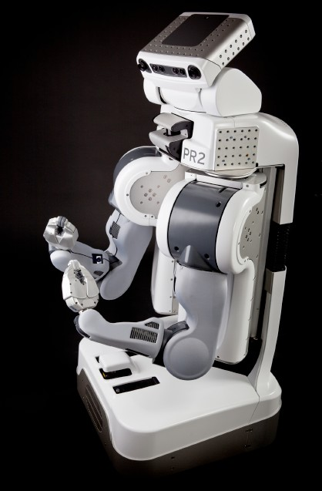
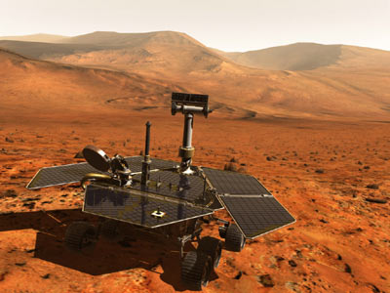
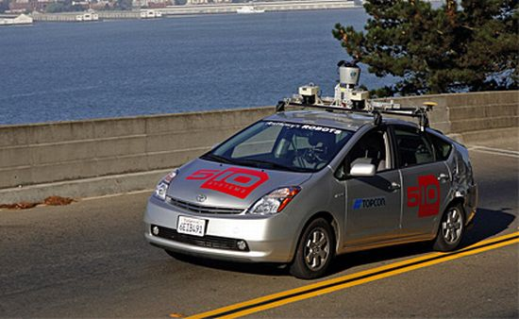
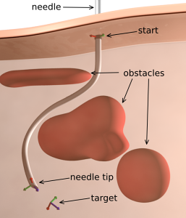
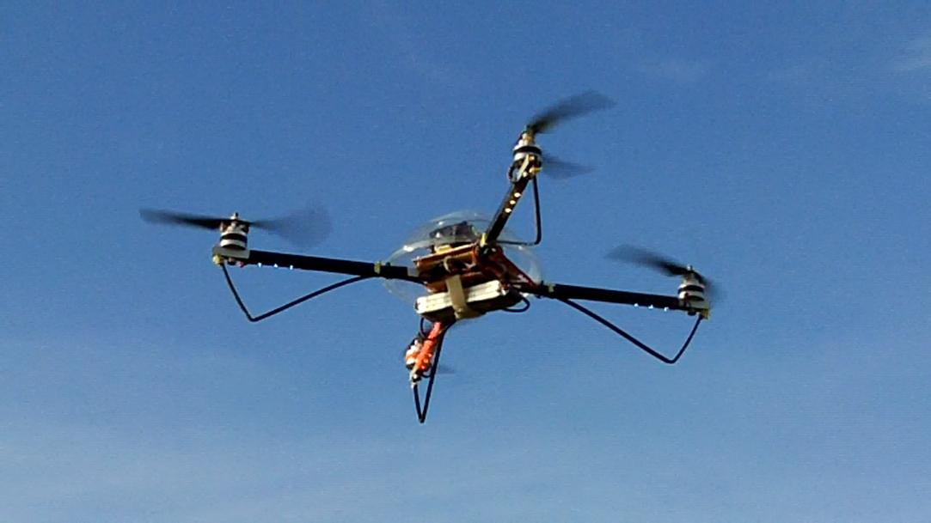
Motion Planning in the Real World
Notes:
Autonomous mobile robots are being increasingly deployed in the real world. Consider personal robots such as the Willow Garage’s PR2, the Google car for autonomous transportation, Mars Rover for autonomous exploration, the quadrotors and aerial drones for aerial surveillance and exploration, and even flexible needles that can steer around sensitive structures to reach the targets while minimizing tissue damage. For these robots to operate in the real world, it is important to compute safe motion plans. We do not want a car to hit a wall for instance, or a flexible needle to pierce vital organs.

Slide 3

Safe Motion Planning
Obstacle
Uncertainty!
Obstacle
Notes:
So what does safe motion planning entail? The objective of motion planning is to plan motions for robots to desired targets while avoiding obstacles in the environment. Consider this mobile robot and a collision-free plan. If everything is ideal, the robot will be able to exactly execute the plan. But there is uncertainty in this real world. This uncertainty arises from actuation errors, noisy sensing, modeling and simulation errors etc.

Slide 4
Motion Planning under Uncertainty
How do we know that a plan is safe a priori to execution?
Estimate the probability of collision; lower the better.
Notes:
It is important to explicitly consider uncertainty while planning. How do we know that a path is safe a priori to execution? We estimate the probability of collision given a plan. The lower the probability of collision, the safer the plan is. This is an important component of motion planners that explicitly consider uncertainty.

Slide 5
Problem Definition
Inputs:
Dynamics model:
Motion noise (Gaussian):
Observation model:
Sensing noise (Gaussian):
Plan:
State
Control input
Notes:
This brings us to the problem definition. We assume that we are given the possibly nonlinear dynamics model of the robot. x_t is the robot state (position, velocity, acceleration etc. and other attributes), u_t is the control input, m_t is motion noise that is assumed to be zero mean and known variance. The sensing model relates the sensor measurement to the state of the robot and the sensing noise is assumed to be Gaussian with zero mean and known variance. We also assume that a nominal plan is computed using a motion planner. This plan is discretized assuming a fixed time-step, the same time-step used for planning.

Slide 6
Problem Definition
Inputs:
State estimation (Kalman filter)
Feedback control (Linear controller)
: (Estimate of )
:
Notes:
To handle uncertainty during execution and to prevent it from blowing up, we assume that the robot is controlled to stay close to the plan. For this, we use a combination of state estimation and feedback control to correct errors due to uncertainty during execution. State estimation is performed using a Kalman filter, of which there are several variants, and it gives us an estimate of the deviation from the nominal state. The feedback controller is assumed to be linear, for instance PID or LQR control, could be used. Based on the state estimate, the controller computes the correction in control input required to keep the robot close to the plan.

Slide 7
Objective
Estimate a priori probability of collision
Subroutine for many methods for motion planning under uncertainty
Notes:
The objective is to estimate the probability of collision of the robot a priori to execution. This would serve as an important subroutine for many methods for motion planning under uncertainty.

Slide 8
Approach 1: Monte Carlo Estimation
Handle arbitrary noise models
How many samples?
Slow if performed repeatedly
Notes:
One possible approach to estimate the collision probability is to use Monte-Carlo simulations. We can simulate the execution of the robot using artificially added motion and sensing noise and count the number of collisions that occur. This method works for arbitrary noise models but it is not clear how many samples are required to reliably estimate the probability of collision. Also, this process is slow if performed repeatedly as a subroutine for a planner.
Can we do better if we assume that the noise is Gaussian?

Slide 9
Approach 2: A Priori State Distributions
Compute a priori state distributions along plan
Berg et al. [RSS 10], Bry and Roy [ICRA 11], Vitus and Tomlin [ICRA 11]
For:
Notes:
If we assume that the motion and sensing noise is Gaussian, then the resulting probability distributions of the robot state along the plan are also Gaussian. The true state and estimated state evolve as follows (animation). The distribution of the state x_t is then given by the following expression.

Slide 10
Approach 2: A Priori State Distributions
X
X
Distributions are propagated regardless of obstacles
Notes:
Prior work does not account for collisions with obstacles. Consider the samples drawn from a distribution around a state. They are propagated without considering if any of the prior states resulted in a collision. This leads to overly conservative distributions, which leads to overly conservative probability estimates.

Slide 11
Approach 2: A Priori State Distributions
Overly conservative probability estimate!
Should be:
Notes:
The probability of collision can be estimated using these distributions. The probability that the robot is collision-free for all stages of the plan is approximately computed as the product of the probabilities that the robot is collision-free at each stage of the plan. This is a problem because a solution might not be found even if one exists because it does not satisfy the safety requirement of a planner. So we need to compute conditional distributions of collision-free states only.
This is overly conservative! It should instead be the product of the probability that the robot is collision-free conditioned on the fact that the previous states of the robot are all collision-free.

Slide 12
Our Approach
where:
X
X
Propagation:
Key insight: Approximate collision-free states with truncated Gaussians
and propagate
Notes:
To do this, we approximate the collision-free states with truncated Gaussians. These truncated Gaussians effectively discount all colliding states from the distribution, and can be propagated further to better approximate the collision-free states of the robot along the plan. We are interested in computing these revised distributions with new subscripts, which implies conditioning on the all prior states being collision-free.

Slide 13
Truncating Conditional Distributions
Notes:
Lets take a look at how the truncation happens. Consider a Gaussian state distribution at time instant t of the plan. Let us assume that the free space is convex. It can be described by a combination of linear inequalities of the form: ax <= b. Since the true state and the estimate are correlated, it is important to truncate the joint conditional distribution. Instead of truncating the state distribution directly, we truncate the joint distribution of the true state and the estimated state. By applying the following transformations, we get the following. To truncate the Gaussian, we transform the problem from R^2n to R and truncate the 1D Gaussian. The area beyond the constraint gives the probability of collision w.r.t this particular constraint. Once the mean and variance are computed, we transform the Gaussian back to R^2n. The deltas in the mean and variance are then subtracted from the original means and variances. The details of how the deltas are computed can be found in our paper.

Slide 14
Non-Convex Regions
Notes:
We have seen how we can truncate these distributions w.r.t. one constraint and we have assumed that the free space is convex. What if we have non-convex regions? We decompose the free space into approximately locally-convex regions. Consider a non-convex environment and a state distribution along a plan. We transform the environment such that the distribution of the robot position is converted to a unit sphere. We then sequentially process the obstacle geometry in increasing order of distance from the origin and prune away inconsequential geometry. The liner constraints that define a locally convex region are given by the normal to the vector of closest approach.

Slide 15
Truncating Gaussians: Multiple Constraints
Previously used for Kalman filtering with state constraints
D. Simon [2006], Tully et al. [IROS 11]
Novelty: Truncation independent of order in which constraints are processed
Notes:
The idea of using truncated Gaussians is not new. This has been previously explored for kalman filtering with state constraints. However, unlike prior methods, our truncation method is novel in that it is independent of the order in which constraints are processed and hence always gives a unique solution. This means that our truncation method can also be used for filtering with state constraints.

Slide 16
Estimating Collision Probability
Boole’s inequality
where:
Notes:
Now that we have the accurate a priori state distributions, we estimate the collision probability as follows. The collision probability is the complement of the probability that all the robot states along the plan are collision-free. A conservative estimate of the probability that the robot at a particular time-step is collision-free is obtained using Boole’s inequality as follows. Here cdf is the standard cumulative distribution function.
Boole’s inequality states that for a finite set of events, the probability that at least one event happens is bound by the sum of the individual probabilities.

Slide 17
Car-like Robot
Dynamics model:
Observation model:
Notes:
We evaluate our approach in simulation. First, we consider a car-like robot. The environment consists of a non-convex region as shown here. The start location is up top and the goal is at the bottom. The dynamics model of the car is as follows:. Here x,y are the coordinates of the car position, theta is the orientation and v is the speed.

Slide 18
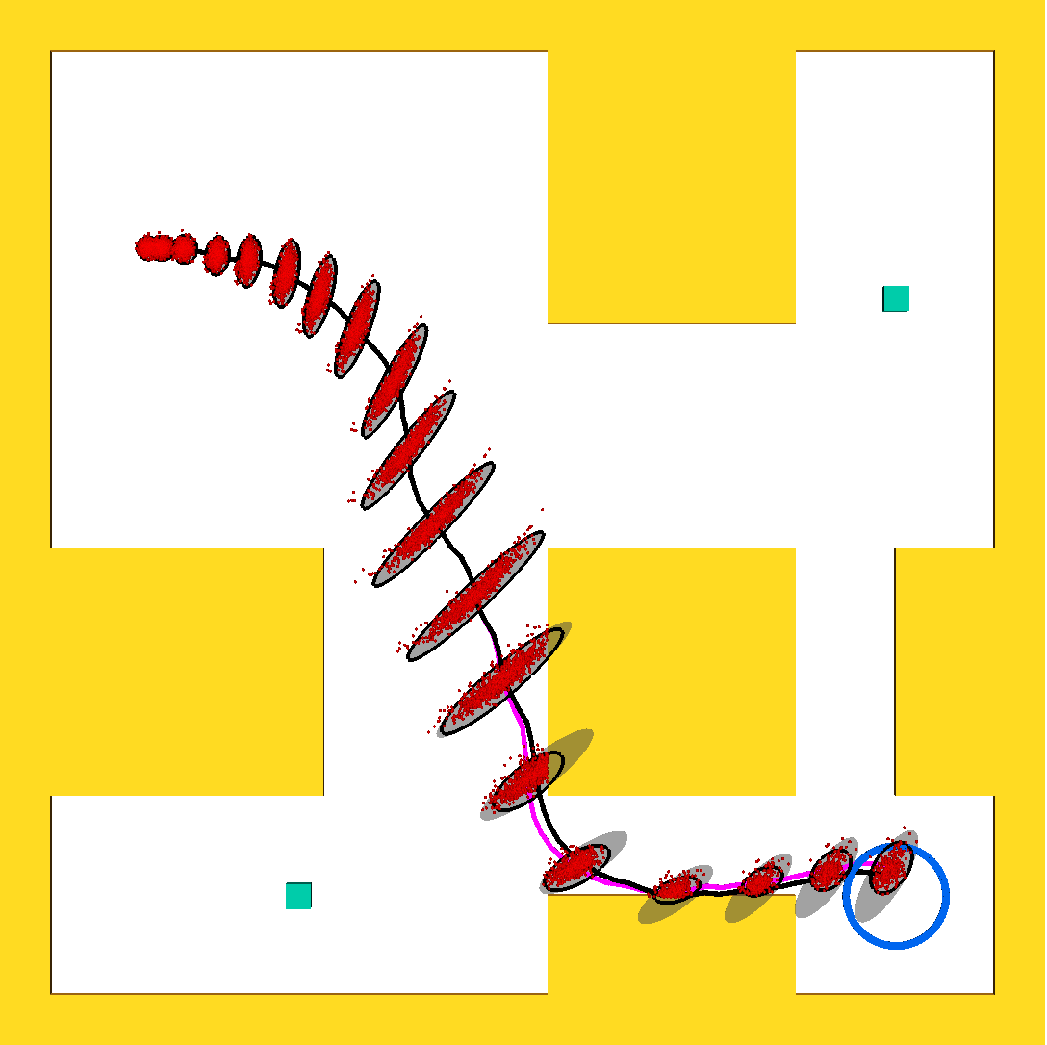
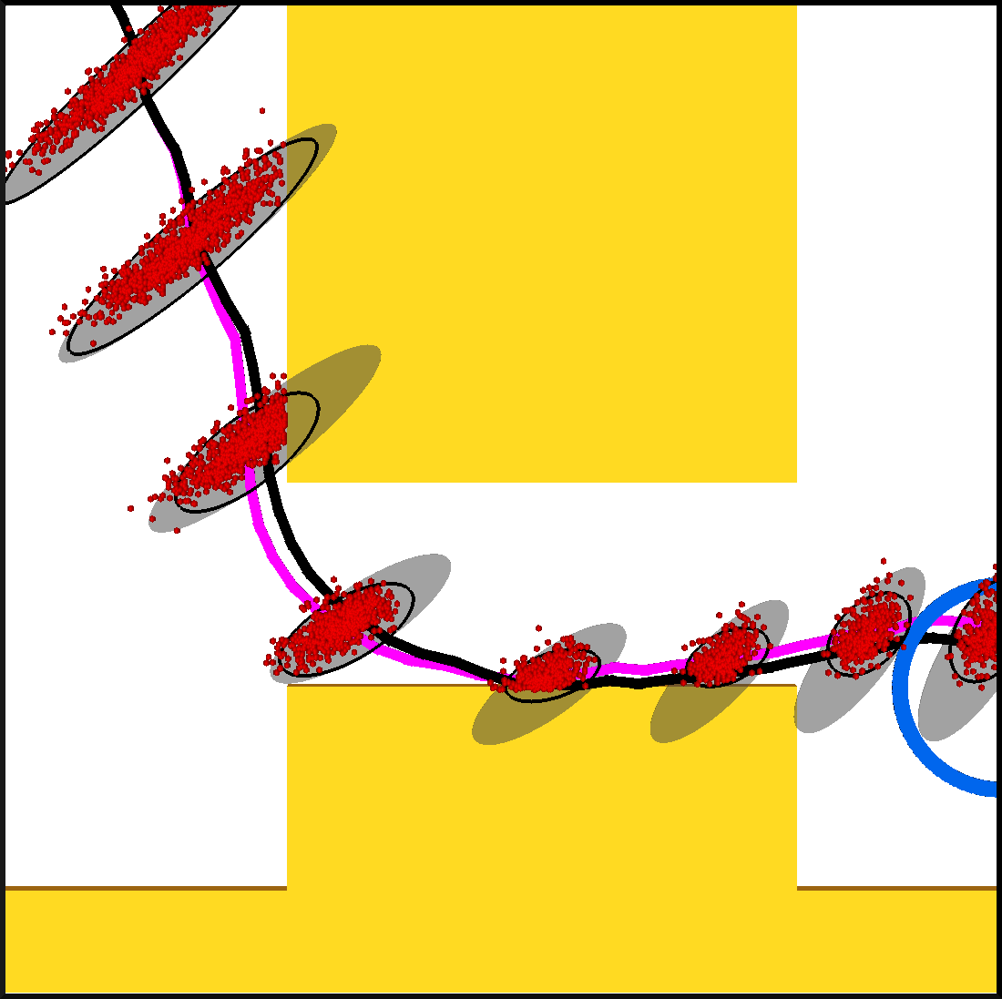
Car-like Robot
Probability collision: Our method – 68.9%
Monte-Carlo – 67.3%

Slide 19
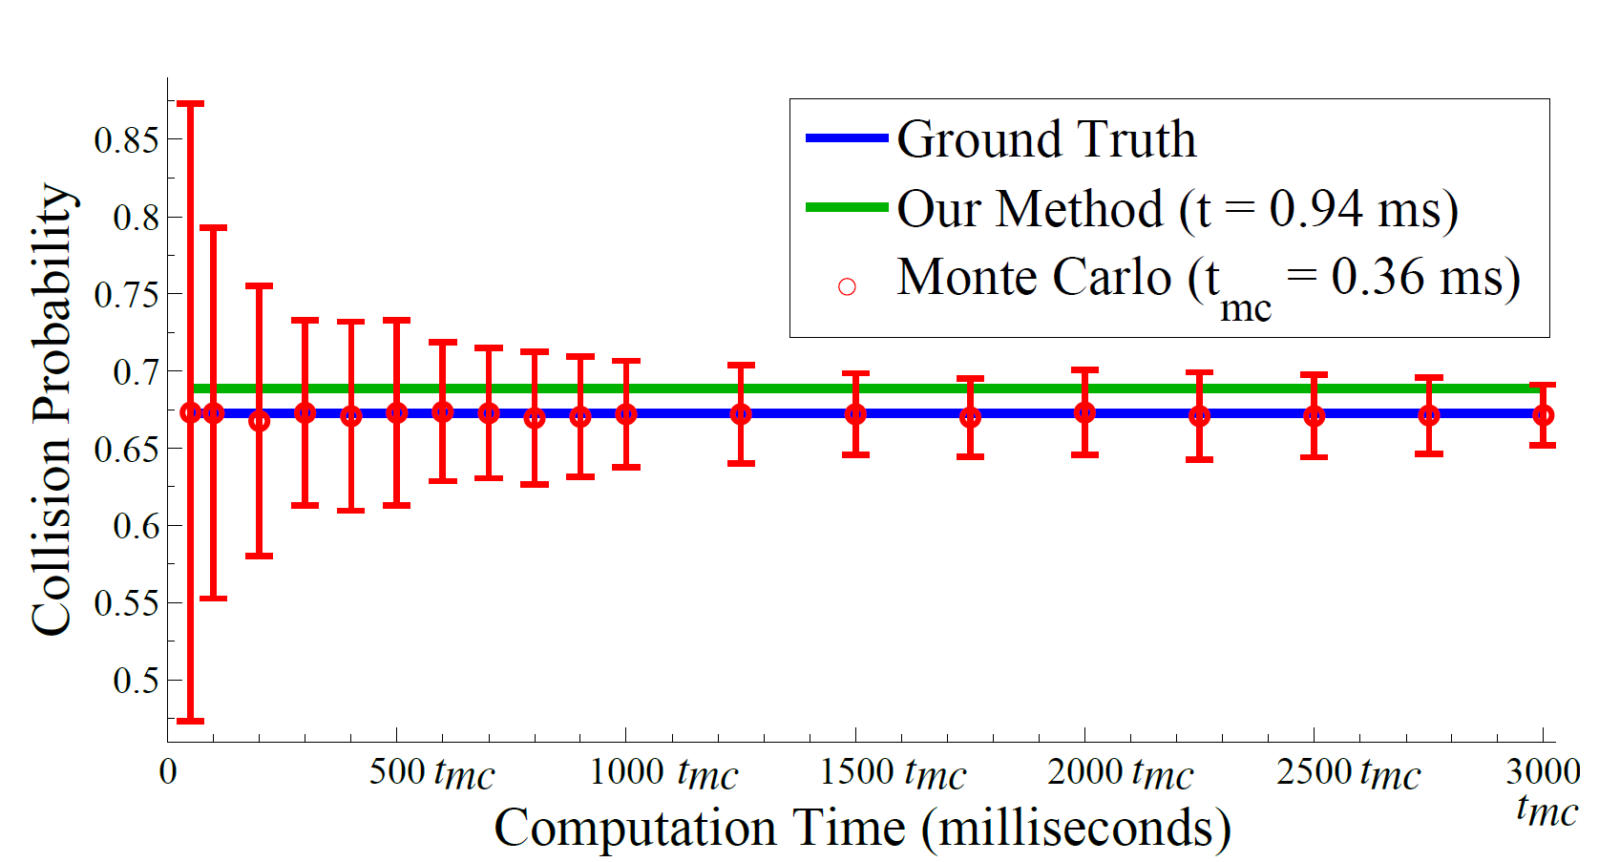
Comparison with Prior Methods
vs. Monte Carlo
Our method |  | Unconditional |  | LQG-MP
MAE (%) | Avg. time | MAE (%) | Avg. time | MAE (%) | Avg. time
3 (± 2) | 9 ms | 28 (± 15) | 6 ms | 52 (± 15) | 4 ms
Computed over 100 plans

Slide 20
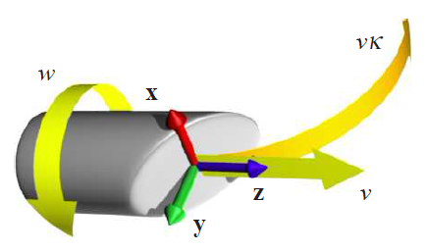
Nonholonomic Flexible Needle
Dynamics model:
Observation model:

Slide 21
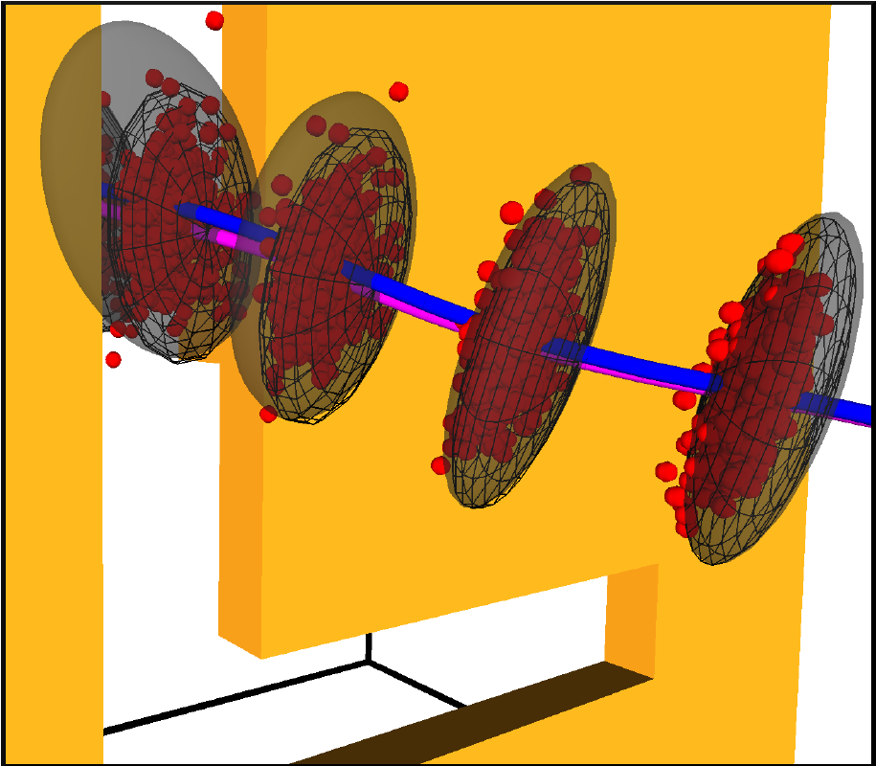
Nonholonomic Flexible Needle
Probability collision: Our method – 54.5%
Monte-Carlo – 52.4%

Slide 22
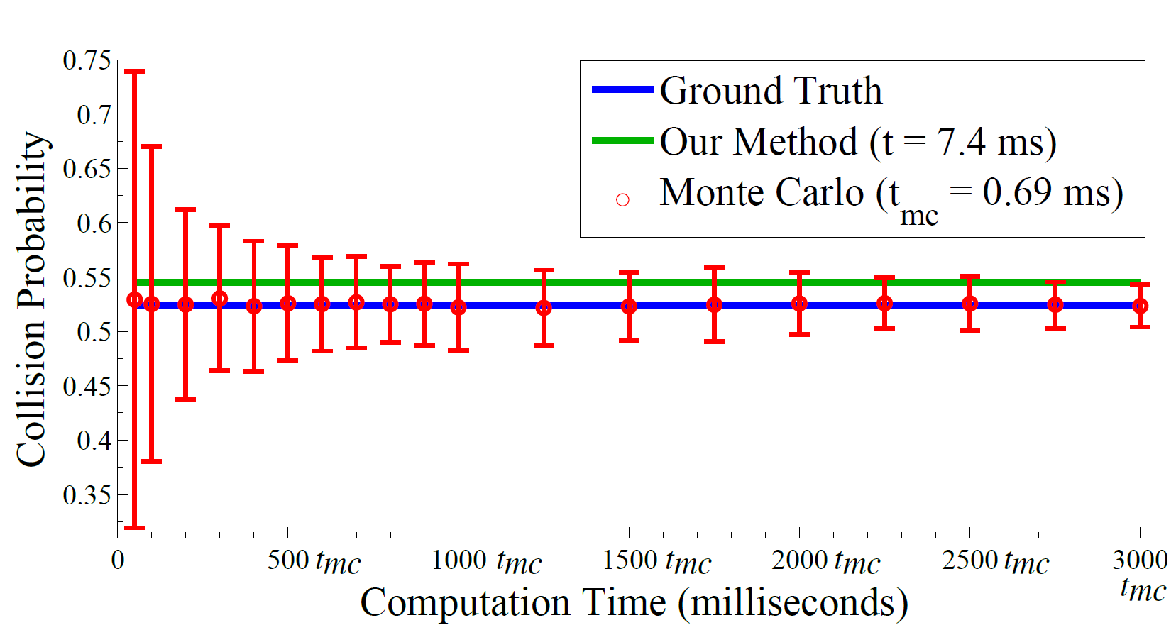
Comparison with Prior Methods
vs. Monte Carlo
Our method |  | Unconditional |  | LQG-MP
MAE (%) | Avg. time | MAE (%) | Avg. time | MAE (%) | Avg. time
5 (± 3) | 14 ms | 21 (± 7) | 12 ms | 62 (± 12) | 10 ms
Computed over 100 plans

Slide 23
Conclusion
Estimating collision probability crucial for characterizing plan safety
Fast, analytical method to estimate collision probability
Accurate estimation based on a priori state distributions along plan
Directly applicable to variety of planners to improve plan quality and performance

Slide 24
Future Work
Principled extension to handle n0n-point robots
Uncertain geometry

Slide 25


Thank You!
Contact:
Sachin Patil: sachin@cs.unc.edu
Jur van den Berg: berg@cs.utah.edu
Ron Alterovitz: ron@cs.unc.edu
Acknowledgements:

Slide 26
ABC
XYZ
PQR

