Slide 1
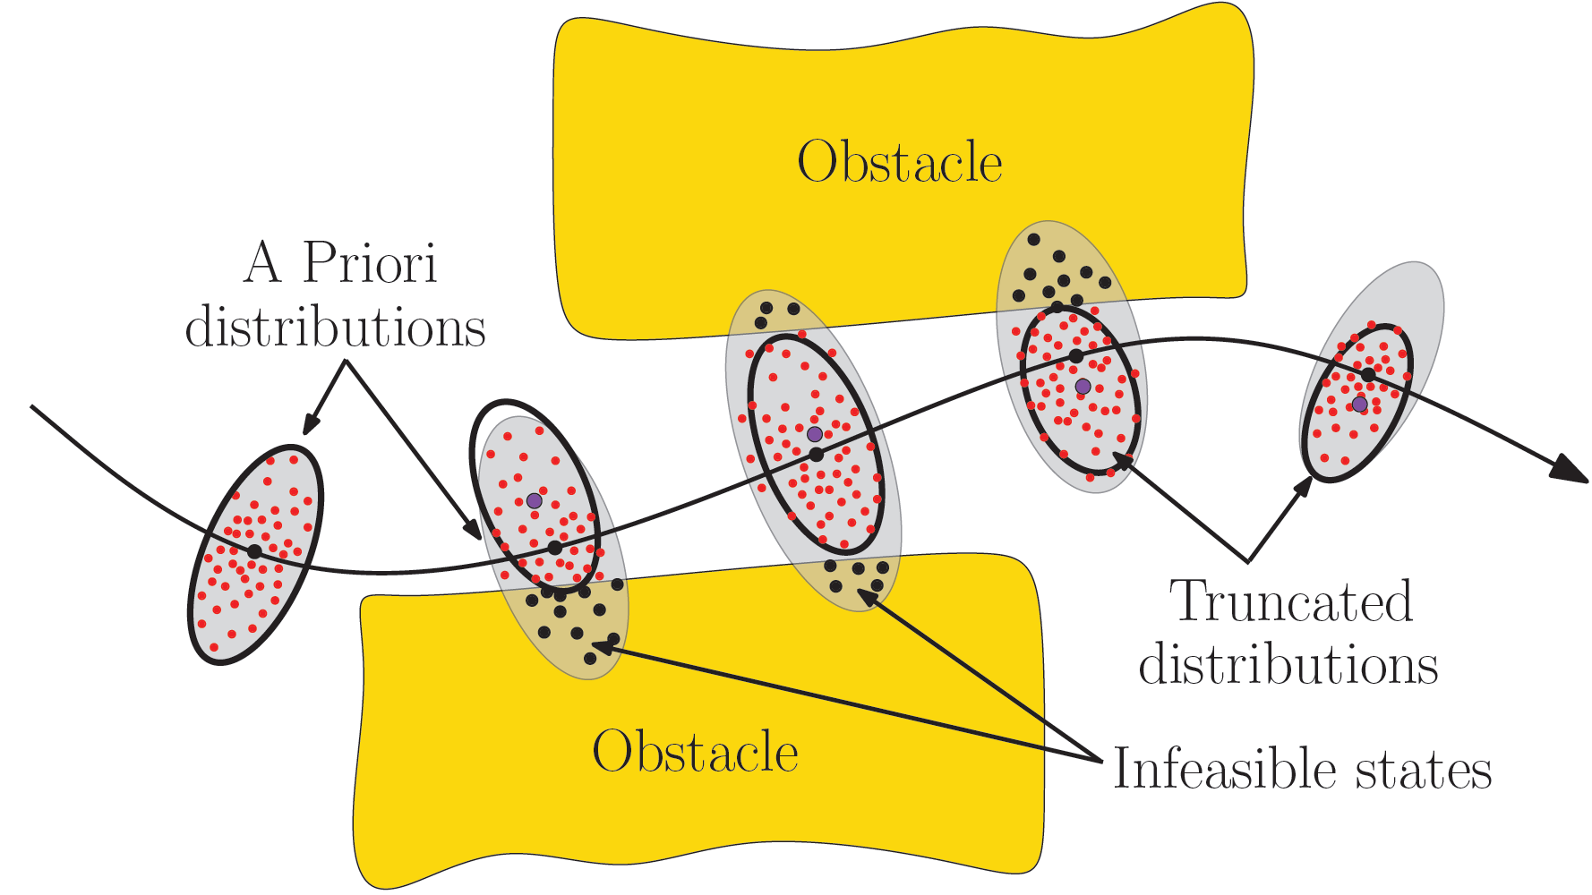
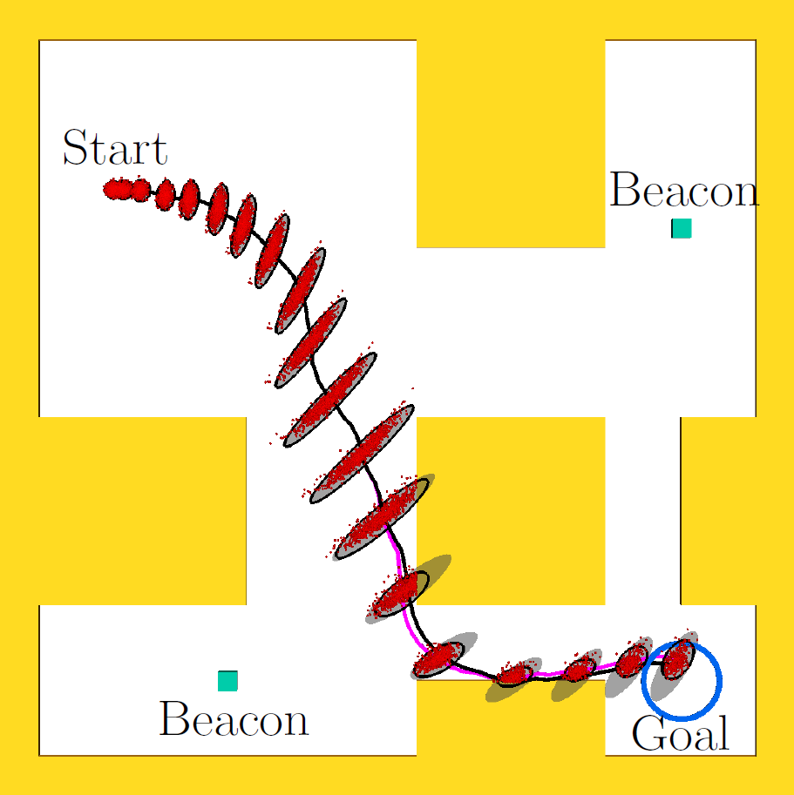
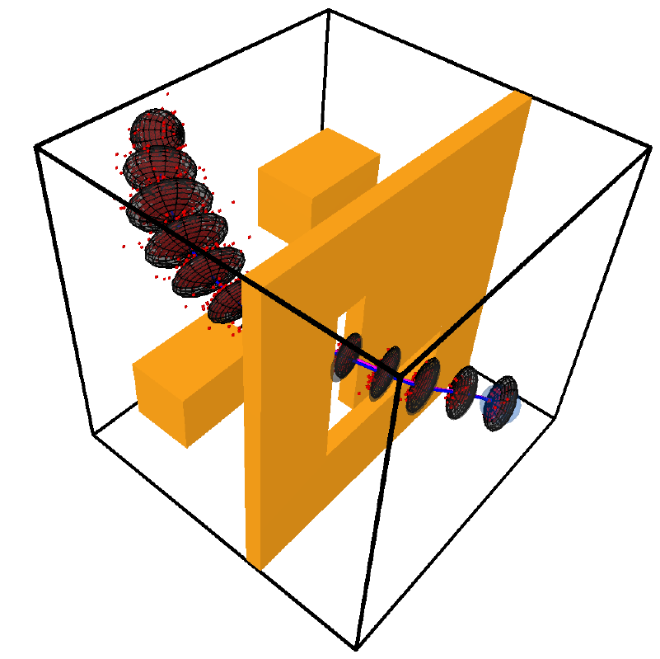
Estimating Probability of Collision for Safe Motion Planning under Gaussian Motion and Sensing Uncertainty
Sachin Patil¹, Jur van den Berg², Ron Alterovitz¹
¹Dept. of Computer Science, UNC Chapel Hill
²School of Computing, University of Utah

Slide 2
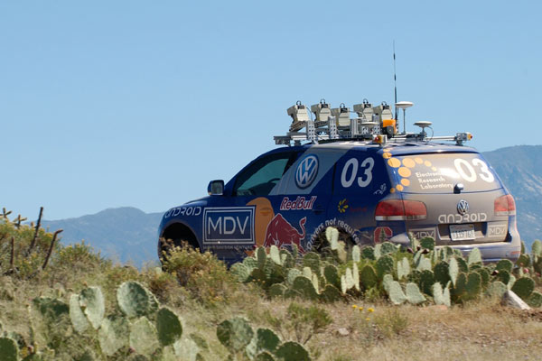
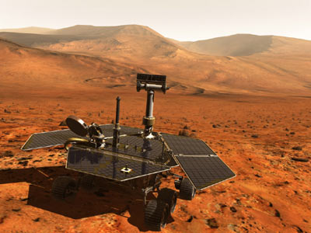
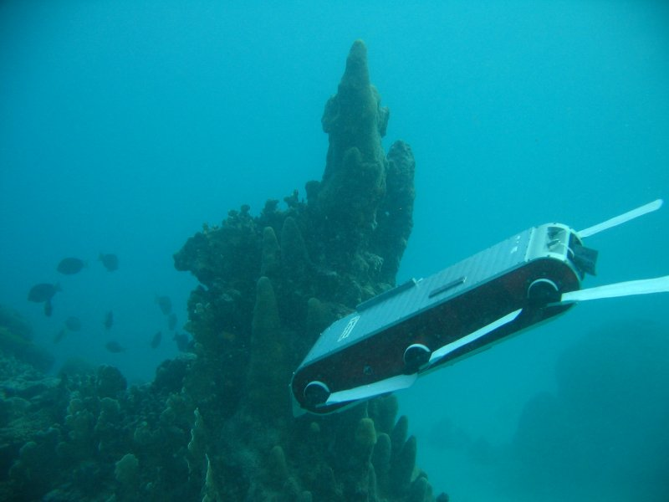
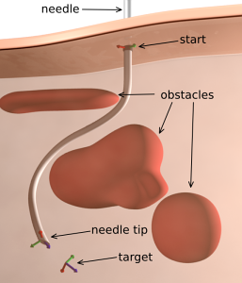
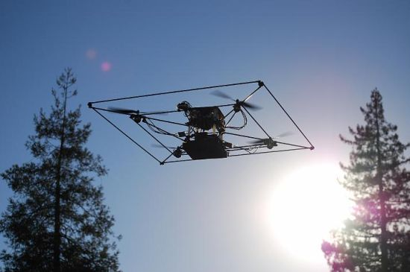
Motion Planning in the Real World

Slide 3

Safe Motion Planning
Obstacle
Uncertainty!
Obstacle

Slide 4
Motion Planning under Uncertainty
How do we know that a plan is safe a priori to execution?
Estimate the probability of collision; lower the better.

Slide 5
Problem Definition
Inputs:
Dynamics model:
Motion noise (Gaussian):
Observation model:
Sensing noise (Gaussian):
Nominal Plan:
State
Control input

Slide 6
Problem Definition
Inputs:
State estimation (Kalman filter)
Feedback control (Linear controller)
: (Estimate of )
:

Slide 7
Objective
Estimate a priori probability of collision
Fast performance: Evaluation for multiple plans; real-time applications

Slide 8
Prior Approach: Monte Carlo Estimation
Handle arbitrary noise models
How many samples?
Slow if performed repeatedly

Slide 9
Prior Approach 2: A Priori State Distributions
Compute a priori state distributions along plan
Berg et al. [RSS 10], Bry and Roy [ICRA 11], Vitus and Tomlin [ICRA 11]
For:
Correlated!

Slide 10
Prior Approach 2: A Priori State Distributions
X
X
Overly conservative probability estimate: collisions are double-counted

Slide 11
Our Approach
where:
X
X
Propagation:
Key insight: Approximate collision-free states with truncated Gaussians
and propagate

Slide 12
Truncating Conditional Distributions

Slide 13
Local Convexification of Free Space
Scenario adapted from Berg et al. [RSS 10]

Slide 14
Truncating Gaussians: Multiple Constraints
Previously used for Kalman filtering with state constraints
D. Simon [2006], Tully et al. [IROS 11]
Novelty: Truncation independent of order in which constraints are processed

Slide 15
Estimating Collision Probability
Boole’s inequality
where:

Slide 16
Car-like Robot
Dynamics model
4-DOF state space
Control inputs: acceleration and turning angle
Nonholonomic motion model
Observation model
Localization using beacons
Speed using speedometer

Slide 17
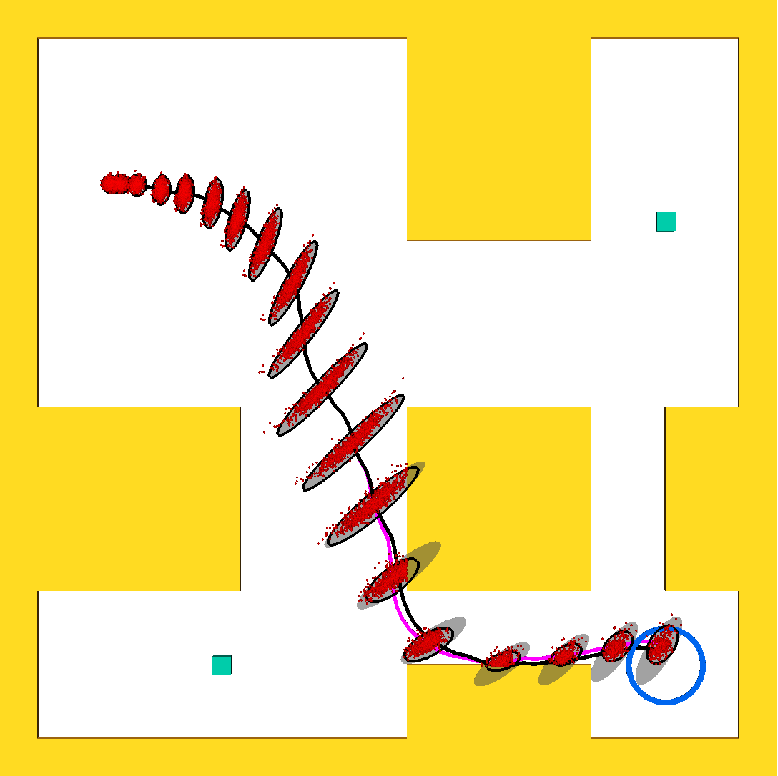
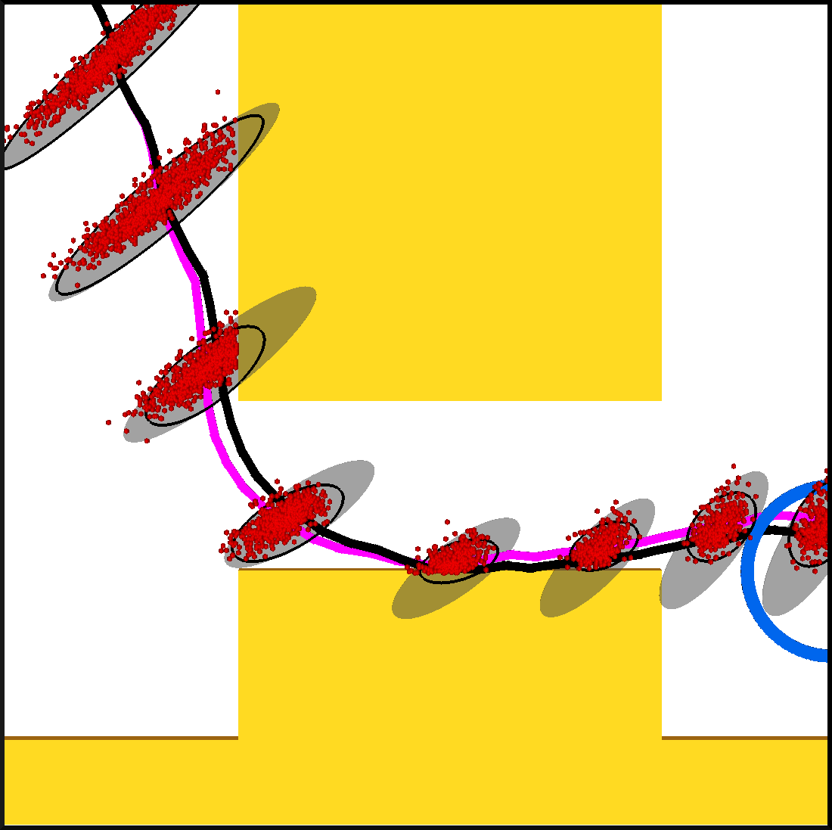
Car-like Robot
Unconditional distributions (3 std dev)
Conditional distributions (3 std dev)
Collision-free Monte-Carlo samples
Nominal plan
Conditional distribution means
Our method – 68.9%
Ground truth – 67.3% (1 million MC samples)

Slide 18
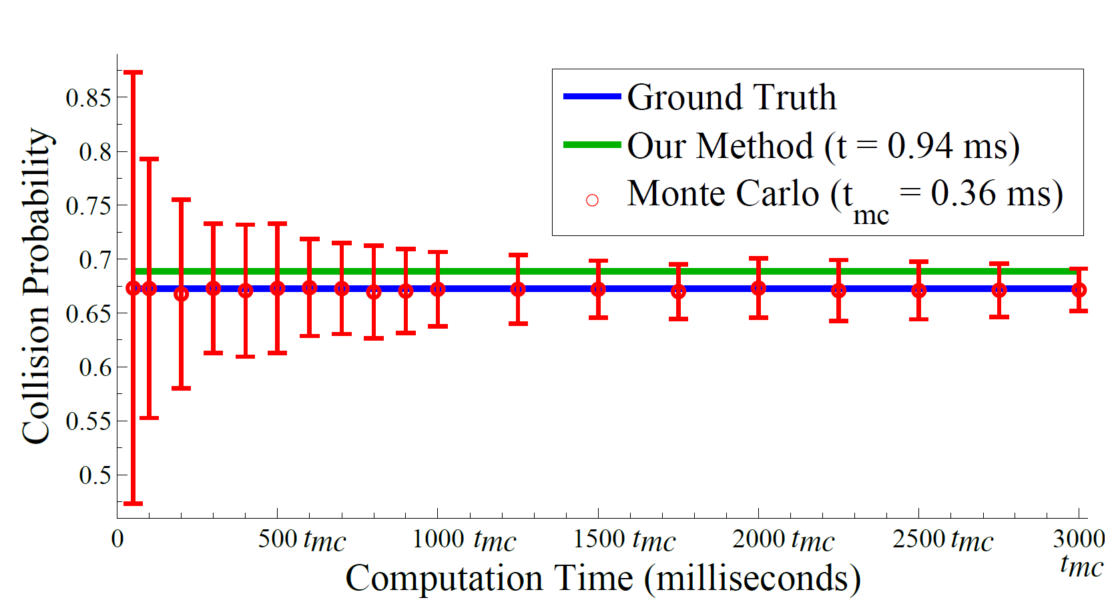
Comparison with Prior Methods
vs. Monte Carlo
Our method |  | Unconditional |  | LQG-MP
MAE (%) | Avg. time | MAE (%) | Avg. time | MAE (%) | Avg. time
3 (± 2) | 9 ms | 28 (± 15) | 6 ms | 52 (± 15) | 4 ms
Computed over 100 plans

Slide 19
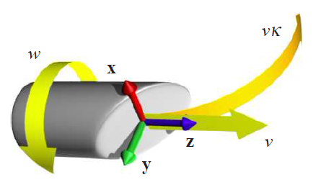
Nonholonomic Flexible Needle
Dynamics model
6-DOF state space
Control inputs: insertion and twist applied at needle base
Variable curvature trajectories
Observation model
Position of needle tip (noisy)

Slide 20
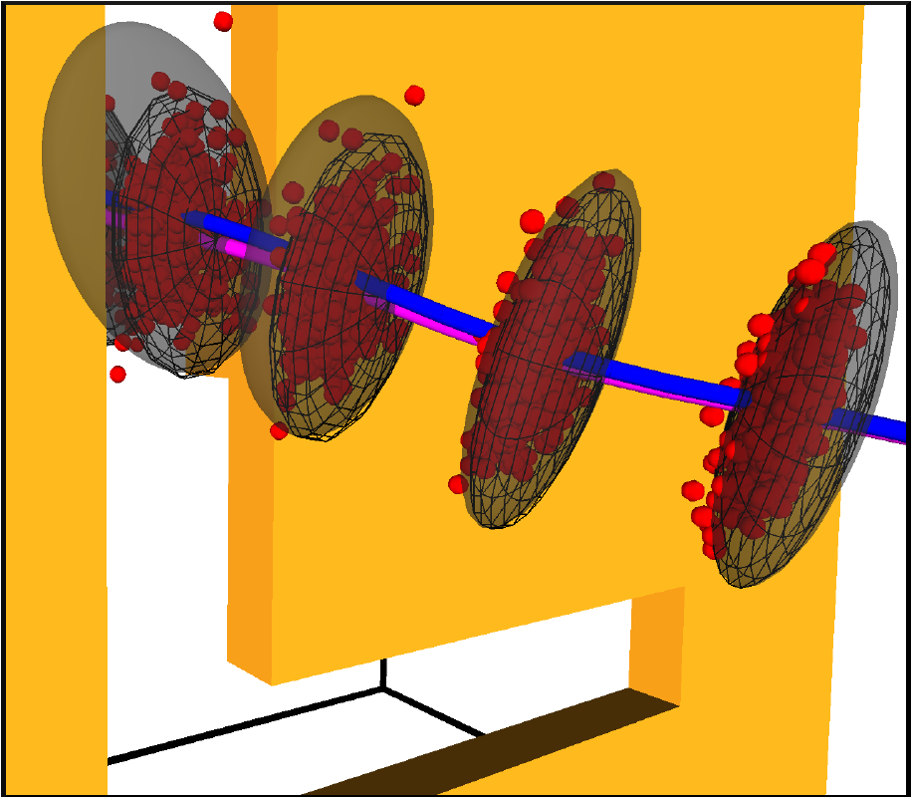
Nonholonomic Flexible Needle
Our method – 54.5%
Ground truth – 52.4% (1 million MC samples)

Slide 21
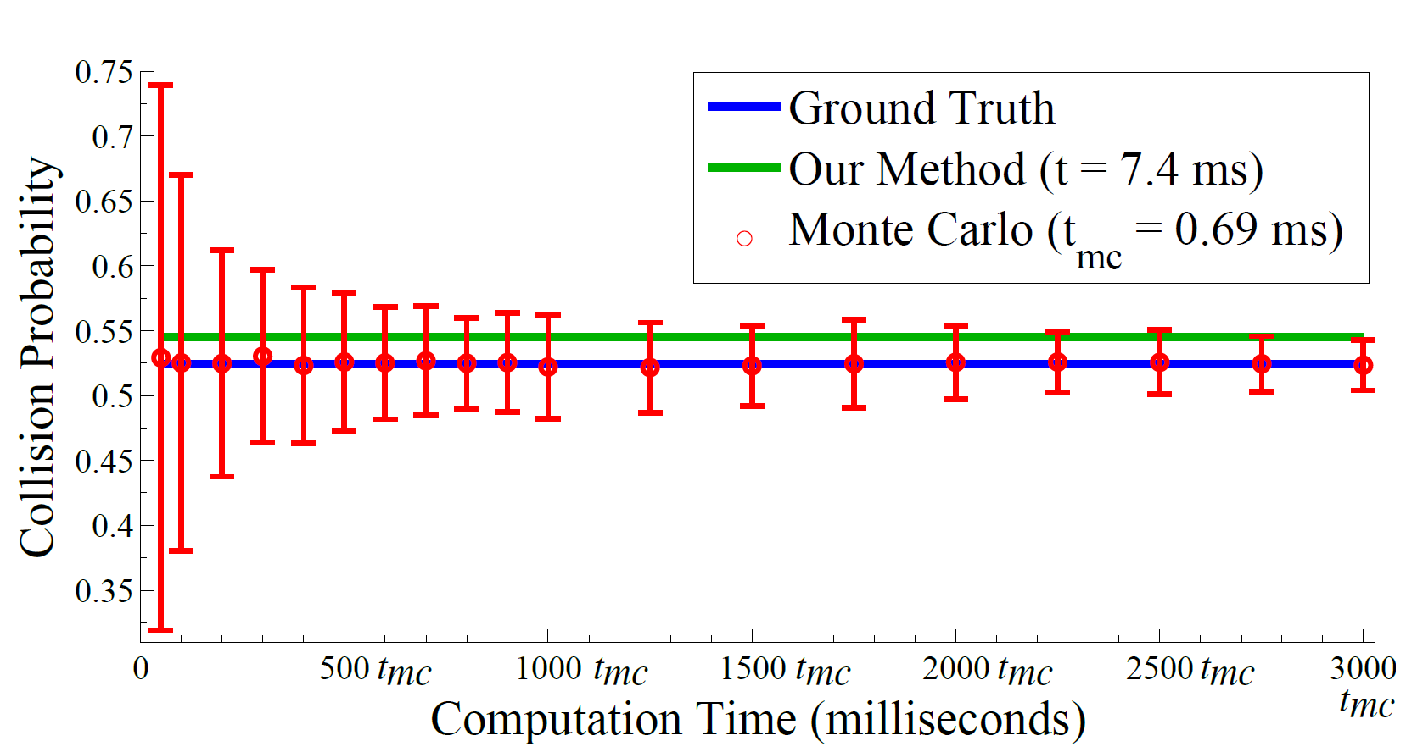
Comparison with Prior Methods
vs. Monte Carlo
Our method |  | Unconditional |  | LQG-MP
MAE (%) | Avg. time | MAE (%) | Avg. time | MAE (%) | Avg. time
5 (± 3) | 14 ms | 21 (± 7) | 12 ms | 62 (± 12) | 10 ms
Computed over 100 plans

Slide 22
Conclusion
Estimating collision probability crucial for characterizing plan safety
Fast, analytical method to estimate collision probability
Accurate estimation based on a priori state distributions along plan
Directly applicable to variety of planners to improve plan quality and performance

Slide 23


Thank You!
Contact:
Sachin Patil: sachin@cs.unc.edu
Jur van den Berg: berg@cs.utah.edu
Ron Alterovitz: ron@cs.unc.edu
Acknowledgements:

Slide 24
ABC
XYZ
PQR

