Slide 1

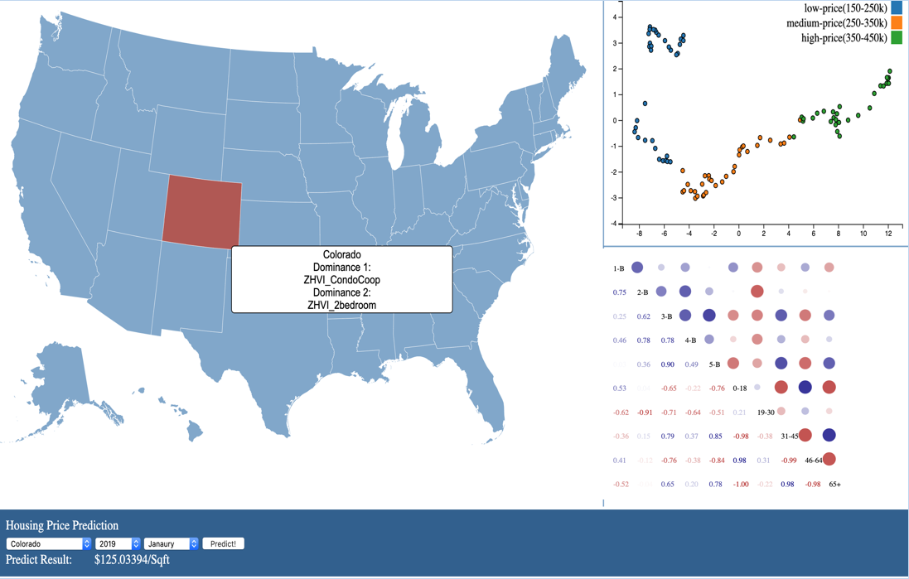
Exploration and Prediction of Housing Prices in the United States Wentao Wu¹, Shengwei Li¹ ¹Computer Science Program, Stony Brook University
Abstract
The goal of this project is to find the most popular house styles in each State in the United States. Based on the past 10 years’ housing data on Zillow.com [1] and U.S. population data on Census.gov [2], the prices of different home types and their correlations are explored. In addition, the population distribution data was merged for analysis of the intrinsic interplays between major house types and age distributions. Our model also provides a prediction of pricing trend in certain areas, which can be insightful reference for people who are thinking about buying house for living or investment purposes.
Dominant House Styles Exploration
For each State in the U.S map[4] selected by user, two of the most dominant home styles will be shown (Dominance 1 and Dominance 2). These are the housing styles that affect the whole housing market price to the most extend, indicating they are two of the most popular house styles in the State selected.
2-PCA Plot
This PCA plot shows the housing price data distribution of selected State among different time points. The more disperse the dots are, the greater price variation there was over the past several years. The different colors represent the relative price level of the selected State among the whole country's housing market.
Correlations Between House Styles and Age Groups
The correlation matrix was built based on data collected from five different houses styles (with 1-5 bedrooms) and five different age groups [3]. Blue and red color represents positive and negative correlations between attributes; and circle sizes indicate the strength of the correlation. For instance, populations of age 31-45 and 65+ have relatively higher positive relations with 3, 4 and 5 bedroom houses in Colorado, as shown in the picture above.
Price Prediction
By choosing 3 key input factors -- State name, Year and Month, and click on the “Prediction!” button, the predicted housing price in $/Sqft will be shown below. The prediction is based on model built by Keras[5].
Conclusion
Here we have successfully found the most dominant housing styles in each State of the U.S. Using 2D PCA plot, we also illustrated the fluctuation and relative level among the US housing market. Moreover, we also presented the correlations between housing styles and different age populations. For future directions, more precise prediction model will need to be developed for specific home types.
References
[1] https://www.zillow.com/
[2] https://www.census.gov/
[3] https://www.d3-graph-gallery.com/graph/correlogram_basic.html
[4] https://github.com/topojson/us-atlas
[5] https://www.kaggle.com/ironfrown/deep-learning-house-price-prediction-keras/notebook

