Slide 1
Summary of Research Work in the past one month
Wentao Gong
Master
Laboratory of Hydraulics
Oct 17th, 2019

Slide 2
Content
Objection
Previous result
Summary of implicit Eluer’s method and Crank-Nicolson method for diffusive term
Future work

Slide 3
Objection
To build up your own solver using adaptive mesh refinement method or other methods, you have to master some basic equations and practice some necessary method for future work.
So today I will continue to use the Finite Difference method to solve some equations....

Slide 4
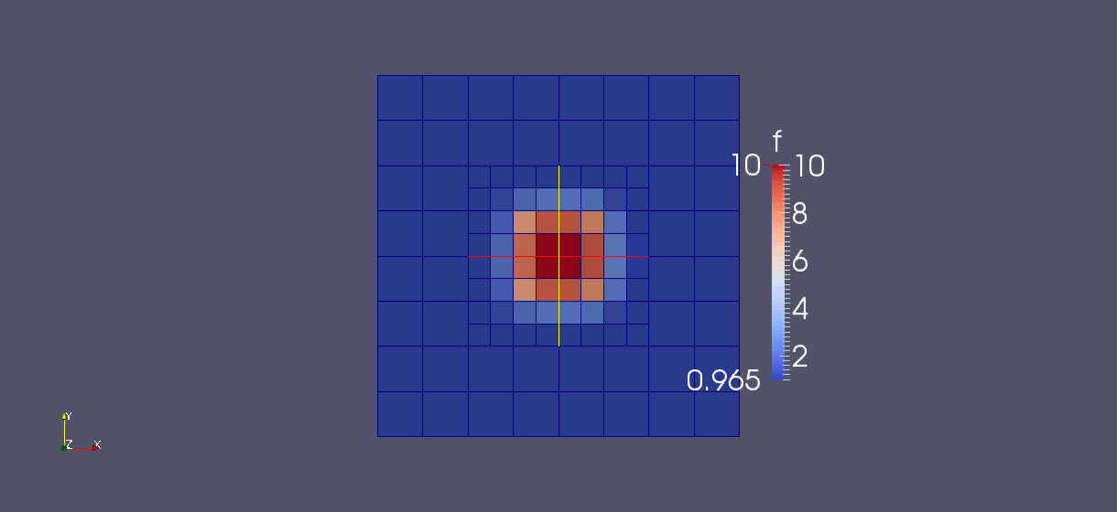
AMR for advection using FTCS metod in 1D
lrefine_min = 1
lrefine_max = 5

Slide 5
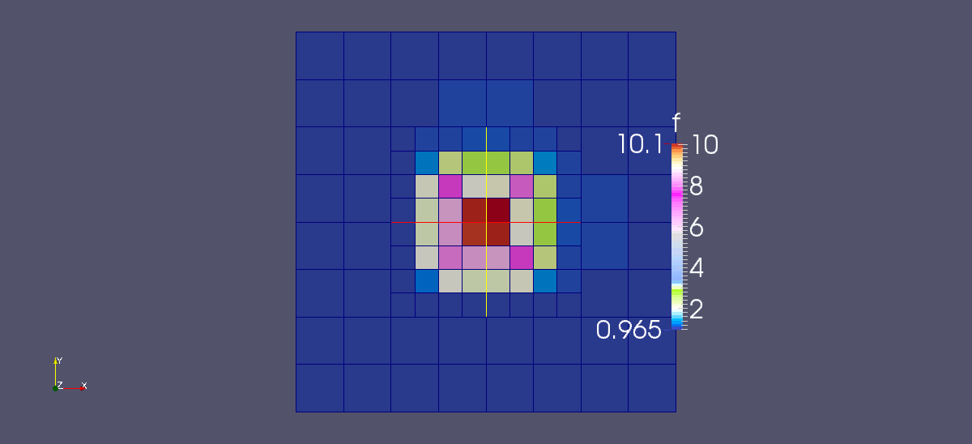
AMR for advection using FTCS metod in 2D
lrefine_min = 1
lrefine_max = 5
The color means the depth of water

Slide 6
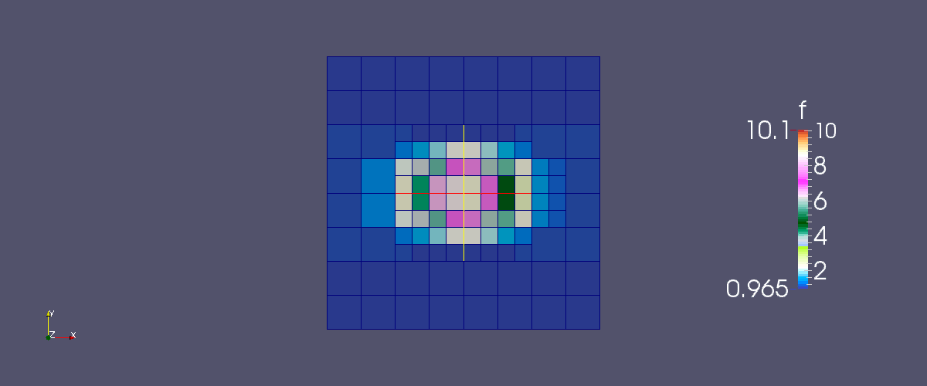
AMR using FTCS metod and Lax-friedrichs method for advection in 1d
lrefine_min = 1
lrefine_max = 5
The color means the depth

Slide 7

AMR for diffusion using explicit difference method in 1D
lrefine_min = 1
lrefine_max = 5
The color means the depth of water

Slide 8

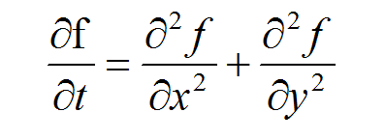
AMR for diffusion using explicit difference method in 2D
lrefine_min = 1
lrefine_max = 5
The color means the depth of water

Slide 9


AMR for advection-diffusion in 1D using explicit difference method
lrefine_min = 1
lrefine_max = 5
The color means the depth of water

Slide 10
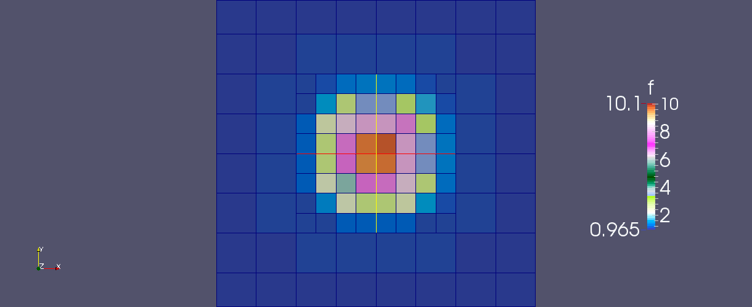
AMR for advection-diffusion in 2d using explicit difference method
lrefine_min = 1
lrefine_max = 5
The color means the depth of water

Slide 11
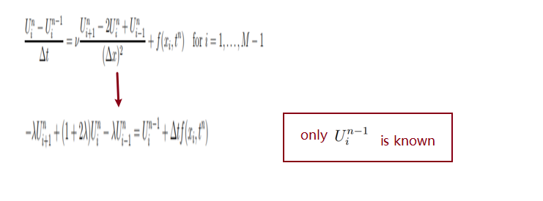
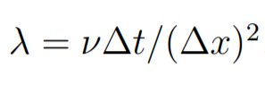
1.1 Implicit scheme for the one-dimensional diffusion equation
u(x,t) , for the time derivation, we use the backward difference
approximation

Slide 12
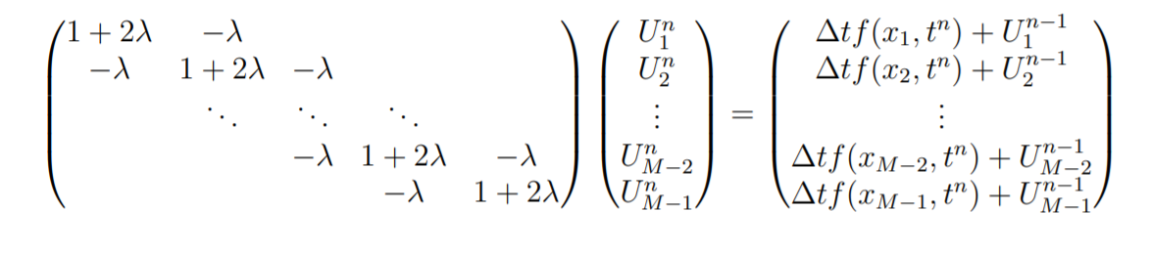
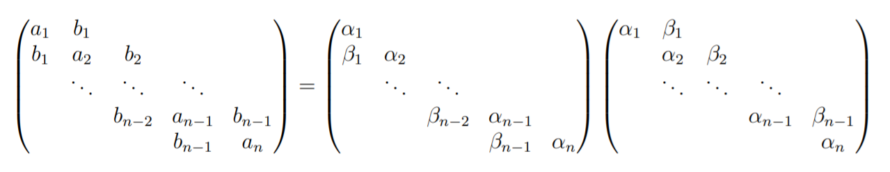
Use the LU Decomposition to solve the linear system

Slide 13
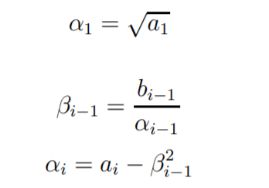


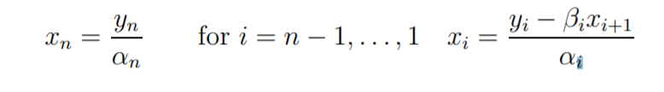
Use the LU Decomposition to solve the linear system

Slide 14
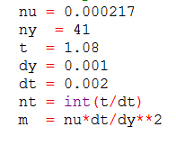

The result of the implicit method for the diffusion equation
the u value means the depth of water

Slide 15
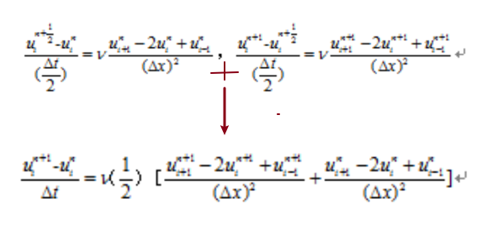

The Crank-Nicolson method for the diffusion equation
As in the backward Euler scheme, the new unkowns are coupled in a linear system

Slide 16
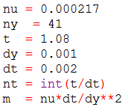
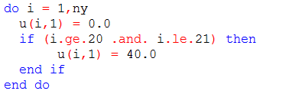
The result of Crank-Nicolson method for diffusion
the u value means the depth of water

Slide 17
Future work
Solve the shallow water equation
Use CIP method to solve the shallow water equation

Slide 18
THANK YOU !

