Slide 1
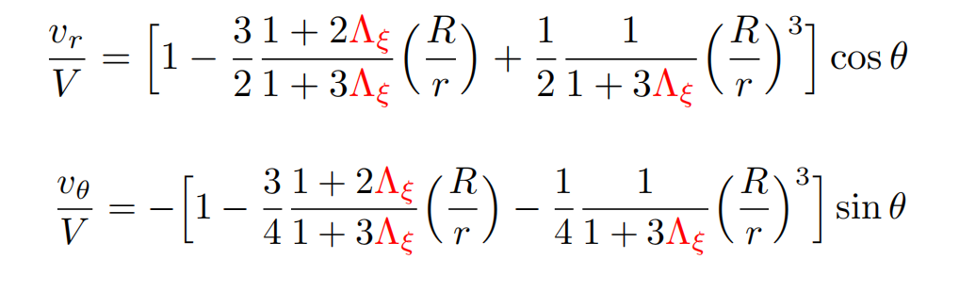
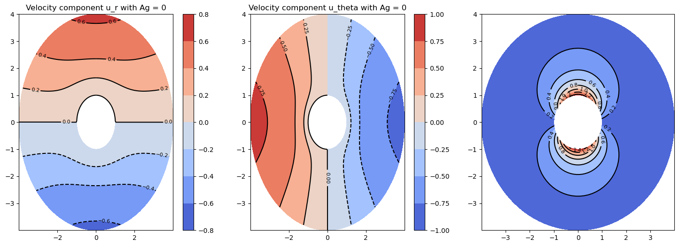
Plot velocity and pressure profiles and then calculate absolute values of the pressures which occur.

