Slide 1
CS 7643: Deep Learning
Topics:
Announcements
Transposed convolutions
Dhruv Batra
Georgia Tech

Slide 2
Administrativia
HW2 + PS2 out
No class on Tuesday 10/03
Guest Lecture by Dr. Stefan Lee on 10/05
No papers to read. No student presentations.
Use the time wisely to work (hint: HW+PS!)
No class on 10/10
Fall break
Next paper reading / student presentations: 10/12
Note on reviews

Slide 3
Note on reviews
Public
Good and bad
Common Problem #1: Vague negatives
“x could have been done better”
Common Problem #2: Virtue Signaling
“I have higher standards than this”
Positive suggestion: Assume good intent
There’s a grad student just like you behind that paper
Snobbery has to be earned

Slide 4
Learnable Upsampling: Transpose Convolution
Recall:Typical 3 x 3 convolution, stride 1 pad 1
Input: 4 x 4
Output: 4 x 4
Slide Credit: Fei-Fei Li, Justin Johnson, Serena Yeung, CS 231n

Slide 5
Learnable Upsampling: Transpose Convolution
Recall: Normal 3 x 3 convolution, stride 1 pad 1
Dot product between filter and input
Input: 4 x 4
Output: 4 x 4
Slide Credit: Fei-Fei Li, Justin Johnson, Serena Yeung, CS 231n

Slide 6
Learnable Upsampling: Transpose Convolution
Recall: Normal 3 x 3 convolution, stride 1 pad 1
Dot product between filter and input
Input: 4 x 4
Output: 4 x 4
Slide Credit: Fei-Fei Li, Justin Johnson, Serena Yeung, CS 231n

Slide 7
Learnable Upsampling: Transpose Convolution
Recall: Normal 3 x 3 convolution, stride 2 pad 1
Input: 4 x 4
Output: 2 x 2
Slide Credit: Fei-Fei Li, Justin Johnson, Serena Yeung, CS 231n

Slide 8
Learnable Upsampling: Transpose Convolution
Recall: Normal 3 x 3 convolution, stride 2 pad 1
Dot product between filter and input
Input: 4 x 4
Output: 2 x 2
Slide Credit: Fei-Fei Li, Justin Johnson, Serena Yeung, CS 231n

Slide 9
Learnable Upsampling: Transpose Convolution
Recall: Normal 3 x 3 convolution, stride 2 pad 1
Filter moves 2 pixels in the input for every one pixel in the output
Stride gives ratio between movement in input and output
Dot product between filter and input
Input: 4 x 4
Output: 2 x 2
Slide Credit: Fei-Fei Li, Justin Johnson, Serena Yeung, CS 231n

Slide 10
Learnable Upsampling: Transpose Convolution
3 x 3 transpose convolution, stride 2 pad 1
Input: 2 x 2
Output: 4 x 4
Slide Credit: Fei-Fei Li, Justin Johnson, Serena Yeung, CS 231n

Slide 11
Learnable Upsampling: Transpose Convolution
3 x 3 transpose convolution, stride 2 pad 1
Input gives weight for filter
Input: 2 x 2
Output: 4 x 4
Slide Credit: Fei-Fei Li, Justin Johnson, Serena Yeung, CS 231n

Slide 12
Learnable Upsampling: Transpose Convolution
3 x 3 transpose convolution, stride 2 pad 1
Sum where output overlaps
Filter moves 2 pixels in the output for every one pixel in the input
Stride gives ratio between movement in output and input
Input gives weight for filter
Input: 2 x 2
Output: 4 x 4
Slide Credit: Fei-Fei Li, Justin Johnson, Serena Yeung, CS 231n

Slide 13
Learnable Upsampling: Transpose Convolution
3 x 3 transpose convolution, stride 2 pad 1
Sum where output overlaps
Other names:
-Deconvolution (bad)
-Upconvolution
-Fractionally strided convolution
-Backward strided convolution
Filter moves 2 pixels in the output for every one pixel in the input
Stride gives ratio between movement in output and input
Input gives weight for filter
Input: 2 x 2
Output: 4 x 4
Slide Credit: Fei-Fei Li, Justin Johnson, Serena Yeung, CS 231n

Slide 14
Transpose Convolution: 1D Example
Output
Input
Filter
ax
ay
az + bx
by
bz
Output contains copies of the filter weighted by the input, summing at where at overlaps in the output
Need to crop one pixel from output to make output exactly 2x input
x
y
z
a
b
Slide Credit: Fei-Fei Li, Justin Johnson, Serena Yeung, CS 231n

Slide 15
Transposed Convolution
https://distill.pub/2016/deconv-checkerboard/

Slide 16
Transposed Convolution
In 3D

Slide 17
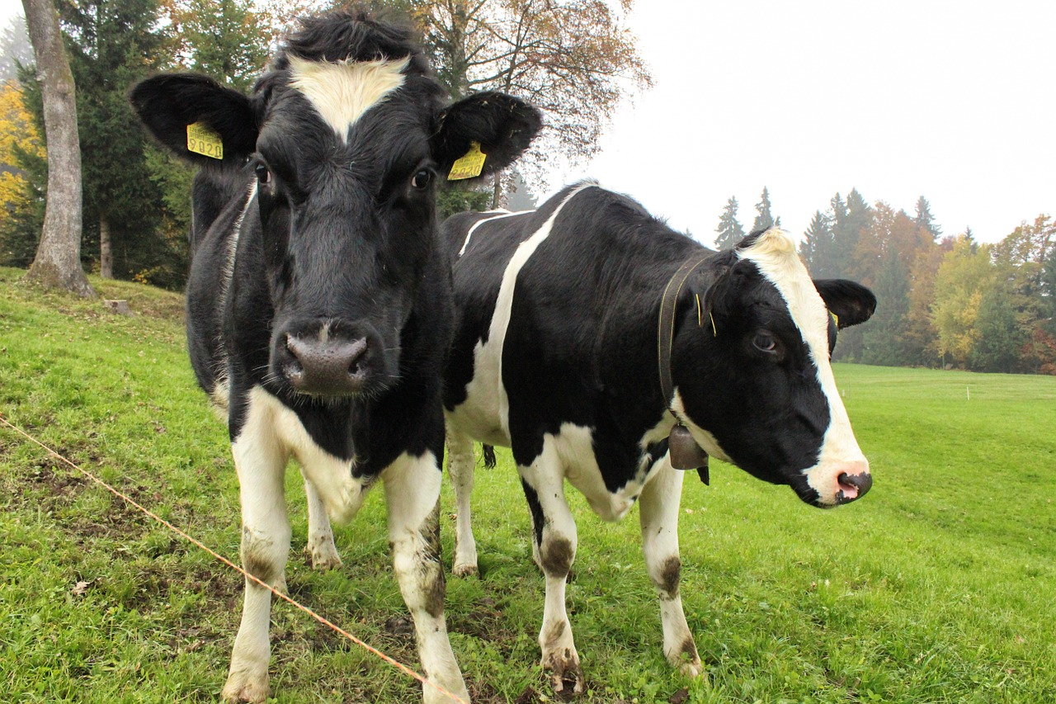
Semantic Segmentation Idea: Fully Convolutional
Downsampling:
Pooling, strided convolution
Design network as a bunch of convolutional layers, with downsampling and upsampling inside the network!
Upsampling:
Unpooling or strided transpose convolution
Med-res:
D₂ x H/4 x W/4
Med-res:
D₂ x H/4 x W/4
Low-res:
D₃ x H/4 x W/4
Input:
3 x H x W
High-res:
D₁ x H/2 x W/2
High-res:
D₁ x H/2 x W/2
Predictions:
H x W
Long, Shelhamer, and Darrell, “Fully Convolutional Networks for Semantic Segmentation”, CVPR 2015 Noh et al, “Learning Deconvolution Network for Semantic Segmentation”, ICCV 2015
Slide Credit: Fei-Fei Li, Justin Johnson, Serena Yeung, CS 231n

Slide 18
What is deconvolution?
(Non-blind) Deconvolution

Slide 19
What does “deconvolution” have to do with “transposed convolution”

Slide 21

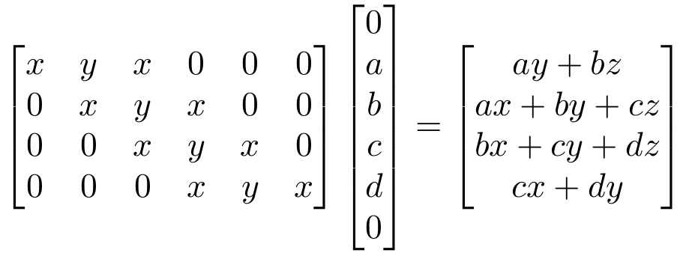
“transposed convolution” is a convolution!
We can express convolution in terms of a matrix multiplication
Example: 1D conv, kernel size=3, stride=1, padding=1
Slide Credit: Fei-Fei Li, Justin Johnson, Serena Yeung, CS 231n

Slide 22

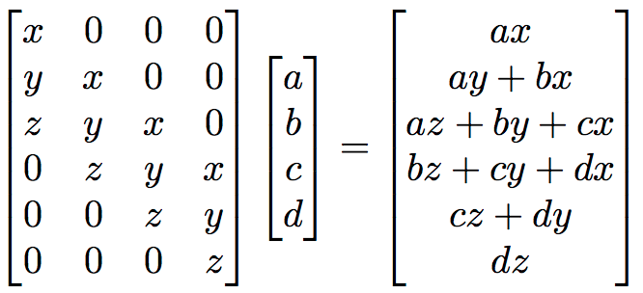
“transposed convolution” is a convolution!
We can express convolution in terms of a matrix multiplication
Convolution transpose multiplies by the transpose of the same matrix:
Example: 1D conv, kernel size=3, stride=1, padding=1
Slide Credit: Fei-Fei Li, Justin Johnson, Serena Yeung, CS 231n

Slide 23
“transposed convolution” is a convolution
We can express convolution in terms of a matrix multiplication
Convolution transpose multiplies by the transpose of the same matrix:
Example: 1D conv, kernel size=3, stride=1, padding=1
When stride=1, convolution transpose is just a regular convolution (with different padding rules)
Slide Credit: Fei-Fei Li, Justin Johnson, Serena Yeung, CS 231n

Slide 24
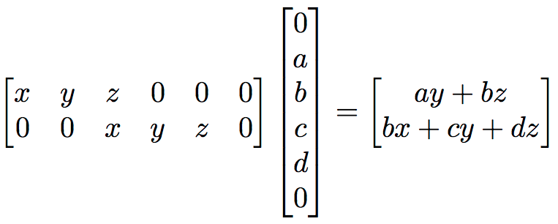
But not always
We can express convolution in terms of a matrix multiplication
Example: 1D conv, kernel size=3, stride=2, padding=1
Slide Credit: Fei-Fei Li, Justin Johnson, Serena Yeung, CS 231n

Slide 25
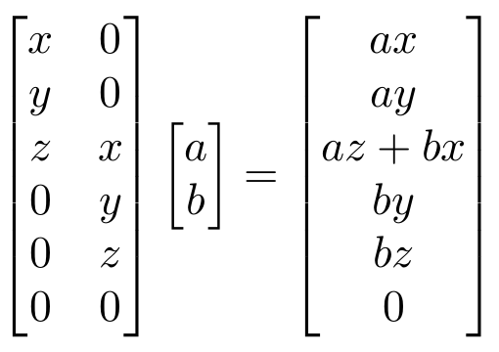
But not always
We can express convolution in terms of a matrix multiplication
Convolution transpose multiplies by the transpose of the same matrix:
Example: 1D conv, kernel size=3, stride=2, padding=1
When stride>1, convolution transpose is no longer a normal convolution!
Slide Credit: Fei-Fei Li, Justin Johnson, Serena Yeung, CS 231n

Slide 26
Student Presentations
Presenters:
Aneeq Zia, Mikhail Isaev, Chris Donlan, Ayesha Khan, Deshraj Yadav, Ardavan Afshar
Google Slides:
https://docs.google.com/presentation/d/1HadX--rN-KC7tJquC2mhDIsteouIYiJKqpNAgz54h5o/edit#slide=id.p
Google Drive
https://drive.google.com/drive/folders/0B8zT-Fl5PDf_dlpBREQwZ1VHa0k?usp=sharing

