Slide 1

On Scalable Computation of Graph Eccentricities
¹Wentao Li, ²Miao Qiao, ¹Lu Qin, ³Lijun Chang, ¹Ying Zhang, ⁴Xuemin Lin
¹University of Technology Sydney
²University of Auckland
³University of Sydney
⁴The University of New South Wales

Slide 2



























Background
Given a graph, eccentricity $ecc\left(v\right)$ is the maximum distance from $v$ to other nodes
$ecc\left(v\right)=\max_{u∈V}dist\left(v,u\right)$
5
5
$$v12$$
$$v8$$
3
3
5
5
4
$$v9$$
$$v3$$
$$v1$$
5
0
1
2
2
3
3
4
4
4
4
5
5
5
$$v6$$
$$v13$$
$$v5$$
$$v1$$
$$v2$$
$$v3$$
$$v4$$
$$v7$$
$$v9$$
$$v5$$
$$v6$$
$$v10$$
$$v13$$
$$v8$$
$$v11$$
$$v12$$
5
4
$$v11$$
4
$$v7$$
3
$$v10$$
4
$$v4$$
$$v2$$

Slide 3
Applications
Important node identification (centrality metric)
Diameter (maximum eccentricity), Radius (minimum eccentricity)
Features for prediction (spammer detection, link prediction)

Slide 4
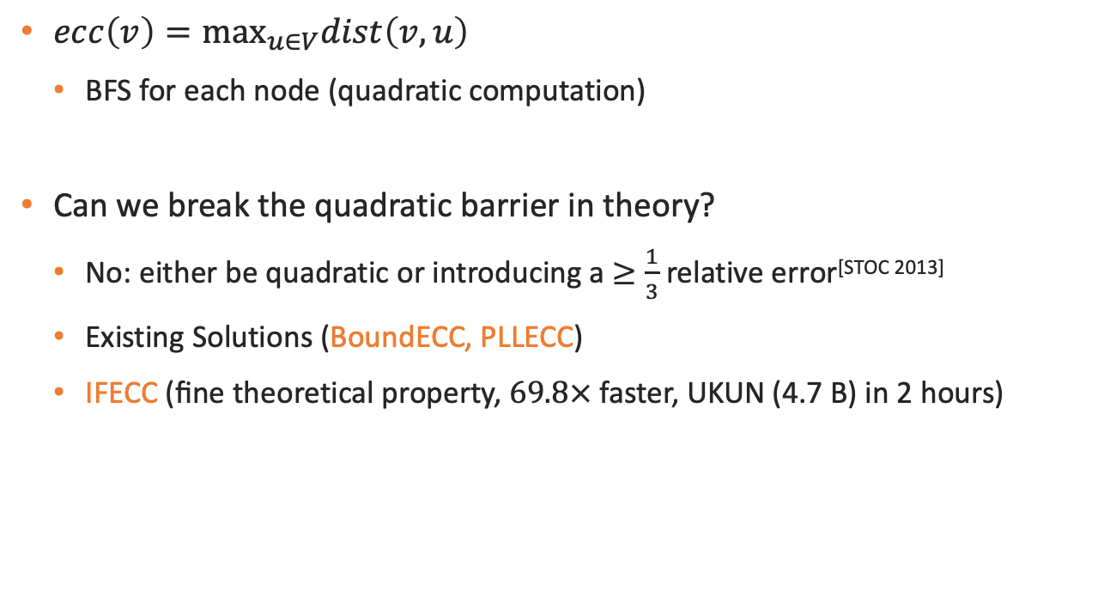
Hardness
$ecc\left(v\right)=\max_{u∈V}dist\left(v,u\right)$
BFS for each node (quadratic computation)
Can we break the quadratic barrier in theory?
No: either be quadratic or introducing a $≥\frac{1}{3}$ relative error^{[STOC 2013]}
Existing Solutions (BoundECC, PLLECC)
IFECC (ﬁne theoretical property, $69.8×$faster, UKUN (4.7 B) in 2 hours)

Slide 5





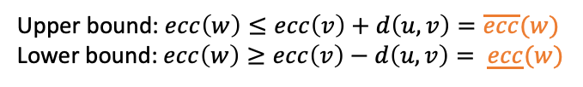

BoundECC: Intuition
BFS for each node (quadratic computation)
Reduce the number of nodes that need to do BFS
Eccentricity Update Rule (if $v$ has eccentricity $ecc(v)$)
node $w$ at distance $d\left(u,v\right)$
Upper bound: $ecc\left(w\right)≤ecc\left(v\right)+d\left(u,v\right)=\overline{ecc}(w)$
Lower bound: $ecc\left(w\right)≥ecc\left(v\right)−d\left(u,v\right)= \underline{ecc}(w)$
$$v12$$
$$v8$$
$$v9$$
$$v3$$
$$v1$$
$$v6$$
$$v13$$
$$v5$$
$$ecc(v3)=3, d(v3,v4)=1$$
$$v11$$
$$v7$$
$$2≤ecc(v4)≤4$$
$$v10$$
$$v4$$
$$v2$$

Slide 6


























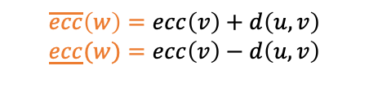



BoundECC: Method
$$v12$$
$$v8$$
$$v9$$
$$v3$$
$$v1$$
$$v6$$
$$v13$$
Set an order for the nodes in the graph
Select a node $v$ for BFS according to this order
Update bounds of other nodes $w$ using eccentricity update rule
$$v5$$
$$v11$$
$$v7$$
$$v10$$
$$v4$$
$$v2$$
$$\overline{ecc}\left(w\right)=ecc\left(v\right)+d\left(u,v\right)$$
$$\underline{ecc}(w)=ecc\left(v\right)−d\left(u,v\right)$$
4
4,8
3,7
3,7
2,6
2,6
2,6
3,5
3,5
3,5
3,5
3,5
3,5
4,4
$$v13$$
$$v1$$
$$v2$$
$$v3$$
$$v4$$
$$v5$$
$$v6$$
$$v7$$
$$v8$$
$$v9$$
$$v10$$
$$v11$$
$$v12$$
$$v13$$
4
4,8
3,7
3,6
3,5
3,5
3,5
4,4
3,5
3,5
3,5
3,5
3,5
4,4
$$v7$$
$$v1$$
$$v2$$
$$v3$$
$$v4$$
$$v5$$
$$v6$$
$$v7$$
$$v8$$
$$v9$$
$$v10$$
$$v11$$
$$v12$$
$$v13$$
Pro: avoid doing BFS for all nodes
Con: no guarantee of #BFSs for an order

Slide 7































PLLECC: Intuition
$$v12$$
$$v8$$
$$v9$$
$$v3$$
$$v1$$
$$v13$$
BoundECC: reduce the number of nodes that need to do BFS
PLLECC: reduce the cost for each node $v$ to determine $ecc(v)$
FFO of reference node as representative
Select a (highest-degree) reference node $z$ (closed to all nodes)
For other nodes, its FFO uses the FFO of the reference node as a substitute
$$v6$$
$$v5$$
$$v7$$
$$v11$$
$$v7$$
$$v10$$
$$v4$$
0
1
1
1
1
1
1
2
2
2
2
3
4
$$v2$$
From near to far
$$v13$$
$$v13$$
$$v12$$
$$v11$$
$$v10$$
$$v9$$
$$v8$$
$$v7$$
$$v6$$
$$v5$$
$$v4$$
$$v3$$
$$v2$$
$$v1$$
4
3
2
2
2
2
1
1
1
1
1
1
0
From far to near
$$v13$$
$$v1$$
$$v2$$
$$v3$$
$$v4$$
$$v5$$
$$v6$$
$$v7$$
$$v8$$
$$v9$$
$$v10$$
$$v11$$
$$v12$$
$$v13$$
Farthest-First Node Order (FFO)

Slide 8



















PLLECC: Method
Select a reference node $z$, get its FFO, initialize other nodes' bounds
Each node $v$ visits nodes in FFO order (by querying distance index)
4
4
3
2
2
2
2
1
1
1
1
1
1
0
reference node
$$v13$$
$$v1$$
$$v2$$
$$v3$$
$$v4$$
$$v5$$
$$v6$$
$$v7$$
$$v8$$
$$v9$$
$$v10$$
$$v11$$
$$v12$$
$$v13$$
Eccentricity Update Rule
querying distance index
$$ecc\left(v\right)+d\left(u,v\right)=\overline{ecc}(w)$$
$$ecc\left(v\right)−d\left(u,v\right)= \underline{ecc}(w)$$
3
$$v9$$
$$\underline{ecc}\left(v9\right)=3,\overline{ecc}\left(v9\right)=4$$
FFO Update Rule
v₉ to the visited nodes $\{v1\}$: $3$
v₉ to the unvisited nodes $\{v2, v3, ⋯, v13\}$: $≤d\left(v9,v13\right)+d(v13,.)=1+3$
Pro: reduce the cost of computing $ecc(v)$ for node $v$
Con: arbitrary distance queries require distance index support

Slide 9
IFECC: Intuition
BoundECC
Con: no guarantee on the required #BFSs for an order
PLLECC
Con: arbitrary distance queries require distance index support
IFECC
Order: Farthest-First Node Order (FFO)
Distance index: replace by BFS on the fly

Slide 10
IFECC: Method
Farthest-First Node Order (FFO)
Set an order for the nodes in the graph
Select a node $v$ for BFS according to this order
Update bounds of other nodes $w$ using eccentricity update rule
and FFO update rule
IFECC
Order: Farthest-First Node Order (FFO)
Distance index: replace by BFS on the fly

Slide 11







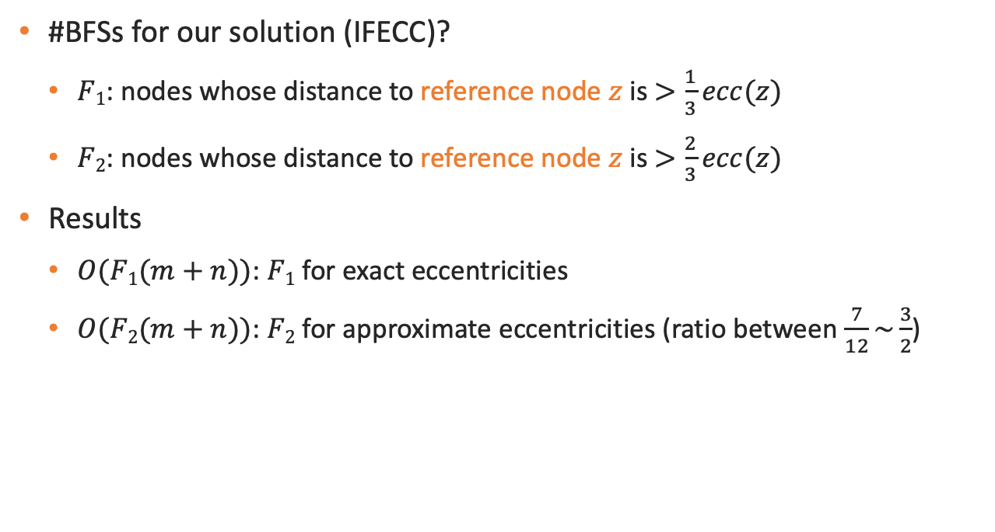









IFECC: Analyze
#BFSs for our solution (IFECC)?
$F1$: nodes whose distance to reference node $z$ is $>\frac{1}{3}ecc(z)$
$F2$: nodes whose distance to reference node $z$ is $>\frac{2}{3}ecc(z)$
Results
$O(F1(m+n))$: $F1$ for exact eccentricities
$O(F2(m+n))$: $F2$ for approximate eccentricities (ratio between $\frac{7}{12}\sim \frac{3}{2}$)
$F2$: $>\frac{2}{3}×4=2$
4
4
3
2
2
2
2
1
1
1
1
1
1
0
$$v13$$
$$v1$$
$$v2$$
$$v3$$
$$v4$$
$$v5$$
$$v6$$
$$v7$$
$$v8$$
$$v9$$
$$v10$$
$$v11$$
$$v12$$
$$v13$$
$F1$: $>\frac{1}{3}×4=1$

Slide 12
IFECC: Result
Name | Dataset | n | m
DBLP | DBLP | 317080 | 1049866
GP | GPlus | 201949 | 1133956
YOUT | Youtube | 1134890 | 2987624
DIGG | Digg | 770799 | 5907132
SKIT | Skitter | 1694616 | 11094209
DBPE | Dbpedia | 3915921 | 12577253
HUDO | Hudong | 1962418 | 14419760
TPD | UK-Tpd | 1766010 | 15283718
FLIC | Flickr | 1624992 | 15476835
BAID | Baidu | 2107689 | 16996139
TOPC | Topcats | 1791489 | 25444207
STAC | Stackoverflow | 2572345 | 28177464
UK02 | UK02 | 18459128 | 261556721
ARAB | Arabic | 22634275 | 552231867
IT | IT | 41290577 | 1027474895
TWIT | Twitter | 41652230 | 1202513046
FRIE | Friendster | 65608366 | 1806067135
SK | SK | 50634118 | 1810050743
UK07 | UK07 | 104288749 | 3293805080
UKUN | UKUN | 130831972 | 4653174411
The experiments were conducted on 20 real-world graphs
The largest graph (UKUN) has more than 4.6 billion edges
billion-scale

Slide 13



IFECC: Result
$O(F1(m+n))$: $F1$ for exact eccentricities
$O(F2(m+n))$: $F2$ for approximate eccentricities (ratio between $\frac{7}{12}\sim \frac{3}{2}$)
$|F1|$ is on average $0.1n$
$|F2|$ is on average $3.4×{10}^{−4}n$

Slide 14

IFECC: Result
IFECC is on average $2675.3×$ faster than BoundECC (11 graphs)
IFECC is on average $69.8×$ faster than PLLECC (12 graphs)
Time Cost

Slide 15
IFECC: Result
PLLECC requires on average more than 36.6 times more memory space than IFECC (due to the expensive distance index)
Space Cost

Slide 16
Conclusion
BoundECC cannot determine #BFSs needed, while PLLECC relies on expensive distance index
IFECC to overcome the limitations of current solutions
Theoretical analysis of IFECC
Experimentally analysis of IFECC

