Slide 1
Predicting Query Execution Time: Are Optimizer Cost Models Really Unusable?
Wentao Wu¹, Yun Chi², Shenghuo Zhu², Junichi Tatemura², Hakan Hacigumus², Jeffrey Naughton¹
¹Dept of Computer Sciences, University of Wisconsin-Madison
²NEC Laboratories America

Slide 2



Motivation
Database as a service (DaaS)
User
Service Provider
Service Level Agreement (SLA)
Database
How to predict the execution time of a query before it runs?
Notes:
Database as a service is more and more popular now, as we are moving into the cloud. In this scenario, the user usually makes some “service level agreement” (SLA) with the database service provider.
Some explanation for SLA: SLA states the service requirement that needs to be ensured by the service provider, and also the penalty if the requirement is not achieved. A natural and common requirement is the required execution time of the query.
So the question is: how can we know the execution time of a query before it runs?

Slide 3
Applications
Admission control
Run this query or not?
Query scheduling
If we decide to run it, when?
Progress monitoring
How long should we wait if something is wrong?
System sizing
How much hardware does it require to run in the given time?
Notes:
In addition, predicting query execution time also has applications in many other important database management issues. For example, admission control..

Slide 4
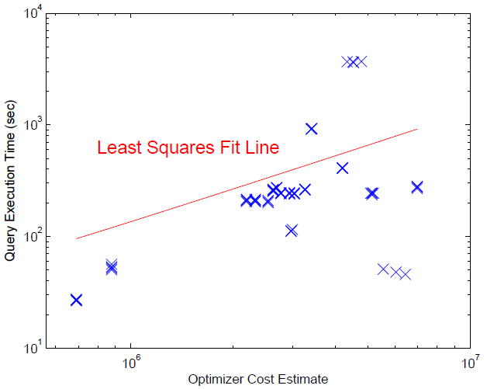
Use Optimizers’ Cost Estimates?
Query optimizers have cost estimates for queries.
Can we just use them?
Previous work ([Ganapathi ICDE’09], [Akdere ICDE’12])
Query optimizers’ cost estimates are unusable.
avg err: 120%
Naïve Scaling:
Predict the execution time T by scaling the cost estimate C,
i.e., T = a · C
Fig. 5 of [Akdere ICDE’12]
Notes:
Previous work in query execution time prediction used machine-learning based methods. The key belief behind these work is that: query optimizers’ cost estimations are not good enough for query execution time prediction. To verify this, they tried to map the cost estimates from the optimizer to the execution time of the query via linear regression.
For example, this figure is from Fig. 5 of the ICDE’12 paper. It shows the linear regression results of the PostgreSQL optimizer’s estimates. The x-axis is the optimizer’s estimate, while the y-axis is the query execution time. We can see that the estimates are often very inaccurate. The average error reported is about 120%.

Slide 5

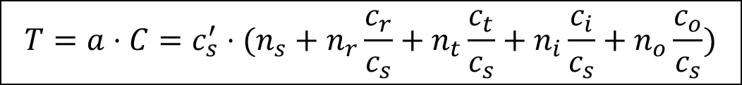
Why Does Naïve Scaling Fail?
Cost Unit | Value
c_{s}: seq_page_cost | 1.0
c_{r}: rand_page_cost | 4.0
c_{t}: cpu_tuple_cost | 0.01
c_{i}: cpu_index_tuple_cost | 0.005
c_{o}: cpu_operator_cost | 0.0025
PostgreSQL’s cost model
The assumptions required (for naïve scaling to work)
The ratios between the c’s are correct.
The n’s are correct.
$$C=n_{s}c_{s}+n_{r}c_{r}+n_{t}c_{t}+n_{i}c_{i}+n_{o}c_{o}$$
Naïve Scaling
$$T=a⋅C={c_{s}^{′}⋅(n}_{s}+n_{r}\frac{c_{r}}{c_{s}}+n_{t}\frac{c_{t}}{c_{s}}+n_{i}\frac{c_{i}}{c_{s}}+n_{o}\frac{c_{o}}{c_{s}})$$
Should be correct!
$$c_{s}^{′}={a⋅c}_{s}=a⋅1.0=a$$
Notes:
However, is this really correct? Namely, is linear regression a correct way of mapping cost estimates to execution time? Let’s take a look at how PostgreSQL comes up with these cost estimates.
PostgreSQL uses a quite straightforward cost model. The cost of an operator O is estimated as the sum of I/O cost and CPU cost. The optimizer further distinguishes sequential and random I/Os. It also treats different CPU operations in different ways. Describe the meaning of c_t, c_i, and c_o.
We can see, linear regression actually admits the correctness of these c’s and n’s, which is far from true in practice.

Slide 6
Beat Naïve Scaling
PostgreSQL’s cost model
To beat naïve scaling
Use machine learning ([Ganapathi ICDE’09], [Akdere ICDE’12])
Calibrate the c’s and the n’s! (our work)
$$C=n_{s}c_{s}+n_{r}c_{r}+n_{t}c_{t}+n_{i}c_{i}+n_{o}c_{o}$$
Unfortunately, both the c’s and the n’s could be incorrect!

Slide 7
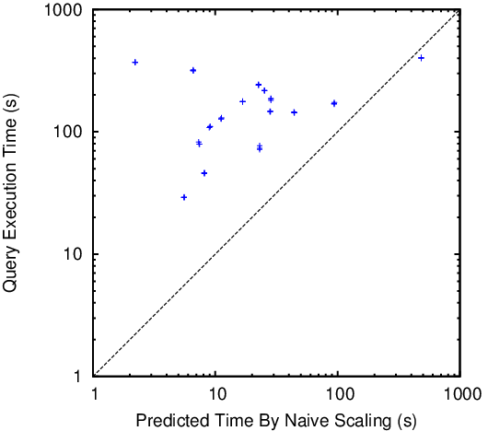
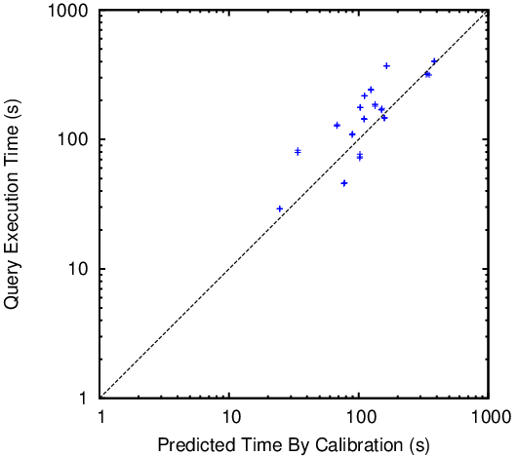
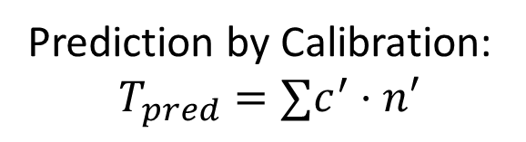
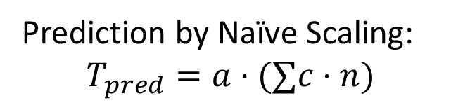
What if We Use Calibrated c’s and n’s?
Cost models become much more effective.
Prediction by Naïve Scaling:
$$T_{pred}=a⋅(∑c⋅n)$$
Prediction by Calibration:
$$T_{pred}=∑c^{′}⋅n′$$

Slide 8
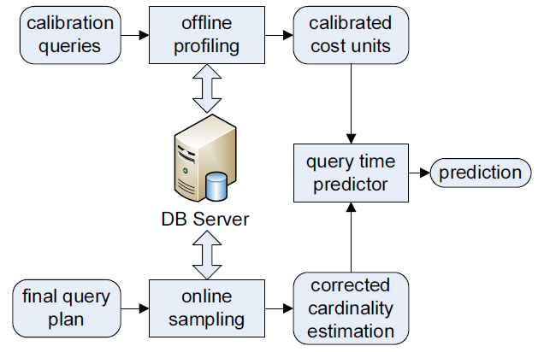
Main Idea
How can we calibrate the c’s and the n’s?
Calibrate the c’s: use profiling queries.
Calibrate the n’s: refine cardinality estimates.
Notes:
So, if we use the correct c’s and n’s in the cost models, what would happen? In our study, we found that the cost models became much more effective, when more accurate (calibrated) c’s and n’s were used. We next describe our calibration approaches and present experiment results. Discuss the big picture of the calibration framework.

Slide 9
Contribution of This Work
We proposed a systematic framework to calibrate the cost models used by the query optimizer.
We showed that the calibrated cost model is much better than naïvely scaling the cost estimates.
We further showed that the calibrated cost model is also much better than the state-of-the-art machine-learning based approaches.

Slide 10
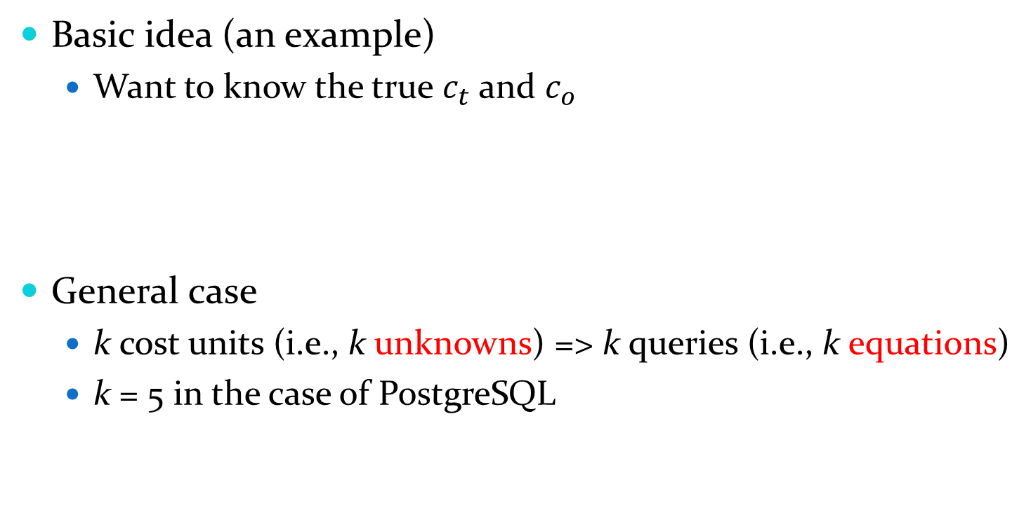
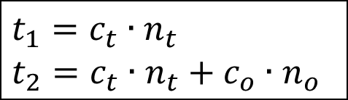
Calibrating The c’s
Cost Unit
c_{s}: seq_page_cost
c_{r}: rand_page_cost
c_{t}: cpu_tuple_cost
c_{i}: cpu_index_tuple_cost
c_{o}: cpu_operator_cost
Basic idea (an example)
Want to know the true $c_{t}$ and $c_{o}$
General case
k cost units (i.e., k unknowns) => k queries (i.e., k equations)
k = 5 in the case of PostgreSQL
q₁: select * from R
q₂: select count(*) from R
R in memory
$$t_{1}=c_{t}∙n_{t}$$
$$t_{2}=c_{t}∙n_{t}+c_{o}∙n_{o}$$

Slide 11
How to Pick Profiling Queries?
Completeness
Each c should be covered by at least one query.
Conciseness
The set of queries is incomplete if any query is removed.
Simplicity
Each query should be as simple as possible.
Notes:
Completeness is “mandatory”, while conciseness and simplicity are just “desirable”. Since the possible number of SQL queries on a given database is infinite, we restrict our attention to concise complete subsets. Simpler queries are desirable, since it is easier to obtain correct values for the n’s (it might be difficult to obtain the right n’s for operators embedded in deep query trees).

Slide 12

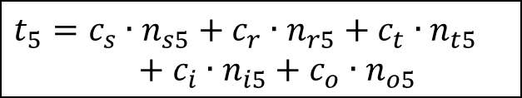



Profiling Queries For PostgreSQL
Isolate the unknowns and solve them one per equation!
R in memory
q₁: select * from R
$$t_{1}=c_{t}∙n_{t1}$$
R in memory
q₂: select count(*) from R
$$t_{2}=c_{t}∙n_{t2}+c_{o}∙n_{o2}$$
q₃: select * from R where R.A < a (R.A with an Index)
R in memory
$$t_{3}=c_{t}∙n_{t3}+c_{i}∙n_{i3}+c_{o}∙n_{o3}$$
R on disk
q₄: select * from R
$t_{4}=c_{s}∙n_{s4}$ + $c_{t}∙n_{t4}$
q₅: select * from R where R.B < b (R.B unclustered Index)
R on disk
$$t_{5}=c_{s}∙n_{s5}+c_{r}∙n_{r5}+c_{t}∙n_{t5}+c_{i}∙n_{i5}+c_{o}∙n_{o5}$$
Notes:
With the three guiding principles shown in the previous slide, we pick profiling queries as follows.

Slide 13
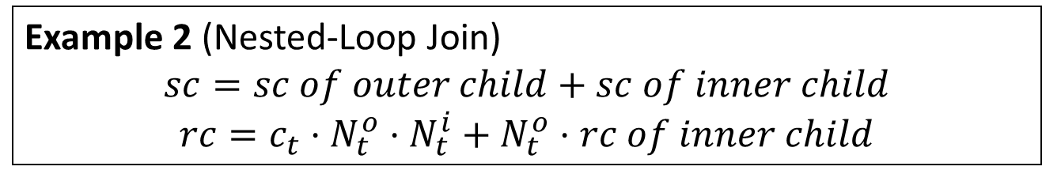
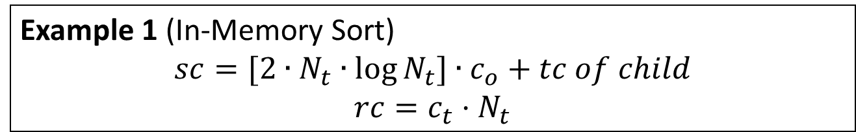
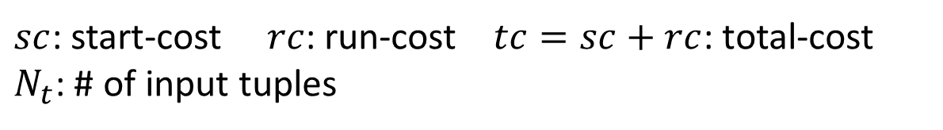
Calibrating The n’s
The n’s are functions of N’s (i.e., input cardinalities).
Calibrating the n’s => Calibrating the N’s
Example 1 (In-Memory Sort)
$$sc=[2∙N_{t}∙\log{N_{t}]∙c_{o}}+tc of child$$
$$rc=c_{t}⋅N_{t}$$
n_{o}
Example 2 (Nested-Loop Join)
$$sc=sc of outer child+sc of inner child$$
$$rc=c_{t}⋅N_{t}^{o}⋅N_{t}^{i}+N_{t}^{o}⋅rc of inner child$$
n_{t}
$sc$: start-cost $rc$: run-cost $tc=sc+rc$: total-cost
$N_{t}$: # of input tuples
Notes:
Our next major step is to calibrate the n’s. Let’s first take a look at how these n’s are obtained.
We present the cost formulas of two typical operators used by PostgreSQL: in-memory sort, and nested-loop join.
The little n’s are thus functions of the big N’s. For different operators, the function is different. However, to calibrate the little n’s, what we need to do is to calibrate the big N’s, regardless of the operator we are concerned with. Calibration of the big N’s then brings us back to the (old) problem of cardinality estimation.

Slide 14
Refine Cardinality Estimates
Cardinality Estimation
 | Traditional Role (Query Optimization) | Our Case (Execution Time Prediction)
# of Plans | Hundreds/Thousands of
1
Time per Plan | Must be very short
Can be a bit longer
Precision | Important
Critical
Approach | Histograms (dominant)
Sampling (one option)
Notes:
The idea is to refine the cardinality estimates of each operator. However, our case is very different from the traditional role played by cardinality estimation. Illustrate the difference. As a result, since we only refine cardinality estimates for the final single plan already chosen by the optimizer, it might be affordable to try some more costly but more accurate approaches. In this work, we chose to use a sampling based approach. The other options are fine.
You should mention that the cardinality estimation errors in query optimizer will not cause trouble if the relative order of plans (based on their cost) does not change. But in the case of query execution time prediction, it is much more important since they are directly used to make the prediction (i.e., we care the actual cost of the plan, not just the ranking of the plans).

Slide 15



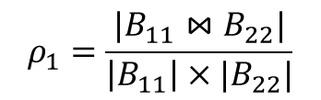

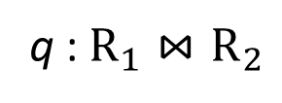

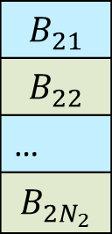


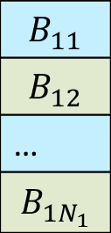

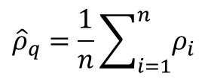
A Sampling-Based Estimator
Estimate the selectivity $ρ_{q}$of a select-join query $q$.
[Haas et al., J. Comput. Syst. Sci. 1996]
q : $R_{1}⋈R_{2}$
n samples
(w/ replacement)
Partition
$$ρ_{1}=\frac{|B_{11}⋈B_{22}|}{\left|B_{11}\right|×|B_{22}|}$$
$$ρ_{1}$$
$$B_{11}$$
$$B_{12}$$
…
$$B_{1N_{1}}$$
$$B_{21}$$
$$B_{22}$$
…
$$B_{2N_{2}}$$
s₁:
$$B_{11}$$
$$⋈$$
$$B_{22}$$
………..
………..
$${\hat{ρ}}_{q}=\frac{1}{n}\sum_{i=1}^{n}{ρ_{i}}$$
$$ρ_{n}$$
s_{n}:
$$B_{1N_{1}}$$
$$⋈$$
$$B_{21}$$
R₁
R₂
The estimator ${\hat{ρ}}_{q}$is unbiased and strongly consistent!
Notes:
This extends previous work from pure join queries to queries with mixed selections and joins.

Slide 16
The Cardinality Refinement Algorithm
Design the algorithm based on the previous estimator.
Problem | Our Solution
1. The estimator needs random I/Os at runtime to take samples.
1. Take samples offline and store them as tables in the database.
2. Query plans usually contain more than one operators.
2. Estimate multiple operators in a single run, by reusing partial results.
3. The estimator only works for select/join operators.
3. Rely on PostgreSQL’s cost models for aggregates. Future work: Add estimators for aggregates ([Charikar PODS’00]).
Notes:
We now have an estimator for a single operator. However, there are several issues in practice: (1) random disk accesses are involved to take samples; (2) a query plan usually contains more than one operator; (3) it cannot work for other operators such as aggregates.
We designed our cardinality refinement algorithm based on this estimator by addressing these issues. We made two key design decisions to make it efficient: 1) take samples offline to reduce random disk accesses; 2) estimate multiple operators in one single run. We showed that in this way, we could preserve the two properties of the estimator for each operator: unbiasedness and strong consistency. For (3), we rely on PostgreSQL's model.

Slide 17

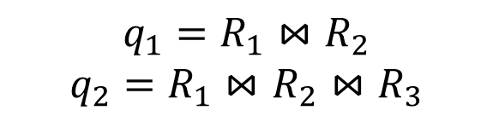


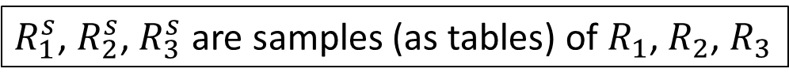






The Cardinality Refinement Algorithm (Example)
$$q_{1}=R_{1}⋈R_{2}$$
$$q_{2}=R_{1}⋈R_{2}⋈R_{3}$$
Plan for q:
agg
agg
$$\hat{ρ_{q_{1}}}=\frac{|R_{1}^{s}⋈R_{2}^{s}|}{|R_{1}^{s}|×|R_{2}^{s}|}$$
$$\hat{ρ_{q_{2}}}=\frac{|R_{1}^{s}⋈R_{2}^{s}⋈R_{3}^{s}|}{|R_{1}^{s}|×{|R}_{2}^{s}|×|R_{3}^{s}|}$$
Rewrite
q₂
Run
$$⋈$$
$$⋈$$
$$⋈$$
q₁
$$⋈$$
$$R_{3}^{}$$
$$R_{3}^{s}$$
$$R_{1}^{}$$
$$R_{2}^{}$$
$$R_{1}^{s}$$
$$R_{2}^{s}$$
$R_{1}^{s}$, $R_{2}^{s}$, $R_{3}^{s}$ are samples (as tables) of $R_{1}$, $R_{2}$, $R_{3}$
Reuse
For agg, use PostgreSQL’s estimates based on the refined input estimates from q₂.
Notes:
Here is an example. q is a query and the leftmost figure presents its plan chosen by the optimizer. Let R_1^s, R_2^s, R_3^s be the samples (materialized views) of R_1, R_2, R_3, respectively. We first rewrite the query plan by replacing the relations with their corresponding samples. We then simply run the modified query (plan), after which we can learn the sizes of the two joins (namely, the two subqueries q_1 and q_2), and estimate the selectivity \rho_{q_1} and \rho_{q_2} accordingly (as shown). The correctness of this implementation is shown in the paper. Finally, we simply call PostgreSQL's model for the aggregate operator. However, the estimated input cardinality (i.e., the size of q_2) of "agg" is now different from the optimizer's original estimate. Therefore, the estimated output cardinality of "agg" might still be refined.
Note that a naïve implementation could be to run the estimator once for each of the two joins (so twice in total), which is actually unnecessary. We showed that reusing the partial results could perserve the unbiasedness and strong consistency of the estimator.

Slide 18
Experimental Settings
PostgreSQL 9.0.4, Linux 2.6.18
TPC-H 1GB and 10GB databases
Both uniform and skewed data distribution
Two different hardware configurations
PC1: 1-core 2.27 GHz Intel CPU, 2GB memory
PC2: 8-core 2.40 GHz Intel CPU, 16GB memory
Notes:
Skewed data follows a Zipf distribution with the parameter z=1.

Slide 19
Calibrating Cost Units
PC1:
Cost Unit | Calibrated(ms) | Calibrated (normalized to c_{s}) | Default
c_{s}: seq_page_cost | 5.53e-2 | 1.0 | 1.0
c_{r}: rand_page_cost | 6.50e-2 | 1.2 | 4.0
c_{t}: cpu_tuple_cost | 1.67e-4 | 0.003 | 0.01
c_{i}: cpu_index_tuple_cost | 3.41e-5 | 0.0006 | 0.005
c_{o}: cpu_operator_cost | 1.12e-4 | 0.002 | 0.0025
PC2:
Cost Unit | Calibrated(ms) | Calibrated (normalized to c_{s}) | Default
c_{s}: seq_page_cost | 5.03e-2 | 1.0 | 1.0
c_{r}: rand_page_cost | 4.89e-1 | 9.7 | 4.0
c_{t}: cpu_tuple_cost | 1.41e-4 | 0.0028 | 0.01
c_{i}: cpu_index_tuple_cost | 3.34e-5 | 0.00066 | 0.005
c_{o}: cpu_operator_cost | 7.10e-5 | 0.0014 | 0.0025
Notes:
The ratios of default values of the c’s are incorrect! For example, on PC1, the ratio of calibrated cpu_tuple_cost to seq_page_cost is about 0.003 instead of 0.01.
One more thing: the profiling stage only needs to be done once as long as the hardware settings do not change. We used different database sizes and data distributions in our experiments, but the profiling stage was done only once for PC1 and PC2.

Slide 20
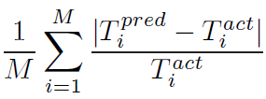
Prediction Precision
Metric of precision
Mean Relative Error (MRE)
Dynamic database workloads
Unseen queries frequently occur.
Compare with existing approaches
Naive scaling
More complex machine learning approaches
Notes:
MRE was used as performance metric in all previous work. We didn’t compare with [Ganapathi ICDE’09], since [Akdere ICDE’12] has showed that both their plan-level and operator-level based approaches outperform [Ganapathi ICDE’09] for dynamic workloads. For ML-based approaches, to simulate dynamic workloads, we use the “leave-one-template-out” strategy. Each time we excluded one template for testing, and used the other templates in training.

Slide 21
Existing Machine-Learning Methods
The idea
Represent a query as a feature vector
Train a regression model
SVM [Akdere ICDE’12]
REP trees [Xiong SoCC’11]
KCCA [Ganapathi ICDE’09]
Did not compare since [Akdere ICDE’12] is better.

Slide 22
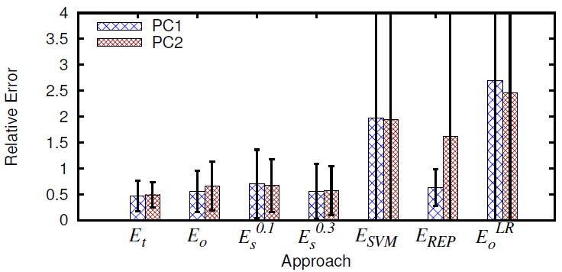
Precision on TPC-H 1GB DB
Uniform data:
Naïve Scaling
E_{t}: c’s (calibrated) + n’s (true cardinalities)
E_{o}: c’s (calibrated) + n’s (cardinalities by optimizer)
E_{s}: c’s (calibrated) + n’s (cardinalities by sampling)
Notes:
E_{t}: calibrated c’s + true n’s
E_{o}: calibrated c’s + optimizer’s estimated n’s
E_{s}: calibrated c’s + refined n’s via sampling (0.1 and 0.3 are sampling ratios, e.g., 0.1 means sample size is 10% of the database size)

Slide 23
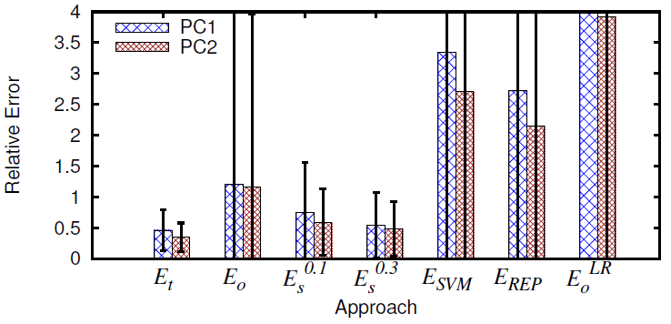
Precision on TPC-H 1GB DB (Cont.)
Skewed data:
E_{t}: c’s (calibrated) + n’s (true cardinalities)
E_{o}: c’s (calibrated) + n’s (cardinalities by optimizer)
E_{s}: c’s (calibrated) + n’s (cardinalities by sampling)
Notes:
E_{t}: calibrated c’s + true n’s
E_{o}: calibrated c’s + optimizer’s estimated n’s
E_{s}: calibrated c’s + refined n’s via sampling (0.1 and 0.3 are sampling ratios, e.g., 0.1 means sample size is 10% of the database size)

Slide 24
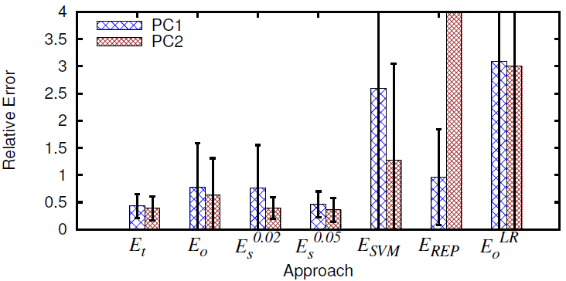
Precision on TPC-H 10GB DB
Uniform data (similar results on skewed data):
E_{t}: c’s (calibrated) + n’s (true cardinalities)
E_{o}: c’s (calibrated) + n’s (cardinalities by optimizer)
E_{s}: c’s (calibrated) + n’s (cardinalities by sampling)
Notes:
The performance of our approach on 10GB database is similar to what we observed on 1GB database. ML-based approaches, however, showed inconsistency in their performance. We have no idea of the particular reason (the execution times of the training/testing queries are quite different on PC1 and PC2).

Slide 25
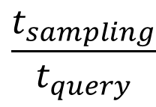
Overhead of Sampling
$$\frac{t_{sampling}}{t_{query}}$$
Additional overhead is measured as
More samples mean higher additional overhead
For close-to-ideal prediction on 1GB DB
30% samples (0.3GB) => 20% additional overhead
For close-to-ideal prediction on 10GB DB
5% samples (0.5GB) => 4% additional overhead

Slide 26
Conclusion
We presented a systematic framework to calibrate the cost units and refine the cardinality estimates used by current cost models.
We showed that current cost models are much more effective in query execution time prediction after proper calibration, and the additional overhead is affordable in practice.

