Slide 1
A Brief Overview of Query Optimization
Wentao Wu
Microsoft Research
2/9/2018

Slide 2
Outline
Architecture of Query Optimizer
Cost Modeling
Dynamic Query Optimization

Slide 3
Architecture of Query Optimizer

Slide 4
Conceptual View
Parse
Abstract Syntax Tree (AST)
Analyze
(Relational) Algebraic
Tree
Query (SQL)
Search (Iterating)
Logical Optimization
Physical Optimization
(Best) Execution Plan
Query Optimization

Slide 5
Logical Optimization
Goal: Produce logically equivalent (relational) algebraic trees.
Common techniques
Push down selections/projections/aggregations.
Reorder joins (inner/outer/semi/anti joins).
Rewrite nested subqueries.
References
[1] U. Dayal. Of nests and trees: A unified approach to processing queries that contain nested subqueries, aggregates, and quantifiers. (VLDB’87)
[2] Weipeng P. Yan, Per-Åke Larson: Eager Aggregation and Lazy Aggregation. (VLDB’95)

Slide 6
Physical Optimization
Goal: Replace logical operators in the algebraic tree with physical operators.
E.g., join => hash/merge/nested-loop join
E.g., aggregation => sort-based/hash-based aggregation
Common techniques
Rule-based: E.g., pattern matching in SparkSQL.
Cost-based: Use a cost model to estimate execution cost of a physical plan.
References
[1] M. Armbrust et al. Spark SQL: Relational Data Processing in Spark. (SIGMOD’15)
[2] Leonard D. Shapiro: Join Processing in Database Systems with Large Main Memories. (ACM Trans. Database Syst., 1986)

Slide 7
Search Framework
Goal: Search for the “best” execution plan (i.e., the plan with the lowest cost).
Common techniques
Bottom-up: Dynamic programming (System R). Used by Oracle, IBM DB2, PostgreSQL.
Top-down: Volcano => Cascades. Used by Microsoft SQL Server, Greenplum (Pivotal).
References
[1] P. Selinger et al.: Access Path Selection in a Relational Database Management System. (SIGMOD’79)
[2] Goetz Graefe: The Cascades Framework for Query Optimization. (IEEE Data Eng. Bull., 1995)
[3] M. A. Soliman et al.: Orca: A Modular Query Optimizer Architecture for Big Data. (SIGMOD’14)

Slide 8
Other References
Surveys
[1] Yannis E. Ioannidis: Query Optimization. (ACM Comput. Surv. 28:1, 1996)
[2] Surajit Chaudhuri: An Overview of Query Optimization in Relational Systems. (PODS’98)
Search frameworks
[1] Guy M. Lohman: Grammar-like Functional Rules for Representing Query Optimization Alternatives. (SIGMOD’88)
[2] Laura M. Haas, Johann Christoph Freytag, Guy M. Lohman, Hamid Pirahesh:
Extensible Query Processing in Starburst. (SIGMOD’89)
[3] Goetz Graefe, William J. McKenna: The Volcano Optimizer Generator: Extensibility and Efficient Search. (ICDE’93)
[4] Immanuel Trummer, Christoph Koch: Solving the Join Ordering Problem via Mixed Integer Linear Programming. (SIGMOD’17)

Slide 9
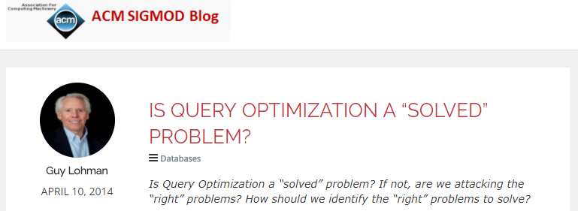
Is Query Optimization a “Solved” Problem?
Well, it has been 40 years since the 1979 System-R paper …
What are the “right” problems that remain unsolved?

Slide 10
Cost Modeling: The Pain

Slide 11
Query Optimizer Needs Good Cost Models
Unlike the other components in a query optimizer, cost modeling lacks a standard procedure and is case-by-case.
It is based on the “knowledge” from the database system developers about the relative execution overheads of different operators.
Common techniques
Analytical modeling: Used by most (if not all) major database systems.
Machine learning: One of the hot research areas in recent years.

Slide 12
Analytic Modeling
Basically develop cost formulas for different operators.
E.g. Cost = CPU cost + I/O cost + Network communication cost
Cost models need validation and calibration.
References
[1] Lothar F. Mackert, Guy M. Lohman: R* Optimizer Validation and Performance Evaluation for Local Queries. (SIGMOD’86)
[2] Lothar F. Mackert, Guy M. Lohman: R* Optimizer Validation and Performance Evaluation for Distributed Queries. (VLDB’86)
[3] W. Du, R. Krishnamurthy, and M.-C. Shan. Query optimization in a heterogeneous dbms. (VLDB’92)
[4] S. Mangegold et al., Generic database cost models for hierarchical memory systems. (VLDB’02)

Slide 13
Machine Learning
Don’t trust the cost formulas made by optimizer developers.
Learn cost functions based on query execution data.
References
[1] A. Ganapathi et al., Predicting Multiple Metrics for Queries: Better Decisions Enabled by Machine Learning. (ICDE’09)
[2] M. Akdere et al., Learning-based Query Performance Modeling and Prediction. (ICDE’12)
[3] J. Li et al., Robust Estimation of Resource Consumption for SQL Queries using Statistical Techniques. (PVLDB 5:11, 2012)
[4] W. Wu et al., Predicting Query Execution Time: Are Optimizer Cost Models Really Unusable? (ICDE’13)
([3] and [4] combine analytic modeling with machine learning.)

Slide 14
Cardinality Estimation: The Hardest Part
No matter you use analytic modeling or machine learning, you need cardinality information (i.e., sizes of intermediate results produced by operators in query execution plans).
Recent work shows that cardinality estimation may be the most (and often the only) important thing in cost modeling.
[1] V. Leis et al., How Good Are Query Optimizers, Really? (PVLDB 9: 3, 2015)
Common techniques
Use histograms: equi-width, equi-depth, multi-dimensional.
Use samples, sketches, statistical models, execution feedback, etc.

Slide 15
Single-column Histograms
Histograms for a single column
Equi-width, equi-depth, V-optimal, …
Attribute-Value-Independence (AVI) assumption: Assume the independence between histograms (i.e., distributions) when estimate selectivity/cardinality for predicates involving more than one columns (e.g., X > 3 and Y < 8).
The estimation error can be exponential under AVI.
References
[1] M. Muralikrishna and David J Dewitt., Equi-depth histograms for estimating selectivity factors for multidimensional queries. (SIGMOD’88)
[2] Yannis E. Ioannidis, Stavros Christodoulakis: On the Propagation of Errors in the Size of Join Results. (SIGMOD’91)
[3] V. Poosala et al., Improved histograms for selectivity estimation of range predicates. (SIGMOD’96)
[4] Yannis E. Ioannidis: The History of Histograms (abridged). (VLDB’03)

Slide 16
Multi-column Histograms
Motivation: Overcome the AVI assumption.
Use histograms to capture the joint distribution across multiple columns.
Drawback: The size increases exponentially w.r.t. the # of columns.
Workload-driven approaches: Only construct multi-column histograms for columns that appear in workload queries.
References
[1] V. Poosala, Y. E. Ioannidis: Selectivity Estimation Without the Attribute Value Independence Assumption. (VLDB’97)
[2] N. Bruno et al., STHoles: A Multidimensional Workload-Aware Histogram. (SIGMOD’01)
[3] I. F. Ilyas et al., CORDS: Automatic Discovery of Correlations and Soft Functional Dependencies. (SIGMOD’04)

Slide 17
Other Approaches
Sampling/Sketches (References)
[1] R. Lipton et al., Practical Selectivity Estimation through Adaptive Sampling. (SIGMOD’90)
[2] P. J. Haas et al., Selectivity and cost estimation for joins based on random sampling. (J. Comput. Syst. Sci., 52:3, 1996)
[3] S. Acharya et al., Join Synopses for Approximate Query Answering. (SIGMOD’99)
[4] Phillip B. Gibbons: Distinct Sampling for Highly-Accurate Answers to Distinct Values Queries and Event Reports. (VLDB’01)
[5] D. Vengerov et al., Join size estimation subject to filter conditions. (PVLDB 8:12, 2015)
[6] Yu Chen, Ke Yi: Two-Level Sampling for Join Size Estimation. (SIGMOD’17)
Theoretical results:
[1] S. Chaudhuri et al., On Random Sampling over Joins. (SIGMOD’99)
[2] M. Charikar et al., Towards Estimation Error Guarantees for Distinct Values. (PODS’00)
[3] M. Riondato et al., The VC-Dimension of SQL Queries and Selectivity Estimation through Sampling. (ECML/PKDD’11)
Statistical models/Feedback (References)
[1] L. Getoor et al., Selectivity Estimation using Probabilistic Models. (SIGMOD’01)
[2] M. Stillger et al., LEO - DB2's LEarning Optimizer. (VLDB’01)
[3] L. Tzoumas et al., Lightweight Graphical Models for Selectivity Estimation Without Independence Assumptions. (PVLDB 4:11, 2011)

Slide 18
Dynamic Query Optimization

Slide 19
Motivation
So far, we have been talking about “static query optimization”.
We assume that a query plan is ready and won’t be changed during execution.
The performance of the query plan is subject to cost modeling, which depends on the accuracy of cardinality estimation, an inherently hard problem.
However, why should we stick with one single query plan?
We shouldn’t!
Dynamic query optimization (a.k.a., interleave query optimization with query execution/processing)
Let’s prepare multiple plans and decide at runtime which one(s) to use.

Slide 20
Two Key Problems
How to generate multiple query plans?
When to switch to a different query plan?
Common techniques
Parametric query optimization
Adaptive/robust query processing
Mid-query re-optimization

Slide 21
Parametric Query Optimization
Mainly used for stored procedures (query templates).
Rather than use one plan for all parameter values, use different plans for different parameter values.
Multiple plans are generate during query compilation/optimization.
Pick one plan before execution depending on the parameter value observed.
References
[1] Y. E. Ioannidis et al., Parametric Query Optimization. (VLDB’92)
[2] A. Hulgeri, S. Sudarshan, Parametric query optimization for linear and piecewise linear cost functions. (VLDB’02)
[3] N. Reddy, J. R. Haritsa: Analyzing Plan Diagrams of Database Query Optimizers. (VLDB’05)
[4] J. R. Haritsa, Query optimizer plan diagrams: Production, reduction and applications. (ICDE’11)

Slide 22
Adaptive/Robust Query Processing
Generate multiple plans during query compilation.
Similar to parametric query optimization (PQO).
Dynamically switch plans based on feedback from execution.
This is different from PQO, which does not switch after execution starts.
References
[1] G. Graefe, K. Ward: Dynamic Query Evaluation Plans. (SIGMOD’89)
[2] G. Antoshenkov: Dynamic Query Optimization in Rdb/VMS. (ICDE’93)
[3] R. L. Cole, G. Graefe: Optimization of Dynamic Query Evaluation Plans. (SIGMOD’94)
[4] R. Avnur, J. M. Hellerstein: Eddies: Continuously Adaptive Query Processing. (SIGMOD’00)
[5] A. Dutt, J. R. Haritsa: Plan bouquets: query processing without selectivity estimation. (SIGMOD’14)

Slide 23
Mid-Query Re-Optimization
Start from the plan generated by the optimizer.
So there is only one plan after query compilation/optimization stage. (This is different from PQO and adaptive/robust query optimization.)
At runtime, keep monitor feedback from query execution.
If there is evidence that the current plan is sub-optimal (e.g., significant cardinality estimation error), stop execution and ask the optimizer to re-optimize the remaining part of the query based on execution feedback.
References
[1] N. Kabra, D. J. DeWitt: Efficient Mid-Query Re-Optimization of Sub-Optimal Query Execution Plans. (SIGMOD’98)
[2] V. Markl et al., Robust Query Processing through Progressive Optimization. (SIGMOD’04)
[3] S. Babu et al., Proactive Re-optimization. (SIGMOD’05)
[4] W. Wu et al., Sampling-based query re-optimization. (SIGMOD’16)

Slide 24
Thank you!

Slide 25
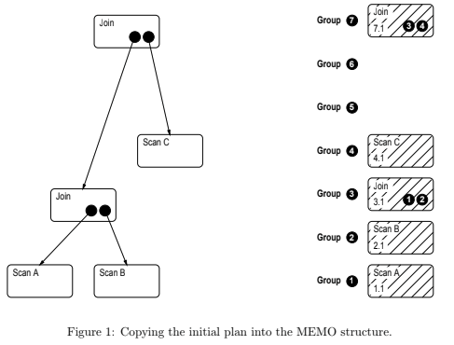
The Optimizer of Microsoft SQL Server
Reference for the example below:
[1] Florian Waas, César A. Galindo-Legaria: Counting, Enumerating, and Sampling of Execution Plans in a Cost-Based Query Optimizer. (SIGMOD’00)

Slide 26
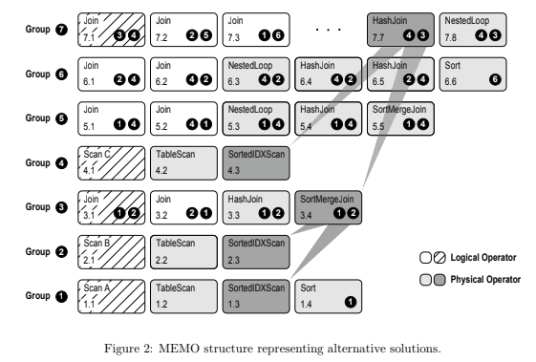
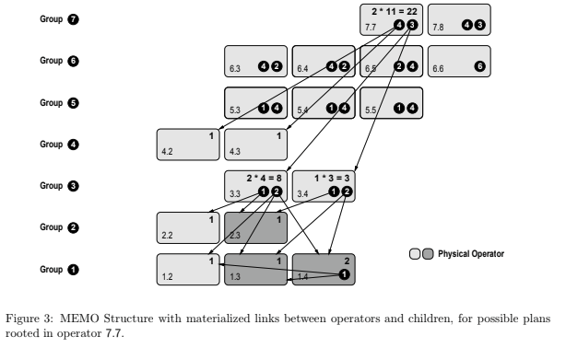
The Optimizer of Microsoft SQL Server (Cont.)

