Slide 1
Probase: A Probabilistic Taxonomy for Text Understanding
Wentao Wu ¹, Hongsong Li ², Haixun Wang ², Kenny Q. Zhu ³
¹ University of Wisconsin, Madison, WI, USA
² Microsoft Research Asia, Beijing, China
³ Shanghai Jiao Tong University, Shanghai, China
Notes:
Hello everyone, welcome to my talk. I am Wentao, and I am from University of Wisconsin-Madison. Today I’m gonna talk our work on Probase: a probabilistic taxonomy for text understanding. This is a joint work with my mentors Hongsong, Haixun, and Kenny, when I was working at Microsoft Research.

Slide 2
Outline
Overview
Iterative Extraction
Taxonomy Construction
Probabilistic Modeling
Evaluation
Conclusion
Notes:
This is the outline of this talk. I will first give an overview of Probase by introducing some backgrounds and our motivation. I will then present the three steps involved in building Probase, respectively, including a novel iterative extraction framework that pulls out isA relationships from a huge Web corpus; a novel taxonomy construction framework based on merging concepts by their senses; and a probabilistic approach to model the plausibility and typicality of the facts contained in Proabase. Finally, I will present our evaluation results and conclude this talk.

Slide 3
Outline
Overview
Iterative Extraction
Taxonomy Construction
Probabilistic Modeling
Evaluation
Conclusion

Slide 4
Text Understanding
Machines need to understand text to unlock the information confined in Web data.
“Pablo Picasso, 25 Oct 1881, Spain”
What’s this?
“animals other than dogs such as cats”
“cats are animals”? or “cats are dogs”?
Notes:
The Web is now becoming the largest database in our world. However, most of the data on the Web is still pure text written in human language. To unlock the information confined in Web data, machines need to understand the text.

Slide 5
Conceptualization
A little piece of knowledge makes the difference.
“Pablo Picasso is a person”
“cats are animals”
Can machines know this?
They can’t.
We need to pass this piece of knowledge to them.
Notes:
It turns out that there is no difficulty for human beings to answer these questions. The reason is that we owns certain kind of knowledge. Here it is no more than some conceptualization procedure. For the first question, we know that Picasso is a person. So most of us will correctly guess that the date is Picasso’s birthdate. For the second question, we clearly know that cats are animals from our childhood. However, how can machines know this? Unfortunately they can’t, and we need to pass this knowledge to them for machines to understand human text.

Slide 6
Taxonomies
A hierarchical structure showing the isA relationships among concepts.
organisms
plants
animals
trees
grass
Notes:
Taxonomies are a general way to organize knowledge. It is a hierarchical structure showing the isA relationships among concepts. This picture shows a tiny taxonomy over the concept “vehicles”.

Slide 7
Limited Size of Concept Space
“How do we compete with the largest companies in US?”
Existing Taxonomies | Number of Concepts
Probase | 2,653,872
YAGO | 352,297
WordNet | 25,229
Freebase | 1,450
DBPedia | 259
NELL | 123
Notes:
People have been building dozens of taxonomies in the past years. However, they have two limitations that make them less effective in practical text understanding tasks. The first problem is that they have limited size of concept space. This table shows the concept space of 10 well-known existing taxonomies. Most of them have only a small number of concepts. The second problem is that they all treat knowledge as “black and white”. We next discuss these two problems, respectively.

Slide 8
Knowledge is Black and White
“How do we compete with the largest companies in US?”
“Vague” concepts
“largest companies in US” => Walmart? Microsoft? P&G?
“beautiful cities” => Seattle? Chicago? Shanghai?
There is inherent uncertainty inside these concepts!
Notes:
Again, why is “knowledge is black and white” a problem? Let’s consider this example sentence again. The concept “largest companies” is inherently vague. There may be millions of companies in China, but only a few of them will be considered the largest ones. This kind of uncertainty is inherent for many useful concepts such as “best universities” and “beautiful cities”. So we argue that modeling the uncertainty within these concepts is essential. Existing taxonomies try to avoid this problem by simply excluding these “vague” concepts.

Slide 9
Probase
Automatically constructed from 1.6 billion web pages (with 92.4% precision).
The largest concept space so far (2.6 million).
Use probabilistic approach to model the uncertainty inside the concepts.
Notes:
To overcome these issues, we build Probase, a universal, general-purpose, probabilistic taxonomy that is automatically constructed from a corpus of 1.6 billion web pages. It has the following three unique characteristics. First, it is built by a novel framework with a novel iterative extraction algorithm and a novel taxonomy construction algorithm based on merging concepts by their senses. This framework leads to a taxonomy with very high precision. Second, it leverages a probabilistic approach to measure the plausibility and typicality of each fact it has. Third, it is the largest taxonomy we know so far, in terms of concept space

Slide 10
Outline
Overview
Iterative Extraction
Taxonomy Construction
Probabilistic Modeling
Evaluation
Conclusion
Notes:
We first describe the iterative extraction framework that extracts isA pairs from the Web corpus.

Slide 11
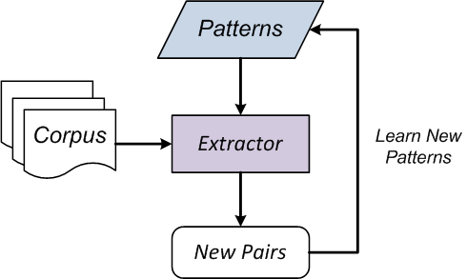
Previous Work
Syntactic Iteration (KnowItAll, TextRunner, NELL)
e.g., Hearst Patterns (as seeds):
NP such as {NP,}*{(or|and)} NP
Notes:
Most existing open-domain information extraction frameworks use frameworks based on syntactic iteration. The idea is that, we need more patterns in order to find more relationships. We begin with a set of seed patterns, and use these patterns to extract a set of pairs. Based on these pairs, we can learn a set of new patterns. And these patterns will then be used to extract more new pairs. We repeat this process until no new pairs can be identified.

Slide 12
Problems of Syntactic Iteration
Syntactic patterns have limited extraction power.
“… animals other than dogs such as cats …”
High quality syntactic patterns are rare.
Good patterns: “x is a country” => x = “China”
Bad patterns: “war with x” => x = “planet Earth”
Recall is sacrificed for precision.
E.g., some methods only focus on extracting proper nouns.
Notes:
However, this idea has three main problems. First, syntactic patterns have limited extraction power. For example, “animals other than dogs such as cats”. Second, High quality syntactic patterns are rare. For example, from the pattern “x is a country”, we may correctly infer x to be “China”. But from the pattern “war with x”, we may incorrectly infer x to be “planet Earth”. Third, recall is often sacrificed to achieve higher precision. For example, some methods only focus on extracting proper nouns.

Slide 13
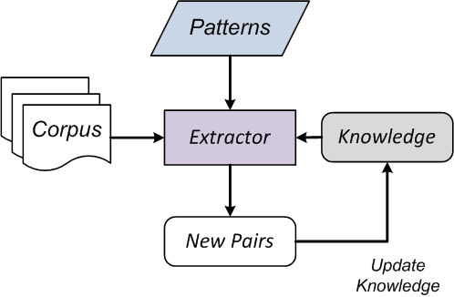
Our Approach
Semantic Iteration
Syntactic Iteration
Semantic Iteration
Notes:
Different from existing work, our iterative extraction framework is based on semantic iteration. The idea is that, in order to find more relationships, we need more knowledge instead of more patterns. Hence, we stick to a set of high quality patterns. When new pairs are extracted, we update the knowledge we already have, and then use the updated knowledge to extract more new pairs.

Slide 14
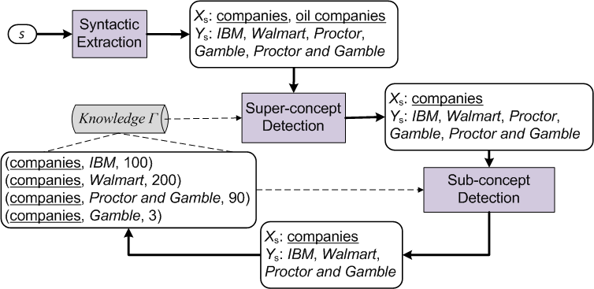
An Example
s: … companies other than oil companies such as IBM, Walmart, Proctor and Gamble, …
Notes:
Here is an example that illustrates the extraction process. After syntactic extraction, we get 2 super-concept candidates and 5 sub-concept candidates. Since we have more than one super-concept candidates, we call super-concept detection. Based on the current Γ, it determines that the super-concept should be “companies” instead of “oil companies”. We further call sub-concept detection. Again, based on the current Γ, it determines that the sub-concepts should be IBM, Walmart, and “Proctor and Gamble”.

Slide 15
Outline
Overview
Iterative Extraction
Taxonomy Construction
Probabilistic Modeling
Evaluation
Conclusion

Slide 16
Goal
Build a taxonomy graph from the edges (“isA” pairs) from the previous data extraction stage.
organisms
(organisms, animals)
(organisms, plants)
(plants, trees)
(plants, grass)
plants
animals
trees
grass
Notes:
The goal of this step is to build a taxonomy graph from the isA pairs extracted from the previous data extraction stage. Namely, we want to establish the hierarchical structure based on the pairs we have identified, as shown in the example here.

Slide 17
Challenges
Should we merge the two “apple” here?
e₁ = (fruit, apple), e₂ = (companies, apple)
Should we merge the two “plants” here?
e₁ = (plants, tree), e₂ = (plants, steam turbines)
Words such as “apple” and “plants” have multiple meanings (senses).
Notes:
However, this task is still not trivial. Consider the two examples here. Should we merge the two “apple”? And should we merge the two “plants”? The answers are both “no”. The words here such as “apple” and “plants” have multiple meanings, or senses. However, how can we know this?

Slide 18
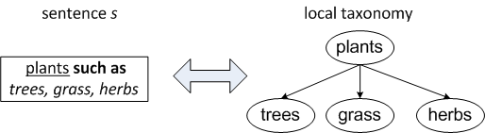
Properties & Operations(1)
Example:
… plants such as trees, grass, and herbs ...
… plants such as steam turbines, pumps, and boilers …
Local Taxonomy Construction
Notes:
We overcome this difficulty by observing several important properties of the “such as” sentences. The first property is that, the super-concepts of the pairs extracted from the sentence should have the same sense. For example, we can easily find the two sentences here in a corpus, but it is almost impossible for us to find sentences like “plants such as trees and boilers”.

Slide 19
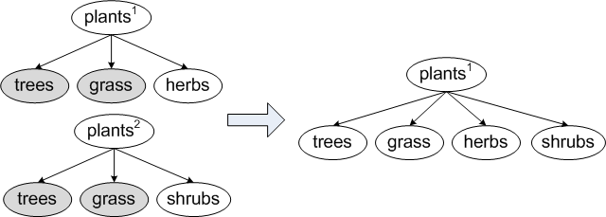
Properties & Operations (2)
Example:
a) … plants such as trees, grass, and herbs ...
b) … plants such as trees, grass, and shrubs ...
Horizontal Merge
Notes:
The second property is that, if two sentences have similar sub-concepts, then their super-concepts are likely to have the same sense. For example, the two “plants” here should have the same sense.

Slide 20
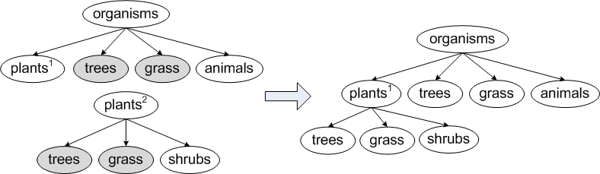
Properties & Operations (3)
Example:
a) … organisms such as plants, trees, grass and animals …
b) … plants such as trees, grass, and shrubs …
c) … plants such as steam turbines, pumps, and boilers …
Vertical Merge
Notes:
The third property says that if two sentences have similar sub-concepts, and the super-concept of one sentence also appears in the candidate sub-concepts of the other sentence, then it is likely that the super-concept is a valid sub-concept of the other super-concept (or, it has the same senses in its two appearances). In the example sentences shown here, the “plants” in a) and b) are likely to have the same sense, but not the “plants” in a) and c).

Slide 21
Outline
Overview
Iterative Extraction
Taxonomy Construction
Probabilistic Modeling
Evaluation
Conclusion

Slide 22
Plausibility
How likely is that the claim “y is an x” is true?
s_{i}: evidence (or sentence) that supports (x, y)
p_{i}: the probability that the evidence s_{i} is true
Notes:
We associate each isA pair in Probase with two probabilities. The first one is plausibility, which measures how likely that the claim “y is an x” is true. Since the pair (x, y) can be extracted from multiple sources, we treat each source as an evidence of (x, y). Assuming independence of the evidence, we can compute the plausibility of (x, y) in this way. Here, p_{i} is the probability that the evidence s_{i} is true. We learn p_{i} by using a Naïve Bayes model. The paper contains the details on how the model is built.

Slide 23
Typicality
Which one is more typical for the concept “bird”? a robin or ostrich?
An instance of “big company” is
also an instance of “company”.
is the plausibility that y is a descendant concept of x.
Notes:
We associate each concept-instance pair with another probability called typicality. Basically, it wants to measure how typical an instance is as a member of a concept. For example, is a robin more typical as a bird than an ostrich? Is Microsoft more typical as a company than Xyz Inc.? As we have mentioned, such typicality information is helpful for understanding many “vague” concepts such as “best universities”.

Slide 24
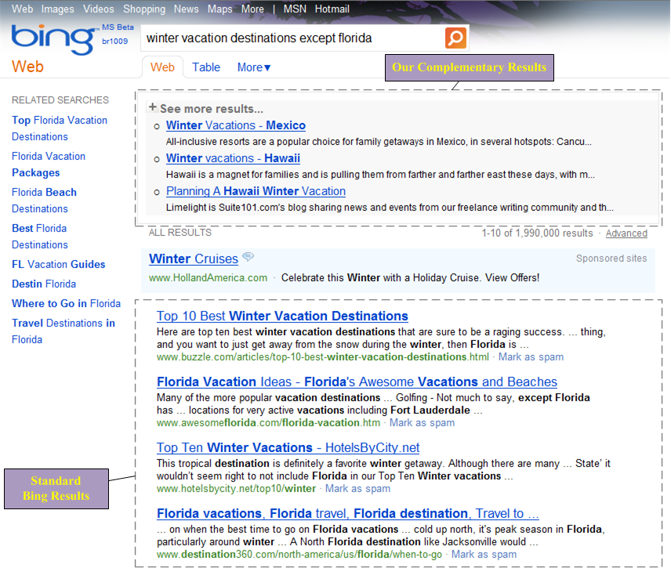
Application of Typicality (1)
Semantic Web Search (ER’12)
Notes:
We have developed several applications built on top of Probase that leverages the typicality we defined. Due to time constraints, I will not go to the details.

Slide 25
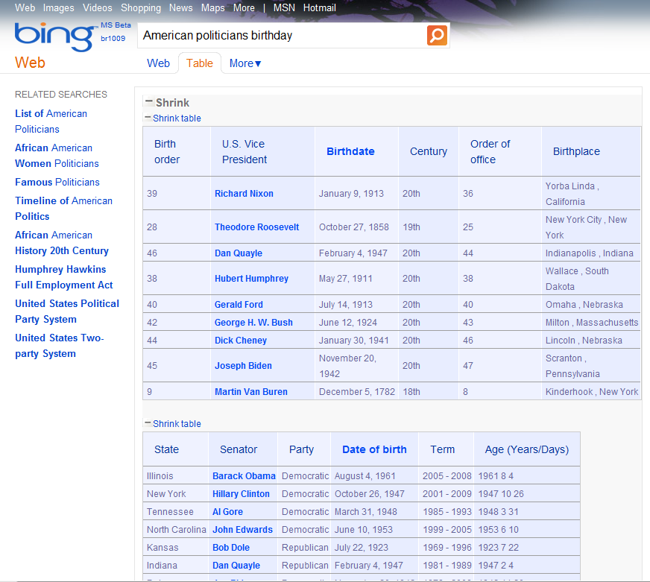
Application of Typicality (2)
Understanding Web Tables (ER’12)

Slide 26
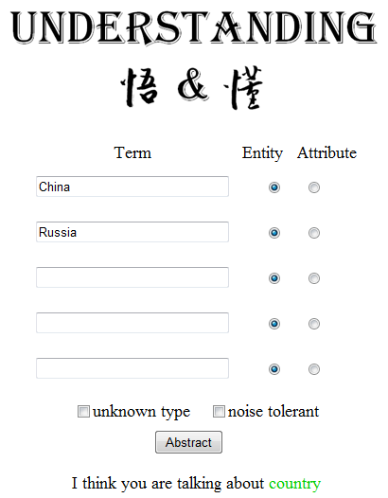
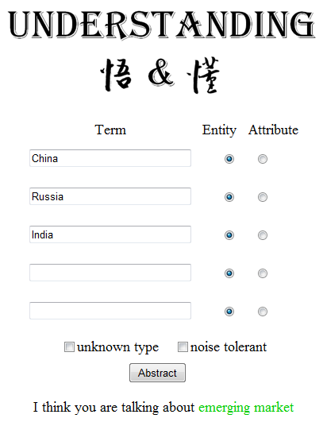
Application of Typicality (3)
Short Text Understanding (IJCAI’11)

Slide 27
Outline
Overview
Iterative Extraction
Taxonomy Construction
Probabilistic Modeling
Evaluation
Conclusion

Slide 28
Concept Space
A concept is relevant if it appears at least once in the top 50 million popular queries in Bing’s query log.
Notes:
The first is the relevance. A concept is relevant if it appears at least once in the queries. We compare Probase with the other four well-known existing taxomies on this metric. Over 660, 000 concepts in Probase are considered as relevant, while the largest number in the other taxonomies is only 70,000 (YAGO). This means, while a small number of basic concepts such as company, country, and city representing common sense knowledge appear very frequently in user queries, Web users do mention other less known concepts. Probase does a good job at capturing these concepts in the long tail. Hence it has a better chance of understanding these user queries.

Slide 29
IsA Relationship Space (1)
The Concept-Subconcept Relationship Space
 | # of isA pairs | Avg # of children | Avg # of parents | Avg level | Max level
Probase | 4,539,176 | 7.53 | 2.33 | 1.086 | 7
WordNet | 283,070 | 11.0 | 2.4 | 1.265 | 14
WikiTaxonomy | 90,739 | 3.7 | 1.4 | 1.483 | 15
YAGO | 366,450 | 23.8 | 1.04 | 1.063 | 18
Freebase | 0 | 0 | 0 | 1 | 1
Notes:
We next evaluate the isA relationship space of Probase. There are two kinds of isA relationships, namely, the concept-subconcept relationships, and the concept-instance relationships. This table compares the concept-subconcept space in terms of the # of isA pairs, average # of children/parents, and so on.
We observe that even with an order of magnitude larger number of concepts, Probase still has a comparable hierarchical complexity to the other taxonomies. Freebase is an exception here by giving trivial numbers, since it does not have any concept-subconcept relationships at all.

Slide 30
IsA Relationship Space (2)
The Concept-Instance Relationship Space
Concept Size Distribution in Probase v.s. Freebase
Notes:
To evaluate the concept-instance relationships, we compare the concept size distribution in Probase and Freebase, since Freebase is the only existing taxonomy that has comparable number of concept-instance relationships with Probase. We observe that, while Freebase focuses on a few very popular concepts like “track” and “book” with more than 1 million instances, Probase contains many more medium to small sized concepts. Therefore, Probase provides a much broader coverage on diverse topics, while Freebase is more informative on specific topics. However, the instances of those big concepts in Freebase such as books are mostly from specific web sites like Amazon, which can be easily merged into Probase.

Slide 31
Precision of the Extracted Pairs
92.4% precision in average over the 40 benchmark concepts.
Notes:
Finally, we evaluate the precision of the extracted isA relationships, regardless of which kind they are. We create a benchmark containing 40 concepts, with various size and domain coverage. For each concept, we pick up to 50 isA instances or subconcepts, and ask human judges to evaluate their correctness. On average, we achieve 92.4% precision over the benchmark concepts. This precision is better than the precision reported in most previous work on open-domain information extraction, including KnowItAll, TextRunner, and NELL. It is even better than the Wikitaxonomy that is constructed based on Wikipedia. To the best of our knowledge, only YAGO (which is another Wikipedia-based taxonomy) reports a better precision than us.

Slide 32
Outline
Overview
Iterative Extraction
Taxonomy Construction
Probabilistic Modeling
Evaluation
Conclusion

Slide 33
Conclusion
We present a novel iterative extraction framework to extract the isA relationships from text.
We present a novel taxonomy construction framework based on merging concepts by their senses.
We use the above techniques to build Probase, which is currently the largest taxonomy in terms of concepts.
We present a novel probabilistic approach to model the plausibility and typicality of the facts in Probase, and demonstrate its effectiveness in important text understanding applications.

Slide 34
Q & A
Thank you ☺
Please visit our website:
http://research.microsoft.com/probase/
for more information about Probase!

Slide 35
Backup Slides

Slide 36
Algorithm Outline (Extraction)
Input: S, the set of sentences matching Hearst Patterns
Output: Γ, the set of isA pairs
Repeat
foreach s in S do
X_{s}, Y_{s} ← SyntacticExtraction(s);
if |X_{s}|>1: X_{s} ← SuperConceptDetection(X_{s}, Y_{s}, Γ);
if |X_{s}|=1: Y_{s} ← SubConceptDetection(X_{s}, Y_{s}, Γ);
add valid isA pairs to Γ;
end
Until no new pairs added into Γ;
Return Γ;
Notes:
The outline of the algorithm is conceptually simple. We repeatedly scan the sentences until no new isA pairs is found. In each round of iteration, we have 3 steps. For each sentence that matches the Hearst pattern, we first call the procedure Syntactic Extraction to obtain a set of candidate super-concepts and a set of candidate sub-concepts, namely, the X_{s} and Y_{s} here. If we have more than one candidate super-concepts, we then call the procedure Super-Concept Detection to try to find the most likely one. If on the other hand, we already know the correct super-concept, we then call the procedure Sub-Concept Detection to find valid sub-concepts. We finally add the valid isA pairs we find into Γ.

Slide 37
Syntactic Extraction
Challenges
… animals other than dogs such as cats …
… classic movies such as Gone with the Wind …
… companies such as IBM, Nokia, Proctor and Gamble …
Strategy
Use “,” as the delimiter to obtain the candidates.
For the last element, also use “and” and “or” to break it down.
Notes:
The goal of syntactic extraction is to obtain candidate super-concepts and sub-concepts from the sentence. However, this is not a trivial task. Consider the sentences shown here. The first sentence shows that the super-concept here does not appear at the position specified by the Hearst Pattern. The second sentence shows that the sub-concept here is not a noun phrase as required by the Hearst Pattern. Finally, the third sentence shows that the word “and” may itself belong to valid sub-concepts. Due to these challenges, we use a rather conservative strategy at this step. We simply use the comma as the delimiter to obtain the candidates. For the last element, we also use “and” and “or” to break it down. We relies on the power of the next two steps to filter improper candidates.

Slide 38
Super-Concept Detection
Find the most likely super-concept among the candidates.
Pick x₁ if r (x₁, x₂) > ε
Assuming independence of y_{i}’s
We maintain a count n(x, y) for each (x, y) in Γ.
Y_{s} is the set of sub-concepts of the sentence s.
p (y_{i} | x₁) = p(x₁, y_{i}) / p(x₁) = n(x₁, y_{i}) / n(x₁).
Notes:
Super-concept detection tries to find the most likely super-concept among the candidates if there are more than one. We define a likelihood ratio of the two candidates with the highest likelihood in this way, and pick x₁ over x₂ if the ratio is above certain threshold. We maintain a count for each pair we have identified in Γ, and the likelihood is computed accordingly.

Slide 39
Super-Concept Detection (Ex)
r (companies, oil companies)
p (y_{i} | x₁) = p(x₁, y_{i}) / p(x₁) = n(x₁, y_{i}) / n(x₁)

Slide 40
Sub-Concept Detection (1)
Find the valid sub-concepts among the candidates.
Observation 1. The closer a candidate sub-concept is to the pattern keywords, the more likely it is a valid sub-concept.
Observation 2. If we are certain a candidate sub-concept at the k-th position from the pattern keywords is valid, then most likely candidate sub-concepts from position 1 to position k-1 are also valid.
E.g., … representatives in North America, Europe, the Middle East, Australia, Mexico, Brazil, Japan, China, and other countries.
Notes:
The goal of sub-concept detection is to find the valid sub-concepts among the candidates. We have two observations. First, the closer a candidate sub-concept is to the pattern keywords, the more likely it is a valid sub-concept. Second, if we are certain that a candidate sub-concept at the k-th positiono from the pattern keywords is valid, then most likely candidate sub-concepts from position 1 to k-1 are also valid. Consider the example sentence here. The valid sub-concepts start from the 5th position, namely, Australia.

Slide 41
Sub-Concept Detection (2)
Strategy
Find the largest scope wherein sub-concepts are all valid:
find the maximum k s.t. p (y_{k} | x) > ε’
Address the ambiguity issues inside the scope y₁, …, y_{k} :
Suppose that y_{j} is ambiguous with two candidates c₁ and c₂.
Assuming independence of y_{i}’s
Pick c₁ if r (c₁, c₂) > ε’’
Notes:
Based on these two observations, our strategy in sub-concept detection is to first find the largest scope wherein sub-concepts are all valid. Namely, we try to find the maximum k such that the likelyhood y_{k} is a valid sub-concept is above some threshold. We then address the ambiguity issues inside the scope from y₁ to y_{k}, by using a similar approach of computing some likelihood ratio.

Slide 42
Sub-Concept Detection (Ex)
r (Proctor and Gamble, Proctor)

Slide 43
Properties of “Such As” (1)
Example:
… plants such as trees and grass ...
… plants such as steam turbines, pumps, and boilers …
Property 1. Let s = {(x, y₁), …, (x, y_{n})} be the isA pairs derived from a sentence . Then, all the x’s in s have a unique sense, that is, there exists a unique i such that (x, y_{j}) |= (x^{i}, y_{j}) holds for all 1 ≤ j ≤ n.
But sentences like “… plants such as trees and boilers …” are extremely rare.
Notes:
We overcome this difficulty by observing several important properties of the “such as” sentences. The first property is that, the super-concepts of the pairs extracted from the sentence should have the same sense. For example, we can easily find the two sentences here in a corpus, but it is almost impossible for us to find sentences like “plants such as trees and boilers”.

Slide 44
Properties of “Such As” (2)
Example:
a) … plants such as trees and grass ...
b) … plants such as trees, grass and herbs ...
Property 2. Let {(x^{i}, y₁), …, (x^{i}, y_{m})} denote pairs from one sentence, and {(x^{j}, z₁), …, (x^{j}, z_{n})} from another sentence. If {y₁, …, y_{m}} and {z₁, …, z_{n}} are similar, then it is highly likely that x^{i} and x^{j} are equivalent, that is, i = j.
The “plants” in a) and b) are highly likely to have the same sense.
Notes:
The second property is that, if two sentences have similar sub-concepts, then their super-concepts are likely to have the same sense. For example, the two “plants” here should have the same sense.

Slide 45
Properties of “Such As” (3)
Example:
a) … organisms such as plants, trees, grass and animals …
b) … plants such as trees, grass, and shrubs …
c) … plants such as steam turbines, pumps, and boilers …
Property 3. Let {(x^{i}, y), (x^{i}, u₁), …, (x^{i}, u_{m})} denote pairs obtained from one sentence, and {(y^{k}, v₁), …, (y^{k}, v_{n})} from another sentence. If {u₁, u₂, …, u_{m}} and {v₁, v₂, …, v_{n}} are similar, then it is highly likely that (x^{i}, y) |= (x^{i}, y^{k}).
The “plants” in a) and b) are highly likely to have the
same sense, but not the “plants” in a) and c).
Notes:
The third property says that if two sentences have similar sub-concepts, and the super-concept of one sentence also appears in the candidate sub-concepts of the other sentence, then it is likely that the super-concept is a valid sub-concept of the other super-concept (or, it has the same senses in its two appearances). In the example sentences shown here, the “plants” in a) and b) are likely to have the same sense, but not the “plants” in a) and c).

Slide 46
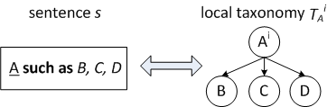
Local Taxonomy
Based on Property 1
Notes:
Based on Property 1, we can merge the super-concepts of the pairs if they come from the same sentence. We call the graph after this merge a “local taxonomy”.

Slide 47
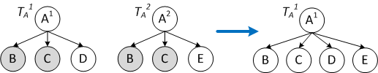
Horizontal Merge
Based on Property 2
Notes:
Based on Property 2, we can merge two local taxonomies into a bigger one. We call this operation “horizontal merge”.

Slide 48
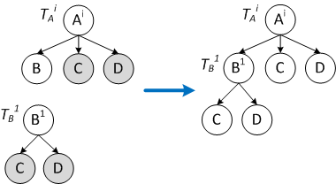
Vertical Merge (1)
Single Sense Alignment (Based on Property 3)

Slide 49
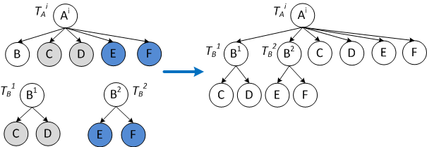
Vertical Merge (2)
Multiple Sense Alignment (Based on Property 3)

Slide 50
Similarity Function
We favor the similarity f (A, B) to be measured by the absolute overlap of the two sets A and B.
Similarity based on relative overlap such as Jaccard similarity will raise weird results (see the paper for an example).
More generally, the similarity function is desired to have the following closure property:
Property 4. If A, A’, B, and B’ are any sets s. t.
and , then Sim(A, B) => Sim(A’, B’).
Notes:
One more thing we need is a function to measure the similarity of two sets of sub-concepts. We favor the similarity f(A, B) to be measured by the absolute overlap of the two sets A and B, since similarity based on relative overlap such as Jaccard similarity will raise weird results (see the paper for an example). More generally, the similarity function is desired to have the following closure property.

Slide 51
Algorithm Outline (Construction)
Input: S, the set of sentences with extracted isA pairs
Output: T, the taxonomy graph
Stage 1: For each s in S, construct a local taxonomy.
Stage 2: Perform all possible horizontal merges.
Stage 3: Perform all possible vertical merges.
Return the graph T after the 3 stages
Notes:
The taxonomy construction algorithm contains 3 stages. In the first stage, we construct a local taxonomy for each input sentence that we have detected the isA pairs. In the second stage, we perform all possible horizontal merges. And in the third stage, we perform all possible vertical merges. The algorithm returns the graph after these 3 stages.

Slide 52
Theoretical Results
Theorem 1. Let T be a set of local taxonomies. Let O^{α} and O^{β} be any two sequences of horizontal and vertical merge operations on T. Assume no further operations can be performed on T after O^{α} or O^{β} . Then, the final graph after performing O^{α} and the final graph after performing O^{β} are identical.
Theorem 2. Let O be the set of all possible sequences of operations, and let M = min{|O| : O O}. Suppose O^{σ} is the sequence that performs all possible horizontal merges first and all possible vertical merges next, then |O^{σ}| = M.

Slide 53
Applications of Typicality (1)
Semantic Web Search
ACM fellows working on semantic web
database conferences in asian cities
Are you interested in the text or instances of “ACM fellows”, “database conferences” and “asian cities”?
Notes:
However, it is really difficult to directly demonstrate the usefulness of typicality. We instead show two applications we built on top of Probase that uses typicality. The first one is semantic web search. Consider the two queries here. Current web search engines will do word-for-word matching for these queries. However, what the user is really interested is the instances of the concepts instead of the concepts themselves. We have built a new search engine prototype to handle these kinds of queries. Basically, we rewrite the queries by substituting the typical instances into the concepts. We then find web pages that hit the queries after rewriting. Our results on a user study about the relevance of the search results significantly outperform existing search engines.

Slide 54
Applications of Typicality (2)
Short Text Understanding (Y. Song et al. IJCAI’11)
Conceptualize from a set of words by performing Bayesian analysis based on the (inverse) typicality T(x|i).
Cluster Twitter messages based on conceptualization signals of words.
Example: India => country / region
India, China => Asian country / developing country
India, China, Brazil => BRIC / emerging market
Notes:
In a recent work, we leveraged Probase in short text understanding. We conceptualize from a set of words by performing Bayesian analysis based on the inverse typicality. Namely, given a set of instances, how typical a concept is to characterize these instances. Here is an example. Given an word “India”, the typical concepts may be country or region. Given two words “India” and “China”, the typical concepts may be Asian country or developing country. Given one more word “Brazil”, the typical concepts may shift to BRIC or emerging market. We further clustered twitter messages based on conceptualization signals of words. Our clustering results outperform all existing approaches. Please see the IJCAI paper for details.

Slide 55
Concept Space (1)
Probase contains more then 2.6 million concepts. Are they useful?
Evaluate this using the top 50 million popular queries in Bing’s query log from a 2-year period.
Metrics in the evaluation
Relevance
Taxonomy Coverage
Concept Coverage
Notes:
We first evaluate the concept space of Probase. A natural question is whether the 2.6 million concepts in Probase are really useful. We evaluate this using the top 50 million popular queries in Bing’s query log from a 2-year period. We define 3 metrics: relevance, taxonomy coverage, and concept coverage. I will explain them one by one.

Slide 56
Concept Space (2)
Relevance: A concept is relevant if it appears at least once.
Notes:
The first is the relevance. A concept is relevant if it appears at least once in the queries. We compare Probase with the other four well-known existing taxomies on this metric. Over 660, 000 concepts in Probase are considered as relevant, while the largest number in the other taxonomies is only 70,000 (YAGO). This means, while a small number of basic concepts such as company, country, and city representing common sense knowledge appear very frequently in user queries, Web users do mention other less known concepts. Probase does a good job at capturing these concepts in the long tail. Hence it has a better chance of understanding these user queries.

Slide 57
Concept Space (3)
Taxonomy Coverage: A query is covered if it contains at least one concept or instance in the taxonomy.
Notes:
The second is the taxonomy coverage. A query is covered if it contains at least one concept or instance in the taxonomy. Probase outperforms the other four taxonomy on this metric. In total, Probase covers more than 81% of the top 50 million queries.

Slide 58
Concept Space (4)
Concept Coverage: A query is covered if it contains at least one concept in the taxonomy.
Notes:
The third is concept coverage. A query is covered if it contains at least one concept in the taxonomy. The difference from taxonomy coverage is that we do not consider instance coverage here. Again, Probase outperforms all the other taxonomies. Also note that, while Freebase has similar taxonomy coverage as Probase, its concept coverage is poor given that it contains only 1,500 concepts.

