Slide 1
Sampling-Based Query RE-OPTIMIZATION
Wentao Wu
Microsoft Research
Notes:
Hello everyone, welcome to my talk. I am Wentao Wu and I am currently a researcher in the DMX group.
It is my pleasure to be here to present my work on sampling-based query re-optimization.
This work was done before I joined Microsoft.

Slide 2
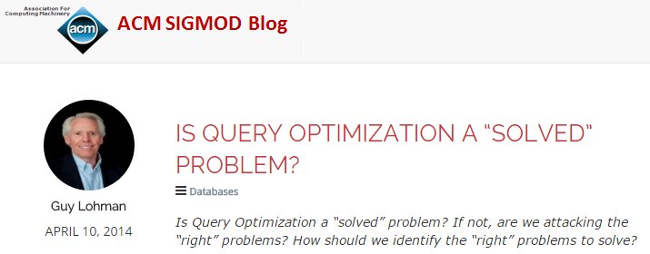
Background
Query optimization remains challenging despite of decades of efforts and progresses.
Cardinality estimation is the key challenge.
Selectivity of join predicates
Correlation of columns
Notes:
Query optimization remains challenging for many queries, in spite of decades of research and engineering effort and progress.
In April 2014, Guy Lohman, a query optimization expert in IBM, published a post on the ACM SIGMOD blog with the title: is query optimization a “solved” problem? In this post, he gave several of his personal “war” stories with DB2 customers regarding poor plans returned by query optimizers, and pointed out several directions that call for more research effort.

Slide 3
Histogram vs. Sampling
Single-column histograms cannot capture data correlations between columns.
Use the attribute-value-independence (AVI) assumption.
Sampling is better than histograms on capturing data correlations.
We run query over exact rather than summarized data.
Notes:
As was pointed out by Lohman, significant cardinality estimation errors often due to data correlations between columns.
Single-column histograms cannot capture data correlations. In practice, the attribute-value-independence assumption is used.
Sampling is in general better than histograms on capturing data correlations, because we can run query over exact rather than summarized data.

Slide 4
But Why are Histograms Dominant?
The overhead is much smaller, compared with other cardinality estimation approaches.
Sampling incurs additional overhead and should be used conservatively.
A naïve idea: use sampling for all plans considered by the optimizer.
Notes:
But why are histograms dominant in practice?
The key reason is that the overhead of histograms is much smaller, compared with other approaches.
Though sampling can capture data correlation better, it incurs additional overhead and should be used conservatively.
A naïve idea of using sampling would be to use it for all plans considered by the optimizer during query optimization.

Slide 5
Cost-Based Query Optimization
Pick the best plan from N candidates:
P1
Merge
Join
P_{N}
Hash
Join
N could be large!
(10² or even 10³)
Hash
Join
C
Nested
Loop
B
…
A
B
A
C
For large N, sampling is not affordable to be used for every plan.
Notes:
In a nutshell, cost-based query optimization can be viewed as follows: the optimizer tries to pick the best plan from N candidate plans.
However, N could often be hundreds or even thousands.
For this large N, the naïve idea of using sampling for every plan considered by the optimizer is not affordable in practice.

Slide 6
Our Idea
Use sampling as a post-processing validation step.
Detect cardinality estimation errors for the final plan returned by the optimizer.
Re-optimize the query if cardinality estimation errors are detected.
Catch big mistakes of the optimizer before the plan runs!
Notes:
While it is infeasible to use sampling for every plan considered by the optimizer, it is feasible to use it for a single plan.
Our intention here is to catch big mistakes of the optimizer before the plan runs.

Slide 7
The Re-optimization Algorithm
Query Optimizer
Query q
Plan P_{q}
Final Plan
Update
Cardinalities
Sampling-based Validation
Refined
Cardinality Estimates Γ

Slide 8
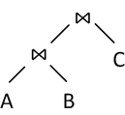
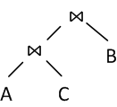

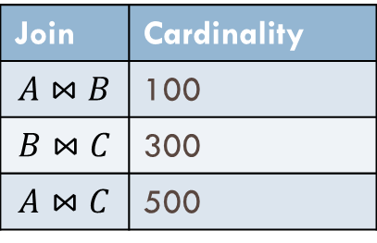
The Re-optimization Algorithm (Cont.)
Example: $q=A⋈B⋈C$
(Final Plan)
P₁
P₂
Query Optimizer
Query q
Join | Cardinality
$$A⋈B$$ | 100
$$B⋈C$$ | 300
$$A⋈C$$ | 500
Update
$A⋈B$: 1000
Sampling-based Validation

Slide 9
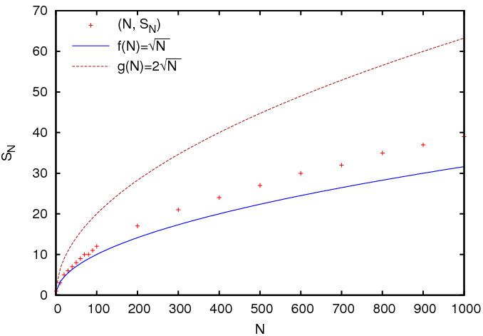

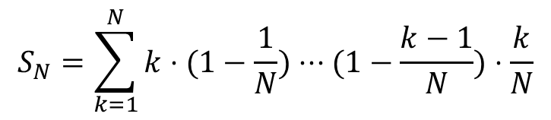
Efficiency of Re-optimization
The worst-case expected number of iterations:
$S_{N}∼O(\sqrt{N}$).
$$S_{N}=\sum_{k=1}^{N}{k⋅(1−\frac{1}{N})⋅⋅⋅(1−\frac{k−1}{N})⋅\frac{k}{N}}$$
N is the number of join trees in the search space.
Notes:
We cannot use sampling to estimate too many quantities.

Slide 10
Quality of Re-optimized Plans
If sampling-based cost estimates are consistent with the actual costs, that is,
then the final re-optimized plan is locally optimal:
However, cost models are imperfect, and cardinality estimates based on sampling are imperfect, too.
See experimental results.
cost_est(P1) < cost_est(P2) => cost_act(P1) < cost_act(P2),
cost_act(P_{final}) <= cost_act(P), for any P in re-optimization.

Slide 11
Experimental Evaluation
We implemented the re-optimization procedure in PostgreSQL 9.0.4.
We have two goals:
Test the approach for “common” cases.
Test the approach for “corner” cases.

Slide 12
Experimental Evaluation (Cont.)
“Common” cases
10GB TPC-H benchmark
“Corner” cases
(Homegrown) Optimizer “Torture Test” (OTT)
Specially designed database and queries with high data correlation that can challenge query optimizers.
Notes:
1. “Common” cases
10GB TPC-H benchmark
2. “Corner” cases
“Optimizer Torture Test” (OTT)
We design workloads that can sufficiently challenge the cardinality estimation approaches used by current optimizers.

Slide 13
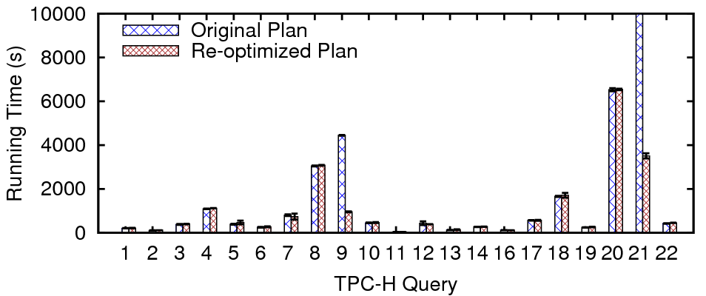
Experimental Evaluation (Cont.)
Results on the 10GB TPC-H database

Slide 14
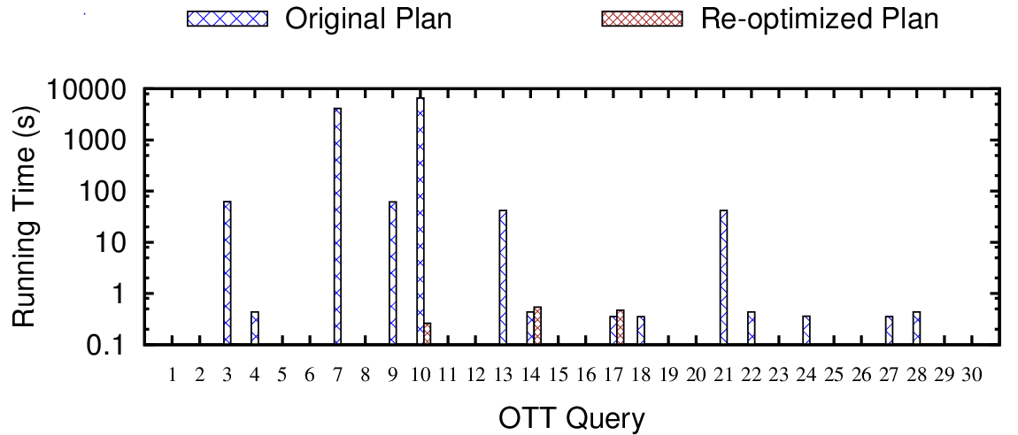
Experimental Evaluation (Cont.)
Results of the “torture test” (5-join queries, log-scale)

Slide 15
Details of OTT
More details about OTT:
K tables R₁, …, R_{K}, with R_{k}(A_{k}, B_{k})
Each R_{k} is generated independently, with B_{k} = A_{k}.
A_{k} (and thus B_{k}) is uniformly distributed.
The queries look like:
$$σ_{A_{1}=c_{1}∧⋅⋅⋅{∧A}_{K}=c_{K}∧B_{1}=B_{2}∧⋅⋅⋅∧B_{K−1}=B_{K}}(R_{1}×⋅⋅⋅×R_{K})$$
Property: These queries are not empty if and only if A₁ = … = A_{K}!
Notes:
More details about OTT:
K tables R₁, …, R_{K}, with R_{k}(A_{k}, B_{k})
Each R_{k} is generated independently, but we enforce B_{k} = A_{k} inside each R_{k}.
A_{k} (and thus B_{k}) is uniformly distributed.
The queries look like:

Slide 16
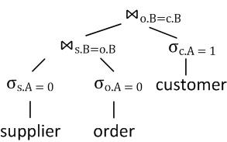
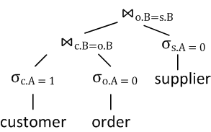
Details of OTT (Cont.)
An instance of OTT used in our experiments:
Use 6 TPC-H tables (excluding “nation” and “region”).
Use a set of empty queries with non-empty sub-queries.
Non-empty
Empty!
Bad Plan
Good Plan
Notes:
1. An instance of OTT:
We use the 6 TPC-H tables excluding the two tiny tables “nation” and “region”).
Add two columns A and B in each table.
Pick an appropriate domain for each A.
Generate a set of queries that are empty, but some of the joins are not empty.
2. Ideally, the optimizer should pick plans that run the empty joins first. The running times in these cases should be close to 0.

Slide 17
Summary
q
Query
Optimizer
Sampling-based Validation
Plan P_{q}
Improved Query Plan
Feedback
Sampling as post-processing: efficiency/effectiveness tradeoff!
Notes:
In this talk, we explored the idea of using sampling as a post-processing, validation step after the optimizer has finished searching for an optimal plan.
We showed that this is a feasible way that can help both provide better query running time estimates and quantify their uncertainty.
Furthermore, by introducing a feedback loop from sampling to the optimization, we could also improve query plans returned by the optimizer, by using an iterative re-optimization procedure.
The take-away message is, by using sampling as post-processing, we can achieve a reasonable efficiency/effectiveness tradeoff in addressing the challenging problems of query running time estimation and query optimization.

Slide 18
Q & A
Thank you☺

Slide 19
Cardinality Estimation Methods
Histograms
Single-column histograms (dominant in current DBMS)
Multi-column histograms
Other methods
Offline approaches: sampling, sketch, graphical models
Online approaches: dynamic query plans, parametric query optimization, query feedback, mid-query re-optimization, plan bouquets
Notes:
Let us now take a quick look at cardinality estimation methods that have been proposed in the literature.
The dominant approach in practice is to use single-column histograms.
Multi-column histograms are often not used because of the storage overhead.
Other methods can fall into two categories: offline and online.
Offline methods usually scan the data and build some synopses.
This category includes sampling, sketch, and graphical models.
Online methods usually start with an initial plan and dynamically change the query plan at runtime.
This category includes dynamic query plans, parametric query optimization, query feedback, mid-query re-optimization, and plan bouquets.

Slide 20









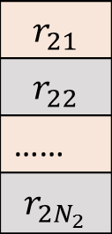


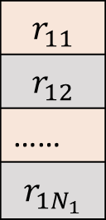









A Sampling-Based Estimator
Estimate the selectivity $ρ_{q}$ of a join query $q$ = $R_{1}⋈R_{2}$.
[Haas et al., J. Comput. Syst. Sci. 1996]
Do a “cross product” over the samples: $ρ\left(i, j\right)=0 or 1$.
$$r_{11}$$
$$⋈$$
$$r_{21}$$
$$ρ(1, 1)$$
|${R^{s}}_{1}⋈{R^{s}}_{2}|$
$$r_{11}$$
$$r_{12}$$
……
$$r_{1N_{1}}$$
$$r_{21}$$
$$r_{22}$$
……
$$r_{2N_{2}}$$
……
…
$$r_{11}$$
$$⋈$$
$$r_{2N2}$$
$$ρ(1, N_{2})$$
$${\hat{ρ}}_{q}=\frac{\sum_{i,j}{ρ(i, j)}}{N_{1}N_{2}}$$
$$r_{1N1}$$
$$⋈$$
$$r_{21}$$
$$ρ(N_{1}, 1)$$
……
…
|${R^{s}}_{1}|×|{R^{s}}_{2}|$
R^{s}₁
R^{s}₂
$$r_{1N1}$$
$$⋈$$
$$r_{2N2}$$
$$ρ(N_{1}, N_{2})$$
The estimator ${\hat{ρ}}_{q}$ is unbiased and strongly consistent.
Notes:
This extends previous work from pure join queries to queries with mixed selections and joins.
// need to highlight a few words but can’t select text for some unknown reason
// change cell colors

Slide 21
Other Sampling-Based Methods
Sampling-Based Estimation of the Number of Distinct Values of an Attribute, VLDB’95
Towards Estimation Error Guarantees for Distinct Values, PODS’00
End-biased Samples for Join Cardinality Estimation, ICDE’06
Join Size Estimation Subject to Filter Conditions, VLDB’15

Slide 22
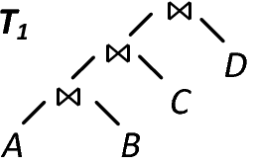
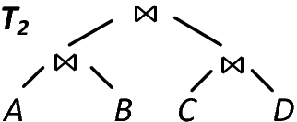
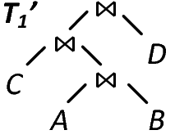
Convergence of Re-optimization
Convergence Condition of Re-optimization
Theorem: The re-optimization procedure terminates when all the joins in the returned query plan have been observed in previous rounds of iteration.
For example, re-optimization will terminate after T₁’ is returned.

Slide 23
Convergence of Re-optimization (Cont.)
The previous convergence condition is sufficient but not necessary.
Re-optimization could terminate even before it meets the previous condition.
Termination
To understand re-optimization better, we need the notion of local/global transformations.

Slide 24
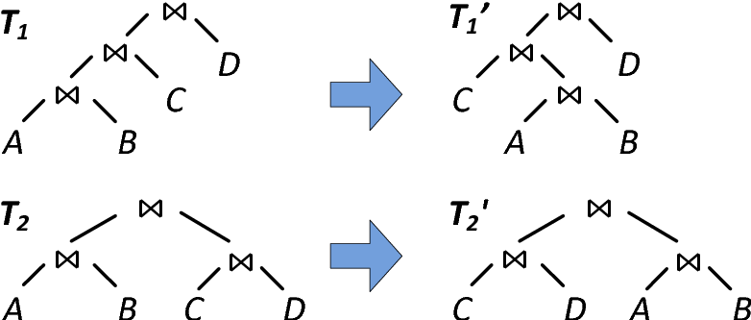
Local/Global Transformations
Local transformation of query plans
Local transformations are those plans that share the same joins.
They only differ in choices of specific physical operators.

Slide 25
Characterization of Re-optimization
The three possible cases in re-optimization:
(1) It terminates in two steps with P2 = P1.
(2) It terminates in n + 1 steps (n > 1) where all plan transitions are global transformations.
(3) It terminates in n + 1 steps (n > 1) where only the last transition is a local transformation: the others are all global transformations.

Slide 26
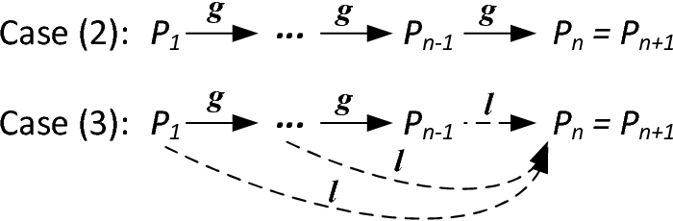
Characterization of Re-optimization (Cont.)
An illustration of Case (2) and (3):
The number of iterations thus depends on the number of global transformations!

Slide 27
Analysis of Efficiency
A probabilistic model for analysis of expected number of steps in re-optimization:
We have N balls in a queue, initially unmarked.
Yes
b₁
…
b_{N}
Is b₁ marked?
Exit
No
b₁
Insert Back
Mark b₁
The probability that the ball will be inserted at any position in the queue is uniformly 1/N.

Slide 28
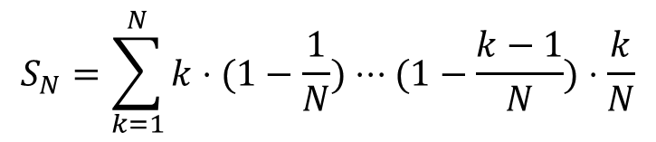
Analysis of Efficiency (Cont.)
The expected number of steps of the previous procedure is:
How is it related to query optimizations?
Think of query plans (or, globally different join trees) as balls!
The uniform distribution employed in the model may be invalid in practice.
We have more analysis for situations where underestimation or overestimation is dominant. (And more analysis could be done in the future.)
$$S_{N}=\sum_{k=1}^{N}{k⋅(1−\frac{1}{N})⋅⋅⋅(1−\frac{k−1}{N})⋅\frac{k}{N}}$$

