Slide 1
Towards Predicting Query Execution Time for Concurrent and Dynamic Database Workloads
Wentao Wu^{1,2}, Yun Chi², Hakan Hacigumus², Jeffrey Naughton¹
¹Dept of Computer Sciences, University of Wisconsin-Madison
²NEC Laboratories America

Slide 2



Background
Database as a service (DaaS)
Other applications
Admission control, query scheduling, progress monitoring, system sizing, etc.
User
Service Provider
Service Level Agreement (SLA)
Database
How can we predict the execution time of a query before it runs?
Notes:
Database as a service is more and more popular now, as we are moving into the cloud. In this scenario, the user usually makes some “service level agreement” (SLA) with the database service provider.
Some explanation for SLA: SLA states the service requirement that needs to be ensured by the service provider, and also the penalty if the requirement is not achieved. A natural and common requirement is the required execution time of the query.
So the question is: how can we know the execution time of a query before it runs?

Slide 3
Motivation
Previous work
Standalone workloads [ICDE’09, ICDE’12, VLDB’12, ICDE’13]
Concurrent but static workloads [EDBT’11, SIGMOD’11]
Real world database workloads
Dynamic: queries are not known a priori.
Our goal: Workloads that are both concurrent and dynamic!
Notes:
In this work, we address the prediction problem for query workloads that are both concurrent and dynamic.

Slide 4
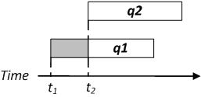

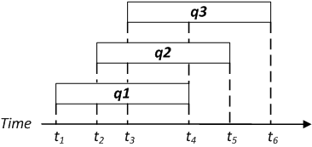
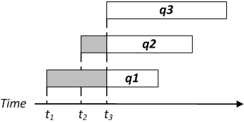
Problem Definition
At time t_{i}, predict the (remaining) execution time for each query in the mix.
(a) At time t₁
(b) At time t₂
(c) At time t₃
Notes:
Let’s first give a specific definition to the prediction problem we are concerned with.
In this picture, we have 3 prediction problems at t1, t2, and t3 respectively.

Slide 5
Main Idea
Cost Unit | Value
c_{s}: seq_page_cost | 1.0
c_{r}: rand_page_cost | 4.0
c_{t}: cpu_tuple_cost | 0.01
c_{i}: cpu_index_tuple_cost | 0.005
c_{o}: cpu_operator_cost | 0.0025
PostgreSQL’s cost model
The n’s won’t change!
Even if the query is running together with other queries
Only the c’s will change!
$$C=n_{s}c_{s}+n_{r}c_{r}+n_{t}c_{t}+n_{i}c_{i}+n_{o}c_{o}$$
Wentao Wu, Yun Chi, Shenghuo Zhu, Junichi Tatemura, Hakan Hacigümüs, and Jeffrey F. Naughton, Predicting query execution time: are optimizer cost models really unusable? In ICDE, 2013.
Notes:
The n’s can be thought of as “the # of sequential pages accessed” and so on..

Slide 6
Main Idea (Cont.)
The c’s change at boundaries of phases during execution.
What should be a phase of a query?
A phase = an operator?
Pipelining of operators => interleaved phases!
We define a phase to be a pipeline.
q₂
Scan B
q₁
Scan A
Scan B
Time
t₁
t₂
t₃
t₄
t₅

Slide 7
Progressive Predictor
The execution of a query mix can then be thought of as
multiple stages of mixes of pipelines
q₁
P₁₁
P₁₂
P₁₃
q₂
P₂₁
P₂₂
P₂₃
q₃
P₃₁
P₃₂
Time
s₀
f₂₁
f₁₁
f₂₂
f₁₂
f₃₁
f₂₃
f₃₂
f₁₃
8 mixes of pipelines during the execution of the 3 queries
We need a predictor for a mix of pipelines!
Notes:
1. We wish to predict the execution times for q₁, q₂, q₃ (starting at time s₀):
q₁ has 3 pipelines: P₁₁, P₁₂, and P₁₃
q₂ has 3 pipelines: P₂₁, P₂₂, and P₂₃
q₃ has 2 pipelines: P₃₁ and P₃₂
2. We hence have 8 mixes of pipelines during the execution of the 3 queries! (e.g., the 1st mix is P₁₁, P₂₁, and P₃₁, the 2nd mix is P₁₁, P₂₂, and P₃₁, and so on.)
What we need now is a predictor for the execution time of each pipeline within a mix!

Slide 8
Predictors for A Mix of Pipelines
An approach based on machine learning
An approach based on analytic models

Slide 9
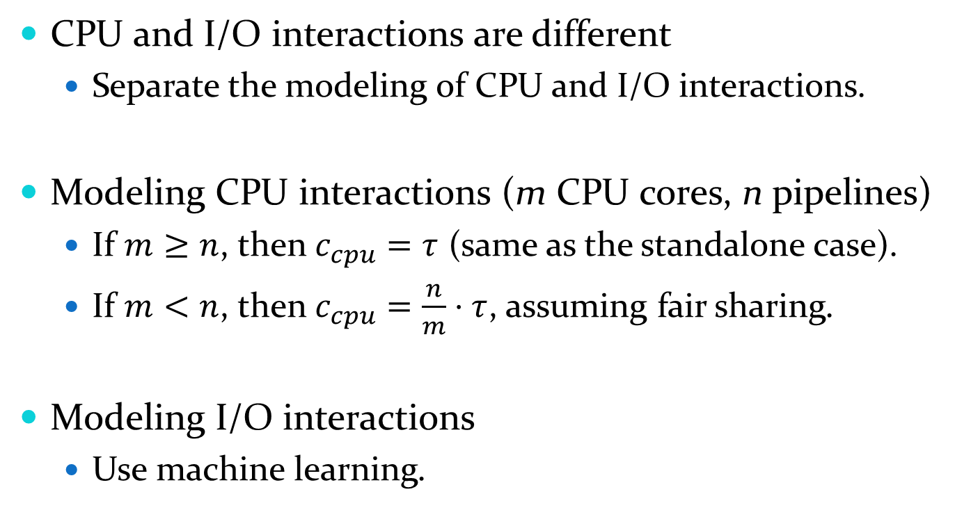
Machine-Learning Based Approach
CPU and I/O interactions are different
Separate the modeling of CPU and I/O interactions.
Modeling CPU interactions (m CPU cores, n pipelines)
If $m≥n$, then $c_{cpu}=τ$ (same as the standalone case).
If $m<n$, then $c_{cpu}=\frac{n}{m}⋅τ$, assuming fair sharing.
Modeling I/O interactions
Use machine learning.
Notes:
CPU and I/O interactions are different, in the sense that CPU interactions are usually negative, while I/O interactions can be either positive or negative.

Slide 10
Modeling I/O Interactions
Previous work
Assume that all the queries are known beforehand.
Run sample mixes and train a regression model.
Apply to static workloads (e.g., report generation).
It cannot be directly applied to dynamic workloads.
We do not know all the queries to be run.
Notes:
Or query templates whose instances have very close execution times.

Slide 11
Modeling I/O Interactions (Cont.)
Observation #1. Fixed DBMS => Fixed # scan operators
Observation #2.
Fixed DBMS + Fixed DB schema => Fixed # scan types
scan type = scan operator + table name (e.g., index scan over orders)
We can apply the machine-learning idea to scan types instead of query templates!
NB: Additional I/O’s (e.g., from hash-joins) => Additional scans
Notes:
Observation 1. For a specific database implementation, the number of possible scan operators is fixed.
Observation 2. For a specific database implementation and a specific database schema, the number of possible scan types is fixed.
A scan type is a specific scan operator over a specific table, e.g., index scan over lineitem. We treat addition I/Os (e.g., I/Os in hash joins when intermediate results are spilled to disk) as additional scans as well.

Slide 12
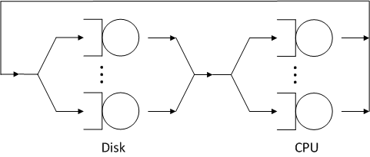
Analytic-Model Based Approach
Problem of the machine-learning based approach
Infinitely many unknown queries/query mixes
Model the system with a queueing network.
Two service centers: Disk, CPU.
Pipelines are customers.
The c’s are the residence times per visit of a customer.
Notes:
1. The system has 2 service centers: the CPU and the Disk.
2. The pipelines (in a mix) are customers that visit the service centers.
3. The c’s that we need are the residence times per visit of a customer, which can be computed by using standard queueing theory techniques.

Slide 13
Analytic-Model Based Approach (Cont.)
The effect of the buffer pool
The buffer pool cannot be modeled as a service center.
We used a model [SIGMETRICS’92]
For the “clock” algorithm used by PostgreSQL

Slide 14
Experimental Settings
PostgreSQL 9.0.4, Linux 3.2.0-26
TPC-H 10GB database
Multiprogramming Level (MPL): 2 to 5
Dual Intel 1.86GHz CPU, 4GB of memory

Slide 15
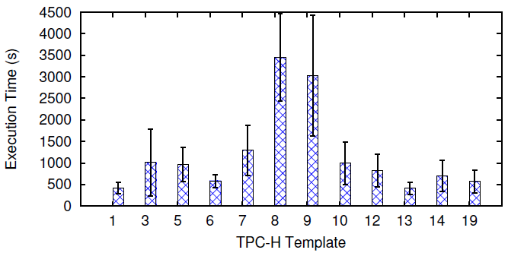
Workloads
2 TPC-H workloads & 3 micro-benchmarking workloads
TPC-H2: 12 templates (Q7, 8, 9 are more expensive)
MB1: heavy index scans with different data sharing rate.
Notes:
The mean and deviation of the query execution times in TPC-H2.

Slide 16
Baseline Approach
For each query in the mix
Predict its time by using the single-query predictor.
Multiply it with the MPL as the prediction.
Intuitively, this approach ignores the impact of query interactions.

Slide 17
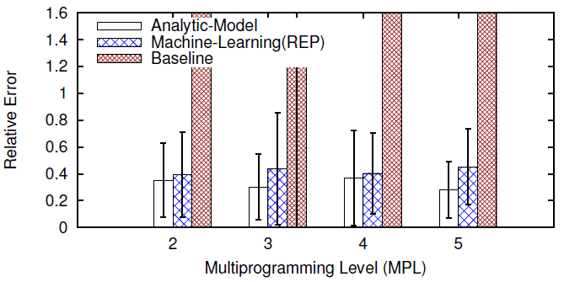
Prediction Accuracy
On TPC-H2 (with more expensive templates)
Notes:
The performance of baseline approach becomes much worse.
The accuracy of our proposed approaches is close to that on TPC-H1.
The analytic-model based approach outperforms the machine-learning based approach by 10%.

Slide 18
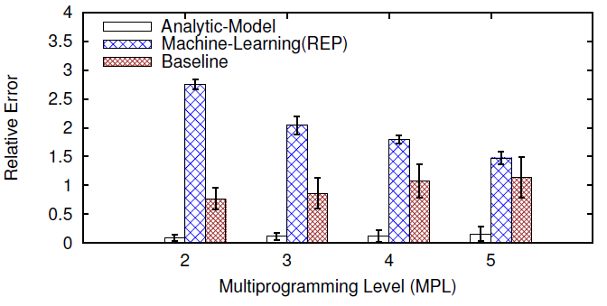
Prediction Accuracy (Cont.)
On MB1 (mixes of heavy index scans)
Notes:
The machine-learning based approach is even worse than the baseline approach.
The analytic-model base approach is the best.

Slide 19
Overhead
Both approaches
need to calibrate the optimizer’s cost model.
The machine-learning based approach
needs a training stage (usually 2 days)
The analytic-model based approach
needs to evaluate the analytic models (usually < 120 ms)
Notes:
Both the machine-learning based and the analytic-model based approach need to calibrate the optimizer’s cost model.
The machine-learning based approach needs a training stage which usually takes 2 days under our experimental settings.
The analytic-model based approach needs to evaluate the analytic models at runtime, which usually takes less than 120 ms under our settings.

Slide 20
Conclusion
To the best of our knowledge, we are the first to
publish a technique to predict query execution times for workloads that are both concurrent and dynamic;
present a systematic exploration of its performance.
We use analytic-model based approaches in addition to machine learning as used by previous work.
We show that our analytic-model based approach can have competitive and often better prediction accuracy than a (new) machine-learning based approach.

Slide 21
Q & A
Thank you☺

Slide 22
Backup Slides

Slide 23
From A Query Plan to Pipelines
Tables:
Students (sid, sname)
Enroll (sid, cid, grade)
P₃
GroupAgg
MergeJoin
SELECT S.sname, AVG (grade) AS gpa
FROM Students S, Enroll E
WHERE S.sid = E.sid
GROUP BY S.sname
Sort
Sort
SeqScan
SeqScan
The example query plan contains 3 pipelines with the execution order: P₁P₂P₃.
P₁
P₂
Students
Enroll

Slide 24
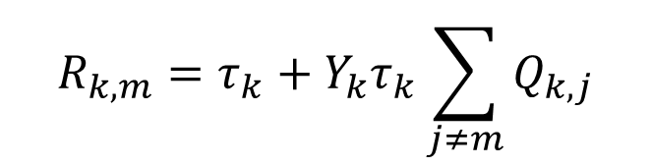
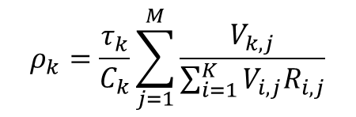
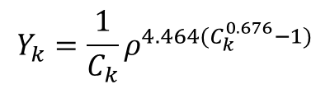
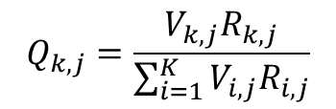
More Details of Queueing Network
Service
Time
Queueing
Time
Residence
Time
$$R_{k,m}=τ_{k}+Y_{k}τ_{k}\sum_{j≠m}{Q_{k,j}}$$
$$Q_{k,j}=\frac{V_{k,j}R_{k,j}}{\sum_{i=1}^{K}{V_{i,j}R_{i,j}}}$$
(Queue Length)
$$Y_{k}=\frac{1}{C_{k}}ρ^{4.464(C_{k}^{0.676}−1)}$$
(Correction Factor, Y_{k} = 1 if C_{k} = 1)
$$ρ_{k}=\frac{τ_{k}}{C_{k}}\sum_{j=1}^{M}{\frac{V_{k,j}}{\sum_{i=1}^{K}{V_{i,j}R_{i,j}}}}$$
(Utility)
Notes:
Perhaps I will skip this slide..

Slide 25
More Details of Buffer-Pool Model
Recall the “clock” algorithm
The buffer pages are organized in a circular queue.
On a buffer miss, the clock pointer scans the pages and chooses the first page with count 0 for replacement.
If a page has a count greater than 0, then the count is decreased by 1.
On a buffer hit, the counter of the page is reset to its maximum value.

Slide 26
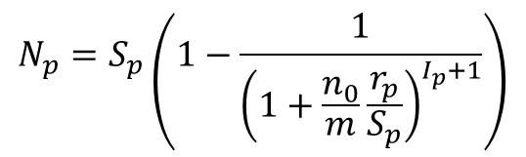
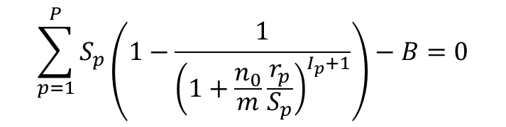
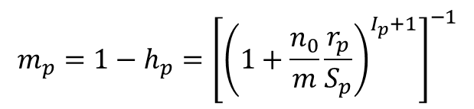

More Details of Buffer-Pool Model (Cont.)
Model the “clock” algorithm by using a Markov chain.
$$\sum_{p=1}^{P}{S_{p}\left(1−\frac{1}{{\left(1+\frac{n_{0}}{m}\frac{r_{p}}{S_{p}}\right)}^{I_{p}+1}}\right)−B=0}$$
(steady-state condition)
$$N_{p}=S_{p}\left(1−\frac{1}{{\left(1+\frac{n_{0}}{m}\frac{r_{p}}{S_{p}}\right)}^{I_{p}+1}}\right)$$
$$h_{p}=\frac{N_{p}}{S_{p}}$$
(# pages in the buffer)
(buffer hit rate)
$$m_{p}=1−h_{p}={\left[{\left(1+\frac{n_{0}}{m}\frac{r_{p}}{S_{p}}\right)}^{I_{p}+1}\right]}^{−1}$$
(buffer miss rate)
expected # accesses to a page in the partition p

Slide 27
Workloads
TPC-H workloads
TPC-H1: 9 light to moderate TPC-H query templates
TPC-H2: TPC-H1 + 3 more expensive templates (Q7, 8, 9)
Create query mixes with Latin Hypercube Sampling (LHS).
Notes:
The mean and deviation of the query execution times in TPC-H2.

Slide 28
Workloads (Cont.)
Micro-benchmarking workloads
MB1: mixes of heavy index scans with different data sharing rate.
MB2: mixes mingled with both sequential scans and index scans.
MB3: similar to MB2, but we replace the scans with real TPC-H queries that contain the corresponding scans.

Slide 29
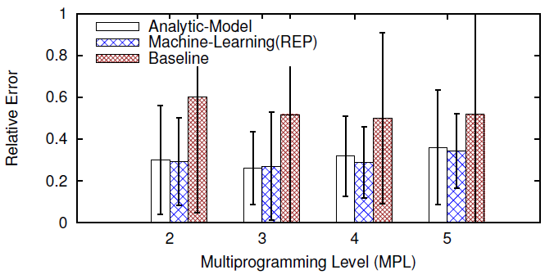
Prediction Accuracy
On TPC-H1 (light to moderate templates)
Notes:
The accuracy of our two approaches are close.
Both of our approaches outperform the baseline approach by 15% to 30%.
This may not be very impressive, considering the simplicity of the baseline approach.

Slide 30
Prediction Accuracy (Cont.)
On TPC-H2 (with more expensive templates)
Notes:
The performance of baseline approach becomes much worse.
The accuracy of our proposed approaches is close to that on TPC-H1.
The analytic-model based approach outperforms the machine-learning based approach by 10%.

Slide 31
Prediction Accuracy (Cont.)
On MB1 (mixes of heavy index scans)
Notes:
The machine-learning based approach is even worse than the baseline approach.
The analytic-model base approach is the best.

Slide 32
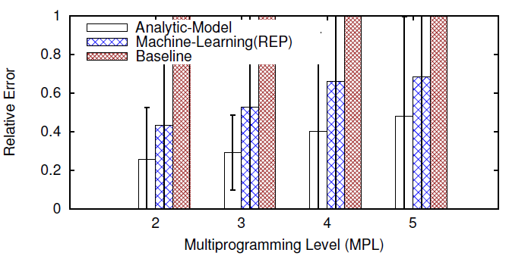
Prediction Accuracy (Cont.)
On MB2 (mixes of sequential scans/index scans)
Notes:
Analytic-model based approach outperforms machine-learning based approach by 20% to 25%.

Slide 33
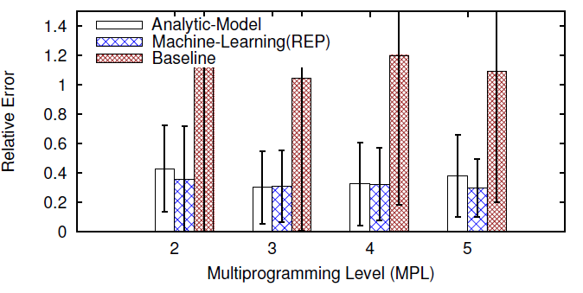
Prediction Accuracy (Cont.)
On MB3 (similar to MB2, but with TPC-H queries)
Notes:
Analytic-model based approach and machine-learning based approach are comparable.

Slide 34
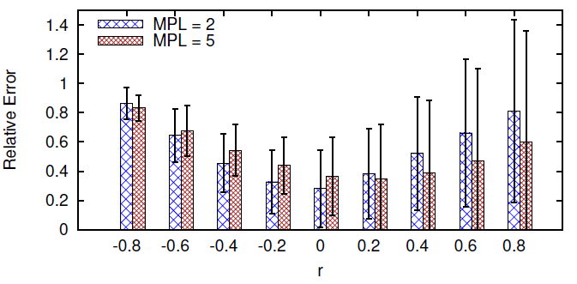
Sensitivity to Errors in Cardinality Estimates
On TPC-H1, with biased errors

Slide 35
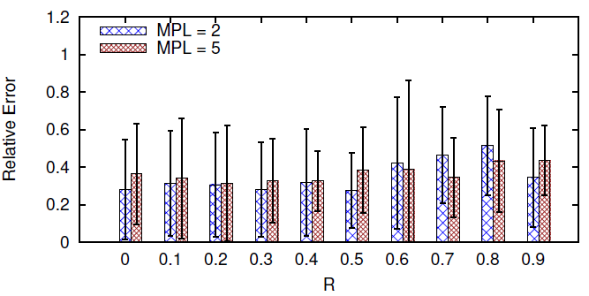
Sensitivity to Errors in Cardinality Estimates (Cont.)
On TPC-H1, with unbiased errors

Slide 36
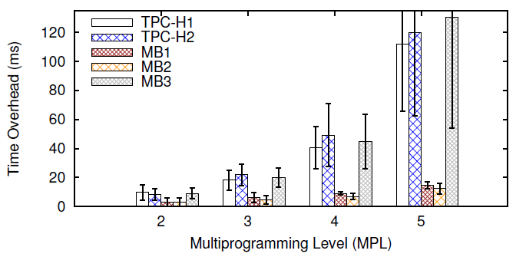
Additional Overhead (Analytic-Model Based Approach)

