Slide 1
Uncertainty-Aware Query Execution Time Prediction
Wentao Wu^{1,2}, Xi Wu², Hakan Hacigumus³, Jeff Naughton²
¹Microsoft Research
²University of Wisconsin-Madison
³Google
Notes:
Hello everyone, welcome to my talk. I am Wentao Wu from University of Wisconsin-Madison.
It is my pleasure to be here to present my work on sampling-based query running time estimation and its application.

Slide 2
Query Execution Time Estimation
Problem Definition
Given a query, estimate its running time before it runs.
Focus on OLAP style, long-running queries.
Applications
Traditionally, cost-based query optimization.
Recently, database as a service (DaaS): admission control, query scheduling, system sizing, …
Notes:
The problem of query running time estimation has been studied for years.
Here is a problem definition.

Slide 3
Previous Work
Single-Query Workload
[Ganapathi ICDE’09], [Xiong SoCC’11], [Akdere ICDE’12], [Li VLDB’12], [Wu ICDE’13]
Multi-Query Workload
[Ahmad EDBT’11], [Duggan SIGMOD’11], [Wu VLDB’13]
None of them is perfect, but none of them tried to quantify the uncertainty in the estimated query execution time.

Slide 4
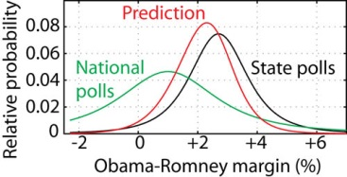
Motivation
Estimates are more useful with confidence intervals.
Measure Uncertainty: point estimate => distribution
Notes:
1. Estimating query execution time is challenging.
None of the existing approaches is perfect.
2. However, none of the existing work has tried to measure the uncertainty in the estimation.
They only provide a single, point estimate of the true execution time.

Slide 5


Caveat
What do we mean by “distribution of likely query execution times”?
Interpretation 1: If we run the query 100 times, what will be the distribution of its running times?
Interpretation 2: If we run the query now, what is the likelihood that it can finish between 100s and 200s?
Notes:
// change the bright red/green color…

Slide 6
Applications
Query optimization
Least-Expected-Cost query optimization [Chu PODS’99]
Robust Query Optimization [Babcock SIGMOD’05]
Query progress monitoring
Provide error bars for the “remaining” query running time.
Database as a service
Distribution-based query scheduling [Chi VLDB’13].

Slide 7
Our Idea
Cost Unit | Value
c_{s}: seq_page_cost | 1.0
c_{r}: rand_page_cost | 4.0
c_{t}: cpu_tuple_cost | 0.01
c_{i}: cpu_index_tuple_cost | 0.005
c_{o}: cpu_operator_cost | 0.0025
PostgreSQL’s cost model
c’s: cost units
n’s: functions of cardinality estimates
$$C=n_{s}c_{s}+n_{r}c_{r}+n_{t}c_{t}+n_{i}c_{i}+n_{o}c_{o}$$
In our previous work [Wu ICDE’13], we proposed a framework that calibrates the c’s and refines the n’s to get better query execution time estimates.
Notes:
This only works if the n’s are correct and the ratios between the c’s are correct.

Slide 8
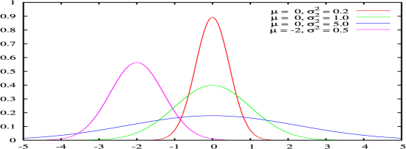
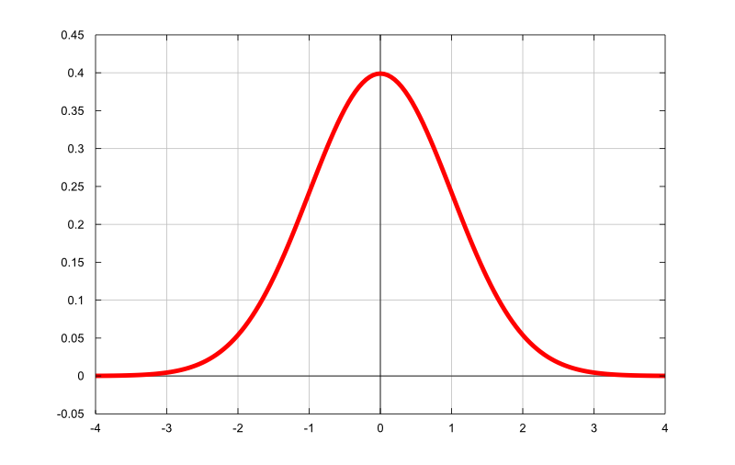
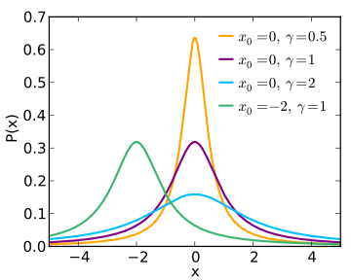
Our Idea (Cont.)
$$t=n_{s}c_{s}+n_{r}c_{r}+n_{t}c_{t}+n_{i}c_{i}+n_{o}c_{o}$$
View the c’s and the n’s as random variables rather than constants!
Pr (c)
t = n · c
Pr (n)
Pr (t)
Notes:
View the c’s and the n’s as random variables rather than fixed constants.
2. Query running time is then also a random variable because it is a function of the c’s and the n’s.
Note: we mean estimated rather than actual time.
3. Characterize the distribution of (the estimated) query running time.

Slide 9
Outlines
The calibration framework
Distributions of the c’s
Distributions of the n’s
Summary

Slide 10
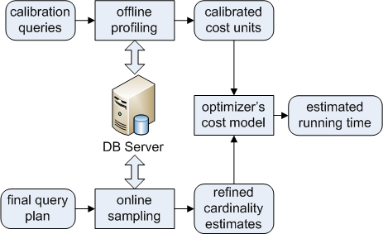
The Calibration Framework
Calibrate the c’s: use calibration queries.
Sampling is used only once for the final chosen plan!
Refine the n’s: refine cardinality estimates.
Notes:
So, if we use the correct c’s and n’s in the cost models, what would happen? In our study, we found that the cost models became much more effective, when more accurate (calibrated) c’s and n’s were used. We next describe our calibration approaches and present experiment results. Discuss the big picture of the calibration framework.

Slide 11
Outlines
The calibration framework
Distributions of the c’s
Distributions of the n’s
Summary

Slide 12
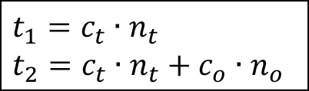
Calibrate The c’s
Cost Unit
c_{s}: seq_page_cost
c_{r}: rand_page_cost
c_{t}: cpu_tuple_cost
c_{i}: cpu_index_tuple_cost
c_{o}: cpu_operator_cost
Basic idea (an example)
Want to know the true values of
c_{t} and c_{o} via calibration queries.
General case
k cost units (i.e., k unknowns) => k queries (i.e., k equations)
k = 5 in the case of PostgreSQL
q₁: select * from R
q₂: select count(*)
from R
R in memory
$$t_{1}=c_{t}∙n_{t}$$
$$t_{2}=c_{t}∙n_{t}+c_{o}∙n_{o}$$

Slide 13




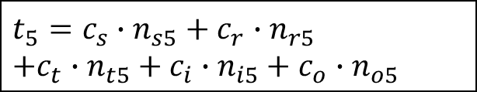
Calibration Queries For PostgreSQL
Isolate the unknowns and solve them one per equation!
R in memory
q₁: select * from R
$$t_{1}=c_{t}∙n_{t1}$$
R in memory
q₂: select count(*) from R
$$t_{2}=c_{t}∙n_{t2}+c_{o}∙n_{o2}$$
q₃: select * from R where R.A < a (R.A with an Index)
R in memory
$$t_{3}=c_{t}∙n_{t3}+c_{i}∙n_{i3}+c_{o}∙n_{o3}$$
R on disk
q₄: select * from R
$t_{4}=c_{s}∙n_{s4}$ + $c_{t}∙n_{t4}$
q₅: select * from R where R.B < b (R.B unclustered Index)
R on disk
$$t_{5}=c_{s}∙n_{s5}+c_{r}∙n_{r5}$$
$$+c_{t}∙n_{t5}+c_{i}∙n_{i5}+c_{o}∙n_{o5}$$
For each c, use multiple queries and take the average.
Notes:
With the three guiding principles shown in the previous slide, we pick profiling queries as follows.

Slide 14
Distributions of the c’s
Assumption: c ~ N(μ, σ²)
m calibration
queries for each c
(μ_{m} , σ_{m}²)
Notes:
1. View the c’s as Normal (i.e., Gaussian) variables. Our approach can still be used if the c’s are not normal. However, the derivation of the distribution of t will be different.
2. We have already known μ by the previous calibration procedure (by using profiling queries).
3. We measure the σ² with a similar approach by computing the variances of the observed c’s.

Slide 15
Outlines
The calibration framework
Distributions of the c’s
Distributions of the n’s
Summary

Slide 16
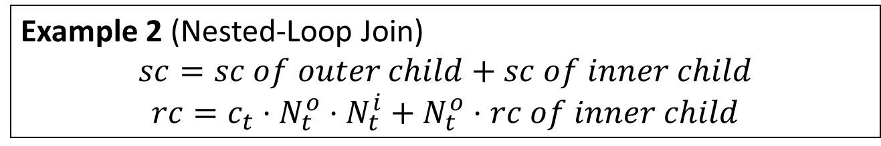
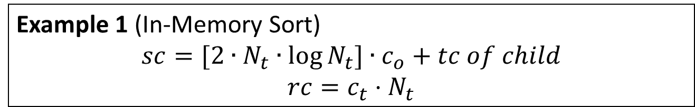
Refine The n’s
The n’s are functions of N’s (i.e., input cardinalities).
Example 1 (In-Memory Sort)
$$sc=[2∙N_{t}∙\log{N_{t}]∙c_{o}}+tc of child$$
$$rc=c_{t}⋅N_{t}$$
n_{o}
Example 2 (Nested-Loop Join)
$$sc=sc of outer child+sc of inner child$$
$$rc=c_{t}⋅N_{t}^{o}⋅N_{t}^{i}+N_{t}^{o}⋅rc of inner child$$
n_{t}
sc: start-cost rc: run-cost tc: total-cost N_{t}: # of input tuples
Notes:
Our next major step is to calibrate the n’s. Let’s first take a look at how these n’s are obtained.
We present the cost formulas of two typical operators used by PostgreSQL: in-memory sort, and nested-loop join.
The little n’s are thus functions of the big N’s. For different operators, the function is different. However, to calibrate the little n’s, what we need to do is to calibrate the big N’s, regardless of the operator we are concerned with. Calibration of the big N’s then brings us back to the (old) problem of cardinality estimation.

Slide 17
Distributions of the n’s
We need to model two quantities:
The selectivities;
The cost functions for different physical operators.
Using mathematics we get distributions of the n’s.

Slide 18




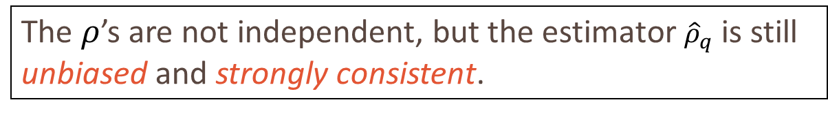
















A Sampling-Based Selectivity Estimator
Estimate the selectivity $ρ_{q}$ of a join query $q$ = $R_{1}⋈R_{2}$.
[Haas et al., J. Comput. Syst. Sci. 1996]
Do a “cross product” over the samples: $ρ\left(i, j\right)=0 or 1$.
$$r_{11}$$
$$⋈$$
$$r_{21}$$
$$ρ(1, 1)$$
|${R^{s}}_{1}⋈{R^{s}}_{2}|$
$$r_{11}$$
$$r_{12}$$
……
$$r_{1N_{1}}$$
$$r_{21}$$
$$r_{22}$$
……
$$r_{2N_{2}}$$
……
…
$$r_{11}$$
$$⋈$$
$$r_{2N2}$$
$$ρ(1, N_{2})$$
$${\hat{ρ}}_{q}=\frac{\sum_{i,j}{ρ(i, j)}}{N_{1}N_{2}}$$
$$r_{1N1}$$
$$⋈$$
$$r_{21}$$
$$ρ(N_{1}, 1)$$
……
…
|${R^{s}}_{1}|×|{R^{s}}_{2}|$
R^{s}₁
R^{s}₂
$$r_{1N1}$$
$$⋈$$
$$r_{2N2}$$
$$ρ(N_{1}, N_{2})$$
The $ρ$’s are not independent, but the estimator ${\hat{ρ}}_{q}$ is still unbiased and strongly consistent.
Notes:
This extends previous work from pure join queries to queries with mixed selections and joins.
// need to highlight a few words but can’t select text for some unknown reason
// change cell colors

Slide 19
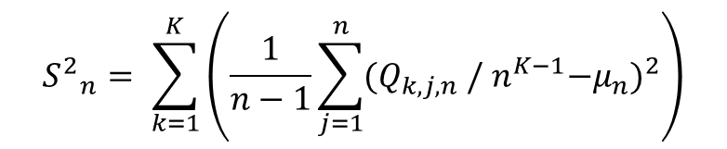
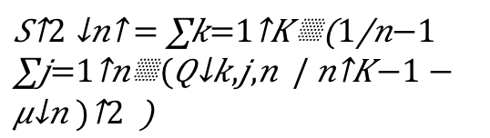
Distributions of Selectivities
Selectivity ~ N(μ_{n}, S²_{n}): by the Central Limit Theorem.
$${S^{2}}_{n}^{}= \sum_{k=1}^{K}{\left(\frac{1}{n−1}\sum_{j=1}^{n}{{(Q_{k,j,n} /{ n}^{K−1}−μ_{n})}^{2}}\right)}$$
(μ_{n} , S²_{n})
Notes:
1. The distribution of the estimated selectivity by the sampling-based estimator is Gaussian:
By the Central Limit Theorem.
2. Again, we have known the mean of the selectivity by the previous cardinality refinement procedure.
Need to know the sample variance.

Slide 20






Modeling Cost Functions
(Different Implementations)
Nested-Loop Join
Generic Cost Function:
$$f=a_{0}N_{l}N_{r}+a_{1}N_{l}+a_{2}N_{r}+a_{3}$$
N_{l} and N_{r} are the left and right input cardinality of the operator.
Notes:
1. Different database systems may have different implementations of even the same physical operator.
2. We focus on generic cost functions that characterize the behavior of an operator based on its execution logic.
For example, the cost function of a nested loop join could be roughly:

Slide 21


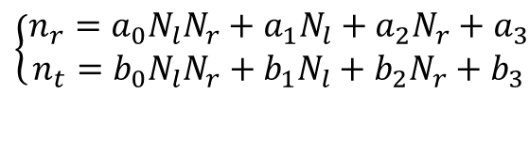
Distributions of the n’s and t
The n’s are asymptotically Gaussian.
More samples => more close to Gaussian
The running time t is also asymptotically Gaussian.
Example: Nested Loop Join
$$t=n_{r}c_{r}+n_{t}c_{t}$$
$$t∼N(E\left[t\right], Var\left[t\right])$$
$$\left\{\begin{aligned}n_{r}=a_{0}N_{l}N_{r}+a_{1}N_{l}+a_{2}N_{r}+a_{3} \\ n_{t}=b_{0}N_{l}N_{r}+b_{1}N_{l}+b_{2}N_{r}+b_{3}\end{aligned}\right.$$
n_{r} and n_{t} are not independent!
Should consider covariances when computing Var[t]!

Slide 22
Outlines
The calibration framework
Distributions of the c’s
Distributions of the n’s
Summary

Slide 23
Put It Together (Review)
Pr (selectivity)
(Gaussian)
Generic Cost Functions
Convergence Theorems
Pr(n)
(Asymptotically Gaussian)
Convergence Theorems
Pr (c)
(Gaussian)
Pr(t)
(Asymptotically
Gaussian)
Cost Model
(t = c · n)

Slide 24
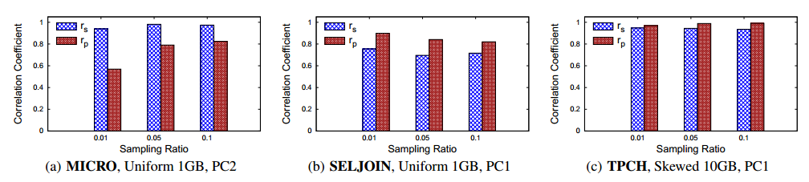
Experimental Evaluation
The idea: larger variances => larger estimation errors
We thus measure the correlation between the two.
We observed strong correlations (i.e., correlation coefficient > 0.7) on almost all the queries tested in our experiments.

Slide 25
Q & A
Thank you☺

Slide 26

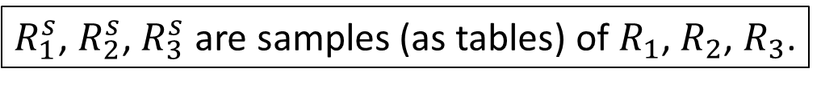







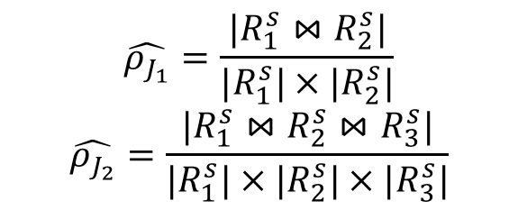
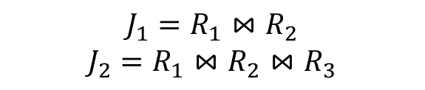
The Cardinality Refinement Algorithm (Example)
$$J_{1}=R_{1}⋈R_{2}$$
$$J_{2}=R_{1}⋈R_{2}⋈R_{3}$$
Plan of q:
agg
agg
$$\hat{ρ_{J_{1}}}=\frac{|R_{1}^{s}⋈R_{2}^{s}|}{|R_{1}^{s}|×|R_{2}^{s}|}$$
$$\hat{ρ_{J_{2}}}=\frac{|R_{1}^{s}⋈R_{2}^{s}⋈R_{3}^{s}|}{|R_{1}^{s}|×{|R}_{2}^{s}|×|R_{3}^{s}|}$$
J₂
Run
Rewrite
$$⋈$$
$$⋈$$
$$⋈$$
J₁
$$⋈$$
$$R_{3}^{}$$
$$R_{3}^{s}$$
$$R_{1}^{}$$
$$R_{2}^{}$$
$$R_{1}^{s}$$
$$R_{2}^{s}$$
Reuse
$R_{1}^{s}$, $R_{2}^{s}$, $R_{3}^{s}$ are samples (as tables) of $R_{1}$, $R_{2}$, $R_{3}$.
For agg, use PostgreSQL’s estimates based on the refined input estimates from J₂.
Notes:
Here is an example. q is a query and the leftmost figure presents its plan chosen by the optimizer. Let R_1^s, R_2^s, R_3^s be the samples (materialized views) of R_1, R_2, R_3, respectively. We first rewrite the query plan by replacing the relations with their corresponding samples. We then simply run the modified query (plan), after which we can learn the sizes of the two joins (namely, the two subqueries q_1 and q_2), and estimate the selectivity \rho_{q_1} and \rho_{q_2} accordingly (as shown). The correctness of this implementation is shown in the paper. Finally, we simply call PostgreSQL's model for the aggregate operator. However, the estimated input cardinality (i.e., the size of q_2) of "agg" is now different from the optimizer's original estimate. Therefore, the estimated output cardinality of "agg" might still be refined.
Note that a naïve implementation could be to run the estimator once for each of the two joins (so twice in total), which is actually unnecessary. We showed that reusing the partial results could perserve the unbiasedness and strong consistency of the estimator.

Slide 27

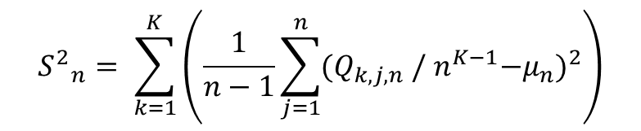
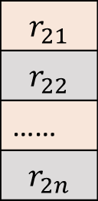
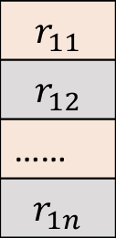
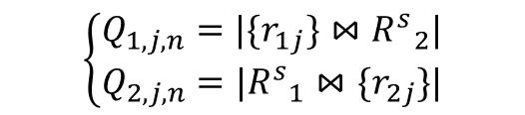


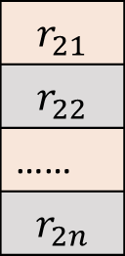
Distributions of Selectivities (Cont.)
Implementation of S²_{n} in PostgreSQL
$${S^{2}}_{n}^{}= \sum_{k=1}^{K}{\left(\frac{1}{n−1}\sum_{j=1}^{n}{{(Q_{k,j,n} /{ n}^{K−1}−μ_{n})}^{2}}\right)}$$
If: r₁₁ ⋈ r₂₁ ∊ R ^{s}₁ ⋈ R ^{s}₂
Then: ++Q_{1, 1, n}
++Q_{2, 1, n}
Example: K = 2 (i.e., $R_{1}⋈R_{2}$)
$$r_{11}$$
$$r_{12}$$
……
$$r_{1n}$$
$$⋈$$
$$r_{21}$$
$$r_{22}$$
……
$$r_{2n}$$
$$r_{11}$$
$$r_{12}$$
……
$$r_{1n}$$
$$r_{21}$$
$$r_{22}$$
……
$$r_{2n}$$
$$\left\{\begin{aligned}Q_{1,j,n}=|\{r_{1j}\}⋈{R^{s}}_{2}^{}| \\ Q_{2,j,n}=|{R^{s}}_{1}^{}⋈\{r_{2j}\}|\end{aligned}\right.$$
$$⋈$$
r_{1j} and r_{2j} are the j-th row of R^{s}₁ and R^{s}₂.
R^{s}₁
R^{s}₂
R^{s}₁
R^{s}₂
2n joins here!
Only 1 join!
Notes:
We further implemented this in PostgreSQL.
The key here is to calculate the Q’s.
To understand what the Q’s are, let’s further see an example.
Suppose that K = 2, namely, we just join two tables.
If each table has n samples, then we would have n Q’s for each table.
Each Q is simply the size of joining one sample tuple from one table with the other whole sample table.
However, a naïve implementation following this would then require 2n joins, which is inefficient.
We can actually be smarter by using only one join between the two sample tables.
We basically maintain a counter for each Q. If a join tuple is presented in the join of the two sample tables, then we simply increment the corresponding two Q’s.
// change the table color

