Slide 1

Factor Windows: Cost-based Query Rewriting for Optimizing Correlated Window Aggregates
Wentao Wu (Microsoft Research)
Philip A. Bernstein (Microsoft Research)
Alex Raizman (Microsoft)
Christina Pavlopoulou (University of California, Riverside)
Notes:
In this talk, I will present our work on “Factor windows: Cost-based query rewriting for optimizing correlated window aggregates”.
I am Wentao Wu from Microsoft Research. This is joint work with my colleagues Phil Bernstein, Alex Raizman, and Christina Pavlopoulou.

Slide 2
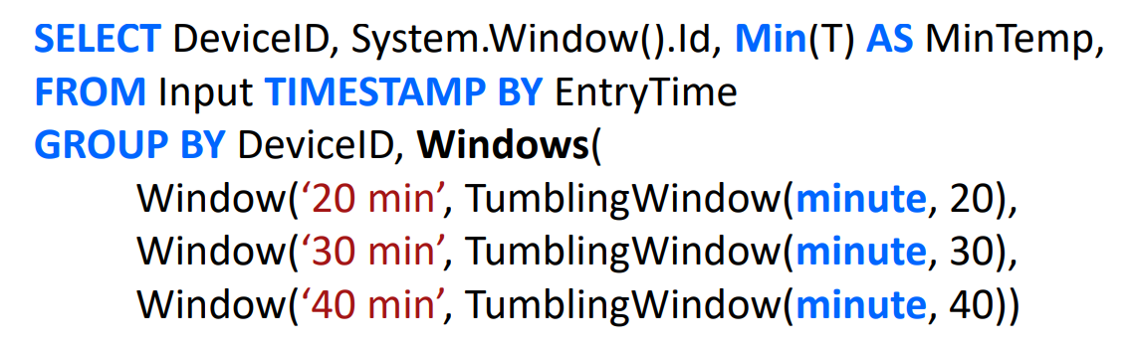
Scenario: Correlated Window Aggregates
An example “window set” query from Azure Stream Analytics: https://azure.microsoft.com/en-us/services/stream-analytics/
Notes:
In real-world stream processing applications, we see many queries that perform correlated window aggregates over the same input stream.
Here is an example of such a “window set” query from Microsoft’s Azure Stream Analytics service, where we want to report the device with the minimum temperature reading every 20, 30, and 40 minutes.

Slide 3
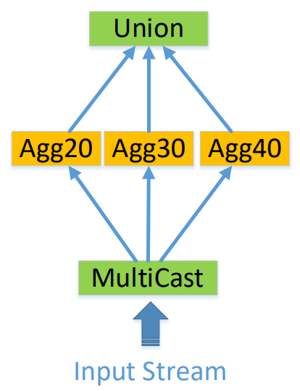
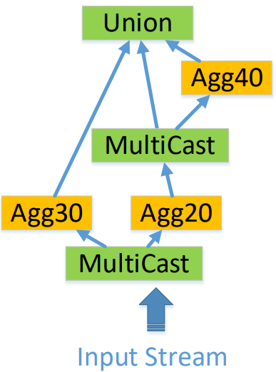
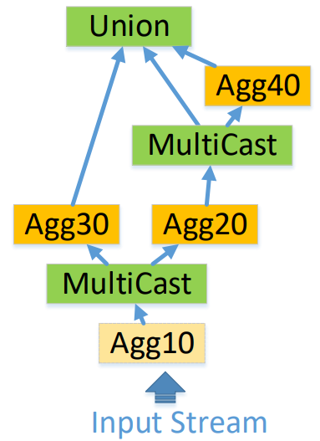
Overview of Our Solution
(a) Default query plan
(b) Optimized query plan
(c) Optimized query plan with factor windows
Notes:
The default execution plan of the previous “window set” aggregate query would look like figure (a) here, where each window aggregate is evaluated independent of each other.
In this work, we propose cost-based query optimization techniques that exploit the overlapping relationships between the windows. The optimized query plan of the example query using our techniques is shown in figure (b). Here, the 40-minute window aggregate uses the output from the 20-minute window aggregate, instead of computing directly on top of the input stream from scratch.
Moreover, we propose “factor windows” to further optimize the query plan, which are windows that are not included by the window set but can help with reducing the overall computation cost. For the example window-set query, its optimized query plan with factor windows is shown in figure (c). Here, we add a 10-minute factor-window aggregate and use its output to compute both the 20-minute and 30-minute window aggregates.
In the rest of this talk, I will walk through the details of our optimization techniques and present experimental evaluation results.

Slide 4
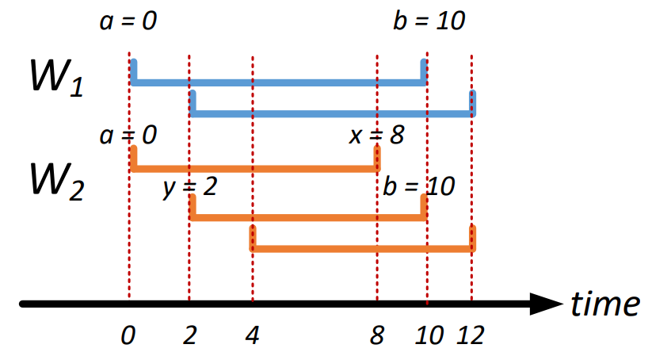
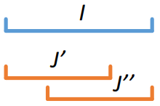
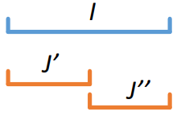
Window Coverage
W
W’
(a) Window coverage
W
W₁ is “covered by” W₂
W’
(b) Window partitioning
Notes:
Let me start by a formal characterization of the overlapping relationships between the windows.
Consider two windows W and W’. We say that W is covered by W’, if each of W’s instance intervals is covered by multiple instance intervals from W’. The right side of this figure presents such a “window coverage” example with two windows W1 and W2. For example, the top interval of W1 is covered by the top two intervals of W2, and the bottom interval of W1 is covered by the bottom two intervals of W2
In particular, if the instance intervals from W’ are disjoint, then we say that W is partitioned by W’.

Slide 5


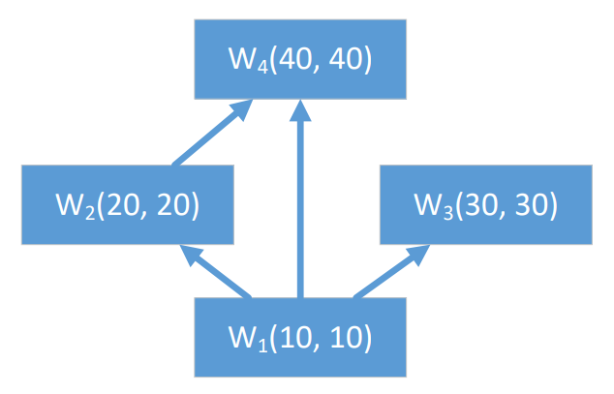

Window Coverage Graph (WCG)
We represent a window as $W⟨r, s⟩$, where$r$ and $s$ represent $W$’s “range” and “slide”.
$W$ is a “tumbling” window if $r=s$.
$W$ is a “hopping” window if $r>s$.
Window coverage graph (WCG)
Vertices represent the windows in the window set.
There is an edge from $W_{2}$ to $W_{1}$ if $W_{1}$ is covered by $W_{2}$.
Example: Consider a window set with four tumbling windows $W_{1}⟨10, 10⟩, W_{2}⟨20, 20⟩,W_{3}⟨30, 30⟩,W_{4}⟨40, 40⟩$.
WCG is a directed acyclic graph (DAG).
r = s
s
r
(a) Tumbling Window
(b) Hopping Window
The WCG representation
of the window set
Notes:
Based on the definition of “window coverage”, we introduce the “window coverage graph (WCG)” to capture the coverage relationships between the windows in a given window set.
We represent a window W as a pair (r, s), where r and s represent W’s range and slide, respectively. If r = s, then W is a tumbling window, as shown in Figure (a) here. Otherwise, if r > s, then W is a hopping window, as shown in Figure (b) here.
The vertices of a WCG represent the windows in the window set. For two windows W1 and W2, there is an edge from W2 to W1 in the WCG if W1 is covered by W2.
The figure here shows the WCG corresponding to the example window-set that contains four tumbling windows.
Clearly, the WCG is a directed acyclic graph (DAG).

Slide 6
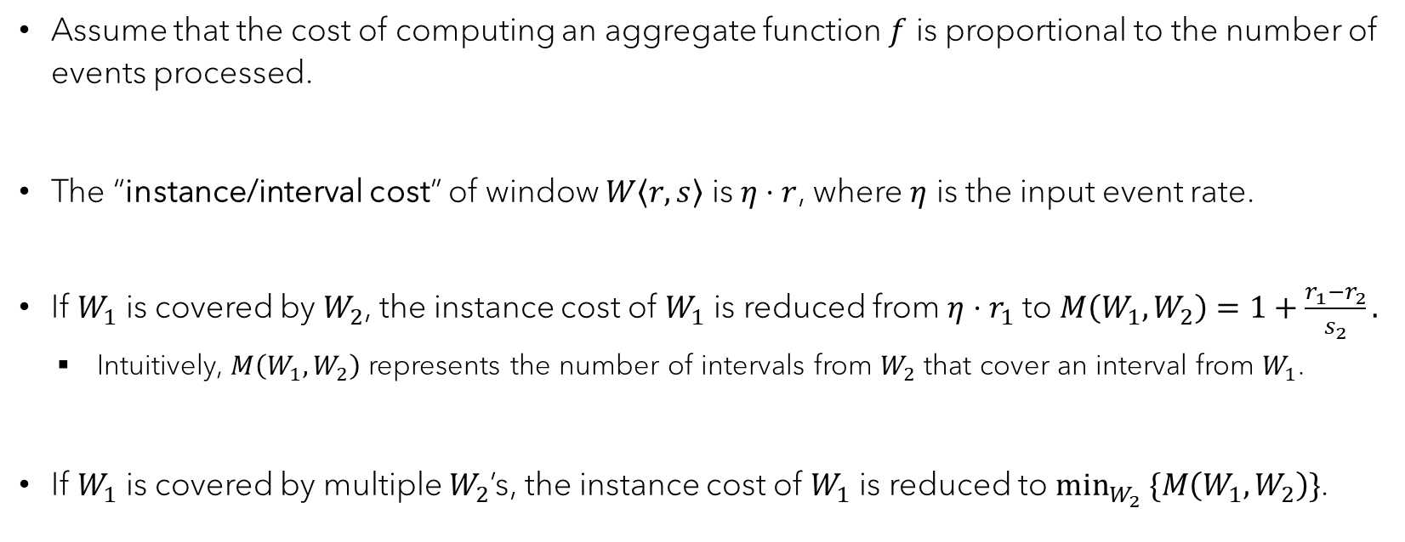
Cost Modeling
Assume that the cost of computing an aggregate function $f$ is proportional to the number of events processed.
The “instance/interval cost” of window $W\left\langle r, s\right\rangle$ is $η⋅r$, where $η$ is the input event rate.
If $W_{1}$ is covered by $W_{2}$, the instance cost of $W_{1}$ is reduced from $η⋅r_{1}$ to $M\left(W_{1},W_{2}\right)=1+\frac{r_{1}−r_{2}}{s_{2}}.$
Intuitively, $M\left(W_{1},W_{2}\right)$ represents the number of intervals from $W_{2}$ that cover an interval from $W_{1}$.
If $W_{1}$ is covered by multiple $W_{2}$’s, the instance cost of $W_{1}$ is reduced to $\min_{W_{2}} \{M\left(W_{1},W_{2}\right)\}$.
Notes:
We propose a cost model to capture the computation cost of an aggregate function f on top of a window set.
We assume that the cost of computing f is proportional to the number of events processed.
The instance/interval cost of a window W(r, s) is therefore eta * r, where eta is the input event rate.
Consider two windows W1 and W2. If W1 is covered by W2, then the instance cost of W1 can be reduced from eta * r1 to M(W1, W2). Intuitively, M(W1, W2) represents the number of intervals from W2 that cover an interval from W1.
Moreover, if W1 is covered by multiple W2’s, then the instance cost of W1 can be further reduced to the minimum M(W1, W2) across all the W2’s.

Slide 7
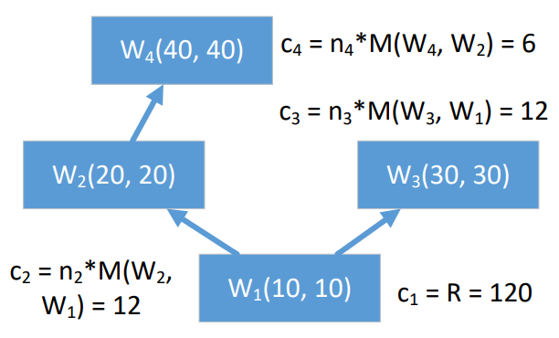

Min-Cost WCG
Example: Consider a window set with $W_{1}⟨10, 10⟩, W_{2}⟨20, 20⟩,W_{3}⟨30, 30⟩,W_{4}⟨40, 40⟩,$.
(a) Initial WCG, cost = 480
(b) Min-cost WCG, cost = 150
Notes:
We can now find the minimum computation cost of evaluating an aggregate function on top of a window set, based on the corresponding WCG.
Again, consider the previous example with four tumbling windows. Figure (a) presents the initial WCG based on the coverage relationships between the windows. For each window W in the WCG with multiple upstream windows, we only keep the edge from the upstream window that results in the minimum computation cost of W. The resulting WCG after this procedure is shown in Figure (b), which we call the “min-cost WCG”.
Here we consider the computation cost of the window set over a period of R = 120. The n_i in Figure (b) represents the number of instances of window W_i that occur in the period of R. For the example here, we can reduce the cost from 480 to 150, a 62.5% reduction. The paper includes additional details on how to derive the costs here.

Slide 8
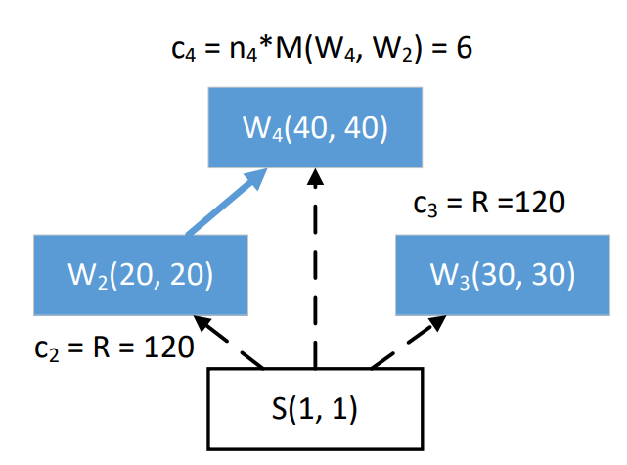
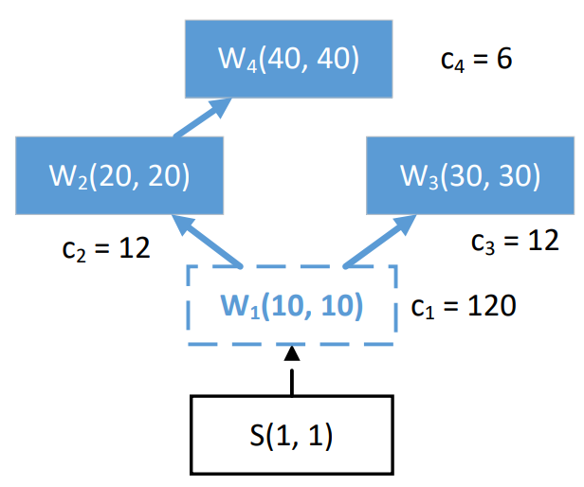

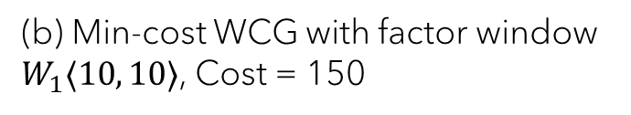
Factor Windows
Factor window - a window not in the input window set that can help reduce the evaluation cost.
I.e., it’s a window that covers some window(s) in the window set.
Example: Consider a window set with $W_{2}⟨20, 20⟩,W_{3}⟨30, 30⟩, W_{4}⟨40, 40⟩$.
(a) Initial WCG (i.e., Min-cost WCG w/o factor window), Cost = 246
(b) Min-cost WCG with factor window
$W_{1}⟨10, 10⟩$, Cost = 150
Notes:
We next introduce “factor windows” to further optimize the query plan represented by the min-cost WCG.
A factor window is a window not in the input window set that can help reduce the evaluation cost. That is, it is a window that covers some window(s) in the window set.
For example, consider a window set with three tumbling windows W2, W3, and W4. The left figure shows the initial WCG, whereas the right figure shows the optimized min-cost WCG with a factor window W1. We can reduce the computation cost from 246 to 150, a 39% reduction. Note that the min-cost WCG without factor windows is the same as the initial WCG in this case. Therefore, using factor windows is essential for the cost reduction observed here.

Slide 9
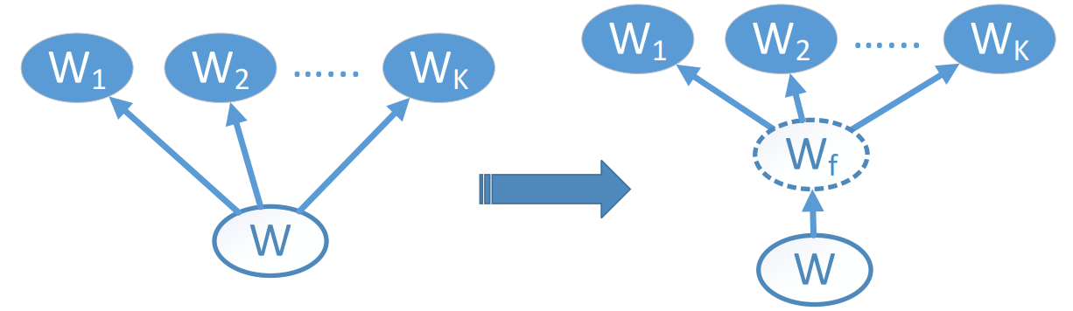
Technical Problem: How to Find the Optimal Factor Windows?
NP-hard problem (Steiner tree)
Our “greedy” solution: Find factor windows that are “locally” optimal.
(1) Candidate generation
(2) Candidate selection
Special treatment for “partitioned by” semantics: See the paper for details.
Notes:
A natural question is then how to find the optimal factor windows for a given WCG.
Unfortunately, this is an NP-hard problem in general. We therefore adopt a “greedy”-style solution to find factor windows that are “locally” optimal. That is, for each window W and its downstream windows W_1 to W_K, we look for the optimal factor window W_f.
Our solution includes two steps: (1) candidate generation and (2) candidate selection, which we will describe next. We also have developed optimized versions of these two steps for the “partitioned by” semantics. Please see our paper for the details.

Slide 10

Candidate Generation
Find eligible slides $S_{f}$.
(1) $s_{d}=gcd\{s_{1}, …, s_{K}\}$
(2) $S_{f}=\{s_{f}:s_{d} mod s_{f}=0 and s_{f} mod s_{W}=0\}$
Find eligible ranges $R_{f}$ for each $s_{f}∈S_{f}$.
$r_{min}=min\left\{r_{1},…,r_{K}\right\}$
$R_{f}=\{r_{f}:r_{f} mod s_{f}=0 and r_{f}≤$ $r_{min}\}$
Construct a candidate factor window $W_{f}=⟨r_{f},s_{f}⟩$ for each pair $\left(r_{f}∈R_{f},s_{f}\right)$.
Notes:
The candidate generation step aims to find eligible factor windows with respect to W and its downstream windows W_1 to W_K.
We break it down into two stages: (1) find eligible slides; and (2) for each eligible slide, find eligible ranges.
For eligible slides, we consider slides that are common factors of the slides of the downstream windows W_1 to W_K and, at the same time, are multiples of the slide of W.
For eligible ranges, we consider ranges that are multiples of each candidate slide, with the constraint that the ranges must be smaller than those of the downstream windows W_1 to W_K.
Finally, we construct a candidate factor window from each pair of candidate slide and candidate range.

Slide 11

Candidate Selection
Compute the “benefit” $δ_{f}$ of each candidate factor window $W_{f}$.
$$δ_{f}=\sum_{j=1}^{K}{n_{j}⋅(\frac{r_{j}−r_{W}}{s_{W}}}−\frac{r_{j}−r_{f}}{s_{f}})−n_{f}⋅(1+\frac{r_{f}−r_{W}}{s_{W}})$$
Select the factor window with the maximum benefit.
Notes:
The candidate selection step determines the best factor window from the candidates, based on their “benefits.”
The benefit delta_f of a candidate factor window W_f is defined as the difference between the costs without and with W_f, which can be computed using the formula here.
You can find additional details in the paper about how to derive this formula.
The candidate selection step simply returns the factor window with the maximum benefit.

Slide 12
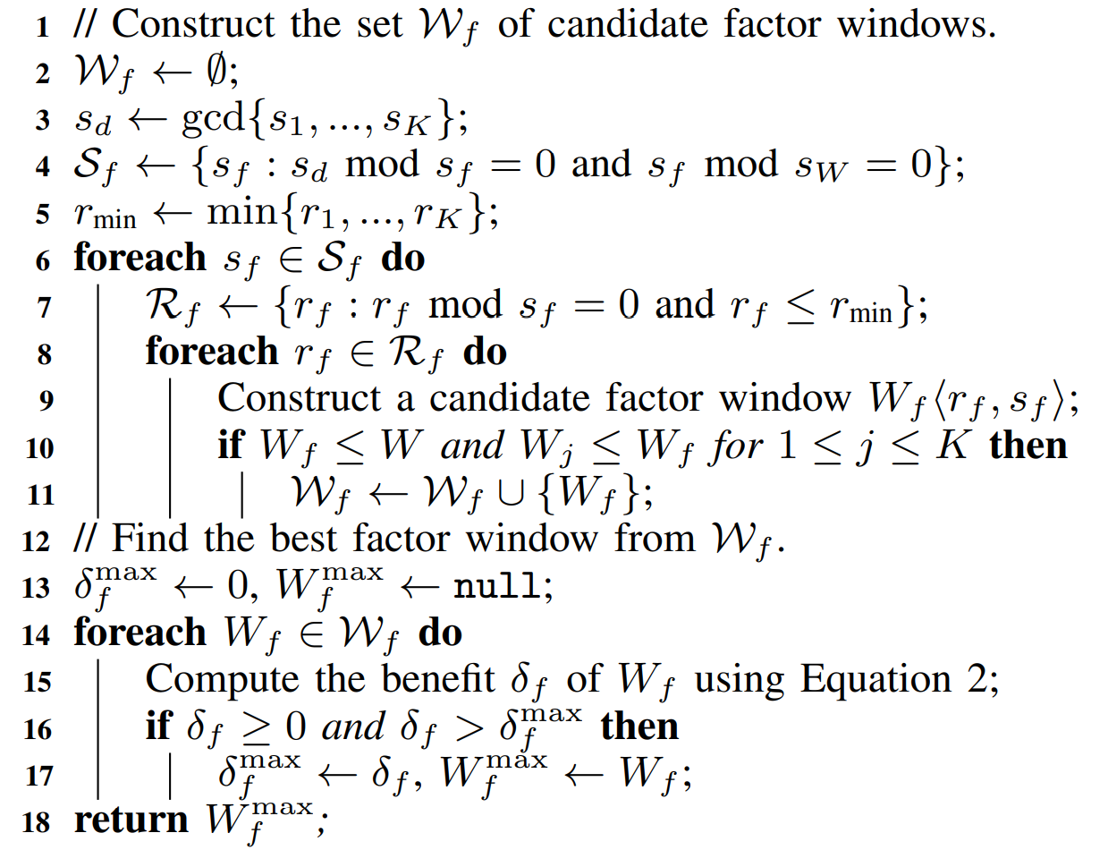
Put Things Together
Candidate
Generation
Candidate
Selection
Notes:
To put things together, the algorithmic description here summarizes the entire procedure of our “greedy” solution to finding the optimal factor window w.r.t. the given W and its downstream windows W_1 to W_K.
We have highlighted the two steps, namely, candidate generation and candidate selection, in the algorithm.

Slide 13
Experimental Settings
Experimental Setup
Prototype: C# implementation that produces optimized query plans (with and without factor windows) represented by Trill expressions.
Performance metric: We measure the throughput of the original plan and the optimized query plans.
Runtime configuration: Single-core execution with 2.2 GHz Intel CPUs and 128 GB main memory.
Datasets
Synthetic Datasets: Synthetic-1M (1 million events), Synthetic-10M (10 million events).
Real Dataset: Real-32M (from DEBS 2012 Grand Challenge, with 32 million events).
Window Sets
RandomGen: Windows with randomly generated slides and ranges.
SequentialGen: Windows whose ranges follow a “sequential” pattern (e.g., 10s, 20s, 30s, 40s, …).
Notes:
Let’s now move on to the experimental evaluation of the proposed optimization techniques.
We implemented a C# prototype that produces optimized query plans (without and with factor windows) represented by Trill expressions.
We measure the throughput of the original query plan and the optimized query plans.
Our experiments were conducted using single-core execution with 2.2 GHz Intel CPU and 128 GB main memory.
We used two synthetic datasets, with 1M and 10M events respectively, as well as a real dataset from the DEBS 2012 Grand Challenge, with 32M events.
Moreover, we generated window sets using two different generators: (1) RandomGen that generates windows with randomly generated slides and ranges; and (2) SequentialGen that generates windows whose ranges follow a “sequential” patten (e.g., 10s, 20s, 30s, 40s, and so on), as we have seen in the previous examples. We observe that this “sequential” pattern is very common in real-world applications.
For each setting, we generate 10 window sets.

Slide 14
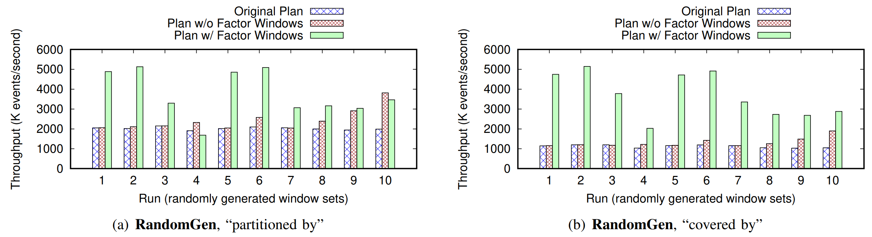
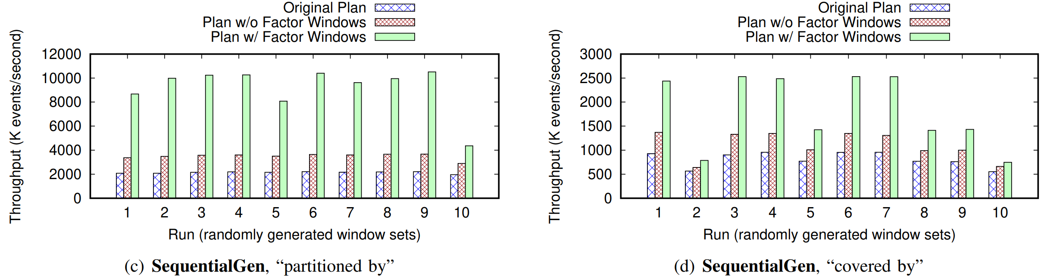
Throughput with and without Factor Windows
Synthetic10M, Window set size = 5
Notes:
We showcase the throughput results with and without factor windows, using the synthetic dataset with 10M events and window sets of size 5.
We have the following observations:
The optimized plan with factor windows can significantly outperform both the original query plan and the optimized plan without factor windows.
The optimized query plans without factor windows are more effective for window-sets generated by SequentialGen than they were in the case of RandomGen. This is not surprising, as the improved correlation between windows generated by SequentialGen can lead to more overlaps and therefore more sharing opportunities.

Slide 15
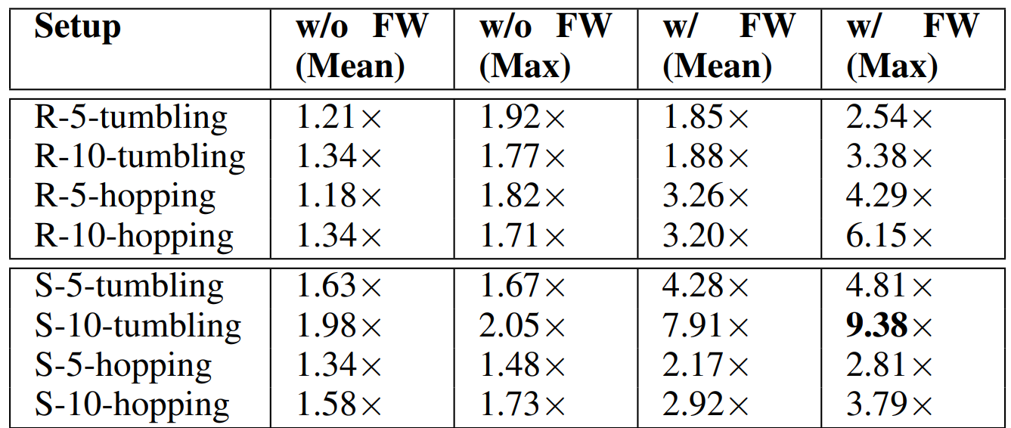
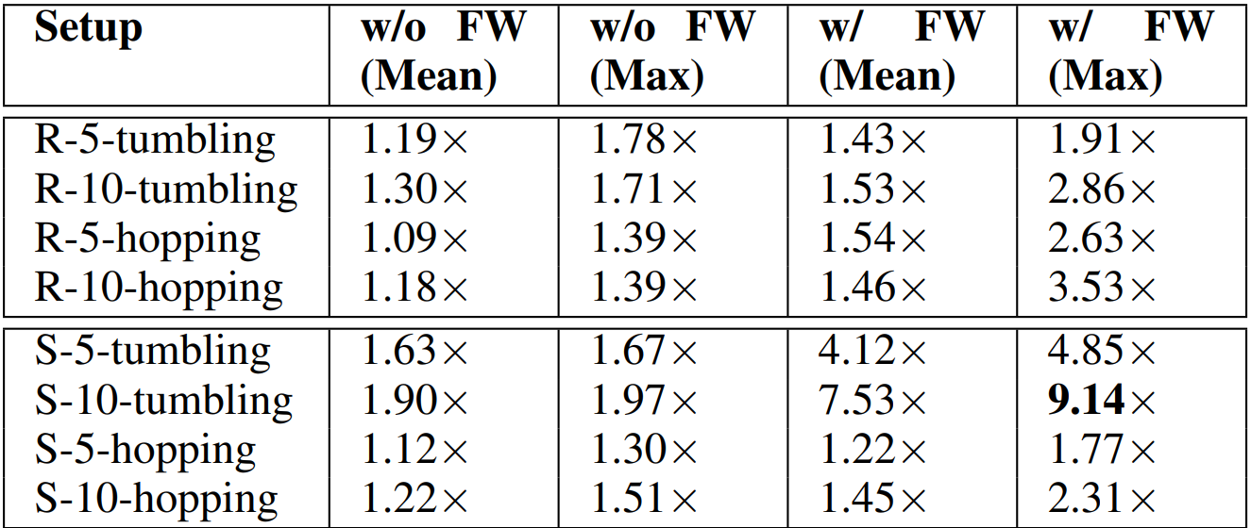
Summary of Throughput Results
Synthetic10M
Window set size = {5, 10}
Real32M
Window set size = {5, 10}
Notes:
Here we summarize the observed throughput results on the synthetic dataset with 10M events and the real dataset with 32M events, when setting the window-set size to 5 and 10.
For each setup (namely, random or sequential window sets, window set size equal to 5 or 10, “covered by” or “partitioned by” semantics), we report the mean and max value of the throughput observed across the 10 window sets generated.
In summary, we observed up to 9.4x and 9.2x throughput boost on the synthetic dataset and the real dataset, respectively, when enabling factor-window based optimizations.

Slide 16
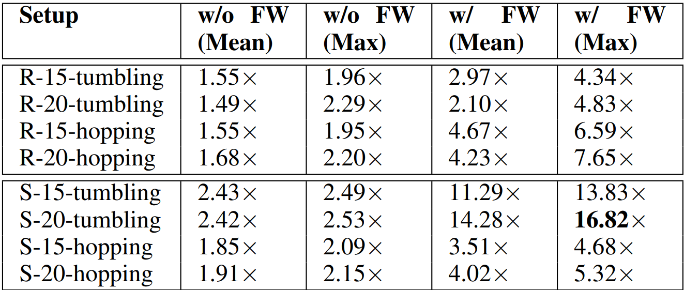
Scalability w.r.t. Window Set Size
Synthetic10M
Window set size = {15, 20}
Notes:
To test the scalability of our optimization techniques, we further increased the window-set size to 15 and 20.
We observe similar throughput boost on the synthetic dataset with 10M events, with up to 16.8x improvement when factor windows are used.

Slide 17
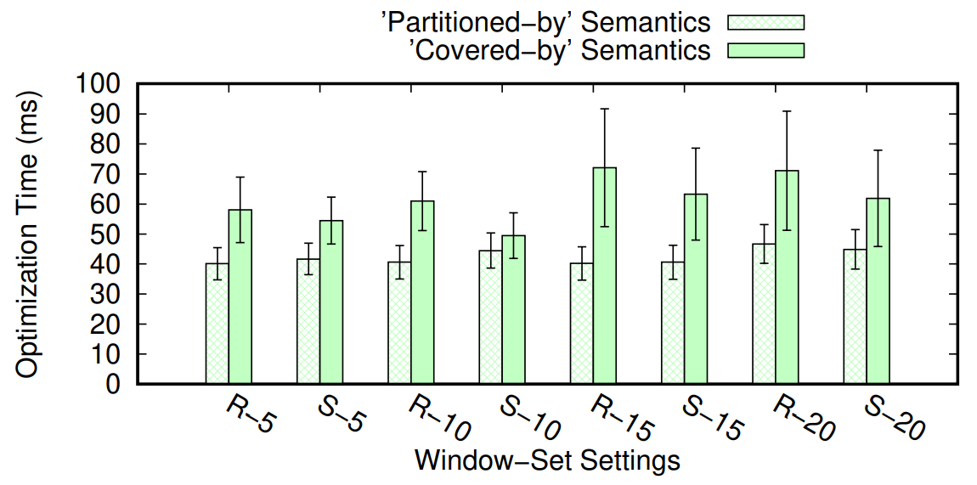
Query Optimization Overhead
Vary window set size from 5 to 20.
Notes:
We also tested the overhead of our query optimization techniques when varying window-set size from 5 to 20.
Overall, the query optimization overhead is negligible (with less than 100 milliseconds).
We also observe that the optimization time of using “covered-by” semantics is typically longer than that of using “partitioned-by” semantics, due to the larger search space with “covered-by” semantics.

Slide 18
Comparison with Window Slicing
Window slicing
Chop the window into smaller chunks (i.e., slices).
Compute the aggregate over the window by aggregating sub-aggregates over the slices.
Scotty (TODS’21): “General stream slicing”
We compare our factor-window based optimization against Scotty on top of Apache Flink.
We use the same data generator developed by Scotty for benchmarking its own performance: https://github.com/TU-Berlin-DIMA/scotty-window-processor.
Notes:
Finally, we compare our optimization techniques with existing window slicing techniques.
The main idea of window slicing is to chop the window into smaller chunks (called slices) and then compute the aggregate over the window by aggregating sub-aggregates over the slices.
Here, we compare our factor-window based optimization against Scotty, which is a “general stream slicing” technique that represents the current state-of-the-art, on top of Apache Flink.
For this purpose, we used the same data generator developed by Scotty for benchmarking its own performance.

Slide 19
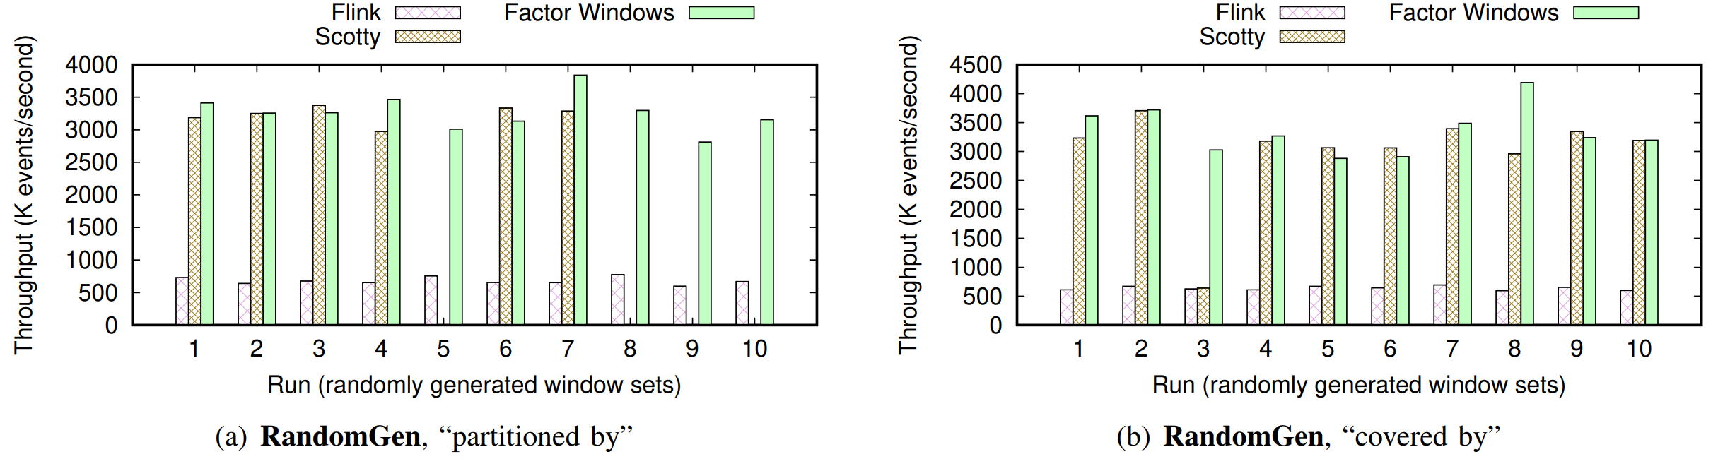
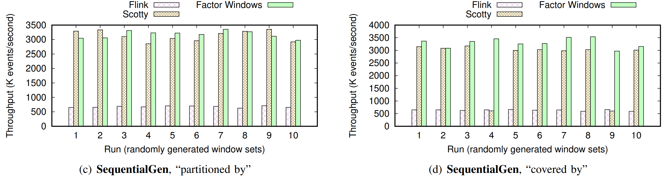
Comparison Results
Window set size = 10
Notes:
Here are the comparison results when setting the window-set size to 10. Since Scotty cannot process some window sets at this scale, we do not further increase the window-set size.
We observe that both Scotty and our factor-window based optimization can significantly outperform the default execution plan produced by Flink (where each window aggregate is evaluated independently), in terms of throughput.
We also observe that in many cases, our factor-window based optimization outperforms Scotty significantly, by up to 5.7x throughput boost (excluding cases where Scotty’s throughput is not available).

Slide 20
Conclusion: Summary of Contributions
We proposed the “window coverage graph” (WCG) abstraction that captures the overlapping relationships between correlated windows.
We proposed a cost-based optimization framework on top of the WCG abstraction, to minimize the computation cost of multi-window aggregate queries.
We extended the cost-based framework by considering “factor windows” and developed technologies to find beneficial factor windows.
We evaluated our techniques on both synthetic and real datasets and demonstrated that the throughput of optimized plans can outperform the original plans by up to 16.8x.
Thank you for viewing our presentation! We’d be happy to hear your comments and questions: wentao.wu@microsoft.com.
Notes:
To conclude, in this work,
We proposed the “window coverage graph” abstraction that captures the overlapping relationships between correlated windows.
We proposed a cost-based optimization framework on top of the WCG abstraction, to minimize the computation cost of multi-window aggregate queries.
We extended the cost-based framework by considering “factor windows” and developed technologies to find beneficial factor windows.
We evaluated our optimization techniques on both synthetic and real datasets, and we demonstrated that the throughput of optimized plans using factor windows can outperform the original plans by up to 16.8x.
Thank you for viewing our presentation! We would be happy to hear your comments and questions.

