Slide 1
Budget-aware Index Tuning with Reinforcement Learning
Wentao Wu (Microsoft Research)
Chi Wang (Microsoft Research)
Tarique Siddiqui (Microsoft Research)
Junxiong Wang (Cornell University)
Vivek Narasayya (Microsoft Research)
Surajit Chaudhuri (Microsoft Research)
Philip A. Bernstein (Microsoft Research)
Notes:
In this talk, I will present our work on “budget-aware index tuning …”
This is joint work with …

Slide 2
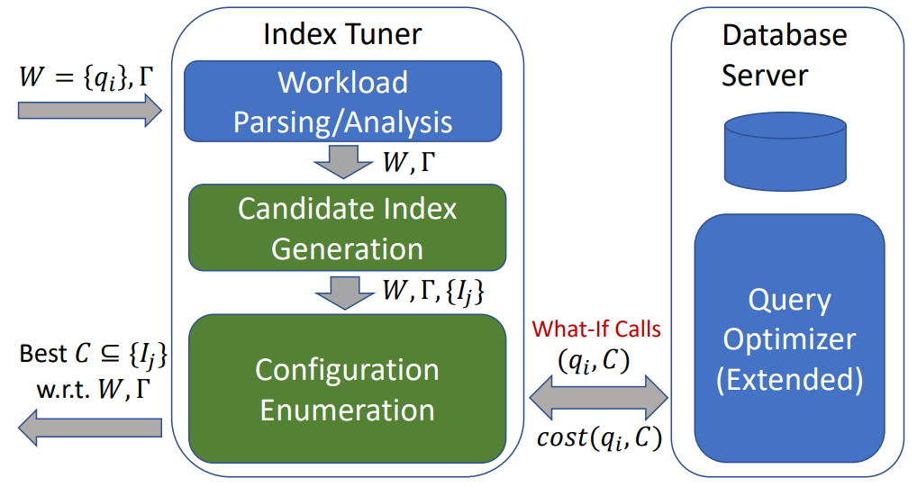
Cost-based index Tuning
Notes:
Let me start by an overview of cost-based index tuning.
An index tuner typically contains the following components: (1) workload parsing and analysis; (2) candidate index generation; and (3) index configuration enumeration.
Given an input workload of SQL queries, we first parse each query and performs analysis such as workload compression, if necessary.
We then look for candidate indexes of the workload, which are indexes that are potentially useful for reducing the workload cost.
Finally, we enter the index configuration enumeration phase, whose goal is to identify a subset of all candidate indexes, called a configuration, that achieves the minimum workload cost with respect to certain constraints.
Common constraints include the maximum number of indexes and/or the maximum storage size allowed.
During configuration enumeration, once a configuration is proposed, we need to know its associated workload cost.
This is obtained via a “what if” API that is an extended functionality of the query optimizer. Specifically, given a pair of query and configuration, the what-if API returns the cost of the query using the indexes in the configuration without creating the indexes.

Slide 3
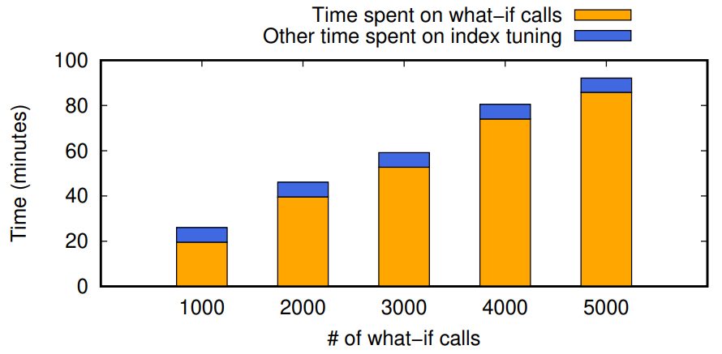
What-if Calls are Expensive
A what-if call is as expensive as a regular query optimizer call
What-if calls dominate index tuning time
TPC-DS, 99 queries, 20 recommended indexes
Notes:
An what-if call to the optimizer is expensive. Just like a regular optimizer call, it has to go through the full query optimization cycle that includes steps such as parsing, analysis, plan enumeration, etc.
To give you an example, this figure shows the time spent on what-if calls compared to other time spent on index tuning, when tuning the TPC-DS workload with 20 recommended indexes.
We can observe that the what-if call time dominates the index tuning time.

Slide 4
Existing Work on Reducing What-if Calls
Reduce the search space of configuration enumeration.
The configuration enumeration problem is NP-hard.
There are exponentially many possible configurations and thus what-if calls.
A classic solution is a greedy search approach that reduces the search space to polynomial size, which remains huge for large/complex workloads.
Other technologies
Restrict the what-if calls to configurations with certain properties, e.g., atomic configurations.
Effective reuse of cached what-if calls, which requires further extension/support from the query optimizer.
Notes:
There has been existing work on reducing the amount of what-if calls in index tuning.
First, there has been work on reducing the search space of configuration enumeration and therefore the amount of what-if calls.
Since the configuration enumeration problem is NP-hard, there are exponentially many possible configurations and thus what-if calls.
A classic solution is a greedy search approach that reduces the search space to polynomial size, which, however, remains huge for large/complex workloads.
Other technologies include, for example, restricting the what-if calls to configurations with certain properties (such as atomic configurations), or more effective reusing of cached what-if calls (which requires further extension and support from the query optimizer).

Slide 5
Budget-aware Index Tuning
End user of index tuning needs to constrain the tuning time instead of letting it run forever.
Microsoft’s Database Tuning Advisor (DTA) allows user to specify the maximum tuning time.
Under constrained tuning time, for large/complex workloads
The number of what-if calls will go beyond the tuning time allowed, despite the previous techniques on reducing the number of what-if calls.
In this work, we study index tuning from a (new) constrained perspective, where
The number of what-if calls (e.g., based on the tuning time budget) is given as a constraint.
We focus on configuration enumeration under constrained number of what-if calls.
Notes:
In practice, however, end user of index tuning often needs to constrain the tuning time, instead of letting it run forever.
For example, Microsoft’s Database Tuning Advisor (DTA) allows user to specific the maximum tuning time.
Under constrained tuning time, for large complex workloads, the number of what-if calls can easily go beyond the tuning time allowed, despite the previous techniques on reducing the number of what-if calls.
In this work, we therefore study index tuning from a new constrained perspective, where the number of what-if calls is given as a constraint.
We focus on the specific problem of configuration enumeration under constrained number of what-if calls.

Slide 6
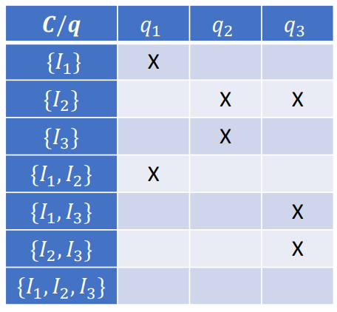

Budget-constrained Configuration Search
Budget allocation matrix
Row – configuration
Column – query
Cell – “X” if a what-if call is used
For cells where what-if calls are not used, we use “derived cost.”
$d\left(q, C\right)=\min_{S⊆C}cost(q, C)$
Problem formulation
Input: W, B (and other constraints $Γ$)
Output: Best configuration C*
Budget constraint: The number of cells marked “X” = B
Notes:
Let me start by giving a more formal problem statement of budget-constrained configuration search.
We introduce a notion called “budget allocation matrix”. Each row of the matrix represents a configuration, whereas each column represents a query in the workload.
A cell is marked “X” if the corresponding (configuration, query) pair is allocated a “what if” call to obtain its cost.
For cells not marked, we use a technique called “cost derivation” to obtain their “derived costs”, which simply takes the minimum “what if” cost of the subsets of the given configuration whose “what if” costs are known.
The problem of budget-constrained configuration search can then be formulated as follows:
Given an input workload W and a budget B on the number of “what if” calls allowed, we want to return the best configuration C such that the number of cells marked in the budget allocation matrix is equal to B.
6. This budget-constrained configuration search problem is NP-hard, since it contains the original configuration search problem (without the budget constraint) as a special case.
7. In the rest of this talk, I will present several heuristic solutions to this problem.

Slide 7
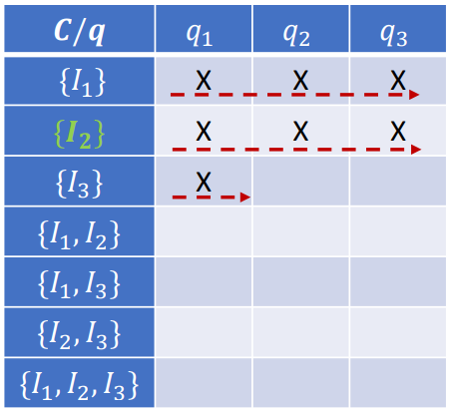
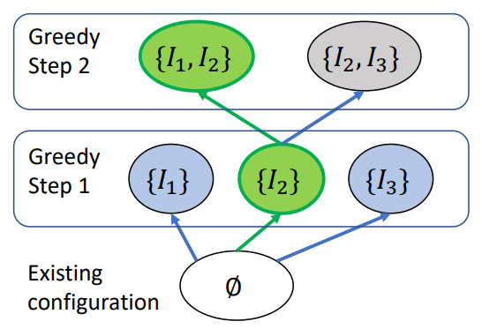
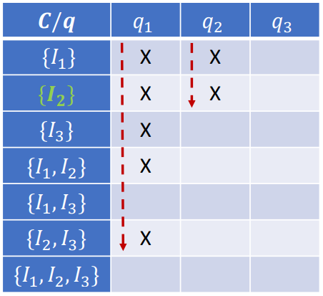
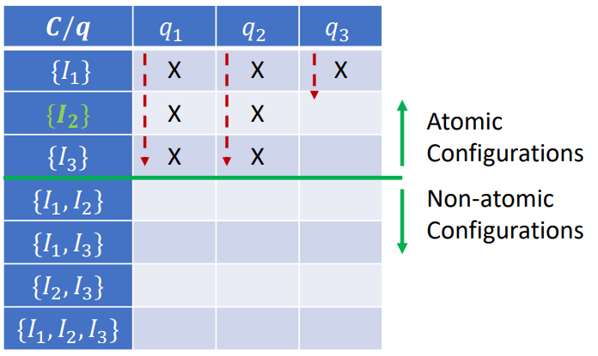
Budget-aware Variants of Greedy Search
Greedy search
(Base) Find the best singleton.
(Induction) Find the best configuration of size k + 1 by extending the best configuration of size k.
Budget allocation in greedy search
First come first serve (FCFS)
Two-phase
Atomic configuration
(b) FCFS
(a) Greedy search
(d) Atomic configuration
(c) Two-phase
Notes:
To start, it is easy to consider some variants of the greedy search strategy, shown in Figure (a), that conform to the budget constraint.
The greedy search strategy starts from an empty configuration and operates in a step-by-step manner.
In each greedy step, it expands the current configuration by adding one more index that results in the minimum workload cost.
One simplest budget allocation strategy in greedy search is “first come first serve”, where we keep issuing “what if” calls to pairs of (configuration, query) encountered during enumeration.
Figure (b) presents the corresponding budget allocation matrix, where we see that the allocation exhibits a “row major” order.
5. Another advanced variant of the greedy search is the so-called “two phase” greedy, where we first run greedy search for each query in the workload to identify its best indexes and then combine them as input to run greedy again at workload-level.
Figure (c) presents the corresponding budget allocation matrix when combining “two phase” greedy with the “first come first serve” strategy, where we see that the allocation exhibits a “column major” order.
6. Moreover, one can further restrict the allocation of “what if” calls to only “atomic configurations” up to a specific size (e.g., 1 or 2).
Figure (d) presents the corresponding budget allocation matrix when combining “two phase” greedy with “atomic configurations”, where we see that the allocation exhibits a “bounded column major” order.

Slide 8
Budget-aware Configuration Search using Reinforcement Learning (RL)
An exploration/exploitation trade-off
Exploration: New configurations that have not yet been visited.
Exploitation: Expand known promising configurations to include more indexes.
Reinforcement learning
A principled way of dealing with exploration/exploitation trade-off.
Notes:
By looking at the previous budget-aware variants of greedy search, we observe an exploration and exploitation trade-off in budget allocation during configuration enumeration.
On one hand, we want to allocate budget to explore new configurations that have not been visited yet.
On the other hand, we want to allocate budget to exploit known promising configurations (e.g., to expand them to include more indexes).
This motivates us to use reinforcement learning to tackle the budget allocation problem, which offers a principled way of dealing with exploration and exploitation trade-offs.

Slide 9
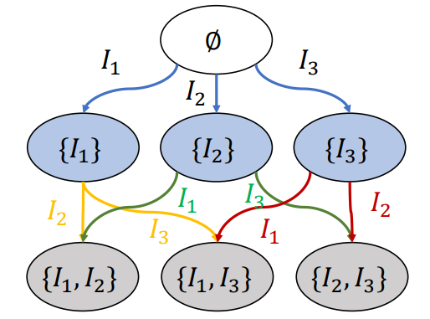


Configuration Search as Markov Decision Process (MDP)
State $s$: Configuration
Action $a$: Index (to be included)
Transition probability $p$: Deterministic
Reward $r$: Percentage improvement of the workload $W$ over the state/configuration $C$
$$η\left(W,C\right)=\left(1−\frac{cost\left(W,C\right)}{cost\left(W,∅\right)}\right)×100\%$$
$$\text{Example} \text{MDP} \text{with} \{I_{1},I_{2}, I_{3}\}$$
Notes:
To apply reinforcement learning, we model configuration search as a Markov Decision Process (MDP).
There are four basic elements in our MDP formulation.
First, the states of the MDP are simply the configurations in the search space. The figure here presents an example MDP with a search space of three indexes, where the nodes represent the states.
Second, the actions represent the indexes to be included. The edges in the figure represent the actions in the example MDP.
Third, the transition probabilities specify how to move from one state to another state in an MDP. In our situation, state transitions are deterministic, as we expand one configuration to generate another.
Finally, the reward of a state (namely, a configuration) C is defined as the percentage improvement of the workload W over the configuration C.

Slide 10
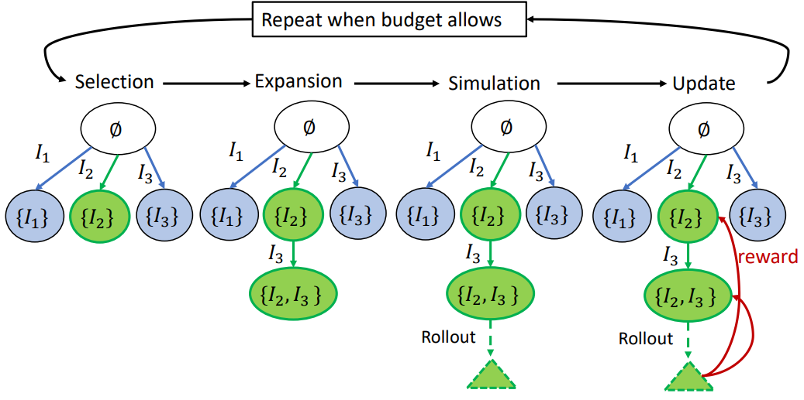
Monte Carlo Tree Search
Notes:
Given the previous MDP formulation, we develop a budget-aware configuration search algorithm based on Monte-Carlo tree search (MCTS).
It works in an iterative manner, and in each iteration we allocate one budget what-if call. The figure here presents a concrete example.
Each iteration includes four basic steps: selection, expansion, simulation, and update.
The selection step visits the current state (namely, configuration) and takes an action (namely, by including an index) based on some action selection policy. It then recursively visits the next state until a leaf state is reached.
If the leaf state has been visited before, the expansion step will extend it by including one more index, using the same action selection policy. This will generate a new leaf state and increase the depth of the tree by 1.
On the other hand, if this is the first time that this leaf state being visited, such as the leaf state that represents the configuration {I2, I3} in the example, then the simulation step will perform a “rollout” by randomly adding more indexes into the configuration represented by the leaf state.
Finally, we evaluate the workload cost improvement over the configuration represented by the leaf state (with rollout), and use that to update the average rewards of the states along the path from the root to the leaf. This is shown as the update step in the figure.
We further devised and evaluated different action selection and rollout policies, as well as policies for extracting the final best configuration from the search tree. Please see our paper for the details.

Slide 11
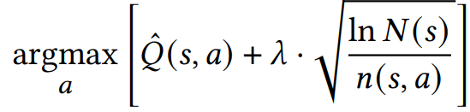
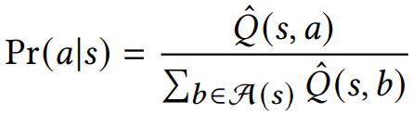
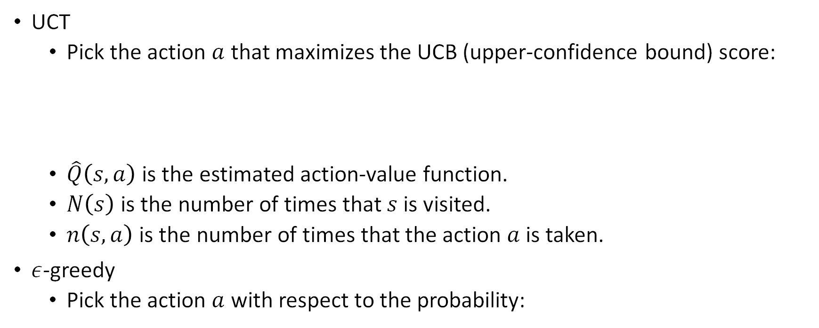
Action Selection Policy
UCT
Pick the action $a$ that maximizes the UCB (upper-confidence bound) score:
$\hat{Q}\left(s,a\right)$ is the estimated action-value function.
$N\left(s\right)$ is the number of times that $s$ is visited.
$n\left(s,a\right)$ is the number of times that the action $a$ is taken.
$ε$-greedy
Pick the action $a$ with respect to the probability:

Slide 12

Action Selection Policy (Cont.)
Address sparsity in the estimated action-value function $\hat{Q}\left(s,a\right)$.
Choose a “prior distribution” for $\hat{Q}\left(s,a\right)$.
Refine the “prior distribution” after observing rewards.
For each action/index $a$, estimate its percentage improvement.
Independent of the state $s$.
Needs to be done in a budget-aware manner.
For each budget what-if call, first select a query, and then select one of its index $a$ (see the paper for details).

Slide 13

Rollout Policy
General rollout policy in MCTS
Expand the visited configuration $s$ by randomly inserting $l$ indexes.
If UCT is used as the action selection policy
Insert $l$ indexes uniformly randomly.
If $ε$-greedy is used as the action selection policy
Insert $l$ indexes based on their “prior distribution.”

Slide 14
Extraction of the Best Configuration
Best configuration explored (BCE)
Return the best configuration found during MCTS.
Best greedy (BG)
Use a greedy strategy to traverse the search tree.
There are various options for the greedy strategy.
Our current implementation
Run the greedy search algorithm again and return the configuration with the minimum derived cost.
This includes both the configurations explored by MCTS and the configurations generated by rollout.

Slide 15
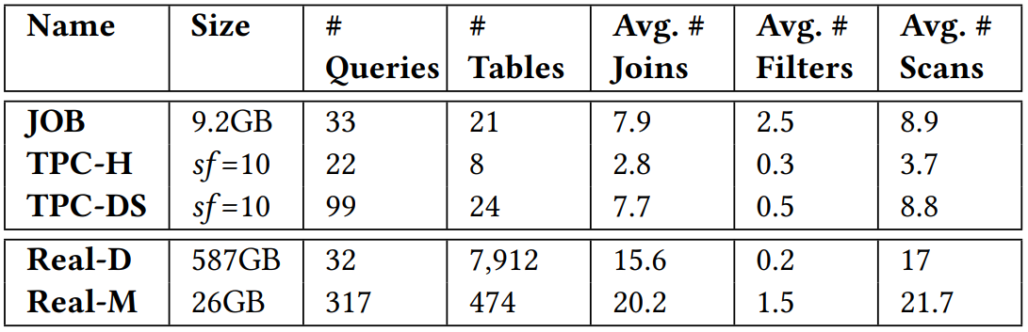
Experiment Settings
Datasets and workloads
Baselines
Budget-aware variants of greedy search
Existing RL approaches to index tuning

Slide 16
Budget-aware Variants of Greedy Search
Vanilla greedy
Standard greedy + FCFS (first come first serve)
Two-phase greedy
Two-phase search + FCFS
Auto-admin greedy
Two-phase greedy + atomic configuration

Slide 17
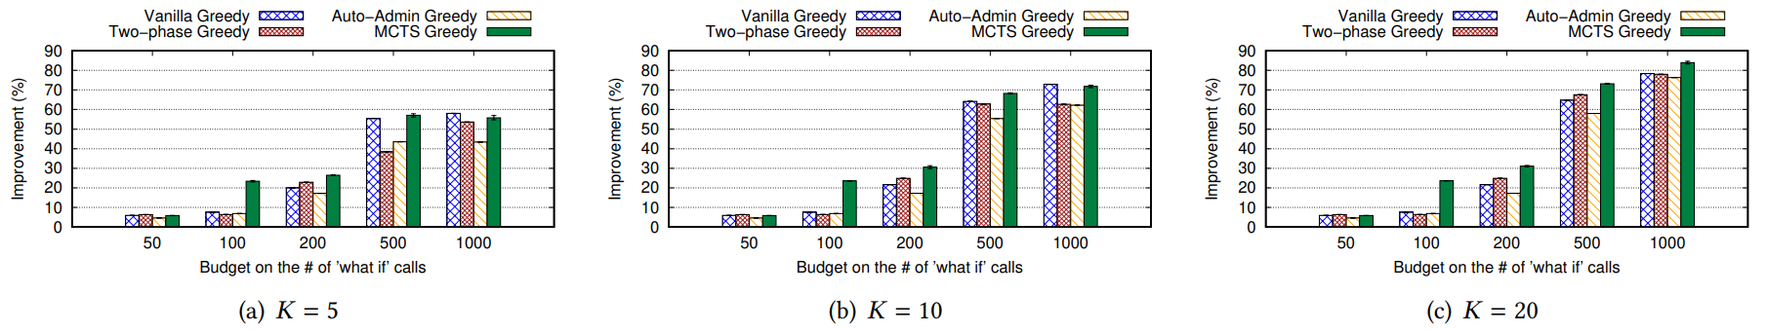
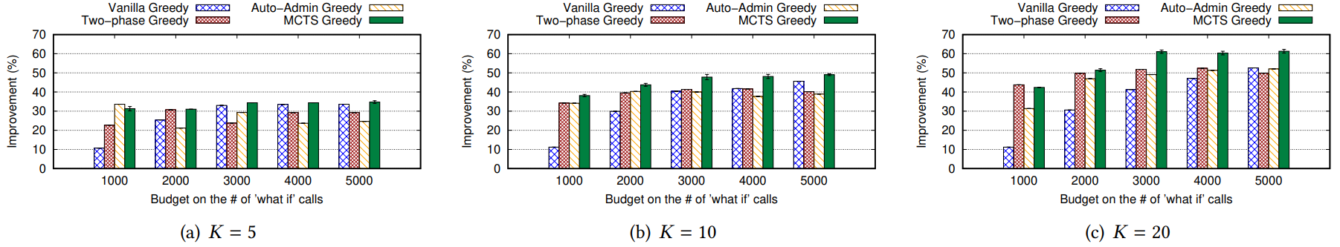
Comparison with Budget-aware Greedy (Benchmark Workloads)
Results on TPC-H
Results on TPC-DS

Slide 18
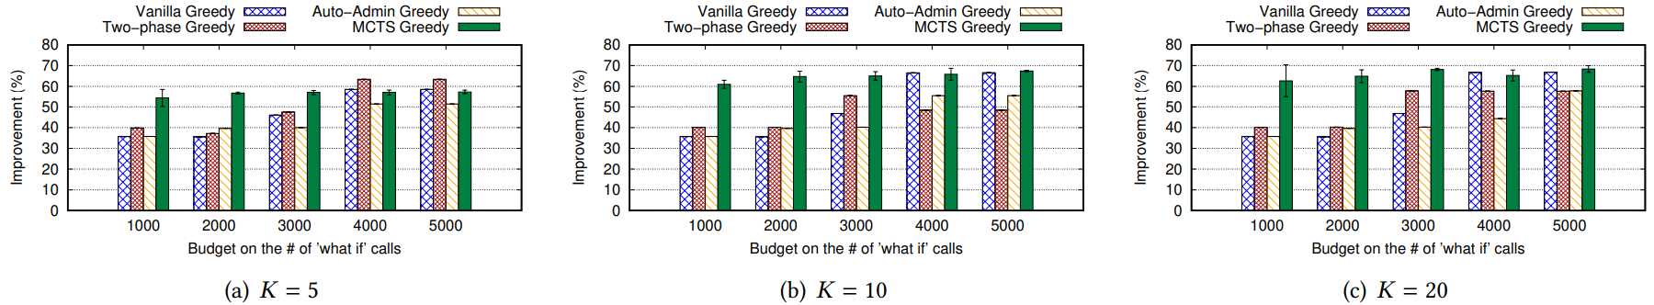
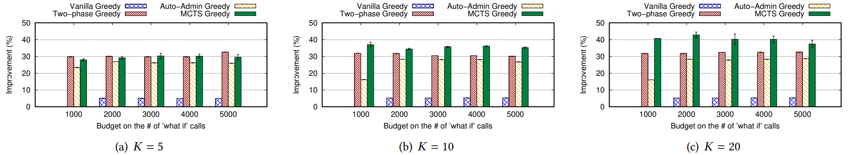
Comparison with Budget-aware Greedy (Real Workloads)
Results on Real-D
Results on Real-M

Slide 19
Existing RL Approaches to Index Tuning
DBA bandits (ICDE 2021)
Model index selection as a “contextual bandit” problem.
Customized to make it budget-aware.
No DBA (arXiv 2018)
Solve the index selection problem using deep RL (e.g., deep Q-learning).
Customized to make it budget-aware.

Slide 20
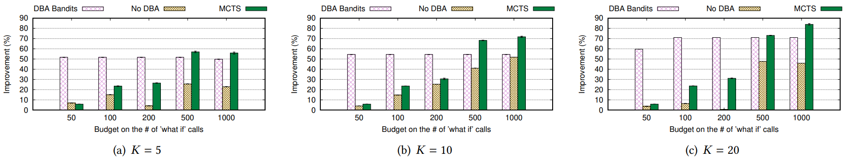
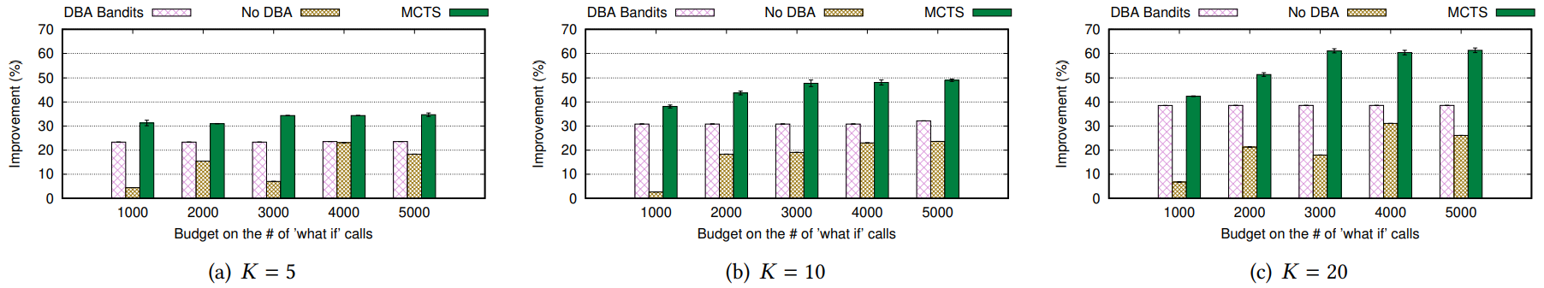
Comparison with Existing RL (Benchmark Workloads)
Results on TPC-H
Results on TPC-DS

Slide 21
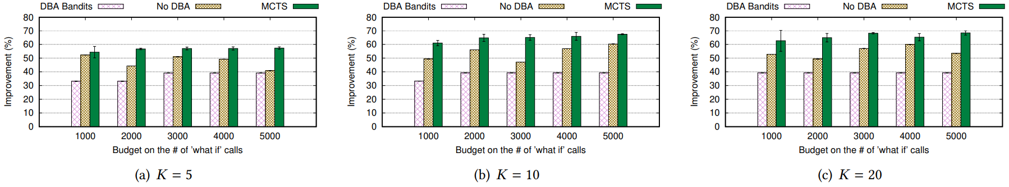
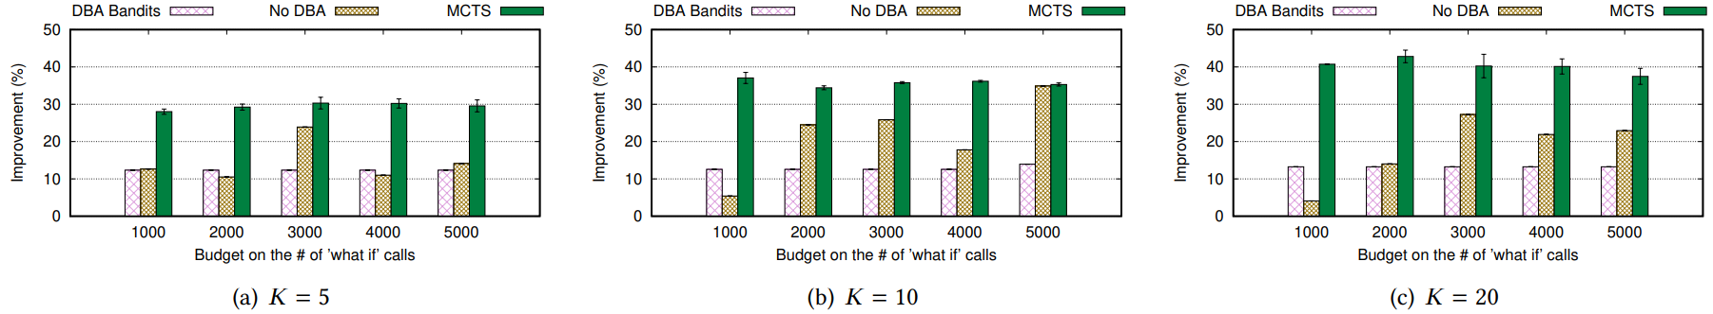
Comparison with Existing RL (Real Workloads)
Results on Real-D
Results on Real-M

Slide 22
Summary of Contributions
We proposed a problem formulation of budget-aware configuration search.
We proposed a MCTS-based framework for budget-aware configuration search.
We demonstrated that our MCTS-based framework outperforms both budget-aware variants of greedy search and existing RL techniques for index tuning, on both industrial benchmarks and real workloads.

