Slide 1
Wii: Dynamic Budget Reallocation in Index Tuning
Xiaoying Wang (Simon Fraser University)
Wentao Wu (Microsoft Research)
Chi Wang (Microsoft Research)
Vivek Narasayya (Microsoft Research)
Surajit Chaudhuri (Microsoft Research)

Slide 2
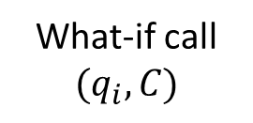


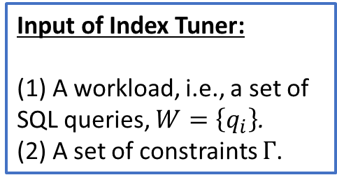
The Architecture of Cost-based Index Tuning
Input of Index Tuner:
(1) A workload, i.e., a set of SQL queries, $W=\left\{q_{i}\right\}$.
(2) A set of constraints $Γ$.
Index Tuner
Database
Server
Workload Parsing/Analysis
Indexable columns, e.g., filter, join, etc.
Candidate Index
Generation
Query Optimizer
(Extended)
What-if call
$$(q_{i},C)$$
Output of Index Tuner:
The best configuration (i.e., subset) of indexes that minimizes the total workload cost:
$$cost\left(W,C\right)=\sum_{q_{i}∈W}{cost(q_{i},C)}$$
Candidate indexes:
I = <key columns, included columns>
Configuration Enumeration
$$cost(q_{i},C)$$

Slide 3
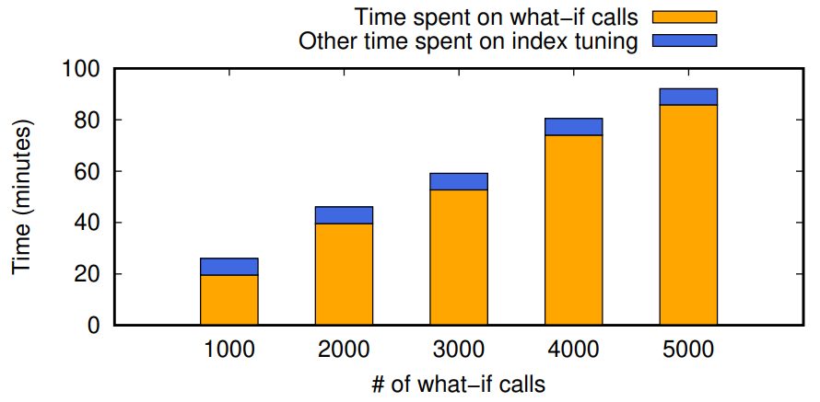
What-if Calls are Expensive
A what-if call is as expensive as a regular query optimizer call.
What-if calls dominate index tuning time.
TPC-DS, 99 queries, 20 recommended indexes
Greedy search (adopted by commercial index tuning software)

Slide 4
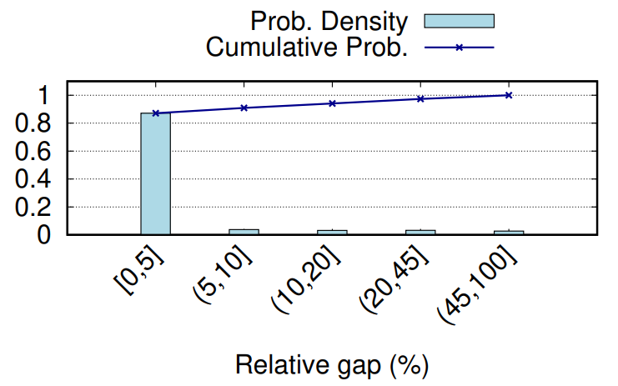

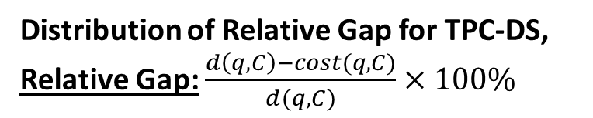
Many What-If Calls Are Inessential
Inessential What-if Call: The relative gap between what-if cost and derived cost is small.
Derived Cost: $d\left(q, C\right)=\min_{S⊆C}cost\left(q, S\right)$, which is an upper-bound of $cost\left(q, C\right)$ if we assume that the cost function is monotonic (i.e., more indexes are better).
Observations:
(1) 80% to 90% of the what-if calls made during index tuning are inessential.
(2) We can replace $cost\left(q, C\right)$ by $d\left(q, C\right)$ for inessential what-if calls to save the overhead of making these what-if calls.
Distribution of Relative Gap for TPC-DS, Relative Gap: $\frac{d\left(q,C\right)−cost(q,C)}{d(q,C)}×100\%$

Slide 5
Can We Skip Inessential What-If Calls?
Challenge: We need to skip an inessential what-if call before it is made.
Idea #1: Skip a what-if call randomly?
Benefit: Almost zero overhead.
We will show that this approach does not work.
Idea #2: Bounding what-if cost (this work):
Develop lower/upper bounds of the true what-if cost (which is unknown without making the call).
Skip a what-if call if the gap between the lower and upper bounds is small enough.

Slide 6
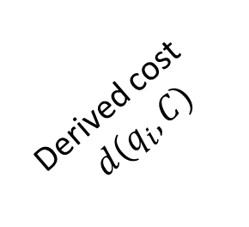
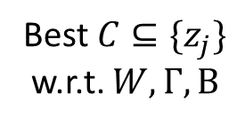
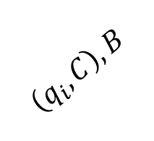

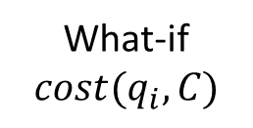


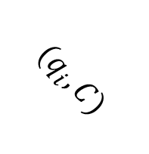
Wii: What-if (Call) Interception
Index Tuner
Database
Server
$$W=\left\{q_{i}\right\}, Γ, B$$
Workload Parsing/Analysis
Wii (What-if interception)
$$W, Γ, B$$
Candidate Index
Generation
Query Optimizer
(Extended)
$$\left(q_{i},C\right), B$$
$$(q_{i},C)$$
$$W, Γ, \left\{z_{j}\right\}, B$$
Derived cost
$$d(q_{i},C)$$
Configuration Enumeration
Best $C⊆\{z_{j}\}$ w.r.t. $W,Γ, B$
What-if $cost(q_{i},C)$

Slide 7
Applications of Wii in Index Tuning
Budget-aware Index Tuning (SIGMOD’22)
A budget on the number of what-if calls is given.
Examples: Greedy search, Monte Carlo tree search (MCTS)
Wii can save on inessential what-if calls and reallocate budget to what-if calls that Wii cannot skip.
Budget reallocation can find better index configuration.
Index Tuning with Unlimited Budget (traditional)
Wii cannot help improve the configuration found.
The best configuration can be found by always making what-if calls given that budget is unlimited.
Instead, Wii can reduce overall index tuning time by avoiding making inessential what-if calls.

Slide 8
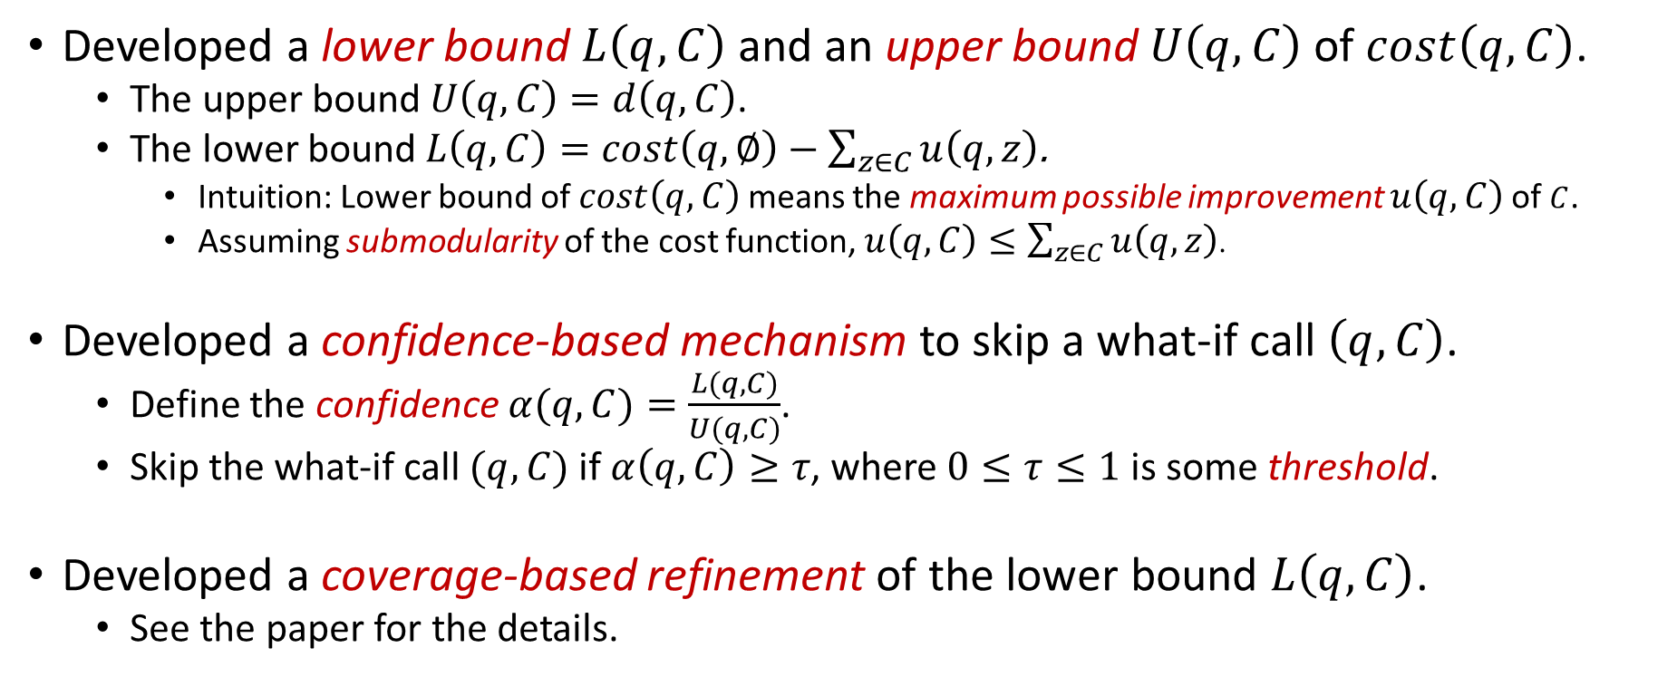
Summary of Technical Contributions
Developed a lower bound $L\left(q,C\right)$ and an upper bound $U\left(q,C\right)$ of $cost\left(q,C\right)$.
The upper bound $U\left(q,C\right)$ $=d\left(q,C\right)$.
The lower bound $L\left(q,C\right)=$ $cost\left(q,∅\right)−\sum_{z∈C}{u\left(q,z\right)}$.
Intuition: Lower bound of $cost\left(q,C\right)$ means the maximum possible improvement $u\left(q,C\right)$ of $C$.
Assuming submodularity of the cost function, $u\left(q,C\right)≤\sum_{z∈C}{u\left(q,z\right)}$.
Developed a confidence-based mechanism to skip a what-if call $\left(q,C\right)$.
Define the confidence $α(q,C)=\frac{L(q, C)}{U(q,C)}$.
Skip the what-if call $(q,C)$ if $α\left(q,C\right)≥τ$, where $0≤τ≤1$ is some threshold.
Developed a coverage-based refinement of the lower bound $L\left(q,C\right)$.
See the paper for the details.

Slide 9
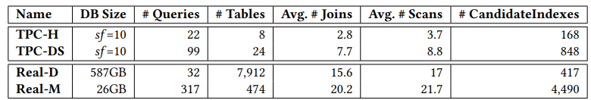
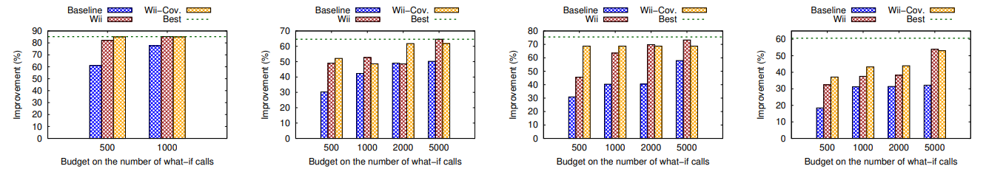
Evaluation: Budget-aware Index Tuning (Index Quality)
Set-up: Greedy search, with # of indexes allowed $K=20$ and confidence threshold $τ=0.9$
(a) TPC-H
(b) TPC-DS
(c) Real-D
(d) Real-M

Slide 10
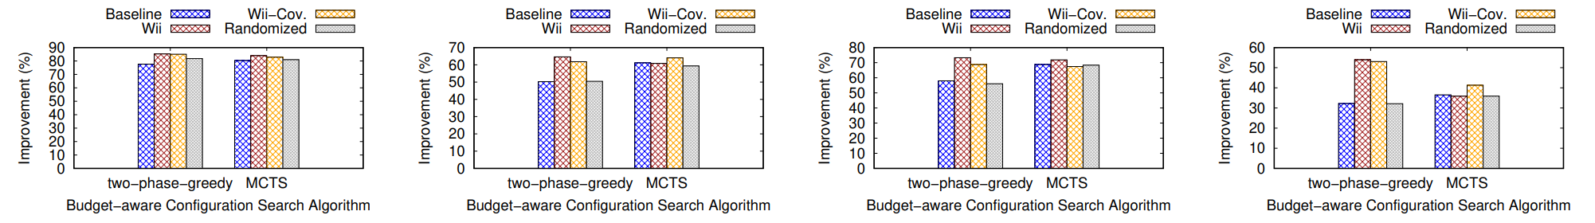
Evaluation: Budget-aware Index Tuning (vs. Random Skipping)
Set-up: # of indexes allowed $K=20$, confidence threshold $τ=0.9$, random skipping probability $p=τ=0.9$ (using the same skipping probability for fair comparison)
(a) TPC-H, B=1,000
(b) TPC-DS, B=5,000
(c) Real-D, B=5,000
(d) Real-M, B=5,000
Remark: The additional computation overhead introduced by Wii, while is higher than random skipping, remains negligible compared to the overall index tuning time.

Slide 11
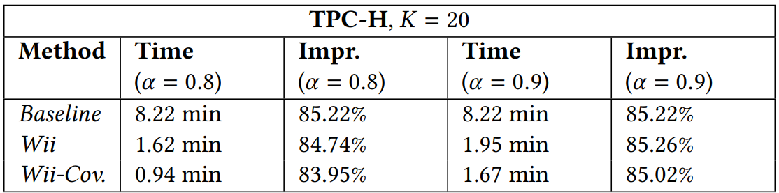
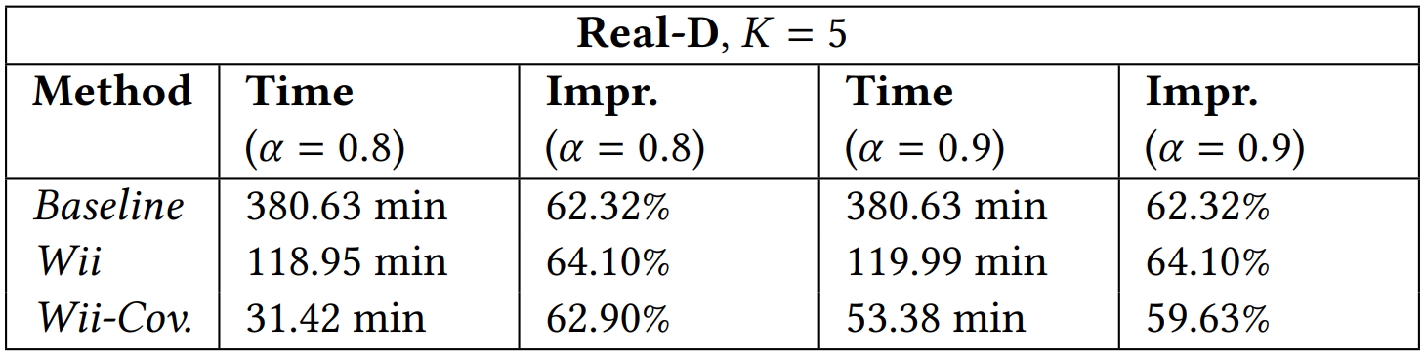
Evaluation: Index Tuning with Unlimited Budget
Wii cannot further improve the index quality achieved by always making what-if calls.
However, Wii can significantly reduce tuning time by skipping inessential what-if calls.

Slide 12
Conclusion
We developed Wii, a lightweight what-if (call) interception mechanism that allows for skipping inessential what-if calls in index tuning.
In budget-constrained index tuning, Wii can significantly improve index quality by reallocating budget to the what-if calls that cannot be skipped.
For index tuning with unlimited budget, Wii cannot improve index quality but can significantly reduce index tuning time.
Thank you! If you have any questions, please contact: wentao.wu@microsoft.com

Slide 13

Backup Slides

Slide 14
Why Can Budget Reallocation Help Improve Index Quality In Budget-aware Index Tuning?
Tables: R(a, b), S(c, d)
Query q:
SELECT a, d FROM R, S
WHERE R.b = S.c AND R.a = 40
Candidate Indexes:
I₁ = [R.a; R.b]
I₂ = [S.c; S.d]
For the filter predicate R.a = 40
For the join predicate R.b = S.c
Budget Allocation: Assume that the budget B = 1 (i.e., we can only make 1 what-if call) and K = 1 (i.e., we can only select one of the two indexes I₁ and I₂ for q).
There are two potential what-if calls to be made: (q, I₁), (q, I₂).
True what-if costs: c(q, I₁) = 180, c(q, I₂) = 50.
Derived costs: d(q, I₁) = 200, d(q, I₂) = 200.
If we make what-if call for (q, I₁), we will select I₁ and the cost of q is c(q, I₁) = 180.
If we make what-if call for (q, I₂), we will select I₂ and the cost of q is c(q, I₂) = 50.

Slide 15
Budget-aware Index Tuning (SIGMOD’22)
User may want to constrain the tuning time when face large/complex workloads.
Microsoft’s Database Tuning Advisor (DTA) allows user to specify a timeout.
Under constrained tuning time, given the dominance of time on making what-if calls, we need to constrain the number of what-if calls made during configuration enumeration.
We call this constrained version of index tuning “budget-aware index tuning”.
Budget allocation: Decide which (q, C) pairs to make what-if calls.
In previous work (SIGMOD’22), we studied the two types of budget-aware index tuning algorithms:
Greedy search (vanilla greedy search and two-phase greedy search)
Monte-Carlo tree search (MCTS)

Slide 16
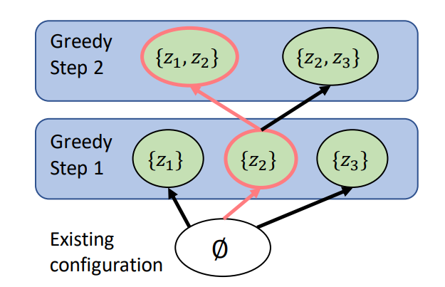
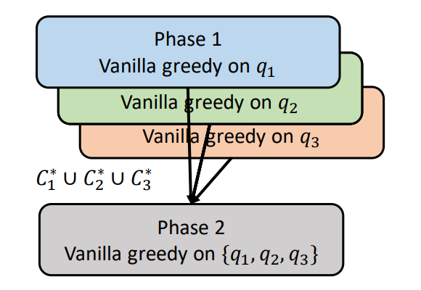
Greedy Search
(a) Vanilla greedy search
(b) Two-phase greedy search

Slide 17
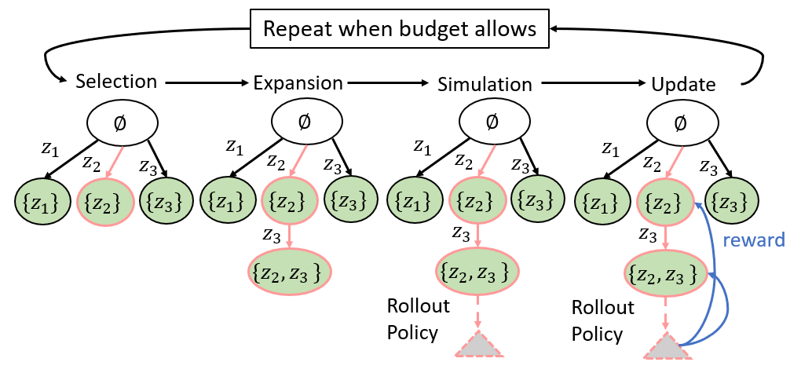
Monte Carlo Tree Search (MCTS)

Slide 18
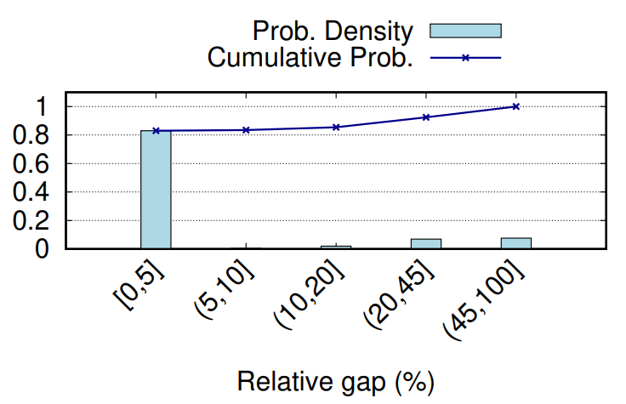
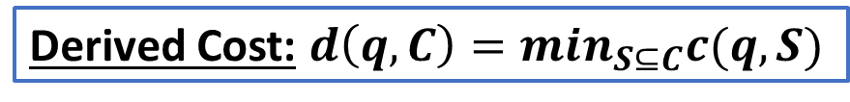
Spurious What-If Calls In Budget Allocation
Distribution of the relative gap between what-if cost and derived cost
(a) Two-phase greedy search
(b) MCTS
Derived Cost: $d\left(q, C\right)=\min_{S⊆C}c(q, S)$

Slide 19
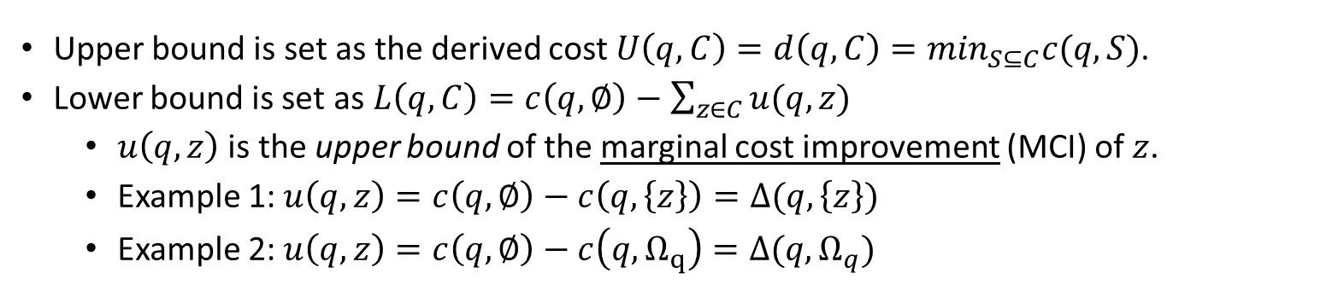
Lower and Upper Bounds
Assumption 1 (Monotonicity): Let $C_{1}$ and $C_{2}$ be two index configurations where $C_{1}⊆C_{2}$. Then ${c(q,C}_{2})≤c(q, C_{1})$.
Assumption 2 (Submodularity): Given two configurations $X⊆Y$ and an index $z∉Y$, we have
$c\left(q, Y\right)−c\left(q,Y∪\left\{z\right\}\right)≤c\left(q,X\right)−c(X∪\left\{z\right\})$.
Upper bound is set as the derived cost $U\left(q,C\right)=d\left(q, C\right)=\min_{S⊆C}c(q, S)$.
Lower bound is set as $L\left(q,C\right)=c\left(q,∅\right)−\sum_{z∈C}{u(q,z)}$
$u\left(q,z\right)$ is the upper bound of the marginal cost improvement (MCI) of $z$.
Example 1: $u\left(q,z\right)=c\left(q,∅\right)−c\left(q,\left\{z\right\}\right)=Δ(q,\left\{z\right\})$
Example 2: $u\left(q,z\right)=c\left(q,∅\right)−c\left(q,Ω_{q}\right)=Δ(q,Ω_{q})$
$Ω_{q}$ represents the “best possible configuration” with ALL candidate indexes of q included.

Slide 20

Confidence-based Skipping
Intuition:
We are more confident to skip a what-if call if its lower and upper bounds are closer.
Definition of confidence $α(q,C)$:
$α(q,C)=1−\frac{U\left(q, C\right)−L\left(q,C\right)}{U\left(q, C\right)}=\frac{L(q, C)}{U(q,C)}$
$0≤α(q,C)≤1$
Confidence-based skipping:
Define some threshold $α$ s.t. $0≤α≤1$.
Skip the what-if call $(q,C)$ if $α\left(q,C\right)≥α$.

Slide 21

Coverage-based Refinement
Problem: The MCI upper bound $u(q,z)$ used by the lower bound $L\left(q,C\right)$ heavily depends on the knowledge of singleton what-if cost $c(q,\left\{z\right\})$.
$u\left(q,z\right)=Δ\left(q,\left\{z\right\}\right)=c\left(q,∅\right)−c\left(q,\left\{z\right\}\right)$, if we know $c(q,\left\{z\right\})$; otherwise, we can only use the “naïve bound” $u\left(q,z\right)=Δ\left(q,Ω_{q}\right)=c\left(q,∅\right)−c\left(q,Ω_{q}\right)$.
Solution: Use “coverage” to estimate $c\left(q,\left\{z\right\}\right)$, if it is not known.
Definition of “coverage”: $ρ\left(q,z\right)=\frac{c\left(q,∅\right)−c(q, \left\{z\right\})}{c\left(q,∅\right)−c(q,Ω_{q})}=\frac{Δ(q,\left\{z\right\})}{Δ(q,Ω_{q})}$.
Estimation of “coverage” using similarity of $\{z\}$ and $Ω_{q}$: $\hat{ρ}\left(q,z\right)=Sim(\left\{z\right\},Ω_{q})$.
See paper for more details.

Slide 22
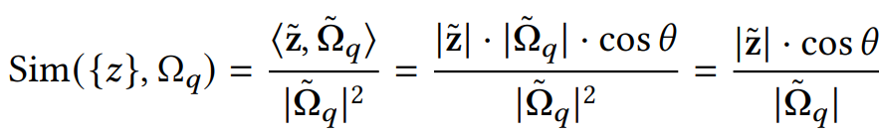
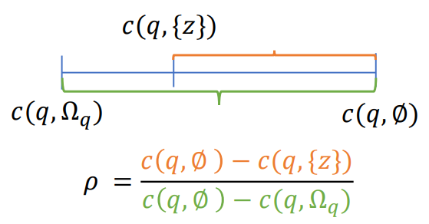
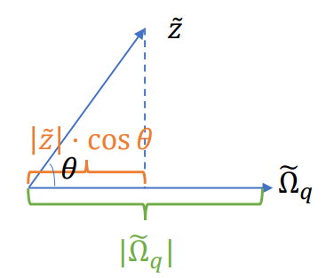
Geometric Interpretation of Coverage
(a) Definition of “Coverage”
(b) Estimation of “Coverage”

Slide 23
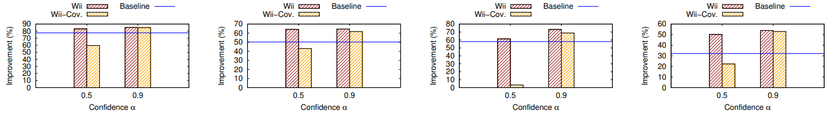
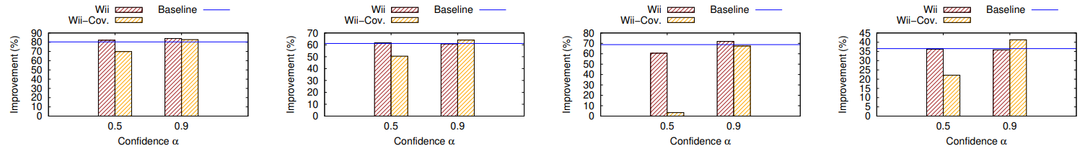

Evaluation: Impact of Confidence Threshold $α$
1. Results for two-phase greedy search, with the number of indexes allowed $K=20$
(a) TPC-H, B=1,000
(b) TPC-DS, B=5,000
(c) Real-D, B=5,000
(d) Real-M, B=5,000
2. Results for MCTS, with the number of indexes allowed $K=20$
(a) TPC-H, B=1,000
(b) TPC-DS, B=5,000
(c) Real-D, B=5,000
(d) Real-M, B=5,000

Slide 24
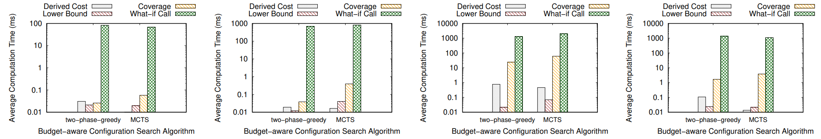
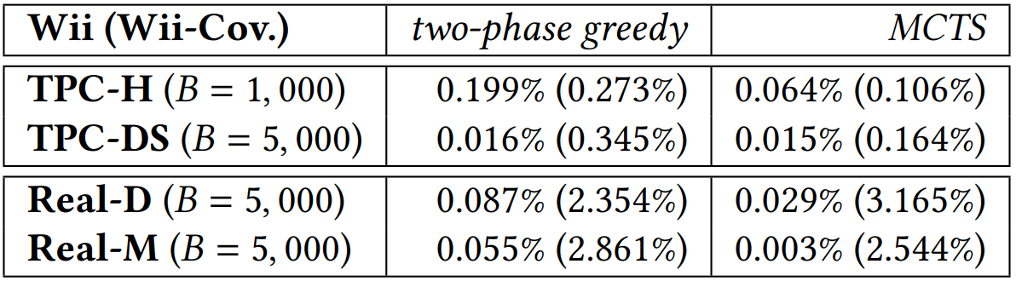
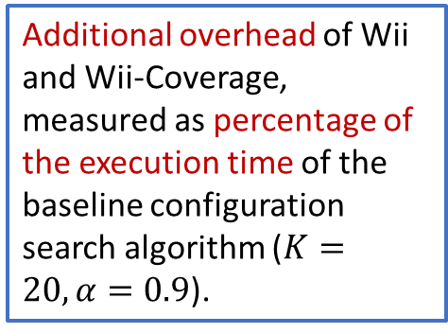
Evaluation: Budget-aware Index Tuning (Overhead)
(a) TPC-H, B=1,000
(b) TPC-DS, B=5,000
(c) Real-D, B=5,000
(d) Real-M, B=5,000
Additional overhead of Wii and Wii-Coverage, measured as percentage of the execution time of the baseline configuration search algorithm ($K=20,α=0.9$).

