Slide 1
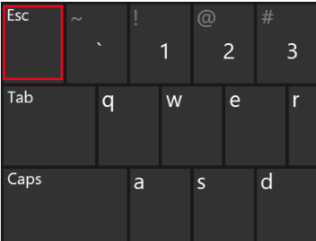
Esc: An Early-Stopping Checker for Budget-aware Index Tuning
Xiaoying Wang, Wentao Wu, Vivek Narasayya, Surajit Chaudhuri
Microsoft Research, Redmond, USA

Slide 2
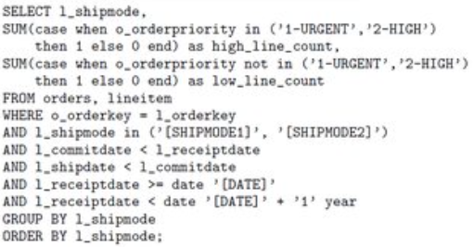


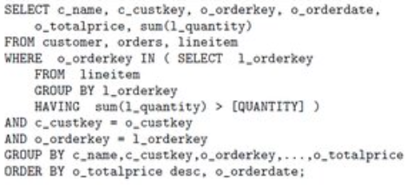
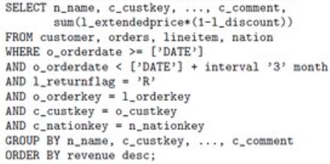
Workload-Driven Index Tuning
SQL Query Workload
Database System
Index Configuration
……
Notes:
Here is a high-level picture of workload-driven index tuning.

Slide 3

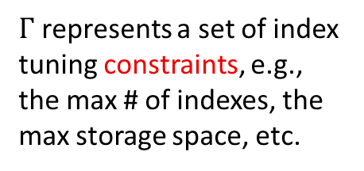
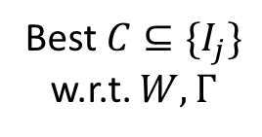




The Architecture of An Index Tuner
$Γ$ represents a set of index tuning constraints, e.g., the max # of indexes, the max storage space, etc.
Index Tuner
Database
Server
$$W=\left\{q_{i}\right\}, Γ$$
Workload Parsing/Analysis
$$W, Γ$$
Candidate Index
Generation
Query Optimizer
(Extended)
$$W, Γ, \{I_{j}\}$$
Configuration Enumeration
What-If Calls
Best $C⊆\{I_{j}\}$ w.r.t. $W,Γ$
$$(q_{i},C)$$
$$cost(q_{i},C)$$
Notes:
Let us look into the internals of the index tuning process. This picture shows the typical architecture of today’s index tuner that has been used by both commercial and open-source database systems.

Slide 4
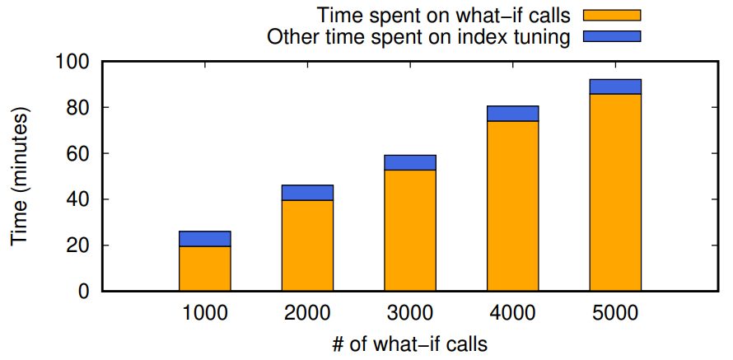
Budget-aware Index Tuning
What-if calls are expensive.
They dominate index tuning time.
Example: TPC-DS with 99 queries
Budget-aware index tuning (SIGMOD 2022)
Constrain the number of what-if calls in configuration enumeration.
Find the best index configuration under the budget constraint.
Proposed algorithms: two-phase greedy (TPG), Monte Carlo tree search (MCTS)

Slide 5
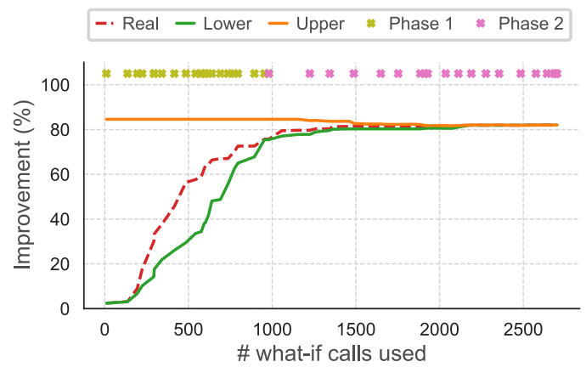
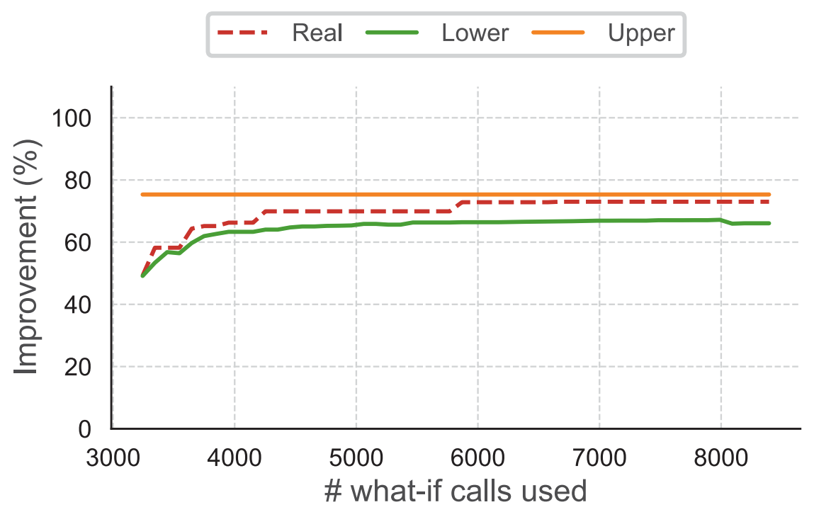
Diminishing Return
Could have stopped here
Could have stopped here
(a) TPC-H, Two-phase greedy search
(b) Real-D, Monte Carlo tree search

Slide 6
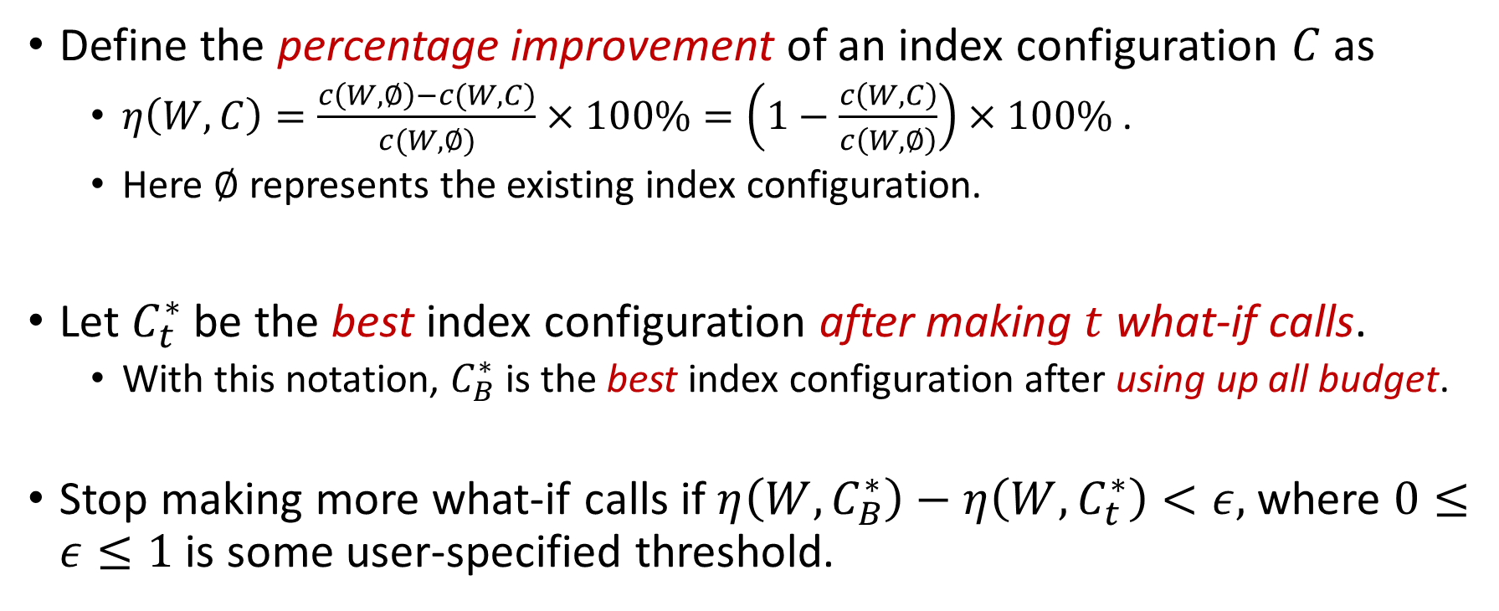
Early Stopping for Budget-aware Index Tuning
Define the percentage improvement of an index configuration $C$ as
$η\left(W,C\right)=\frac{c\left(W, ∅\right)−c(W,C)}{c(W,∅)}×100\%=\left(1−\frac{c\left(W,C\right)}{c\left(W,∅\right)}\right)×100\%$.
Here $∅$ represents the existing index configuration.
Let $C_{t}^{∗}$be the best index configuration after making $t$ what-if calls.
With this notation, $C_{B}^{∗}$is the best index configuration after using up all budget.
Stop making more what-if calls if $η\left(W,C_{B}^{∗}\right)−η\left(W,C_{t}^{∗}\right)<ε,$ where $0≤ε≤1$ is some user-specified threshold.

Slide 7
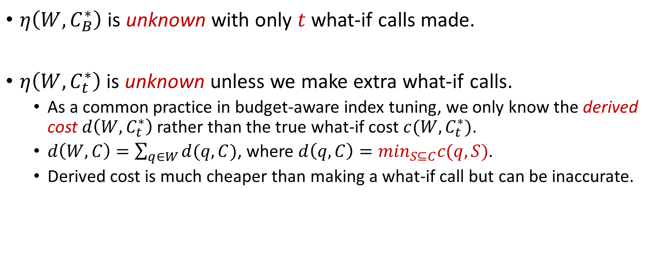
Challenges
$η\left(W,C_{B}^{∗}\right)$ is unknown with only $t$ what-if calls made.
$η\left(W,C_{t}^{∗}\right)$ is unknown unless we make extra what-if calls.
As a common practice in budget-aware index tuning, we only know the derived cost $d\left(W,C_{t}^{∗}\right)$ rather than the true what-if cost $c(W,C_{t}^{∗})$.
$d\left(W,C\right)=\sum_{q∈W}{d(q,C)}$, where $d\left(q,C\right)=\min_{S⊆C}c(q,S)$.
Derived cost is much cheaper than making a what-if call but can be inaccurate.

Slide 8
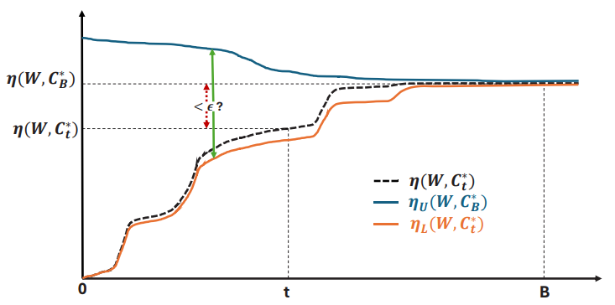
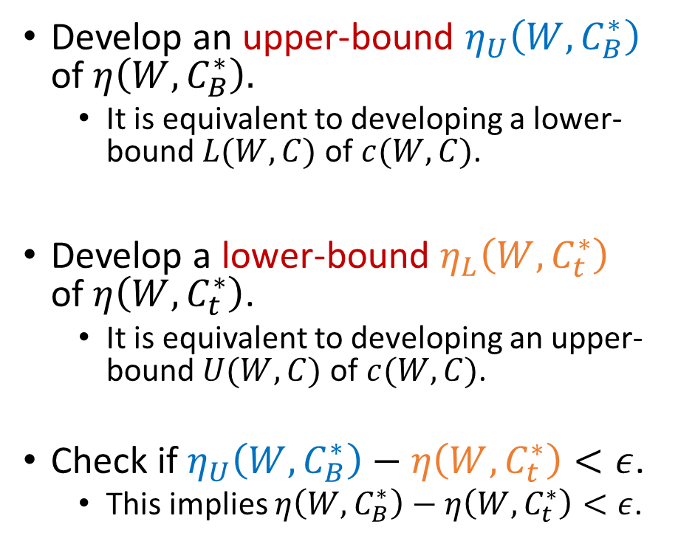
Solutions
Develop an upper-bound $η_{U}\left(W,C_{B}^{∗}\right)$ of $η\left(W,C_{B}^{∗}\right).$
It is equivalent to developing a lower-bound $L(W,C)$ of $c(W,C)$.
Develop a lower-bound $η_{L}\left(W,C_{t}^{∗}\right)$ of $η\left(W,C_{t}^{∗}\right)$.
It is equivalent to developing an upper-bound $U(W,C)$ of $c(W,C)$.
Check if $η_{U}\left(W,C_{B}^{∗}\right)−η\left(W,C_{t}^{∗}\right)<ε$.
This implies $η\left(W,C_{B}^{∗}\right)−η\left(W,C_{t}^{∗}\right)<ε$.

Slide 9
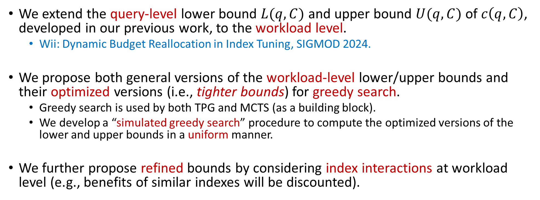
Summary of Technical Details
We extend the query-level lower bound $L(q,C)$ and upper bound $U(q,C)$ of $c\left(q,C\right)$, developed in our previous work, to the workload level.
Wii: Dynamic Budget Reallocation in Index Tuning, SIGMOD 2024.
We propose both general versions of the workload-level lower/upper bounds and their optimized versions (i.e., tighter bounds) for greedy search.
Greedy search is used by both TPG and MCTS (as a building block).
We develop a “simulated greedy search” procedure to compute the optimized versions of the lower and upper bounds in a uniform manner.
We further propose refined bounds by considering index interactions at workload level (e.g., benefits of similar indexes will be discounted).

Slide 10
Early-stopping Verification (ESV)
There is computation overhead of ESV, i.e., computing the lower and upper bounds (e.g., by running simulated greedy search).
As a result, we should not invoke ESV too frequently, which may result in nontrivial computation overhead.
Question: When should we then invoke ESV?

Slide 11
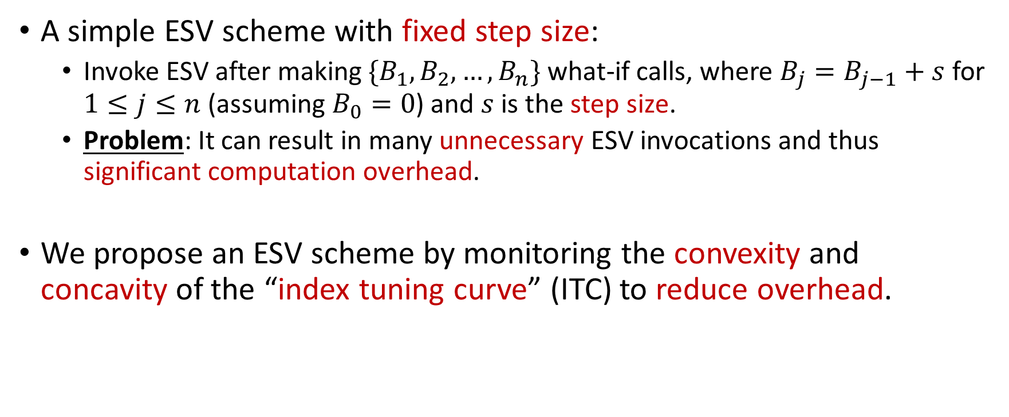
Early-stopping Verification (ESV) Scheme
A simple ESV scheme with fixed step size:
Invoke ESV after making $\{B_{1},B_{2},…,B_{n}\}$ what-if calls, where $B_{j}=B_{j−1}+s$ for $1≤j≤n$ (assuming $B_{0}=0$) and $s$ is the step size.
Problem: It can result in many unnecessary ESV invocations and thus significant computation overhead.
We propose an ESV scheme by monitoring the convexity and concavity of the “index tuning curve” (ITC) to reduce overhead.

Slide 12
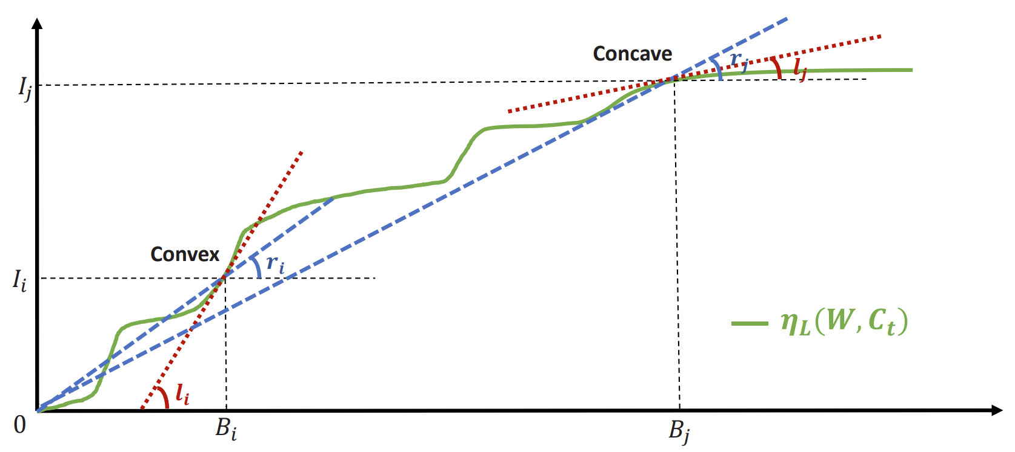
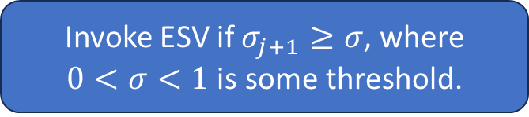
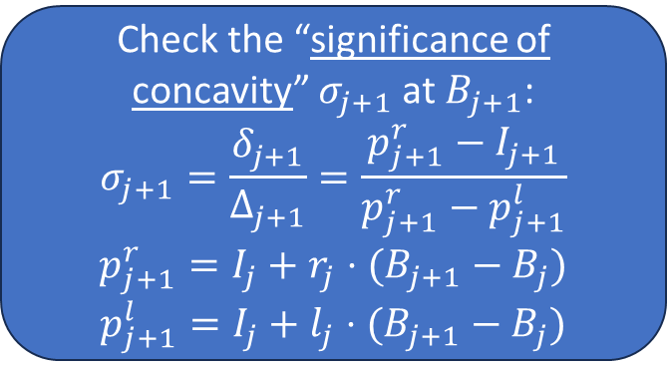

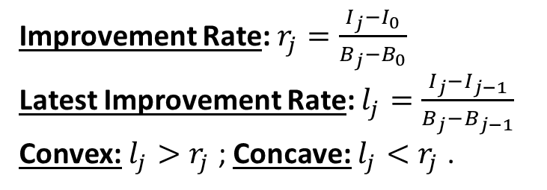
ESVS by Monitoring Convexity/Concavity of ITC
Start with the fixed step-size ESV scheme: $B_{j}=B_{j−1}+s$
Check the “significance of concavity” $σ_{j+1}$at $B_{j+1}$:
$$σ_{j+1}=\frac{δ_{j+1}}{Δ_{j+1}}=\frac{p_{j+1}^{r}−I_{j+1}}{p_{j+1}^{r}−p_{j+1}^{l}}$$
$$p_{j+1}^{r}=I_{j}+r_{j}⋅(B_{j+1}−B_{j})$$
$$p_{j+1}^{l}=I_{j}+l_{j}⋅(B_{j+1}−B_{j})$$
The “index tuning curve” (ITC) represents a function from the number of what-if calls made to the improvement observed.
Improvement Rate: $r_{j}=\frac{I_{j}−I_{0}}{B_{j}−B_{0}}$
Latest Improvement Rate: $l_{j}=\frac{I_{j}−I_{j−1}}{B_{j}−B_{j−1}}$
Convex: $l_{j}>r_{j}$ ; Concave: $l_{j}<r_{j}$ .
Invoke ESV if $σ_{j+1}≥σ$, where
$0<σ<1$ is some threshold.

Slide 13
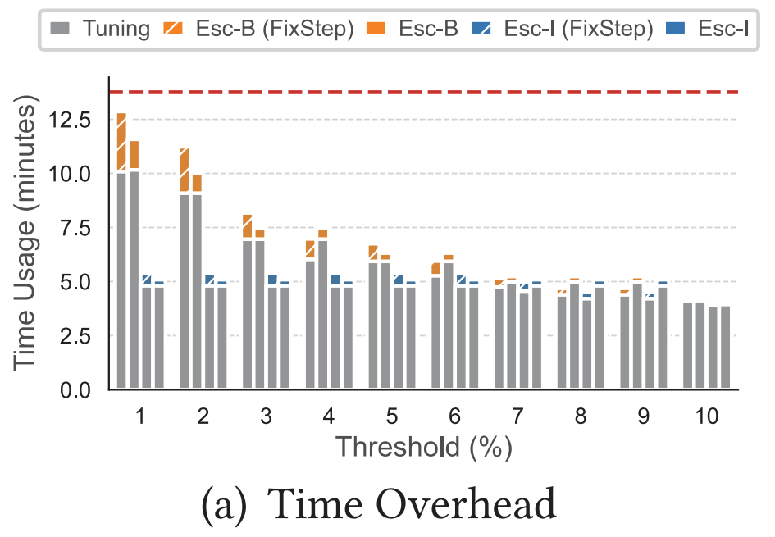
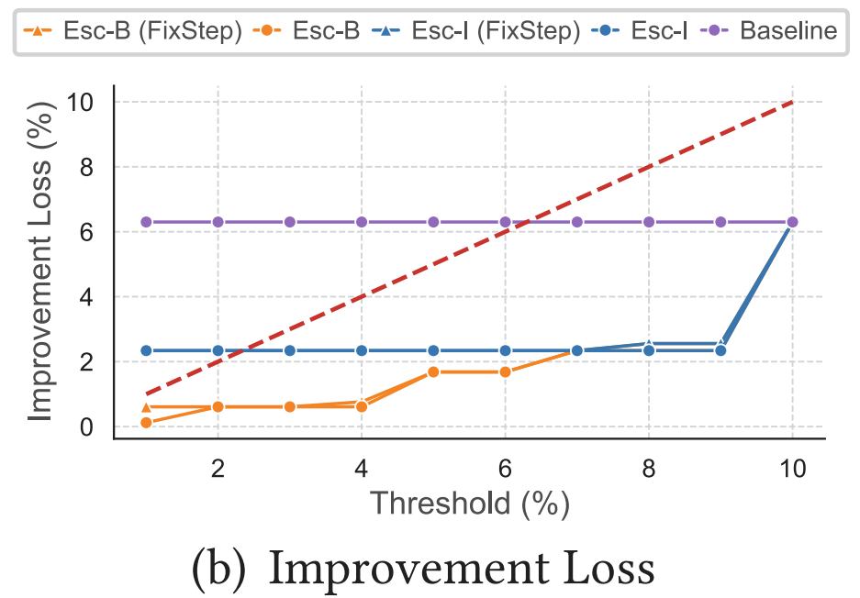
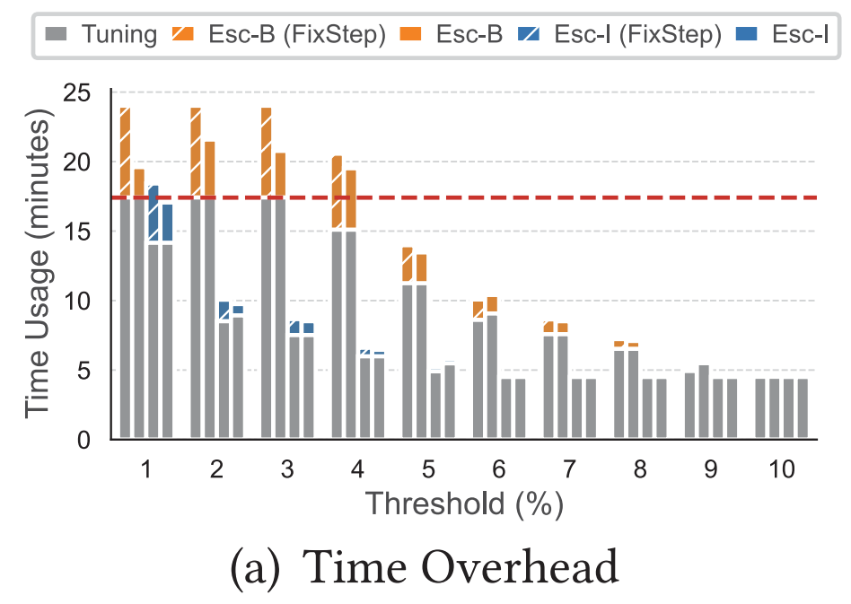
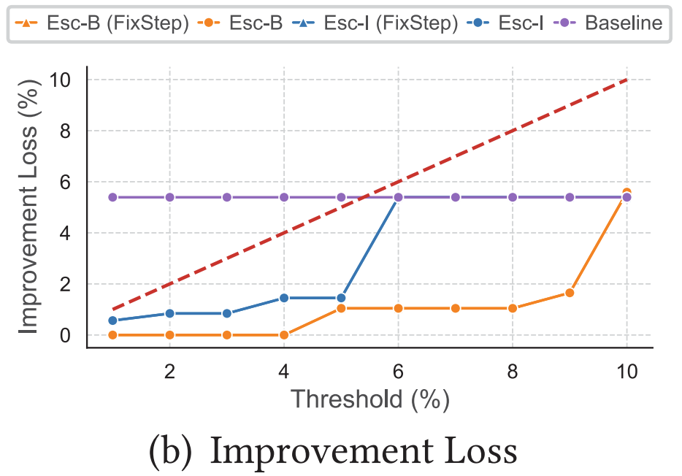
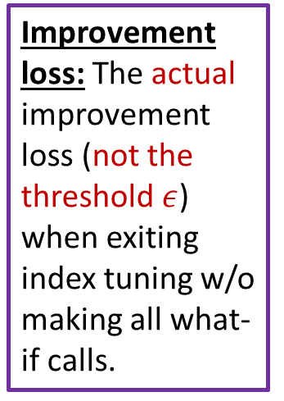
Experimental Evaluation Results (TPC-H)
K is the # of indexes allowed.
B is the budget on the number of what-if calls.
Two-phase greedy search (K = 20, B = 20k)
Improvement loss: The actual improvement loss (not the threshold $ε$) when exiting index tuning w/o making all what-if calls.
Monte Carlo tree search
(K = 20, B = 20k)

Slide 14
Takeaways
We proposed and formulated the problem of “early stopping” in budget-aware index tuning.
We proposed lower and upper bounds of the improvement given by the best configuration after making a certain number of what-if calls to check the early-stopping condition.
We proposed monitoring the convexity and concavity of the index tuning curve to reduce the number of ESVs and thus reduce the overall computation overhead of invoking ESVs.

Slide 15
Backup Slides

Slide 16
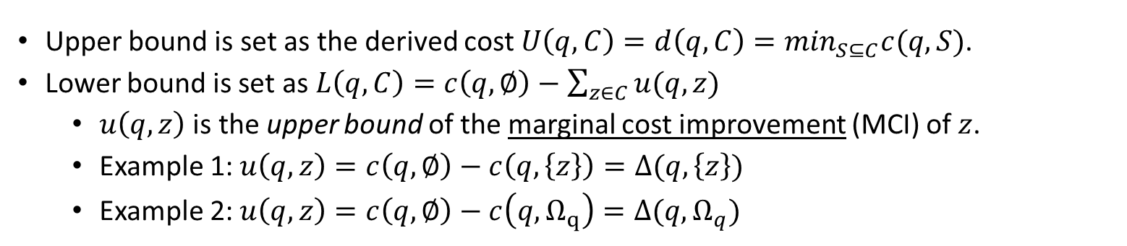
Query-level Lower/Upper Bounds (Wii, SIGMOD 2024)
Assumption 1 (Monotonicity): Let $C_{1}$ and $C_{2}$ be two index configurations where $C_{1}⊆C_{2}$. Then ${c(q,C}_{2})≤c(q, C_{1})$.
Assumption 2 (Submodularity): Given two configurations $X⊆Y$ and an index $z∉Y$, we have
$c\left(q, Y\right)−c\left(q,Y∪\left\{z\right\}\right)≤c\left(q,X\right)−c(X∪\left\{z\right\})$.
Upper bound is set as the derived cost $U\left(q,C\right)=d\left(q, C\right)=\min_{S⊆C}c(q, S)$.
Lower bound is set as $L\left(q,C\right)=c\left(q,∅\right)−\sum_{z∈C}{u(q,z)}$
$u\left(q,z\right)$ is the upper bound of the marginal cost improvement (MCI) of $z$.
Example 1: $u\left(q,z\right)=c\left(q,∅\right)−c\left(q,\left\{z\right\}\right)=Δ(q,\left\{z\right\})$
Example 2: $u\left(q,z\right)=c\left(q,∅\right)−c\left(q,Ω_{q}\right)=Δ(q,Ω_{q})$
$Ω_{q}$ represents the “best possible configuration” with ALL candidate indexes of q included.

