Slide 1
GazimbaSpeech
Link

Slide 2

It is Gazimba, your new personal assistant! He can do almost everything what you need!

Slide 3

Works like magic!

Slide 4

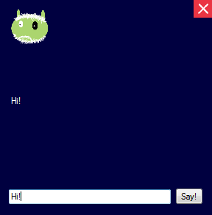
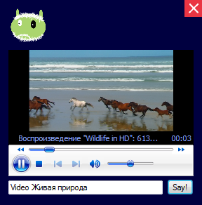
Wow!

