Slide 1
GazimbaSpeech
Link

Slide 2
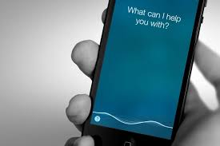
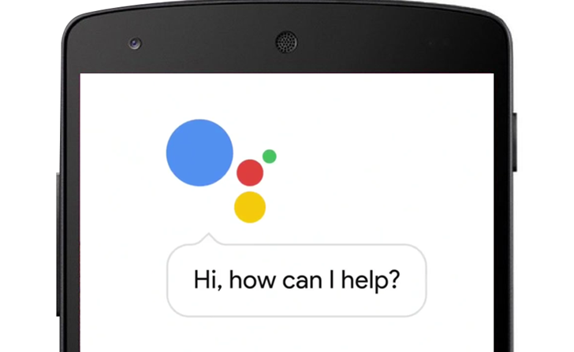
What is this?
Almost everybody who owed a smartphone know what is siri and google assistant

Slide 3

Well then, why to not do the same for the PC’s?
Why there is no software for my PC that would help me…

Slide 4

It is Gazimba, your new personal assistant! He can do almost everything what you need!

Slide 5

Works like magic!

Slide 6

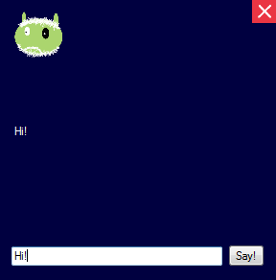
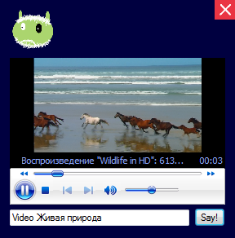
Wow!

Slide 7

Totally free!

