Slide 1
Cmp Sci 187:
Introduction to Software Design
Following Chapter 1 of text
(Koffmann and Wolfgang)
Notes:
Notes for title slide

Slide 2
Outline
The software challenge and the software life cycle
Activities of each phase of the software life cycle
Using top-down design and object-oriented design
Managing complexity:
  Data abstraction
  Procedural abstraction
  Information hiding
Class diagrams document interactions between classes

Slide 3
Outline (2)
Abstract data types:
  Role in modeling
  Implementing them with classes and interfaces
Use cases: tool to document interaction with a user
Software design process example:
  Design and implementation of an array-based telephone directory
Sequence diagrams: tool for documenting the interaction between multiple classes used in a program

Slide 4
The Software Challenge
Software is ...
  Used for a long time
  Updated and maintained
  By people who did not write it
Initial specification may be incomplete
Specification clarified through extensive interaction between user(s) and system analyst(s)
Requirements specification needed at the beginning of any software project
Designers and users should both approve it!

Slide 5
Things Change!
Users’ needs and expectations change
  Use reveals limitations and flaws
  Desire for increased convenience, functionality
  Desire for increased performance
Environment changes
  Hardware, OS, software packages (“software rot”)
  Need to interact with clients, parent org., etc.
  Law and regulations change
  Ways of doing business
  Style, “cool” factor

Slide 6
The Software Life Cycle
Software goes through stages as it moves from initial concept to finished product
The sequence of stages is called a life cycle
Must design and document software:
  In an organized way for:
    Understanding and ...
    Maintenance (change) after the initial release
The maintainer is not necessarily the author!
  ... and even authors forget
  ... and no one can keep all details in mind at once

Slide 7
Software Life Cycle Models:
The Waterfall Model
Simplest way to organizing activities in stages
Activities are:
  Performed in sequence
  Result of one flows (falls) into the next
The Waterfall Model is simple ... but unworkable
  Fundamental flaw: Assumption that each stage can and must be completed before the next one occurs
  Example: User may need to see finished product to express true requirements!

Slide 8
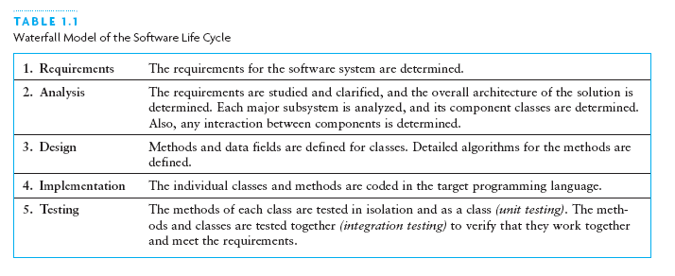
Waterfall Model

Slide 9
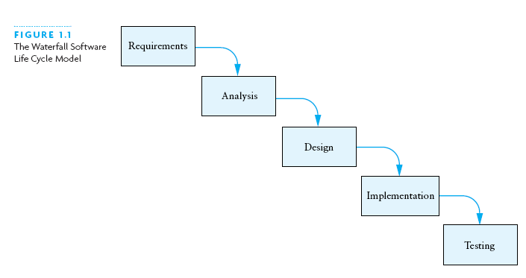
Waterfall Model (2)

Slide 10
Other Software Life Cycle Models
Common theme among models: stages or cycles
Unified Model:
  Cycles are called phases and iterations
  Activities are called workflows
The four phases of the Unified Model:
  Inception
  Elaboration
  Construction
  Transition

Slide 11
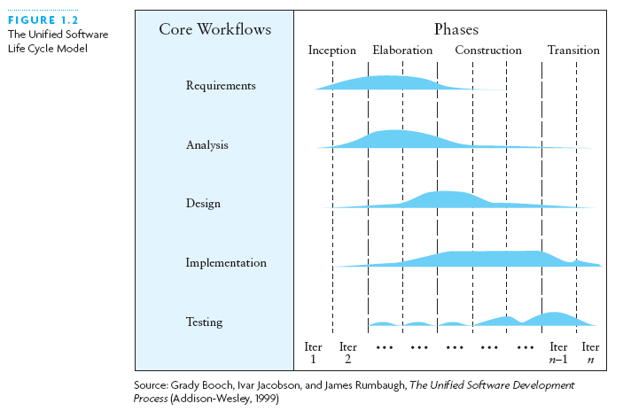
Other Software Life Cycle Models (2)

Slide 12
Software Life Cycle Activities
Activities essential for successful development:
  Requirements specification
  Architectural, component, & detailed designs
  Implementation
  Unit, integration, and acceptance testing
  Installation and maintenance

Slide 13
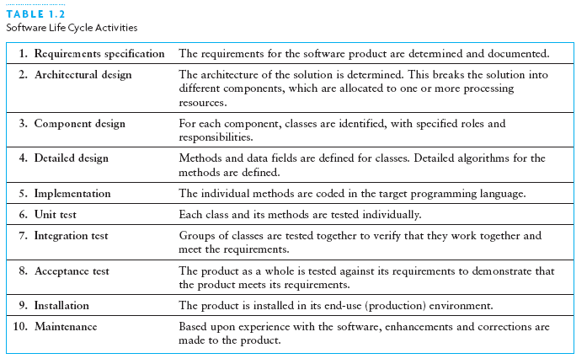
Software Life Cycle Activities Defined

Slide 14
Software Life Cycle Activities (more)
Requirements Specification
  System analyst works with users to clarify the detailed system requirements
  Questions include format of input data, desired form of any output screens, and data validation
Analysis
  Make sure you completely understand the problem before starting the design or program a solution
  Evaluate different approaches to the design

Slide 15
Software Life Cycle Activities (continued)
Design
  Top-down: break system into smaller subsystems
  Object-oriented: identify objects and their interactions
  UML diagrams: tool to show interactions between:
    Classes (inside the system)
    Classes and external entities

Slide 16
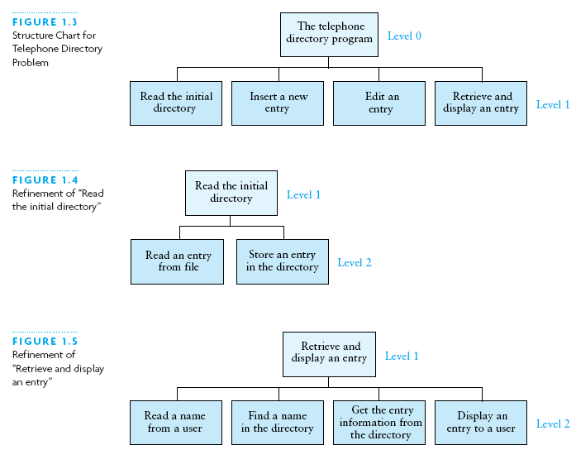
Example of Top-Down: Stepwise Refinement

Slide 17
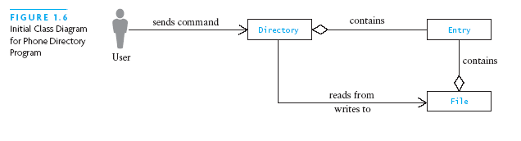
Example of Object-Oriented: Class Diagram

Slide 18
Using Abstraction to Manage Complexity
An abstraction is a model of a physical entity or activity
  Models include relevant facts and details
  Models exclude matters irrelevant to system/task
Abstraction helps programmers:
  Complex issues handled in manageable pieces
Procedural abstraction: distinguishes ...
  What to achieve (by a procedure) ...
  From how to achieve it (implementation)
Data abstraction: distinguishes ...
  Data objects for a problem and their operations ...
  From their representation in memory

Slide 19
Using Abstraction to Manage Complexity (2)
If another class uses an object only through its methods, the other class will not be affected if the data representation changes
Information hiding: Concealing the details of a class implementation from users of the class
  Enforces the discipline of data abstraction

Slide 20
Abstract Data Types, Interfaces, and
Pre- and Post-conditions
A major goal of software engineering: write reusable code
Abstract data type (ADT): data + methods
A Java interface is a way to specify an ADT
  Names, parameters, return types of methods
  No indication of how achieved (procedural abstraction)
  No representation (data abstraction)
A class may implement an interface
  Must provide bodies for all methods of the interface

Slide 21
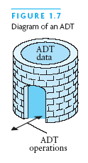
Abstract Data Types, Interfaces, and
Pre- and Postconditions (2)

Slide 22
Abstract Data Types, Interfaces, and Pre- and Postconditions (continued)
You cannot instantiate (new) an interface
But you can:
  Declare a variable that has an interface type
  Use it to reference an actual object, whose class implements the interface
A Java interface is a contract between
  The interface designer and ...
  The coder of a class that implements the interface
Precondition: any assumption/constraint on the method data before the method begins execution
Postcondition: describes result of executing the method

Slide 23
Requirements Analysis:
Use Cases, and Sequence Diagrams
Analysis first step: study input and output requirements:
  Make sure they are understood and make sense
Use case:
  User actions and system responses for a sub-problem
  In the order that they are likely to occur
Sequence diagram:
  Shows objects involved across the horizontal axis
  Shows time along the vertical axis
  See page 26 for an example; shows:
    User, PDApplication, PhoneDirectory, BufferedReader, PDUserInterface object + a number of method calls

Slide 24
Design of an Array-Based Phone Directory
Case study shows:
  Design
  Implementation
  Testing of a software-based phone directory
In UML class diagrams:
  + sign next to a method/attribute means it is public
  - sign next to a method/attribute means it is private

Slide 25
Design of Array-Based Phone Directory
Classes/interfaces to design include:
  PDUserInterface: interface; later we consider:
    Console (command line) UI class
    Graphical (JOptionPane) UI class
  PDApplication: main / driving class
  PhoneDirectory: interface
  ArrayBasedPD: class implementing PhoneDirectory
  DirectoryEntry: class, for one item in the directory

Slide 26
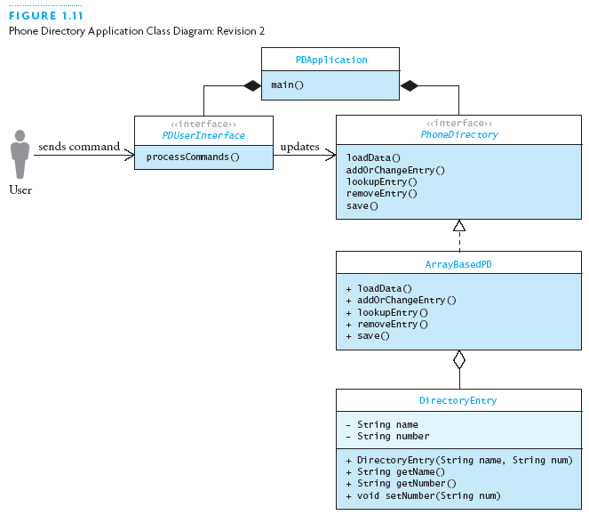
Design of Array-Based Phone Directory (2)

Slide 27
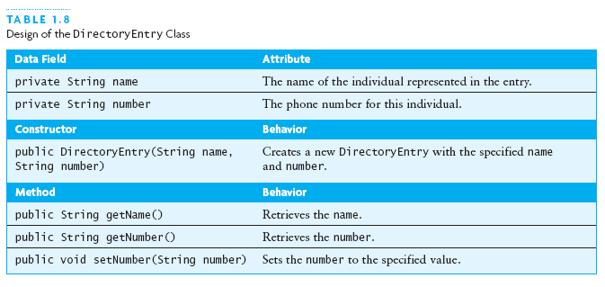
Design of Array-Based Phone Directory (3)

Slide 28
Design of DirectoryEntry
Simple class, similar to Person in Java review:
  Two private fields, for name and number
  Two-argument constructor
  Get methods for both fields
  Set method for number (only)

Slide 29
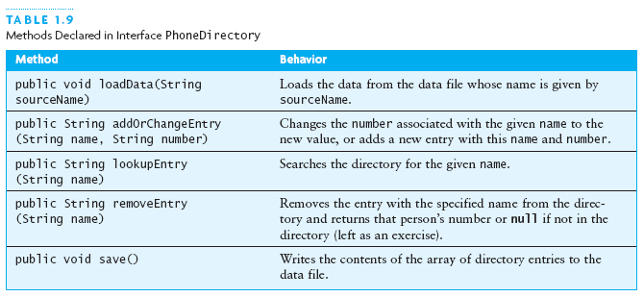
Design of Array-Based Phone Directory (4)

Slide 30
The PhoneDirectory Interface
/**
* The interface for the telephone directory.
* @author Koffman & Wolfgang
*/
public interface PhoneDirectory {
...
}
Shows syntax of an interface
Shows a javadoc comment and the @author tag

Slide 31
PhoneDirectory.loadData
/** Load the data file containing the
* directory, or establish a connection with
* the data source.
* @param sourceName The name of the file
* (data source) with the phone directory
* entries
*/
void loadData (String sourceName);
Shows syntax of method in an interface (note ;)
Shows a javadoc comment with the @param tag
Since returns void, no @return tag

Slide 32
PhoneDirectory.lookupEntry
/** Look up an entry.
* @param name The name of the person
* to look up
* @return The number, or null if name
* is not in the directory
*/
String lookupEntry (String name);
Shows a javadoc comment with the @return tag
I prefer a space before the ( in a declaration (not a call)

Slide 33
PhoneDirectory.addOrChangeEntry
/** Add an entry or change an existing entry.
* @param name The name of the person being
* added or changed
* @param number The new number to be assigned
* @return The old number or, if a new entry,
* null
*/
String addOrChangeEntry (String name,
String number);
Shows a javadoc comment with two @param tags

Slide 34
PhoneDirectory.removeEntry
/** Remove an entry from the directory.
* @param name The name of the person to be
* removed
* @return The current number. If not in
* directory, return null
*/
String removeEntry (String name);

Slide 35
PhoneDirectory.save
/** Method to save the directory.
* pre: The directory is loaded with data.
* post: Contents of directory written back to
* the file in the form of name-number pairs
* on adjacent lines;
* modified is reset to false.
*/
void save ();
Illustrates pre/post conditions

Slide 36
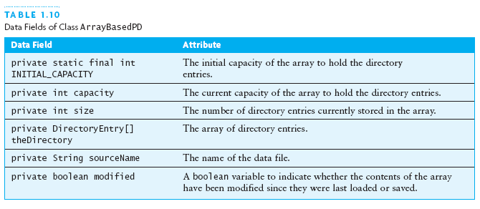
Design of Array-Based Phone Directory (5)

Slide 37
Design of ArrayBasedPD.loadData
Input: a file name; Effect: read initial directory from the file
Create a BufferedReader for the input
Read the first name
while the name is not null
Read the number
Add a new entry using method add
Read the next name

Slide 38
Design of ArrayBasedPD.addOrChangeEntry
Input: name and number; Effect: change number of existing entry, or make new entry if there was none
Call method find to see if the name is in the directory
if the name is in the directory
change number with DirectoryEntry.setNumber
Return the previous value of the number
else
Add a new entry using method add
Return null

Slide 39
Design of Array-Based Phone Directory (6)
Remaining method designs proceed along the same lines
The class diagram changes, showing private fields and methods added ....

Slide 40
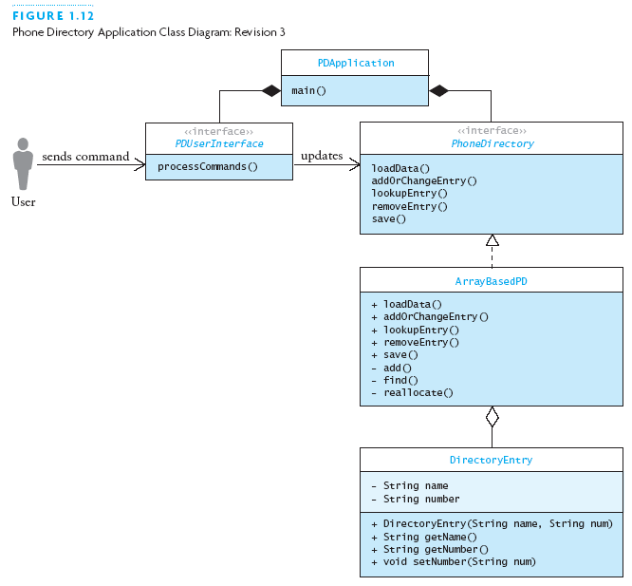
Design of Array-Based Phone Directory (7)

Slide 41
Implementing and Testing the Array-Based Phone Directory: ArrayBasedPD.java
import java.io.*;
/** This is an implementation of the
* PhoneDirectory interface that uses an
* array to store the data.
* @author Koffman & Wolfgang
*/
public class ArrayBasedPD
implements PhoneDirectory {
...
} // note: import, javadoc, implements

Slide 42
ArrayBasedPD Data Fields (1)
// Data Fields (with javadoc comments)
/** The initial capacity of the array */
private static final int INITIAL_CAPACITY = 100;
/** The current capacity of the array */
private int capacity = INITIAL_CAPACITY;
/** The current size of the array (number of
directory entries) */
private int size = 0;

Slide 43
ArrayBasedPD Data Fields (2)
/** The array to contain the directory data */
private DirectoryEntry[] theDirectory =
new DirectoryEntry[capacity];
/** The name of the data file that contains the
directory data */
private String sourceName = null;
/** Boolean flag indicates if the directory was
modified since it was loaded or saved. */
private boolean modified = false;

Slide 44
ArrayBasedPD.loadData
public void loadData (String sourceName) {
// Remember the source name.
this.sourceName = sourceName;
try { ...
} catch (FileNotFoundException ex) {
// Do nothing — no data to load.
return;
} catch (IOException ex) {
System.err.println(“Directory load failed.");
ex.printStackTrace();
System.exit(1);
}
}

Slide 45
ArrayBasedPD.loadData (2): Inside try
BufferedReader in = new BufferedReader(
new FileReader(sourceName));
while (true) {
String name, number;
// read name and number from succeeding lines
if ((name = in.readLine()) == null) break;
if ((number = in.readLine()) == null) break;
// insert entry (if got both name and number)
add(name, number);
}
in.close(); // should always close input
Slightly different loop approach from the text
Same assign-in-if-condition “hack”

Slide 46
ArrayBasedPD.loadData (3): alternate
boolean more = true;
while (more) {
more = false;
String name = in.readLine();
if (name != null) {
String number = in.readLine();
if (number != null) {
add(name, number);
more = true;
}
}
}
Nested if statements not as pleasant (what if 7 inputs?)
Control variables tend to be harder to understand/get right

Slide 47
ArrayBasedPD.addOrChangeEntry
public String addOrChangeEntry (String name,
String number) {
String oldNumber = null;
int index = find(name);
if (index > -1) {
oldNumber = theDirectory[index].getNumber();
theDirectory[index].setNumber(number);
}
else {
add(name, number);
}
modified = true;
return oldNumber;
}

Slide 48
ArrayBasedPD.save
public void save() {
if (!modified) return; // save not needed
try {
// Create PrintWriter for the file.
PrintWriter out = new PrintWriter(
new FileWriter(sourceName));
...
} catch (Exception ex) {
System.err.println(“Directory save failed");
ex.printStackTrace();
System.exit(1);
}
}

Slide 49
ArrayBasedPD.save (2)
// Write each directory entry to the file.
for (int i = 0; i < size; i++) {
// Write the name.
out.println(theDirectory[i].getName());
// Write the number.
out.println(theDirectory[i].getNumber());
}
// Close the file.
out.close();
modified = false;

Slide 50
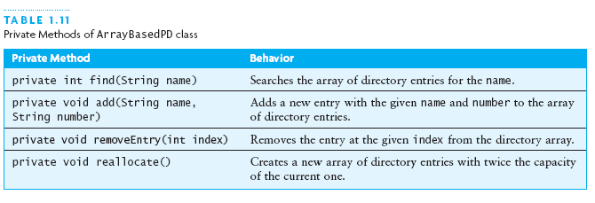
Implementing and Testing the Array-Based Phone Directory

Slide 51
ArrayBasedPD.find
private int find (String name) {
for (int i = 0; i < size; i++) {
if (theDirectory[i].getName().equals(name)) {
return i;
}
}
return -1; // Name not found.
}

Slide 52
ArrayBasedPD.add
private void add (String name, String number) {
if (size >= capacity) {
reallocate();
}
theDirectory[size++] =
new DirectoryEntry(name, number);
}
Differs from text in use of ++
Note that size means number of names stored,
while capacity means the number the array can hold

Slide 53
ArrayBasedPD.realloc
private void reallocate () {
capacity *= 2;
DirectoryEntry[] newDirectory =
new DirectoryEntry[capacity];
System.arraycopy(theDirectory, 0,
newDirectory, 0,
theDirectory.length);
theDirectory = newDirectory;
}
Arguments to arraycopy are:
  fromDir, fromIndex
  toDir, toIndex
  number of elements to copy

Slide 54
Testing ArrayBasedPD
Empty data file
Data file with only one name-number pair
Data file with odd number of lines
Data file with more pairs than initial array size
Retrieve names not in directory as well as ones that are
After a change, verify the new information
Check that after changes, the changes, plus all new information, are in the newly written file
Note: This code does not check for empty strings!

Slide 55
Implementing PDUserInterface
Text offers two classes that implement the UI interface:
  PDGUI: Uses JOptionPane for graphical UI
  PDConsoleUI: Uses console stream I/O (System.in and System.out)
Text gives good recipes here that you can use as models
We will not cover them in detail here

