Slide 1
Customer Relationship Prediction
Team 11 WMW: Wenting Su, Mohan Liu, Wei Huang

Slide 2
The KDD Cup 2009

Slide 3
The KDD Cup 2009
The KDD Cup 2009 offers the opportunity to work on large marketing databases from the French Telecom company Orange
An industrial customer analysis platform able to build prediction models with a very large number of input variables has been developed by Orange Labs.
The challenge is to beat the in-house system developed by Orange Labs.

Slide 4
What we could predict from CR data…
To predict the propensity of customers
switch provider (churn),
buy new products/services (appetency)
buy upgrades/add-ons proposed to them to make the sale more profitable (upselling).
Let’s analyze churn (switch provider)

Slide 5
Dataset

Slide 6
The feature of Dataset
Two marketing databases from Orange, the French Telecom company
A small dataset has 50,000 instances, 230 features
A large dataset has 50,000 instances, 15,000 features
The data were anonymized by replacing actual text or labels by meaningless codes and not revealing the meaning of the variables, to protect the privacy of the customers whose records were used

Slide 7
The challenges in Dataset
Heterogeneous data (numerical and categorical variables). The small dataset has 40 categorical features (out of 230), while the large dataset has 260 categorical features (out of 15000).
Noisy data
Unbalanced distributions of predictive variables, sparse target values (only 1 to 7 percent of the examples belong to the positive class)
Lots of missing values.

Slide 8
What technology we used…
Two steps:
Data Preprocessing by Python, Spark, PCA
Machine Learning by ANN

Slide 9
Data Preprocessing

Slide 10
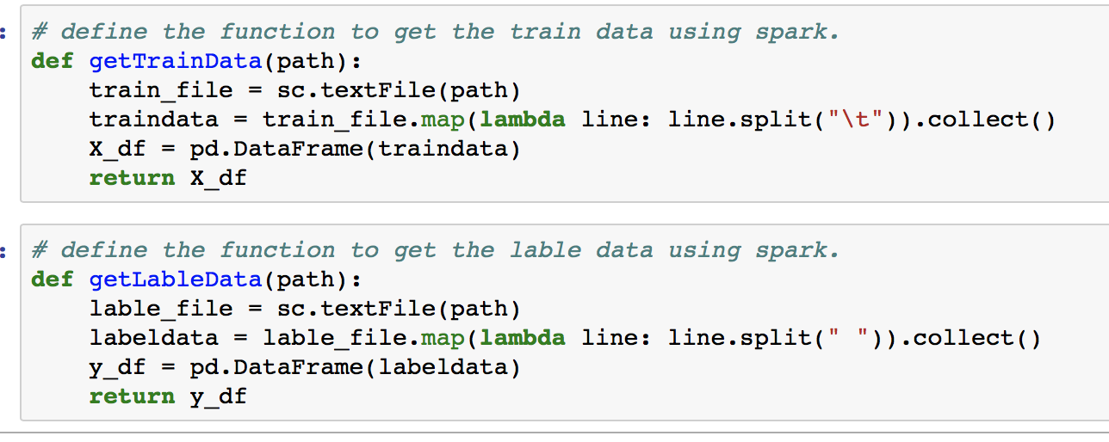
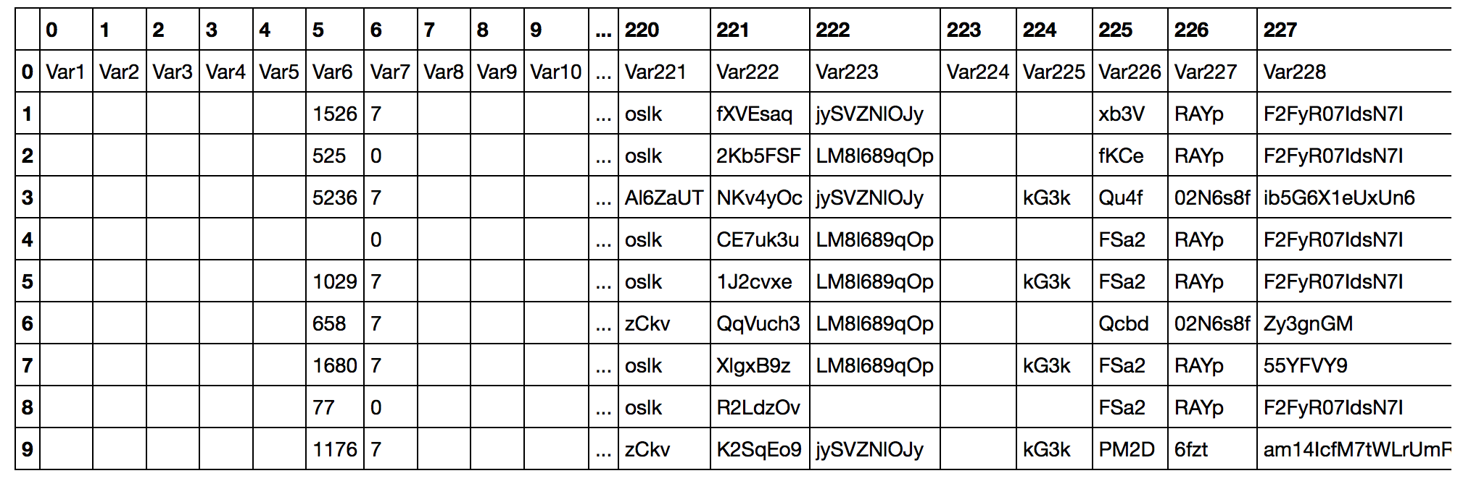
Step1: Collect train data and label data Technique: Spark, Python

Slide 11
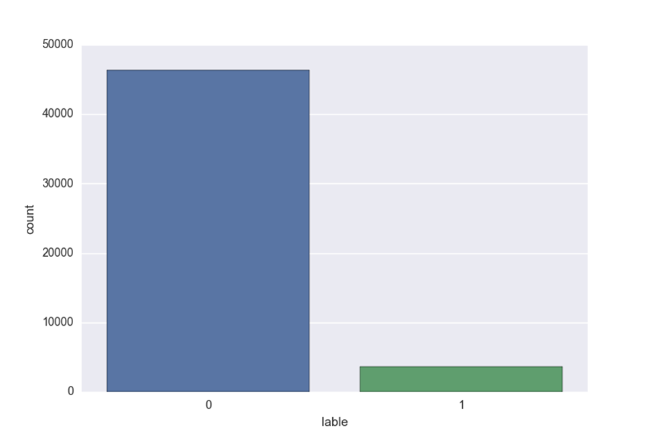
Step2: Processing Missing Data Technique: Panda
Dealing with String Empty Data
Dealing with Numerical Missing Data
Encoding categorical data
Combine the numerical data and categorical data.
Label Encoding

Slide 12
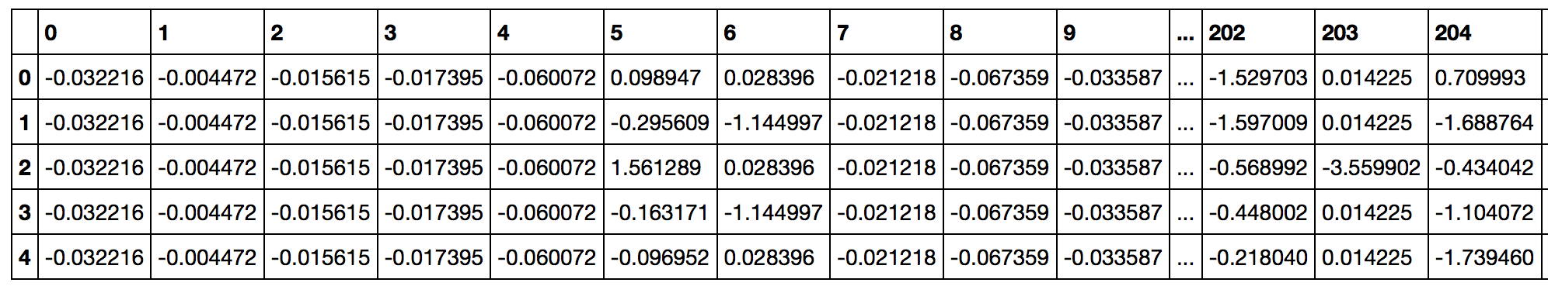
Step3: Feature Scaling
Makes sense to standardize the data using StandardScaler( ) function
A requirement for the optimal performance of many machine learning algorithms

Slide 13
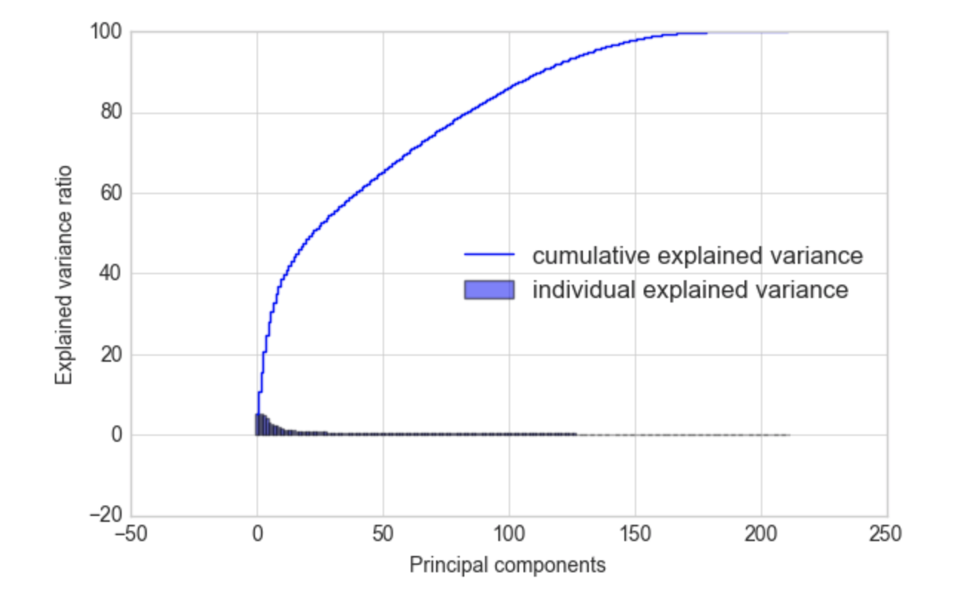
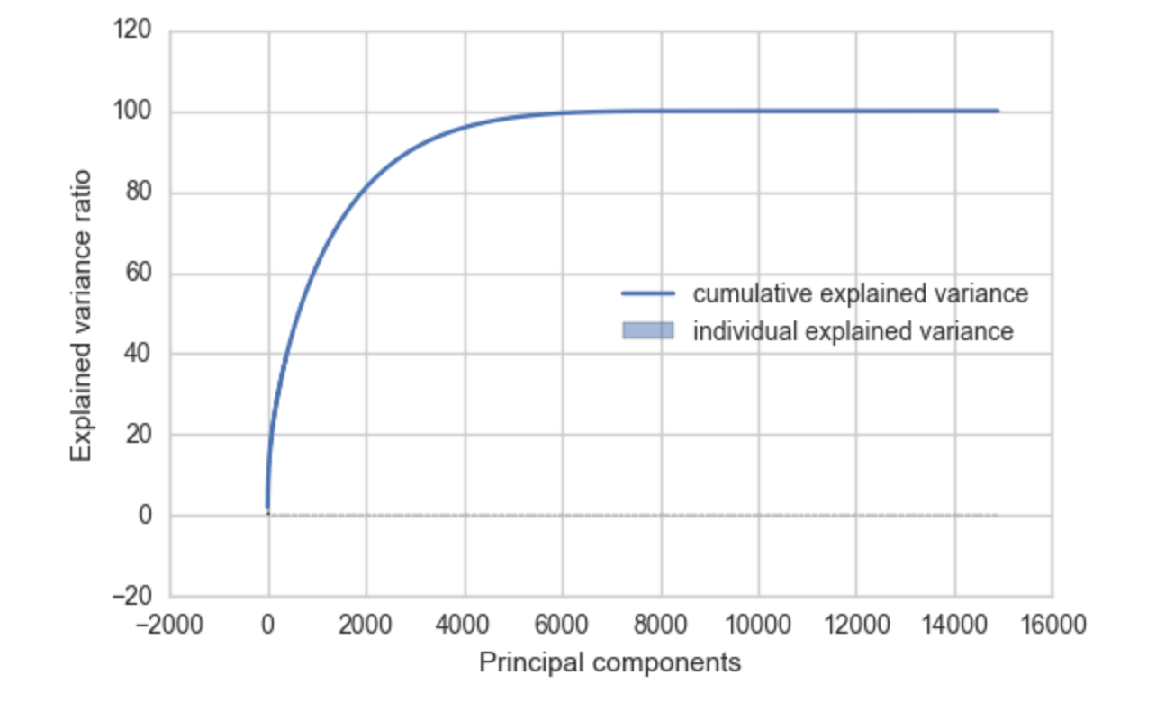
Step4: PCA
Computing Eigenvectors and Eigen values
Selecting Principal Components
Projection Onto the New Feature Space
Small Dataset
Large Dataset

Slide 14
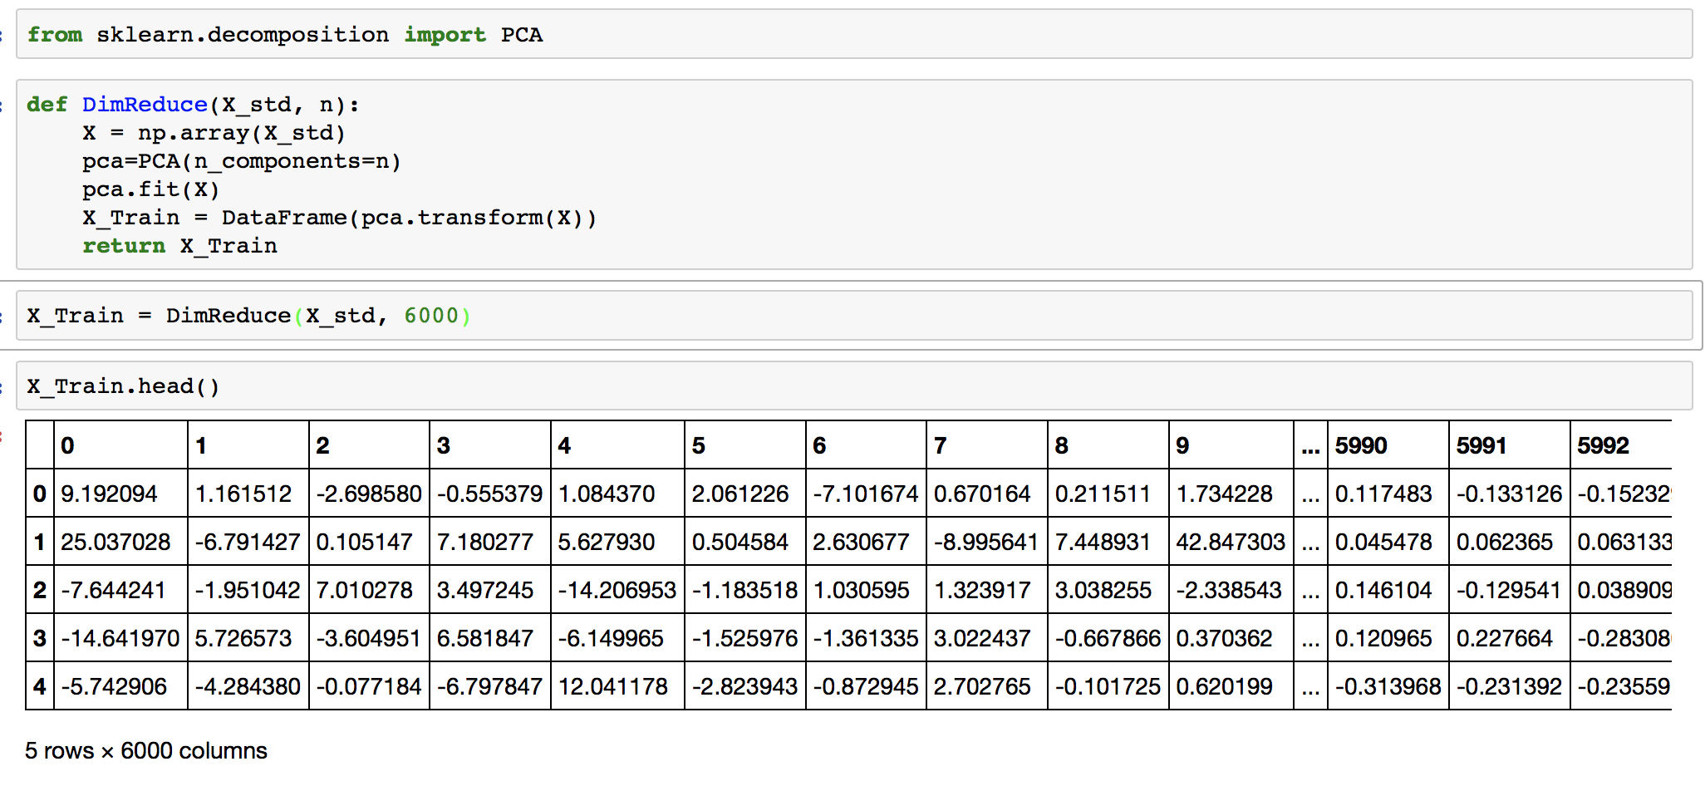
Outcome after data preprocessing
For the small dataset, after data preprocessing we reduced the column count to 212 (delete columns that are all empty).
For the large dataset, we reduced the column count to 6000 with PCA while retaining 98% of variance

Slide 15
Machine Learning (Artificial Neural Network)

Slide 16
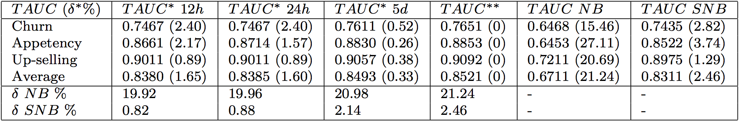
Orange Lab
An extension of the Naïve Bayes classifier, called “Selective Naïve Bayes classifier”
The base line Orange had provided for Churn is 0.7435

Slide 17
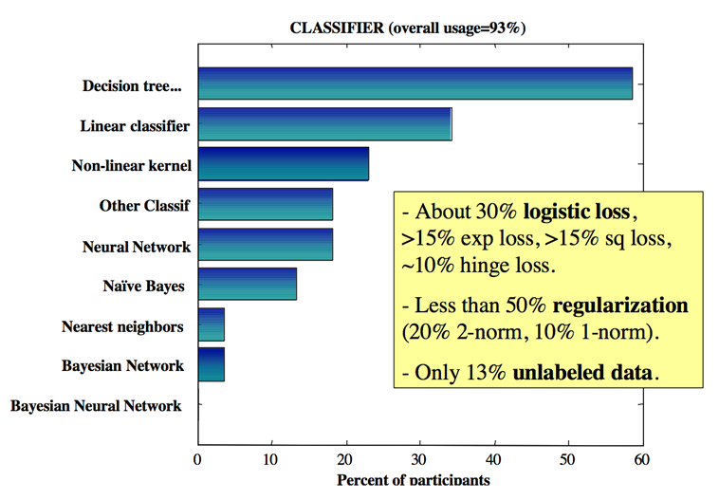
Choice of Classification Algorithms of original participants

Slide 18
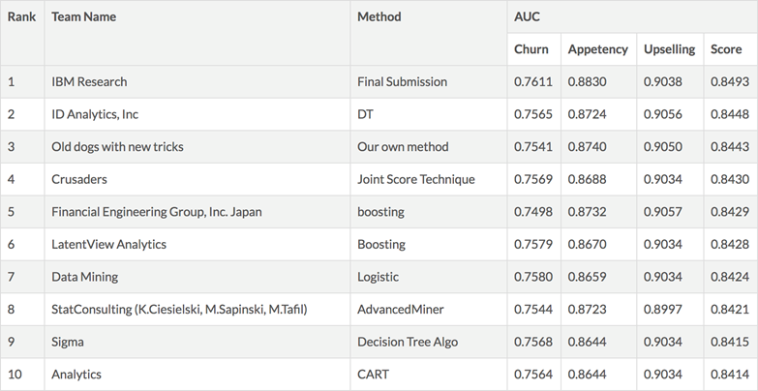
Top 10 results of original challenge

Slide 19
Comparison
Decision Tree Learning
Neural Networks
more efficient with large numbers of labeled examples
less efficient with large numbers of features or high dimensionality
much quicker than the typical neural network to build or learn a model
For highly non-linear boundaries between classes, neural networks are more likely to find appropriate boundaries because decision trees will have to approximate a non-linear boundary with a series of axis parallel splits.

Slide 20
Why no ANN? Why not ANN?
Artificial Neural Network was used, but only by around 20% percent of the original participants, while none of whom made it to the top 10.
Neural Network’s poor performance in the original challenge is hardware in 2009

Slide 21
Our outcome

Slide 22
Combination1 on small dataset
212 columns, 50,000 rows
Test size | No. of hidden layer | No. of neurons in hidden layer | Activation function | Activation function of output layer | Optimizer | Batch size | Epochs
30% | 2 | 106 | linear | sigmoid | Adam | 10 | 20

Slide 23
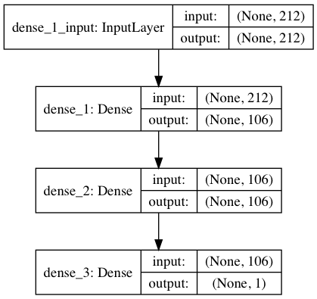
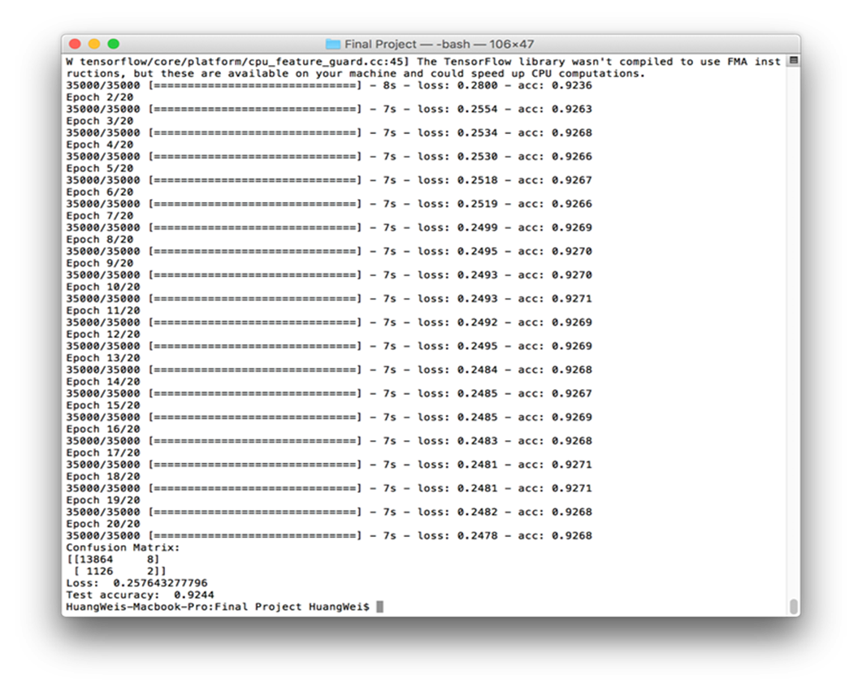
Combination1 on small dataset

Slide 24
Combination2 on small dataset
212 columns, 50,000 rows
Test size | No. of hidden layer | No. of neurons in hidden layer | Activation function | Activation function of output layer | Optimizer | Batch size | Epochs
30% | 2 | 106 | relu | sigmoid | Adam | 10 | 20

Slide 25
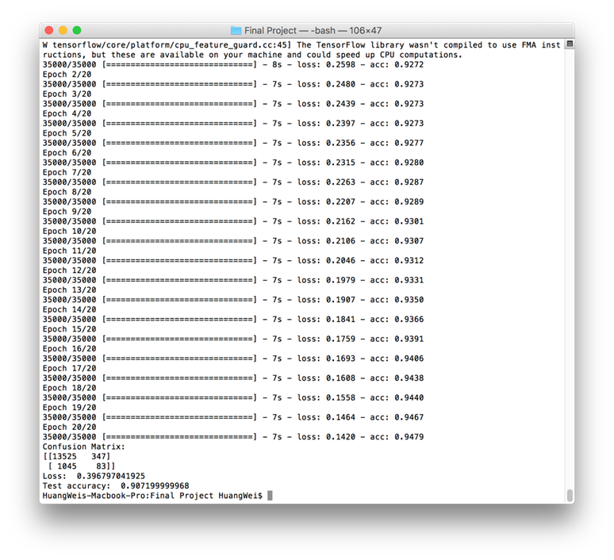
Combination2 on small dataset

Slide 26
Combination3 on small dataset
212 columns, 50,000 rows
Test size | No. of hidden layer | No. of neurons in hidden layer | Activation function | Activation function of output layer | Optimizer | Batch size | Epochs
30% | 3 | 106 | relu | sigmoid | Adam | 10 | 20

Slide 27

Combination3 on small dataset

Slide 28
Combination1 on large dataset
6,000 columns, 10,000 rows
Test size | No. of hidden layer | No. of neurons in hidden layer | Activation function | Activation function of output layer | Optimizer | Batch size | Epochs
30% | 2 | 3000 | linear | sigmoid | Adam | 10 | 10

Slide 29
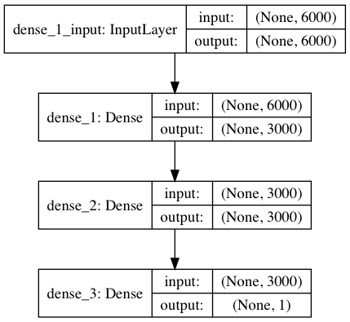
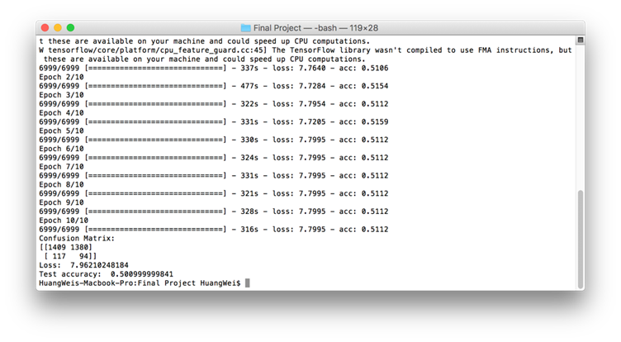
Combination1 on large dataset

Slide 30
Combination2 on large dataset
6,000 columns, 10,000 rows
Test size | No. of hidden layer | No. of neurons in hidden layer | Activation function | Activation function of output layer | Optimizer | Batch size | Epochs
30% | 1 | 3000 | relu | sigmoid | Adam | 10 | 10

Slide 31
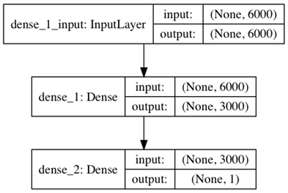
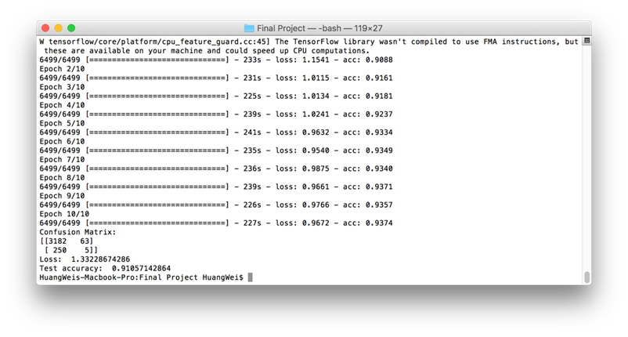
Combination2 on large dataset

Slide 32
ANN Parameter tuning
We found the ANN performed bad on predicting positive examples
The probable reason are:
the scarcity of positive example in the dataset (which is also one of the challenges of this dataset)
the ANN on large dataset is over-fitted.

Slide 33
Rearranged the small dataset
7,344 rows containing half positive and half negative examples
Test size | No. of hidden layer | No. of neurons in hidden layer | Activation function | Activation function of output layer | Optimizer | Batch size | Epochs
30% | 2 | 106 | relu | sigmoid | Adam | 10 | 20

Slide 34
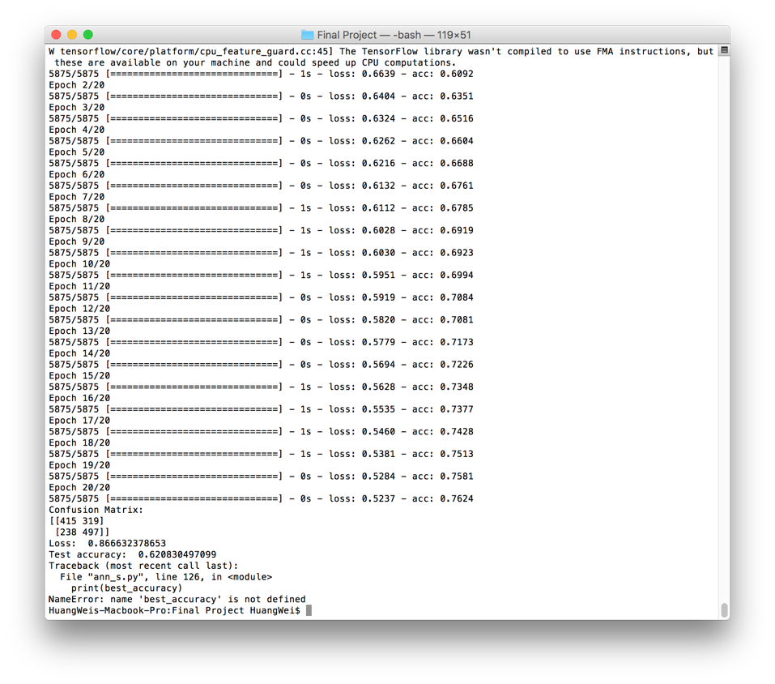
Rearranged the small dataset
As shown, training accuracy is much higher than testing. It’s over-fitted.

Slide 35
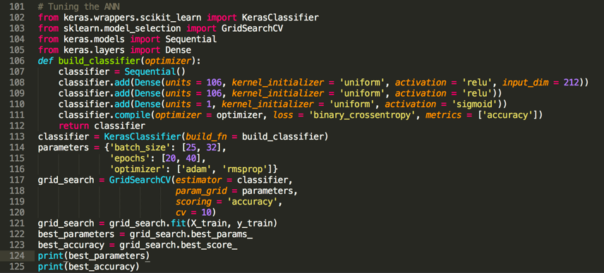
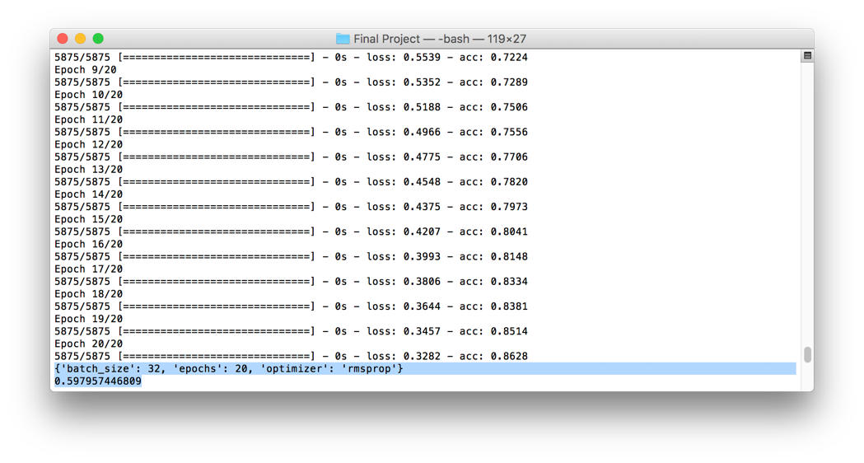
Tuning code on small dataset

Slide 36
Conclusion and Future Work

Slide 37
Conclusion
Small Dataset
Large Dataset
Successful on dataset preprocessing and ANN building
Got a better prediction accuracy than the original KDD competition
Although we did not completely process the dataset on our local machine and finish our work on a real cluster due to the tight time
We did finish the process for one chunk, which is 1/5 of the whole dataset, and our methodologies in both data processing and machine learning are working.
The accuracy for positive example prediction is generally bad for both size of dataset.

Slide 38
Future Work
Run data preprocessing on a real cluster.
Try to improve ANN training process with big data methodologies.
Add model selection for ANN and fine tune its parameters.
More in-depth analysis on positive example prediction accuracy.

Slide 39
Thank you for your patience

