Slide 1
04
四、系统测试

Slide 2
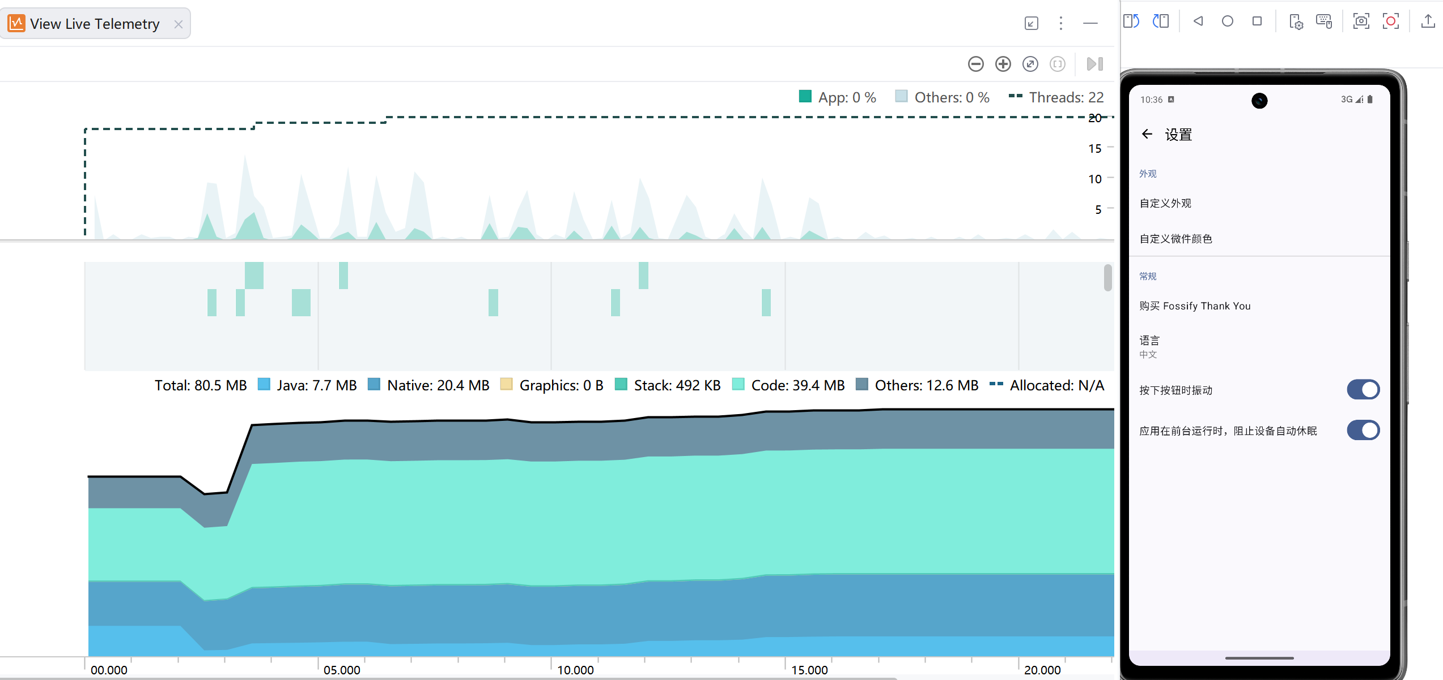
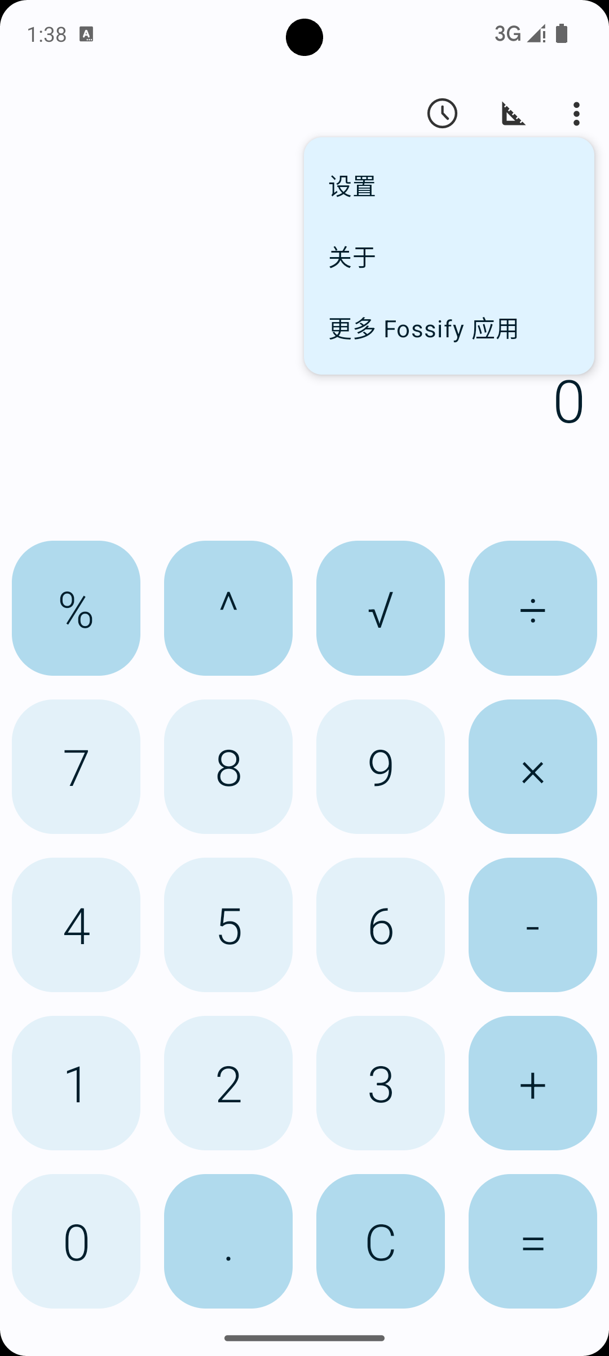
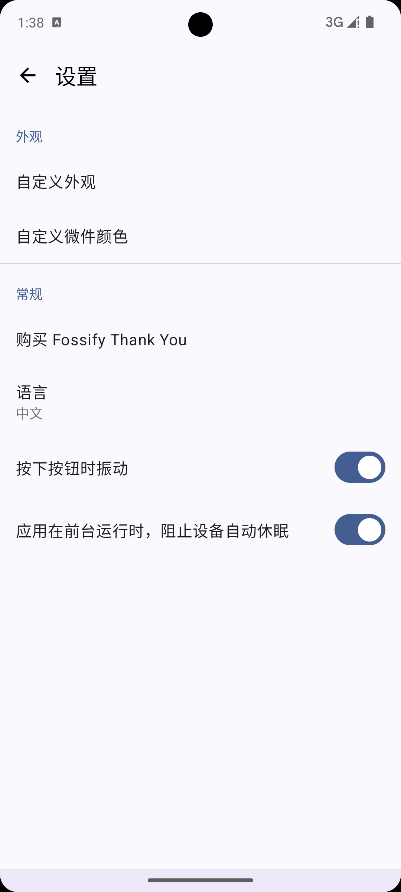
4.3 SettingsActivity 内存监控验证
Android Profiler 实时监控
借助 Android Studio Profiler 的 View Live Telemetry 功能，对 Fossify Calculator 的 SettingsActivity 进行内存实时监视。
测试覆盖设置项切换、页面进出等典型用户操作场景，持续采集内存使用数据。
监控数据概览
Total: 80.5 MB | Java: 7.7 MB | Native: 20.4 MB
Graphics: 0 B | Stack: 492 KB | Code: 39.4 MB
App CPU: 0% | Threads: 22
内存曲线平稳，无持续增长趋势
测试步骤
1. 启动 Profiler 连接设备
2. 打开 View Live Telemetry
3. 进入 SettingsActivity
4. 切换各项设置
5. 返回主界面
6. 观察内存曲线变化
验证结论：SettingsActivity 内存曲线平稳，进出页面后内存正常回落，
未发现明显内存泄漏，LeakCanary 无泄漏提醒。
打开设置菜单
SettingsActivity

Slide 3
4.1 内存泄漏检测与分析
LeakCanary 工具介绍
测试方法与流程
LeakCanary 是 Square 开源的 Android 内存泄漏检测库，能够在应用运行时自动检测 Activity、Fragment 等组件的内存泄漏问题。
当检测到对象未被正常回收时，LeakCanary 会自动触发堆转储（Heap Dump），分析引用链并生成详细的泄漏报告。
1. 集成 LeakCanary
在 build.gradle 中添加依赖，Application 类中初始化安装。
2. 构造泄漏场景
打开测试页面，模拟 Activity 持有外部引用，关闭页面后制造内存泄漏。
3. 触发检测
LeakCanary 自动监控对象回收状态，当 retained 对象达阈值时触发 Heap Dump。
4. 分析结果
通过系统通知栏获取泄漏提醒，查看引用链定位泄漏根因。
检测项 | 说明
检测目标 | Activity / Fragment 等组件生命周期泄漏
检测原理 | 弱引用监控 + Heap Dump + 引用链分析
触发条件 | retained 对象超过阈值（默认5个）自动触发
输出结果 | 系统通知栏提醒 + 详细泄漏分析报告

Slide 4

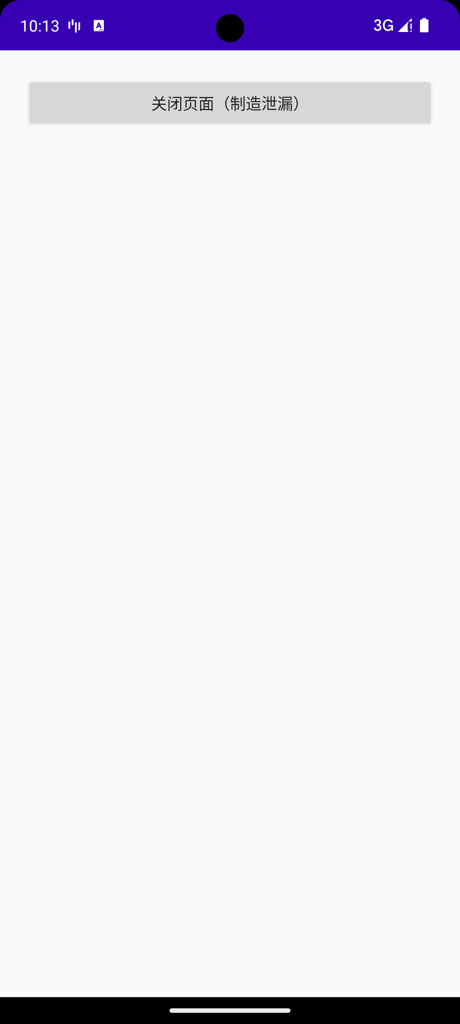
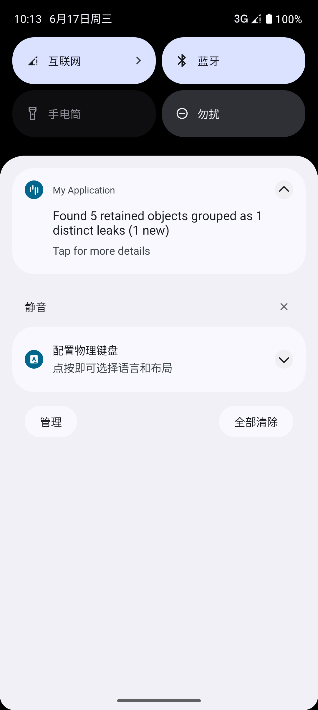
4.2 LeakCanary 泄漏检测实例
Step 1: 打开泄漏页面
Step 2: 关闭页面制造泄漏
Step 3: LeakCanary 泄漏提醒
进入测试页面，该页面持有外部静态引用
点击按钮关闭页面，Activity 未被 GC 回收
LeakCanary 检测到 5 个 retained 对象，系统通知栏弹出泄漏提醒
检测结果：LeakCanary 成功发现 1 处新的内存泄漏，通过系统通知栏明显提醒开发者。点击通知可查看完整的引用链（Reference Chain）和泄漏对象详情，帮助快速定位泄漏根因。

Slide 5

编辑标题文本
EDIT THE TITLE TEXT HERE
ENTER THE CORE TEXT CONTENT
ENTER THE CORE TEXT CONTENT
Enter the text.Enter the text.Enter the text.Enter the text.
Enter the text.Enter the text.Enter the text.Enter the text.
Enter the text.Enter the text.Enter the text.Enter the text.
Enter the text.Enter the text.Enter the text.Enter the text.
ENTER THE CORE TEXT CONTENT
Enter the text.Enter the text.Enter the text.Enter the text.
Enter the text.Enter the text.Enter the text.Enter the text.

Slide 6
编辑标题文本
EDIT THE TITLE TEXT HERE
在此输入标题
在此输入标题
在此输入标题
在此输入标题
在此输入标题
Enter the core text here.
Enter the core text here.
Enter the core text here.
Enter the core text here.
Enter the core text here.
Enter the core text here.
Enter the core text here.
Enter the core text here.
Enter the core text here.
Enter the core text here.
Enter the core text here.
Enter the core text here.
Enter the core text here.
Enter the core text here.
Enter the core text here.
Enter the core text here.
Enter the core text here.
Enter the core text here.
Enter the core text here.
Enter the core text here.
Enter the core text here.
Enter the core text here.
Enter the core text here.
Enter the core text here.
Enter the core text here.

Slide 7
编辑标题文本
EDIT THE TITLE TEXT HERE
EDIT CORE TEXT
EDIT CORE TEXT
Enter the text.Enter the text.Enter the text.
Enter the text.Enter the text.Enter the text.
Enter the text.Enter the text.Enter the text.
Enter the text.Enter the text.Enter the text.
EDIT CORE TEXT
EDIT CORE TEXT
Enter the text.Enter the text.Enter the text.
Enter the text.Enter the text.Enter the text.
Enter the text.Enter the text.Enter the text.
Enter the text.Enter the text.Enter the text.
EDIT CORE TEXT
EDIT CORE TEXT
Enter the text.Enter the text.Enter the text.
Enter the text.Enter the text.Enter the text.
Enter the text.Enter the text.Enter the text.
Enter the text.Enter the text.Enter the text.

Slide 8
编辑标题文本
EDIT THE TITLE TEXT HERE
编辑段落文本
编辑段落文本
Enter the core title content here.
Enter the core title content here.
Enter the core content.
Enter the core title content here.
Enter the core title content here.
Enter the core content.
Step01
Step02
编辑段落文本
编辑段落文本
Enter the core title content here.
Enter the core title content here.
Enter the core content.
Enter the core title content here.
Enter the core title content here.
Enter the core content.
Step04
Step03

Slide 9

EDIT THE TITLE TEXT HERE
CORE CONTENT
EDIT TEXT
EDIT TEXT
EDIT TEXT
Enter the text.Enter the text.
Enter the text.Enter the text.
Enter the text.Enter the text.
Enter the text.Enter the text.
Enter the text.Enter the text.
Enter the text.Enter the text.
EDIT TEXT
EDIT TEXT
EDIT TEXT
Enter the text.Enter the text.
Enter the text.Enter the text.
Enter the text.Enter the text.
Enter the text.Enter the text.
Enter the text.Enter the text.
Enter the text.Enter the text.

Slide 10

编辑标题文本
EDIT THE TITLE TEXT HERE
CORE TEXT
CORE TEXT
01
01
01
Enter the text.Enter the text.Enter the text.
Enter the text.Enter the text.Enter the text.
02
Enter the text.Enter the text.Enter the text.
Enter the text.Enter the text.Enter the text.
CORE TEXT
CORE TEXT
01
01
03
Enter the text.Enter the text.Enter the text.
Enter the text.Enter the text.Enter the text.
04
Enter the text.Enter the text.Enter the text.
Enter the text.Enter the text.Enter the text.
EDIT CORE CONTENT
Enter the text.Enter the text.Enter the text.Enter the text.
Enter the text.Enter the text.Enter the text.Enter the text.

Slide 11
编辑标题文本
EDIT THE TITLE TEXT HERE
EDIT CONTENT
EDIT CONTENT
EDIT CONTENT
10
20
50
%
%
%
编辑文本内容
编辑文本内容
编辑文本内容
编辑文本内容
编辑文本内容
编辑文本内容
编辑文本内容
编辑文本内容
编辑文本内容
编辑文本内容
编辑文本内容
编辑文本内容
56,138￥
63,151￥
92,517￥

Slide 12
编辑标题文本
EDIT THE TITLE TEXT HERE
编辑段落文本
TEXT HERE
编辑段落文本
Enter the core content here.
Enter the core content here.
Enter the content.
Enter the core content here.
Enter the core content here.
Enter the content.
02
01
TEXT HERE
TEXT HERE
03
04
编辑段落文本
编辑段落文本
TEXT HERE
Enter the core content here.
Enter the core content here.
Enter the content.
Enter the core content here.
Enter the core content here.
Enter the content.

Slide 13

编辑标题文本
EDIT THE TITLE TEXT HERE
Enter the core content here.Enter the core content here.Enter the core content here.
Enter the core content here.Enter the core content here.Enter the core content here.
Enter the core content here.Enter the core content here.Enter the core content here.
Enter the core content here.Enter the core content here.Enter the core content here.

Slide 14


教育学院
REPLY TO REPORT
谢谢您的观赏
Enter the core content here.Enter the core text.Enter the text here.Enter the core content.Enter the content.Enter the text.Enter the content.Enter the content.
答辩人：第一PPT
院校：第一PPT

