Slide 1
Comparison between random walk-based methods and graph-baed methods for dependency graph
Yunyu Liu, Jiaxin Du

Slide 2
Introduction
Problem: Multi-aspect sentiment analysis task
In reality, we have multiple aspects in a long sentence ⇒
Dependency graph becomes more important.
predict whether the sentence is neutral, positive, or negative

Slide 3
Introduction
Other approach: graph-based models
Our approach: random walk-based method + graph structural information
only aggregate info from neighboring words
can’t handle higher-order relationships

Slide 4
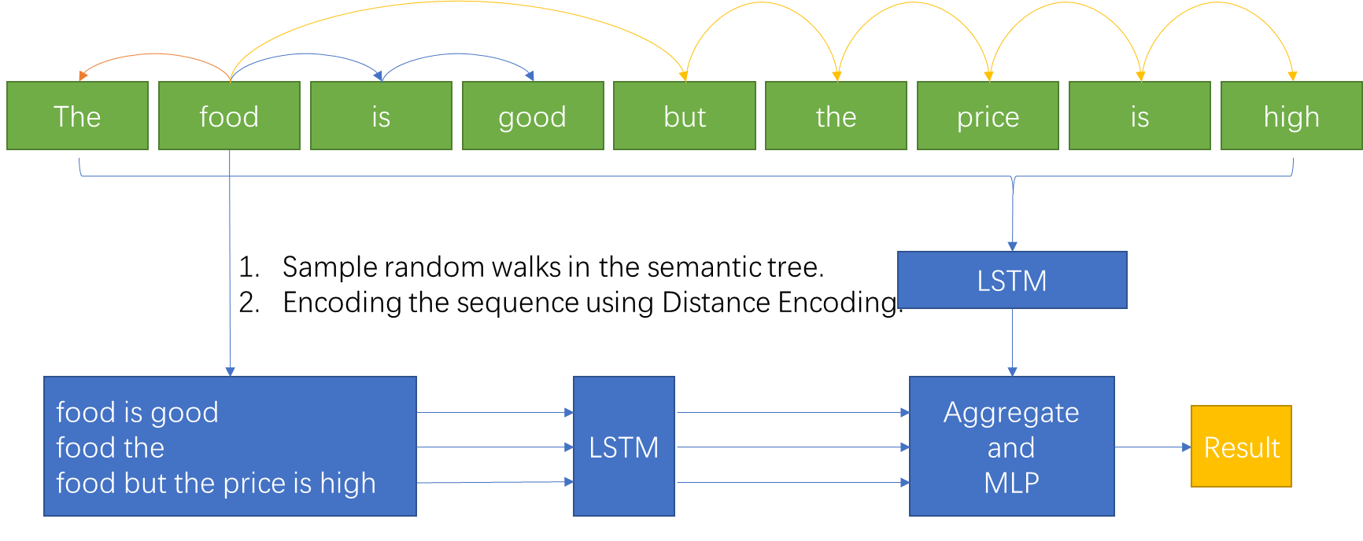
Method

Slide 5

Random Walk and Distance Encoding
Random Walk: x= {w1, w2, …}, sampled starting from the aspects.
Distance Encoding: simulate high-order GNN representation power.
where spdw is the shortest path distance from the word,
w to the aspect word on the dependency graph.

Slide 6
Experiment
Dataset: REST14, REST15, REST16
Reviews from the real world applications, including restaurants, hotels, etc.
Noisy: not grammatically correct
Maria Pontiki, Dimitris Galanis, John Pavlopoulos, Harris Papageorgiou, Ion Androutsopoulos, and Suresh Manandhar. SemEval-2014 task 4: Aspect based sentiment analysis. In Proceedings of the ACL International Workshop on Semantic Evaluation, pp. 27–35, 2014.

Slide 7
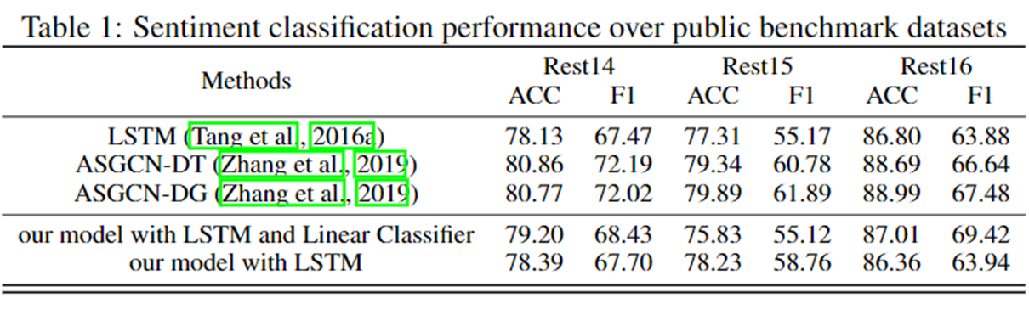
Experiment
LSTM: directly apply LSTM on entire sentence
ASGCN: graph-based models, using lots of tricks including attention and GCN networks

Slide 8
Discussion
Ours perform better than LSTM and worse than graph-based model
Reason1: dependency graph is too small so that graph-based models can handle while our sampling based models need to sample a lot of walks to capture all information.
Reason2: ASGCN also applies attention mechanism, which is more powerful than traditional sequential models .

Slide 9
Future work
Use large-scale dataset, including knowledge graphs, scholar network, etc.
Improve the sampling algorithm because we start from a random word but sometimes the aspect is a phrase.

