Slide 1
Machine Learning HW1
COVID-19 Cases Prediction

Slide 2
Outline
Objectives
Task Description
Data
Evaluation Metric
Kaggle
Grading
Code Submission
Deadlines
Hints
Regulations again
Useful Links

Slide 3
Objectives
Solve a regression problem with deep neural networks (DNN).
Understand basic DNN training tips
e.g. hyper-parameter tuning, feature selection, regularization, ...
Get familiar with PyTorch.

Slide 4
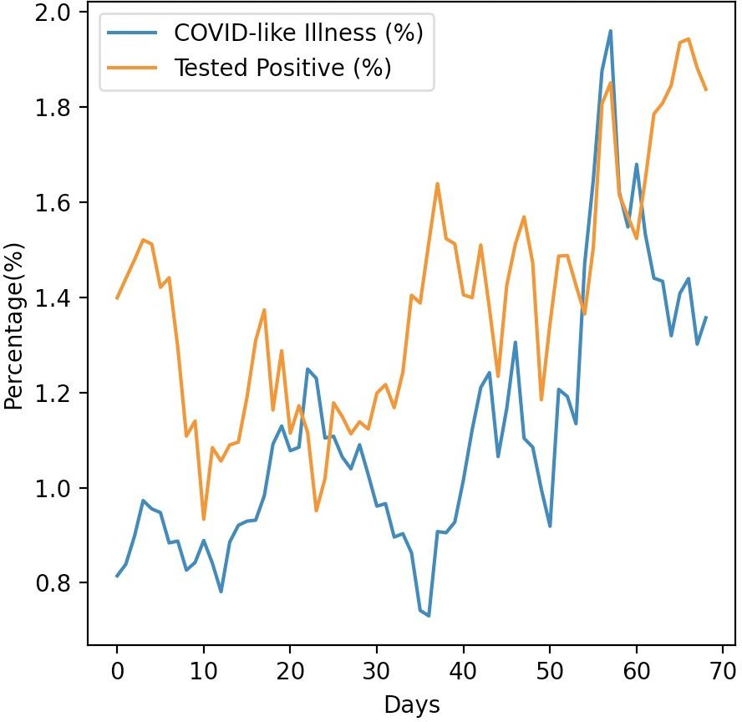
Task Description
COVID-19 Cases Prediction
Source: Delphi group @ CMU
A daily survey since April 2020 via facebook.
Do not attempt to ﬁnd any related data! Using additional data is prohibited and your ﬁnal grade x 0.9 !

Slide 5




Task Description
Given survey results in the past 3 days in a speciﬁc state in U.S., then predict the percentage of new tested positive cases in the 3rd day.
survey
positive cases
survey
positive cases
survey
positive cases
Day 3
Day 1
Day 2

Slide 6


Data - Delphi's COVID-19 Surveys
Conducted surveys via facebook (every day & every state)
Survey: symptoms, COVID-19 testing, social distancing, mental health, demographics, economic eﬀects, ...

Slide 7




Data - Delphi's COVID-19 Surveys
estimation for all population in that state
(data we are using)
All population in a certain state of the U.S.
some samples
survey

Slide 8
Data - Delphi's COVID-19 Surveys
States (40, encoded to one-hot vectors)
e.g. AL, AK, AZ, ...
COVID-like illness (4)
e.g. cli,ili (inﬂuenza-like illness), ...
Behavior Indicators (8)
e.g. wearing_mask, travel_outside_state, ...
Mental Health Indicators (5)
e.g. anxious, depressed, ...
Tested Positive Cases (1)
tested_positive (this is what we want to predict)
Percentage

Slide 9

Data - One-hot Vector
One-hot vectors:
Vectors with only one element equals to one while others are zero. Usually used to encode discrete values.
AL (Alabama) AK (Alaska) AZ (Arizona) AR (Arkansas)
one-hot encoding
If state code = AZ (Arizona)
WI (Wisconsin)

Slide 10
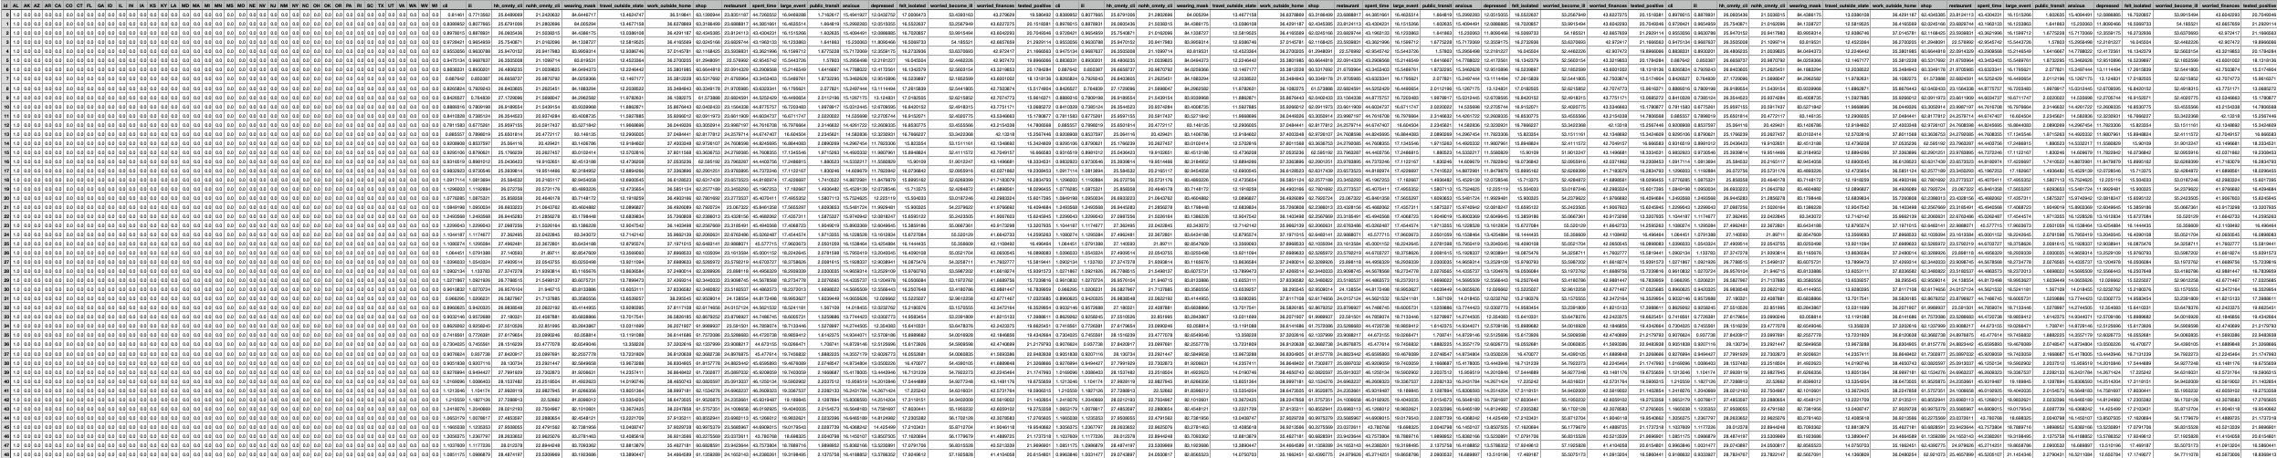
Data - Training
covid.train.csv (2140 samples)
state one-hot encoding (40)
Day 1 features
(18)
Day 2 features
(18)
Day 3 features
(18)
tested positive
1 row = 1 sample

Slide 11
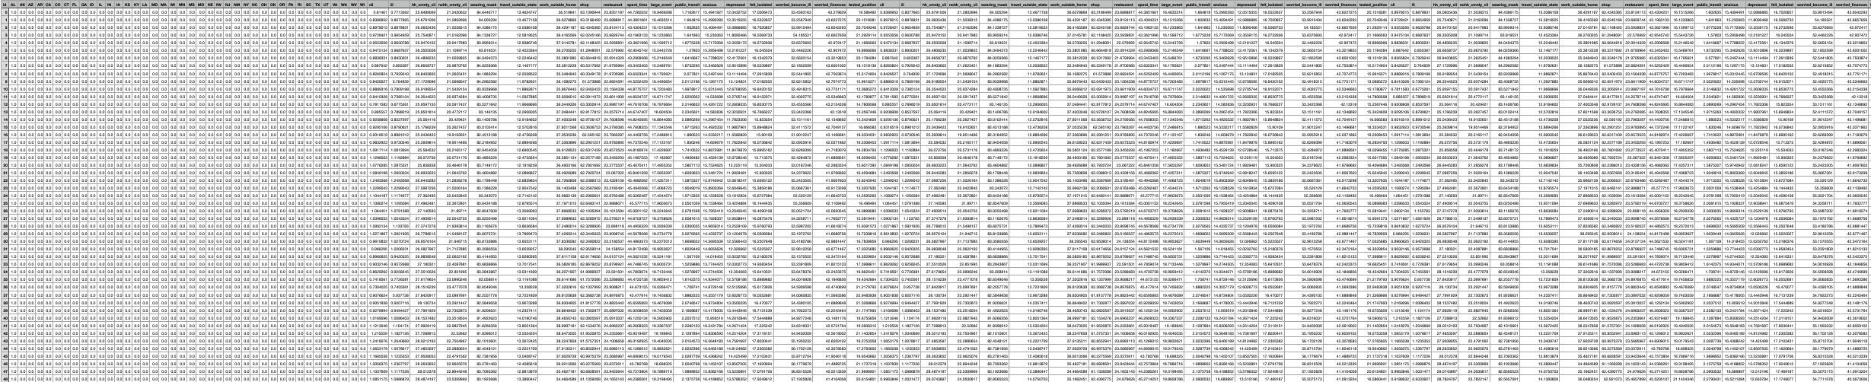
Data - Testing
covid.test.csv (560 samples)
state one-hot encoding (40)
Day 1 features
(18)
Day 2 features
(18)
Day 3 features
(17)
1 row = 1 sample

Slide 12
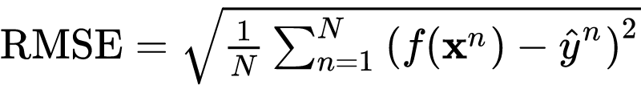
Evaluation Metric
Root Mean Squared Error (RMSE)
your model
ground truth label (correct answer)
input features (testing data)

Slide 13
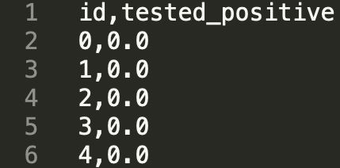
Kaggle
Link: https://www.kaggle.com/t/bf6a0d249e5e467f8c9d439331eeadba
Displayed name: <student ID>_<department_something>
e.g. 410785007_CSIE_Chen
Submission format: .csv ﬁle
See sample code

Slide 14
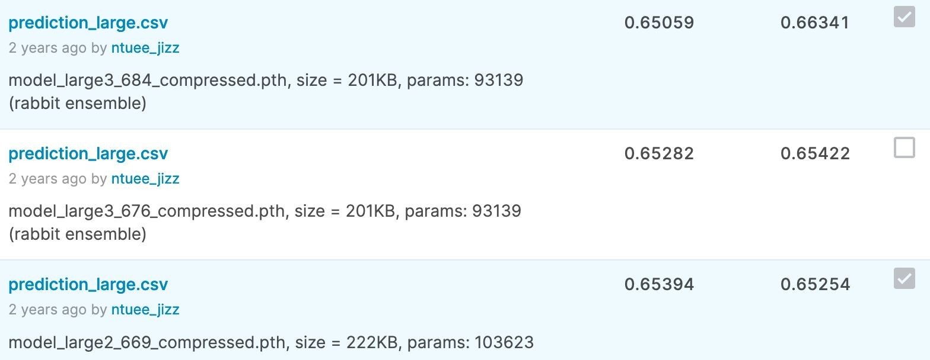
Kaggle - Submission
You may submit up to 5 results each day (UTC).
Up to 2 submissions will be considered for the private leaderboard.
remember to select 2 results for your ﬁnal scores before the competition ends!

Slide 15
Grading
Simple baseline
Simple baseline
(public) (private)
+1 pt (sample code)
+1 pt (sample code)
+1 pt
+1 pt
+1 pt
+1 pt
+4 pts
Medium baseline (public)
Medium baseline (private)
Strong baseline (public)
Strong baseline (private)
Upload code to 數位學苑
期末分數換算，該題得分*1.25
Total: 10 pts

Slide 16
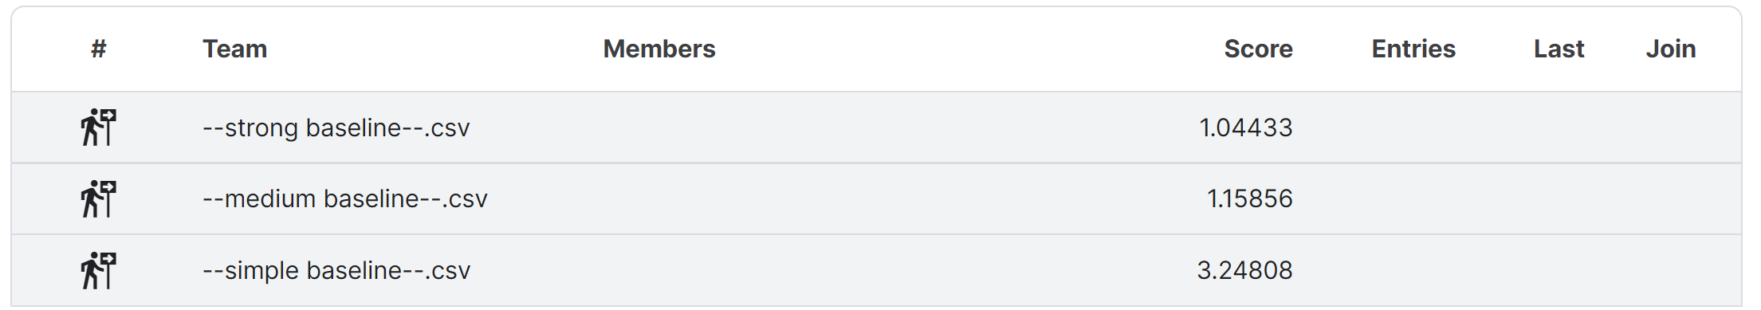
Grading - Kaggle
We might change the strong baseline if it’s too hard.

Slide 17
Grading - Bonus
If you got 10 points, we make your code public to the whole class.
In this case, if you also submit a PDF report brieﬂy describing your methods, you get a bonus of 0.5 pt.
(your report will also be available to all students)
Report template

Slide 18
Code Submission
數位學苑(4pts)
Compress your code and report into
<student ID>_hw1.zip
e.g. 410785007_hw1.zip
We can only see your last submission.
Do not submit your model or dataset.
If your code is not reasonable, your semester grade x 0.9.

Slide 19
Code Submission
You must specify the source of your code.
E.g., add a Reference block at the bottom of your code.

Slide 20

Code Submission
Your .zip ﬁle should include only
Code: either .py or .ipynb
Report: .pdf (only for those who get 10 points)
Example:

Slide 21
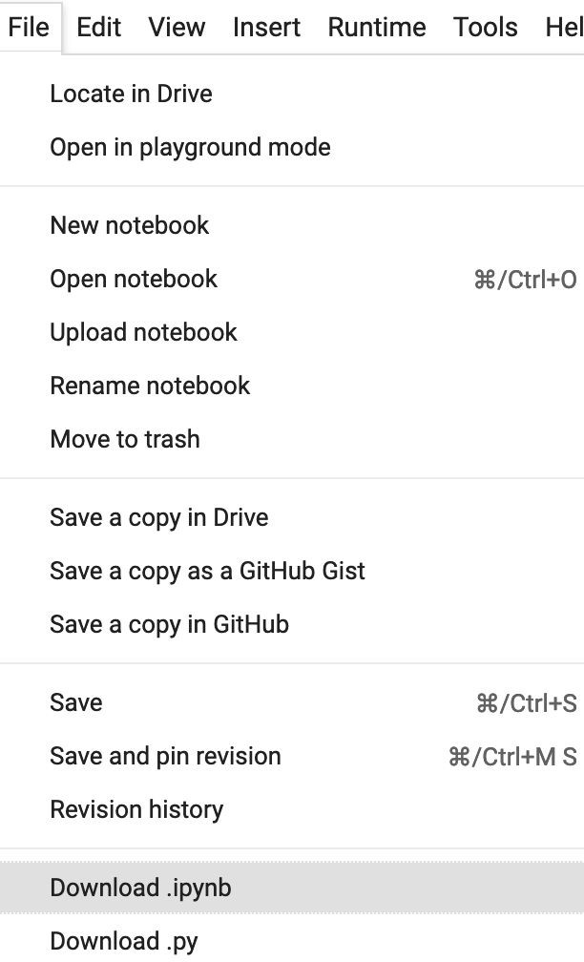
Code Submission
How to download your code from Google Colab?

Slide 22
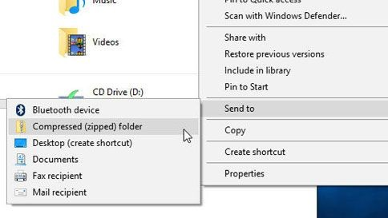
Code Submission
How to compress your folder?
Method 1 (for Windows users)
https://support.microsoft.com/en-us/windows/zip-and-unzip-ﬁles-f6dde0a7-0fec-8294-e1d3-703ed85e7ebc
1
2

Slide 23
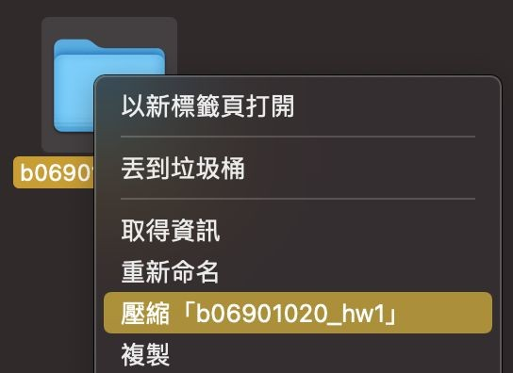
Code Submission
How to compress your folder?
Method 2 (for Mac users)
https://support.apple.com/guide/mac-help/mchlp2528/mac
Compress “b06901020_hw1”

Slide 24
Code Submission
How to compress your folder?
Method 3 (command line)
zip -r <name>.zip <directory name>
e.g.
zip -r 410785007_hw1.zip 410785007_hw1

Slide 25
Deadlines
Kaggle
2023/03/20 23:59 (UTC+8)
Code Submission (數位學苑)
2023/03/22 23:59 (UTC+8)
No late submission!
Submit early!

Slide 26
Hints
Simple Baseline
Sample code
Medium Baseline
Feature selection: 40 states + 2 tested_positive
注意註解，或許能找到隱藏在code裡的bug。
Strong Baseline
Feature selection (what other features are useful?)
DNN architecture (layers? dimension? activation function?)
Training (mini-batch? optimizer? learning rate?)
L2 regularization
There are some mistakes in the sample code, can you ﬁnd them?

Slide 27
Regulations Again
You should ﬁnish your homework on your own.
You should not modify your prediction ﬁles manually.
Do not share codes or prediction ﬁles with any living creatures.
Do not use any approaches to submit your results more than 5 times a day.
Do not search or use additional data or pre-trained models.
Your ﬁnal grade x 0.9 if you violate any of the above rules.
Prof. Wu & TAs preserve the rights to change the rules & grades.

Slide 28
If any questions, you can ask us via...
Email
kafuchino0410@gmail.com
The title should begin with “[ml_hw1]”
盡量用email而不是數位學苑來寄信，方便助教回信

Slide 29
Useful Links
Hung-yi Lee, Regression & Gradient Descent (Mandarin)
(link1, link2, link3, link4, link5, link6)
Hung-yi Lee, Tips for Training Deep Networks (Mandarin)
(link1, link2)
Google Machine Learning Crash Course (English)
(Regularization, NN Training)
https://pytorch.org/docs/stable/index.html
https://www.google.com/
(If Google or Stackoverﬂow can answer your questions, you may take advantage of them before asking the TAs.)

Slide 30
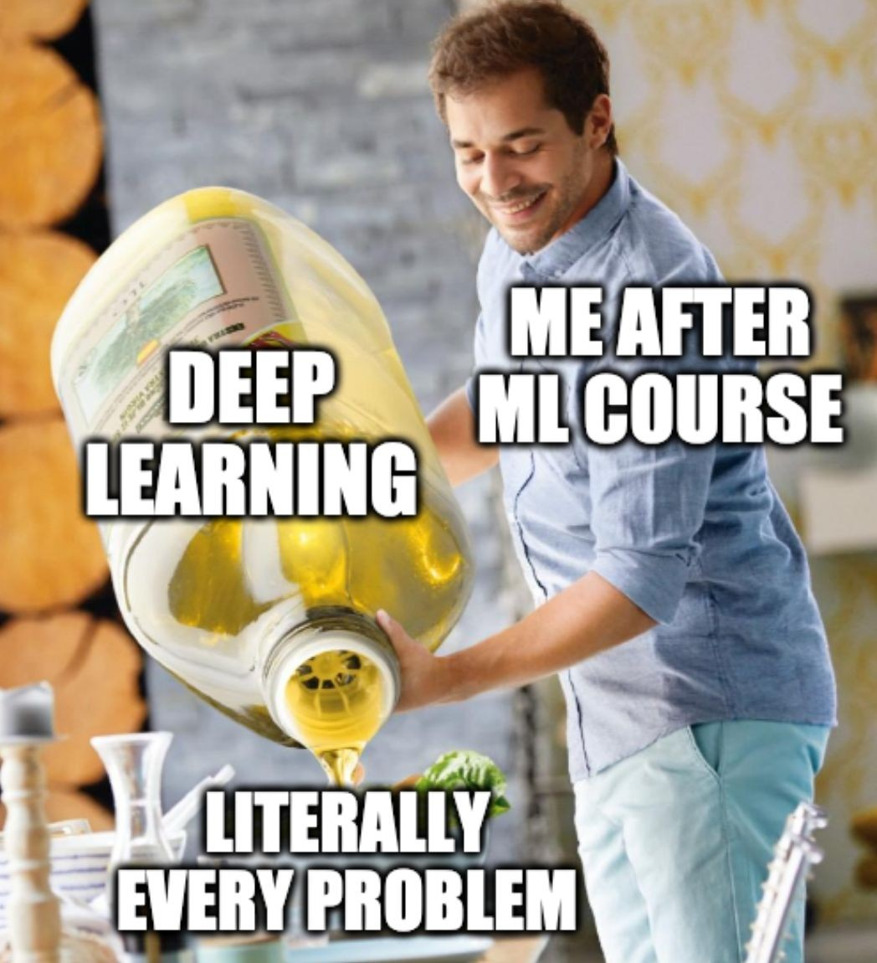
Have fun and wish you good luck!

