Slide 1
Machine Learning HW2
ML TAs

Slide 2
Outline
2-1 Phoneme Classiﬁcation (8pt/10pt)
Task Introduction
Dataset & Data Format
Kaggle Submission Format
Grading

Slide 3
2-1 Phoneme Classiﬁcation

Slide 4
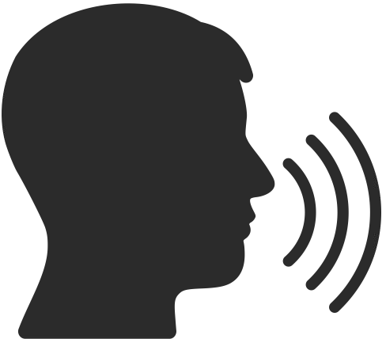

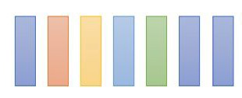
Task Introduction
Machine
Task: Multiclass Classiﬁcation
Framewise phoneme prediction from speech.
M M M AH AH SH SH IH IH IH N N N N ...
What is a phoneme?
A unit of speech sound in a language that can serve to distinguish one word from the other.
bat / pat , bad / bed
Machine Learning → M AH SH IH N L ER N IH NG

Slide 5
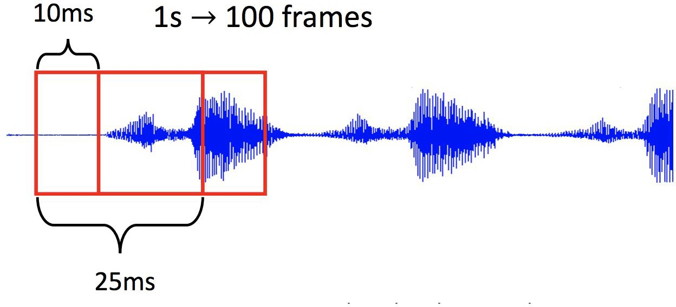
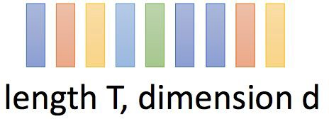
Task Introduction
Data Preprocessing
a vector
39-dim MFCC
80-dim ﬁlter bank
...
frame

Slide 6
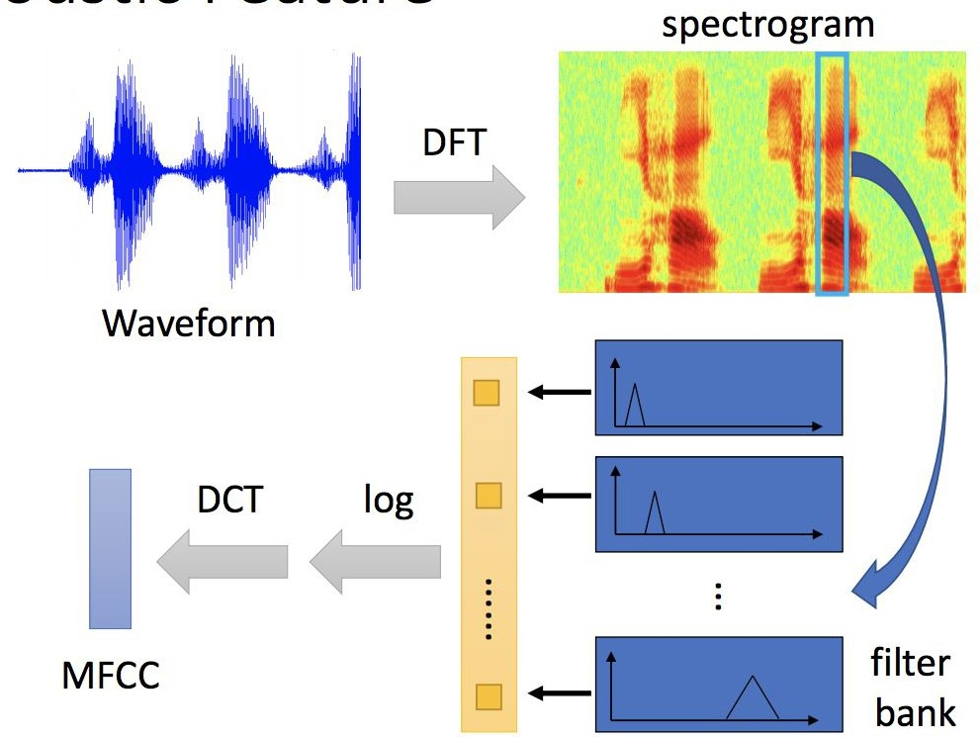
Task Introduction
Acoustic Features - MFCCs (Mel Frequency Cepstral Coefﬁcients)
For more details,
please refer to Prof. Lin-Shan Lee’s [Introduction to Digital Speech Processing] Chap.7
Image ref.
Prof. Hung-Yi Lee
[2020Spring DLHLP] Speech Recognition
vector

Slide 7

More Information About the Data
shape (11,39)
label
Since each frame only contains 25 ms of speech, a single frame is unlikely to represent a complete phoneme
Usually, a phoneme will span several frames
Hint: post-processing may help
Concatenate the neighboring phonemes for training
In this HW, we concatenate the past and the future ﬁve frames for training (total 11 frames)
You may reshape the input (1,429) back to (11,39) to get
separated 11 frames
Just remember that the label corresponds to the center frame
Finding testing labels or doing human labeling are strictly
prohibited!
prev frames
future frames
ﬂatten
reshape to (11,39)
shape (1,429)
ﬂatten 11 frames
11 * 39 = 429 dim
...
Introduction to Digital Speech Processing

Slide 8
Dataset & Data Format
Dataset: TIMIT Acoustic-Phonetic Continuous Speech Corpus
Phonetically balanced for English
Data Format (The TAs have already preprocessed the data)
timit_11/
train_11.npy → training data (# of training frames, 11 x feature dim)
train_label_11.npy → framewise phoneme label (0-38)
test_11.npy → testing data (# of testing frames, 11 x feature dim)
Acoustic features (39-dim MFCC)
Concatenate the past and the future ﬁve frames (feature dim = 11 x 39)
The phoneme label of each input corresponds to the center frame
Using additional data is prohibited. Your ﬁnal grade will be multiplied by 0.9!

Slide 9
Class | Phoneme | Example | Class | Phoneme | Example | Class | Phoneme | Example
0 | iy | beet | 13 | l | lay | 26 | dx | muddy
1 | ih | bit | 14 | r | ray | 27 | g | gay
2 | eh | bet | 15 | y | yacht | 28 | p | pea
3 | ae | bat | 16 | w | way | 29 | t | tea
4 | ah | but | 17 | er | bird | 30 | k | key
5 | uw | boot | 18 | m | mom | 31 | z | zone
6 | uh | book | 19 | n | noon | 32 | v | van
7 | aa | bob | 20 | ng | sing | 33 | f | fin
8 | ey | bait | 21 | ch | choke | 34 | th | thin
9 | ay | bite | 22 | jh | joke | 35 | s | sea
10 | oy | boy | 23 | dh | then | 36 | sh | she
11 | aw | bout | 24 | b | bee | 37 | hh | hay
12 | ow | boat | 25 | d | day | 38 | sil | silence/closure sounds

Slide 10
Sample Code
Colab Link:
https://colab.research.google.com/drive/1B77oG7rZfyWAOOhQjUlOprsPEGyPxM2i?usp=sharing
Simple baseline
You should able to pass the simple baseline using the sample code provided.
Strong baseline
Model architecture (layers? dimension? activation function?)
Training (batch size? optimizer? learning rate? epoch?)
Tips (batch norm? dropout? regularization?)

Slide 11
Grading (10pt/10pt)
(4pt) Submit code to 數位學苑
(1pt) Public simple baseline
(2pt) Public strong baseline
(1pt) Private simple baseline
(2pt) Private strong baseline
期末分數換算，該題得分*1.25

Slide 12
Grading
Simple baseline
Simple baseline
(public) (private)
+1 pt (sample code)
+1 pt (sample code)
+1 pt
+1 pt
+1 pt
+1 pt
+4 pts
Medium baseline (public)
Medium baseline (private)
Strong baseline (public)
Strong baseline (private)
Upload code to 數位學苑
期末分數換算，該題得分*1.25
Total: 10 pts

Slide 13
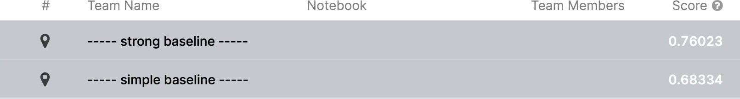
Grading - Kaggle
0.74347
0.69112

Slide 14
Bonus (0.5pt)
If you get full marks in this part, we will make your code public to the class.
In this case, if you also submit a PDF report brieﬂy describing your methods (<100 words in English), you get a bonus of 0.5 pt.
(your report will also be available to all students)
Report template

Slide 15
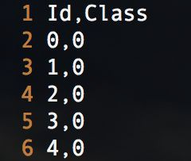
Kaggle Submission
Kaggle Link:3/25公布
Displayed name: <student ID>_<anything>
e.g. 410785007 _puipui
For auditing, don’t put your student ID in your displayed name.
Submission format: .csv ﬁle
Evaluation metric: accuracy

Slide 16
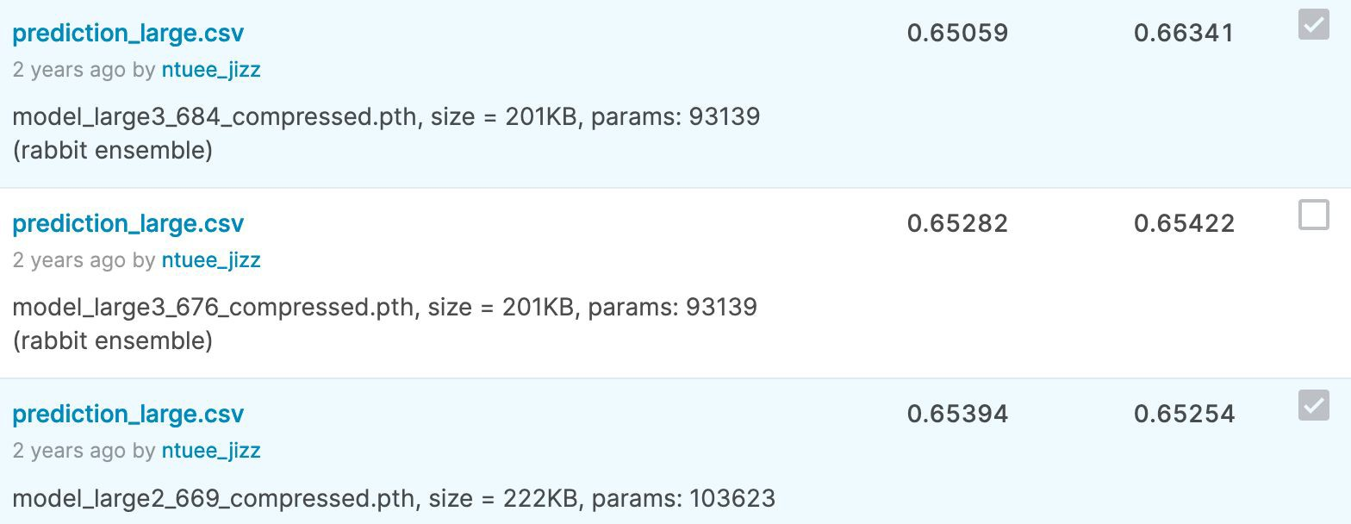
Kaggle Submission
You may submit up to 5 results each day (UTC).
Up to 2 submissions will be considered for the private leaderboard.
remember to select 2 results for your ﬁnal scores before the competition ends!

Slide 17
Code Submission
Compress your code and report, then submit it to數位學苑.
<student ID>_科系英文縮寫_hw2.zip
e.g. 410785007 _CSIE_hw2.zip
We can only see your last submission.
Do not submit your model or dataset.
If your code is not reasonable, your ﬁnal grade will be multiplied by 0.9!

Slide 18

Code Submission
Your .zip file should include only
Code: either .py or .ipynb
Report: .pdf (only for those who got 8 points in part one)
Example:

Slide 19
Deadlines
Kaggle
2023/04/03 23:59 (UTC+8)
Code Submission (數位學苑)
2023/04/05 23:59 (UTC+8)
No late submission!
Submit early!

Slide 20
Regulation
You should NOT plagiarize, if you use any other resource, you should cite it in the reference. (＊)
You should NOT modify your prediction files manually.
Do NOT share codes or prediction files with any living creatures.
Do NOT use any approaches to submit your results more than 5 times a day.
Do NOT search or use additional data or pre-trained models.
Your final grade x 0.9 if you violate any of the above rules.
Prof. Lee & TAs preserve the rights to change the rules & grades.
(＊) Academic Ethics Guidelines for Researchers by the Ministry of Science and Technology

Slide 21
If any questions, you can ask us via...
Email
maypp555@gmail.com
The title should begin with “[ml_hw2]”

