Slide 1
ECE 2140 SOC Design Convolution Neural Network on FPGA Theta
1 min
Thibaut Lanois: THL26@pitt.edu
Wen Wen: WEW55@pitt.edu
Pan Jieming: JIP40@pitt.edu

Slide 2
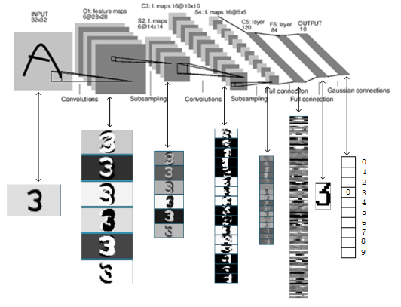
A Typical Convolutional Neural Network (LeNet-5)
Convolutional Operation
LeNet-5: Y. LeCun, L. Bottou, Y. Bengio, and P. Haffner. Gradient-based learning applied to document recognition. Proceedings of the IEEE, november 1998.

Slide 3
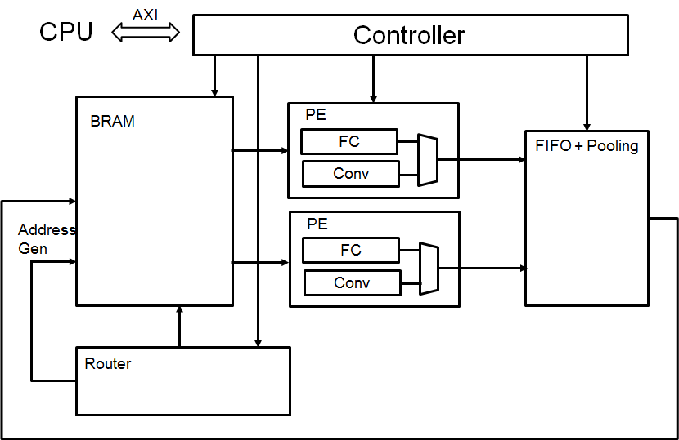
CNN SoC System Architecture Overview
3 min
Convolutional layers account for over 90% computation
FPGA has inherent parallelism
Convolution layer
Fully connected layer
FIFO + Pooling layer
Controller
Router

Slide 4
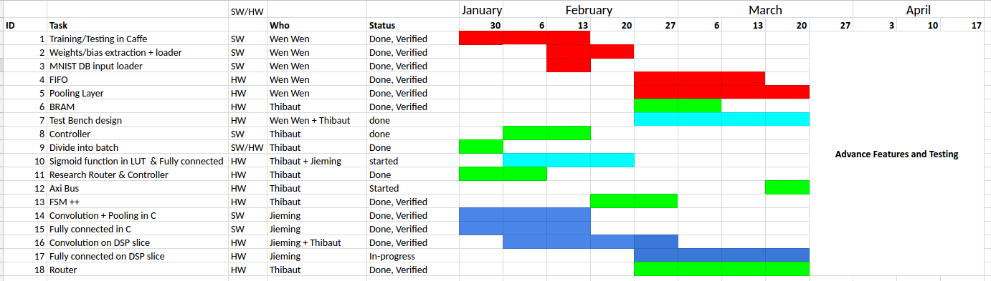
Schedule and Status
2 min
Accomplishments last week:
For given input image from CPU, Convolution/Pooling layer work as expected
For router/controller/convo/pooling/BRAM, Individual/Integrated Test Benches design, synthesis, integration done
Fully connected layer is in-progress
Working on this week:
AXI bus for communication between CPU and FPGA
Performance boosting with constraints
Challenges/ Difficulties / Needs in Integration Testing
Floating-point to (16-bit) fixed-point data conversion
Data/weight address calculation

Slide 5
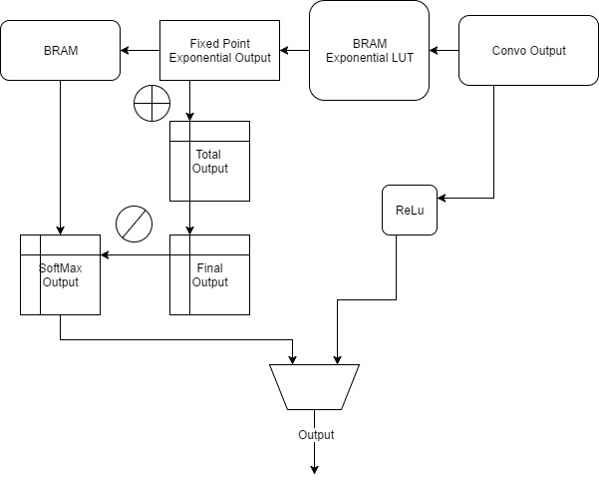
Fully connected layer (Optional Feature)
2 min
Function:
Softmax:
Preloading a BRAM with 512 fixed-point exponential values.
Another BRAM is used to store the exponential of the output of the convolution for Softmax calculation later.
A register is used to accumulate the sum of all outputs for Softmax.
ReLU
Selection between ReLu and SoftMax function

Slide 6
2 min
Fully connected layer (Optional Feature)
280++ lines of code
ReLu
Preload Exponential LUT
Exponential conversion

Slide 7
Convolution layer - overview
2 min
Function: To accelerate the computation of convolution of the kernels over the feature map with FPGA resources.
Difficulties
Timing of control signals
Fixed-point multiplication
Precision degradation
Solution
Controls go through the pipeline
Using DSP IP from Xilinx
1) Using 32 bit as output of the multiplier and then shifting data width downto 16 bit again, 2) Checking possible data overflow in shrinked 16 bit data with 32 bit outputs.

Slide 8
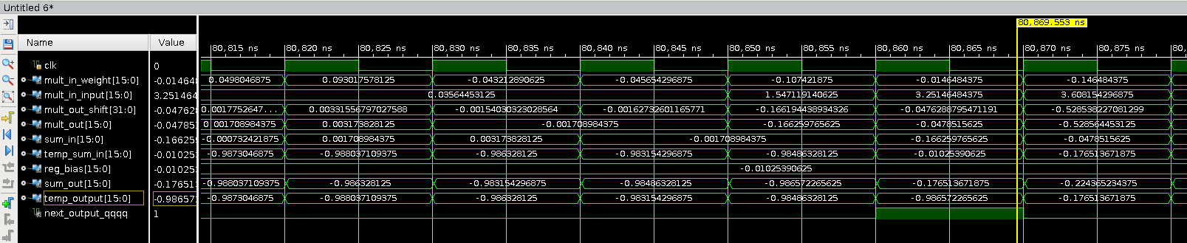
Convolution layer - simulation
Testing through Integer and then Fixed point
Next_output is registered through the pipeline.
When Next_output is equal to 1, bias is added and accumulation starts.
Bit shift happens at the output of multiplication.

Slide 9
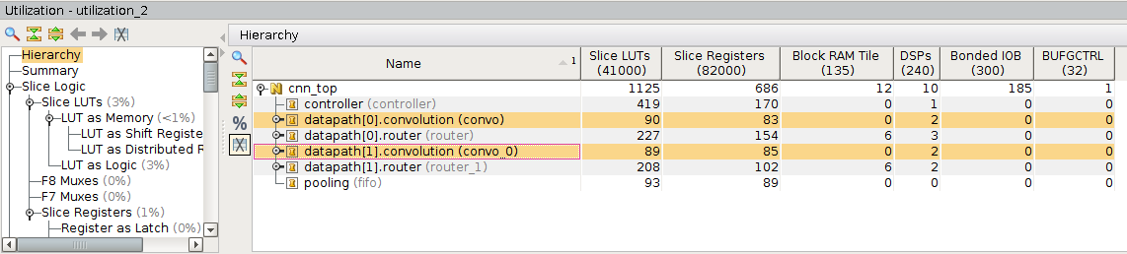
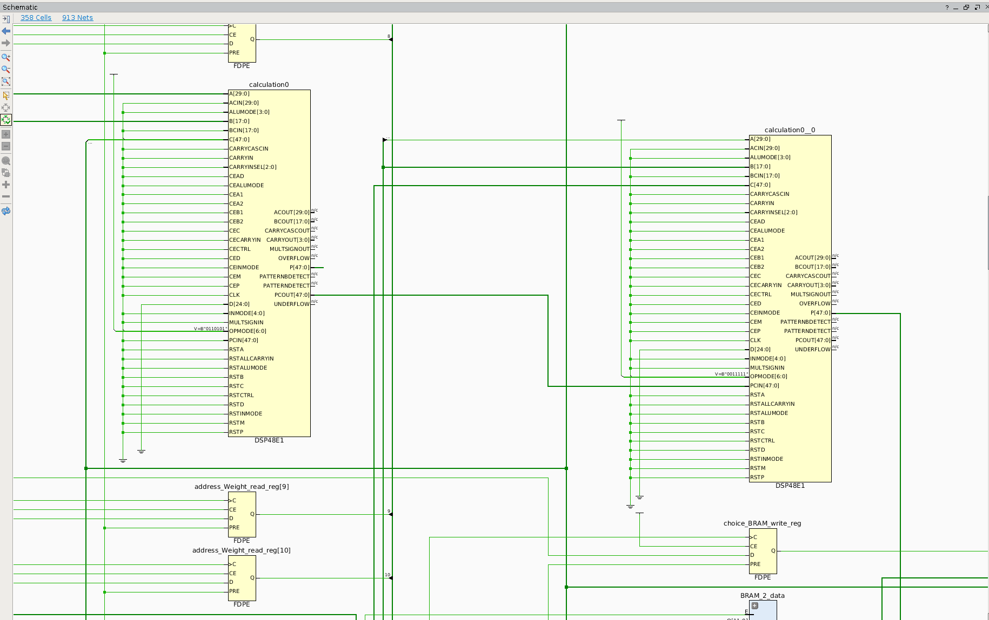
Convolution layer - synthesis
Final synthesis of the convolution block
Utilization
DSPs used in Convolution module

Slide 10
Router | controller - overview
2 min
Function: to propagate the flow of data through the Pipelined Execution (Convolution and pooling)
Difficulties
Timing of control signals
Data addressing at the end of the rows
Data addressing at the end of the feature maps
Solution
Mealy FSM
Did simulation a lot of time until addresses and data meet the expected ones ...

Slide 11
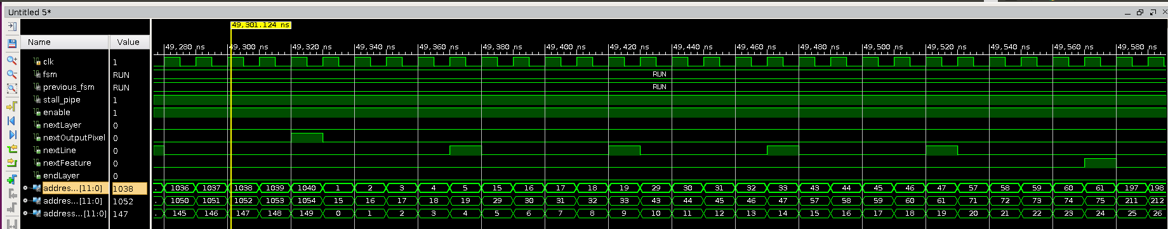
Router | controller - simulation
Testing through 2 output data every cycle and the corresponding weight

Slide 12
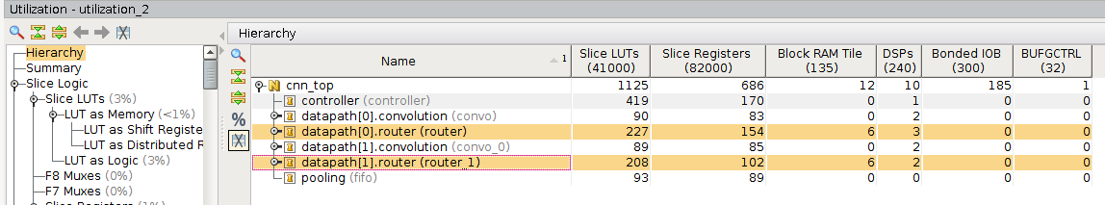
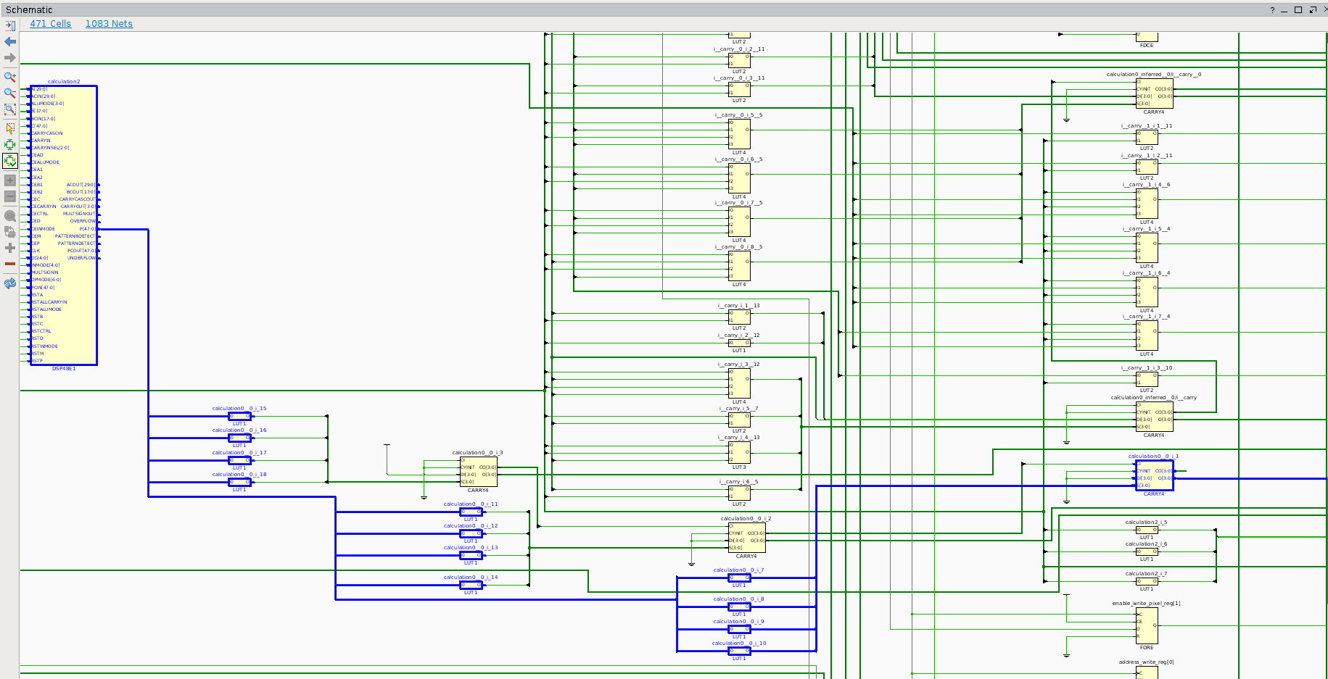
Router | controller - synthesis
Final synthesis of the router and controller blocks
Utilization
Route for calculating data address jumping to
new row

Slide 13
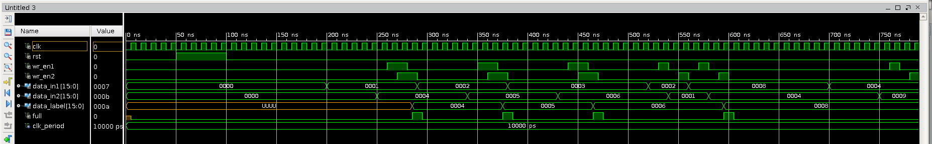
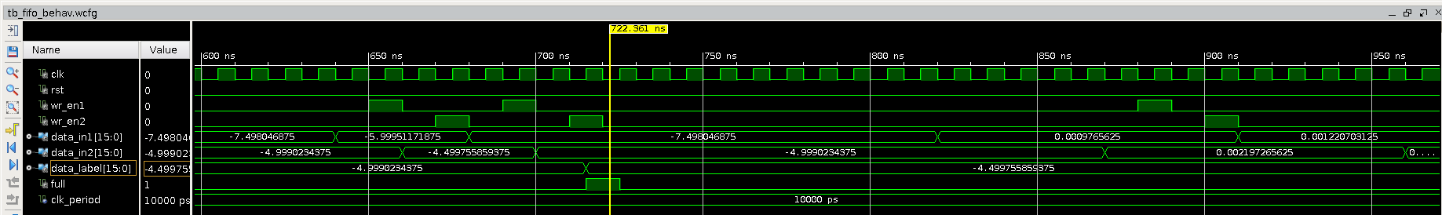
FIFO | Pooling Layer - overview/simulation
2 min
Function: enable the parallelism and serializing feature maps from PEs (Processing Element) which conduct convolutional operations.
Testing through 2 input data every a few cycles and waiting for 4 data and then obtaining the maximum one
Integer
Fixed-point & negative

Slide 14
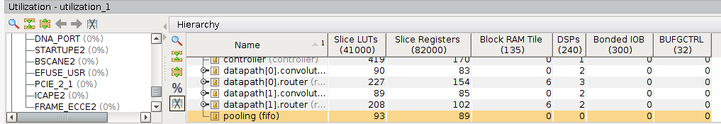
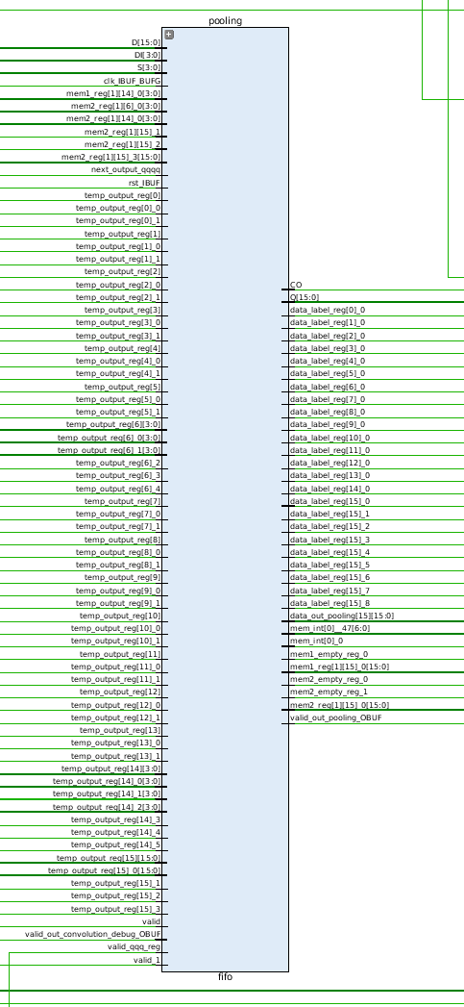
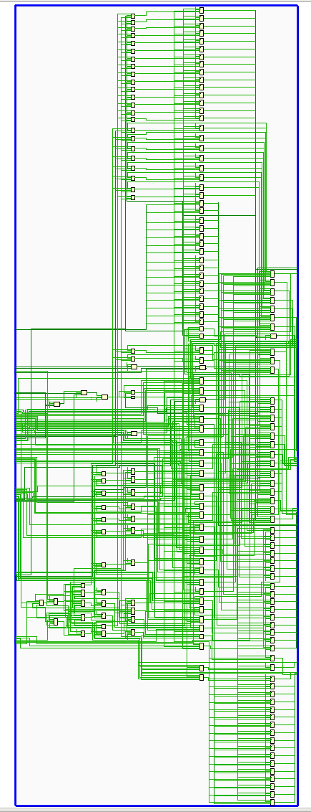
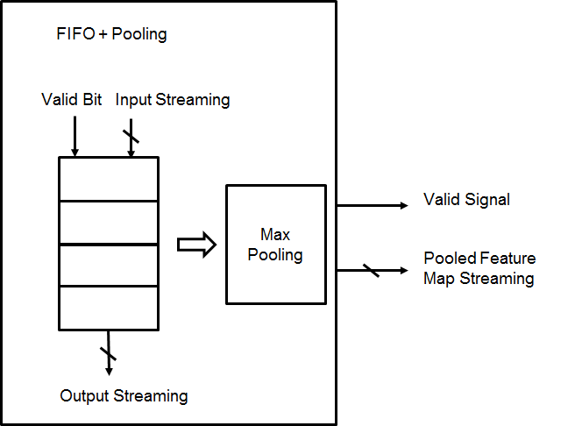
FIFO | Pooling Layer - synthesis
Final synthesis of the fifo and pooling blocks
Utilization
Schematics screenshots
FIFO | Pooling
Overview

Slide 15
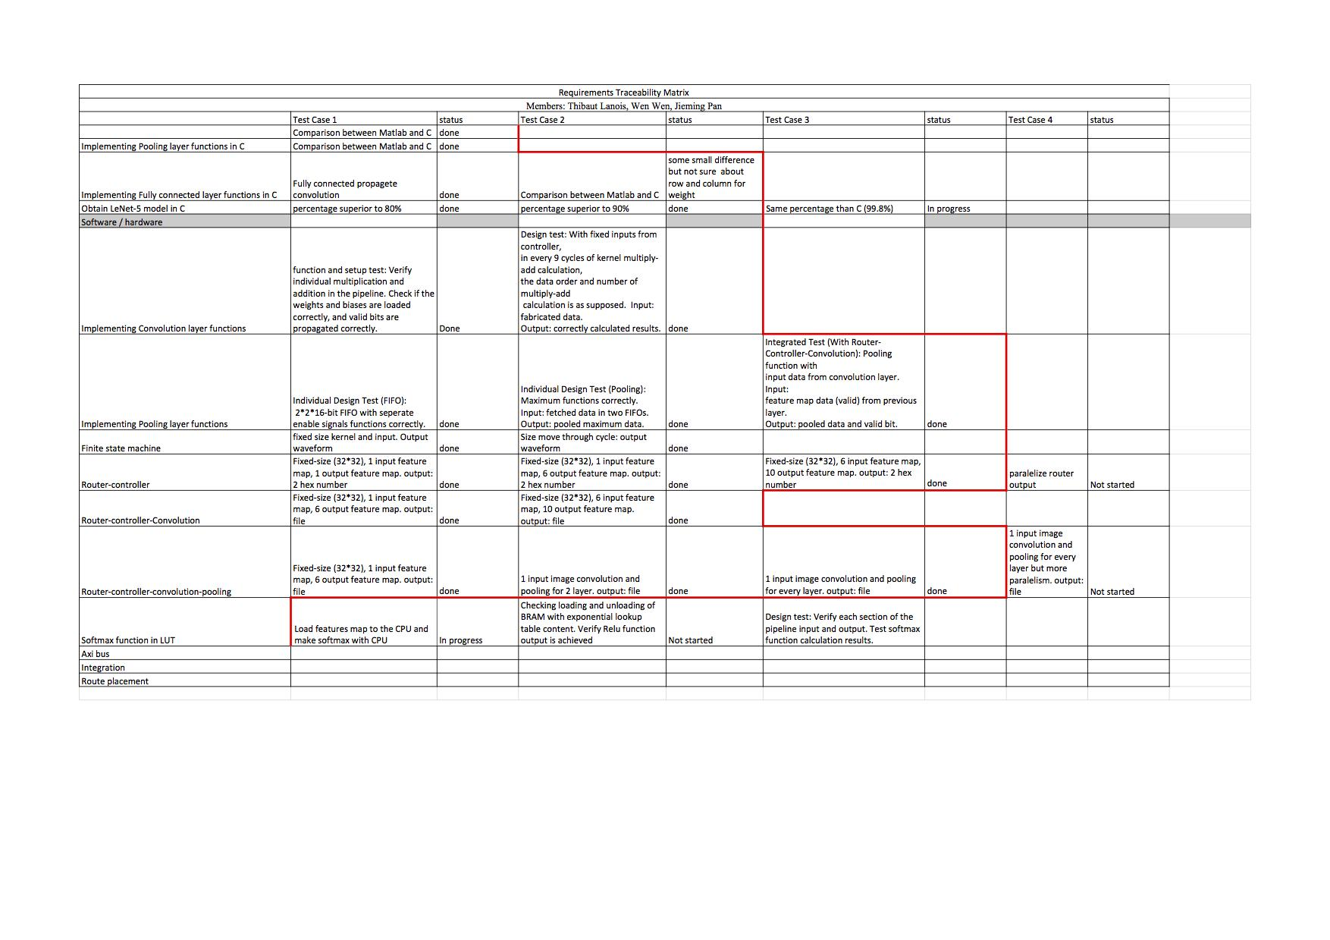
Requirement Traceability Matrix
We’ve followed the RTM to test/debug our hardware system as the table below.
The test cases on the right of the red line are completed, and the left ones are in-progress.

Slide 16
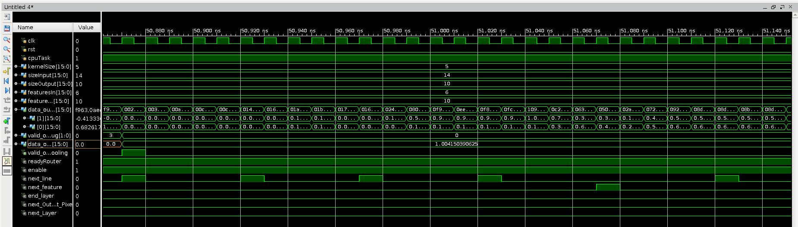
Final Testing waveform
Integration of controller/router/convolution/pooling modules works as expected.
Output from Convolutional Layer
Input from CPU
Output from Pooling Layer

Slide 17
Final testing files
We compared the immediate data after pooling layer between C codes and hardware design as table below.
For obtaining one single output, 4x5x5x6=600 multiply-add calculations accumulate errors.
Within average error rate of ~ 0.0243, the results can be considered as acceptable.
16-bit Fixed-point in FPGA |  | 32-bit Floating-point in C |  | Absolute Error | Relative Error (%)
HEX | REAL | HEX | REAL | Avg: 0.0191
1011 | 1.015 | 1066 | 1.025 | 0.0100 | 0.9756
FFF2 | -0.002 | 0047 | 0.017 | 0.0190 | 111.7647
FA0B | -0.375 | FA7A | -0.345 | 0.0300 | 8.6957
03C8 | 0.230 | 0426 | 0.259 | 0.0290 | 11.1969
FD42 | -0.130 | FD97 | -0.150 | 0.0200 | 13.3333
E810 | -1.484 | E864 | -1.475 | 0.0090 | 0.6102
FA36 | -0.325 | FA9F | -0.333 | 0.0080 | 2.4024
E6F0 | -1.510 | E763 | -1.538 | 0.0280 | 1.8205

Slide 18
<CNN on FPGA theta> Summary
5 min
Accomplishments last week:
For given input image from CPU, Convolution/Pooling layer work as expected
For router/controller/convo/pooling/BRAM, Individual/Integrated Test Benches design, synthesis, integration done
Fully connected layer is in-progress
Working on this week:
AXI bus for communication between CPU and FPGA
Performance boosting with constraints
Challenges/ Difficulties / Needs in Integration Testing
Floating-point to (16-bit) fixed-point data conversion
Data/weight address calculation

