Slide 1
ECE 2140 SOC Design Convolution Neural Network on FPGA Theta
1 min
Thibaut Lanois: THL26@pitt.edu
Wen Wen: WEW55@pitt.edu
Pan Jieming: JIP40@pitt.edu

Slide 2
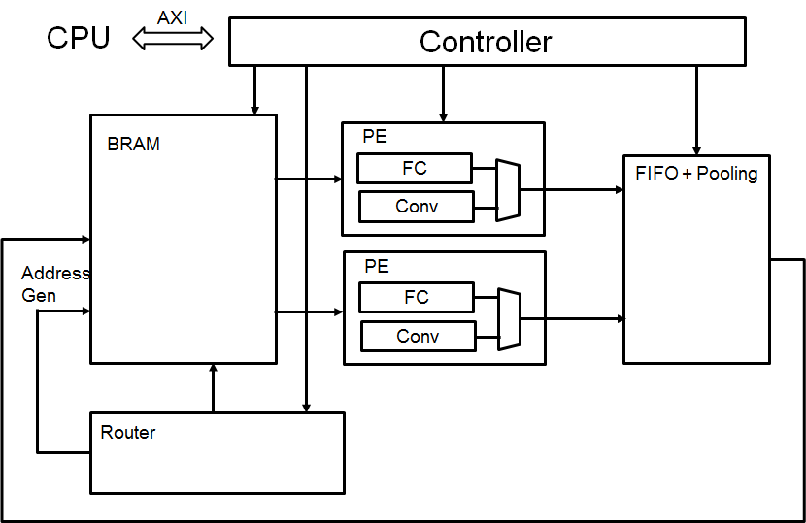
CNN Overview
3 min
Convolutional layers account for over 90% computation
FPGA has inherent parallelism
Convolution layer
Fully connected layer
FIFO + Pooling layer
Controller
Router

Slide 3
SoC System Architecture

Slide 4
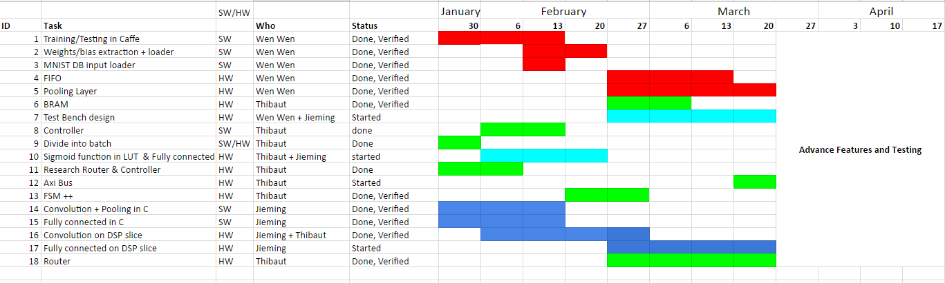
<CNN on FPGA theta> Overview
2 min
Schedule and Status
Accomplishments last week:
Finished VHDL
Working on this week:
Test Bench, synthesis, integration
Challenges/ Difficulties / Needs
Addressing 4D array in VHDL
A bit late. (1 or 2 weeks)
Still final TestBench and synthesis

Slide 5
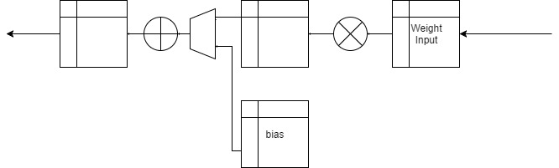
<CNN on FPGA theta> - Convolution layer
2 min
This block is used to accelerate the computation of convolution of the kernels over the feature map (hardware)
Bias, Weight, 16 bit float data
Arithmetic addition and multiplication for each float data implemented using DSP slice
120 lines of VHDL code
Jieming + Thibaut
3/17/17 Design done (Behaviour simulated)

Slide 6


<CNN on FPGA theta> - Fully connected layer
2 min
This block is used to execute ReLu or SoftMax function(hardware)
Using LUT and IEEE 754 single precision mode for exponential calculation
Each 16 bit float data will pass through ReLu
BRAM to store added data float for SoftMax calculation
ReLu or SoftMax function
100 lines (incomplete)
Jieming
3/20/17 ++

Slide 7
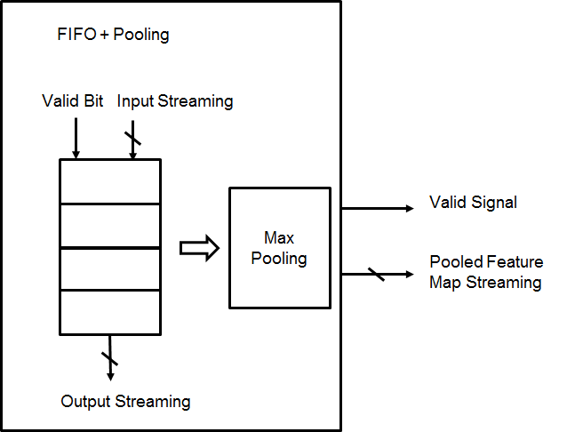
<CNN on FPGA theta> - FIFO+Pooling Layer
2 min
This block is used to enable the parallelism and serializing feature maps from PEs (Processing Element) which conduct convolutional operations.
Input: Feature map streams (Convolutional Layer) (4x16-bit) and valid signals from PE (4-bit)
Output: Pooled feature map streams
~270 lines of VHDL codes
Wen
3/17/2017 Design done (Behavior Simulated)

Slide 8
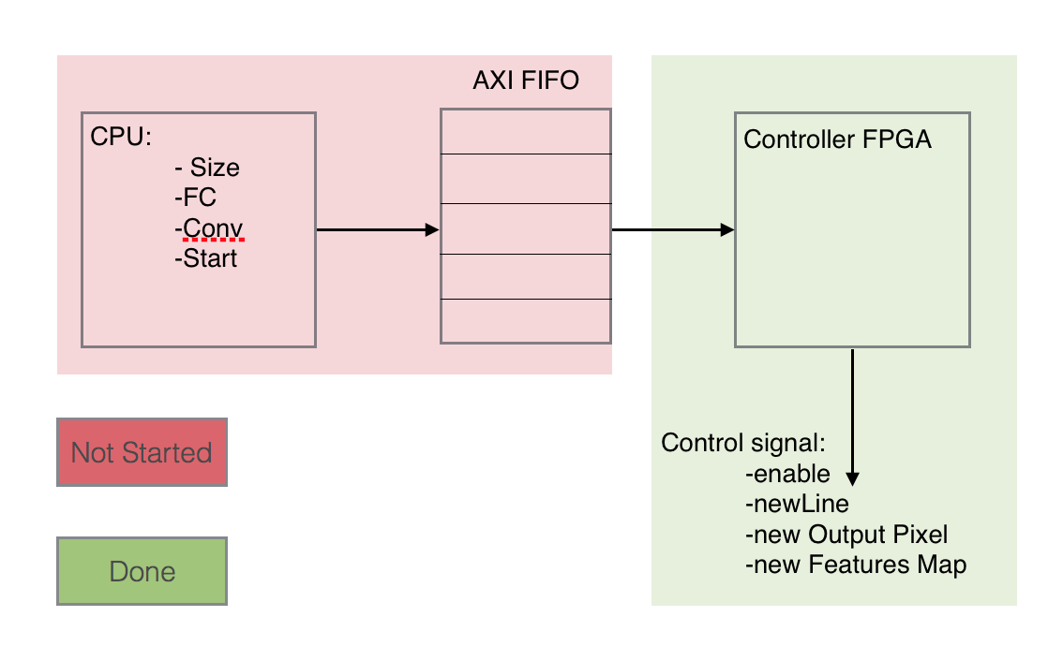
<CNN on FPGA theta> - Controller
2 min
This block is used to divide into batch, switch between batches, select computation units in order to facilitate process flow (hardware)
CPU signals for activation and reset
Setting up all control signals + switch between states
200 lines of VHDL codes
Thibaut
VHDL Done
Synthesis works

Slide 9
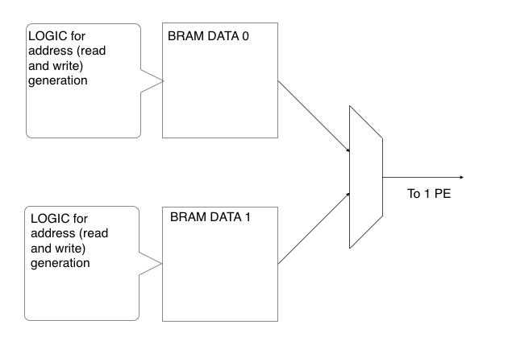
<CNN on FPGA theta> - Router
2 min
This block is used to facilitate data propagation
data flow
Manage data and weight between features map and layer
A lot of issue to parallelize the router, it should work now but only tested until 4 PEs.
400 lines of codes
Thibaut
03/13/2017

Slide 10
Test Bench
Comparison between Matlab and our C code (MathConvNet and C). Done
Generation of file with the output of every layer for the C code. Done
Transform C Data file into hexadecimal ( with 16 bit float format using Matlab).
Fill Vivado simulation with hexadecimal data
Compare output with golden standard

Slide 11
<CNN on FPGA theta> Summary
5 min
Accomplishments last week:
Finished VHDL
Challenges/ Difficulties
Addressing 4D array in VHDL
A bit late. (1 or 2 weeks)
Still final TestBench and synthesis

