Slide 1
ECE 2140 SOC Design Convolution Neural Network on FPGA Theta
Thibaut Lanois: THL26@pitt.edu
Wen Wen: WEW55@pitt.edu
Pan Jieming: JIP40@pitt.edu

Slide 2
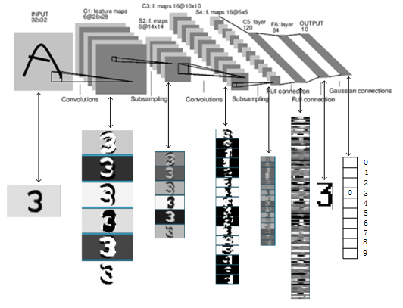
A Typical Convolutional Neural Network (LeNet-5)
Convolutional Operation
LeNet-5: Y. LeCun, L. Bottou, Y. Bengio, and P. Haffner. Gradient-based learning applied to document recognition. Proceedings of the IEEE, november 1998.

Slide 3
Project Overview
Stage 1: Caffe model on Le-Net 5
Training
Extracting Weights and Bias
Stage 2: CNN in C (93% accuracy)
Stage 3: CNN in Hardware
Router and FIFO
Convolution and Pooling
Test Bench
Advance features:
Parallel (# of features x 2 threads @200MHz)
Softmax Fully-connected

Slide 4
Training & Software Development Flow
Caffe Framework
Modified prototext file
to implement Lenet-5
Training the Lenet-5 with MNIST test sets
Matlab script & C parse to extract/read
Weights & Biases
Inference Model in C
Compare intermediate data
Matlab codes w/ Matconv for CNN calculations

Slide 5

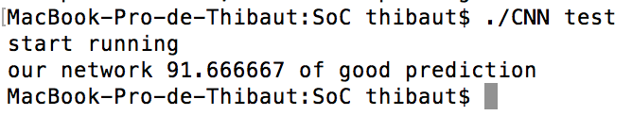
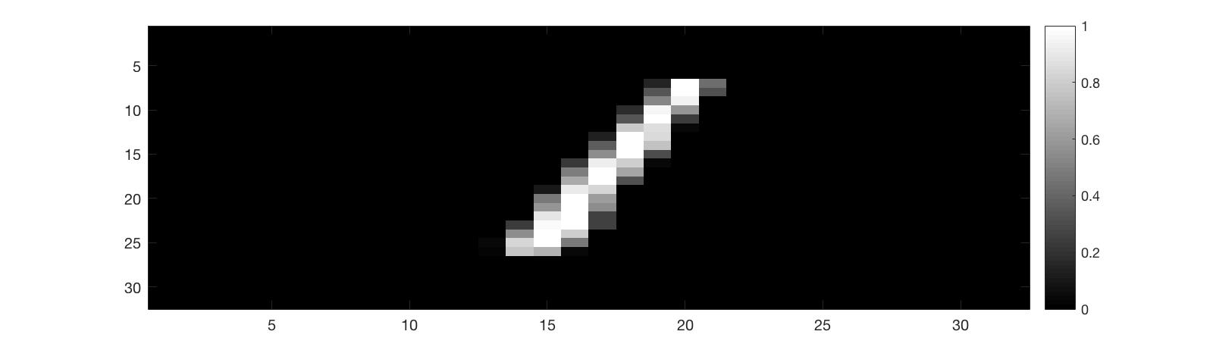
CNN in C
Successfully implement the full Le-Net 5 model in C
Convolution and Pooling layers have the exact output as Matlab (Matconvnet lib)
Achieved 93% good prediction for batch 0 (verification training)
Overall 87% good prediction
Provide golden output data between layers

Slide 6
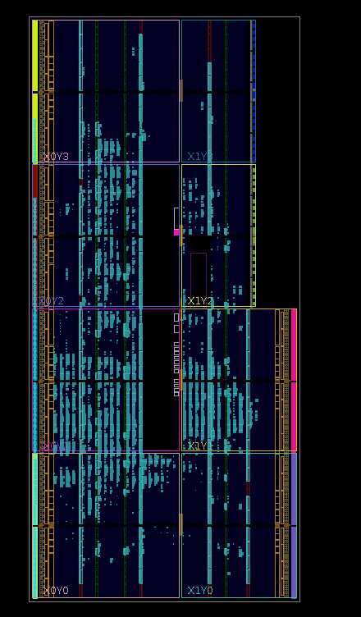
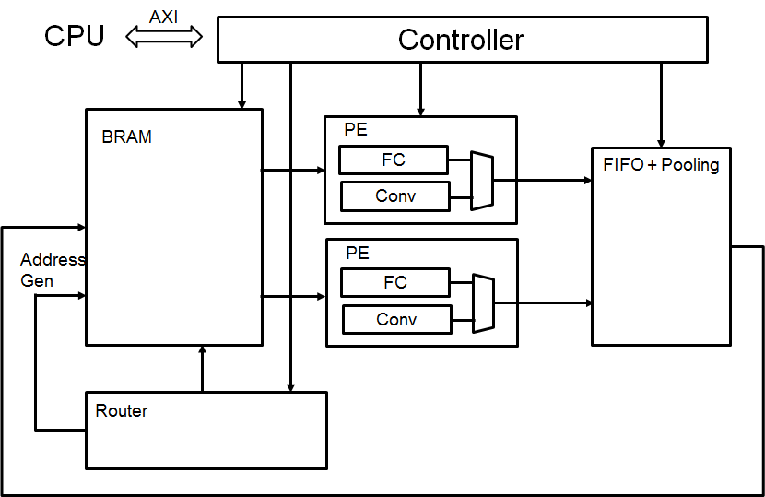
CNN in Hardware

Slide 7
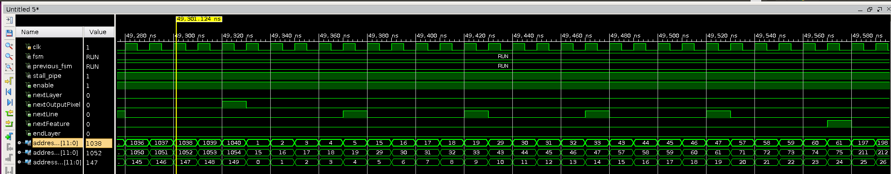
Router & Controller
Function: to propagate the flow of data through the Pipelined Execution (Convolution and pooling)
Testing through 2 output data every cycle and the corresponding weight

Slide 8
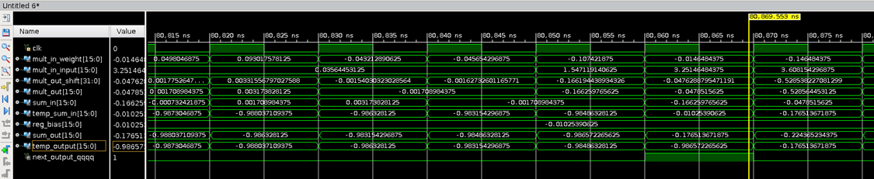
Convolution
Function: To accelerate the computation of convolution of the kernels over the feature map with FPGA resources.
Testing through Integer and then Fixed point
Next_output is registered through the pipeline.
When Next_output is equal to 1, bias is added and accumulation starts.
Bit shift happens at the output of multiplication.

Slide 9
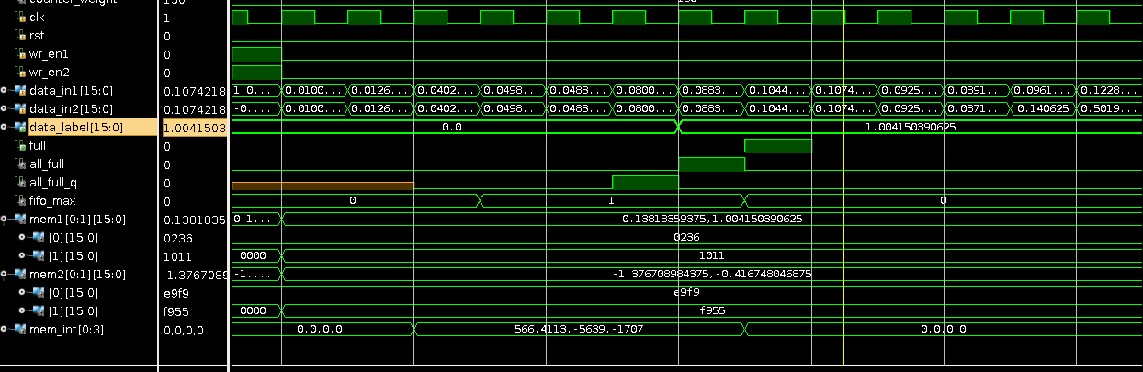
FIFO | Pooling Layer
Function: enable the parallelism and serializing feature maps from PEs (Processing Element) which conduct convolutional operations.
Testing through 2 input data every a few cycles and waiting for 4 data and then obtaining the maximum one, and enable pooling out ready signal
Pooled max data out of four
Four input data to be pooled
Pooling data ready signal

Slide 10
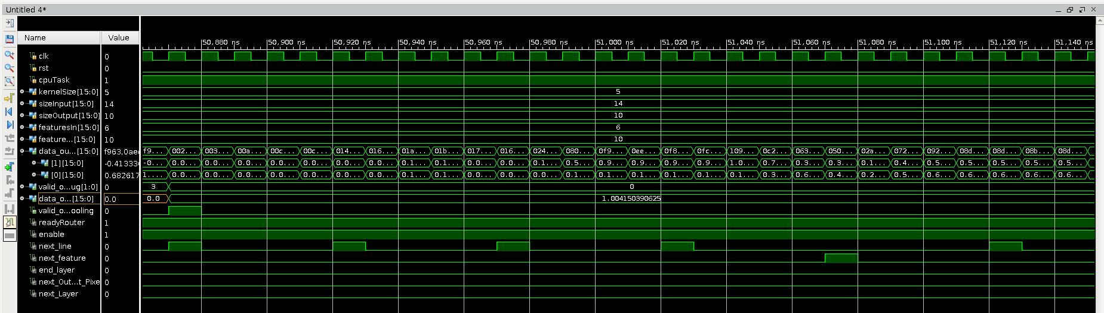
Final Testing waveform
Integration of controller/router/convolution/pooling modules works as expected.
Output from Convolutional Layer
Input from CPU
Output from Pooling Layer

Slide 11
Final testing files
We compared the immediate data after pooling layer between C codes and hardware design as table below.
For obtaining one single output, 4x5x5x6=600 multiply-add calculations accumulate errors.
Within average error rate of ~ 0.0243, the results can be considered as acceptable.
16-bit Fixed-point in FPGA |  | 32-bit Floating-point in C |  | Absolute Error | Relative Error (%)
HEX | REAL | HEX | REAL | AVG: 0.02331
1011 | 1.0042 | 1066 | 1.0249 | 0.0207 | 2.01970924
FFF2 | -0.0034 | 0047 | 0.0173 | 0.0207 | 119.6531792
FA0B | -0.3723 | FA7A | -0.3452 | 0.0271 | 7.850521437
03C8 | 0.2363 | 0426 | 0.2593 | 0.023 | 8.870034709
FD42 | -0.1714 | FD97 | -0.1506 | 0.0208 | 13.81142098
E810 | -1.4961 | E864 | -1.4756 | 0.0205 | 1.389265384
FA36 | -0.3618 | FA9F | -0.3362 | 0.0256 | 7.61451517
E6F0 | -1.5664 | E763 | -1.5383 | 0.0281 | 1.826691803

Slide 12
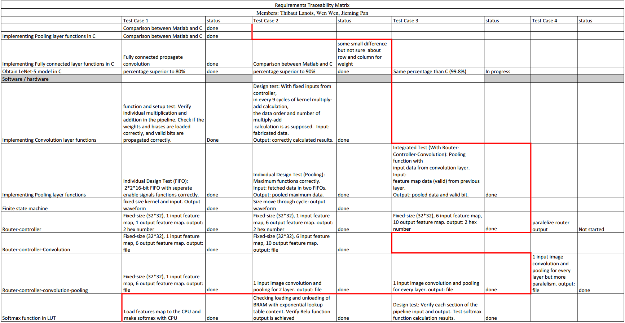
Requirement Traceability Matrix
We’ve followed the RTM to test/debug our hardware system as the table below.
The test cases on the right of the red line are completed, and the left ones are in-progress.

Slide 13
CNN SoC System Architecture Overview
Convolutional layers account for over 90% computation
FPGA has inherent parallelism
Convolution layer
Fully connected layer
FIFO + Pooling layer
Controller
Router

Slide 14
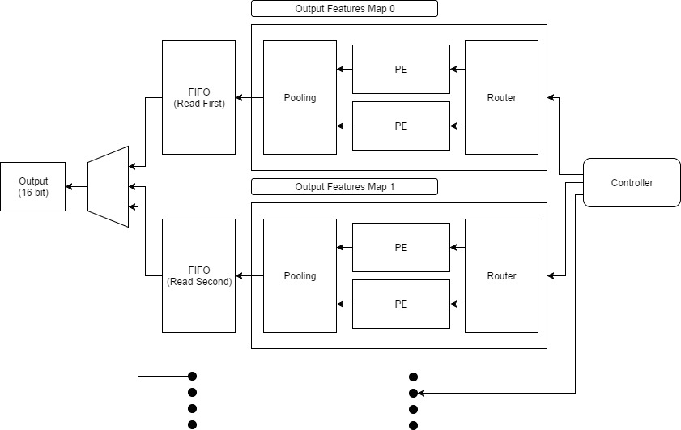
Parallelism

Slide 15
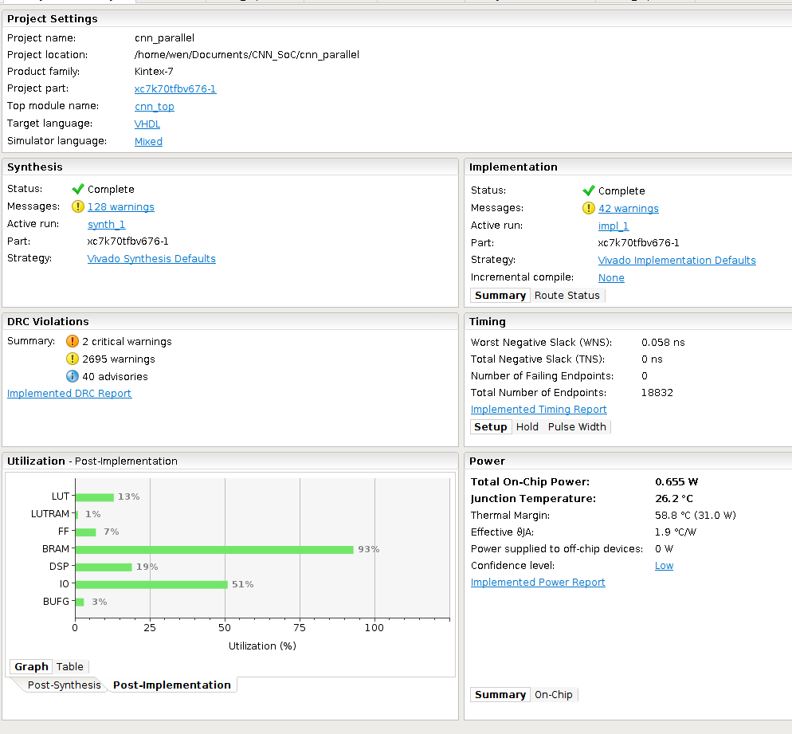
Final Implementation - Timing
Timing pass @200MHz
No hold time delay

Slide 16
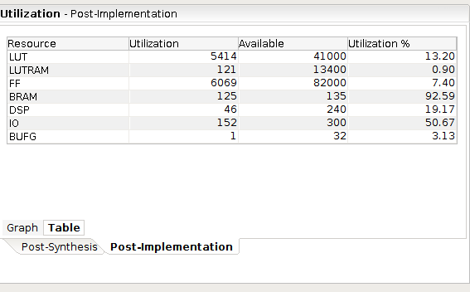
Final Implementation - Utilization
Our model utilizes 92.6% of BRAM and 20% of DSP
Majority of our computation is done using DSP
BRAM will be a limiting factor (memory transfer)

Slide 17
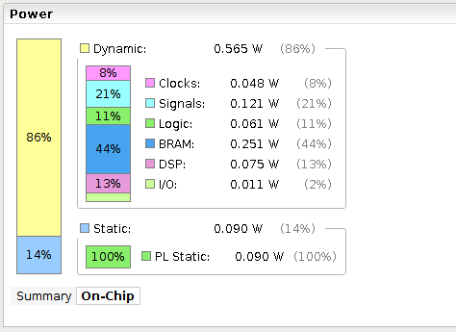
Final Implementation - Power
@200MHz and 20 thread, we only consume 0.655W
Power efficient as compared to using a CPU

Slide 18
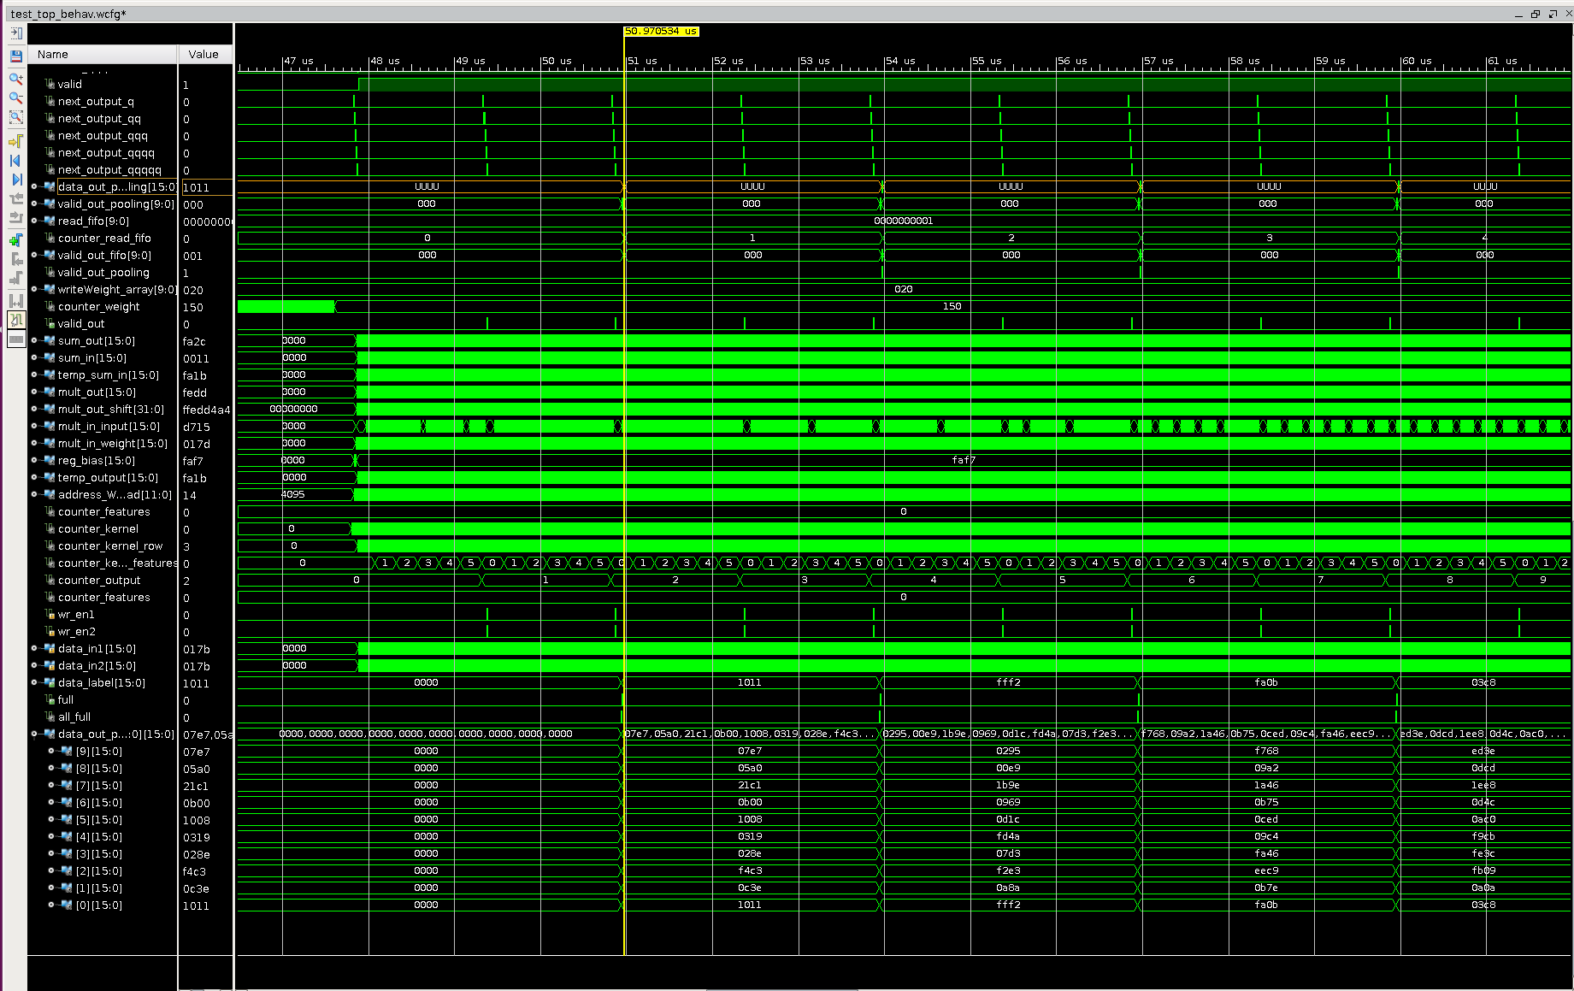

Slide 19
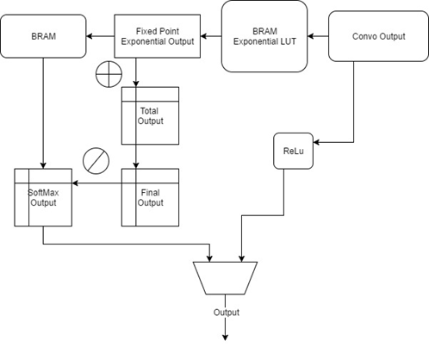
Fully connected - Softmax
ReLu is implemented in our system
Decided to implement Softmax separately as we need 32 bit input

Slide 20
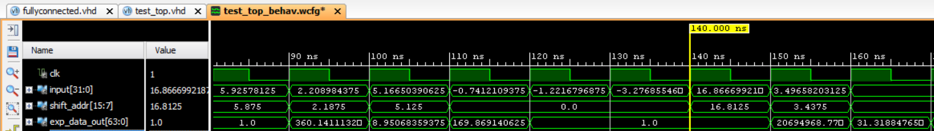
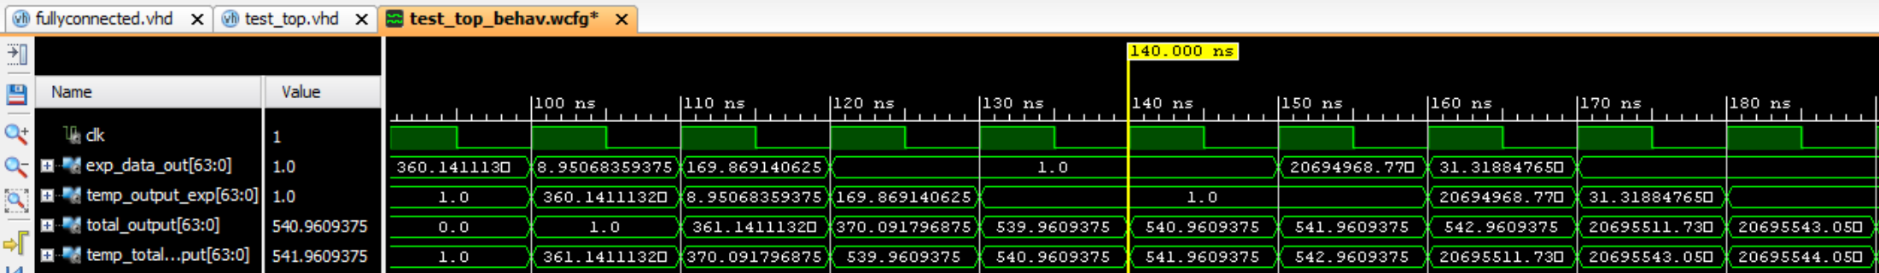
Fully connected layer - Softmax
Exponential LUT - 32 bit input -> 9 bit index -> 64 bit exponential value
Softmax divisor - Adding all exponential values (11 fractional parts)

Slide 21
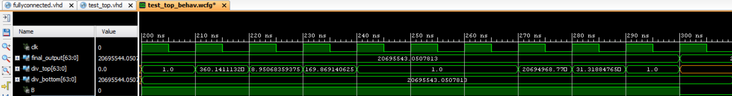
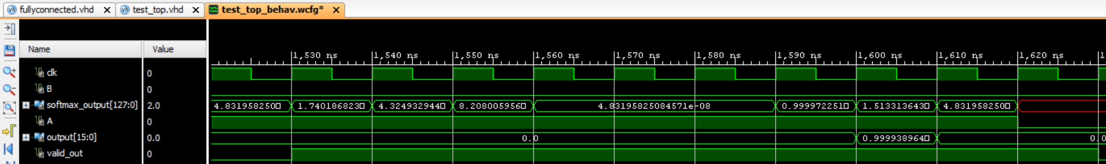
Fully connected layer - Softmax
Division - 64 x 64 division and valid control (11 fractional parts)
Division - 128 bit output (63 fractional parts)

Slide 22
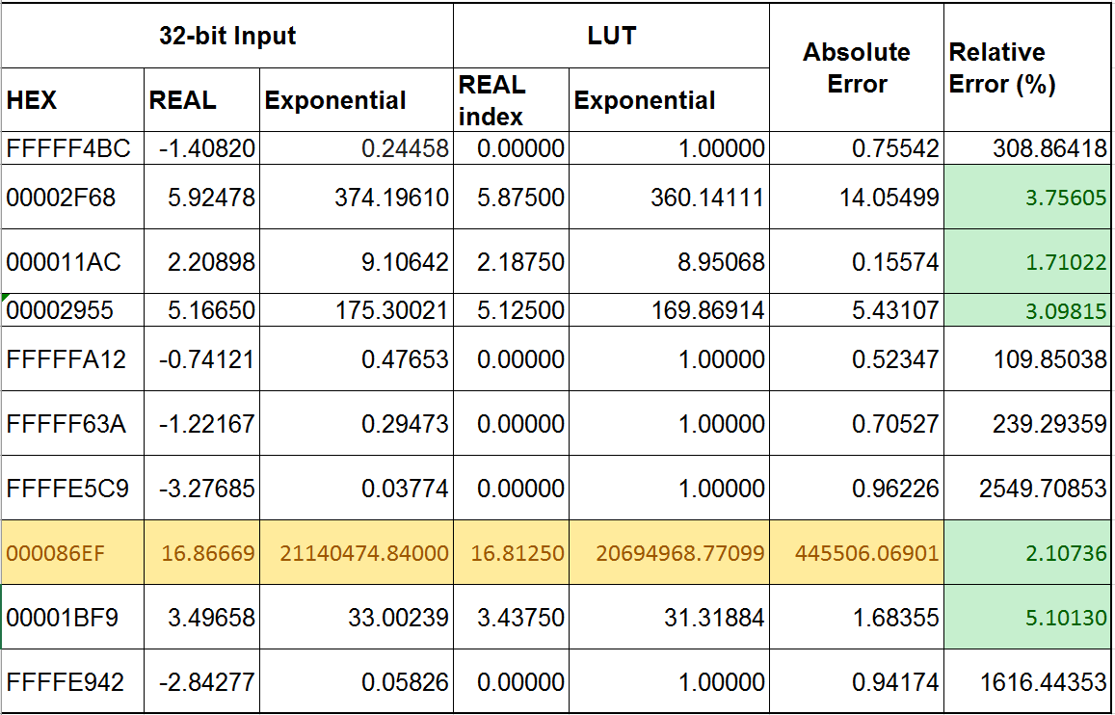
Softmax accuracy

Slide 23
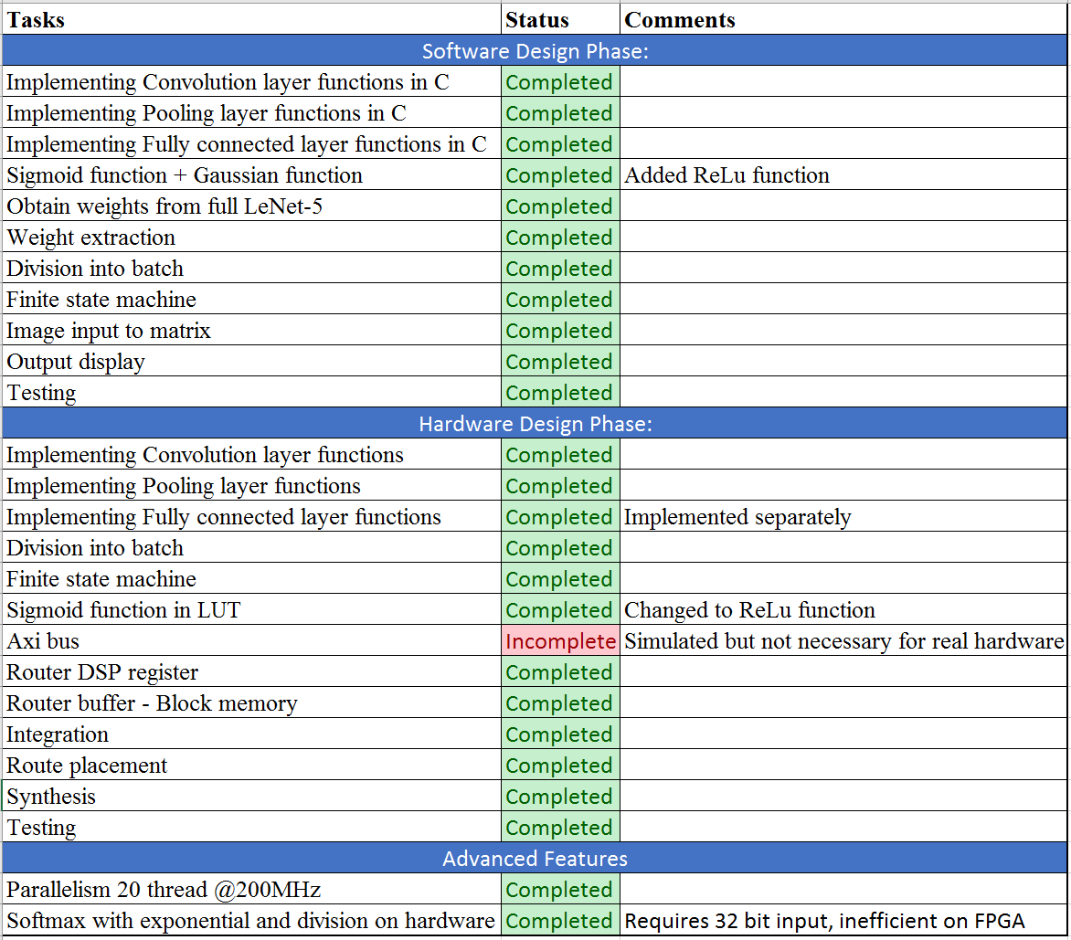
Statement of work

Slide 24
Thank you!
Questions?

