Slide 1
Implementation of Convolutional Neural Network on FPGA
Team: Neural Network – Theta
Members: Thibaut Lanois, Wen Wen, Jieming Pan

Slide 2
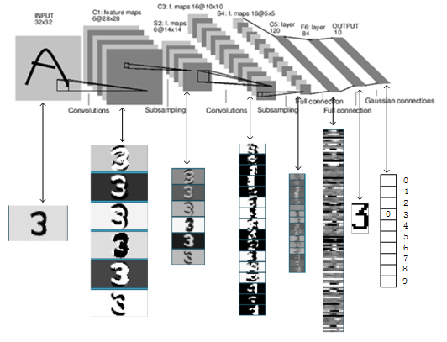
A Typical Convolutional Neural Network (LeNet-5)
LeNet-5: Y. LeCun, L. Bottou, Y. Bengio, and P. Haffner. Gradient-based learning applied to document recognition. Proceedings of the IEEE, november 1998.

Slide 3
Why Implement CNN on FPGA?
Convolutional layers account for over 90% computation
[1] A. Krizhevsky, etc. Imagenet classification with deep convolutional neural networks. NIPS 2012.
[2] J. Cong and B. Xiao. Minimizing computation in convolutional neural networks. ICANN 2014
FPGA has inherent parallelism

Slide 4
Previous Designs
Training CNN (weights) mainly on GPUs
Interferences(predicting) can be implemented on a variety of accelerators
ASIC [1]
GPU [2]
FPGA [3] [4] [5] [6] – More energy-efficient than GPU, more configurable/scalable than ASIC
[1] Dadiannao: A machine-learning supercomputer. MICRO 2014
[2] GPU-based simulation of cellular neural networks for image processing. IJCNN 2009
[3] A programmable parallel accelerator for learning and classification. PACT 2010
[4] A Dynamically Configurable Coprocessor for Convolutional Neural Networks. ISCA 2010;
[5] Design and Implementation of an FPGA-based Real-Time Face Recognition System. (short paper) FCCM 2011;
[6] Memory-Centric Accelerator Design for Convolutional Neural Networks. ICCD 2013

Slide 5
Previous Designs
Industry Efforts on Mapping CNN onto FPGAs:
Project Catapult – Microsoft [1]
Efficient Implementation of Neural Network Systems Built on FPGAs, and Programmed with OpenCL – Intel [2]
[1] https://www.microsoft.com/en-us/research/project/project-catapult/
[2] https://www.altera.com/solutions/technology/machine-learning/overview.html

Slide 6
Our Goals
CNN implementation
Starting from simplified NN with one convolutional, pooling and output layer
Finally achieve a well-known neural network with at least one convolutional layer (LeNet-5)
Testing on MNIST datasets (handwriting digits) [1]
Performance
Accuracy: 90%+
Speed: 100ms@100MHz
Advanced Features
Deeper network(more convolutional layers)
Introducing training phase
[1] http://yann.lecun.com/exdb/mnist/

Slide 7
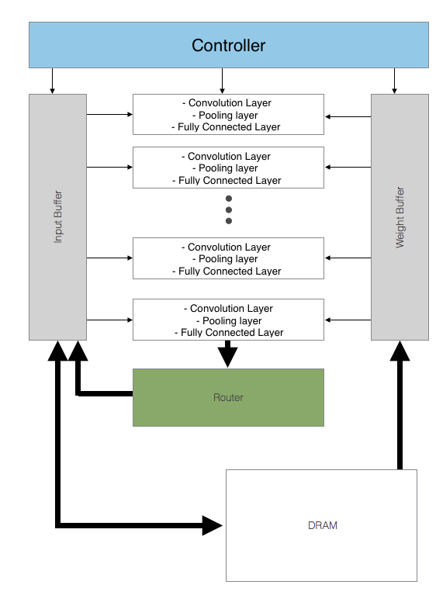
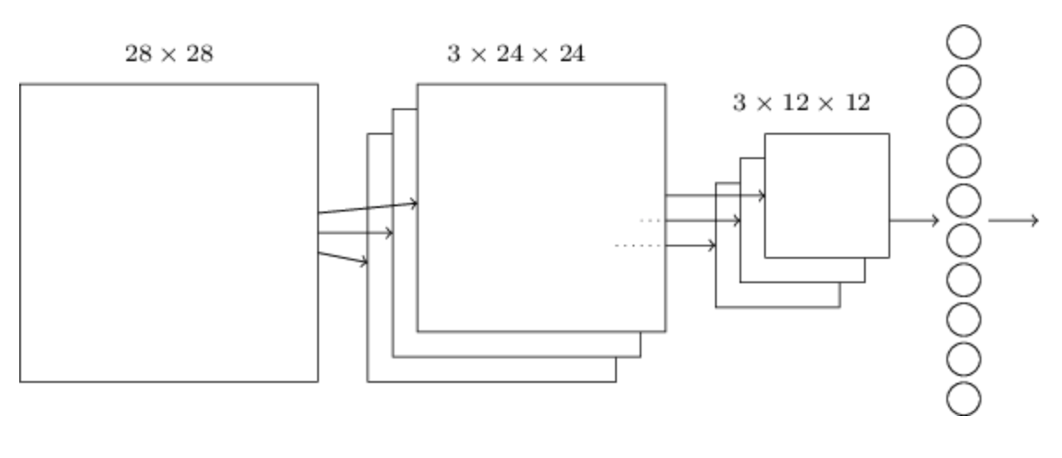
Convolution Neural Network

Slide 8
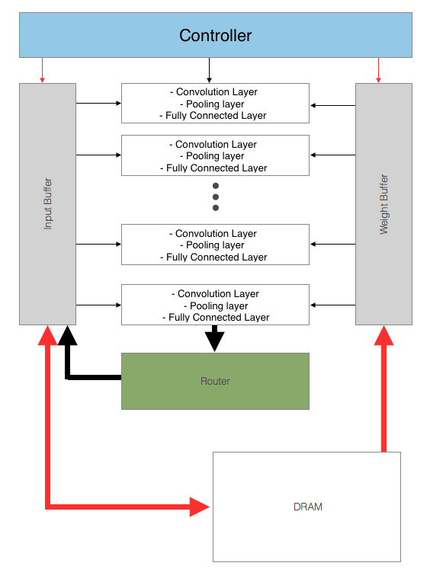
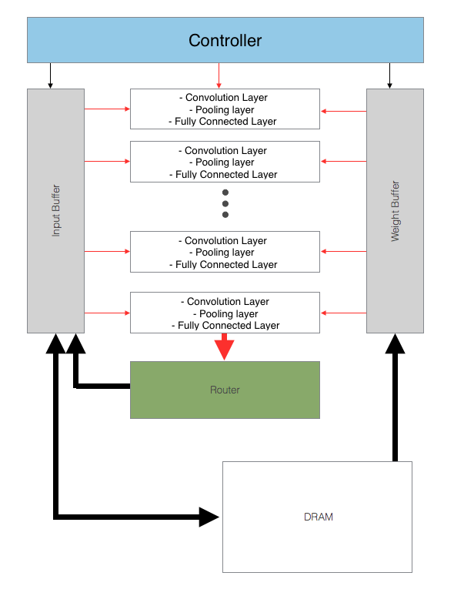
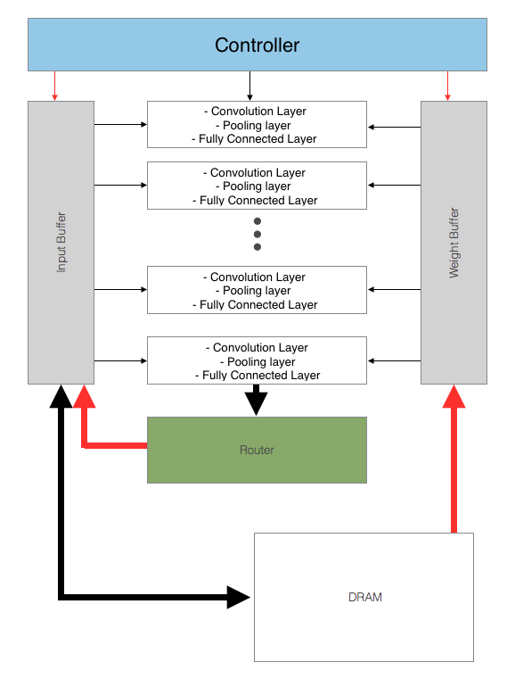
What are the different steps ?
Bring DATA
Calculation
Bring DATA

Slide 9
Tasks
Software
Training in order to obtain the Weight (Python or Matlab)
Hardware
Input / output
Number representation / sigmoid function
Memory (DRAM & Buffer)
Calculation Unit (Convolution, Pooling, Fully connected)
Router
Controller
Verification
Test by block
Exactly the same result as the software simulation

Slide 10
Schedule
Software Development | Calculation Cores | Router & Controller | Testing
 | Training
 |  | Input / output
Hardware development | Research Router & Controller |  | Calculation Cores |  | Testing
 |  |  | Router & Controller |  | Test bench
 |  |  |  | Input / output

Slide 11
Advance Features
Improve accuracy
More hidden layers
Pre-processing image
Elastic distortion
Increase number of feature map
Activation function
Increase Throughput
Lower image resolution
Reduce number of fixed points
Optimize code, synthesis, placement and routing
Training

