Slide 1

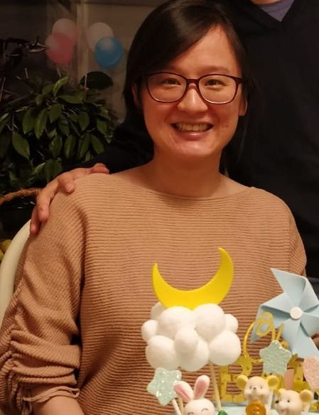
Test2
Character Builder
Student: Wen Xu
Student ID:301098127
Course: Programming 2
Course Code: 001

