Slide 1
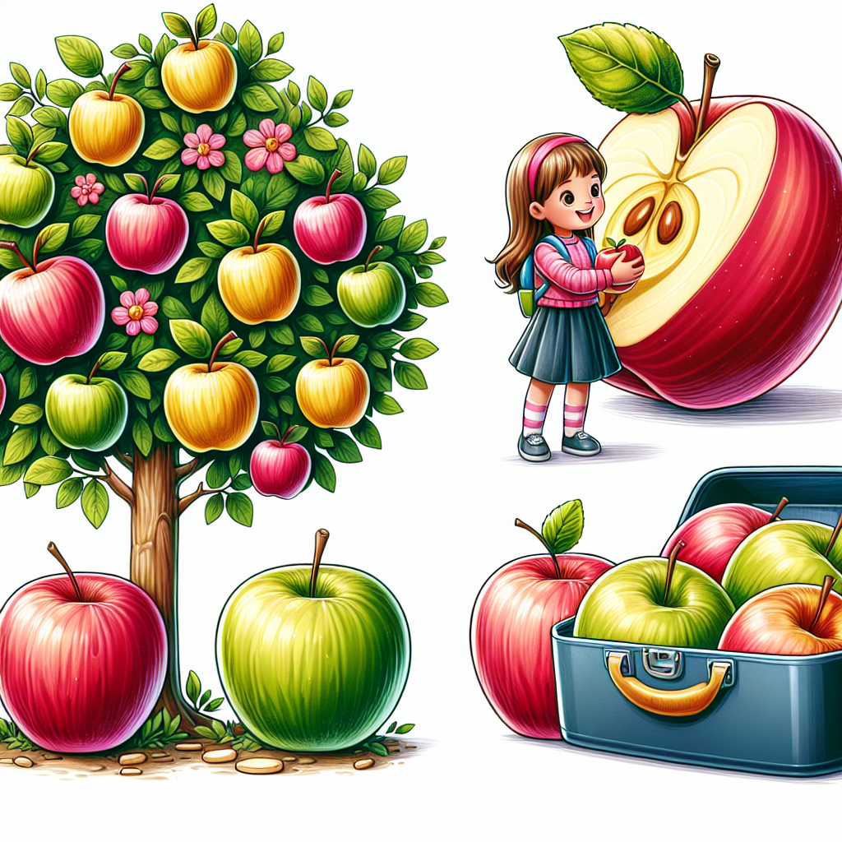
apple
An apple is a round, sweet fruit that grows on trees. It can be red, green, or yellow, and has a crunchy inside with small seeds in the middle.
For example, Sarah brought a shiny red apple in her lunchbox to eat during snack time.

